Slide 1
Excel final assessment
Name : Selva Viswanath Senthilkumar
LMS : LVADSUSR113
Employee ID - 4306

Slide 2
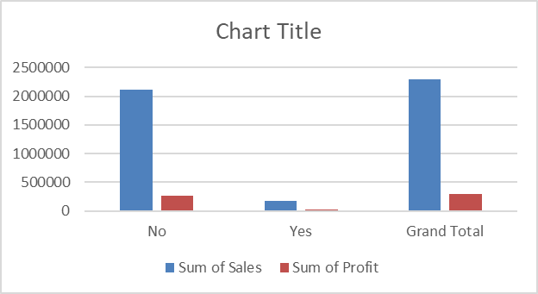
QUESTION 1
Formula:
to get return column: =IFNA( VLOOKUP(B2,Returns!$A$2:$B$297,2,FALSE),"No")
Insights:
We can see the percentage of returned orders is 8.005%
In terms of Sales, the loss due to returns is 180504.28
In terms of Profit, the loss due to returns is 23232.3615
Inference:
Significant percentage of Returns says that the Customers were dissatisfied with the products, which are need to be improved.
It has very significant impact on both Sales and Profit
Percentage of returned orders : 8.005%

Slide 3
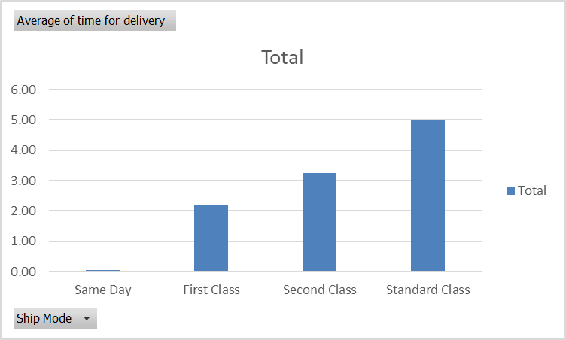
QUESTION 2
Insights:
Same day is the Fastest mode
Standard Class is the Slowest mode
Inference:
It can be seen that “Standard” delivery takes too much time than and is also less preferred.

Slide 4
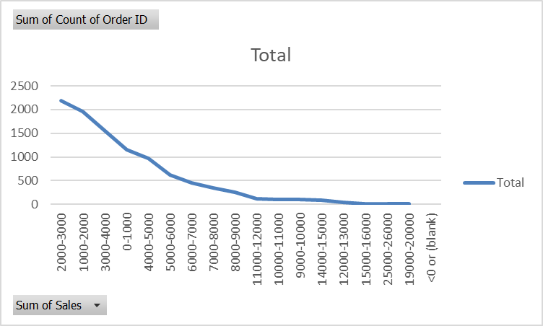
QUESTION 3
Row Labels | Sum of Count of Order ID
2000-3000 | 2183
1000-2000 | 1965
3000-4000 | 1555
0-1000 | 1153
4000-5000 | 965
5000-6000 | 627
6000-7000 | 455
7000-8000 | 353
8000-9000 | 254
11000-12000 | 112
10000-11000 | 109
9000-10000 | 96
14000-15000 | 81
12000-13000 | 41
15000-16000 | 18
25000-26000 | 15
19000-20000 | 12
Grand Total | 9994
Insights:
Customers with total sales of [2000-3000 $] make most of the frequent orders
Customers with total sales of more than 10,000$ make least orders
Inference:
The Most High value customers lay in the range of total sales [0 to 10,000 $]
This is the high value segment that the store has to focus more.

Slide 5
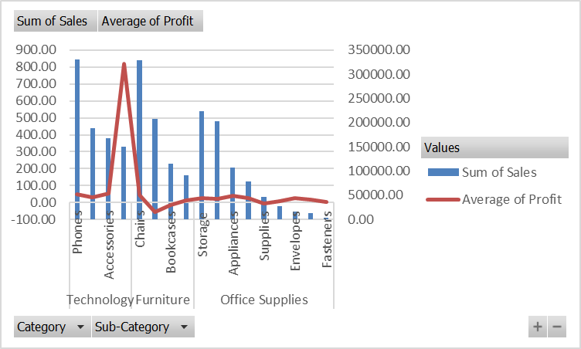
QUESTION 4
Insights:
Technology is the top-selling category
Phones is the sub-category within Technology that makes most total sales.
But Copiers make highest Average Profit Margin.
In Furniture, Chairs is the top-selling sub category.
Inference:
It Can be inferenced that Technology makes Top sales and also has highest Profit margin.

Slide 6
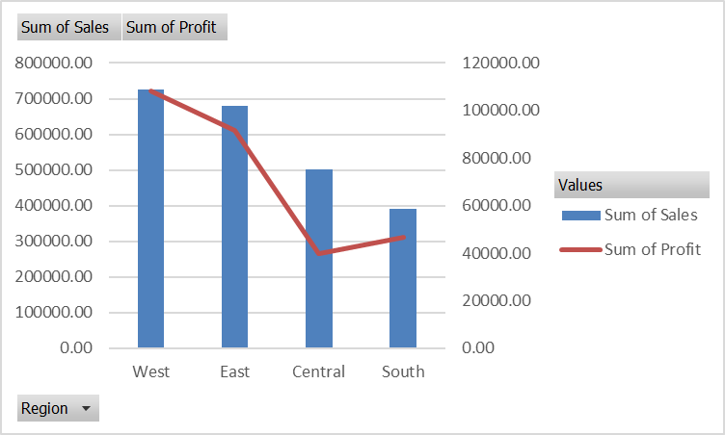
QUESTION 5
Insights:
West region has the highest sales and Profit
South has the least Sales
Central has the least Profit
Inference:
In terms of profit, Even though Central region has higher sales than Sales, It has the least profit.
Profit trend is varying between Central and South

Slide 7
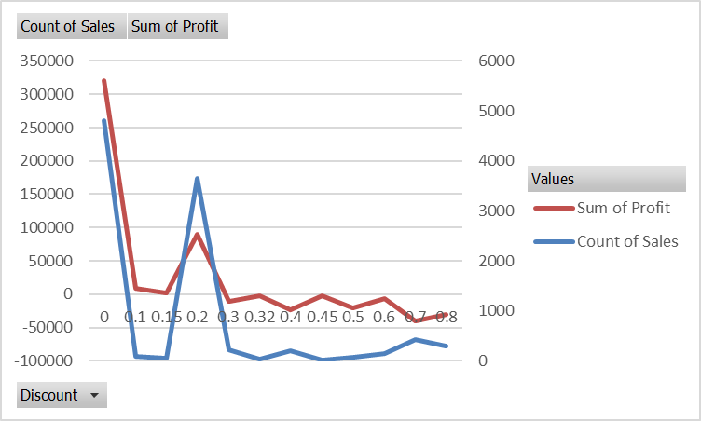
QUESTION 6
Insights:
From the combi-graph: discount of 20% has high positive impact on both sales and profit.
Any other discount rate has negative impact on profit
Inference:
A discount of 20% has best positive impact.
The Discount is not strongly correlated to both quantity and profit.

Slide 8
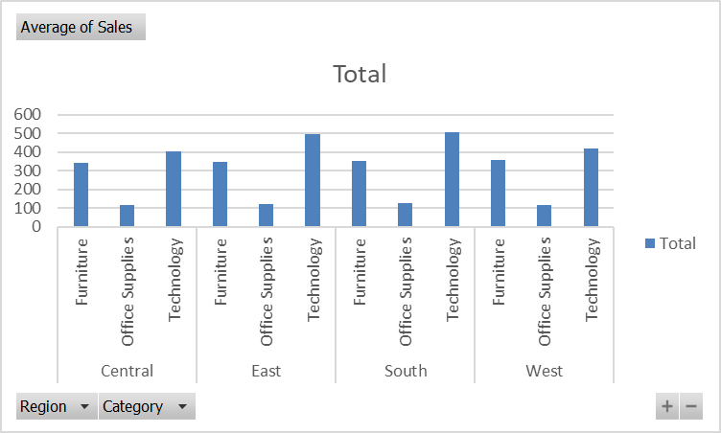
QUESTION 7
Insights:
Furnitures and technology make most of the sales and profit.
Inference:
The Technology has the highest Growth potential.
One way of penetrating this market would be selling new Tech products like AR/VR

Slide 9
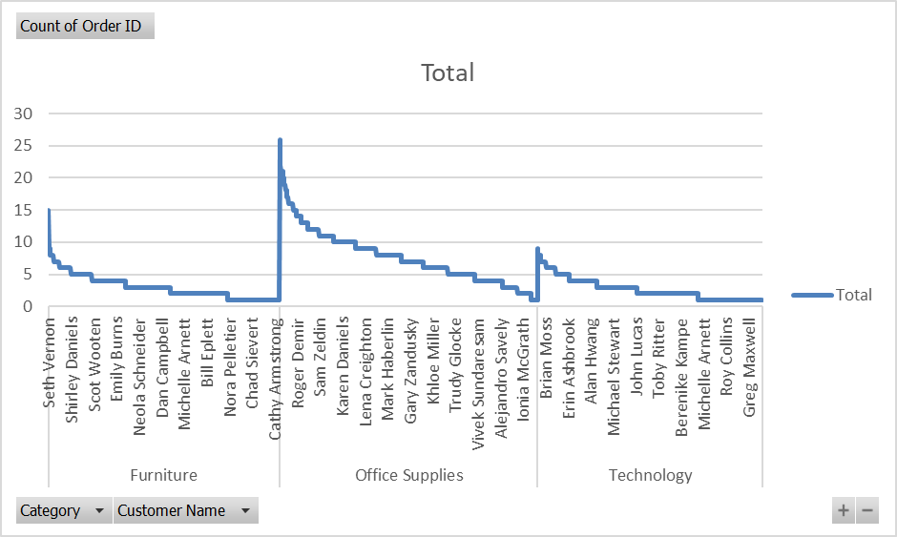
QUESTION 8
Insights:
There are a lot of repeating customers but focused on specific categories.
Inference:
The Store can give discounts and gifts for a certain category and specific customers.

Slide 10
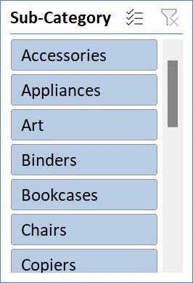
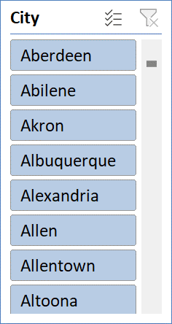
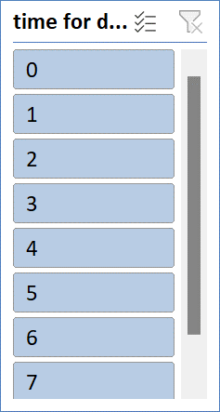
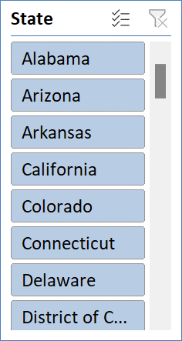
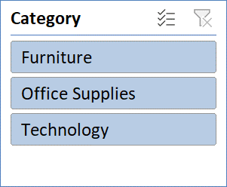
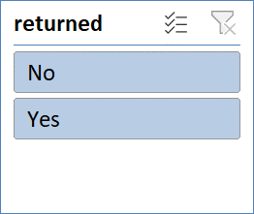
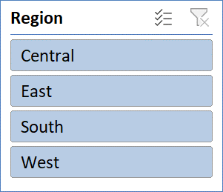
Dashboard

Slide 11
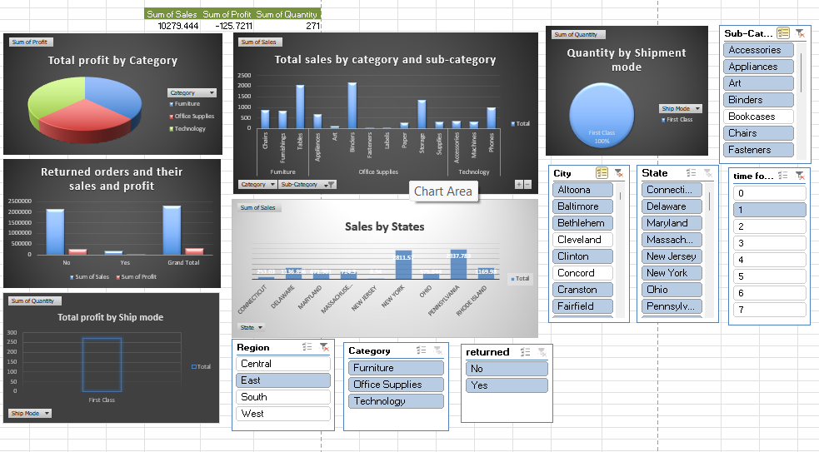
Screen shot for dashboard

