Slide 1
Essentials of UrbanCode Deploy v6.1
QQ147
Applications
Notes:
Module 4 - Applications

Slide 2
Module overview
After completing this module, you should be able to complete these tasks:
  Create and correctly scope applications
  Create environments and application processes
  Create tags
  Use and create approvals, notifications, and status gates
  Use and create properties
Notes:
Module 4 - Applications

Slide 3
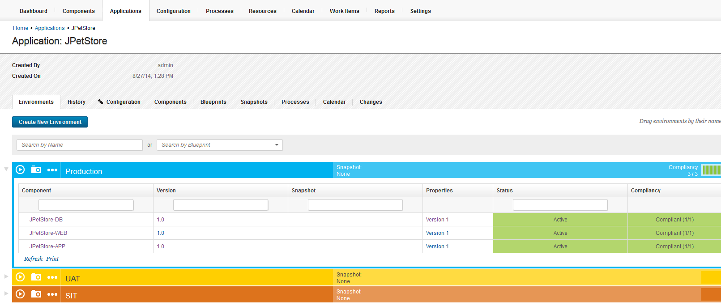
What are applications in UrbanCode Deploy?
Applications handle the orchestration of deployments to a target environment.
Notes:
Module 4 - Applications
An application is a container for environments and application processes. Application processes work on component processes to do deployment. You see the power when you have lots of components – the application orchestrates what gets done and when.

Slide 4
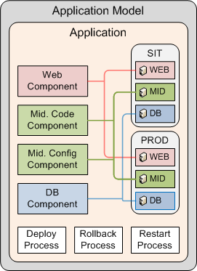
Application terminology
Components
  A grouping of files to deploy
  You define which components belong to the application
Environments
  Define target hosts
  Add specific resources to an environment
Processes
  Define steps to install, configure, rollback deployments
Blueprints
  Set up a new environment quickly
Notes:
An application model is like a container for environments, components and processes. These get added to an application. First components are added to an application. Resources get placed into environments. The way you create an environment is by adding resources to an environment. Blueprints are like templates. You can add resource templates to a blueprint and that’s how you set up the environment.
Module 4 - Applications

Slide 5
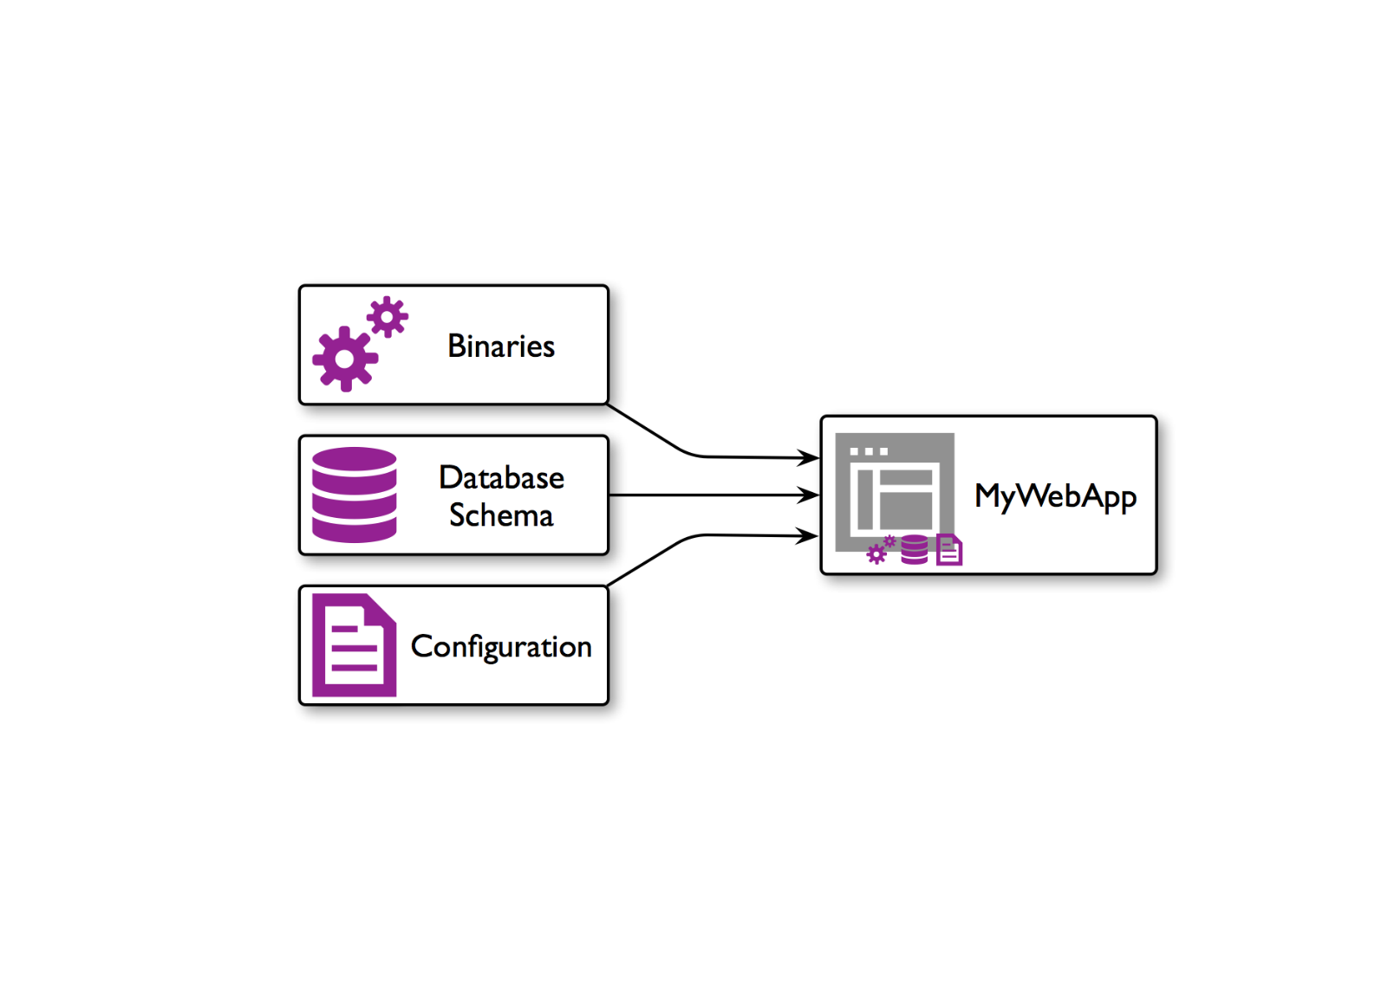

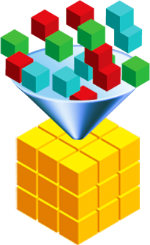



Application scoping
Defining an application:
  Determine what components must be deployed together
Components
Composite application
Notes:
An application orchestrates a deployment. In order for an application to orchestrate a deployment you must tell it what components to deploy together.
Module 4 - Applications

Slide 6
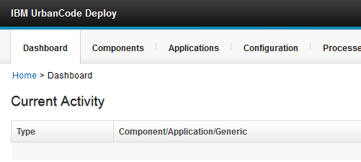
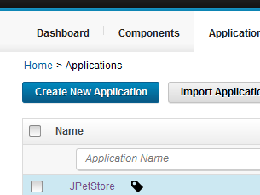
Creating an application
1.
Click the Applications tab.
2.
Click Create New Application.
Notes:
Module 4 - Applications

Slide 7
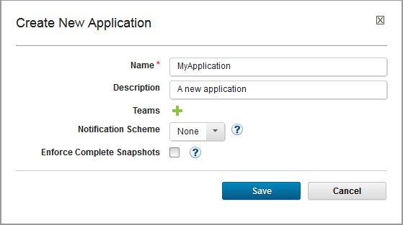
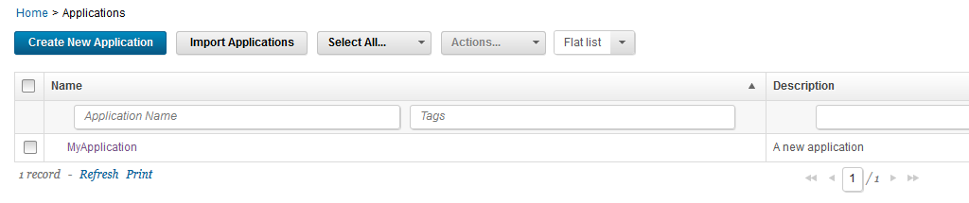
Creating an Application
3.
Complete the form, and click Save.
The application is included in the Applications list.
Notes:
Module 4 - Applications

Slide 8
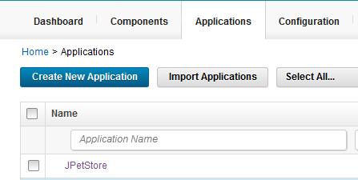

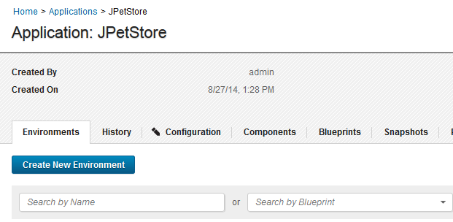
Adding components to an application
1.
Choose the Application that requires components.
Before you add components to an application, they must be created first. See the “Components” module for more information about creating components
2.
Click the Components tab.
Notes:
Module 4 - Applications

Slide 9
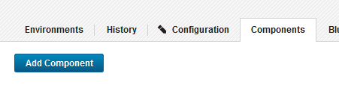
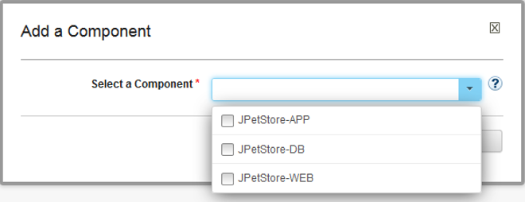
Adding components to an application
3.
Choose the application that requires components.
4.
Choose the components to add.
The components that are added here also must be added to an application environment. Instructions for adding these resources to environments are available on the “Adding resources to an environment” slide.
Notes:
Module 4 - Applications

Slide 10
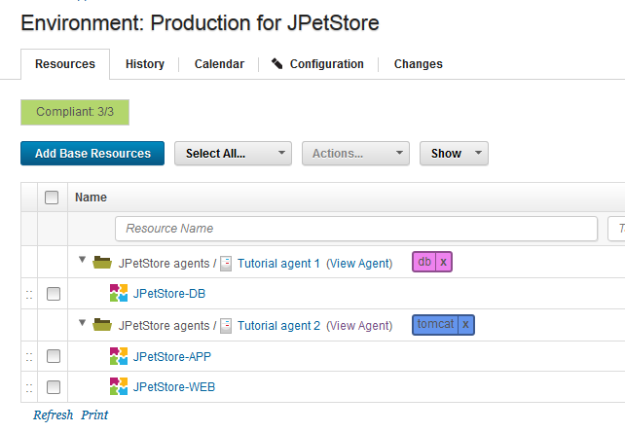
Applications: Environments
An environment is a collection of resources that are required to host an instance of an application.
  Resources include agents and components.
Environment resources
Notes:
Application, like many UrbanCode words, does double-duty. Narrowly, it is an object; broadly it is reasonable to consider the final deployment an 'application.' Users talk about it that way.
An environment has resources. An environment has component and agent resources and the third type of resource is an organizational container—called a resource group.
Module 4 - Applications

Slide 11
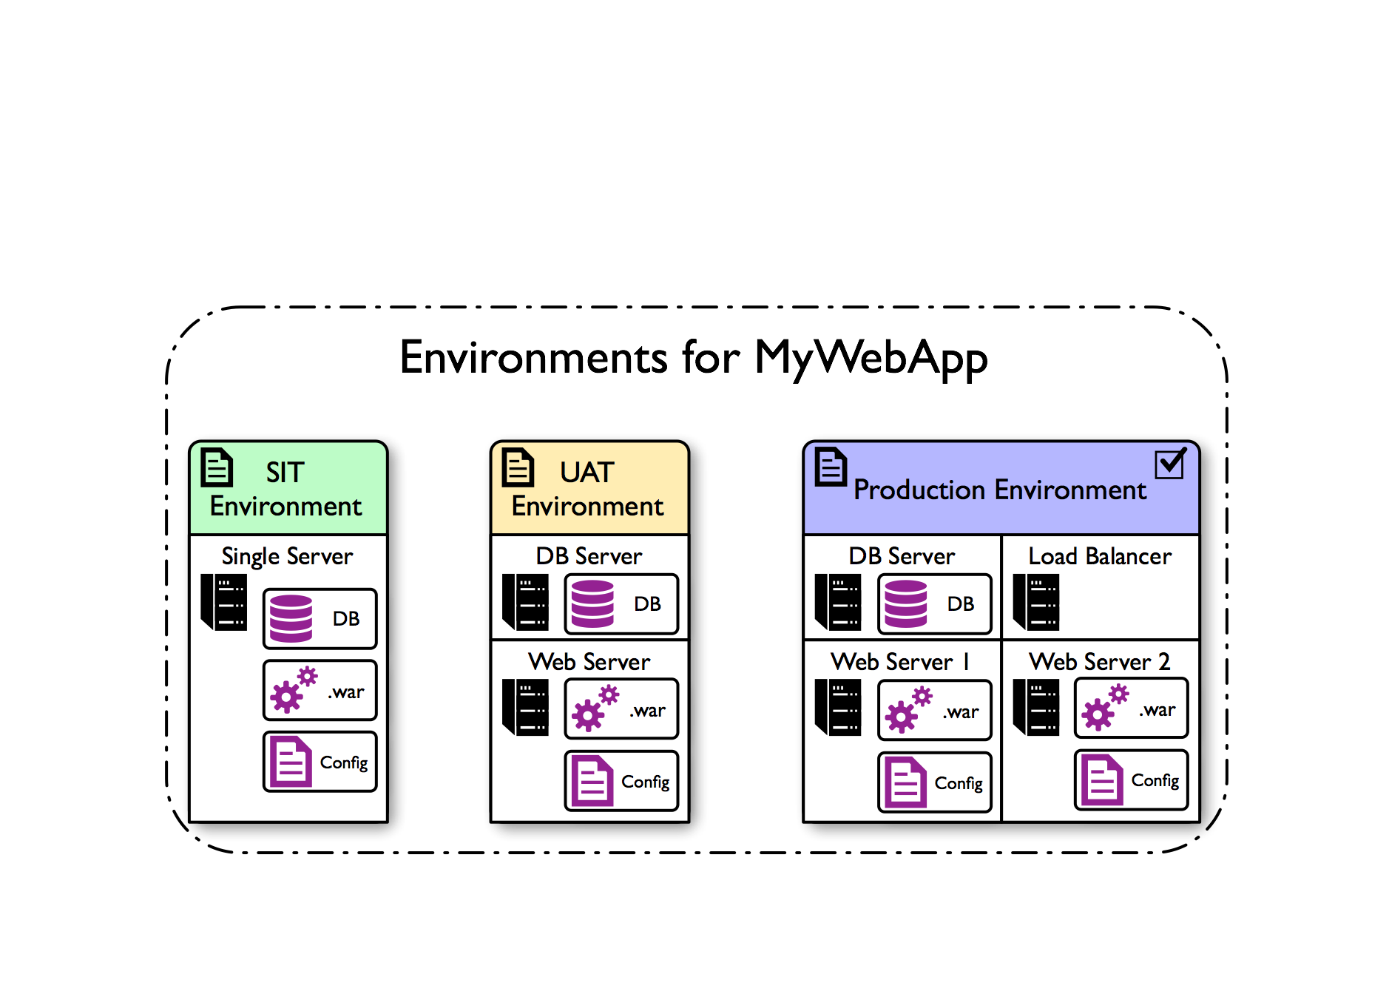
Applications: environments
Environments within Applications can have different topologies, configurations, and settings for the environment
Notes:
In this slide you see the environments in the application. There are 3 environments. Each environment is different. You see two test environments UAT and SIT – with the same components in each. But the components go to different computers in each environment. In a test environment you would not worry as much about performance as you do in production. Usually you do have several environments for every application. It is pretty standard to have multiple environments. The application is an object that contains components with processes that operate on it. The application is the traffic cop – says this one goes first, and this is where it goes. The application process does the controlling – like a symphony director.
Module 4 - Applications

Slide 12
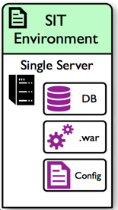
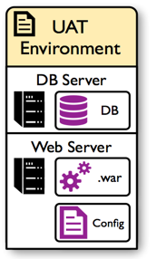
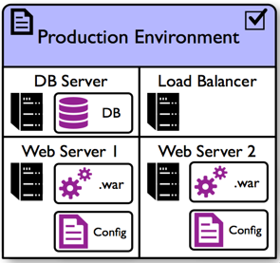
Environment topologies
Two servers with an installed agent on each. The database server contains the database component and the web server contains the web and config components
A more distributed and production-ready topology. Each server has an installed agent with the database server that still contains the database component, but there are load-balanced web servers that each contain a web and config component.
A single server with an installed agent contains all three components: Database, Web, and Config
Notes:
A component has to be added to an application then added to every environment as a resource. In a production environment you have added some components twice because there are multiple severs. Note there is a load balancer here in the production environment. You do not need load balancers in test environments because performance doesn’t matter much there. The load balancer in production decides what server gets the next request. In the production environment topology the load balancer gets all requests and the load balancer determines where to send the request.
Module 4 - Applications

Slide 13
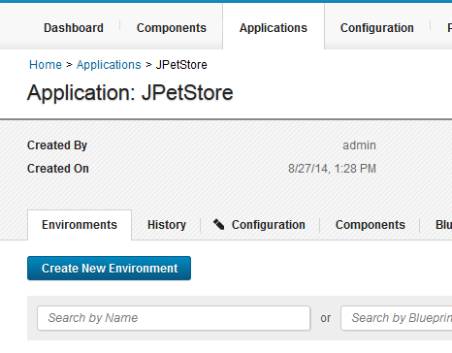
Creating an environment
1.
Click the Applications tab.
2.
Click Create New Environment.
Notes:
Module 4 - Applications

Slide 14
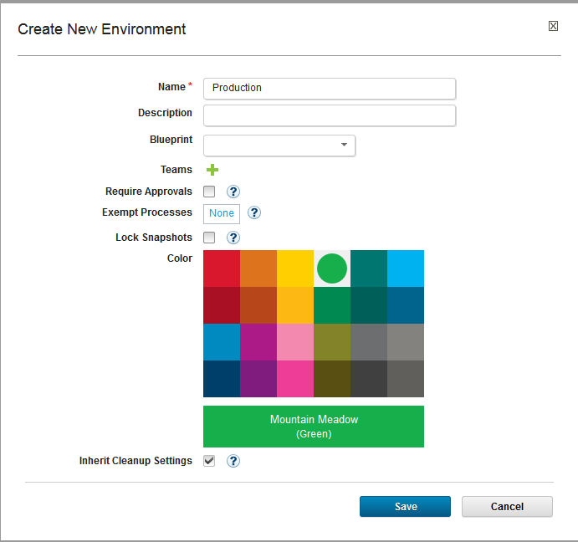
Creating an Environment
3.
Complete the fields, and click Save.
Notes:
You can choose a blueprint here if you have one. A blueprint defines what resources go into the environment in a generic way.
Module 4 - Applications

Slide 15
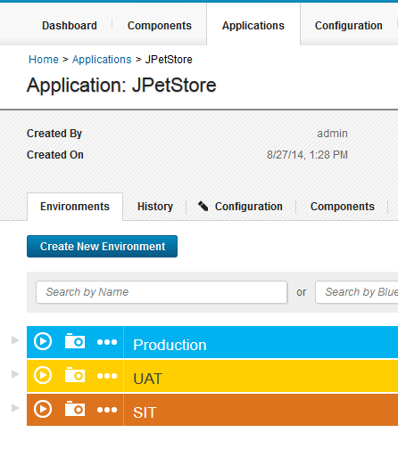
Adding resources to environment
Before adding resources to an environment, they must be created first. See the “Resources” module for more information about creating agents
1.
On the Environments tab, choose the environment to add resources to.
Notes:
If you are not using a blueprint then you need to add resources to an environment.
Module 4 - Applications

Slide 16
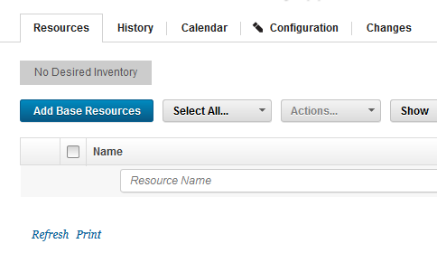
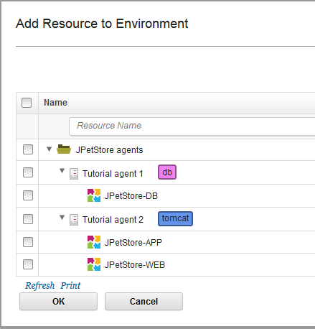
Adding resources to an environment
2.
On Resources tab, click Add Base Resources.
Choose the resources to add to the environment.
Notes:
Here you have components mapped to agents in your resources. You always add components to agents. This slide shows the UAT environment that was shown on slide 12 where there is the DB component on the DB server and the other two components on the web server. You could set up a blueprint that maps components and agents to resources. In real production environments there are scores of agents.
Module 4 - Applications

Slide 17
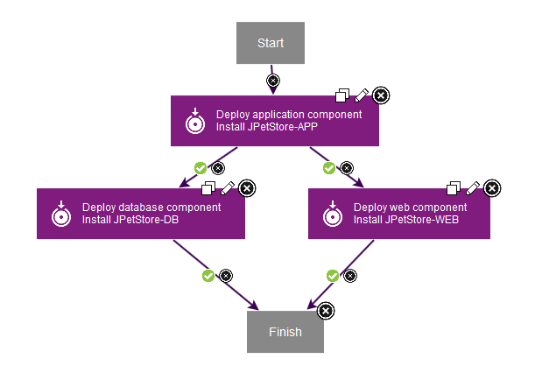
Applications: Processes
Application processes provide overall deployment orchestration.
Steps in an application process represent the various component processes and tasks that are required to complete a deployment.
Notes:
An application process looks just like a component process but these steps are not from plug-ins. Steps for applications are hard coded into UrbanCode Deploy. The application process only proceeds to the next step when the previous step is successful. If the component process fails, then the application process stops. You can see where the failure occurred in UrbanCode Deploy and you can examine each step in a component process if there is a failure. Troubleshooting is made easy in the user interface.
Module 4 - Applications

Slide 18
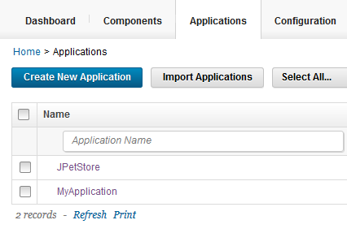
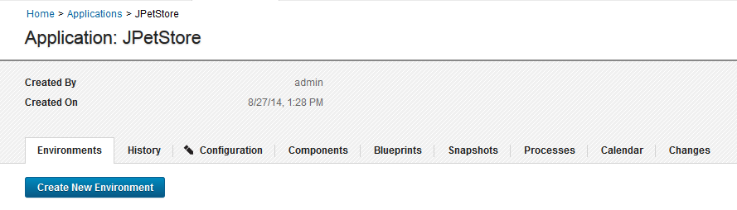
Creating an application process
1.
On Applications tab, choose the application for the process.
2.
Click the Processes tab.
Notes:
Module 4 - Applications

Slide 19
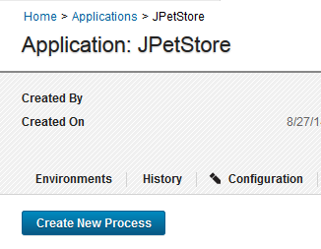
Creating an Application Process
3.
Click Create New Process.
Notes:
Module 4 - Applications

Slide 20
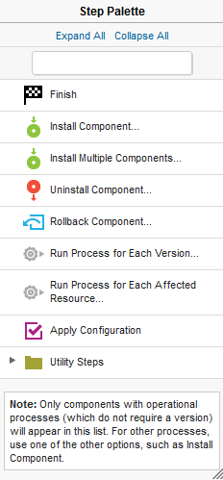
Application process steps
Deploy multiple components in one step
Choose a component deployment process to run
Switch between different incremental component versions
Remove all component versions from the environment
Runs a component process for each component version
Runs a generic process on each resource that is affected in the application process
Runs an operational (non-version) or config deployment process
Notes:
Here is the application process step palette. These are the options of steps you could add to an application process.
Module 4 - Applications

Slide 21
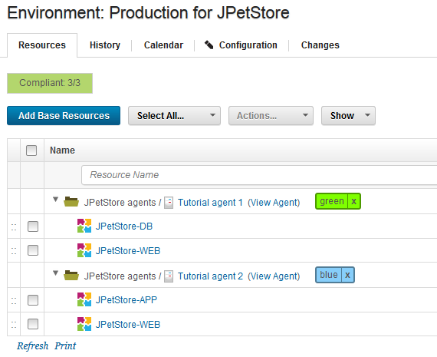
Application process: Tag use
Tags can be set on resources in an environment to help you exercise fine-grained control over which resources a deployment runs. Tagging is commonly used in load-balancing situations.
Notes:
This is tagging that is done on resources and then the tags are seen when the application process runs a deployment. Tags were also covered in the Resources module. You could tag your agents on servers either blue or green and take one set down for maintenance and deploy only to the green servers.
Module 4 - Applications

Slide 22

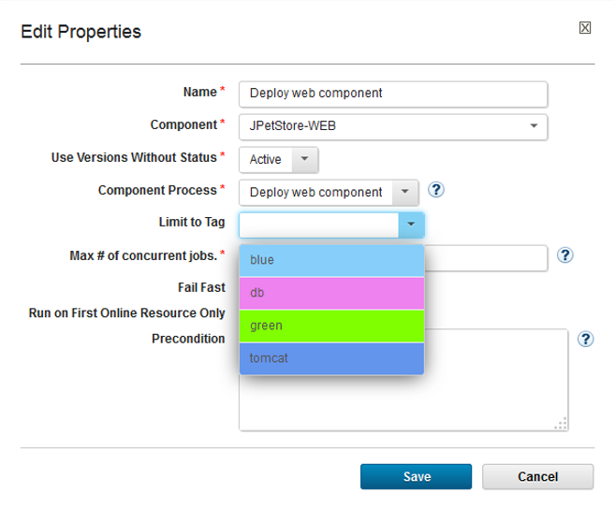
Application Process – Tag Usage
When adding an Install Component step, there is a choice to limit the deployment to a specific resource tag
Notes:
Module 4 - Applications

Slide 23
Application approvals and status gates
In addition to roles and permissions, you can ensure that an environment is not tampered with or left in an unwanted state:
  Environment approvals can be set to require an administrator or manager to approve a process run against an environment
      Such an approval is particularly useful in production environments
  Status gates can check a component version in an environment for a certain status before that version is deployed
      Example: Deploy only component versions with a “Passed all tests” status.
Notes:
Most companies use approvals in one form or another. In many cases, they have requirements they must follow as part of industry regulations.
Some customers could use approvals in an external system like ServiceNow. In those cases, they would use the UrbanCode Deploy ServiceNow plugin at the beginning of an application process to check the status of an external approval. You would configure the process to fail if the approval was not found.
You can also model approvals in UrbanCode Release. There is a bit more flexibility in UrbanCode Release, as privileged users have the ability to create temporary exemptions.
Module 4 - Applications

Slide 24
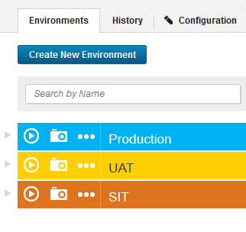
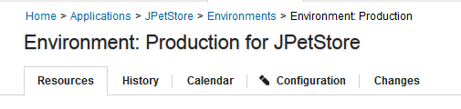
Creating approvals
1.
Choose the environment that requires enable approvals.
2.
Click the Configuration tab.
Notes:
Module 4 - Applications

Slide 25
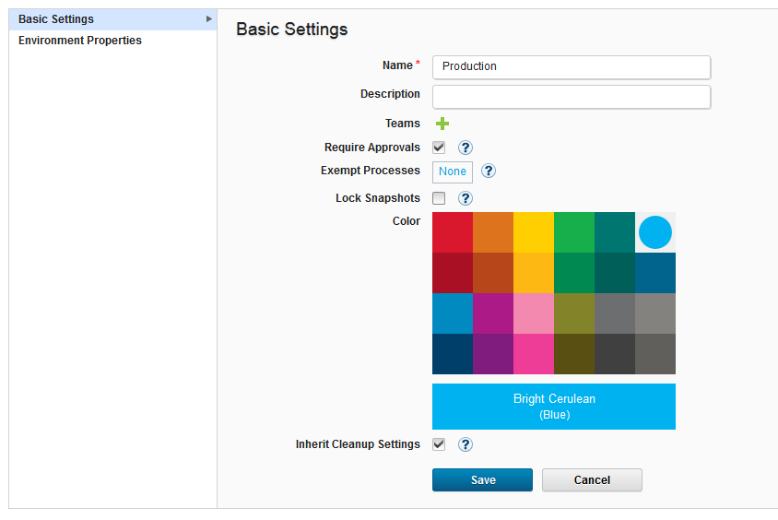
Creating approvals
3.
Select Require Approvals, and save the settings.
Notes:
Module 4 - Applications

Slide 26
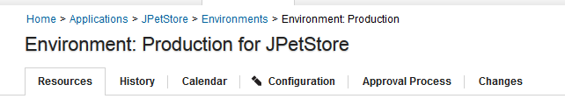
Creating approvals
4.
Click the Approval Process tab.
Notes:
Module 4 - Applications

Slide 27
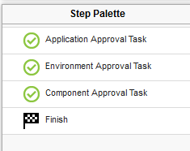
Creating approvals
5.
Choose from three approval tasks.
Each approval task can be associated with approvers with different roles. If all three tasks are selected, the environment requires three separate approvals to move forward with a process.
Notes:
Module 4 - Applications

Slide 28
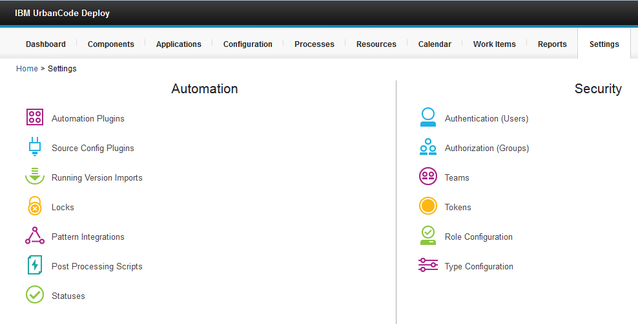
Creating status gates
1
2
Notes:
Module 4 - Applications

Slide 29
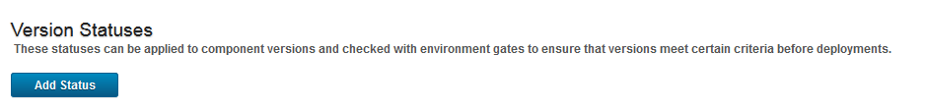
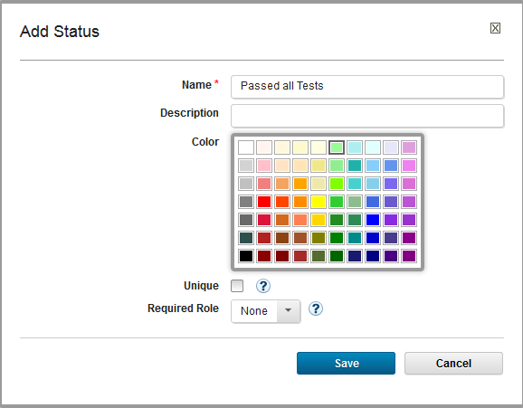
Creating Status Gates
3
Click Add Status.
4
Enter details, and save.
Notes:
Module 4 - Applications

Slide 30
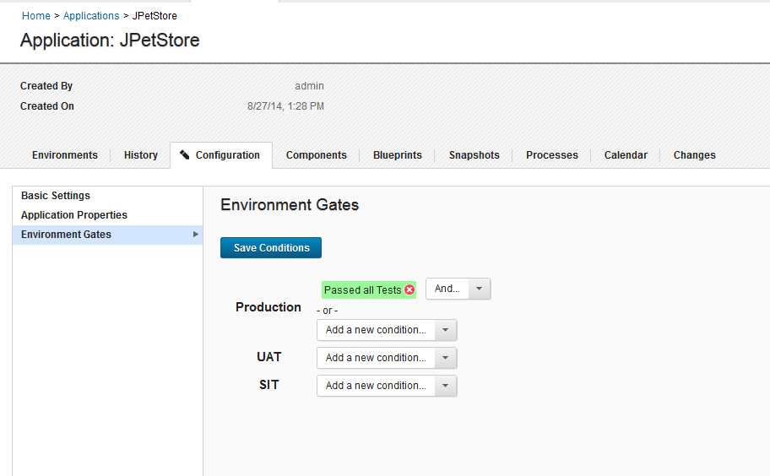
Creating status gates
5
6
7
Choose an environment that requires gates, and add conditions.
Notes:
Module 4 - Applications

Slide 31
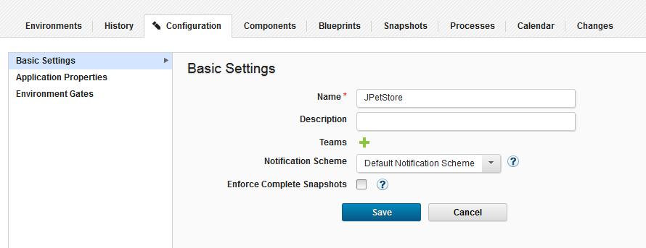
Application notifications
Add a notification scheme to the application;
  Notifications are sent to appropriate parties based on scheme.
  Schemes and mail settings configurations specified on the main Settings tab.
1
2
3
Notes:
You can set up your own notifications – it’s not hard to do. This is to notify people of deployment, rollback, or problems. You have to set up triggers and email addresses. Not sure how many customers actually use it. Default is to notify people if an application process succeeds or fails. You put in roles –so if an admin is selected anyone with an admin role would get notified.
Module 4 - Applications

Slide 32
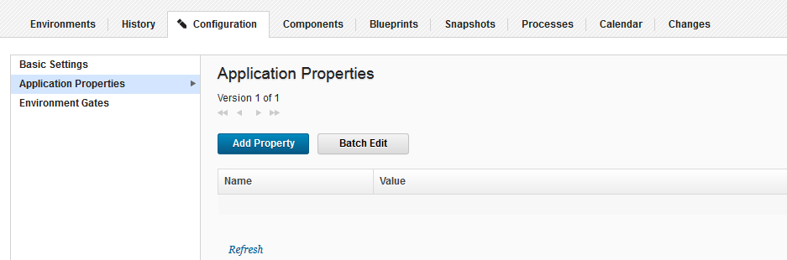
Application properties
Application properties can be accessed by any application process or component process that is run against an environment in the application.
1
2
3
Notes:
When you put a property on an application its scope can reach any component or process within the application. It would be a property that all processes and components would need to share.
Module 4 - Applications

Slide 33
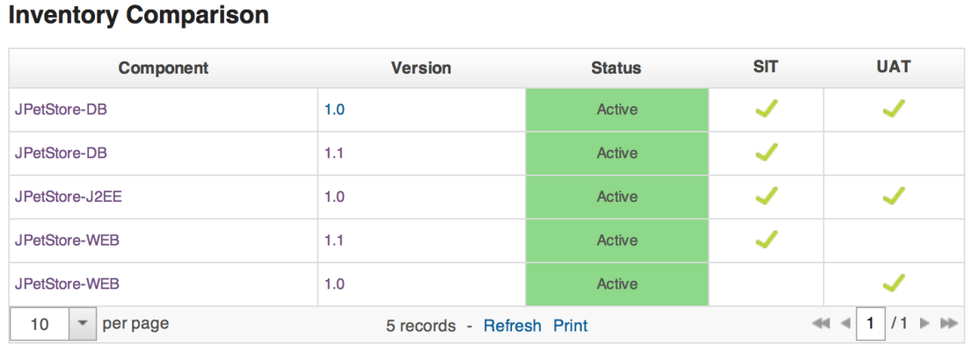
Snapshots
To create a snapshot, you specify which version of components and processes to include in the snapshot.
Typically, to create a snapshot you copy the components and processes from an environment where you deployed the application without errors.
Notes:
The concept of snapshot is similar to the concept of snapshot in other tools such as a vmware snapshot. It’s used for rollbacks or to deploy certain versions of components. You would look at the inventory to see what components were successfully deployed where to choose the components for a snapshot. Snapshots save time and increase efficiency.
Module 4 - Applications

Slide 34
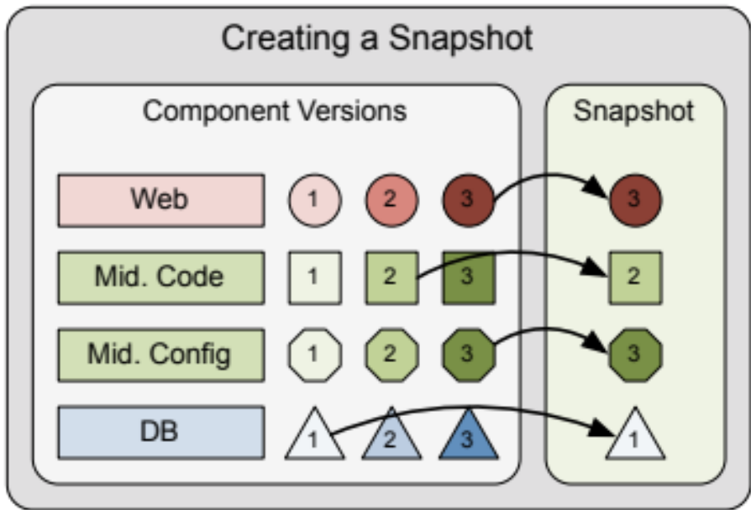
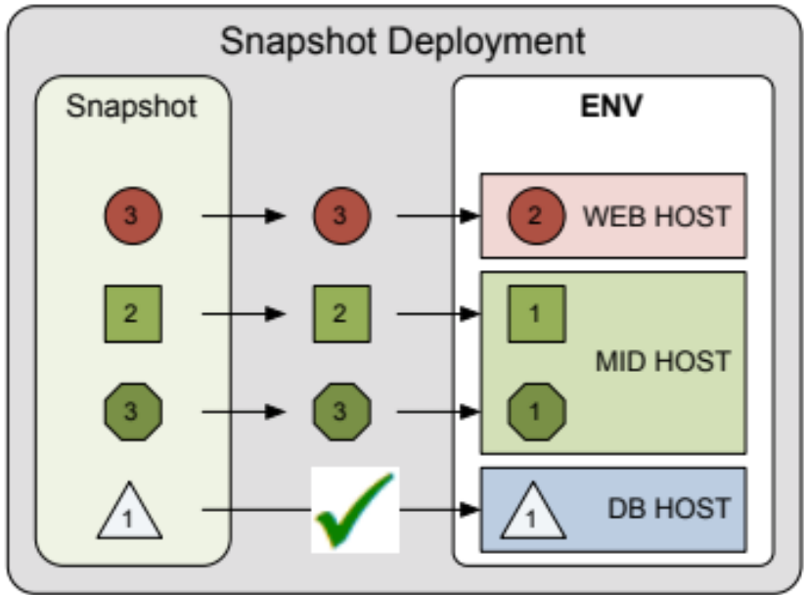
Snapshots
Create a snapshot after testing
Snapshots contain deployable components and configuration
Deployment changes are tracked by default
Snapshots help in these areas:
  Automation, audits, and visibility
Notes:
The versions of components are selected to add to the snapshot. You can select any version assigned to an application. You select the application then create a snapshot. Then you select the components for the snapshot. If you select an incremental version of a component, it also pulls in earlier versions of that component. When you run a deployment you select a snapshot to deploy. This is done in the deployment lab exercise.
Module 4 - Applications

Slide 35
Review questions
How is a blueprint used?
What do applications do?
What do applications consist of?
Why are environment approvals used?
How are status gates used?
Notes:
Answers to review questions:
1. Blueprints are used to add resources to environments.
2. Applications orchestrate deployments to target environments.
3. Applications are like containers consisting of components, environments (with resources mapped to environments), processes and optionally blueprints. They run on the component processes.
4. Environment approvals – The intent of an environment approval is for someone in a role like an administrator to approve a process be run on an environment. You can have an administrator approve a deployment.
5. Status gates – Check to make sure a component is a certain version before it is deployed.
Module 4 - Applications

Slide 36
Module overview
After completing this module, you are now able to complete these tasks:
  Create and correctly scope applications
  Create environments and application processes
  Create tags
  Use and create approvals, notifications, and status gates
  Use and create properties
  Create snapshots
Notes:
Module 4 - Applications

