Slide 1
Essentials of UrbanCode Deploy V6.1 QQ147
Components

Slide 2
Agenda
What are components?
Aspects of a component
Creating a component
Importing Component versions
Component processes
Component templates
Notes:
Module 3 - Components

Slide 3
Objectives
After completing this module you are able to:
Import artifacts to create a component
Set environment properties on components
Add versions to the components
Create component processes
Create component templates
Notes:
Module 3 - Components

Slide 4
What are components?
Components represent deployable items along with user-defined processes that operate on them. For example:
  A typical Java­™ Platform, Enterprise Edition application typically has three components (application, database, and web components).
  Large applications might have many more.
Notes:
Components are like containers for artifacts. The PetStore course lab has 3 components.
Module 3 - Components

Slide 5
Features of a component
The main features that make up a component are as follows:
Source configuration
Component versions
Component properties
Component processes
Notes:
For the source config it just defines the source type. The source types used to be baked in and now they are plug-ins. Some of the component fields depend on the source configuration plug-in.
Version - Incremental and complete versions.
Component properties can be anything you want them to be.
Component processes – These do 90% of the work on the component. The application does the other 10% of the work on the component. You run an application to deploy a component. The application process does some of the directing and stuff like that.
Module 3 - Components

Slide 6
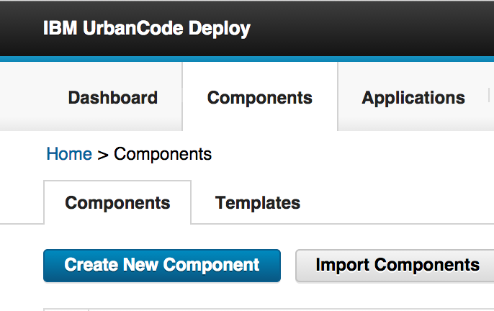
Creating a component
To create a component:
Choose the Components tab.
Create New Component.
Notes:
Note that components may be manually imported into UrbanCode Deploy. In the class lab we import the components.
Module 3 - Components

Slide 7
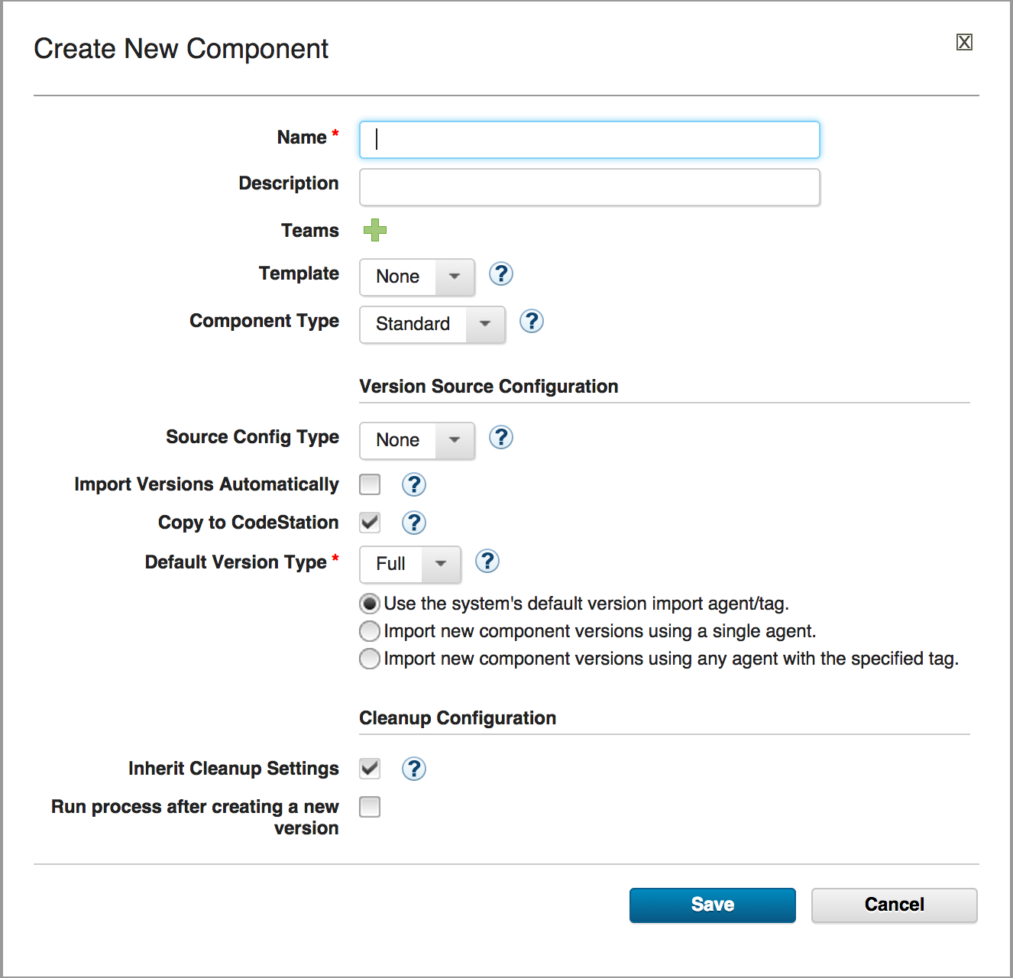
Creating a component
You see this page:
Notes:
After you choose the source config type the form changes depending on the source config plugin. You will get different fields. When you create the component, component artifacts go into a repository – if you use codestation (it comes with UrbanCode Deploy, that is where the components go). Usually a component consists of artifacts. If you have file type as the source config type you need to then specify a base path where to find the files. There are about 12 source config types. Only 2 types of component – with zOS the file structures and coding change. But if you are not putting it on the mainframe everything else is the same. A component can be considered a container for artifacts and the processes that operate on them. If you want to use a template you use it there. Then you get a type of component with pre-defined attributes. With a template you can already have processes pre-defined.
Module 3 - Components

Slide 8
Creating a component
The fields on the form:
Name: Provide a name for the component. It might reflect the item or tier of the application to be deployed.
Description: An optional field to elaborate on the contents of this component.
Notes:
Some fields are shared by all components but some fields are unique depending on the component’s source.
Module 3 - Components

Slide 9
Creating a component
Teams: With this field, you can associate a team with a component. To learn more about teams, see the security module or refer to the documentation.
Template: Components can be created from a template. Templates are covered later in this module.
Notes:
Module 3 - Components

Slide 10
Creating a component
Component Type: You can select one of two types of components, Standard and z/OS. Choose z/OS only if this component is intended to be deployed to a mainframe.
Notes:
Module 3 - Components

Slide 11
Creating a component
Source Config Type: In this field, you can define how artifacts are associated with a component. Several available choices come with the product. The available choices are defined by source configuration plug-ins. Each plug-in defines a single type of artifact. You can import artifacts manually or have IBM UrbanCode Deploy import them automatically.
Notes:
Source Config Type is a way of specifying where you get artifacts. When artifacts are imported automatically, IBM UrbanCode Deploy periodically checks the artifacts for changes.
Whenever changes are detected, a new component version is created. You can control how often artifacts are checked.
Source could be DB tables—not every artifact is a file.

Slide 12
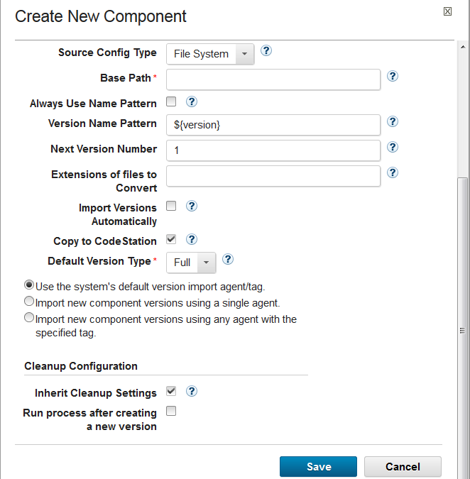
Source config type file system
Notes:
Module 3 - Components

Slide 13
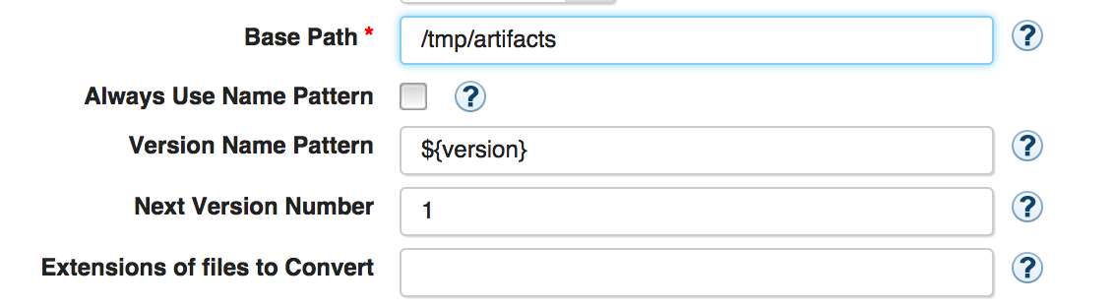
Creating a component
Use Base Path for importing a file system. In the field, you specify where to get the files for importing. The files are moving from the file system to the UrbanCode Deploy artifact repository for storage until they are deployed.
Notes:
The example used here is of importing a "file system." By importing a file system, the component gets the files it will use. Import implies movement. That's exactly what is happening. The files are moving from the file system to the UrbanCode Deploy CodeStation artifact repository, where they are stored until they are moved again (deployed). In the deployment process, you specify another directory, which is called a working directory, that defines where to place the artifacts during the deployment.

Slide 14
Creating a component
Import Versions Automatically: If this option is selected, IBM UrbanCode Deploy polls the Source Config for new versions.
Copy to Codestation: Select this option, if you want to store the component versions in the IBM UrbanCode Deploy repository (Codestation).
Notes:
Usually you do not import versions automatically – you don’t always want new versions. The time interval for polling is set in system settings.
You normally do copy to codestation unless you have your own repository. If you use codestation you select copy to codestation.
Module 3 - Components

Slide 15
Creating a component
Default Version Type: Two version types are available: full and incremental. Choose Full, if the contents of the component versions represent the entire component. Choose Incremental, if the contents are a subset of the full component. For this course you select Full versions.
Notes:
There are two types of versions Full and Incremental. With an incremental version the agent compares the incremental version to the inventory and deploys only the changed artifacts. It's not practicle to redeploy entire databases, for instance Incrementals are used a lot with databases because you do not want to change the whole database. You do not want to replace a whole database every time you have a change. Incrementals are often the ones that are rolled back.
Module 3 - Components

Slide 16
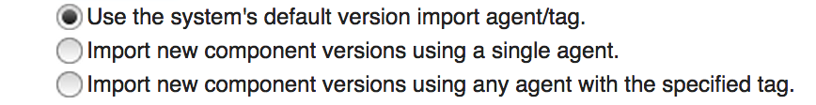
Creating a component
Import version settings:
These settings determine which agent is
responsible for importing the versions into
IBM UrbanCode Deploy. Typically the first
selection is fine.
Notes:
You have to use some agent to import stuff into codestation. You set this up – you pick an agent to use by default. You can pick an agent with a deployment or by default it uses the system agent. If you choose the second you specify the agent – you are forced to pick an agent. 3rd is you have a bunch of agents and it doesn’t matter which agent does the work - you can select the agent by a tag.
Module 3 - Components

Slide 17
Creating a component
Inherit Cleanup Settings: Select this check box to inherit the cleanup settings that are defined for the server. If not, you must define your own cleanup policies.
Run process after creating a new version: Select this check box to launch a process immediately after the IBM UrbanCode Deploy system recognizes a new version.
Notes:
You usually check the inherit clean up box. That is to use the default behavior. This has to do with how long versions are kept in codestation. You can change the length of time the versions stay in codestation in the system settings. The default is forever. If you have lots of versions that is probably not what you want to do. By default it keeps every version forever.
Run process after creating a new version – this is not typically used, normally you would not do this. But if you want you could run a generic process and the trigger might be any time you import a new version. If you have automatic import – it’s a generic process that is kicked off when there is a new version in codestation.
Module 3 - Components

Slide 18
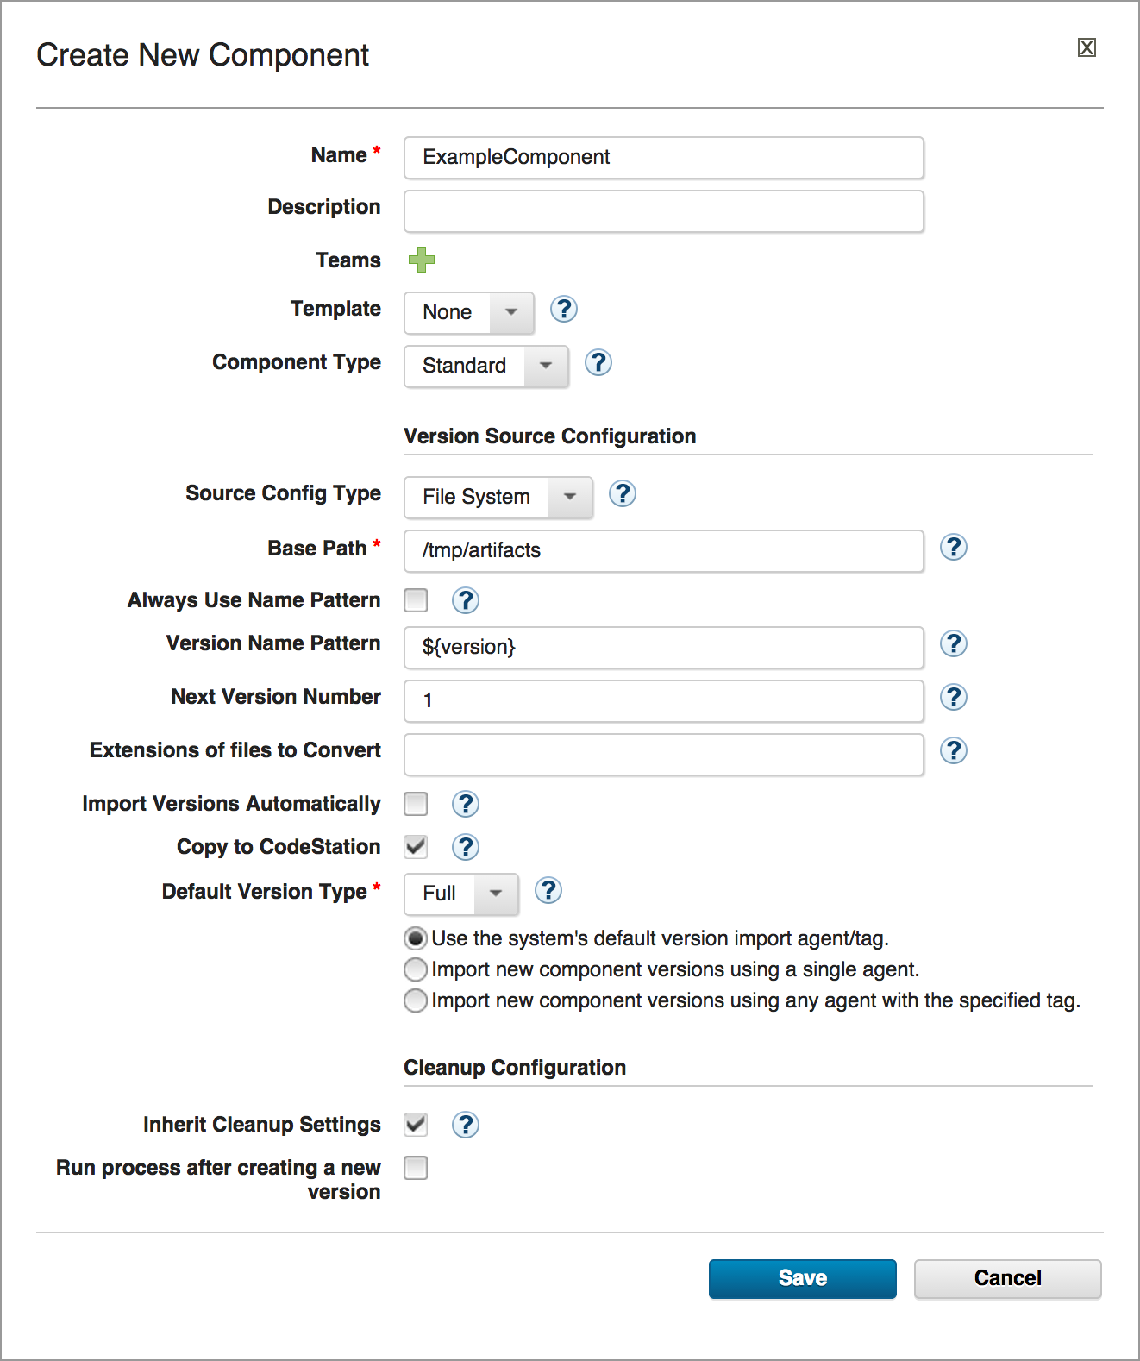
Creating a component
Upon completion, your form looks like this illustration:
Notes:
Module 3 - Components

Slide 19
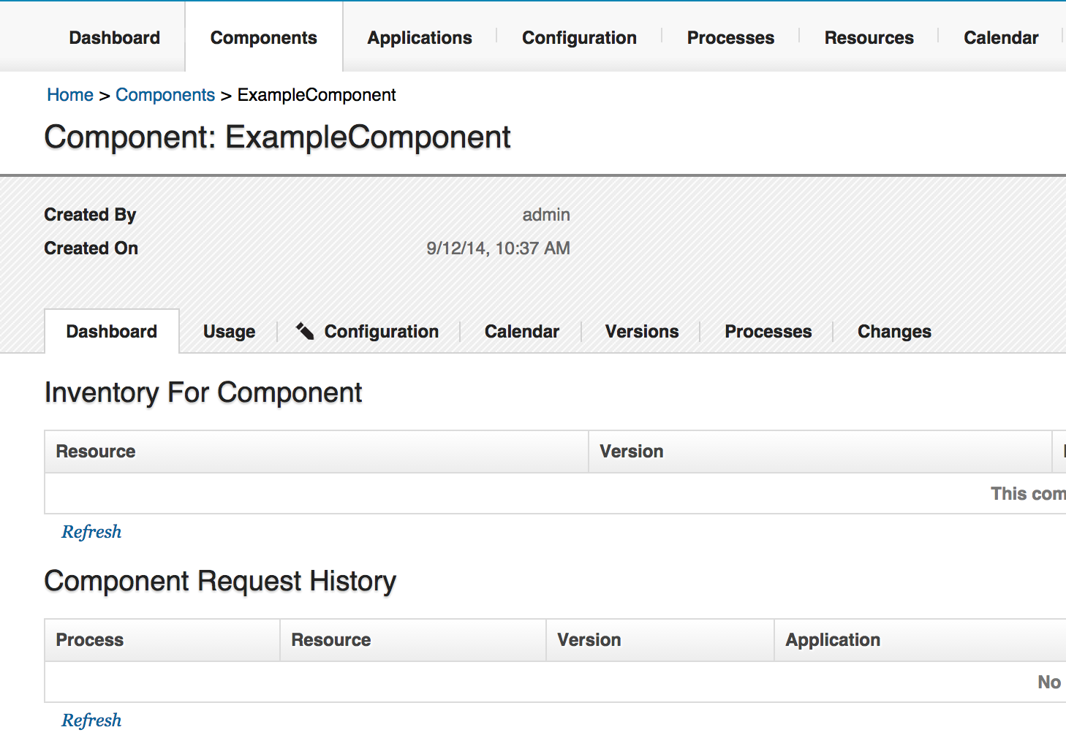
Creating a component
Next, click Save, and you see your new component.
Notes:
Module 3 - Components

Slide 20
Version import overview
After learning how to create a component, you learn how to create a component version. Components can have many component versions. These versions are deployed later.
For the example, the File System Source Config type is used. Before importing the versions, you must check a few things first.
Notes:
This is about creating a component version. This is how you manually create a version of a component. You defined parameters of a component and here you give it artifacts. You defined where the artifacts were located but you haven’t loaded the artifacts into codestation yet. This is how you get them into codestation. If we had selected auto version import it would have gone to get the versions. It is better to have a manual import to become familiar with process. In the JPetStore lab there is a manual import.
Module 3 - Components

Slide 21
Version import overview
Recall that Use the system’s default version import agent/tag was selected earlier in this module.
Next, define which agent to use for importing the versions.
Notes:
Module 3 - Components

Slide 22
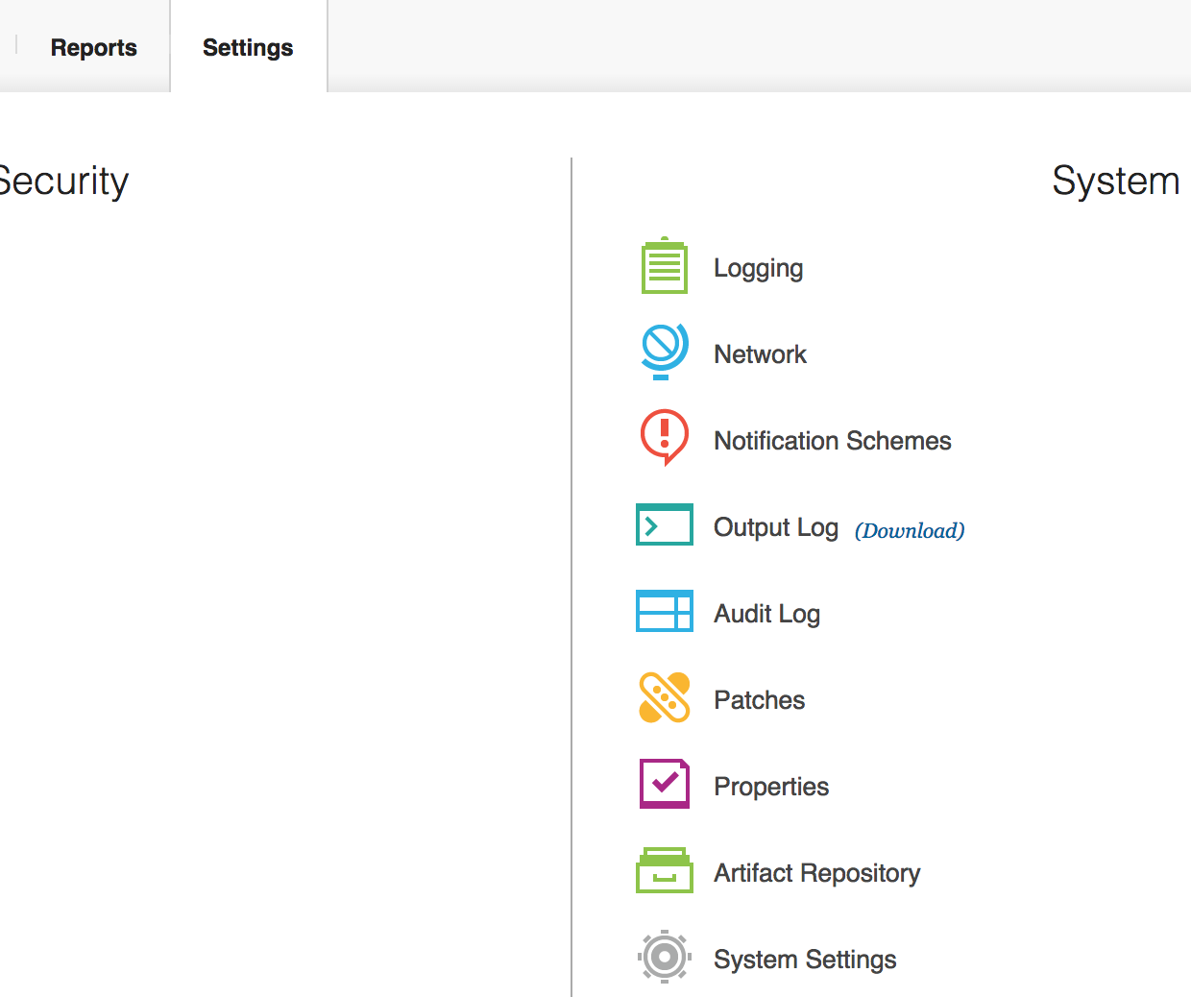
Version import overview
Notes:
Module 3 - Components

Slide 23
Version import overview
After you click System Settings, to the left you see General Settings, and near the bottom there is an entry for Agent for Version Imports. Choose the agent to use to import the versions. Typically the agent is on the same computer where the artifacts are located. For help on installing agents, see the product documentation for Agent Installation.
Check the next slide for a screen capture.
Notes:
Module 3 - Components

Slide 24
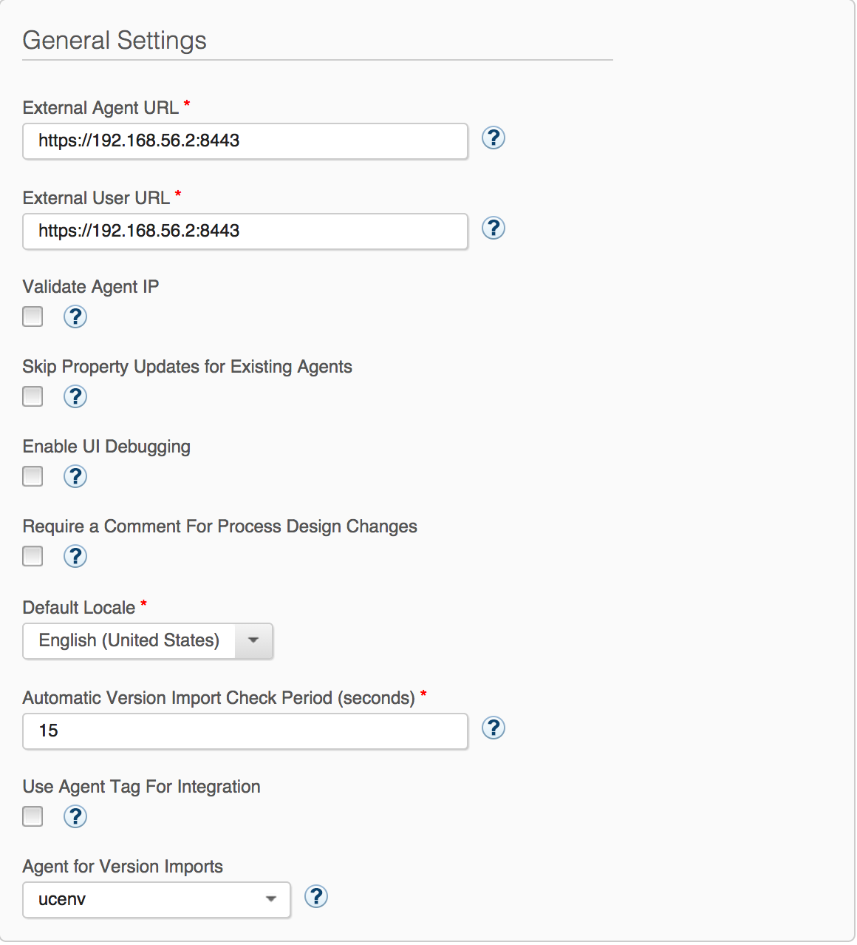
Version import overview
Notes:
Module 3 - Components

Slide 25
Version import overview
As you can see, we have a file located in this directory:
/tmp/artifacts
The file is called myApp.ear.
This file will be imported into IBM UrbanCode Deploy. Next, you import the file.
Notes:
Module 3 - Components

Slide 26
Version import overview
To import the file, you must return to the Component. Click the Components tab, and then click the component that you created. You see this page:
Notes:
Module 3 - Components

Slide 27
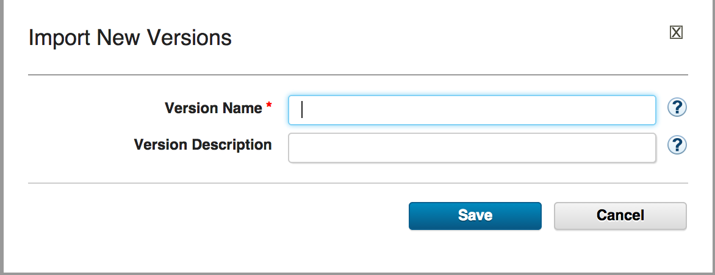
Version import overview
Next, click the Versions tab, and then click Import new Versions. You see this page:
Notes:
Module 3 - Components

Slide 28
Version import overview
In the Version Name field, define the name of the version to import.
For example, enter 1.3.0.4.
Then, click Save.
Notes:
Module 3 - Components

Slide 29
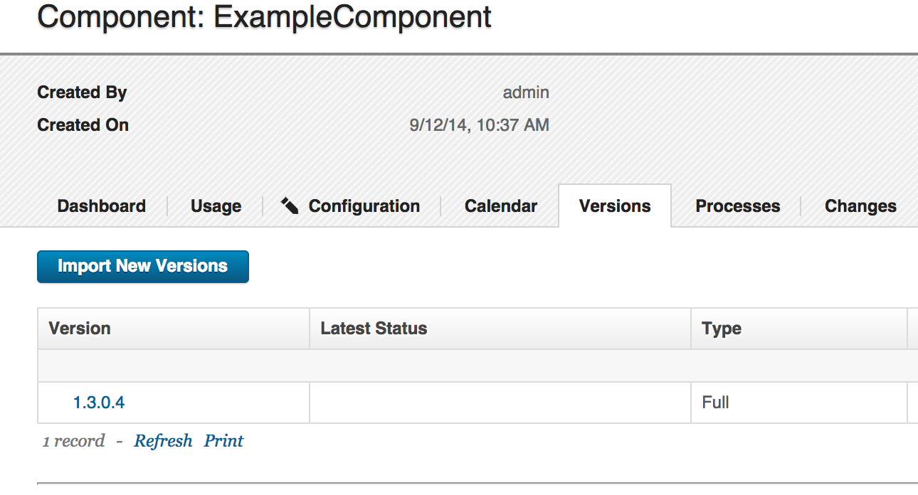
Version import overview
You see the imported version.
Notes:
Module 3 - Components

Slide 30
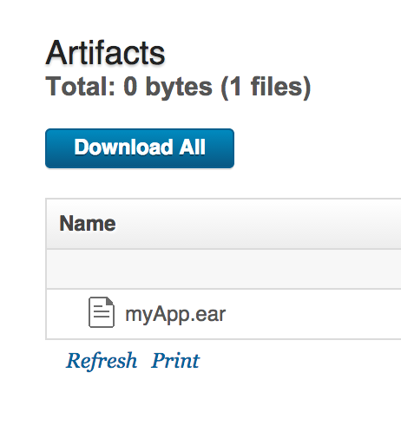
Version import overview
By clicking the new version, you see the files that were imported under the Artifacts section.
Notes:
Artifacts are not always files – could be a database. It will put all the artifacts into codestation and they will all be in component version 1.3.0.4.
Module 3 - Components

Slide 31
Component processes
After you import a version, you define a process for how to deploy that version. The idea is to create a repeatable process that can be reused as new versions of the component are developed.
Notes:
Module 3 - Components

Slide 32
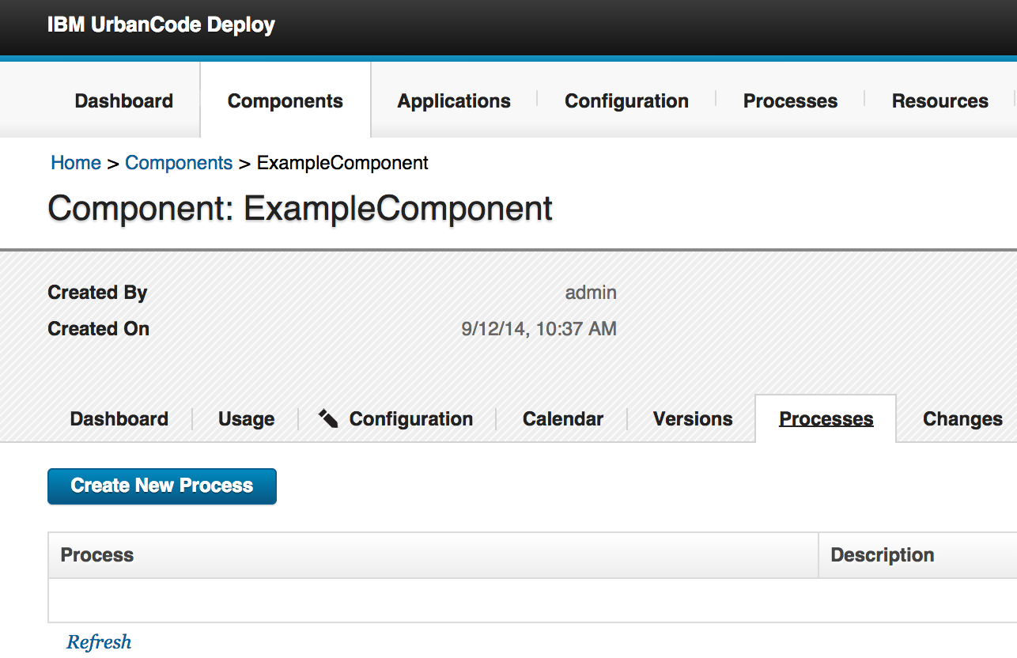
Component processes
First, go back to the component, and click the Process tab.
Notes:
Module 3 - Components

Slide 33
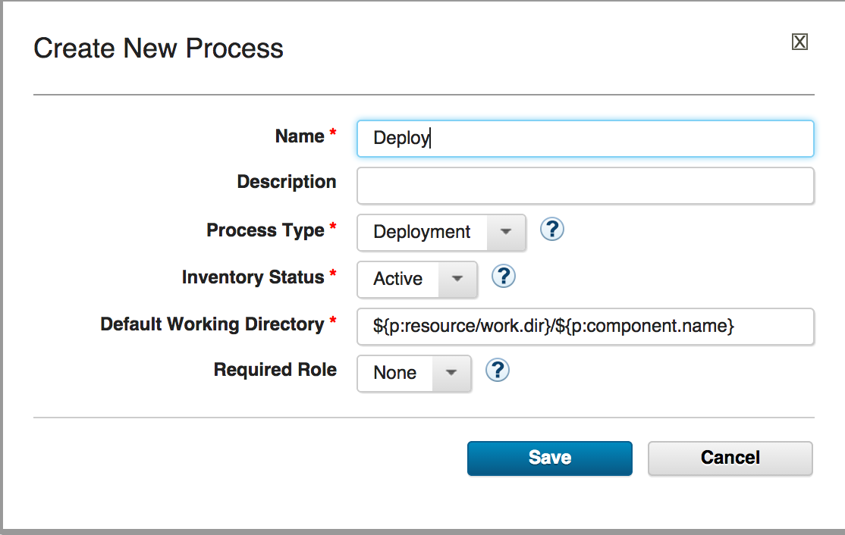
Component processes
Next, click Create New Process, and name the process. For example, type Deploy.
Notes:
There are different types of component processes, deployment is the most commonly used. Uninstall takes a component off a resource. It leaves the component but it takes it off a resource. Operational - does not change actual inventory but changes properties. An operational process does not add anything new to the environment. Operational could do something to the environment like start a server.
Module 3 - Components

Slide 34
Component processes
You also see a few other fields:
Process Type: This value determines how the component handles updating the inventory in UrbanCode Deploy. For more information, see Inventory Management.
Inventory Status: This value is the status to be applied to the inventory. Typically, you use the default value, Active.
Notes:
Process type - After you import a version, you define the process type that deploys it. The idea is to create a repeatable process that can be reused as new versions of the component are developed.
Inventory status - You can make your own statuses – you could have a complicated deployment that goes through different stages in which case you could create your own statuses and direct UCD to use the different statuses but by default there is only one – active.
Module 3 - Components

Slide 35
Component processes
The Default Working Directory: This value is the location from which the agent runs the process on the target computer. By default, you see this entry:
${p:resource/work.dir}/${p:component.name}
This location is a property that resolves to the agent installation location on the target server.
For example, the property resolves to this value:
/opt/ibm-ucd/agent/var/work/exampleComp
Notes:
This is the location where the agent is going to do the work. The property resolves to an actual spot where the component process does the work.
Module 3 - Components

Slide 36
Component processes
Required Role: Set this value to restrict access to a specific role of users who can run this process. For more information, see the Security module in the course or in the documentation.
Finally, click Save.
Notes:
This is security – you restrict access to the process by roles that are defined in security.
Module 3 - Components

Slide 37
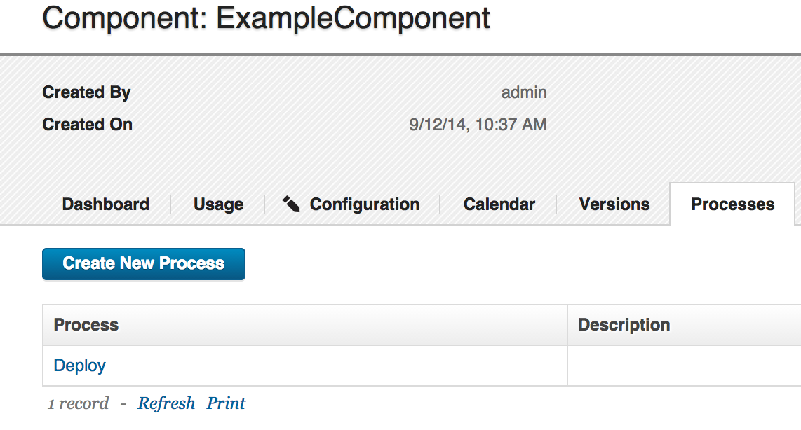
Component processes
Now you can see the process.
Notes:
Module 3 - Components

Slide 38
Component processes
Next, click the new process. Click the word Deploy. This action takes you to the graphical design process editor. Here, you define the automation for the process. See the next slide.
Notes:
Module 3 - Components

Slide 39
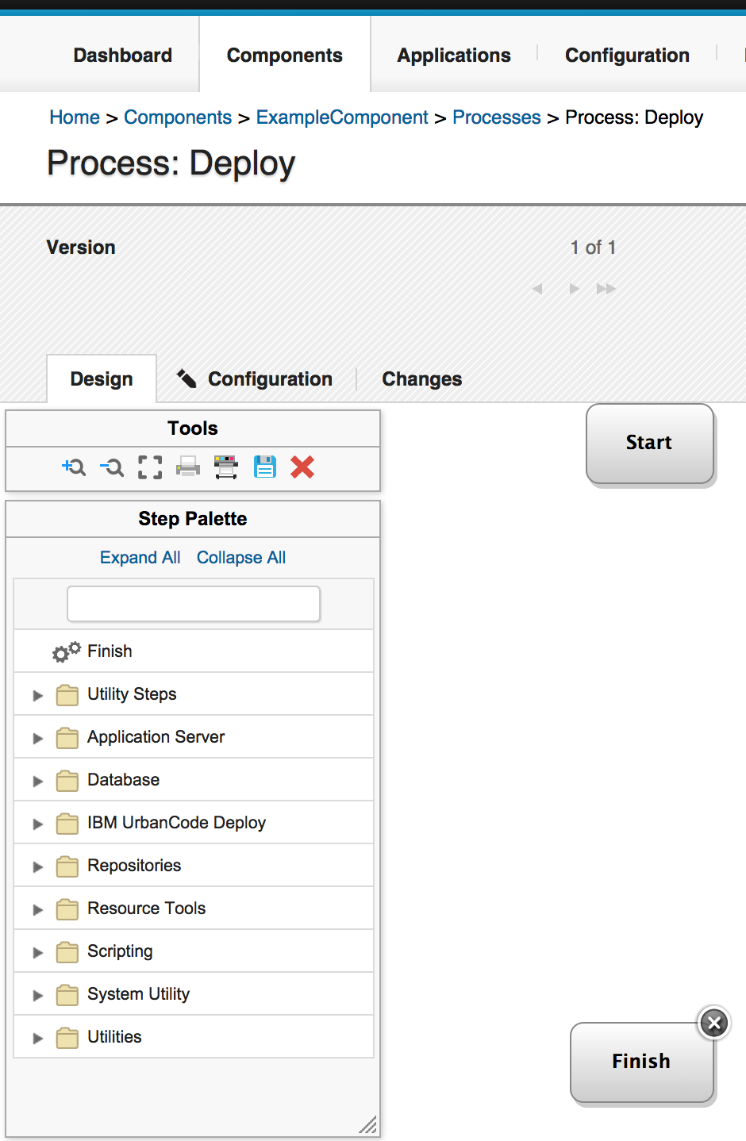
Component processes
Notes:
The plugins on the left are shipped with the product.
Module 3 - Components

Slide 40
Component processes
To the left you see the Step Palette. The palette includes the available automation steps to drag onto the process editor field. The steps that are available are determined by the plug-ins that have been loaded into UrbanCode Deploy. A full list of plug-ins can be found here at this address:
https://developer.ibm.com/urbancode/plugins/
Notes:
Module 3 - Components

Slide 41
Component processes
To the right, you see the START and FINISH blocks. These determine the start and end points of the automation process.
The next step is to create a simple process to copy the file to the target server.
Notes:
Module 3 - Components

Slide 42
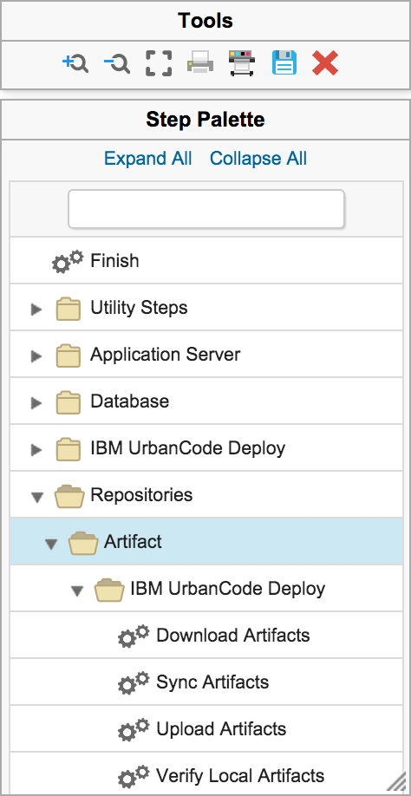
Component processes
First, find the Download Artifacts step in the palette.
Notes:
You do not always have a download artifacts step. But for a deployment process it is the most commonly used step – the agent pulls the artifacts from codestation into the working directory. The default working directory is the location we talked about earlier on slide 35 that the property resolved to.
Module 3 - Components

Slide 43
Component processes
Click the Download Artifacts step, and drag it between the START and FINISH steps.
You see the step editor. This is depicted on the next slide.
Notes:
To the left you see the Step Palette. The palette provides automation steps that you can drag onto the process editor. The available steps are determined by the installed plug-ins. Some plug-ins are shipped with the product and you can install others.
Module 3 - Components

Slide 44
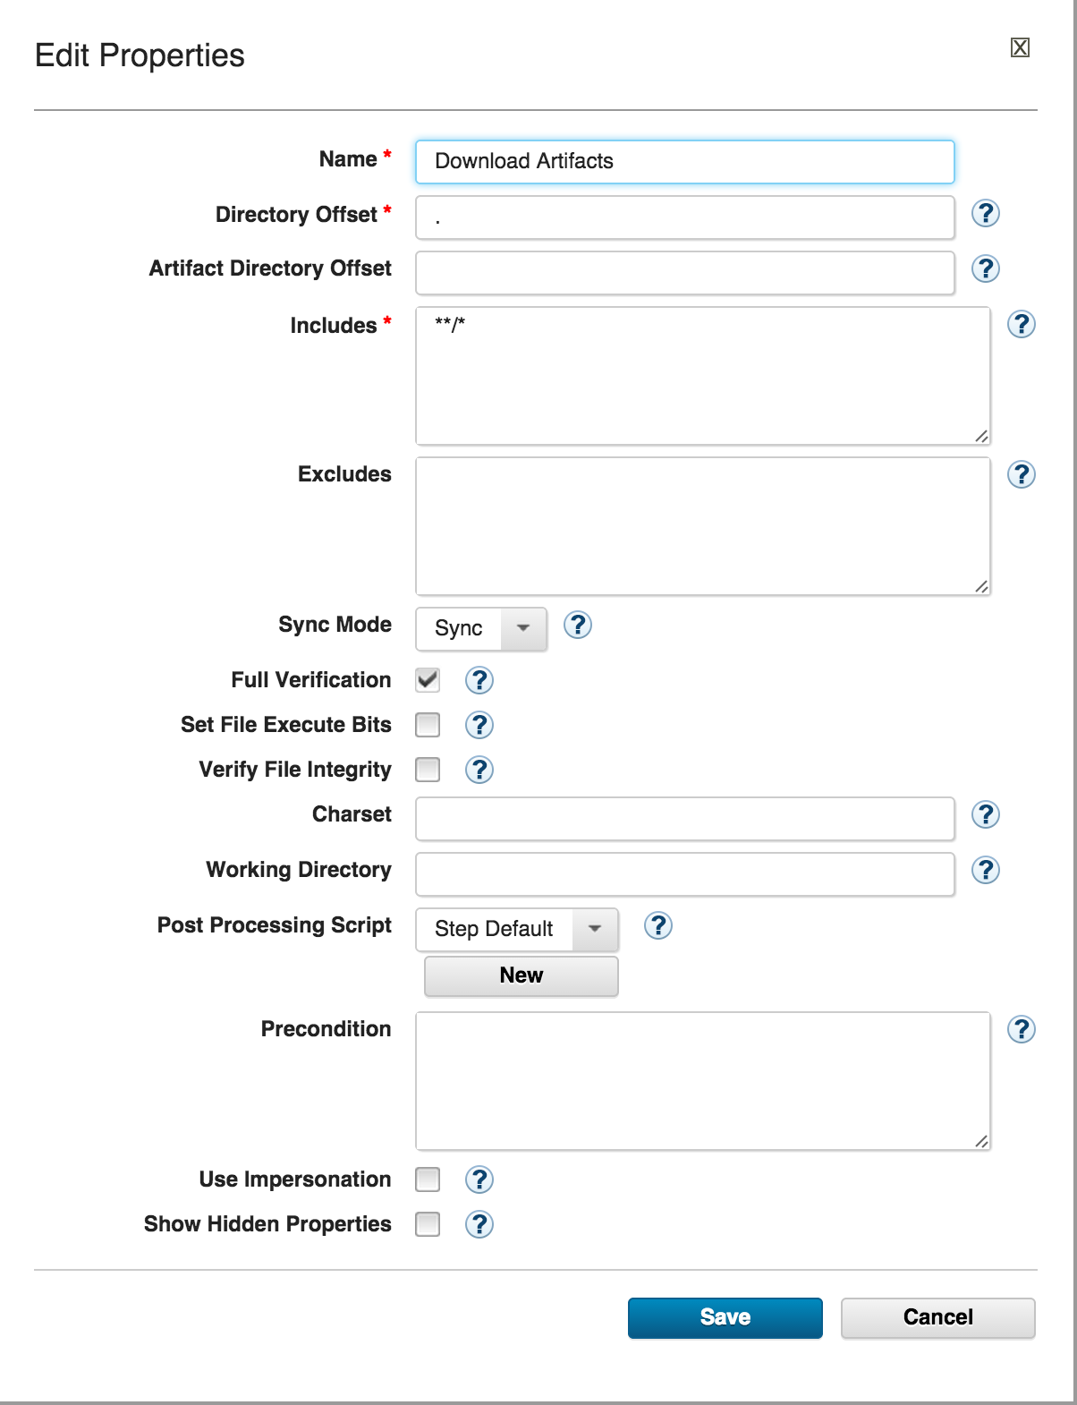
Component processes
Notes:
Module 3 - Components

Slide 45
Component processes
When you drag a step into the process editor, you can edit the fields for that step. The Download Artifacts step is prepopulated with information that you can use. Simply save this step as is. The fields define the inclusion of all files to be downloaded from the component version (**/*).
Notes:
Module 3 - Components

Slide 46
Component processes
Click Save for the step. You see the step in the middle of the process designer.
Next, connect the START box to the Download Artifacts step. Then, connect the Download Artifacts step to the FINISH box.
Notes:
Module 3 - Components

Slide 47

Component processes
If you hover your mouse pointer over the START box, you see a blue circle that includes an arrow.
Click that arrow, and drag it to the
Download Artifacts step to connect the two.
Notes:
Module 3 - Components

Slide 48
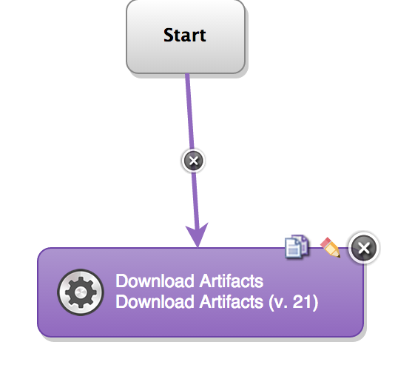
Component processes
The two steps are connected:
Notes:
Module 3 - Components

Slide 49
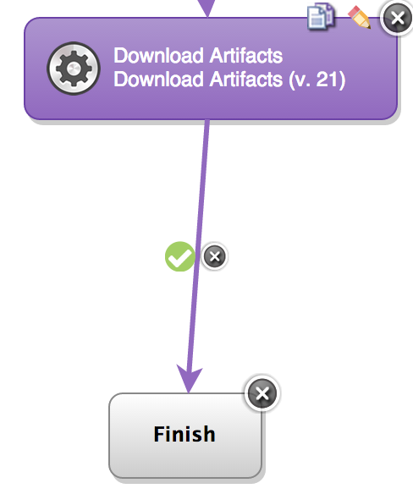
Component processes
Next, connect the Download Artifacts step to the FINISH box in the same way as you did before.
Notes:
Module 3 - Components

Slide 50
Component processes
Notice that this line has a green circle with a white check mark inside it. This mark indicates the direction to go if the Download Artifacts step is complete. You can click the green circle to cycle through other options.
Notes:
Module 3 - Components

Slide 51


Component processes
The red circle indicates the direction to go if the
previous step fails. The gray circle indicates
that you want the process to follow a specific
path regardless of whether the step passes or fails.
Notes:
Module 3 - Components

Slide 52

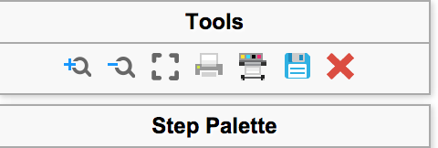
Component processes
Finally, save the process. To save your process, click the diskette icon at the top of the step palette.
Notes:
Module 3 - Components

Slide 53
Component templates
Ideally, you do not want to create new component processes and duplicate configurations every time that you add a component. For this reason, there are component templates. Now that you are familiar with how to create a component and the working parts of a component, the next step is to look at component templates.
Notes:
Component templates allow you to reuse component processes on a different component – or you could define the properties for any component you create. It could include the component processes or it could not.
Module 3 - Components

Slide 54
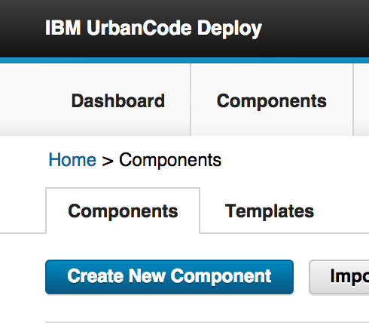
Component templates
Click the main Components tab in the upper left, and then click Templates.
Notes:
Module 3 - Components

Slide 55
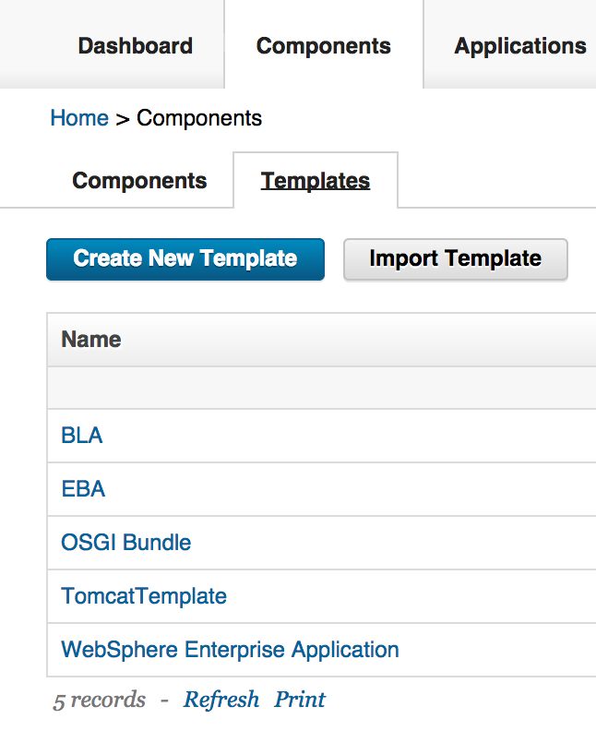
Component templates
You see a complete list of the available component templates.
Notes:
Module 3 - Components

Slide 56
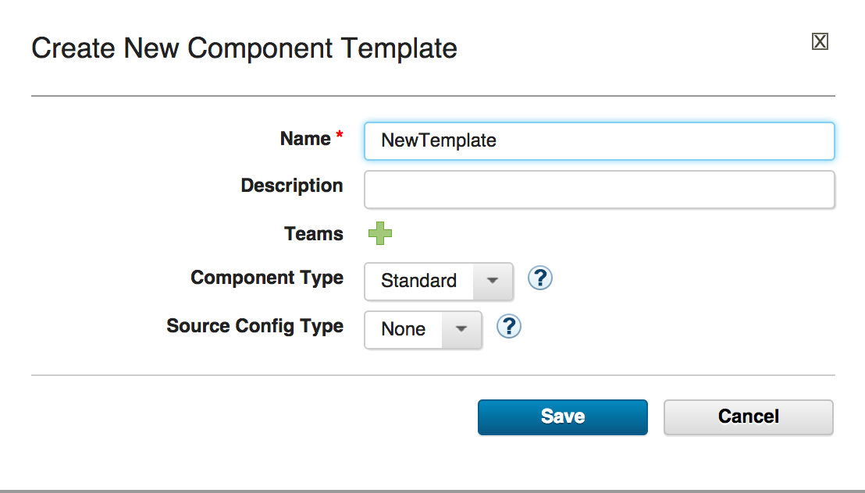
Component templates
Click Create New Component Template,
name the template, and then click Save.
Notes:
Module 3 - Components

Slide 57
Component templates
Examine the component template and notice how similar it is to a component. The component template has all the same attributes as a defined component, except for versions and a few others.
The idea is to design a component template with the corresponding processes. Then, when you create a component you can simply choose your template and import the version.
Notes:
Module 3 - Components

Slide 58
Component templates
Organizations create templates for processes that are used throughout teams and organizations. For example, if an organization deploys applications to IBM® WebSphere® Application Server or Tomcat, they might create a WebSphere template and a Tomcat template. These templates define the processes for deploying applications to the application servers.
When they want to create a component to be deployed to WebSphere Application Server or Tomcat, they can reuse the template.
Notes:
Module 3 - Components

Slide 59
Summary
You are familiar with how to complete these tasks:
Import artifacts to create a component
Add versions to components
Create component processes
Create component templates
Notes:
Module 3 - Components

