Slide 1
Essentials of UrbanCode Deploy v6.1
Deployment
Notes:
Module 5 - Deployment

Slide 2
Module overview
After completing this module, you should be able to complete these tasks:
  Examine Inventory
  Create Snapshots
  Request a deployment process
  Deploy to an environment
  Examine logging
  Run reports
Notes:
Module 5 - Deployment

Slide 3
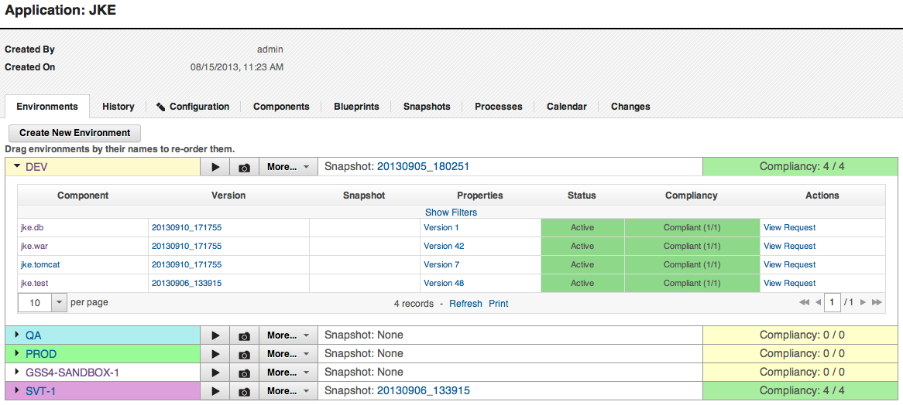
Deployment: Inventory
UrbanCode Deploy retains an inventory and history for environments and resources
Compliancy shows whether actual component inventory matches expected inventory
Snapshots are known working sets of components
Shows which component versions are deployed on the environment
Shows what version of properties were used for deployment
Notes:
When you deploy what you have in your application it becomes your standard of what you want. If a component didn’t make it to an environment then it will not show compliancy. Components get added to an inventory when the application is deployed. If everything went well it will be in compliance, if it didn’t you will know.
You can have properties on components and properties on componnent resources. On resources you can have properties on them also. You could have changed the properties on a component. Component properties are things that are consumed by component processes that could be relative to other components. Component properties could be things about artifacts.
Inventory tracks all the components that are there. You could have components there that are not from snapshots. It tracks components that you tried to deploy. You see the inventory for each environment.
Module 5 - Deployment

Slide 4
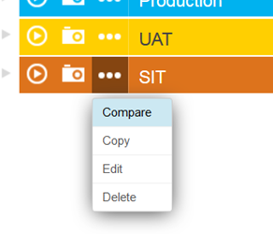
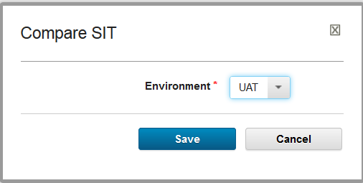
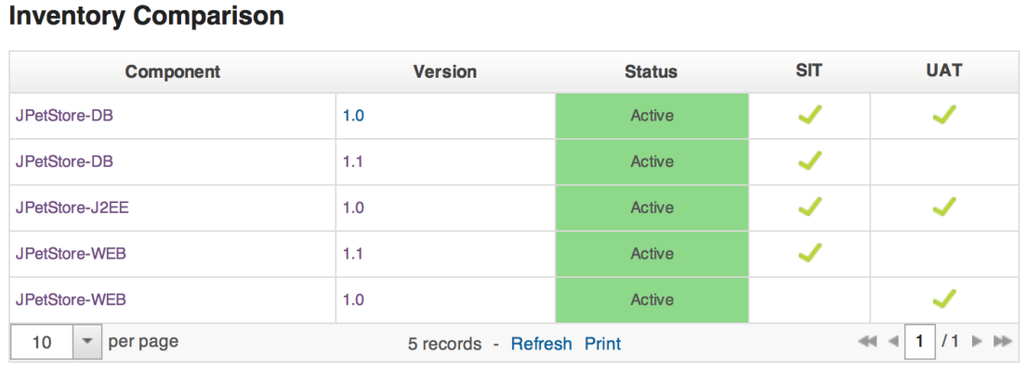
Deployment: Inventory
Inventories between environments can be compared
1.
2.
3.
File and configuration differences can also be viewed here
Notes:
This is what you examine before you create a snapshot.
Module 5 - Deployment

Slide 5
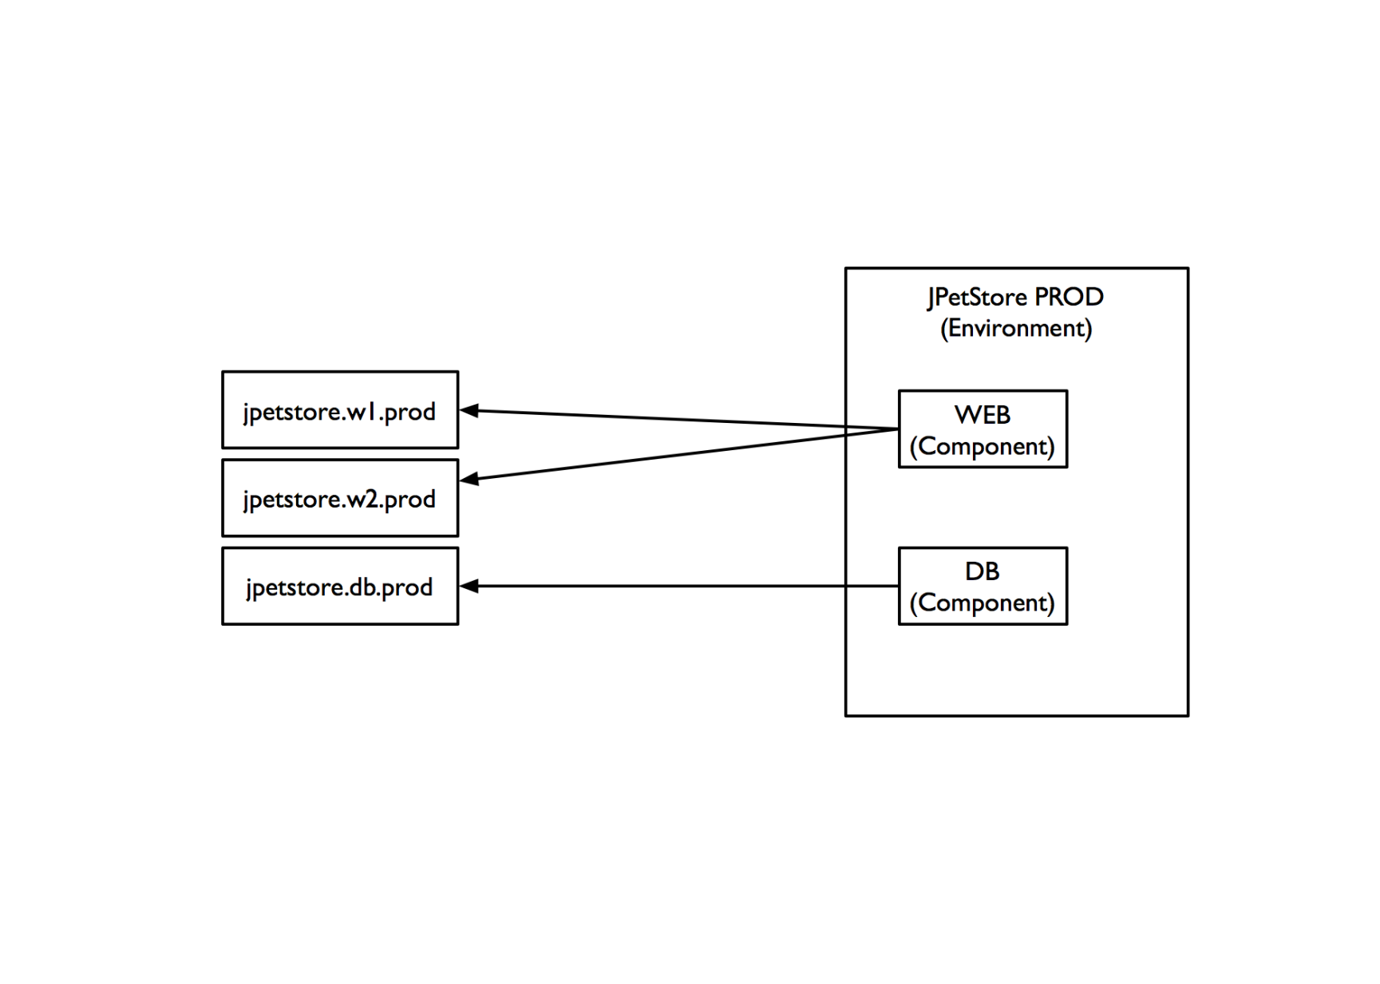
Deployment: Inventory compliancy
Fresh environment
- Mapped to some resource, but nothing has been deployed
Notes:
Two versions of the web component here. You created environment, resource group, there is no inventory yet because nothing is deployed.
The resource is the abstract mapping of the target. It’s an abstract object that points to a physical machine.
Module 5 - Deployment

Slide 6
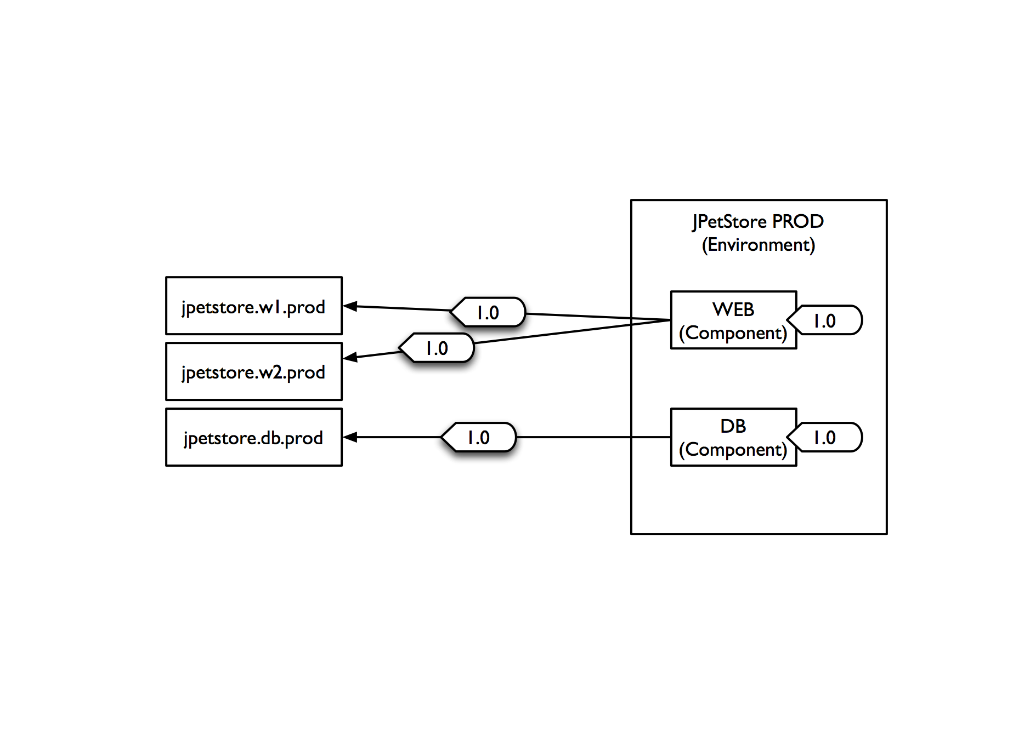
Deployment: Inventory compliancy
Deploy 1.0 of WEB and DB
- Since no resources have any inventory, we target all of them
- As soon as deployment begins, we set desired inventory for
the environment
Notes:
The language is a bit confusing. It’s talking the actual deployment target which is mapped to a resource. When is inventory set? Not when you set up the environment, the inventory is not set up yet. You must run deployment tto get inventory -that’s when it sets the compliancy.
Module 5 - Deployment

Slide 7
Deployment: Inventory compliancy
Deploy 1.0 of WEB and DB
- Since no resources have any inventory, we target all of them
- As soon as deployment begins, we set desired inventory for
the environment
Notes:
Module 5 - Deployment

Slide 8
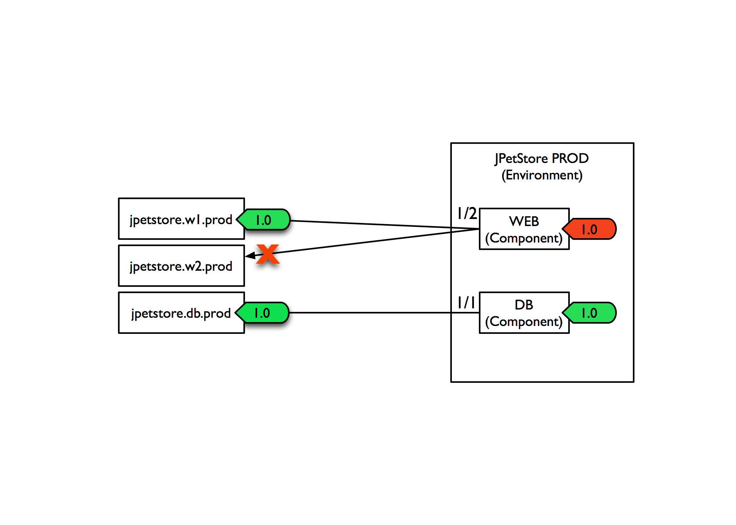
Deployment: Inventory compliancy
Failure!
- DB worked, but one of the web machines was down
- Environment is shown as “noncompliant”
- Two machines have “actual inventory” due to successful
deployment
Notes:
Resource describes where the deployment is going. It just identifies the computer target.
Module 5 - Deployment

Slide 9
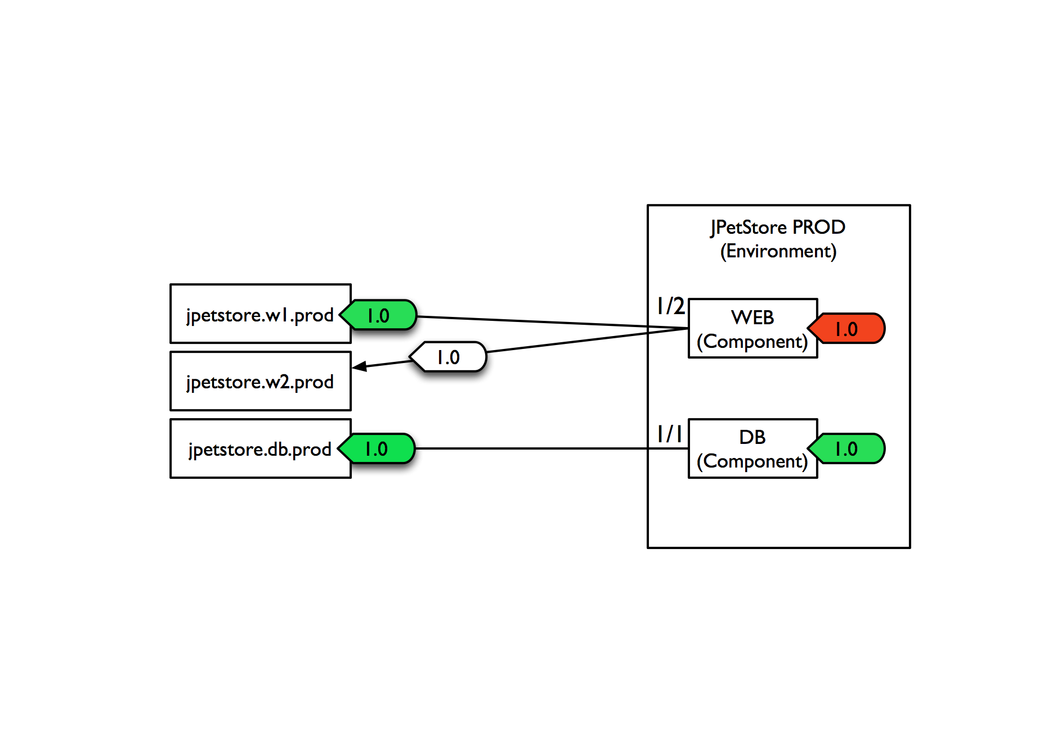
Deployment: Inventory compliancy
Retry
- Deploy the same thing, but it checks inventory first
(Only resources missing the desired inventory)
Notes:
Module 5 - Deployment

Slide 10
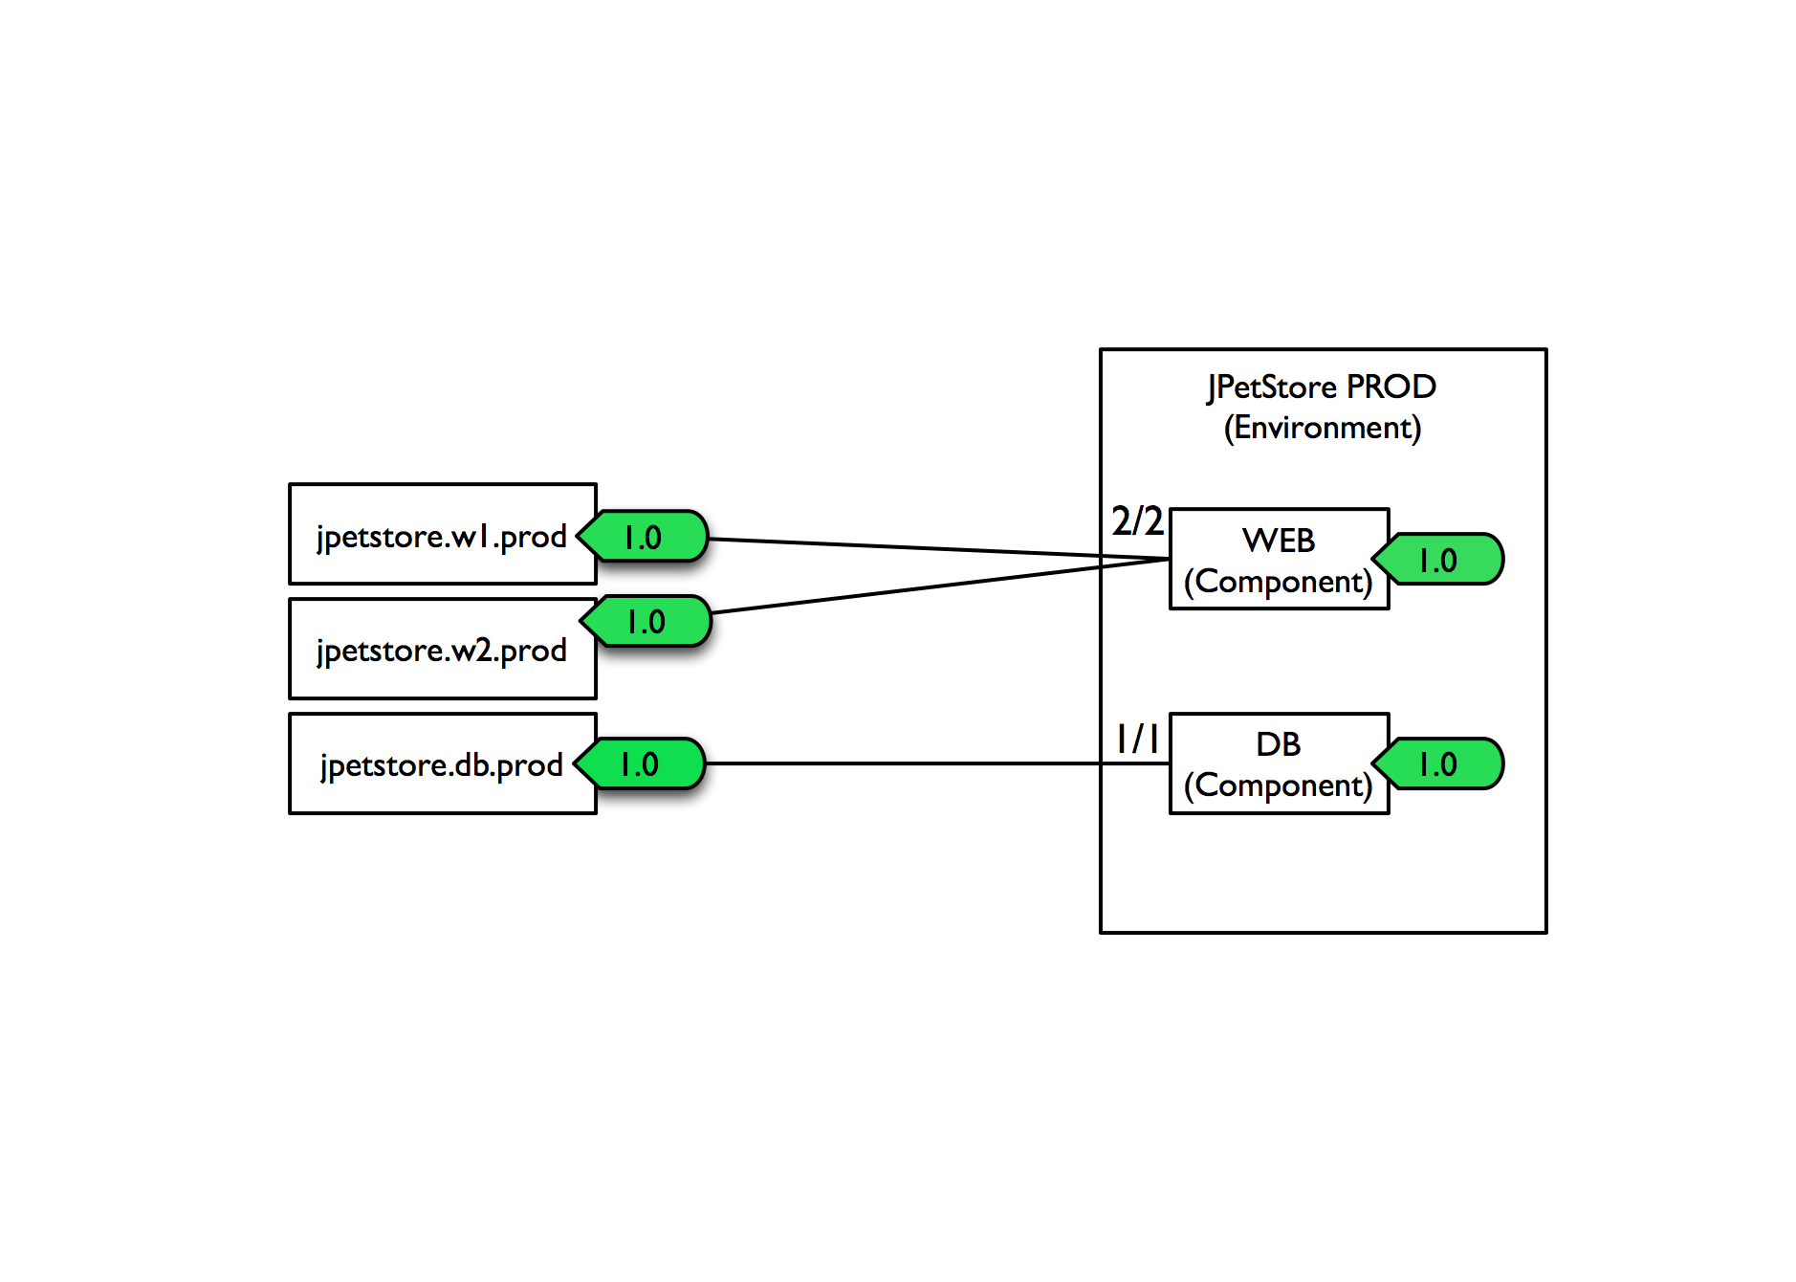
Deployment: Inventory compliancy
Success!
Notes:
Module 5 - Deployment

Slide 11
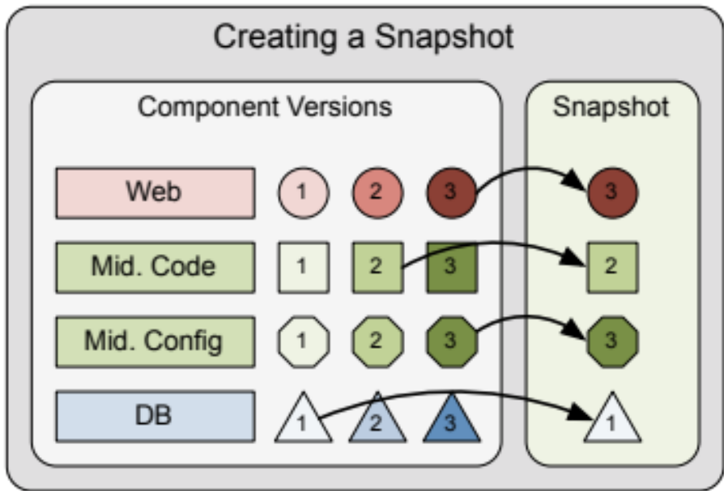
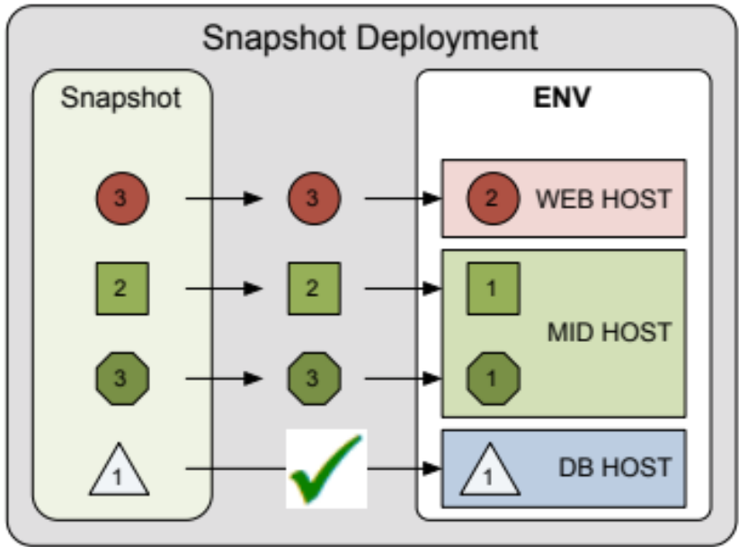
Deployment: snapshots
Snapshots are collections of component versions and configuration
Typically taken after successful testing has been completed on an non- production environment, then can be deployed to other environments
Useful for automation, auditing, and visibility
Can be compared with other snapshots
Snapshot deployment can be previewed in an environment
Notes:
Module 5 - Deployment

Slide 12
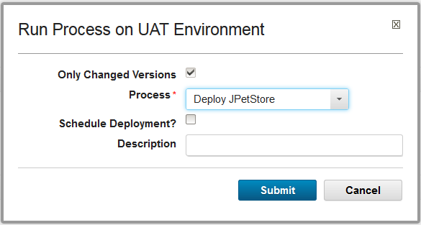
Process request
When you have a snapshot you select the environment to deploy to
and select the Process to use for the deployment. It may be the same
Process used to deploy to another environment.
Notes:
As environments get more critical you could have differences in a final production environment. Take a snapshot of your final test environment or final production environment. You move the snapshot from test to production and you have a problem, you go back to the snapshot you have of production. So you always have a baseline snapshot of what was working in production.
Module 5 - Deployment

Slide 13
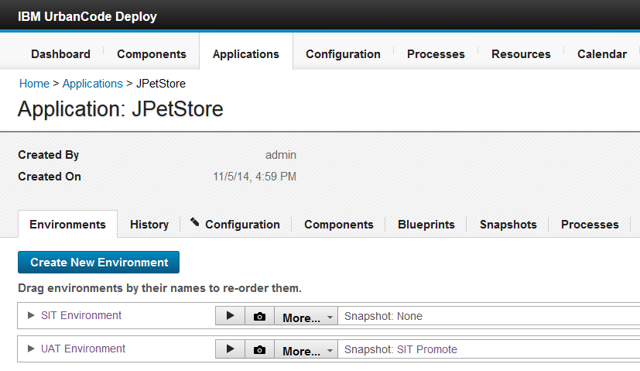
Environments
User defined set of resources that host an application.
Environments have different topologies
Environments are assigned to specific applications
Approvals are assigned to specific environments
Note: UrbanCode Deploy maintains an inventory of every artifact that is deployed to each environment
and tracks the differences between them..
Notes:
You cannot create an environment naked on it’s own it is always part of an application. An application has the whole lifecycle in it usually. It contains all the components that you are worried about. You might have an application for every business unit or every application.
Module 5 - Deployment

Slide 14
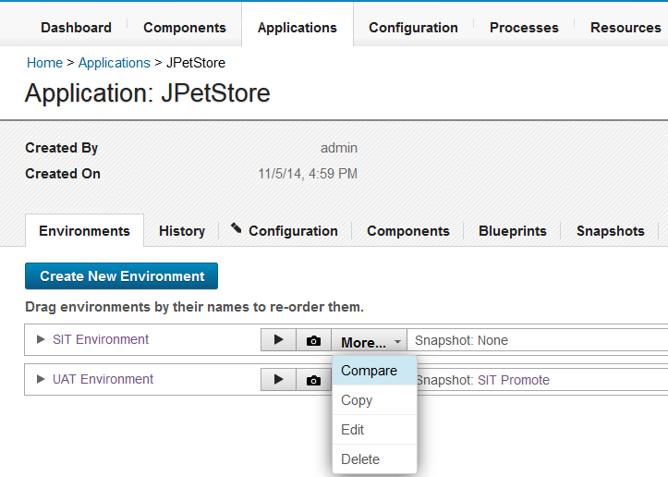
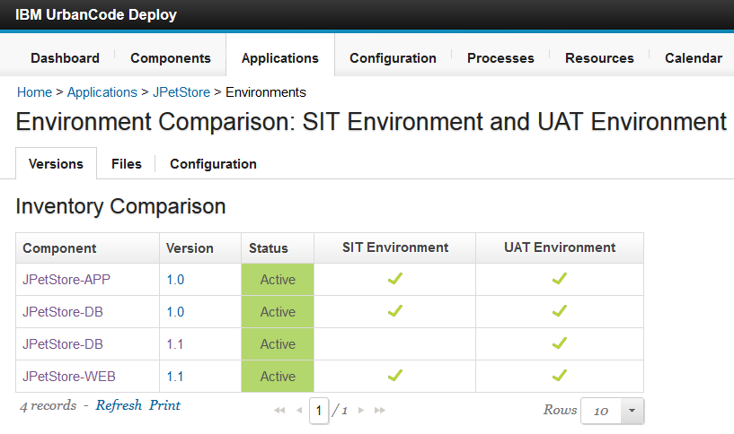
Comparing environments
Select the environment to compare, click save and the environment comparison list opens. The component versions in each environment is shown.
You can compare differences between environment properties.
You can compare differences between environment files.
Notes:
This is assuming the environment sare all part of the same application. You can’t compare environments from different applications.
Module 5 - Deployment

Slide 15
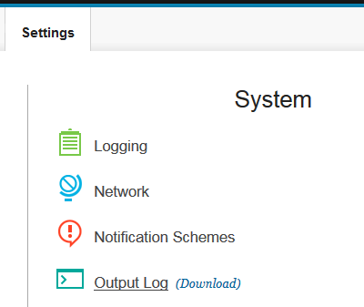
Output log
Server output is written to the server_install_directory/var/log/deployserver.out log file.
You can open the file directly or access it from the UI (Settings > System > Output Log).
Notes:
This is what you use to troubleshoot a deployment.
Module 5 - Deployment

Slide 16
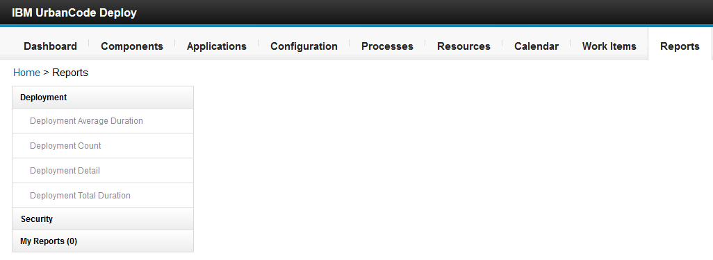
Reports
Deployment reports - contain historical information about deployments. Data can be filtered in various ways and reports can be printed and saved. In addition, you can save search criteria for later use.
Security reports - provide information about user roles and privileges.
Notes:
Reports are good for showing how long things took. If you have performance issues reports are good for sorting it out. Security reports gives you rosters of what teams are assigned to different componnts, and what teams are assigned to different environments. Reports could show what roles or users, or teams could do what. Reports are good for administrators.
Module 5 - Deployment

Slide 17
Module summary
In this module you learned:
  Examine Inventory
  Create Snapshots
  Request a deployment process
  Deploy to an environment
  Examine logging
  Run reports
Notes:
Module 5 - Deployment

