Slide 1
Essentials of UrbanCode Deploy QQ147
Resources
Notes:
Course Title
Module X - Module Title

Slide 2
Module overview
After you complete this module, you should be able to complete these tasks:
  Identify how resources relate to agents
  Recognize how tags and properties are important for resources
  Describe how agents communicate
  Configure a destination topology for deployments
  Identify how to test agent connectivity
  Describe the properties used for resources
Notes:
Course Title
Module X - Module Title

Slide 3
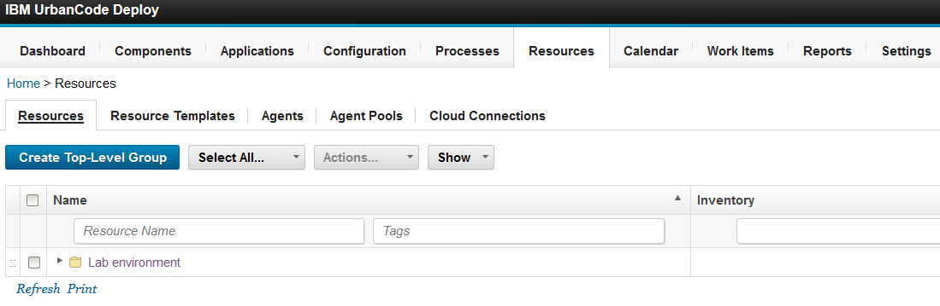
The purpose of a resource
To organize what you are going to deploy and where
Notes:
Resources are a fairly new concept in UrbanCode Deploy; properties are what differentiate resources. To configure your resources you need to know your topology. But you don’t need to know all the details of it. Might not know the names of the agents yet. Properties are important to resources. A resource is where you deploy to but you do not always have an agent mapped to a resource. You might use a proxy agent, if you do not want an agent on a server. You can do agentless type deployments. If you don’t want to install an agent on every machine you deploy to you don’t have to. Resources could be components (the what), environments (the where), agents(the how).
Course Title
Module X - Module Title

Slide 4
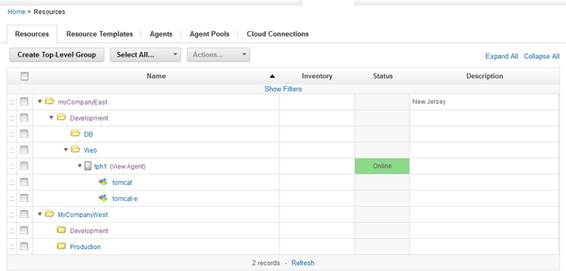
Resource types
Resource group
Agent
Component
Resource group
Agent resource
Component resource
Notes:
There are multiple levels of resource groups . You have this tree structure available and customers can model their infrastructure with this. Many customers have a complicated topology – multiple data centers and multiple levels of permissions. You can see it in the tree structure. It is usually a collaborative effort between IBM and the customer to figure out the topology and how to map it to Resources. Resources help you to organize and structure your deployment targets and what you are going to deploy.
There are also agent pool resources. Resource groups can be:
Static groups (the default type)
Dynamic groups
You can use resource groups to reduce the maintenance of properties and mappings. When you create the group, select “Manage Members Automatically” to create a dynamic group that will be populated by using a naming convention or property lookup.
Agent resources are required to specify where automation will run.
Agent pool resources are used infrequently. When a step must run, but the location doesn’t matter, use an agent pool to distribute the load for things like API calls.
Component resources can only be added to agent resources or child agent resources.
Group of agents is an agent pool – distributes the workload. Whichever one is available you can use.

Slide 5
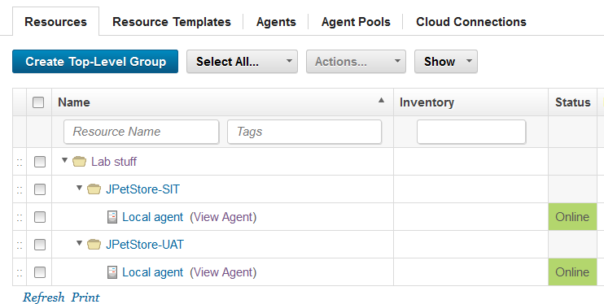
Resources in the lab environment
Notes:
Shown here is the resource hierarchy that is set up for the class lab. However, components have not been added yet to the resource hierarchy. A resource group called Lab stuff is created. In the resource hierarchy are two resources: one for Software Integration Test (SIT) and one for User Acceptance Test (UAT). These are deployment targets. Resources represent deployment targets. Agents and components can be resources also. The SIT resource and the UAT resource are both bound to an agent. Later, the SIT and UAT resources are assigned to environments. It is possible that both environments exist on the same server. They might use the same agent- but they might not.
What’s the difference between a resource and an environment? The answer is the resources are for a higher level of abstraction.
An SIT resource is also an organizational resource.
The agent resource is in the hierarchy.
Resources don’t do anything unless you have an agent and a component. Agents define where it is being done and the component resource defines what to do.
Resources exist because of properties. Each resource can have a property.

Slide 6
Key points about resources
Resources are assigned to environments.
A resource represents a logical deployment target that typically resolves to an agent. The agent does the work.
Resources are based on an architectural model.
Resource groups act as containers that components or agents are assigned to.
Resources have properties and tags.
Resources can contain other resources in a hierarchical tree structure.
The resource hierarchy model is especially effective when several logical deployment targets are located on the same computer.
Notes:
You attach a resource to an environment.
Originally, resources were not required. They were created to provide properties and tags (especially the latter). Instead of just adding agents and components to environments, you add them to containers (resources) that can have their own properties, which facilitates reuse and flexibility.
Your current infrastructure, deployment procedures, and other requirements determine whether you need one or multiple resources per environment.
Resources aid in management; inventory is tracked for resources. Resources are created and managed through the user interface.
A resource may group resources. The top level is always organizational.
Organizational resource: Used to organize.
Component type: Must be added to an organizational resource.
Agent type: Must be added to an organizational resource.

Slide 7
Agents
Agents
  Are installed on each deployment target
  Communicate with the UrbanCode Deploy server to receive file transfers and initiate operations on local computers to install and initiate the application pieces
Notes:
Agents are typically installed on each deployment target. An agent must be installed on each operating system upon which local commands need to be invoked as part of the deployment. Agents can serve as proxies by making remote calls to machines, that is an agent on a relay server. Relay server communicates to agents on different hosts.
Course Title
Module X - Module Title

Slide 8
Agent connectivity: Overview
First, the agent connects over Java™ message service (JMS) and subscribes to a topic.
Over JMS, the server instructs the agent to run a plug-in step and provides a URL for HTTP connectivity.
The agent downloads the required plug-in, runs the step, and then sends execution output back to the server over HTTP.
Notes:
The agent connects to the JMS for security reasons and then uses HTTP.
Course Title
Module X - Module Title

Slide 9
Agent connectivity
States:
  Offline: No connection.
  Connecting: JMS connectivity is available, but there is no HTTP connection. When an agent is in this state, the server can send a signal for upgrade or restart.
  Online: HTTP and JMS connectivity.
Agents must be online to run deployments
  Offline agent handling can be configured on each application process. By default, processes “fast fail” if any agents in the environment are offline.
Notes:
Course Title
Module X - Module Title

Slide 10
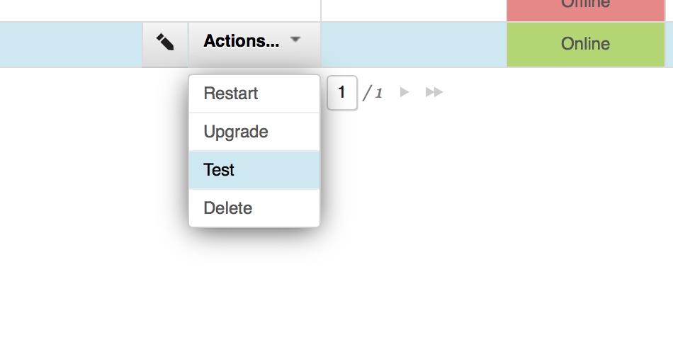
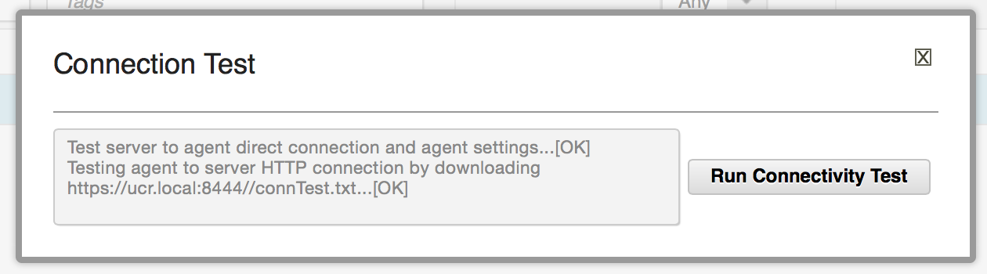
Agent connectivity
Connection test
  Click Resources > Agents > some_agent > Test
  Click Run Connectivity Test
Notes:
You can restart or upgrade too – you get messages in the dashboard if agents are not online. Agents are resources and you can’t do anything without agents.
Course Title
Module X - Module Title

Slide 11
Resources and properties
Resources are logical targets. They are defined by property context. Properties help to ease organization.
Examples of resources:
  WebSphere Cluster
  IIS Application Pool
  Oracle DB Schema
Tree structure
  Resources inherit properties from parents
  For example, when executing at the cluster level, there is access to the cell name
Notes:
Here are some more examples of resources. Properties can help facilitate reuse of resources. There is a mapping of the component (what) to the where(group resources.
Course Title
Module X - Module Title

Slide 12
Properties
Examples:
  Destination directories
  Credentials
  API endpoints
  JDBC connection strings
Inheritance
Resource role properties
  Properties specific to the function that the resource performs
  For example, the cell name is always defined on resources that have the WebSphereCell role.
Notes:
Properties tell you more information about resources. Properties are credentials like user id, password so the resource can get into where it is going. Properties help define a resource, they give you more information about a resource. Component resources might have a property like an installation directory that might change from machine to machine.
Course Title
Module X - Module Title

Slide 13
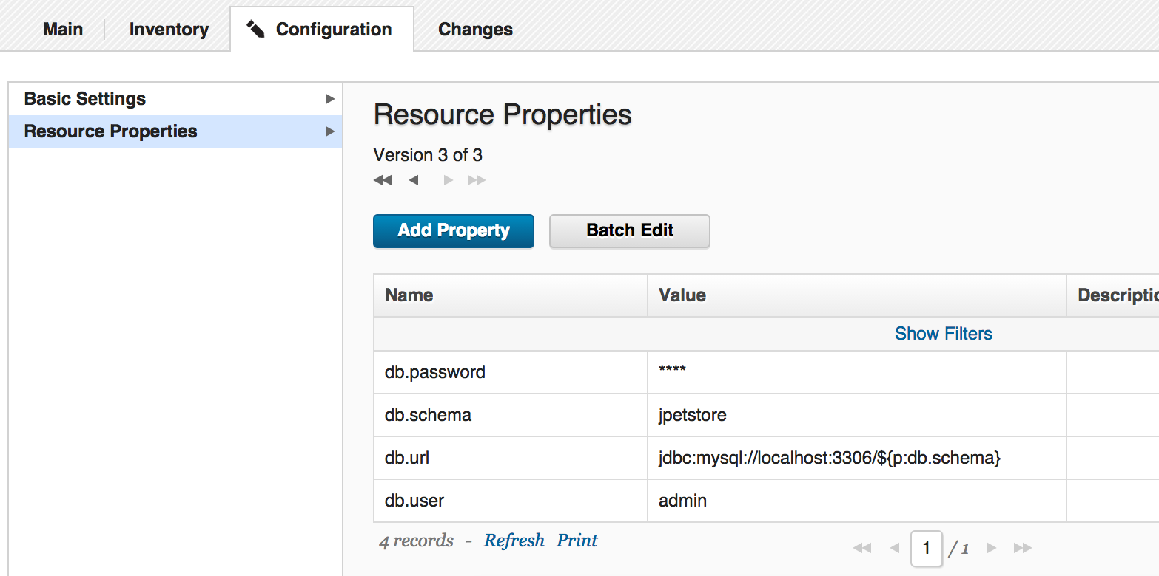
Properties
Ad-hoc resource properties can be accessed on the configuration subtab of the resource.
Notes:
Properties are location information and credentials – information to reach the target.
Course Title
Module X - Module Title

Slide 14
Tags
Zero downtime scenarios:
  When you orchestrate processes, you might want to run automation in phases. To do run in phases, you can use resource tags.
  By tagging primary servers as “Primary,” you have the ability to limit application process steps to run only on primary servers.
  Tags can be used to model a blue-green or A-B deployment.
Notes:
Resources are the only things that have tags. But this will change very soon. For example, if you have a server farm, you do not want all the servers to go down simultaneously. Therefore, you tag half of them green and half blue. In your process, you could take down the green servers for maintenance, and then take down the blue. Tags allow for fancy footwork. Tags help you control where you are deploying. Tags are elegant and easy to use.

Slide 15
Resource templates
A resource template is a model for a group of resources. The template, which is a starting point for creating new resources, contains a hierarchy of resources, groups, and agent prototypes.
Resource templates contain agent prototypes, which represent agents that are not yet installed or connected to an environment. When you create an environment, you can use a resource template as a model for the environment. Then you can map real agents to the agent prototypes in the template.
Resource templates provide a pattern for an environment. For example, you can use resource templates to represent dynamic cloud environments.
Notes:
There are a couple different ways that resource templates are usually used. The resource template is meant to be used around cloud environments. It shortens some work –here is the topology and here is where the components go. But you may not know everything about a deployment. There are some unknown variables in a cloud environment.
Resource templates are also used by customers that want to test out their resource structure and topology. If they want to spin up, run tests, tear it down and then they have the results captured in their template. They want to save the work they did. Resource templates allow you to keep up with the process. If they have the same topology throughout this process, then they can use the resource template to help save the work they did and save time.
Course Title
Module X - Module Title

Slide 16
Cloud provisioning
Resource templates contain agent prototypes.
Prototypes contain expected names, and “wait” for new agents to come online with those names.
Components can be mapped to prototypes, which allows the system to deploy the correct artifacts and configuration.
See the following article for more details:
  https://developer.ibm.com/urbancode/docs/urbancode-deploy-templates-blueprints-for-softlayer/
Notes:
If they are doing cloud provisioning they are probably using UrbanCode Deploy with patterns. Patterns is more infrastructure heavy.
Course Title
Module X - Module Title

Slide 17
Quiz
What is the purpose of a resource?
What are 3 types of resources?
Where are agents installed?
What are some examples of properties that could be used on resources?
Notes:
Course Title
Module X - Module Title

Slide 18
Summary
You can complete these activities:
  Identify how resources relate to agents
  Recognize how tags and properties are important for resources
  Describe how agents communicate
  Configure a destination topology for deployments
  Identify how to test agent connectivity
  Describe the properties used for resources
Notes:
Course Title
Module X - Module Title

