Slide 1
Virtualization
101

Slide 2
What is Virtualization?
Notes:
Virtualization
http://en.wikipedia.org/wiki/Virtualization
虚拟化
http://baike.baidu.com/view/729629.htm

Slide 3
Desktop Virtualization
Server Virtualization
Network Virtualization
Storage Virtualization
Application Virtualization

Slide 4
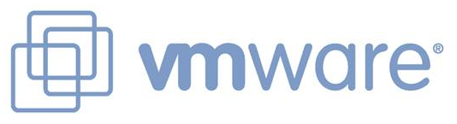

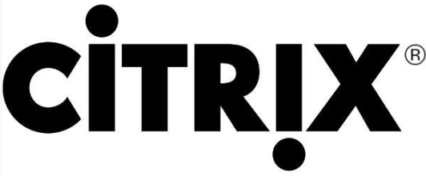
Vendors of Virtualization

Slide 5
Benefits from Virtualization
Save money and energy
Simplify management

Slide 6
Desktop Virtualization
VMware Workstation (Local)
Microsoft Virtual PC (Local)
Citrix XenDesktop (Centralized)

Slide 7
Desktop Virtualization Architecture
V i r t u a l
Applications
Applications
Applications
Guest OS
(Windows)
Guest OS
(Linux)
Guest OS
(VMware ESX)
Virtual Machine
Virtual Machine
Virtual Machine
P h y s i c a l
Virtual Machine Manager
Host OS
Hardware

Slide 8
Components of Virtual Machines?
Configuration file
Hard disk file(s)
Virtual machine state file
In-memory file

Slide 9
Comparison
VMware Workstation
  Costs more
  More host & guests support
  Better features (Snapshots, USB)
  64-bit hosts and guests
Microsoft Virtual PC
  Free
  Less hosts & guests support
  Less VM features and capabilities

Slide 10
Uses
Development
Testing
Training

Slide 11
Server Virtualization
Software (SoftV)
Hardware (HardV)

Slide 12
SoftV Server Virtualization
VMware Server

Slide 13
SoftV Server Virtualization Architecture
V i r t u a l
Applications
Applications
Applications
Guest OS
(Windows)
Guest OS
(Linux)
Guest OS
(VMware ESX)
Virtual Machine
Virtual Machine
Virtual Machine
P h y s i c a l
Virtual Machine Manager(Server Products)
Host OS(Server Products)
Hardware

Slide 14
HardV Server Virtualization
Microsoft Virtual Server
Citrix XenServer
VMware ESX Server
Microsoft Hyper-V Server
VMware ESXi Server

Slide 15
HardV Server Virtualization Architecture
V i r t u a l
Applications
Applications
Guest OS
(Windows)
Guest OS
(Linux)
Virtual Machine
Virtual Machine
Host OS
Virtualization Layer
P h y s i c a l
Hardware

Slide 16
HardV Server Virtualization Architecture
Applications
Applications
Applications
V i r t u a l
Guest OS
(Windows)
Guest OS
(Linux)
Guest OS
(VMware ESX)
Virtual Machine
Virtual Machine
Virtual Machine
Host OS + Virtualization Layer
P h y s i c a l
Hardware

Slide 17
HardV Server Virtualization Architecture
Applications
Applications
Applications
V i r t u a l
Guest OS
(Windows)
Guest OS
(Linux)
Guest OS
(VMware ESX)
Virtual Machine
Virtual Machine
Virtual Machine
Virtualization Layer (Hypervisor)
P h y s i c a l
Hardware

Slide 18
What is a hypervisor?
A hypervisor, also called a virtual machine manager (VMM), is a program that allows multiple operating systems to share a single hardware host. Each operating system appears to have the host's processor, memory, and other resources all to itself. However, the hypervisor is actually controlling the host processor and resources, allocating what is needed to each operating system in turn and making sure that the guest operating systems (called virtual machines) cannot disrupt each other.

Slide 19
ESX & ESXi
ESX has a Service Console is based on Red Hat Enterprise Linux 3 (Update 6) that is heavily modified and stripped down and is used for management purposes. During the boot process the Service Console bootstraps the VMKernel using initrd and then turns over full control of all hardware resources to the VMkernel. When the VMkernel takes over the hardware resources of the host, the Service Console is warm booted and managed as a privileged virtual machine within the VMkernel.
ESXi does not have a full Service Console but instead has a limited management console based on an implementation of the Posix variant of Unix within a Busybox framework and has many features that you will find in the full Service Console.
Notes:
Understand the Difference between ESX and ESXi
http://www.vmware.com/products/vsphere/esxi-and-esx/compare.html

Slide 20
Techniques of VMware
VMotion
Storage VMotion
High Availability
Memory Reclamation

Slide 21
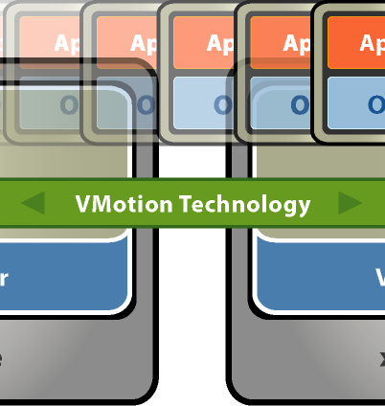
VMotion
VMotion allows you to quickly move an entire running virtual machine from one host to another without any downtime or interruption to the virtual machine This is also known as a “hot” or “live” migration.
The entire state of a virtual machine is encapsulated and the VMFS file system allows both the source and the target ESX host to access the virtual machine files concurrently. The active memory and precise execution state of a virtual machine can then be rapidly transmitted over a high speed network. The virtual machine retains its network identity and connections, ensuring a seamless migration process.
Notes:
VMware VMotion
http://www.vmware.com/files/pdf/VMware-VMotion-DS-EN.pdf

Slide 22
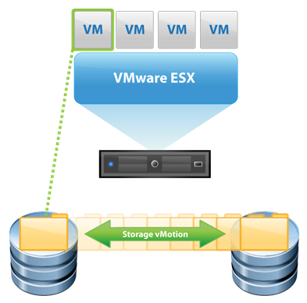
Storage VMotion
Storage VMotion is a new feature introduced in ESX 3.5, it allows you to migrate a running virtual machine and its disk files from one datastore to another on the same ESX host
The difference between VMotion and Storage VMotion is that VMotion simply moves a virtual machine from one ESX host to another but keeps the storage location of the VM the same, Storage VMotion on the other hand changes the storage location of the virtual machine while it is running and moves it to another datastore on the same ESX host. The virtual machine can be moved to any datastore on the ESX host which includes local and shared storage.
Notes:
VMware Storage VMotion
http://www.vmware.com/files/pdf/VMware-Storage-VMotion-DS-EN.pdf

Slide 23
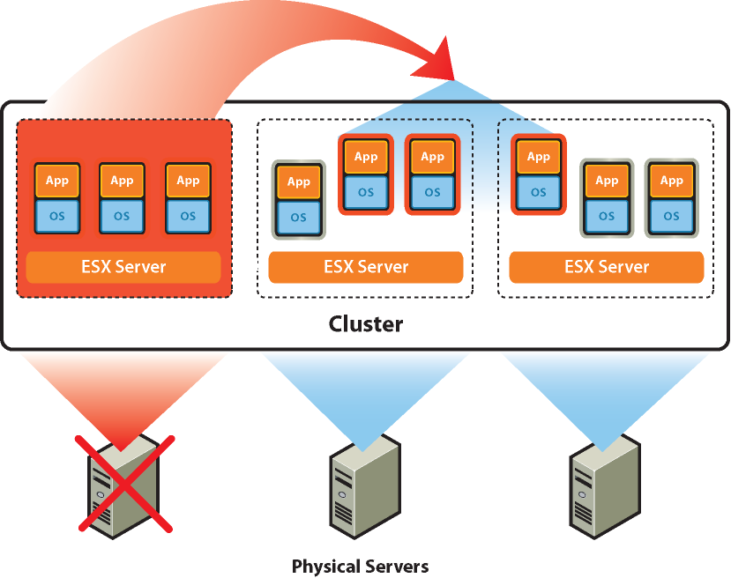
High Availability (HA)
Continuously monitors all hosts in a cluster and restarts virtual machines affected by a host failure on other hosts
Can also monitor guest OS's for a failure via a heartbeat and restart them on the same host in case of a failure
Continuously monitors and chooses the optimal physical servers within a resource pool on which to restart virtual machines (if used in conjunction with DRS)
Notes:
VMware High Availability
http://www.vmware.com/files/pdf/VMware-High-Availability-DS-EN.pdf

Slide 24
