Slide 1

gRPC Design and Implementation

Slide 2

Motivation for RPC systems
Large-scale distributed systems actually composed of microservices
Allows loosely-coupled and even multilingual development
Scalability: things, cores, devices, nodes, clusters, and data centers (DCs)
Communication predominantly structured as RPCs
Many models of RPC communication
Terminology: Client uses a stub to call a method running on a service/server
Easiest interfaces (synchronous, unary) resemble local procedure calls translated to network activity by code generator and RPC library
High-performance interfaces (async, streaming) look like Active Messaging
Long way from textbook description of RPCs!

Slide 3
Application composed of microservices
Monitoring Task
Server
Server
Stub
Stub
Server
Computation Task
Stub
UI Task
Data Store Task

Slide 4
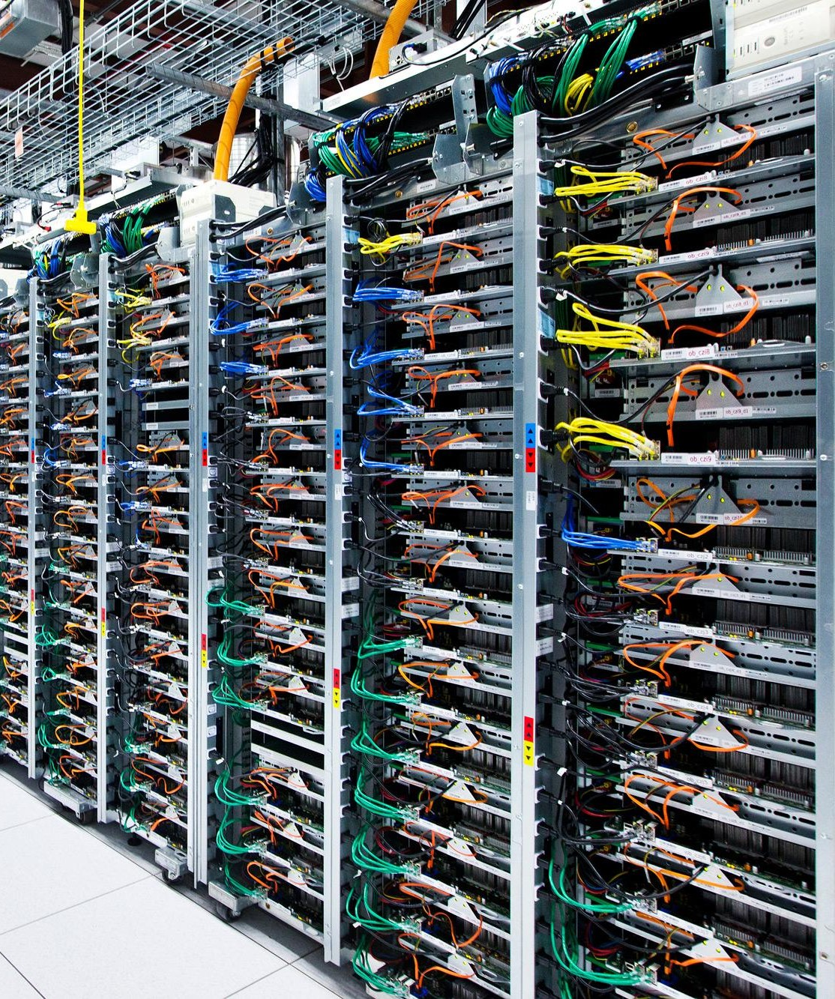
gRPC: Motivation
Google has had 4 generations of internal RPC systems, called Stubby
All production applications and systems built using RPCs
Over 10¹⁰ RPCs per second, fleetwide
APIs for C++, Java, Python, Go
Not suitable for open-source community! (Tight coupling with internal tools)
Apply scalability, performance, and API lessons to external open-source

Slide 5
gRPC: Summary
Multi-language, multi-platform framework
Native implementations in C, Java, and Go
C stack wrapped by C++, C#, Node, ObjC, Python, Ruby, PHP
Platforms supported: Linux, Android, iOS, MacOS, Windows
This talk: focus on C++ API and implementation (designed for performance)
Transport over HTTP/2 + TLS
Leverage existing network protocols and infrastructure
Efficient use of TCP - 1 connection shared across concurrent framed streams
Native support for secure bidirectional streaming
C/C++ implementation goals
High throughput and scalability, low latency
Minimal external dependencies

Slide 6


Using HTTP/2 as a transport

Slide 7
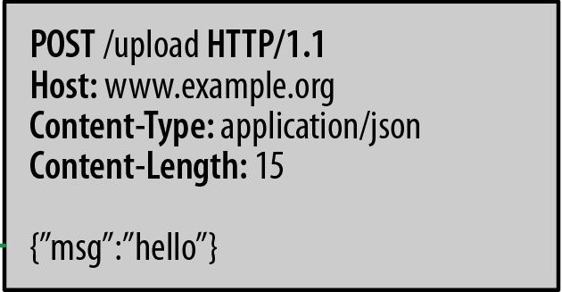
Using an HTTP transport: Why and How
Network infrastructure well-designed to support HTTP
Firewalls, load balancers, encryption, authentication, compression, ...
Basic idea: treat RPCs as references to HTTP objects
Encode request method name as URI
Encode request parameters as content
Encode return value in HTTP response

Slide 8
Using an HTTP/1.1 transport and its limitations
Request-Response protocol
Each connection supports pipelining
… but not parallelism (in-order only)
Need multiple connections per client-server pair to avoid in-order stalls across multiple requests → multiple CPU-intensive TLS handshakes, higher memory footprint
Content may be compressed
… but headers are text format
Naturally supports single-direction streaming
… but not bidirectional

Slide 9
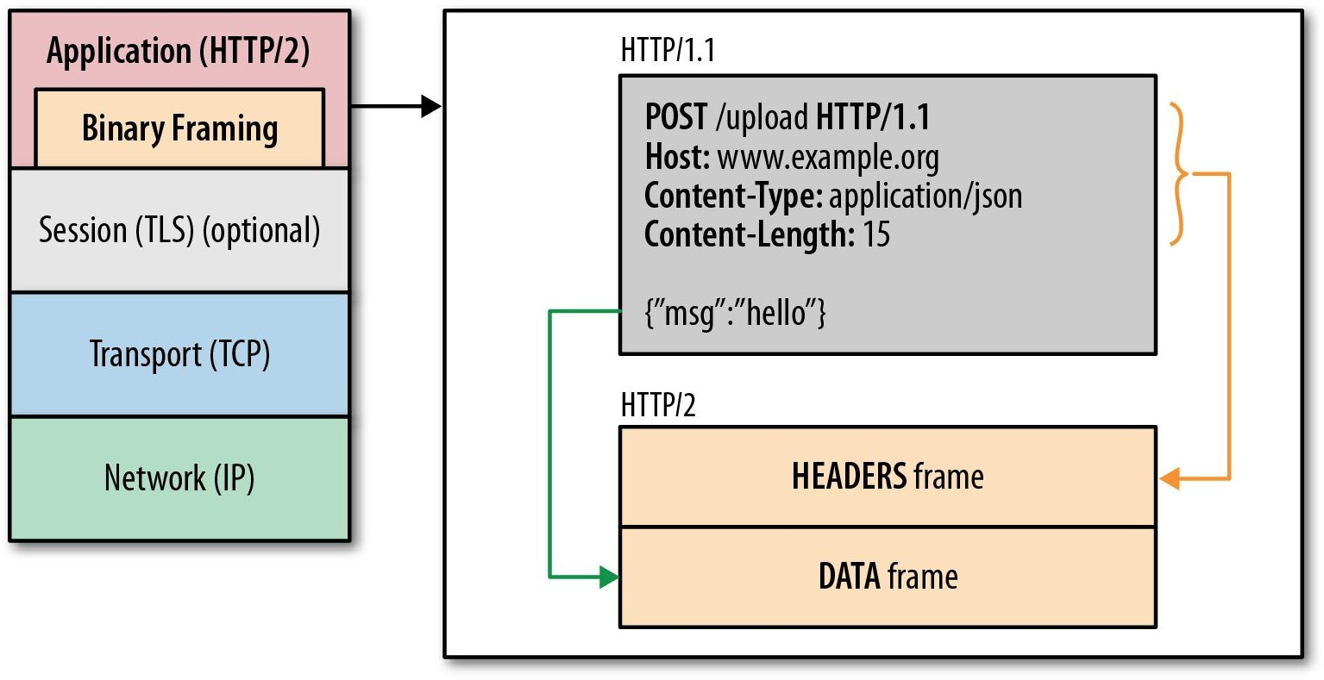
HTTP/2 in a Nutshell
One TCP connection for each client-server pair
Request → Stream
Streams are multiplexed using framing
Compact binary framing layer
Prioritization
Flow control
Server push
Header compression
Directly supports bidirectional streaming

Slide 10



HTTP/1.1
http://www.http2demo.io/
HTTP/2

Slide 11
gRPC

Slide 12

gRPC in a nutshell
IDL to describe service API
Automatically generates client stubs and abstract server classes in 10+ languages
Takes advantage of feature set of HTTP/2

Slide 13
An Aside: Protocol Buffers
syntax = “proto3”;
message Person { string name = 1; int32 id = 2; string email = 3;
enum PhoneType { MOBILE = 0;
HOME = 1;
WORK = 2;
}
message PhoneNumber { string number = 1; PhoneType type = 2;
}
repeated PhoneNumber phone = 4;
}
Google’s Lingua Franca for serializing data: RPCs and storage
Binary data representation
Structures can be extended and maintain backward compatibility
Code generators for many languages
Strongly typed
Not required for gRPC, but very handy

Slide 14
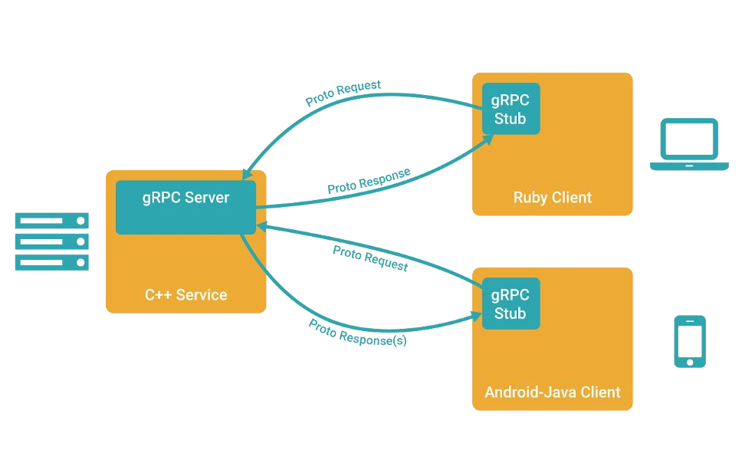
Example gRPC client/server architecture

Slide 15
Getting Started
Define a service in a .proto file using Protocol Buffers IDL
Generate server and client stub code using the protocol buffer compiler
Extend the generated server class in your language to fill in the logic of your service
Invoke it using the generated client stubs

Slide 16
Example Service Definition
service RouteGuide {
rpc GetFeature(Point) returns (Feature);
rpc RouteChat(stream RouteNote) returns (stream RouteNote);
}
message Point {
int32 Latitude = 1; int32 Longitude = 2;
}
message Feature { string name = 1; Point location = 2;
}
message RouteNote { Point location = 1; string message = 2;
}

Slide 17
An (anonymized) case study
Service needs to support bidirectional streaming with clients
Attempt 1: Directly use TCP sockets
Functional in production data center, but not on Internet (firewalls, etc)
Programmer responsible for all network management and data transfer
Attempt 2: JSON-based RPC over two HTTP/1.1 connections
Start two: one for request streaming and one for response streaming
But they might end up load-balanced to different back-end servers, so the backing servers require shared state
Can only support 1 streaming RPC at a time for a client-server pair
Attempt 3: gRPC
Natural fit

Slide 18
Authentication
SSL/TLS
gRPC has SSL/TLS integration and promotes the use of SSL/TLS to authenticate the server, and encrypt all the data exchanged between the client and the server.
Optional mechanisms are available for clients to provide certificates to accomplish mutual authentication.
OAuth 2.0
gRPC provides a generic mechanism to attach metadata to requests and responses. Can be used to attach OAuth 2.0 Access Tokens to RPCs being made at a client.

Slide 19
Wrap-up

