Slide 1
Developing a Dapp – Part 3 (Code)
B. RAMAMURTHY
©2019, ALL RIGHTS RESERVED
BINA@BUFFALO.EDU
HTTP://WW.CSE.BUFFALO.EDU/FACULTY/BINA
TEACHING PROFESSOR
COMPUTER SCIENCE AND ENGINEERING
DIRECTOR, BLOCKCHAIN THINKLAB
PROGRAM DIRECTOR, DATA-INTENSIVE COMPUTING PROGRAM

Slide 2
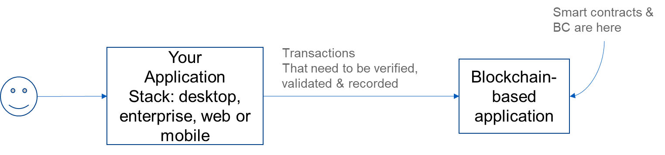
Decentralized Systems
Let’s define decentralized systems.
Is a type of distributed system.
Then what is special about this system: it allows peer-to-peer transactions of digital assets among unknown participants.
These participants operate beyond the boundaries of trust.
Participants can join and leave as they wish.
Dapp is blockchain-based component of a larger system
Distributed system
Decentralized System

Slide 3
Topics for discussion
Blockchain node and blockchain server (slides 4-12)
Structure and working of a Dapp (slides 13-17)
APIs (slides 18-20)
Ethereum blockchain web3 API (slides 22-24)
Dapp request-response (slides 25-26)
Summary

Slide 4
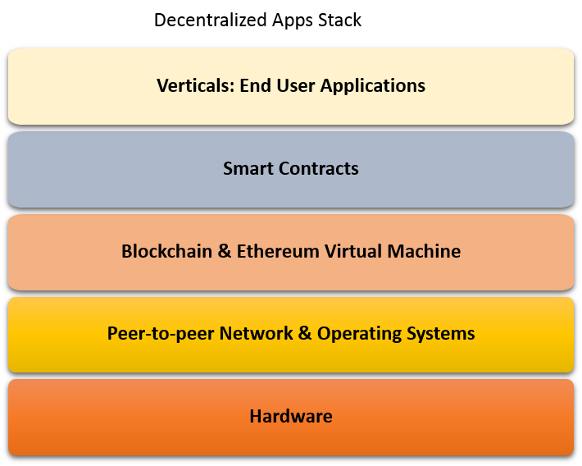
Blockchain node, and Dapp development
We can start here with user interface
but that requires web development skills
JS, HTML
This is a single node
Let’s begin here
In coding a
smart contract
Notes:
This is very high level view of the Dapp stack.
It has
In the next several slides we will dig deeper into the architecture of the blockchain-based Dapp using actual COMMANDs that are used to create the architectural components of the Dapp. It is important that you have mastered basics concepts from the Course 1, Course 2 and some knowledge of command line interface to get the best out of this course.

Slide 5
How does a Dapp work?
Dapp, a decentralized application, solves a problem that requires blockchain services and blockchain infrastructure for realizing its purpose.
Typically design of a Dapp has a front-end, a blockchain back-end and the code connecting the two.
In such an architecture, the front-end of the Dapp channels any external stimulus from the users to the blockchain infrastructure and returns any response back to them.
--It initiates transactions to invoke functions on the smart contract that in turn records the transactions, state transitions and receipts on the blockchain.

Slide 6
Design of Dapp Front-end
Front-end of the Dapp can be as simple as a command line interface.
It also can be a sophisticated web app or easy to use mobile app.
Front-end development may involve web development (html/js/css and web app frameworks such as express) for a web-client, mobile app development for a mobile client and so on.
We will use a simple basic web app as frontend for the Dapps for our labs.
Notes:
Push vs pull mode?

Slide 7
Blockchain Server-Client
You can map the blockchain architecture we discussed here to the client/server architecture we are so familiar with in the context of web applications and database server/client, mobile server/client model.
Here blockchain server is the Ethereum “node” (not node.js) and underlying infrastructure, and client or the front-end is a web client with embedded web3.js script, communicating using JSON over RPC pipeline.

Slide 8
Dapp with command line interface (CLI)
eth.sendTransaction({from:<address>, to:<address> , value: <value>})
Node0:geth client
Node1:geth client
NodeN:geth client
Distributed Ethereum blockchain server and network (say, network id 15)
Notes:
Here is a simple Dapp architecture with the nodes that we created earlier with geth command and ethereum blockchain server and network.
Once the nodes havebeen initialized and are on the same network, they can transact among them using command line interface.
Also you should able to deploy a smart contract from the command line. In this case, you will be using web3deploy script and interact with a smart contract using ABI definition and smart contract address. Be aware that these commands may have lengthy payload and parameters and may span multiple lines.
Moreover a command line interface may not be familiar to a non-programmer/user of the Dapp.
So we will use a simple but intuitive web interface as a front-end to the blockchain Dapp.

Slide 9
Architecture of a Dapp
Web App
Web App
Web App
….
web3
web3
web3
….
JSON/RPC
JSON/RPC
JSON/RPC
….
RPC port
RPC port
RPC port
….
Node1:geth client
Node2:geth client
….
NodeN:geth client
Distributed Ethereum blockchain protocol server network
Notes:
So far we have discussed various components of a blockchin server and geth client.
Here is a simple architecture for Dapp. We have multiple full nodes with only three of them Node1, Node2 and NodeN shown.
Geth command is used to expose the rpc port, using the command say 8544: geth --rpc --rpcport 8544
From the web client, functions including smart contract deploy and invoke functions are facilitated through web3.js module and web3 script.

Slide 10
Web3 API
web3.js library when included in the Dapp
<script type="text/javascript" src="../dist/web3.js"></script>
Lets you use the web3 object provided by the web3.js library and all its objects.
It also lets you communicate with the local node through the RPC port.
It also provides access to eth object and its function via: web3.eth and
net object: web3.net and their respective functions.
Additionally to whisper API: web3.ssh is used for secure “gossiping” and enables the Whisper protocol that is a precursor for next generation Dapps.
Notes:
https://github.com/ethereum/wiki/wiki/JSON-RPC
https://github.com/ethereum/web3.js/tree/master/example

Slide 11
Importance of web3
Web3 is a javascript library that is specifically designed for use with web client of Ethereum Dapps.
It is portal through which all the underlying operations of the Ethereum node and blockchain server can be invoked.
For example: smart contract deployment, smart contract function invocation
You will use web3 in the development of the front end of the Dapp and for interacting with the blockchain.

Slide 12
Architecture of a Dapp: here is a revised architecture of a Dapp
Web App
Web App
Web App
….
web3
web3
web3
….
RPC
RPC
RPC
….
RPC port
RPC port
RPC port
….
Node1:geth client
Node2:geth client
….
NodeN:geth client
eth net ssh admin debug miner
txpool personal APIs
eth net ssh admin debug miner
txpool personal APIs
eth net ssh admin debug miner
txpool personal APIs
Distributed Ethereum blockchain protocol server network
Notes:
Now that we know the APis, Here is a simple architecture for Dapp. It comprises multiple full nodes with only three of them Node1, Node2 and NodeN shown.
Geth command is used to expose the rpc port: geth --rpc --rpcport 8544 --rpcapi=”web3,net,eth,admin,personal,debug’’
Blockchain functions including smart contract deploy and invoke functions are facilitated through web3.js module and web3 script. For example, eth and net objects can be instantiate within web3 module and their respective functions can be invoked from the web interface.

Slide 13
Tracing a call/request from a web front of Dapp (request-response.. )
So far we discussed structural and API details.
When a web request is initiated by a user, if it is regular web app request, it is directed to the http endpoint (say, port 8080) and to the web server to be executed.
For a Dapp:
--geth client has to expose a RPC endpoint using the command --rpcport XXXX where XXXX is the RPCport.
--A web3 object instantiated in the web page script (recall that web3.js is a javascript library)
--Requests/Calls on invoked on this web3 object
--Requests are transmitted as JSON over the RPC pipeline between the web client and the geth client
--requested call/function is executed using appropriate API and the results returned through the RPC pipeline.

Slide 14
Single node
Web App
….
web3
RPC
….
RPC port
Node1:geth client
eth net ssh admin debug miner
txpool personal APIs

Slide 15
Getting Started with Dapp development
We will begin with smart contract development.
A smart contract will define:
Functions that need blockchain services
Functions that result in transactions that are to be recorded on blockchain
Data needed for the functions
Data that represent states whose transitions needed to be recorded on the blockchain
Events and declarations to invoke events (for a later discussion)
Tokens for payment management (these can be included in the functions, but we separate it out) (for a later discussion)
We will use Solidity language and Ethereum blockchain
Lets begin by examining a sample smart contract dealing with the problem of voting. We will learn the syntax and semantics of Solidity statements as we go.

Slide 16
Problem Statement: Ballot
Voting or Ballot represents the universal problem of choosing a winner or a leader using the democratic process of voting.
It is representative of a wide variety of scenarios from reviews for a product and its purchase based on good reviews it received, to passing a law or a budget in a governing body.
Recall the design process we discussed earlier that is repeated here:

Slide 17
Design steps
Problem statement: Counters are very versatile and useful device. It could be a part of a decentralized application. For example: population counter; birth and death entry. You cannot get any more decentralized than this.
Step 1: Use case (Unified Modeling Language) diagram. Identify user and operations and supporting operations.
Step 2: Using the use case and the problem statement as guidance, identify, user, digital assets and transactions.
Step 3: Design the “contract” diagram (derivative of “class” diagram)
Step 5: Implement the contract in a blockchain-specific language. In our case, we will use Solidity and Ethereum blockchain. Ethereum Metropolis—Constantinople to be exact.
Step 6: Test it using a web-IDE call Remix.

Slide 18
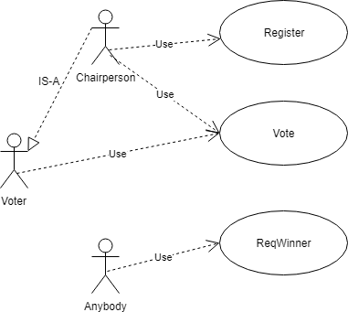
Design step 1 : use case diagram

Slide 19
Design step 2 : Identify users, digital assets, transactions, roles
Users: voters, chairperson
Digital assets: identity of users, vote, whether voted or not, list of voters, list of ballots, what else?
Transactions: register, vote, (need to recorded), count (no need?)
Roles: chairperson and voter
Rules: Chairperson organizes the voting. Voters are identified by their “account” addresses. Here is the logic or the rules to implement:
Only chairperson can register other voters.
Voter can be registered only once.
Only registered voters can vote.
Voters can vote only once.
There is no “write in”. That is, voters can vote only for the items presented
Chairperson’s vote has double (2) the weightage of the regular voter (1).

Slide 20
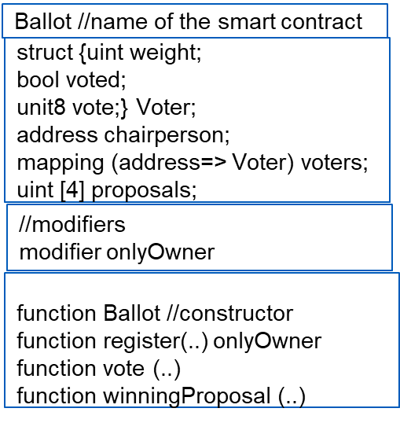
Design step 3 : Design Contract diagram
We skip step 4 , pseudo code
and move onto step 5 and step 6.

Slide 21
Design steps : 5 and 6
Problem statement: Counters are very versatile and useful device. It could be a part of a decentralized application. For example: population counter; birth and death entry. You cannot get any more decentralized than this.
Step 1: Use case (Unified Modeling Language) diagram. Identify user and operations and supporting operations.
Step 2: Using the use case and the problem statement as guidance, identify, user, digital assets and transactions.
Step 3: Design the “contract” diagram (derivative of “class” diagram)
Step 5: Implement the contract in a blockchain-specific language. In our case, we will use Solidity and Ethereum blockchain. Ethereum Metropolis—Constantinople to be exact.
Step 6: Test it using a web-IDE call Remix.
This problem is from Solidity read the docs: https://solidity.readthedocs.io/en/v0.5.3/solidity-by-example.html?highlight=ballot

Slide 22
Summary
We designed and developed a sample smart contract.
Your assignment before we meet Monday is to use the same design steps to create the smart contract for marketplace Lab1
Ask your TAs, discuss among your team members.
Caution: is DB stays outside, it is not inside the smart contract.

