Slide 1
SOA Basics

Slide 2
Topics
Quick introduction to SOA
Composite applications
Services and SOA

Slide 3
Quick Introduction to SOA

Slide 4
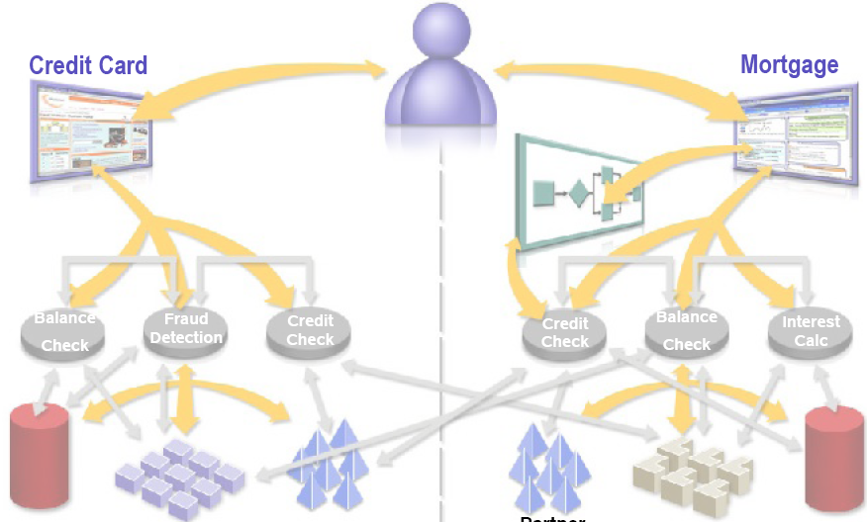
Pre-SOA Scenario
Customer
Data
Back-
End
System
Partner
Credit
Data
Partner
Credit
Data
Back-
End
System
Customer
Data

Slide 5
SOA-Enabled Scenario
Partner Credit
Data
Back-End
System
Back-End
System
Customer
Data

Slide 6
SOA Layers
Shared Network-based Layered Services

Slide 7
Benefits of SOA
Flexible (Agile) IT
  Adaptable to changing business needs
Faster time to market
  Reuse existing code, minimize new development
Business and process-driven
  New business opportunities
Greater ROI
  Leverage existing IT asset

Slide 8
Service Oriented Architecture (SOA)
An architectural principle for structuring systems into coarse-grained services
Technology-neutral best practice
Emphasizes the loose coupling of services
New services are created from existing ones in a synergistic fashion
Strong service definitions are critical
Services can be re-composed when business requirements change

Slide 9
Composite Applications

Slide 10
Applications
Developers need to build end-to-end applications
  Front-end user interfaces
  Middle-tier business logic
  Back-end resources
With the right approach, developers can...
  Reuse existing parts
  Build new parts
  Glue old and new parts together
With the wrong approach, developers must...

Slide 11
Applications
Real-world applications are...
  ...not Web applications
  ...not Java EE applications
  ...not Swing forms
  ...not Web services
  ...not BPEL processes
  ...not SOA
  ...not JBI
  ...not RDBMSs
  ...not (your favorite technology)
Real-world applications use many or all of these

Slide 12
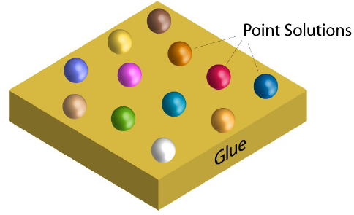
Traditional Application Development
Point technologies, products, and APIs
  For example: EJB, Spring, Hibernate, JSF, Servlets, Struts, etc.
Lots of glue written by developers
  Requires a great deal of expertise & time
  Inflexible

Slide 13
Composite Applications
A way to compose applications from reusable parts
Composite applications employ SOA principles
  Features exposed as Web services
  Standards-based interaction between services
  Are themselves composable

Slide 14
Services and SOA

Slide 15
What Are Services?
Black-box components with well-defined interfaces
  Performs some arbitrary function
  Can be implemented in myriad ways
Accessed using XML message exchanges
  Using well-known message exchange patterns (MEPs)
Metadata in the form of WSDL describes...
  Abstract interfaces
  Concrete endpoints

Slide 16
What Can Services Do?
Perform business logic
Transform data
Route messages
Query databases
Apply business policy
Handle business exceptions
Prepare information for use by a user interface
Orchestrate conversations between multiple services

Slide 17
How Are Services Implemented?
Enterprise JavaBeans™ (EJB™) technology
BPEL
XSLT
SQL
Business rules
Mainframe transaction
EDI transform
Humans (yes, really!)
…

Slide 18
Example: Purchase Service

Slide 19
Purchase Service Functions

Slide 20
Purchase Service Functions

Slide 21

Enterprise Integration Patterns
SOA and Patterns
Messaging
Using the EIP language to design message flows

Slide 22
What have we seen in Healthcare Domain?
Lots of different systems
  Sources and Sinks
  Some you are in control of, others not
Lots of different data types
  And representations
Lots of different participants
  Organizations agreeing to share data
All connected via network
  A complex distributed system

Slide 23
How to Integrate?
The architectural question is how to integrate all these systems into something
  Coherent
  Extensible
  Maintainable
  (reasonably) simple to understand
This is really what SOA was designed to tackle
  Complexity management
  Change management

Slide 24
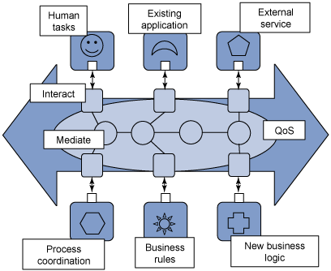
SOA

Slide 25
What is a Pattern?
An abstraction that defines high level
  Relationships between components
  Actors
  Reusable
  Independent of implementation
  Encapsulates knowledge already learned
    When you face a problem, consider existing patterns that are applicable – saves you from re-inventing the wheel and making the same mistakes as others
  Patterns are the language by which system architecture and design are expressed and shared.

Slide 26
What is an Enterprise Integration Pattern (EIP)?
An enterprise is a ‘big’ business
  Often contain legacy apps, COTS apps, third party services and internal components
What is integration?
  Making all those bits work together seamlessly to fulfill business workflow
So an EIP is a reusable abstraction that is useful in solving the problems raised by enterprise Integration

Slide 27
Back to Basics
The EIPs we will look at are Defined by
  Gregor Hohpe, Bobby Woolf and others in
  Enterprise Integration Patterns: Designing, Building, and Deploying Messaging Solutions
  http://www.eaipatterns.com/index.html
  Well worth looking at!
They leverage the most primitive building block that distributed systems are based on:
  The Message

Slide 28
Messages
A message is a discrete piece of data sent from one application to another
Messages typically contain headers (metadata) and a body (application payload)
metadata
data
Data description
superset
Do something
Something happened!

Slide 29
Middleware
Messages are exchanged between middleware (message oriented middleware)
  The middleware understands the message format
  Does not always understand the contents of the message, in particular the body.
    It does understand at least some of the metadata in the headers
Middleware is the glue that combines the higher level applications.

Slide 30
Messages and Middleware
Machine A
Machine B
Machine C
Distributed Applications
Middleware Services
OS, e.g.
Windows
OS, e.g.
Mac OS X
OS, e.g.
Linux
Network
messages

Slide 31
Loose Coupling
Essential for
  complexity management
  Allowing change
  Allowing growth
Message oriented middleware helps to create loosely coupled systems
  Based on the simplest exchange pattern (one-way)
  Message format and metadata is independent of the components the middleware connects.

Slide 32
Middleware acting as an Enterprise Service Bus (ESB)
The ESB is the glue between different components. It passes messages via the bus
To different destinations. Means there is a many to one relationship between components.
Components are glued to the bus, not each other.

Slide 33
Sending a Message
The second simple abstraction:
  Channel
A component that can send a message from a source to a destination
  Could be implemented in many ways
    Method invocation
    TCP/IP message
    Pigeon

Slide 34
Sending a message
Channels are one-way
Which means communications are asynchronous
To model request/response use two channels

Slide 35
Binding Messages to Applications
Applications are independent of the messaging system
So you need adapters that are able to take application specific
data and create a message and send it to a channel.
At the other side you need Message endpoints that can receive a message
From a channel and pass it to an application in an application specific way.
These are the glue components to bind applications to the messaging system.
If an application changes, then the adapter or endpoint needs changing
Isolates change across the system.

Slide 36
Putting it together
Message goes to adapter, then to channel, then to endpoint.
So far so simple. But we have really solved any integration problems yet

Slide 37
Transformation
Sending and receiving applications may expect different data types or formats.
So we may need to transform the message somehow to suit the receiving application.

Slide 38
Translation
Notation is not strict
Arrows are often
A short cut for channels

Slide 39
Pipes and Filters
The inclusion of the translator works for now
  But what if there are other steps that need to take place, for example if the message has been signed and encrypted then we need to verify the signature and decrypt message.
  Signature verification and decryption are common processes
    We don’t want to hard code these into endpoints or the translator. We want to reuse.
A pipes and filters architecture allows us to do this.
  The message passes through a number of components that process the message (filters)
  They send the message down the pipe (channel) they are connected to.
  They all deal with the same message/channel abstraction
  They can be composed flexibly depending on the circumstance

Slide 40
Processing Chain

Slide 41
Routing
We can now send a message down a channel and apply various processing/filtering steps.
  Each filter is connected to an incoming and an outgoing channel
But the endpoints are hard coded.
  This is not flexible
  What if an endpoint changes?
  Introduce a Router
  A router knows where to send a message
    E.g. a Content-Based Router could use
      Message type (in headers)
      Message content (in body)
    Or a Context Based Router
      Receives context information from a central configuration location
      For example a ‘testing’ context could route differently to a ‘production’ context.

Slide 42
Routing
A Router is connected to multiple channels and contains
The logic to decide which channel it should send to.

Slide 43
Multiple Recipients
Not all channels want to be point to point.
Here a recipient list router is used to send to a predetermined set of endpoints

Slide 44
Multiple Recipients
Here the publish/subscribe pattern is modeled. Endpoints subscribe to channels
That are of interest to them. Subscribers receive messages.
This moves the logic of knowing who should receive messages to the endpoints.
The channel does not need to know who the subscribers are or why they have subscribed.

Slide 45
Routing
A content based router and a recipient list are not that loosely coupled
  The first needs to know how to map content to channels
    What if either changes?
  The latter has to know about all recipients
    What if that needs to change?
The pub/sub channel is more loosely coupled
  It doesn’t know or care about who gets the message
  But there may be situations where you need to ensure that a message is only processed exactly once
    E.g. credit card transaction

Slide 46
Dynamic Routing
In the content based router example, some steps are hard coded and routing decisions are made after some pre-processing.
  To make it more flexible, we could move the router to the beginning of the route. But the route is still hard coded in the router.
In more sophisticated routes, you may want to change the routing path as you move through the route.
  The processing done by one filter may affect how later filter processing is done.
  For example error processing
  Routes that encapsulate one or more coarse grained business level functions that connect various underlying subsystems together.

Slide 47
Process Manager
Process Manager sends to channels and each component returns results to the
Process manager.
One central decision point that can evaluate at runtime.
But messages always go back to manager which increases overhead.

Slide 48
Process Manager
Exception Handling using Process Manager

Slide 49
Routing Slip
This allows each processor to pass the message to the next processor without going back to a central unit.
  The processing chain is calculated up front
  The ‘slip’ is the calculated route. It is put into the message metadata
  Filters have small generic routers attached to them
  These mini routers update the slip, then pass the message to the next channel in the list
Can be used for service orchestration
  Multiple underlying services performing a higher level business function
Downside: route cannot be altered after it has been initialized

Slide 50
Scatter Gather
Rather than defining long sequential processing chains, it may be possible to execute steps in parallel
  For example you could check a user’s account status and whether the item they have ordered is in stock at the same time.
  These processes are not dependent on one another so they can be executed in parallel
  The results of both processes can be aggregated and decisions made about how to proceed.

Slide 51
Splitter and Aggregator

Slide 52
Scatter Gather
To facilitate this, metadata could be added to the message header to define the processes that need to be completed and processing status values.
  So the aggregator knows
    When all processes have finished
    What actions to take based on the return values of the processors

Slide 53
Splitter and Aggregator

Slide 54
Message Exchange Patterns
Channels are one way, so the basic building block of a messaging system is asynchronous communication.
We have seen the pub/sub exchange pattern
We have seen the scatter/gather exchange pattern
The request/response is also very common
  Web Services
  HTTP

Slide 55
Request Response
Channels are one-way
Which means communications are asynchronous
To model request/response use two channels and a correlation ID in the messages. This potentially adds overhead.
But remember that channels are an abstract pattern
You could implement a channel that returns data down an open TCP connection if request/response is required and an open connection is available.
This is actually not uncommon. For example a channel that uses HTTP (in built request/response) will often use an HTTP Accept response header for asynchronous communications. For request/response messages it can send data down the open socket and pass the data to the message endpoint which experiences it as asynchronous.

Slide 56
System Management
Message oriented systems are loosely coupled
  But that can make debugging and verifying message flow very difficult especially when distributed across many machines and service
  There are various techniques for coping with this that use the messaging framework itself to control and monitor.
  Two levels of monitoring
    System level – message processing time, throughput
      Look at most at some of the metadata in message
    Business application monitoring
      Look at the payload of the messages

Slide 57
Control Bus
Process Manager revisited, this time with a channel to a control bus.
The control bus receives messages created by the Process Manager in response to the messages that it processes.
Allows monitoring exceptions, throughput, processing time, keeping a message history.
A separate channel from the control bus to the process manager allows runtime configuration of the manager.

Slide 58
Wire Tap
A wire tap is a simple Recipient List with two recipients. One channel is the tap that can be switched on or off (via Control Bus) when messages need to be inspected in a point to point channel.

Slide 59
Detour
A Detour routes a message via a different route for validation, testing and debugging purposes. A Context Based Router can be used to implement the pattern, for example if the control bus signals to the router that the validation route should be taken.

Slide 60
Enterprise Integration Patterns
Patterns are a way of dealing with complexity in a coherent way
EIPs are compos-able message oriented patterns for building loosely coupled systems that need to integrate diverse sub-systems

Slide 61
The Enterprise Service Bus
Introduction using Mule

Slide 62
Agenda
What is Mule?
How do you use Mule?
What are the core Mule concepts?
Learning mule with File endpoints

Slide 63
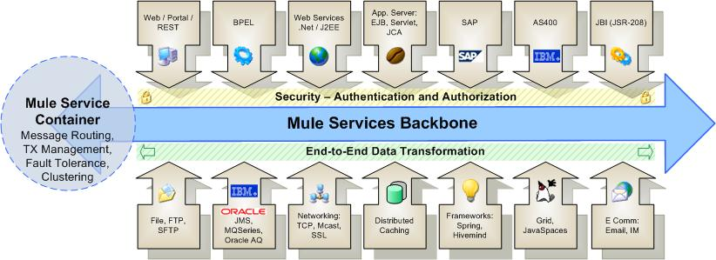
Enterprise Service Backbone
Mule is an open-source Enterprise Service Backbone (ESB)

Slide 64
Mule is Has Advanced Technologies
SEDA
  Staged Event-Driven Architecture
Java NIO
  Java New Input/Output

Slide 65
SEDA
SEDA decomposes a complex, event-driven software application into a set of stages connected by queues
This design avoids the high overhead associated with thread-based concurrency models, and decouples event and thread scheduling from application logic
By performing admission control on each event queue, the service can be well-conditioned to load, preventing resources from being overcommitted when demand exceeds service capacity
SEDA employs dynamic control to automatically tune runtime parameters (such as the scheduling parameters of each stage) as well as to manage load, for example, by performing adaptive load shedding
Decomposing services into a set of stages also enables modularity and code reuse, as well as the development of debugging tools for complex event-driven applications

Slide 66
Java NIO
NIO is a collection of Java programming language APIs that offer advanced features for intensive I/O operations
NIO facilitates an implementations that can directly use the most efficient operations of the underlying platform
NIO includes:
  Buffers for data of primitive types
  Character set encoders and decoders
  A pattern-matching facility based on Perl-style regular expressions (in package java.util.regex)
  Channels, a new primitive I/O abstraction
  A file interface that supports locks and memory mapping
  A multiplexed, non-blocking I/O facility for writing scalable servers

Slide 67
Mule’s “Moves Things Around”
Folder to folder
Queue to queue
Shared memory to shared memory
Using different types of transports
In a flexible way

Slide 68
XML Pipeline
An XML pipeline is a series of operation that are performed on one or more XML files
Examples include:
  validate
  transform
  prune (remove nodes)
  split (break a single XML file into many files)
  merge (join two or more files together)

Slide 69
CRV Example
SSN
Stripped
CRV
County
Audit
County
Approval
State
Audit
State
Approval
Submit
CRV
Deed
Matched
CRV
Income
Tax
Audit
Flow of XML document through approval processes

Slide 70
Decomposition
Remove
SSN
Element
Modify
Value
Add
Element
Modify
Value
Add
Element
Validate
Split
Store
Example of XML Operations used on CRV

Slide 71
Declarative Approach
Focus on specifying "What" not "How"
Empower business analysis to write machine-readable specifications
Hide the "How" behind services with clear interfaces (SOA)

Slide 72
Core Mule Concepts
Mule Manager
Mule Model
Universal Message Object (UMO)
Endpoints
External Applications

Slide 73
Universal Message Object (UMO)
A UMO is a type of Java object that can
  receive events "from anywhere"
  send events
UMO Components are usually your business objects. They are components that execute business logic on an incoming event
UMO are standard JavaBeans (containers)
There is no Mule-specific code in your components
Mule handles all routing and transformation of events to and from your objects based on the configuration of your component

Slide 74
Transport
A transport or "provider", is a set of objects that add support to Mule to handle a specific kind of transport or protocol
Examples
  the "Email Provider" enables Mule to send and receive messages via the SMTP, POP and IMAP protocols

Slide 75
Connector
A connector is the object that sends and receives messages on behalf of an endpoint.
Connectors are bundled as part of specific transports or providers.
For example, the FileConnector can read and write file system files.

Slide 76
Router
A router is the object that do something with messages once they have been received by a connector, or prior to being sent out by the connector

Slide 77
Filter
A filter optionally filters incoming or outgoing messages that are coming into or going out from a connector.
For example, the File Provider comes with a FilenameWildcardFilter that restricts which files are read by the connector based on file name patterns. For example only files with the .xml extension can be routed.
Filters are used in conjunction with Routers.

Slide 78
Transformer
A transformer optionally changes incoming or outgoing messages in some way
This is usually done to make the message format useable by a downstream function
Examples:
  the ByteArrayToString transformer converts byte arrays into String objects.

Slide 79
Mule Event Flow
Endpoint
(Message Receiver)
Inbound
Inbound Router
The nine stages of a mule event
  first 2 – inbound
  middle 4 – component
  last 2 – outbound
Interceptor
Inbound Transformer
Component
Service Invocation
Interceptor
Outbound Router
Outbound Transformer
Outbound
Endpoint
(Message Dispatcher)
Optional Step

Slide 80
Message Receiver Endpoint
Endpoint
(Message Receiver)
Inbound Router
Some event triggers a message flow
  A file being written into a folder
  A message arriving on a message queue
  A record in a database
  Data written to a socket
Interceptor
Inbound Transformer
Service Invocation
Interceptor
Outbound Router
Outbound Transformer
Endpoint
(Message Dispatcher)

Slide 81
Inbound Router
Endpoint
(Message Receiver)
The inbound router is the fist step in a message. Functions typically performed by an inbound router
  Filtering
  Remove duplicate messages
  Matching messages
  Aggregation (combining)
  Re-sequence data
  Forwarding
See also
  IdempotentReceiver
  CorrolationAggregator
  CorrelationResequencer
Inbound Router
Interceptor
Inbound Transformer
Service Invocation
Interceptor
Outbound Router
Outbound Transformer
Endpoint
(Message Dispatcher)

Slide 82
Interceptor
Endpoint
(Message Receiver)
Used to intercept message flow into your service component
Used trigger monitor/events or interrupt the flow of the message
Example: an authorization interceptor could ensure that the current request has the correct credentials to invoke the service.
Inbound Router
Interceptor
Inbound Transformer
Service Invocation
Interceptor
Outbound Router
Outbound Transformer
Endpoint
(Message Dispatcher)

Slide 83
Inbound Transformer
Endpoint
(Message Receiver)
Inbound Router
If the inbound data is not in the correct format for the service it must be transformed at this point
Interceptor
Inbound Transformer
Service Invocation
Interceptor
Outbound Router
Outbound Transformer
Endpoint
(Message Dispatcher)

Slide 84
Service Invocation
Endpoint
(Message Receiver)
Inbound Router
The actual service is performed
In mule, this is generally a Java object
Service invocation can also be a "pass through"
Interceptor
Inbound Transformer
Service Invocation
Interceptor
Outbound Router
Outbound Transformer
Endpoint
(Message Dispatcher)

Slide 85
Outbound Router
Endpoint
(Message Receiver)
Inbound Router
Dispatching the data to all the relevant endpoints
Interceptor
Inbound Transformer
Service Invocation
Interceptor
Outbound Router
Outbound Transformer
Endpoint
(Message Dispatcher)

Slide 86
Built-in Router Classes
Inbound | Outbound | Response
Idempotent Receiver | Filtering Outbound Router | Response Aggregator
Selective Consumer | Recipient List
Aggregator | Multicasting Router
Resequencer | Chaining Router
Forwarding Consumer | Message Splitter
 | Filtering List Message Splitter
 | Filtering Xml Message Splitter
 | Exception Based Router

Slide 87
Outbound Transformer
Endpoint
(Message Receiver)
Any transformations that needs to be done on the message after a service has been performed on the message can be executed before it is put into the endpoint
See Also
  EnvelopeInterceptor
Inbound Router
Interceptor
Inbound Transformer
Service Invocation
Interceptor
Outbound Router
Outbound Transformer
Endpoint
(Message Dispatcher)

Slide 88
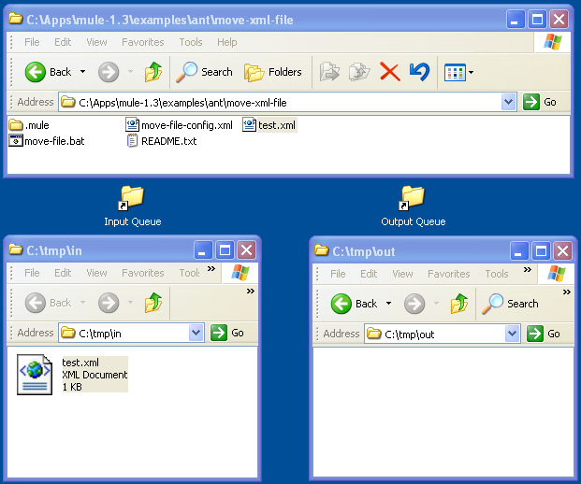
Test Environment

Slide 89
Omitted From Examples for Brevity
<?xml version="1.0" encoding="UTF-8"?>
<!DOCTYPE mule-configuration PUBLIC "-//MuleSource //DTD mule-configuration XML V1.0//EN"
"http://mule.mulesource.org/dtds/mule-configuration.dtd">

Slide 90
Outline of Move All Files
<mule-configuration>
<model>
<mule-descriptor>
<inbound-router>
<endpoint
address="file:///c:/mule-class/in"/>
</inbound-router>
<outbound-router>
<router>
<endpoint
address="file:///c:/mule-class/out"/>
</router>
</outbound-router>
</mule-descriptor>
</model>
</mule-configuration>

Slide 91
Move All Files – Procedural Details
<mule-configuration id="Mule_File_Move" version=" 1.0">
<connector name="SystemStreamConnector" className="org.mule.providers.stream.SystemStreamConnector"/>
<model name="move-all-files">
<mule-descriptor name="move-file" implementation="org.mule.components.simple.BridgeComponent">
<inbound-router>
<endpoint address="file:///c:/tmp/in"/>
</inbound-router>
<outbound-router>
<router className="org.mule.routing.outbound.OutboundPassThroughRouter">
<endpoint address="file:///c:/tmp/out"/>
</router>
</outbound-router>
</mule-descriptor>
</model>
</mule-configuration>

Slide 92
Only Moving XML Files
<inbound-router>
<endpoint address="file:///c:/mule-class/in">
<filter pattern="*.xml"
className=
"org.mule.providers.file.filters.FilenameWildcardFilter"/>
</endpoint>
</inbound-router>
Add the filter line to only move files with the extension "*.xml". If you add a file "foobar.txt to the input folder it will not be moved.

Slide 93
Keeping the Name The Same
<outbound-router>
<router className="org.mule.routing.outbound.OutboundPassThroughRouter">
<endpoint
address=
"file:///c:/mule-class/out?outputPattern=$[ORIGINALNAME]"
/>
</router>
</outbound-router>
Add the outputPattern parameter to keep the output name the same as the input.

Slide 94
Happy Path and Exceptions
Stop
Stop
Stop
Start
Step 1
Step 2
Step 3
Stop
By default, error free documents follow a central path known as the "happy path"
Documents that have errors may be handled in different ways (rejected, warnings etc.)

Slide 95
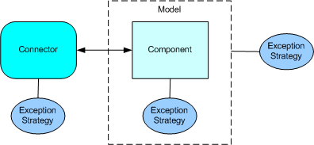
Exception Handling
Mule has a special way of handling non-happy path processing. This is called an "Exception Strategy" but is it really just and exception path and there is very little strategy involved.
There are three places you can associate an exception strategy
  connector
  component
  model (set for all components in a model)

Slide 96
Exception Strategy
<exception-strategy className=org.mule.impl.DefaultComponentExceptionStrategy">
<endpoint address="file:///c:/mule-class/error"/>
</exception-strategy>
We want all invalid documents to be moved into the error folder.

Slide 97

Sample XML
Given the following XML Schema file:
XML Schema validation will generate an error message when it gets to the fourth invalid data element:
<?xml version="1.0" encoding="UTF-8"?>
<Data>
<Element1>Hello World!</Element1>
<Element2>String</Element2>
<Element3>String</Element3>
<DansInvalidDataElement>This is Dans invalid data element</DansInvalidDataElement>
</Data>

Slide 98
Validating against an XML Schema
<outbound-router>
<router className="org.mule.routing.outbound.FilteringXmlMessageSplitter">
<endpoint
address="file:///c:/mule-class/out?outputPattern=$[ORIGINALNAME]"/>
<properties>
<property name="validateSchema" value="true"/>
<property name="externalSchemaLocation"
value="file:///c:/mule-class/labs/07-validate/my-schema.xsd"/>
</properties>
</router>
</outbound-router>
To validate the XML Schema, just add two properties:
1) tell it to validate the document
2) tell it what file to use and where to find it

Slide 99
Error Message
document : cvc-complex-type.2.4.d: Invalid content was found starting with element 'DansInvalidDataElement'. No child element is expected at this point.
This error message is generated on the Mule console when an invalid data element is found. But what should we do with it? How do we redirect it to the appropriate user?

Slide 100
Lab case:1
This application demonstrates a simple HTTP request-response activity. Mule responds to end user calls submitted via Web browser with a message that reads, "Hello World". This example was designed to demonstrate the ability of a Mule application to interact with an end user via an HTTP request. The goal is to introduce users to Anypoint Studio by illustrating a very simple functionality.

Slide 101
Flow
<?xml version="1.0" encoding="UTF-8"?>
<mule version="EE-3.6.1" xmlns="http://www.mulesoft.org/schema/mule/core" xmlns:core="http://www.mulesoft.org/schema/mule/core" xmlns:doc="http://www.mulesoft.org/schema/mule/documentation" xmlns:http="http://www.mulesoft.org/schema/mule/http" xmlns:spring="http://www.springframework.org/schema/beans" xmlns:xsi="http://www.w3.org/2001/XMLSchema-instance" xsi:schemaLocation="http://www.mulesoft.org/schema/mule/http http://www.mulesoft.org/schema/mule/http/current/mule-http.xsd http://www.springframework.org/schema/beans http://www.springframework.org/schema/beans/spring-beans-current.xsd http://www.mulesoft.org/schema/mule/core http://www.mulesoft.org/schema/mule/core/current/mule.xsd">
<http:listener-config doc:name="HTTP Listener Configuration" host="0.0.0.0" name="HTTP_Listener_Configuration" port="8081"/>
<flow name="HelloWorldFlow1">
<http:listener config-ref="HTTP_Listener_Configuration" doc:description="This endpoint receives an HTTP message." doc:name="Recieve HTTP request" path="helloWorld"/>
<set-payload doc:description="This processor sets the payload of the message to the string 'Hello World'." doc:name="Set Payload to a constant string" value="Hello World"/>
</flow>
</mule>

Slide 102
This example illustrates how to use the database connector to connect to a MySQL database. After reading this document and creating and running the example in Mule, you should be able to leverage what you have learned to create an application that connects to a MySQL database.

Slide 103
Use case
The application receives an HTTP request and
then filters out any "favicon.ico" browser requests.
It then transforms an inbound property into a flow variable.
The message is routed according to the flow variable associated
with the message. A new payload is set based on the routing logic,
this payload is then sent as an HTTP response.

Slide 104
Loan Broker Sample EIP book
The main loanbroker flow that:
i) Receives a customer request
ii) Performs a lookup of the customer credit profile using a component binding
iii) Determines the bank that should be used to request quotes
iv) Sends the request to the selected banks and aggregates responses
v) Selects the lowest quote from the list of quotes
vi) Returns the response to the client

Slide 105
The customer submits a loan application by
email, fax, online, or in a local branch. The customer receives a confirmation email.
Bank analyzes the conditions for a loan arrangement offer and the customer is notified if the loan application is approved or rejected. Approved customers receive a loan arrangement offer.

