Slide 1
Implementing an ESB using Mule
A Real World Example
JavaZone 2005
Ross Mason
ross.mason@symphonysoft.com

Slide 2
Agenda
Overview of ESB
Introduction to Mule
Mule and JBI
Real-world Application
  Application Overview
  Systems Involved
  Design Considerations
  Event Flows
Implementation with Mule
  Components
  Transports
  Returning the Loan Quote
  Fault Tolerance
  Scaling
Summary

Slide 3
Introduction to ESB
What is it?
  Enterprise Service Bus is an evolving architecture technique to integrate incompatible business applications over a common messaging bus.
Why do we need it?
  Many of the applications we write are in fact integration projects. Only the most simple applications do not need to interact with other applications.
Where does SOA fit in?
  ESB is one architecture style that abides by the rules of a Service Orientated Architecture.
What is JBI?
  Java Business Integration (JSR:208) is an emerging standard that defines common interfaces for components and message exchanges for application integration.
Does this all sound familiar?
  There is nothing new about integration, we've been doing it for years. So why the hype?

Slide 4
Properties of an ESB
Loosely Coupled
Event-Driven
Highly Distributed
Security/Authorization
Abstract Endpoints
Intelligent Routing
Data Transformation (inbound/outbound)
Reliable Messaging
Multi-Protocol Message Bus
Light Weight

Slide 5
Introduction to Mule
Service container and messaging platform
Supports a variety of topologies including ESB
Highly Scalable; uses SEDA event model
Lightweight and embeddable
Transactional; Local and Distributed
Fault tolerance; Exception management
Secure; authentication/authorization (Using Spring/Acegi)
Powerful event routing capabilities (based on EIP book)
Support for over 20 messaging protocols/transports
End-to-End Data Transformation
Management and Monitoring using JMX
BPEL Support
Deployment: JAR, WAR, RAR, EAR.

Slide 6
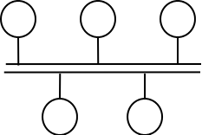
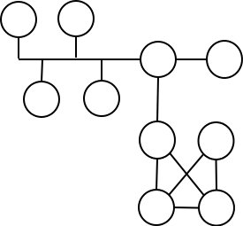
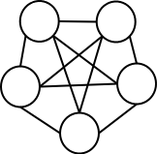
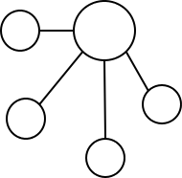
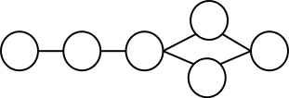
Mule Topologies
Enterprise Service Bus
Peer Network
Enterprise Service Network
Client/Server and Hub n' Spoke
Pipeline

Slide 7
Mule and JBI
Is Mule a JBI container?
There is a separate project called Mule JBI that is a JBI implementation that reuses the Mule service stack.
Does Mule work with JBI?
You can use Mule transports, components and transformers inside any JBI container. Mule provides a couple of components that allows JBI components to subscribe and publish events to and from Mule.
Do Mule and JBI compete?
JBI solves a subset of messaging problems. Mule addresses the basic need to move any kind of data (not just XML) between services in an organization
Which is best for me?
Mule of course!
The reason Mule integrates with other JBI engines and provides it own JBI container is that one integration solution will never satisfy all integration needs.
Mule levels the playing field allowing you to pick and choose which technologies to integrate with.

Slide 8
Mule and JBI Differences
JBI
  Described in terms of Service Engines (SEs) which are akin to components that execute business logic.
  Binding Components (BCs) implement protocols to provide connectivity to SEs.
  JBI uses a Message Exchange to manage interactions between components.
  Targeted a specifically at integration. Normalized Message
Mule
  Components are POJOs, EJBs, Spring Beans, Remote objects.
  The component never needs to call Mule APIs making them totally portable.
  Flexible endpoint model where a component may have zero or more inbound and outbound endpoints.
  Message routing is done via routers that are associated with the component.
  Mule is a ubiquitous messaging platform.
  A distributed container for wiring components.

Slide 9
Loan Broker
A Real World Example

Slide 10
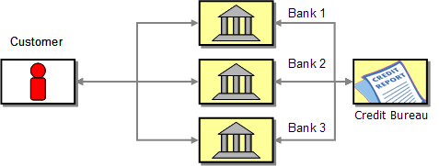
Shopping for Loans
Customer calls different banks to find the best deal.
Each bank asks customer for his or her social security number, the amount of the loan and the desired term.
Each bank then investigates the customer's credit background, usually by contacting a credit agency, before it finally sends the customer a quote.
Once the customer has received quotes from all banks, he or she can then select the best offer, i.e. the lowest rate. [1]

Slide 11
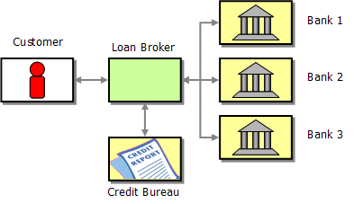
The Loan Broker
This process can be automated to allow customers to obtain the best quote on-line from a far broader range of banks, in much less time than if he or she were to obtain all the quotes one by one.
  Upon receiving customer request, Loan Broker:
  obtains the credit information for that customer from the credit agency
  requests quotes for the customer from banks listed with the Lender Service
  sends aggregate compilation of quotes to the customer for selection. [2]

Slide 12
Components
Loan Broker Service | Receives LoanRequests (customer, SS number, loan amount, duration) and is responsible for aggregating LoanQuotes into response for the request.
Credit Agency Service | An external service provider that provides crediting checking on customers to ensure the loan amount requested is feesible.
Credit Agency Gateway | Marshals a request between the message bus and the Credit Agency Application.
Lender Service | Based on the customer's credit scoring, loan amount and duration, the lender service will select banks from which to request a LoanQuote.
Lender Gateway | Marshals a request from the message bus to the Lender Application.
Banking Gateway | Dispatches LoanRequests to one or more banks.

Slide 13
Orchestration
LoanBroker (Http/Rest)
  Receives Requests over Http from a client application, such as a web browser.
Credit Agency (EJB)
  Is an EJB application that is managed by the Loan Broker company. It exposes an EJB called creditAgency with a method getCreditProfile.
Lender Application (VM)
  Is a local component, a Pojo that will determine which lenders should be used.
Banks (SOAP)
  For simplicity of this example all banks expose the same WS interface, though it's quite feasible to configure Mule to invoke different interfaces for different banks.
Gateways (JMS)
  Gateways marshal the requests from the message bus to external applications and services.

Slide 14
Design Considerations
Constraints
  Application needs to support request/response processing model.
  Will get a high volume of requests.
  Synchronous processing will not give us enough throughput.
Transports
  Using a JMS message bus
  Need to invoke services over JMS, Http/Rest, VM, and SOAP.
  Need to invoke services in external application containers (EJB).
  Expose components as Web services (Banks).
Message
  The message on the bus is referred to as a LoanQuoteRequest. In this example this is a Java bean but in real scenarios an XML document would be used.

Slide 15
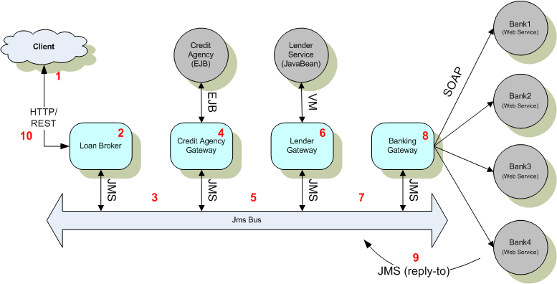
Loan Broker Design

Slide 16
Request Event Flow
Client application makes a request sending the LoanBroker a CustomerQuoteRequest Message.
LoanBroker creates a LoanQuoteRequest Message.
Mule sends the message to the Credit Agency Gateway via JMS
The Gateway marshals the request and invokes the CreditAgency EJB. The component used in the RelectionMessageBuilder which automatically attaches the CreditProfile to the LoanQuoteRequest message.
Mule sends the Message to the Lender Gateway via JMS
The Gateway uses the VM transport to invoke the Lender Application.
Mule sends the Message to the Banking Gateway via JMS
The Banking Gateway in this example invokes the Banks using SOAP.
Each of the Banks attaches a quote to the request and sends it back to the LoanBroker via the ReplyTo address provided by the Banking Gateway.
The ResponseRouter on the Loan Broker Service receives the responses on the ReplyTo address. It selects the lowest quote received for the request and returns it to the client.

Slide 17
Loan Broker
Implementation with Mule

Slide 18
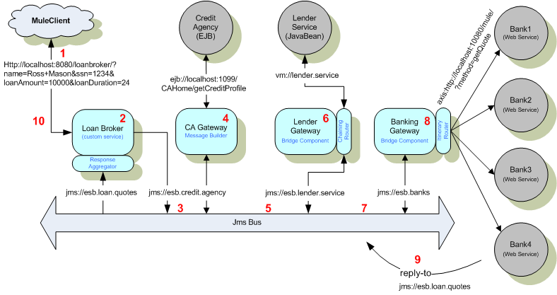
Design With Mule

Slide 19
The Message
Lets start by defining the LoanQuoteRequest Message. In this example the
Message is a Java bean and is the common message format on the bus.
Normally this would be XML, but Mule allows us to pass any data format around.
public class LoanQuoteRequest implements Serializable
{
/** The request contains Customer info and loan amount and duration*/
private CustomerQuoteRequest customerRequest;
/** credit profile for the customer */
private CreditProfile creditProfile;
/** A list of lenders for this request */
private Bank[] lenders;
/** A loan quote from a bank */
private LoanQuote loanQuote;
.......
}

Slide 20
Client Request
The whole chain of events is initiated with a client request. This is done over Http using Mule's REST support. It is described in the Endpoint address –
  jetty:rest://localhost:8080/loanbroker
Here we're saying -
  Embed a Jetty Servlet Engine
  Use the Rest servlet for receiving requests
  Listen on localhost:8080
  Bind the Rest servlet to the context /loanbroker
The request from the client would look like –
  http://localhost:8080/loanbroker/?name=Ross+Mason&ssn=1234& loanAmount=10000&loanDuration=24

Slide 21
The Message
The Loan Broker endpoint receives the request as a set of Http parameters, but we need to transform this into a CustomerQuoteRequest object before the Loan Broker component receives it.
We do this by configuring a custom transformer on the endpoint.
public Object transform(Object src, UMOEventContext context)
throws TransformerException {
String name = context.getStringProperty("name");
int ssn = context.getIntProperty("ssn");
double amount = context.getDoubleProperty("loanAmount");
double duration = context.getDoubleProperty("loanDuration");
Customer customer = new Customer(name, ssn);
CustomerQuoteRequest request =
new CustomerQuoteRequest(customer, amount, duration);
return request;
}

Slide 22
Loan Broker Service
The Loanbroker service actually doesn't need to do anything but trigger the LoanQuoteRequest on the bus. Mule handles all routing transformation and passing the quote back to the callee.
The transformer configured on the REST inbound endpoint for the LoanBroker converts the REST parameters into a CustomerQuoteRequest object.
public class LoanBroker
{
public LoanQuoteRequest requestLoanQuote(
CustomerQuoteRequest request) throws Exception
{
LoanQuoteRequest bqr = new LoanQuoteRequest();
bqr.setCustomerRequest(request);
return bqr;
}
}

Slide 23
Loan Broker Configuration
All the detail is in the Loan Broker configuration.
<mule-descriptor name="LoanBroker"
implementation="org.mule.samples.loanbroker.esb.LoanBroker">
<inbound-router>
<endpoint address="jetty:rest://localhost:8080/loanbroker"/>
</inbound-router>
<outbound-router>
<router className="org.mule.routing.outbound.OutboundPassThroughRouter">
<endpoint address="jms://esb.credit.agency"/>
</router>
</outbound-router>
<response-router timeout="10000">
<endpoint address="jms://esb.loan.quotes"/>
<router className="
org.mule.samples.loanbroker.esb.routers.BankQuotesResponseAggregator"/>
</response-router>
</mule-descriptor>

Slide 24
Credit Agency Gateway
The Credit Agency code is even easier! We use a standard Mule Component called a ReflectionMessageBuilder which builds a message based on a set of results from endpoint invocations.
It will use reflection to determine how to set the result of the last endpoint invocation as a property on the master message.
There are other MessageBuilder components such as the ScriptMessageBuilder component which is a JSR-223 (Scripting) component that allows you to manipulate the payload after each request using Groovy, JavaScript, Rhino or any other supported scripting language.

Slide 25
Credit Agency Configuration
<mule-descriptor name="CreditAgencyGateway"
implementation="org.mule.components.builder.ReflectionMessageBuilder">
<inbound-router>
<endpoint address="jms://credit.agency"/>
</inbound-router>
<outbound-router>
<router className="org.mule.routing.outbound.FilteringRouter">
<endpoint address="ejb://localhost:1099/local/CreditAgency?method=getCreditProfile“
transformers=“LoanQuoteRequestToCreditProfileArgs” responseTransformers="CreditProfileXmlToCreditProfile“/>
<properties>
<list name="methodArgumentTypes">
<entry value="java.lang.String"/>
<entry value="java.lang.String"/>
</list>
</properties>
</endpoint>
<endpoint address="jms://esb.lender.service"/>
</router>
</outbound-router>
</mule-descriptor>

Slide 26
Credit Agency Configuration
We invoke the CreditAgency application using an EJB endpoint –
ejb://localhost:1099/local/CreditAgency?method=getCreditProfile
This endpoint tells Mule to –
  Look up an EJB object at localhost:1099
  Use the JNDI name local/CreditAgency
  Invoke the method getCreditProfile on the EJB object
Notice also the transformers and responseTransformers attibutes on the endpoint. These tell Mule how to marshal for the Application.
  LoanQuoteRequestToCreditProfileArgs – Extracts the method arguments from the request as an array used to invoke getCreditProfile.
  CreditProfileXmlToCreditProfile – Parses the response Xml and creates a CreditProfile object that will be set on the LoanQuoteRequest.

Slide 27
Lender Gateway
Lender Service
  The Lender Agency is a Mule component, that receives events directly using the VM transport.
Leander Gateway
  The Lender Gateway marshals requests from the bus to the lender service.

Slide 28
Lender Gateway Configuration
Lender Service
<mule-descriptor name="LenderService" implementation="org.mule.samples.loanbroker.esb.LenderService">
<inbound-router>
<endpoint address="vm://lender.service"/>
</inbound-router>
</mule-descriptor>
Lender Gatway
<mule-descriptor name="LenderGateway”
implementation="org.mule.components.simple.BridgeComponent">
<inbound-router>
<endpoint address="jms://esb.lender.service"/>
</inbound-router>
<outbound-router>
<router className="org.mule.routing.outbound.ChainingRouter">
<endpoint address="vm://lender.service"/>
<endpoint address="jms://esb.banks"/>
</router>
</outbound-router>
</mule-descriptor>

Slide 29
Banking Gateway
The Banking Gateway is responsible for distributing requests to a list of lenders.
The ReciptientList router configured on this gateway is responsible for extracting the endpoints from the message and invoking them. The RecipientList is a type of Itinerary-based router that extracts its itinerary as a static list from the event.
<mule-descriptor name="BankingGateway"
implementation="org.mule.components.simple.BridgeComponent">
<inbound-router>
<endpoint address="jms://esb.banks"/>
</inbound-router>
<outbound-router>
<router className="org.mule.routing.outbound.StaticRecipientList">
<reply-to address="jms://esb.loan.quotes"/>
</router>
</outbound-router>
</mule-descriptor>

Slide 30
Banks
The banks in this example are just simple beans that return a fixed interest rate and are exposed as SOAP services.
<mule-descriptor name="Bank1"
inboundEndpoint="axis:http://localhost:10001/services"
implementation="org.mule.samples.loanbroker.Bank">
</mule-descriptor>
Note to expose a component as an Axis service all you need to do is add an Axis endpoint!

Slide 31
Choosing the best Quote
Once a back has a quote it passes it to Mule which will send the Quote on the reply-to endpoint specified by the Banking Gateway.
Looking back at the LoanBroker configuration, there is a response-router configured as -
<response-router timeout="10000">
<endpoint address="jms://esb.loan.quotes"/>
<router className="org.mule.samples.loanbroker.esb.routers.
BankQuotesResponseAggregator"/>
</response-router>
The BankQuoteResponseAggregator is responsible for picking the lowest quote. But before that happens Mule needs to make sure all responses are received for the request.
This is done using message correlation managed by Mule.

Slide 32
Event Correlation
When a event is dispatched from the Banking Gateway a correlationId and correlationGroupSize is attached to the SOAP message. This is a function of the Recipient List router. It attaches the following information -
  CorrelationId – and Id that associates all the dispatched events to the same group
  CorrelationGroupSize – how many events are in the group.
  CorrelationSequence – the order in which the events were dispatched.
The Response Router reads these correlation headers when events are received and correlates the events.
When the event group correlation is complete the response-router invokes itself where developers can plug in custom logic.

Slide 33
Response Aggregation
The BankQuoteResponseAggregator implements a single method that works out the lowest quote before passing it back to Mule to route the response back to the client.
protected UMOMessage aggregateEvents(EventGroup events) throws RoutingException {
. . . .
List list = events.getEvents();
for (Iterator iterator = list.iterator(); iterator.hasNext();) {
event = (UMOEvent) iterator.next();
quote = (LoanQuote)event.getTransformedMessage();
logger.info("Processing quote: " + quote);
if (lowestQuote == null) {
lowestQuote = quote;
} else if (quote.getInterestRate() < lowestQuote.getInterestRate()) {
lowestQuote = quote;
}
}
return new MuleMessage(lowestQuote, event.getProperties());
}

Slide 34
Transports
Most Mule transports can be configured using just the endpoint address. i.e. tcp://localhost:45454 contains all the information necessary to make a TCP connection.
However for JMS and EJB we need to define configuration properties for each such as Jndi information.
This is done by configuring connectors in our MuleXml.

Slide 35
Transport Configuration
EJB Connector (OpenEJB – Local Server. See http://openejb.org)
<connector name="ejbConnector" className="org.mule.providers.ejb.EjbConnector">
<properties>
<property name="jndiInitialFactory" value="org.openejb.client.LocalInitialContextFactory"/>
<property name="securityPolicy" value="security.policy"/>
<map name="jndiProviderProperties">
<property name="openejb.base" value="."/>
<property name="openejb.configuration" value="../conf/openejb.conf"/>
</map>
</properties>
</connector>
JMS Connector (ActiveMQ)
<connector name="jmsConnector" className="org.mule.providers.jms.JmsConnector">
<properties>
<property name="connectionFactoryJndiName" value="ConnectionFactory"/>
<property name="jndiInitialFactory" value="org.activemq.jndi.ActiveMQInitialContextFactory"/>
<property name="specification" value="1.1"/>
</properties>
</connector>

Slide 36
Fault Tolerance
Exception Strategies
  Can be defined on components and connectors
  Can be defined globally of for each connector or component
  Can handle different exception types differently.
  Exception hierarchy provides all available information
  Event payloads can be re-routed on exception
Connection Strategies
  Control how connectors connect to underlying resources
  Allow for flexible retry policies
  Notifications of failed connections
  Consistent endpoint state maintained
  Can alter routing paths based on failed connections

Slide 37
Scaling
SEDA Model
  Mule is SEDA-based, which is an architecture designed for high concurrency and throughput.
JMS Clustering
  Currently Mule can use JMS clustering to distribute events to a cluster of Mule Nodes.
Application Server Clustering
  Mule can be embedded inside a JCA container and allow the App server to manage its resources and cluster instances.
New Clustering Support
  The next release of Mule will provide clustering and distribution using JGroups/JBossCache.
Load Balancing using Mule
  You can use a Mule instance to provide load-balancing over any transport.

Slide 38
Summary
An ESB integrating a client application and 3 back office systems.
Combined a number of transports including HTTP, JMS, EJB and Web Services.
Easy to add in Exception handling, transactions, etc. All done through configuration.
All event routing, management, transformation is handled by Mule.
Very little code to write. Just domain-specific logic.
A fully functional ESB in about an hour!

Slide 39
The Mule Project
Project was founded in 2003.
It was started after experiences with a large Financial ESB project.
There are now 10 developers who help support it and add new features.
Has an active user community.
Is being used in companies such as HP, Sony, Deutche Bank and CitiBank.
SymphonySoft has been started by Mule developers to help support and provide professional services to these projects.
For more information go to - http://mule.codehaus.org.

Slide 40
Resources
EIP Book (Loan Broker Example) [1][2]
  http://www.eaipatterns.com/ComposedMessagingExample.html
  http://www.eaipatterns.com/index.html
Introduction to ESBs – Rick Robinson
  http://www-106.ibm.com/developerworks/xml/library/ws-esbscen/
ESB Learning Guide
  http://searchwebservices.techtarget.com/general/1,295582,sid26_gci1085711,00.html
Introduction to SEDA – Matt Welsh
  http://www.eecs.harvard.edu/~mdw/papers/mdw-phdthesis.pdf
Mule User Guide
  http://mule.codehaus.org/User+Guide

Slide 41
Slides and Code
To get this Loan Broker ESB code and these slides go to -
  http://mule.codehaus.org/LoanBroker
There are other examples too -
  http://mule.codehaus.org/Examples

Slide 42
Questions
?

