Slide 1


Slide 2
Topics
Integration, SOA, and ESB
What Mule ESB is (and isn’t)
Mule Architecture & Components
Configuration & Deployment
Enterprise Integration Patterns

Slide 3
Integration Projects
Why we integrate
–
Users don't care where business functions and information reside
We don't always own or control all the pieces
intranet & external partners
Cheaper than building new solutions from scratch
Users want access to information from various devices - browsers, mobile phone, handhelds, ...
–
–
–

Slide 4
Integration Projects (cont.)
➢
How we integrate
Set up meetings with business domain experts Identify systems and processes
More meetings…
Map data flows then model
Patterns are extremely helpful
Yet more meetings…
Define services & message formats Start coding away…
➢
But, then what happens?

Slide 5

Integration Approaches/Technologies
➢
Custom, point-to-point solutions
–
Information silos live on
➢
Service Oriented Architecture (SOA)
–
Enables loose coupling of services that are OS & programming language independent
Web services (SOAP, REST), RPC, CORBA, etc.
–
➢
Enterprise Service Bus (ESB)
–
–
–
Helps orchestrate & manage the chaos Good place to centralize general services Encourages best practices

Slide 6
Why use an ESB
➢
Integration Styles
➢
ESB Advantages
–
–
–
–
–
Batch
File Transfer Shared Database Request/Reply Messaging
–
–
–
–
–
–
–
Supports all styles Bridges legacy systems Modular architecture Simple and flexible
Easy to test and maintain Scalable
Can be a step towards SOA
●
●
Synchronous Asynchronous

Slide 7
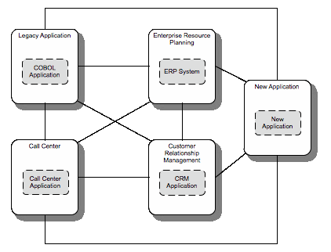
Why use an ESB (before)

Slide 8
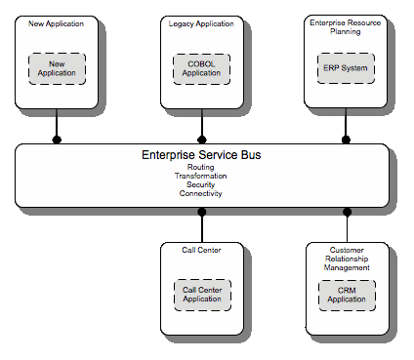
Why use an ESB (after)

Slide 9
What is Mule ESB?
“Mule is a lightweight integration platform and service container that allows you to quickly and easily connect your applications together. Mule provides a robust, secure and scalable platform to build enterprise applications offering an array of transports such as JMS, HTTP, Email, FTP, JDBC and many more. It also offers a rich set of features for web services, message routing, mediation, transformation and transaction management. Designed around the ESB (Enterprise Service Bus) concept.”
-- www.mulesource.org

Slide 10
What is Mule ESB? (cont.)
Service creation and hosting | Expose transport end-points, EJBs, Spring beans, and POJOs as modular and reusable services Host services as a lightweight service container
Service mediation | Separate business logic from messaging Shield service components from message formats and protocols Enable location-independent service calls
Message routing | Route messages based on content and complex rules Filter, aggregate and re-sequence in-bound messages
Data transformation | Exchange data across applications with varying data formats Transform data as needed, based on need Format messages across heterogeneous transport protocols

Slide 11
What Mule ESB isn’t
➢
➢
It does not place restrictions on your environment
It is not message queuing, it uses other (JMS capable) products
–
And, it does not require message queues
➢
➢
It is not complex
It does not need to be “the grand master of all integration endpoints across the enterprise”
–
–
Think big, start small
It plays nicely with other ESBs

Slide 12
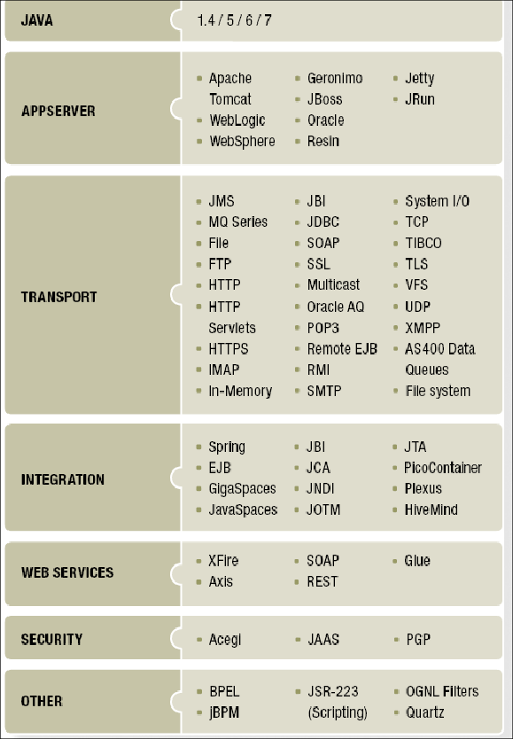
Why use Mule ESB
➢
➢
➢
Decouples Business Logic Location Transparency
Transport Protocol Conversion
Message Transformation Message Routing Message Enhancement Reliability (Transactions) Security
Scalability
➢
➢
➢
➢
➢
➢

Slide 13
Why choose Mule
➢
No prescribed message format
–
–
XML, CSV, Binary, Streams, Record, Java Objects Mix and match
➢
Zero code intrusion
–
–
Mule does not impose an API on service objects Objects are fully portable
➢
Existing objects can be managed
–
–
POJOs, IoC Objects, EJB Session Beans, Remote Objects REST & Web Services
➢
Easy to test
–
–
–
Mule can be run easily from a JUnit test case Framework provides a Test compatibility kit Scales down as well as up

Slide 14
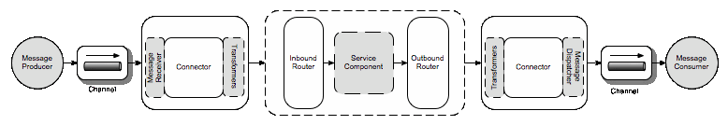
Mule ESB Architecture
Architecture is based on concepts discussed in Enterprise Integration Patterns

Slide 15
Mule Components
Endpoint
–
Channel, MessageReceiver, Connector
Transformer
–
Message transformation / enhancement
Router
–
Message flow control (inbound/outbound)
Service Component
–
Your integration logic lives here

Slide 16
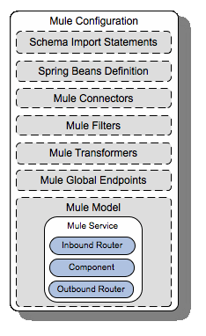
Mule Configuration
➢
➢
Spring based
mule-config.xml (default)
Multiple config files using import
➢

Slide 17
Mule Deployment
Standalone
MMC(Mule Management Console)
Cloud Hub

Slide 18





Enterprise Integration Patterns
➢
Message Filter
–
Service component receives specific message types
➢
Message Translator
–
Transformer: change format, tag names, etc.
➢
Content Enricher (Message Enhancement)
–
add additional data to message
➢
Content-based Router
–
Route message based on contained data
➢
Messaging Bridge
–
Send message between different protocols or messaging systems

Slide 19




Enterprise Integration Patterns (cont.)
➢
Content Filter
–
Shrink message to fewer data items
➢
Polling Consumer
–
File directory, email, FTP
➢
Scatter-Gather
–
Send to multiple endpoints / aggregate replies
➢
Splitter
–
Batches, Lists, Collections, etc.
➢
Wire Tap
–
Inspect messages during flight (logging, monitoring, etc.)

Slide 20
References
http://www.mulesoft.org
https://forums.mulesoft.com/
https://www.facebook.com/groups/Mulesoft/

Slide 21
Thank Q!!!

