Slide 1
CSE 403
Performance Profiling
These lecture slides are copyright (C) Marty Stepp, 2007. They may not be rehosted, sold, or modified without expressed permission from the author. All rights reserved.

Slide 2
What's wrong with this code?
public class BuildBigString {
public final static int REPS = 8000;
public static String makeString() {
String str = "";
for (int n = 0; n < REPS; n++) {
str += "more";
}
return str;
}
// Builds a big, important string.
public static void main(String[] args) {
System.out.println(makeString());
}
}

Slide 3
What's wrong with this code?
public class Fibonacci {
public static void main(String[] args) {
// print the first 10000 Fibonacci numbers
for (int i = 1; i <= 10000; i++) {
System.out.println("fib(" + i + ") is " + fib(i));
}
}
// pre: n >= 1
public static long fib(int n) {
if (n <= 2) {
return 1;
} else {
return fib(n - 2) + fib(n - 1);
}
}
}

Slide 4
What's wrong with this code?
import java.util.*;
// A set of words in our game.
public class WordDictionary {
private List<String> words = new ArrayList<String>();
public void add(String word) {
words.add(word.toLowerCase());
}
public boolean contains(String word) {
return words.contains(word.toLowerCase());
}
}

Slide 5
Code performance questions
Did you choose the right data structure?
Are you using the right sorting algorithm?
Is your recursive method TOO recursive?
Are you throwing away a computation that could prove useful later?
Are you creating too many objects unnecessarily or otherwise wasting memory?

Slide 6
Optimization metrics
runtime / CPU usage:
  what lines of code the program is spending the most time in
  what call/invocation paths were used to get to these lines
    naturally represented as tree structures
memory usage:
  what kinds of objects are sitting on the heap
  where were they allocated
  who is pointing to them now
  "memory leaks" (does Java have these?)

Slide 7
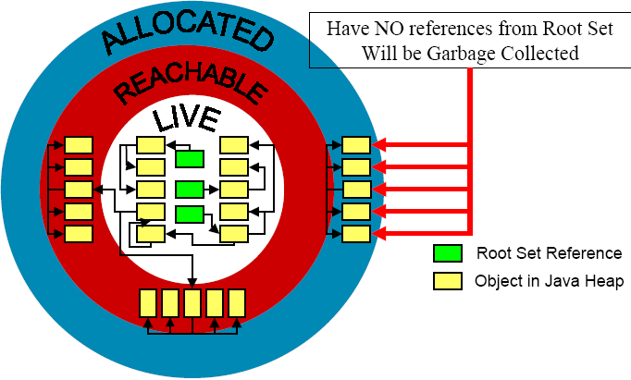
Java's memory model

Slide 8
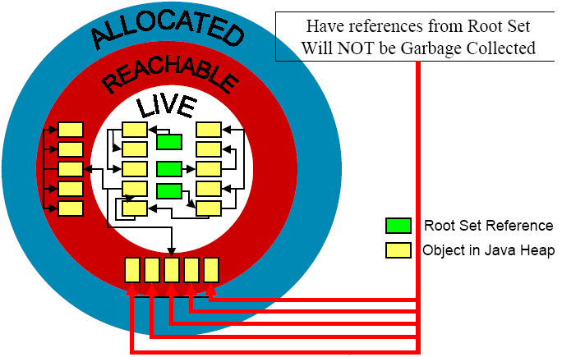
Java's memory model 2

Slide 9
Garbage collection
A memory manager that reclaims objects that are not reachable from a root-set
root set: all objects with an immediate reference
  all reference variables in each frame of every thread's stack
  all static reference fields in all loaded classes
  JNI references to Java objects stored in the C heap

Slide 10
Heap and garbage collection
Size
Heap Size
GC
GC
GC
GC
GC
Max Occupancy
Total size of reachable objects
Total size of allocated objects
Time

Slide 11
Profiling, benchmarking, ...
profiling: Measuring relative system statistics.
  Where is the most time being spent? ("classical" profiling)
    Which method takes the most time?
    Which method is called the most?
  How is memory being used?
    What kind of objects are being created?
    This in especially applicable in OO, GCed environments.
  Profiling is not the same as benchmarking or optimizing.
benchmarking: Measuring the absolute performance of your app on a particular platform.
optimization: Applying refactoring and enhancements to speed up code.

Slide 12
Profiling motivation
Why use a profiler?
  your intuition about what's slow is often wrong
  performance is a major aspect of program acceptance by users / customers
Profiler advantages:
  accuracy
  completeness
  solid, statistical information
  platform- and machine-independence
When should I profile my code?

Slide 13
What profiling tells you
Basic information:
  How much time is spent in each method? ("flat" profiling)
  How many objects of each type are allocated?
Beyond the basics:
  Program flow ("hierarchical" profiling)
    Do calls to method A cause method B to take too much time?
  Per-line information
    Which line(s) in a given method are the most expensive?
    Which methods created which objects?
  Visualization aspects
    Is it easy to use the profiler to get to the information you're interested in?

Slide 14
Types of profilers
there are a variety of types of profilers
  insertion
  sampling
  instrumenting
there is usually a trade-off in terms of:
  accuracy
  speed
  granularity of information
  intrusiveness

Slide 15
Insertion profiling
insertion: placing special profiling measurement code into your program automatically at compile-time
pros:
  can be used across a variety of platforms
  very accurate (in some ways)
cons:
  requires recompilation or relinking of the app
  profiling code may affect performance
    difficult to calculate exact impact

Slide 16
Sampling profiling
sampling: monitoring CPU or VM at regular intervals and saving a snapshot of CPU and/or memory state
  This data is then compared with the program's layout in memory to get an idea of where the program was at each sample.
pros:
  no modification of app is necessary
cons:
  less accurate; varying sample interval leads to a time/accuracy trade-off
    a high sample rate is accurate, but takes a lot of time
  very small methods will almost always be missed
    if a small method is called frequently and you have are unlucky, small but expensive methods may never show up
  sampling cannot easily monitor memory usage

Slide 17
Instrumented VM profiling
instrumenting the Java VM: Modifying the Java Virtual Machine's code so that it records profiling information.
  Using this technique, each and every VM instruction can be monitored
pros:
  the most accurate technique
  can monitor memory usage data as well as time data
  can easily be extended to allow remote profiling
cons:
  the instrumented VM is platform-specific

Slide 18
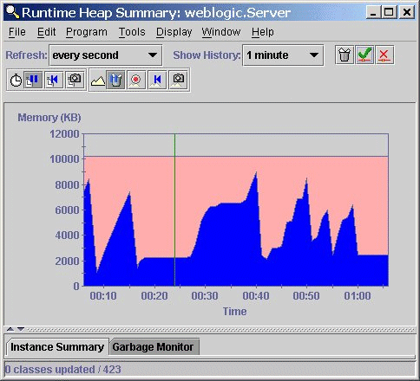
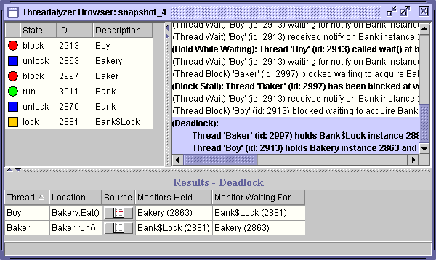
Tools
Many free Java profiling/optimization tools available:
  TPTP profiler extension for Eclipse
  Extensible Java Profiler (EJP) - open source, CPU tracing only
  Eclipse Profiler plugin
  Java Memory Profiler (JMP)
  Mike's Java Profiler (MJP)
  JProbe Profiler - uses an instrumented VM
hprof (java -Xrunhprof)
  comes with JDK from Sun, free
  good enough for anything I've ever needed

Slide 19
Using hprof
usage: java -Xrunhprof:[help]|[<option>=<value>, ...]
Option Name and Value Description Default
--------------------- ----------- -------
heap=dump|sites|all heap profiling all
cpu=samples|times|old CPU usage off
monitor=y|n monitor contention n
format=a|b text(txt) or binary output a
file=<file> write data to file off
depth=<size> stack trace depth 4
interval=<ms> sample interval in ms 10
cutoff=<value> output cutoff point 0.0001
lineno=y|n line number in traces? Y
thread=y|n thread in traces? N
doe=y|n dump on exit? Y
msa=y|n Solaris micro state accounting n
force=y|n force output to <file> y
verbose=y|n print messages about dumps y

Slide 20
Sample hprof usage
To measure CPU usage, try the following:
  java -Xrunhprof:cpu=samples,depth=6,heap=sites
Settings:
  Takes samples of CPU execution
  Record call traces that include the last 6 levels on the stack
  Only record the sites used on the heap (to keep the output file small)
After execution, open the text file java.hprof.txt in the current directory with a text editor

Slide 21
java.hprof.txt organization
THREAD START/END: mark the lifetime of Java threads
TRACE: represents a Java stack trace. Each trace consists of a series of stack frames. Other records refer to TRACEs to identify (1) where object allocations have taken place, (2) the frames in which GC roots were found, and (3) frequently executed methods.
HEAP DUMP: a complete snapshot of all live objects in the heap.
SITES: a sorted list of allocation sites. This identifies the most heavily allocated object types, and the TRACE at which those allocations occurred.
CPU SAMPLES: a statistical profile of program execution. The VM periodically samples all running threads, and assign a quantum to active TRACEs in those threads. Entries in this record are TRACEs ranked by percentage.
CPU TIME: a profile of program execution obtained by measuring the time spent in individual methods (excluding the time spent in callees), as well as by counting the number of times each method is called.

Slide 22
CPU samples
Located at the bottom of the file
Lists the same method multiple times if the traces are different
The "trace" number references traces that are described in detail in the trace section
CPU SAMPLES BEGIN (total = 3170) Mon Nov 22 09:10:30 2004
rank self accum count trace method
1 2.15% 2.15% 68 241 java.io.FileInputStream.readBytes
2 1.77% 3.91% 56 1772 java.util.AbstractList.iterator
3 1.17% 5.08% 37 3829 edu.stanford.nlp.parser.
lexparser.ExhaustivePCFGParser.
initializeChart
4 1.10% 6.18% 35 1636 java.util.AbstractList.iterator
5 0.91% 7.10% 29 1915 java.lang.String.substring
6 0.82% 7.92% 26 2076 java.lang.String.
.
.
CPU SAMPLES END

Slide 23
Stack traces
.
.
TRACE 1636:
java.util.AbstractList.iterator(AbstractList.java:336)
java.util.AbstractList.hashCode(AbstractList.java:626)
java.util.HashMap.hash(HashMap.java:261)
java.util.HashMap.put(HashMap.java:379)
edu.stanford.nlp.util.Counter.incrementCount(Counter.java:199)
edu.stanford.nlp.util.Counter.incrementCount(Counter.java:220)
.
.
TRACE 1772:
java.util.AbstractList.iterator(AbstractList.java:336)
java.util.AbstractList.hashCode(AbstractList.java:626)
java.util.HashMap.hash(HashMap.java:261)
java.util.HashMap.get(HashMap.java:317)
edu.stanford.nlp.util.Counter.getCount(Counter.java:114)
edu.stanford.nlp.util.Counter.totalCount(Counter.java:75)
.
.

Slide 24
Heap sites
Very limited information: how much space allocated for objects of each class, at what stack trace
SITES BEGIN (ordered by live bytes) Mon Nov 22 09:10:30 2004
percent live alloc'ed stack class
rank self accum bytes objs bytes objs trace name
1 20.70% 20.70% 4105296 1326 4105296 1326 3815 [F
2 1.63% 22.33% 322560 2016 322560 2016 3829 edu.stanford.nlp.parser.
lexparser.IntTaggedWord
3 1.32% 23.65% 261576 1458 1555336 9200 92 [C
4 1.22% 24.87% 242080 890 902768 3319 3153 java.lang.Object
5 1.12% 25.99% 221520 2769 566320 7079 2885 java.util.HashMap$Entry
6 1.03% 27.02% 205120 6410 667520 2086 3208 java.util.HashMap$KeyIterator
7 0.93% 27.96% 184960 2312 369920 4624 1261 [C
.
.
SITES END

Slide 25
Visualization tools
CPU samples
  critical to see the traces to modify code
  hard to read - far from the traces in the file
  HP's HPjmeter analyzes java.hprof.txt visually
    http://www.hp.com/products1/unix/java/hpjmeter/
  another good tool called PerfAnal builds and navigates the invocation tree
Heap dump
  critical to see what objects are there, and who points to them
  very hard to navigate in a text file!
  Tools: HPjmeter or HAT navigate heap objects
    https://hat.dev.java.net/

Slide 26
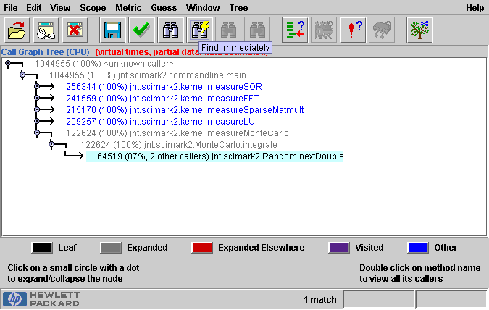
HPjmeter
Useful tool for analyzing java.hprof.txt
Can display heap (memory/objects) data,
CPU samples, call trees

Slide 27
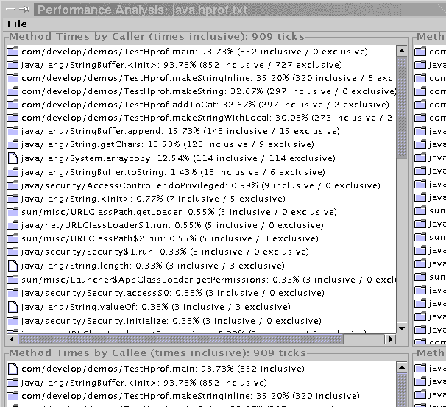
PerfAnal
helps you navigate the information contained in java.hprof.txt file
creates 4 views:
  CPU inclusive by caller
  CPU inclusive by callee
  CPU inclusive by line number
  CPU exclusive
  Plus some thread stuff
easy to use:
  download PerfAnal.jar, put in same folder as your program
  java -jar PerfAnal.jar ./java.hprof.txt

Slide 28
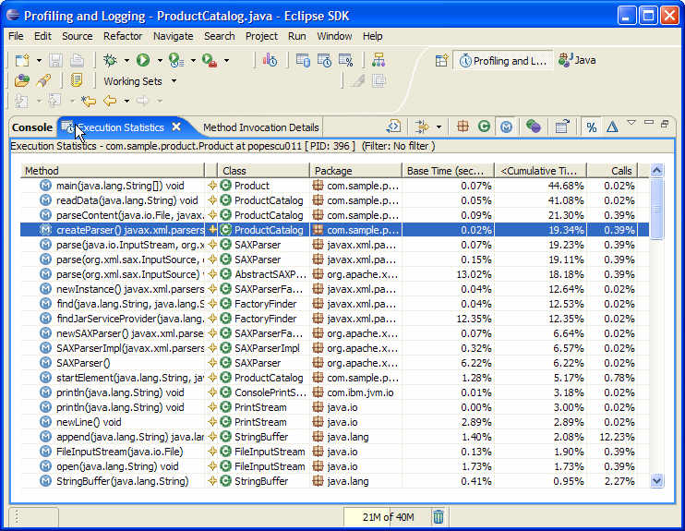
TPTP
a free extension to Eclipse for profiling
  difficult to install, but very powerful

Slide 29
Profiling Web languages
Javascript
  Venkman: http://www.mozilla.org/projects/venkman/
PHP
  APD: http://www.pecl.php.net/package/apd
  Benchmark: http://pear.php.net/benchmark
  DBG: http://dd.cron.ru/dbg
  Xdebug: http://xdebug.derickrethans.nl/
Ruby on Rails
  ruby-prof: http://ruby-prof.rubyforge.org/
JSP
  x.Link: http://sourceforge.net/projects/xlink/

Slide 30
Warnings
CPU profiling really slows down your code!
  Design your profiling tests to be very short
  CPU Samples is better than CPU Time
CPU samples don't measure everything
  Doesn't record object creation and garbage collection time, which can be significant!
Output files are very large, especially if there is a heap dump

Slide 31
What to do with profiler results
observe which methods are being called the most
  these may not necessarily be the "slowest" methods!
observe which methods are taking the most time relative to the others
  common problem: inefficient unbuffered I/O
  common problem: poor choice of data structure
  common problem: recursion call overhead
  common problem: unnecessary re-computation of expensive information, or unnecessary multiple I/O of same data

Slide 32
What to do after optimization
Sometimes performance bottlenecks exist in Sun's Java APIs, not in your code. What to do?
  It's all about the user experience.
    If your slow code is GUI-related, add some display that informs the user that work is actually happening (progress bars, hourglass).
  Can you use a different call, another algorithm or component?
    maybe reduce the frequency of calls to a method
  Are you using the framework / API effectively?

