Slide 1
Java Applets
- Basic intro
Based on slides from Deitel & Associates, Inc.
Revised by T. A. Yang

Slide 2
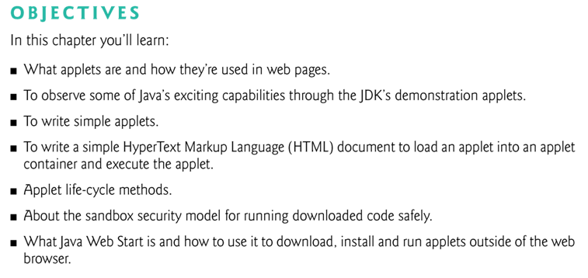

Slide 3
23.1 What are applets?
Applets are Java programs that are typically embedded in HTML (HyperText Markup Language) or XHTML (Extensible HTML) documents.
Pre-installed on a web server are various web pages (HTML), Java applets, Java servlets, and/or other server-side applications (PhP, JSP, etc.)
When a Java-enabled web browser loads a web page containing an applet, the applet is downloaded into the browser and executed by the JVM on the browser’s computer.

Slide 4
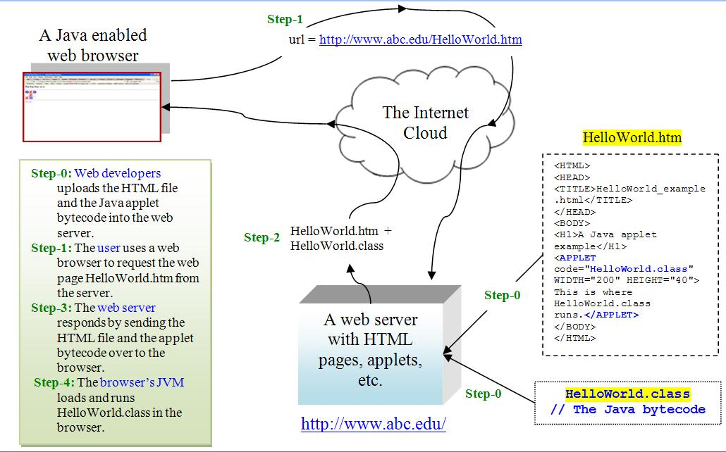

Slide 5
The applet container:
The application in which an applet executes
The applet container loads the applet’s class(es), creates an instance of the applet and manages its life cycle.
The applet container
provides support for the applet programming model, and
restricts the applet’s capabilities (for security reasons).
Example applet containers:
The web browser is a typical container for running applets embedded in a HTML file.
The Java Development Kit (JDK) includes one applet container called the appletviewer for testing applets as you develop them and before you embed them in web pages.

Slide 6
Running the HelloWorld applet:
http://sce.uhcl.edu/yang/teaching/AppletHelloWorld/AppletHelloWorld.htm
Several methods:
Using the AppletViewer application (part of JDK)
Using a web browser to open the local HelloWorld.htm
Using a web browser to open the HelloWorld.htm from a web server

Slide 7
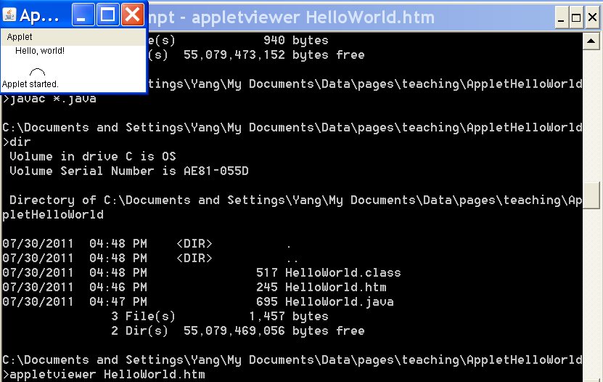
Running HelloWorld.htm using the AppletViewer:

Slide 8
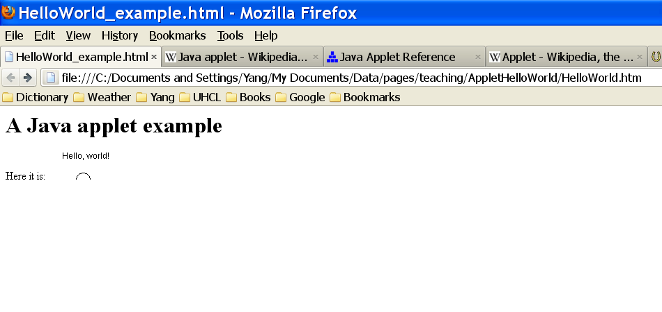
Running HelloWorld.htm using a web browser:

Slide 9
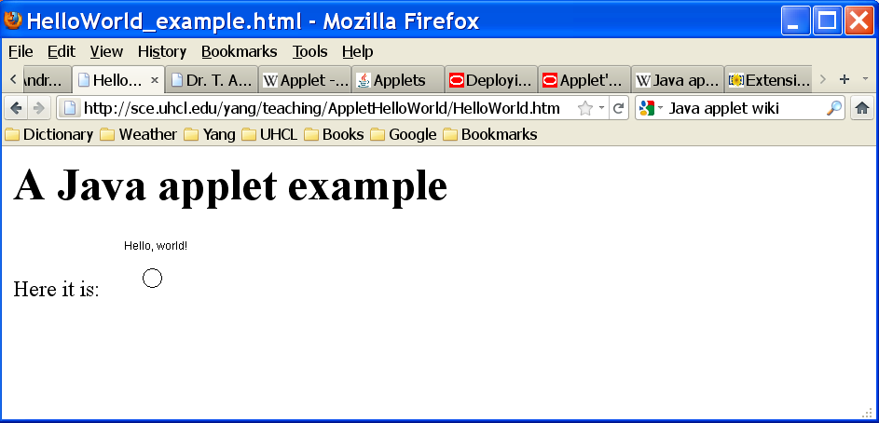
Running the applet loaded in a web server: http://sce.uhcl.edu/yang/teaching/AppletHelloWorld/HelloWorld.htm

Slide 10
// HelloWorld.java applet code
// source: http://en.wikipedia.org/wiki/Java_applet
import java.applet.Applet;
import java.awt.*;
public class HelloWorld extends Applet {
// This method is mandatory, but can be empty (i.e., have no actual code).
public void init() { }
// This method is mandatory, but can be empty.(i.e.,have no actual code).
public void stop() { }
// Print a message on the screen (x=20, y=10).
public void paint(Graphics g) {
g.drawString("Hello, world!", 20,10);
// Draws a circle on the screen (x=40, y=30).
g.drawArc(40,30,20,20,0,360);
}
}

Slide 11
When an applet container encounters an applet element in an HTML document, it loads the applet’s .class file (or files) from the same location that contains the XHTML document.
The applet element has several attributes.
Attribute code indicates the applet’s .class file.
Attributes width and height specify the dimensions of the applet.

Slide 12
Applet Life-Cycle Methods
Five applet methods are called by the applet container from the time the applet is loaded into the browser to the time it’s terminated by the browser.
These methods correspond to various aspects of an applet’s life cycle.
Figure 23.8 lists these methods, which are inherited into your applet classes from class JApplet.

Slide 13
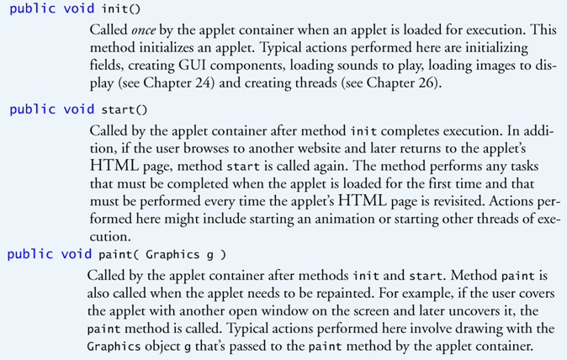

Slide 14
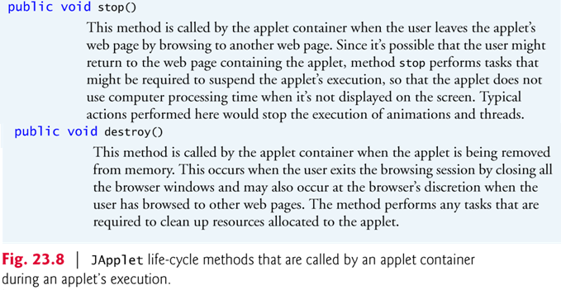

Slide 15
Sample Applets Provided with the JDK
Demonstration applets provided with the JDK.
Each sample applet comes with its source code.
The demo directory contains several subdirectories.
The applets directory contains demonstration applets.
The jfc (Java Foundation Classes) directory contains applets and applications that demonstrate Java’s powerful graphics and GUI capabilities.
Figure 23.1 provides a brief description of each demo applet.

Slide 16
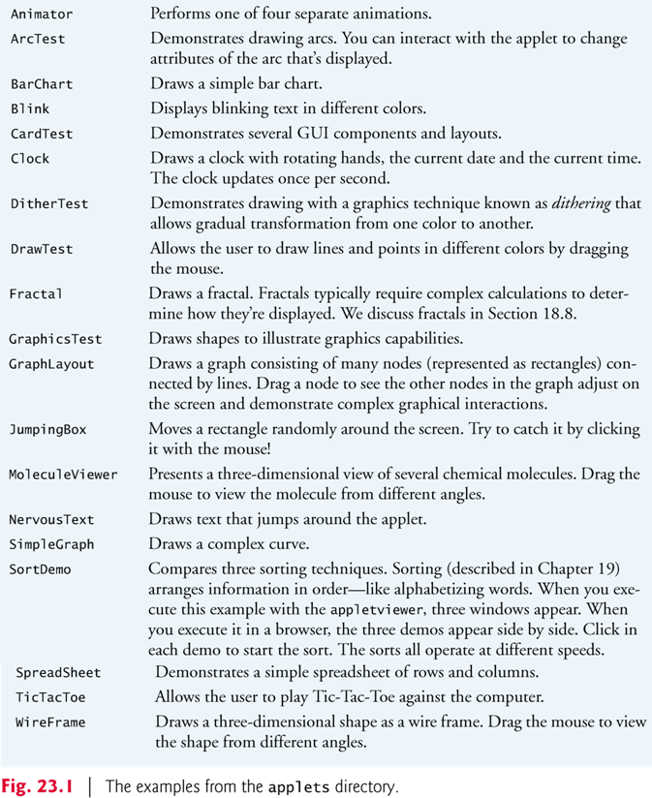

Slide 17
