Slide 1

Intro to Java
The Java Virtual Machine

Slide 2
What is the JVM
a software emulation of a hypothetical computing machine that runs Java bytecodes (Java compiler output)
ISV’s can license the JVM from Sun Microsystems

Slide 3
Licensing
To have a JVM licensed Sun must approve the implementation
Rigid test procedure with published suite of test code.
Core classes must not be modified
  this was the root of the Sun/Microsoft Lawsuit

Slide 4
JVM Versions
Separate versions for command line and browser environments
Many restrictions on browser version to ensure the Java security model and robustness of the JVM

Slide 5
Browser JVM Restrictions
Can only communicate with IP address from which the applet was served
No access to local file system
can only connect to IP address that applet was served from
no access to local devices
the current security model allows ways around these restrictions

Slide 6
Java Run-Time System
Just-in-time
Compiler
Byte
Code
Verifier
Class
Loader
Hardware
Java
Runtime
Interpreter

Slide 7
The Virtual Machine
Target Hardware - all CISC and RISC
Machine type - stack (similar to Forth VM)
A number of companies have promised a Java chip but haven’t delivered…yet

Slide 8
Instruction Set
“Big Endian” encoding - large order bits in the lower address
instructions are byte aligned for memory efficiency
currently 160 opcodes
instructions closely aligned to Java source

Slide 9
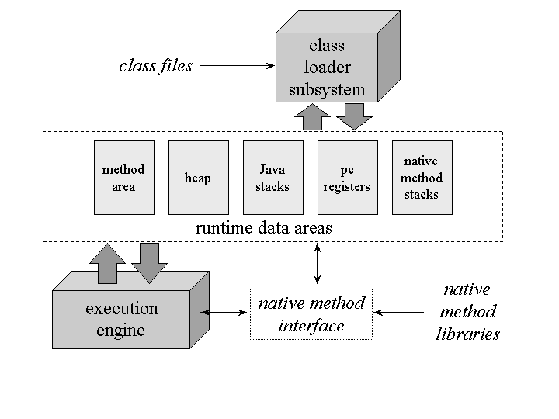
The Java Virtual Machine

Slide 10
Registers
pc - Program Counter
optop - Pointer to top of operand stack
frame - pointer to current execution environment
vars - pointer to the the first (0th) local variable in the current execution environment

Slide 11
The Java Stack
As threads are created each thread get a Java Stack and a pc
Creates a stack frame for each method of a class
  Local Variables
  Execution Environment
  Operand Stack

Slide 12
Local Variables
Array of 32 bit variables
  types longer than 32 bit (double) use consecutive cells
  pointed at by vars register
  loaded onto and stored from operand stack

Slide 13
Execution Environment
Info about the current state of the Java Stack
  previous method involked
  pointer to local variables
  pointers to top and bottom of operand stack

Slide 14
Operand Stack
32 bit FIFO
holds the arguments for the opcodes
a subsection of the Java Stack
  primary area for current status of bytecode execution

Slide 15
Garbage Collected Heap
Memory from which class instances are allocated
interpreter monitors memory usage and reclaims memory when no longer in use
garbage collection is automatic (unlike C/C++)

Slide 16
The Memory Area
Method Area - bytecodes for all Java Methods
Constant Pool - class names, method and field names, string constants

Slide 17
Virtual Machine Limitations
4 Gb internal addressing due to 32 bit wide stack implementation
Methods are limited to 32 Kb due to 16 bit offset addressing used for branching
256 local variables /stack (8 bit field)
32k constant pool entries per method

Slide 18
Available Platforms
Unix (many)
Windows/NT/95/95/2000/XP
OS/2
Linux
VM/CMS (1Q98)
MVS / S390 (1Q98)

