Slide 1
Java Virtual Machine (JVM)

Slide 2
Lecture Objectives
Learn about the Java Virtual Machine (JVM)
Understand the functionalities of the class loader subsystem
Learn about the linking process:
  Verification
  Preparation
  Resolution
Understand the class initialization process
Learn about the steps involved in the class instantiation

Slide 3
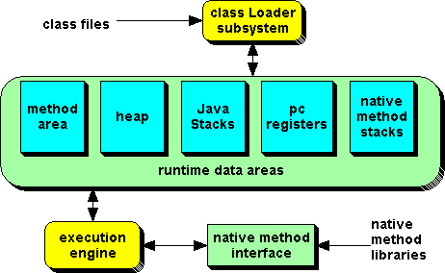
Introduction to the JVM
JVM is a component of the Java system that interprets and executes the instructions in our class files.
The following figure shows a block diagram of the JVM that includes its major subsystems and memory areas.
Figure 1: Memory configuration by the JVM.

Slide 4
Introduction to the JVM (Cont’d)
Each instance of the JVM has one method area, one heap, and one or more stacks - one for each thread
When JVM loads a class file, it puts its information in the method area
As the program runs, all objects instantiated are stored in the heap
The stack area is used to store activation records as a program runs

Slide 5
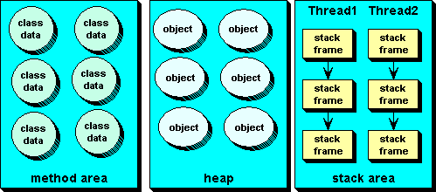
Introduction to the JVM (Cont’d)
Figure 2: Content of Memory Blocks at runtime.

Slide 6
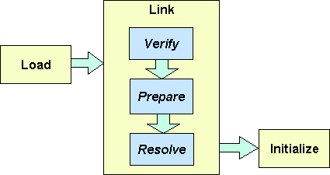
The Class Loader Subsystem
The class loader performs three main functions of JVM, namely: loading, linking and initialization
The linking process consists of three sub-tasks, namely, verification, preparation, and resolution
Figure 3: Class loading process.

Slide 7
Class Loading Process
Loading means reading the class file for a type, parsing it to get its information, and storing the information in the method area.
For each type it loads, the JVM must store the following information in the method area:
  The fully qualified name of the type
  The fully qualified name of the type's direct superclass or if the type is an interface, a list of its direct super interfaces .
  Whether the type is a class or an interface
  The type's modifiers ( public, abstract, final, etc)
  Constant pool for the type: constants and symbolic references.
  Field info : name, type and modifiers of variables (not constants)
  Method info: name, return type, number & types of parameters, modifiers, bytecodes, size of stack frame and exception table.

Slide 8
Class Loading Process (Cont’d)
The end of the loading process is the creation of an instance of java.lang.Class for the loaded type.
The purpose is to give access to some of the information captured in the method area for the type, to the programmer.
Some of the methods of the class java.lang.Class are:
Note that for any loaded type T, only one instance of java.lang.Class is created even if T is used several times in an application.
To use the above methods, we need to first call the getClass() method on any instance of T to get the reference to the Class instance for T.
public String getName()
public Class getSupClass()
public boolean isInterface()
public Class[] getInterfaces()
public Method[] getMethods()
public Fields[] getFields()
public Constructor[] getConstructors()

Slide 9
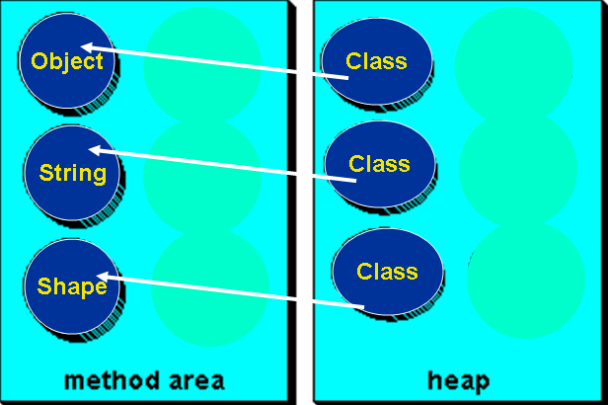
Class Loading Process (Cont’d)
Figure 4: Instances of Class objects created in the heap at runtime.

Slide 10
Class Loading Process (Cont’d)
import java.lang.reflect.Method; // Required!
//you must import your Circle class
public class TestClassClass{
public static void main(String[] args) {
String name = new String(“Ahmed”);
Class nameClassInfo = name.getClass();
System.out.println("Class name is : “ + nameClassInfo.getName());
System.out.println("Parent is : “ + nameClassInfo.getSuperclass());
Method[] methods = nameClassInfo.getMethods();
System.out.println("\nMethods are: ");
for(int i = 0; i < methods.length; i++)
System.out.println(methods[i]);
}
}

Slide 11
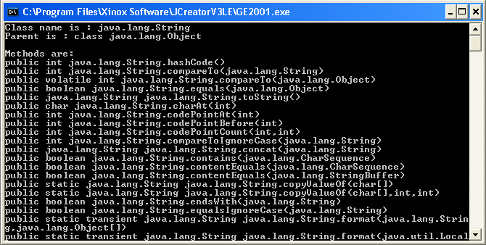
Class Loading Process (Cont’d)
public methods are displayed ONLY!

Slide 12
Class Loading Process (Cont’d)
What if we do not have an object of a class T and would like to know whether the class of type T is loaded in the method are? Then, the class Class provides us the following method for such purpose:
public static Class forName(String className) throws ClassNotFoundException
import java.lang.reflect.Method;
public class TestClassClass{
public static void main(String[] args) throws Exception {
Class test = Class.forName("TestClassClass");
System.out.println("\nClass name is: "+test.getName());
System.out.println("Superclass is: "+test.getSuperclass());
System.out.println("\nMethods are: ");
Method[] methods = test.getMethods();
for(int i = 0; i<methods.length; i++)
System.out.println(methods[i]);
}
}

Slide 13
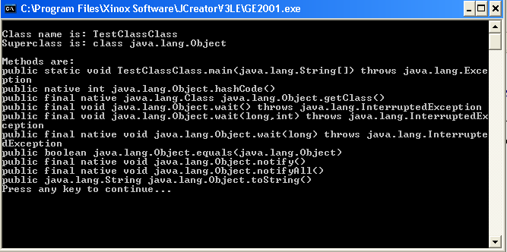
Class Loading Process (Cont’d)

Slide 14
Verification During Linking Process
The next process handled by the class loader is Linking. This involves three sub-processes: Verification, Preparation and Resolution
Verification is the process of ensuring that binary representation of a class is structurally correct
The JVM has to make sure that a file it is asked to load was generated by a valid compiler and it is well formed
Class B may be a valid sub-class of A at the time A and B were compiled, but class A may have been changed and re-compiled
Example of some of the things that are checked at verification are:
  Every method is provided with a structurally correct signature
  Every instruction obeys the type discipline of the Java language
  Every branch instruction branches to the start not middle of another instruction

Slide 15
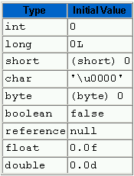
Preparation
In this phase, the JVM allocates memory for the class (i.e static) variables and sets them to default initial values.
Note that class variables are not initialized to their proper initial values until the initialization phase - no java code is executed until initialization.
The default values for the various types are shown below:

Slide 16
Resolution
Resolution is the process of replacing symbolic names for types, fields and methods used by a loaded type with their actual references.
Symbolic references are resolved into a direct references by searching through the method area to locate the referenced entity.
For the class below, at the loading phase, the class loader would have loaded the classes: TestClassClass, String, System and Object.
The names of these classes would have been stored in the constant pool for TestClassClass.
In this phase, the names are replaced with their actual references.
public class TestClassClass{
public static void main(String[] args){
String name = new String(“Ahmed”);
Class nameClassInfo = name.getClass();
System.out.println("Parent is: “ + nameClassInfo.getSuperclass());
}
}

Slide 17
Class Initialization
This is the process of setting class variables to their proper initial values - initial values desired by the programmer.
Initialization of a class consists of two steps:
  Initializing its direct superclass (if any and if not already initialized)
  Executing its own initialization statements
The above imply that, the first class that gets initialized is Object.
Note that static final variables are not treated as class variables but as constants and are assigned their values at compilation.
class Example1 {
static double rate = 3.5;
static int size = 3*(int)(Math.random()*5);
...
}
class Example2 {
static final int angle = 35;
static final int length = angle * 2;
...
}

Slide 18
Class Initialization (Cont’d)
After a class is loaded, linked, and initialized, it is ready for use. Its static fields and static methods can be used and it can be instantiated.
When a new class instance is created, memory is allocated for all its instance variables in the heap.
Memory is also allocated recursively for all the instance variables declared in its super class and all classes up is inheritance hierarchy.
All instance variables in the new object and those of its superclasses are then initialized to their default values.
The constructor invoked in the instantiation is then processed according to the rules shown on the next page.
Finally, the reference to the newly created object is returned as the result.

Slide 19
Class Instantiation
Rules for processing a constructor:
Assign the arguments for the constructor to its parameter variables.
If this constructor begins with an explicit invocation of another constructor in the same class (using this), then evaluate the arguments and process that constructor invocation recursively.
If this constructor is for a class other than Object, then it will begin with an explicit or implicit invocation of a superclass constructor (using super). Evaluate the arguments and process that superclass constructor invocation recursively.
Initialize the instance variables for this class with their proper values.
Execute the rest of the body of this constructor.

Slide 20


Class Instantiation: Example 1
class GrandFather {
int grandy = 70;
public GrandFather(int grandy) {
this.grandy = grandy;
System.out.println("Grandy: "+grandy);
}
}
class Father extends GrandFather {
int father = 40;
public Father(int grandy, int father) {
super(grandy);
this.father = father;
System.out.println("Grandy: "+grandy+" Father: "+father);
}
}
class Son extends Father {
int son = 10;
public Son(int grandy, int father, int son) {
super(grandy, father);
this.son = son;
System.out.println("Grandy: "+grandy+" Father: "+father+" Son: "+son);
}
}
public class Instantiation {
public static void main(String[] args) {
Son s = new Son(65, 35, 5);
}
}

Slide 21
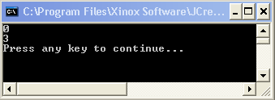
Class Instantiation: Example 2
class Super {
Super() {
printThree();
}
void printThree() {
System.out.println("three");
}
}
class Test extends Super {
int three = (int)Math.PI; // That is, 3
public static void main(String[] args) {
Test t = new Test();
t.printThree();
}
void printThree() {
System.out.println(three);
}
}

Slide 22
Drill Exercises
Write a program to show that each loaded type has only one instance of java.lang.Class associated with it, irrespective of how many times it is used in a class.
Write a program to show that Loading may be caused either by creating an instance of a class or by accessing a static member.
Write a class to show that class variables are initialized with their default values when loaded. Also show that instance variables are initialized with their default values when an object is created.
Demonstrate that Verification actually takes place in the Loading process. To do this, write a class, Base, and a class, SubClass, that extends Base. Compile both classes. Then modify Base by changing the signature of one of its methods and compile it alone. Now write a test program that uses Subclass and try to compile and run it.

