Slide 2
Java Performance Tuning
Monitoring Java Applications
Tuning GC & Heap

Slide 3
#1 Module Coverage
In this module we will cover the following:
Garbage Collection & Threads in JVM
What is method profiling & why it is important
Object Creation Profiling & Why it is important ?
Gross memory monitoring
Monitoring JVM

Slide 4
#2 Module Coverage
About thread profiling
Client Server Communications
We will summarize on - “All in all - What to monitor”
Monitoring JVM

Slide 5
Why discuss GC & Threads ?
There is no point discussing monitoring and tuning without understanding fundamentals of GC & Threads.
We will discuss in general how GC works.
We will also discuss in general how Threads behave in JVM.
In order to uderstand GC we also need to understand the memory structure first. Hence we will start with understanding the memory model of Java.
GC in JVM
Monitoring Java Applications
Notes:
There is no point in proceeding further and trying to understand anything on performance front till the time we do not understand what is GC and how it works fundamentally.
Here we will discuss everything that we need to, with regards to GC. What is GC, how it happens, when it happens and why is it important for performance tuning. We will also discuss “root objects” with respect to GC. Here we will not discuss how to tune GC as this is covered in another session.
We will also discuss how Threads (once put in service) work, its execution, the different states of Thread, Object Monitor etc. This is extremely important to understand the Thread Dumps.

Slide 6
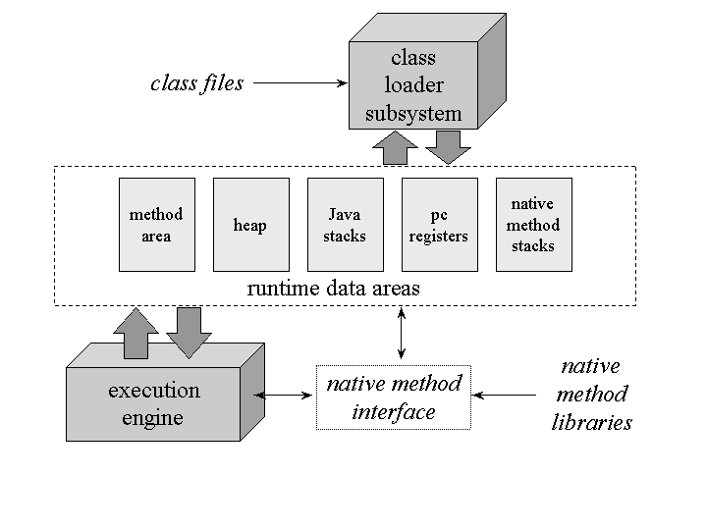
#1 Memory Structure
Classloader is the subsystem that loads classes.
Heap is where the object allocation is done
Non Heap area typically comprises of Method Area, Code Cache and Permanent Generation.
PC are program counters that tracks the control of execution in stack
Execution is the JVM that provides services to Java Application
GC in JVM
Monitoring Java Applications

Slide 7
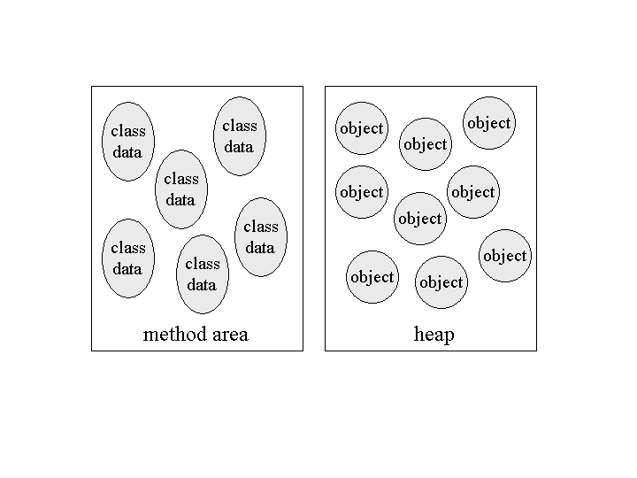
#2 Method Area & Heap
Classloader loads the class
Creates an object of class Class and stores the bytecode information in fields, methods etc. All this meta data is stored in perm gen.
Static variables comes into existence while loading the class.
If reference variable then object is in heap and reference is in perm gen
Objects of class Class is created in perm gen.
GC in JVM
Monitoring Java Applications

Slide 8
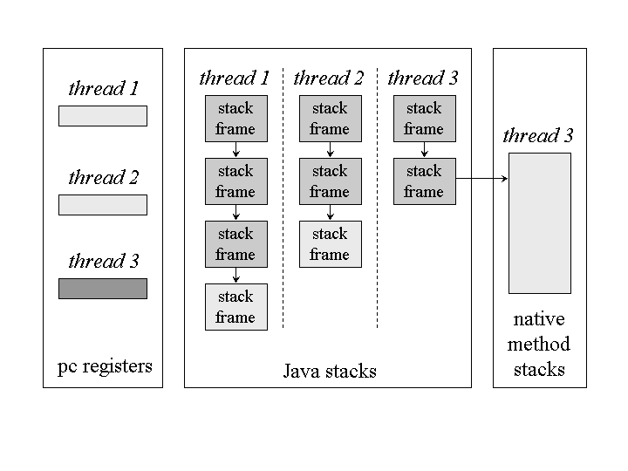
#3 Runtime Data Areas exclusive to each thread
Each thread is allocated 1 stack object.
Each method is allocated a frame.
Program Counter tracks the flow of execution in thread
Native threads are not within Java Stack
GC in JVM
Monitoring Java Applications

Slide 9
#4 What is GC & When it happens
Heap stores all the application objects.
Program never frees memory
GC frees memory.
The way to think about GC in Java is that it’s a “lazy bachelor” that hates taking out the trash and typically postpones the process for some period of time. However, if the trash can begins to overflow, java immediately takes it out In other words - if memory becomes scarce, java immediately runs GC to free memory
GC in JVM
Monitoring Java Applications
Notes:
Why Garbage Collection ?
The name "garbage collection" implies that objects no longer needed by the program are "garbage" and can be thrown away. A more accurate and up-to-date metaphor might be "memory recycling." When an object is no longer referenced by the program, the heap space it occupies can be recycled so that the space is made available for subsequent new objects. The garbage collector must somehow determine which objects are no longer referenced by the program and make available the heap space occupied by such unreferenced objects. In the process of freeing unreferenced objects, the garbage collector must run any finalizers of objects being freed.
In addition to freeing unreferenced objects, a garbage collector may also combat heap fragmentation. Heap fragmentation occurs through the course of normal program execution. New objects are allocated, and unreferenced objects are freed such that free portions of heap memory are left in between portions occupied by live objects. Requests to allocate new objects may have to be filled by extending the size of the heap even though there is enough total unused space in the existing heap. This will happen if there is not enough contiguous free heap space available into which the new object will fit. On a virtual memory system, the extra paging (or swapping) required to service an ever growing heap can degrade the performance of the executing program. On an embedded system with low memory, fragmentation could cause the virtual machine to "run out of memory" unnecessarily.
Garbage collection relieves you from the burden of freeing allocated memory. Knowing when to explicitly free allocated memory can be very tricky. Giving this job to the Java virtual machine has several advantages. First, it can make you more productive. When programming in non-garbage-collected languages you can spend many late hours (or days or weeks) chasing down an elusive memory problem. When programming in Java you can use that time more advantageously by getting ahead of schedule or simply going home to have a life.
A second advantage of garbage collection is that it helps ensure program integrity. Garbage collection is an important part of Java's security strategy. Java programmers are unable to accidentally (or purposely) crash the Java virtual machine by incorrectly freeing memory.
A potential disadvantage of a garbage-collected heap is that it adds an overhead that can affect program performance. The Java virtual machine has to keep track of which objects are being referenced by the executing program, and finalize and free unreferenced objects on the fly. This activity will likely require more CPU time than would have been required if the program explicitly freed unnecessary memory. In addition, programmers in a garbage-collected environment have less control over the scheduling of CPU time devoted to freeing objects that are no longer needed.
When does GC happen ?
Garbage Collection occurs when you execute System.gc() (A hint to the JVM that it is the right time to run GC) - this is known as explicit synchronous call to GC. GC mostly occurs asynchronously when free memory available to VM gets low. -noasyncgc option was available prior to java 1.2 to force JVM to not execute asynchronous GC (it still used to execute when VM ran out of memory as opposed to when it got low on memory)
On the other side - There is no guarantee as to when or if the JVM will invoke the garbage collector -- even if a program explicitly calls System.gc(). Typically, the garbage collector won't be automatically run until a program needs more memory than is currently available. At this point, the JVM will first attempt to make more memory available by invoking the garbage collector. If this attempt still doesn't free enough resources, then the JVM will obtain more memory from the operating system until it finally reaches the maximum allowed.

Slide 10
#10 Why is GC Monitoring important !
More time in GC means more pauses of application threads
More number of objects, higher is the memory foot print and thereby more work for GC
Large heap - more time for GC
Small heap - less time but frequent
Memory leaks (loitering objects) can make GC kick very often
GC in JVM
Monitoring Java Applications

Slide 11
#11 Why is GC Monitoring Important !
GC compute intensive - CPU overhead. More the time taken by GC, slower will be your application.
Throughput : Total time spent in not doing GC.
Pause Time: The time for which the app threads stopped while collecting.
Footprint: Working size of JVM measured in terms of pages and cache lines (See glossary in notes)
Promptness: time between objects death and its collection.
GC in JVM
Monitoring Java Applications
Notes:
When evaluating a garbage collection algorithm, we might consider any or all of the following criteria:
Pause time. Does the collector stop the world to perform collection? For how long? Can pauses be bounded in time?
Pause predictability. Can garbage collection pauses be scheduled at times that are convenient for the user program, rather than for the garbage collector?
CPU usage. What percentage of the total available CPU time is spent in garbage collection?
Memory footprint. Many garbage collection algorithms require dividing the heap into separate memory spaces, some of which may be inaccessible to the user program at certain times. This means that the actual size of the heap may be several times bigger than the maximum heap residency of the user program.
Virtual memory interaction. On systems with limited physical memory, a full garbage collection may fault nonresident pages into memory to examine them during the collection process. Because the cost of a page fault is high, it is desirable that a garbage collector properly manage locality of reference.
Cache interaction. Even on systems where the entire heap can fit into main memory, which is true of virtually all Java applications, garbage collection will often have the effect of flushing data used by the user program out of the cache, imposing a performance cost on the user program.
Effects on program locality. While some believe that the job of the garbage collector is simply to reclaim unreachable memory, others believe that the garbage collector should also attempt to improve the reference locality of the user program. Compacting and copying collectors relocate objects during collection, which has the potential to improve locality.
Compiler and runtime impact. Some garbage collection algorithms require significant cooperation from the compiler or runtime environment, such as updating reference counts whenever a pointer assignment is performed. This creates both work for the compiler, which must generate these bookkeeping instructions, and overhead for the runtime environment, which must execute these additional instructions. What is the performance impact of these requirements? Does it interfere with compile-time optimizations?
Very important
Users have different requirements of garbage collection. For example, some consider the right metric for a web server to be throughput, since pauses during garbage collection may be tolerable, or simply obscured by network latencies. However, in an interactive graphics program even short pauses may negatively affect the user experience.
Glossary
Cache Line: Data is transferred between memory and cache in blocks of fixed size, called cache lines.
Virtual Memory Page: Nearly all implementations of virtual memory divide a virtual address space into pages, blocks of contiguous virtual memory addresses. Pages are usually at least 4 kilobytes in size; systems with large virtual address ranges or amounts of real memory generally use larger page sizes.

Slide 12
#5 Types of Collectors - Reference Counting
Reference Counting: Each object has a reference count.
Collector collects the object with 0 references.
Simple but requires significant assistance from compiler - the moment the reference is modified compiler must generate code to change the count
Unable to collect objects with cyclic references - like doubly linked list or tree where child maintains reference to parent node.
Java does not use Reference Counting. STW collector.
GC in JVM
Monitoring Java Applications

Slide 13
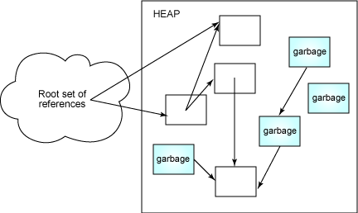
#6 Types of Collectors - Tracing Collectors
Collector takes snapshot of root objects - objects that are being referred from stack (local variables) and perm gen (static variables)
Starts tracing objects reachable from root objects and marks them as reachable.
Balance is garbage
All collectors in Java are of type tracing collector.
Stop the world collector.
GC in JVM
Monitoring Java Applications
Notes:
None of the standard garbage collectors in the JDK uses reference counting; instead, they all use some form of tracing collector. A tracing collector stops the world (although not necessarily for the entire duration of the collection) and starts tracing objects, starting at the root set and following references until all reachable objects have been examined. Roots can be found in program registers, in local (stack-based) variables in each thread's stack, and in static variables.

Slide 14
#7 Types of Collectors - Mark-Sweep
This is the basic tracing collector.
Marking: Object has mark bit in block header; clears mark of all objects and then marks that are reachable.
Sweep: Collector runs through all the allocated objects to get the mark value. Collects all objects that are not marked.
There are two challenges with this collector:
Collectors has to walk through all allocated objects in sweep phase.
Leaves heap fragmented
GC in JVM
Monitoring Java Applications
Notes:
Mark-sweep is simple to implement, can reclaim cyclic structures easily, and doesn't place any burden on the compiler or mutator like reference counting does. But it has deficiencies -- collection pauses can be long, and the entire heap is visited in the sweep phase, which can have very negative performance consequences on virtual memory systems where the heap may be paged.
The big problem with mark-sweep is that every active (that is, allocated) object, whether reachable or not, is visited during the sweep phase. Because a significant percentage of objects are likely to be garbage, this means that the collector is spending considerable effort examining and handling garbage. Mark-sweep collectors also tend to leave the heap fragmented, which can cause locality issues and can also cause allocation failures even when sufficient free memory appears to be available.

Slide 15
#8 Types of Collectors - Copying Collector
Overcomes challenges of Mark-Sweep. (This collection is aka - Scavenge)
Creates two spaces - active and inactive
Moves surviving objects from active to inactive space.
Roles of spaces is flipped.
Advantages - a) Does not have to visit garbage objects to know its marker. b) Solves the reference locality issue.
Disadvantages - a) Overhead of copying objects b) adjusting references to point to new location
Interesting downside: When standing on its own , it needs memory 2wice as the heap to be reliable; because when the collector starts, it does not know how much will be the live objects in from space.
GC in JVM
Monitoring Java Applications
Notes:
In a copying collector, another form of tracing collector, the heap is divided into two equally sized semi-spaces, one of which contains active data and the other is unused. When the active space fills up, the world is stopped and live objects are copied from the active space into the inactive space. The roles of the spaces are then flipped, with the old inactive space becoming the new active space.
Copying collection has the advantage of only visiting live objects, which means garbage objects will not be examined, nor will they need to be paged into memory or brought into the cache. The duration of collection cycles in a copying collector is driven by the number of live objects. However, copying collectors have the added cost of copying the data from one space to another, adjusting all references to point to the new copy. In particular, long-lived objects will be copied back and forth on every collection.

Slide 16
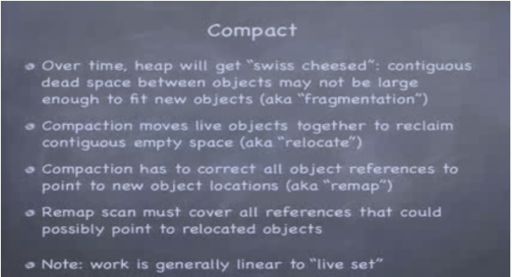
#9 Types of Collectors - Mark-Compact
Overcomes challenges of Copy (Twice size is not needed) & Mark-Compact (no fragmentation)
Marking - Same as Mark-Sweep i.e. Visits each live objects and marks as reachable.
Compaction - Marked objects are copied such that all live objects are copied to the bottom of the heap.
Clear demarcation between active portion of heap and free area.
Long lived objects tend to accumulate at the bottom of the heap so that they are not copied again as they are in copying collector.
CMS (Concurrent Mark Sweep ) garbage collection does not do compaction. ParallelOld garbage collection performs only whole-heap compaction, which results in considerable pause times.
GC in JVM
Monitoring Java Applications
Notes:
Note: There is something called incremental collector as well that divides the monolithic gc work into smaller discrete operations with potentially long gaps in between. It is associated with STW such that it slices up STW collected into smaller pieces.
Copying collectors have another benefit, which is that the set of live objects are compacted into the bottom of the heap. This not only improves locality of reference of the user program and eliminates heap fragmentation, but also greatly reduces the cost of object allocation -- object allocation becomes a simple pointer addition on the top-of-heap pointer. There is no need to maintain free lists or look-aside lists, or perform best-fit or first-fit algorithms -- allocating N bytes is as simple as adding N to the top-of-heap pointer and returning its previous value, as suggested in Listing 1:
Listing 1. Inexpensive memory allocation in a copying collector
void *malloc(int n) {
if (heapTop - heapStart < n)
doGarbageCollection();
void *wasStart = heapStart;
heapStart += n;
return wasStart;
}
Developers who have implemented sophisticated memory management schemes for non-garbage-collected languages may be surprised at how inexpensive allocation is -- a simple pointer addition -- in a copying collector. This may be one of the reasons for the pervasive belief that object allocation is expensive -- earlier JVM implementations did not use copying collectors, and developers are still implicitly assuming allocation cost is similar to other languages, like C, when in fact it may be significantly cheaper in the Java runtime. Not only is the cost of allocation smaller, but for objects that become garbage before the next collection cycle, the deallocation cost is zero, as the garbage object will be neither visited nor copied.

Slide 17
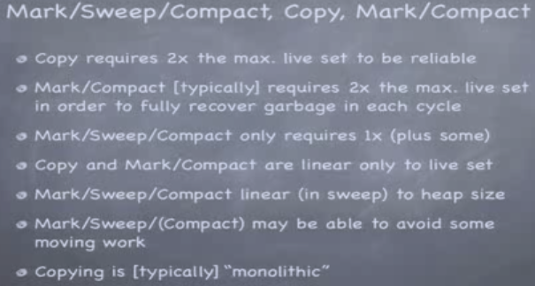
#10 Copy Vs Mark Sweep Compact
2x refers to “Twice the memory”
GC in JVM
Monitoring Java Applications
Notes:
Note: There is something called incremental collector as well that divides the monolithic gc work into smaller discrete operations with potentially long gaps in between. It is associated with STW such that it slices up STW collected into smaller pieces.
Copying collectors have another benefit, which is that the set of live objects are compacted into the bottom of the heap. This not only improves locality of reference of the user program and eliminates heap fragmentation, but also greatly reduces the cost of object allocation -- object allocation becomes a simple pointer addition on the top-of-heap pointer. There is no need to maintain free lists or look-aside lists, or perform best-fit or first-fit algorithms -- allocating N bytes is as simple as adding N to the top-of-heap pointer and returning its previous value, as suggested in Listing 1:
Listing 1. Inexpensive memory allocation in a copying collector
void *malloc(int n) {
if (heapTop - heapStart < n)
doGarbageCollection();
void *wasStart = heapStart;
heapStart += n;
return wasStart;
}
Developers who have implemented sophisticated memory management schemes for non-garbage-collected languages may be surprised at how inexpensive allocation is -- a simple pointer addition -- in a copying collector. This may be one of the reasons for the pervasive belief that object allocation is expensive -- earlier JVM implementations did not use copying collectors, and developers are still implicitly assuming allocation cost is similar to other languages, like C, when in fact it may be significantly cheaper in the Java runtime. Not only is the cost of allocation smaller, but for objects that become garbage before the next collection cycle, the deallocation cost is zero, as the garbage object will be neither visited nor copied.

Slide 18


#11 Very important
GC in JVM
Monitoring Java Applications
Notes:
Note: There is something called incremental collector as well that divides the monolithic gc work into smaller discrete operations with potentially long gaps in between. It is associated with STW such that it slices up STW collected into smaller pieces.
Copying collectors have another benefit, which is that the set of live objects are compacted into the bottom of the heap. This not only improves locality of reference of the user program and eliminates heap fragmentation, but also greatly reduces the cost of object allocation -- object allocation becomes a simple pointer addition on the top-of-heap pointer. There is no need to maintain free lists or look-aside lists, or perform best-fit or first-fit algorithms -- allocating N bytes is as simple as adding N to the top-of-heap pointer and returning its previous value, as suggested in Listing 1:
Listing 1. Inexpensive memory allocation in a copying collector
void *malloc(int n) {
if (heapTop - heapStart < n)
doGarbageCollection();
void *wasStart = heapStart;
heapStart += n;
return wasStart;
}
Developers who have implemented sophisticated memory management schemes for non-garbage-collected languages may be surprised at how inexpensive allocation is -- a simple pointer addition -- in a copying collector. This may be one of the reasons for the pervasive belief that object allocation is expensive -- earlier JVM implementations did not use copying collectors, and developers are still implicitly assuming allocation cost is similar to other languages, like C, when in fact it may be significantly cheaper in the Java runtime. Not only is the cost of allocation smaller, but for objects that become garbage before the next collection cycle, the deallocation cost is zero, as the garbage object will be neither visited nor copied.

Slide 19
#1 Threads - Understanding is Important
Threads for better performance; however more the number of threads - more are the challenges
Threads when not sharing data - challenges are less
Challenges with threads - race condition, deadlock, starvation, livelock
Deadlocked threads are dreaded - can eat up CPU time
For monitoring threads, understanding thread states is important
Thread in JVM
Monitoring Java Applications

Slide 20
#2 Thread States
New - Created but not yet started.
Runnable - Executing but may be waiting for OS resources like CPU time.
Blocked - Waiting for the monitor lock to enter syncrhonized block or after being recalled from the wait-set on encountering notify.
Waiting - As a result of Object.wait(), Thread.join(), LockSupport.park().
Thread in JVM
Monitoring Java Applications

Slide 21
#3 Thread States
Timed Waiting : As a result of Thread.sleep(), Thread.wait(timeout), Thread.join(timeout)
Terminated : Execution Completed
Thread in JVM
Monitoring Java Applications

Slide 22
#4 Race Condition
Two concurrent threads changing the state of same object
While one thread has not finished writing to memory location, the other thread reads from it.
Synchronization- is the solution.
We all know what is synchronization. Really ? Read on....
Thread in JVM
Monitoring Java Applications
Notes:
Synchronization
When a thread exists a synchronized block, it performs a write barrier - it must flush out any variables modified in the block to main memory before releasing the lock. Similarly when entering the synchronized block it performs a read barrier - it is like invalidating the local memory and fetching any variables that are referenced in the block from main memory.
Atomicity is guaranteed with synchronization
Source of following : Wikipedia - http://en.wikipedia.org/wiki/Race_condition
Software flaws in life-critical systems can be disastrous. Race conditions were among the flaws in the Therac-25 radiation therapy machine, which led to the death of at least three patients and injuries to several more.[2] Another example is the Energy Management System provided by GE Energy and used by Ohio-based FirstEnergy Corp. (among other power facilities). A race condition existed in the alarm subsystem; when three sagging power lines were tripped simultaneously, the condition prevented alerts from being raised to the monitoring technicians, delaying their awareness of the problem. This software flaw eventually led to the North American Blackout of 2003.[3] GE Energy later developed a software patch to correct the previously undiscovered error.

Slide 23
#5 Synchronization Semantics
The semantics of includes
Mutual exclusion of execution based on state of semaphore
Rules about synchronizing threads interaction with main memory. In particular, the acquisition and release of lock triggers memory barrier -- a forced syncrhonization between the threads local memory and main memory.
The last point is the one which is very often not known by developers.
Thread in JVM
Monitoring Java Applications
Notes:
Synchronization
When a thread exits a synchronized block, it performs a write barrier - it must flush out any variables modified in the block to main memory before releasing the lock. Similarly when entering the synchronized block it performs a read barrier - it is like invalidating the local memory and fetching any variables that are referenced in the block from main memory.
Atomicity is guaranteed with synchronization
Source of following : Wikipedia - http://en.wikipedia.org/wiki/Race_condition
Software flaws in life-critical systems can be disastrous. Race conditions were among the flaws in the Therac-25 radiation therapy machine, which led to the death of at least three patients and injuries to several more.[2] Another example is the Energy Management System provided by GE Energy and used by Ohio-based FirstEnergy Corp. (among other power facilities). A race condition existed in the alarm subsystem; when three sagging power lines were tripped simultaneously, the condition prevented alerts from being raised to the monitoring technicians, delaying their awareness of the problem. This software flaw eventually led to the North American Blackout of 2003.[3] GE Energy later developed a software patch to correct the previously undiscovered error.

Slide 24
#6 DeadLock - Can Hurt Performance Badly
Deadlock occurs when two or more threads are blocked for ever, waiting for each other.
Object o1 and o2. Thread t1 and t2 starts together.
Thread t1 starts and locks o1 and then without releasing lock on o1, after 100ms tries to lock o2.
Thread t2 starts and locks o2 and then without releasing the lock, tries to lock o1
There is a sure deadlock - t1 is occupying o1 monitor hence t2 will not get access to o1 and t2 has occupied monitor of o2 and hence t1 will not get access to o2
Thread in JVM
Monitoring Java Applications
Notes:
public static void main(String[] args) throws InterruptedException {
final Object o1 = new Object();
final Object o2 = new Object();
Thread t1 = new Thread() {
public void run() {
synchronized (o1) {
{
setName("t1");
}
System.out
.println("Thread t1 has obtained the monitor of o1");
System.out
.println("Some work is being done by t1 on o1 while occupying the monitor of o1......");
try {
Thread.sleep(100);
} catch (InterruptedException e) {
// TODO Auto-generated catch block
e.printStackTrace();
}
synchronized (o2) {
System.out
.println("Thread t1 has now taken the monitor of o2");
System.out
.println("Some work is being done by t1 on o2 while occupying the monitor of o2");
}
}
}
};
Thread t2 = new Thread() {
{
setName("t2");
}
public void run() {
synchronized (o2) {
System.out
.println("Thread t2 has obtained the monitor of o2");
System.out
.println("Some work is being done by t2 while occupying the monitor of o2");
synchronized (o1) {
System.out
.println("Thread t2 has now taken the monitor of o1");
System.out
.println("Some work is being done by t2 on o1 while occupying the monitor of o1");
}
}
}
};
t1.start();
t2.start();
}

Slide 25
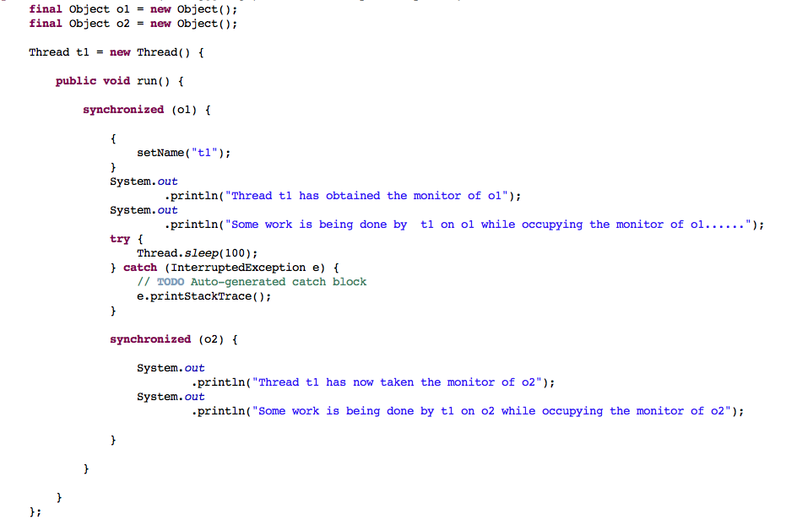
#7 DeadLock - Can Bring JVM to Knees
Thread in JVM
Monitoring Java Applications

Slide 26
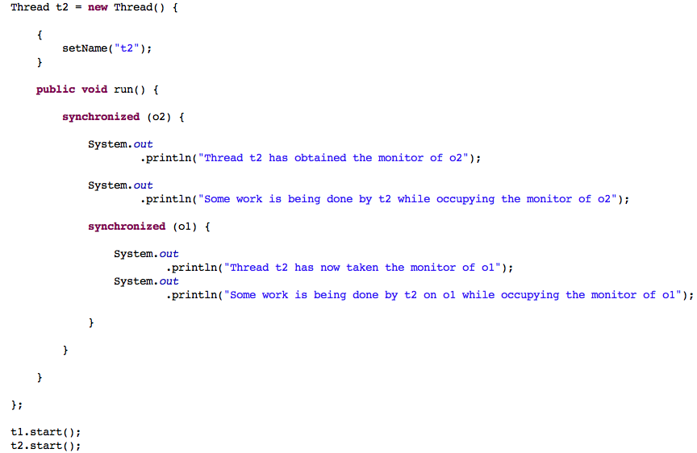
#8 DeadLock - Can Bring JVM to Knees
Thread in JVM
Monitoring Java Applications

Slide 27
#9 Starvation & LiveLock
A less common situation as compared to DeadLock; Starvation happens when one thread is deprived of the resource (a shared object for instance) because other thread has occupied it for a very long time and not releasing it.
LiveLock - Again less common situation where - Two threads are responding to each other’s action and unable to proceed.
Thread in JVM
Monitoring Java Applications
Notes:
A less common situation as compared to DeadLock. Starvation happens when one thread is deprived of the resource (a shared object for instance) because other thread has occupied it for a very long time and not releasing it.
LiveLock: Again a less common a situation where - Two threads are responding to each other’s action and unable to proceed.

Slide 28
#1 Monitoring Methods
What if your application is running slow at one point of execution
You can pin point exactly the execution path where the performance is bad.
There is probably a method that is taking time more than expected
You need to profile the application to trace method calls.
Visual VM is a good tool - Lets use it
Method Profiling
Monitoring Java Applications
Notes:
In this unit we will discuss how to profile the java application in order to get hot spots (the methods taking more time). We will learn the techniques of identifying such hotspots using Visual VM as the tool. We will write our own code and run Visual VM method profiler as an agent over it to do the profiling.

Slide 29
#2 Tracing Methods using Visual VM
Get the test program from here: http://www.mslearningandconsulting.com/documents/28301/83860/MethodCallProfileTest.java.
Study the program, run it and start visual VM
Select the process
Go to Profiler
Select settings and remove all the package names from “Do not profile classes” and save the settings
Run CPU Profiler
Go back to application console and hit “enter” twice to start runThreads method
Let the profiling complete and save the snapshot
Method Profiling
Monitoring Java Applications
Notes:
If visualvm has problems try doing the following:
Kill all java processes
On command prompt echo %TMP%
What ever the tmp folder is, go to that folder and search for hsperf....
Rename the folder to match the hsperf_<username> - User name is case sensitive

Slide 30
#3 Observations of Method Profile
Select the Hot Spots from the tabs below the Snapshot.
Note which method and from which thread is taking maximum time.
You will notice that FloatingDecimal.dtoa method is taking max time.
Select Combined option from the tab. Now double click on FloatingDecimal.dtoa and see the trace to FloatingDecimal.dtoa
Method Profiling
Monitoring Java Applications
Notes:
An inferred call from the StringBuffer to append a double, which calls String.valueOf(), which calles Double.toString(), which in turn creates a FloatingDecimal object <init> is standard way to write a constructor call; <clinit> is standard way to show a class initializer being executed. FloatingDecimal is a class that handles most of the logic involved in converting floating-point numbers.
Note: The classes mentioned above describing the method call trace may be different with different vendor of JVM (Java for Mac, Sun Java, IBM Java, jrockit from BEA all may have different stack trace. However, almost all of them will show FloatDecimal as a class taking max time

Slide 31
#1 Objects Churned in memory
More the number of objects in memory, more work for GC.
Object creation itself is compute intensive job.
Leaking (loitering) object can be all the more dangerous and can lead to OOME.
Memory Profiling can help find the objects which are taking max space. We can also get number of instances of given class.
We will use Visual VM for the purpose
Profiling Obj Creation
Monitoring Java Applications
Notes:
Method profiling is not enough. We need to probe into the number of objects that are being churned into memory. We also need to find objects that are leaking (loitering actually) and are long lived
Does java leak memory ? No and Yes. No because GC ensures that there are no objects left that are un-referenced. Yes because the application design may have a flaw which can leave (unintentionally) a reference to an object which will prevent it to be collected - Loitering Object is what it is appropriately known as.
Memory leakages, especially ClassLoader Leaks can create havoc and can bring your JVM down. We will learn how to find such Memory Leaks and causes behind such leaks. We will use appropriate tools in order to do the Object Profiling.

Slide 32
#2 Visual VM Memory Profiler
Download the code from here: http://www.mslearningandconsulting.com/documents/28301/83860/Object+Creation+Profiling.zip
Run the code and select the Java Process in Visual VM.
Now hit the enterkey on console.
Go to sampler option and select memory (if not present then VM >> Tools >> Plugins >> Install Sampler)
Monitor the amount of memory taken by LargeObject.
Also the byte array object - this will take max memory
Profiling Obj Creation
Monitoring Java Applications

Slide 33
#3 Can Java Application Leak Memory ?
What is memory leak ? The object is created in heap and there is a reference to it; at some point in time, the application looses access to the reference variable (you would call it a pointer in C ) before reclaiming memory that was allocated for the object.
Is memory leak possible in Java ? No & Yes
No - There is no way that the object has lost reference and GC does not collect it.
Yes - There can be an object which has a strong reference to it but the design of the application is such that application will never use the reference - such are loitering objects
Profiling Obj Creation
Monitoring Java Applications

Slide 34
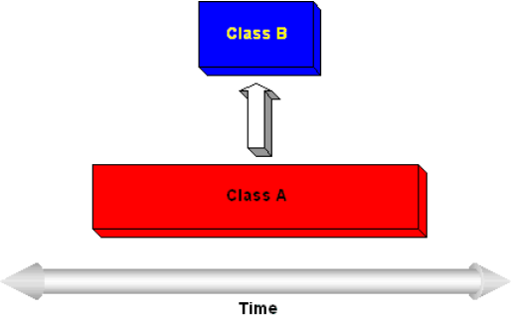
#4 Possible Leaking Objects in Java
Consider that ClassA is instantiated and has a life equal to life of JVM. Now if ClassA refers to an instance of ClassB and if ClassB is an instance of UI widget, it is quite likely that the UI is eventually dismissed by the user. In such a case that instance will always be held in memory as it is being referred by instance of ClassA. Instance of ClassA will be considered as loitering.
You cannot find loitering objects by simple looking at memory utilization in Activity Monitor or Task Manager
You need better tools. For e.g. Jprobe, Yourkit etc.
Profiling Obj Creation
Monitoring Java Applications

Slide 35
#6 General Tips to Avoid Memory Leaks
Collection classes, such as hashtables and vectors are common places to find the cause of memory leak.
Use static variables thoughtfully. Especially final static.
If registering an instance of ActionListener Class, do not forget to unregister once the event is invoked (some programming platforms like ActionScript supports registration by WeakReference.
Profiling Obj Creation
Monitoring Java Applications
Notes:
You can prevent memory leaks by watching for some common problems. Collection classes, such as hashtables and vectors, are common places to find the cause of a memory leak. This is particularly true if the class has been declared static and exists for the life of the application.
Another common problem occurs when you register a class as an event listener without bothering to unregister when the class is no longer needed. Also, many times member variables of a class that point to other classes simply need to be set to null at the appropriate time.

Slide 36
#7 General Tips.... (Contd.)
Avoid static references esp. final fields.
Avoid calling str.intern() on lengthy Strings as this would put the the string object referred to by str in StringPool.
Avoid storing large objects in ServletContext in web applications.
Unclosed open streams can cause problems.
Unclosed database connections can cause problems.
Profiling Obj Creation
Monitoring Java Applications
Notes:
Even if the JDBC driver were to implement finalize, it is possible for exceptions to be thrown during finalization. The resulting behavior is that any memory associated with the now "dormant" object will not be reclaimed, as finalize is guaranteed to be invoked only once. (Though usually you may reach max connections before you hit memory limits)

Slide 37
#8 ClassLoader Leak
Tomcat server crashes after several redeployments
The ClassLoader object does not get unloaded thereby maintaining references to all the metadata. OOME - PermGen Space error.
Each ClassLoader objects maintains cache of all the classes it loads.
Object of each class maintains the reference to its class object
Profiling Obj Creation
Monitoring Java Applications

Slide 38
#8 ClassLoader Leak (contd.)
Consider this :
A long running Thread
Loads a class with custom ClassLoader
The object is created of loaded class and a reference of that object is stored in ThreadLocal (say through constructor of loaded class)
Now even if you clear the newly created object, class reference object and the loader, the loader will remain along with all the classes it loaded
Profiling Obj Creation
Monitoring Java Applications

Slide 39
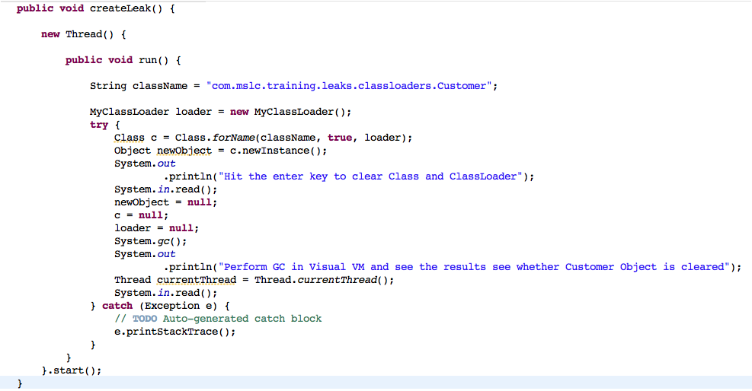
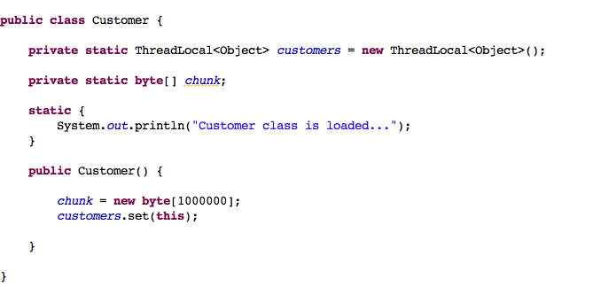
#9 ClassLoader Leak Code
New Thread
Custom ClassLoader
Instance in ThreadLocal
Profiling Obj Creation
Monitoring Java Applications
Notes:
Source code at : /Users/MuhammedShakir/working/CourseCaseStudies/allJavaTechnologies/performanceProject/com/mslc/training/leaks/classloaders

Slide 40
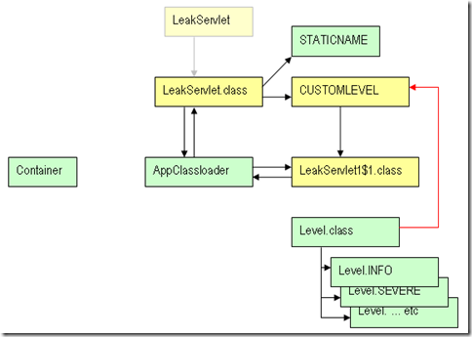
#10 ClassLoader Leak - java.util.Level
On destroy of container, LeakServlet looses reference and hence it is collected
AppClassLoader is not collected because LeakServlet$1.class is referencing it.
LeakServlet$1.class is not collected because CUSTOMLEVEL object is referencing it.
CUSTOMLEVEL object is not collected because Level.class (through its static variable called known) is referencing it.
Level.class is not collected as it is loaded by BootStrapClassLoader
Since AppClassLoader not collected, OOME Perm......
Profiling Obj Creation
Monitoring Java Applications

Slide 41
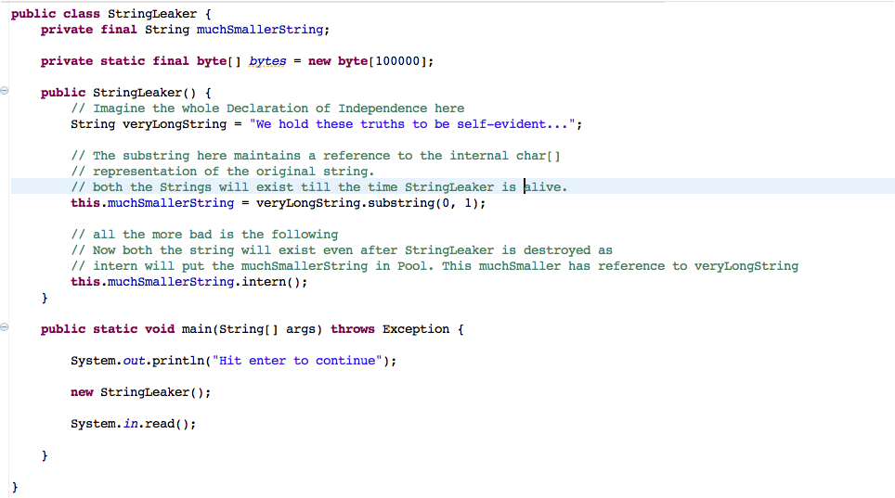
#10 Strings Leaking because of substring
// Instead use the following
this.muchSmallerString = new String(veryLongString.substring(0, 1));
Profiling Obj Creation
Monitoring Java Applications

Slide 42
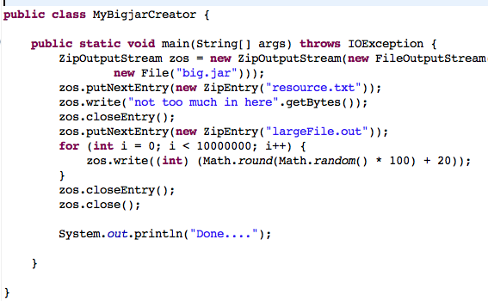
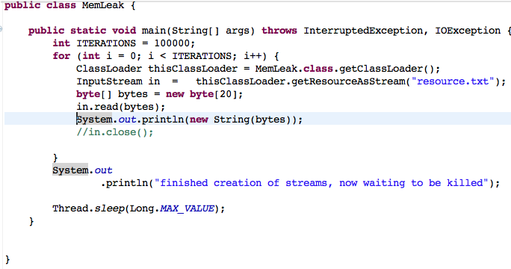
#10 Closing of Streams is Important
Create a BigJar
Read the contents
Profiling Obj Creation
Note that stream is not closed - Check memory consumption in Visual VM
Monitoring Java Applications

Slide 43
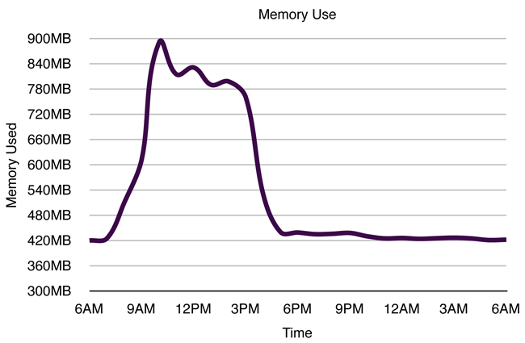
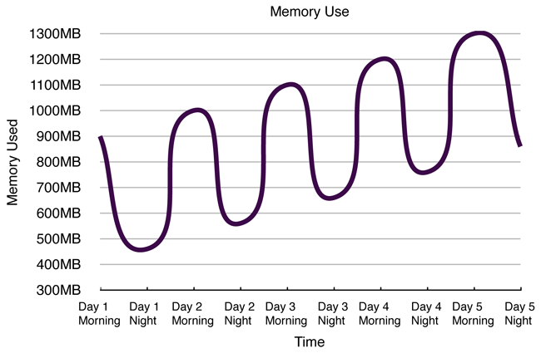
#5 Monitoring Memory Leak
Where is the leak ?
Peak Load Concept: To distinguish between a memory leak and an application that simply needs more memory, we need to look at the "peak load" concept. When program has just started no users have yet used it, and as a result it typically needs much less memory then when thousands of users are interacting with it. Thus, measuring memory usage immediately after a program starts is not the best way to gauge how much memory it needs! To measure how much memory an application needs, memory size measurements should be taken at the time of peak load—when it is most heavily used.
Profiling Obj Creation
Monitoring Java Applications
Notes:
There is one special case that should be noted here: a program that needs to be restarted periodically in order to prevent it from crashing with an OutOfMemoryError alert. Imagine that on the previous graph the max memory size was 1100MB. If the program started with about 900MB of memory used, it would take about 48 hours to crash because it leaks about 100MB of memory per day. Similarly, if the max memory size was set to 1000MB, the program would crash every 24 hours. However, if the program was regularly restarted more often than this interval, it would appear that all is fine.
Regularly scheduled restarts may appear to help, but also might make "upward sloping memory use" (as shown in the previous graph) more difficult to notice because the graph is cut short before the pattern emerges. In a case like this, you'll need to look more carefully at the memory usage, or try to increase the available memory so that it's easier to see the pattern.

Slide 44
#1 Why Gross Memory Monitoring ?
The objects are allocated in heap.
At any point of time if the memory available to create objects is less than what is needed, you will encounter dreaded OOME.
Monitoring gross memory usage is important so that you can identify the memory limits for your application.
It is important to understand how memory is used, claimed and freed by JVM.... Be engaged....
Gross Memory Monitoring
Monitoring Java Applications
Notes:
Gross memory usage monitoring is important - you would not want to see your application crashing because of OOME. So, is it that max amount of memory given to JVM will serve the purpose and give good performance ? or min amount of memory will be better for your app ? These are some of the questions that we will address. In short “How much memory you really need for your app ?” is what we will discuss here. We will also take a short discussion on whether 32 bit or 64 bit - which one will give better performance - very interesting stuff

Slide 45
#2 Heap Memory Usage by JVM
Initial size : -Xms and max size : -Xmx
Runtime.getRuntime().totalMemory() returns currently grep-ed memory.
If JVM needs more memory, expansion happens - max to the tune of -Xmx
OOME if memory needs goes beyond -Xmx
OOME if expansion fails because OS does not have memory to provide (rare case).
Will revisit this topic while discussing more on tuning.
Download and run this class : http://www.mslearningandconsulting.com/documents/28301/83860/MonitorHeapExpansion.java
Gross Memory Monitoring
Monitoring Java Applications
Notes:
JVM allocates memory for the heap based on -Xms and -Xmx. If not specified default sizes are used (may vary based on GC algo and JVM implementation). I am using OpenJDK for Mac OS and by default it takes 75M as initial size and 1GB as max memory.
JVM claims memory from the OS equal to size specified in -Xms this is total memory claimed to start with. Runtime.getRuntime().totalMemory() will return this memory as soon as you start your JVM
As memory needs keeps growing, JVM claims more memory from OS - At any given point in time, Runtime.getRuntime().totalMemory() returns the currently claimed memory from OS.
What ever may be the memory needs, JVM will never be able to claim memory more than what is specified by -Xmx. Runtime.getRuntime().maxMemory() returns the max memory that can be claimed from OS.
It is important to note that memory needs can keep varying and may be low in non-peak hours and high in peak-hours of usage. JVM implementations allow expansion of totalMemory and contraction.
When does your application encounter OOME ?
When totalMemory is less than maxMemory and JVM encounters a need to claim more memory from the OS. But OS itself is unable to provide the requested memory - OOME error occurs. This happens very rarely.
totalMemory reached approximately equals maxMemory and JVM needs more memory, JVM will throw OOME - thumb rule : JVM never claims memory from OS more than what is specified by -Xmx
The most important point of all from performance perspective is that the max and min size must be carefully and thoughtfully set. The reason is that if there if the number of times the expansion / contraction happens is very high, then your JVM will end up getting fragmented memory. Referencing objects on fragmented memory and garbage collection will be more costly in terms of performance as compared to contiguous area of memory.
Many a times you will see that for enterprise apps architects would prefer setting min size as same as max so that there is no expansion at all. Needless to say that this must be thoughtfully done.
Note that Runtime.getRuntime().totalMemory does not include one of the survivor spaces, since only one can be used at any given time, and also does not include the permanent generation, which holds metadata used by the virtual machine.

Slide 46
#1 Monitoring Threads - JConsole
Re-run the DeadLock program you have written earlier.
Start JConsole >> Threads.
Click on “Detect DeadLock”. You will fine two threads identified to be in deadlock.
Study the other things like state which can help to detect LiveLock or Starvation if any.
Recollect the discussion we did on Thread states
Thread Profiling
Monitoring Java Applications
Notes:
In this unit we will cover how to profile threads, get the Thread Dumps and analyze the same.

Slide 47
#2 Monitoring Threads - jstack
Use jstack in order to get thread dump while your jvm is running
Jstack prints stack traces for java threads for a given process.
Run the MonitoringHeapExpansion program and use jstack to study the stack trace.
Thread Profiling
Monitoring Java Applications
Notes:
There are many tools that are bundled with Sun JDK and they are as follows:
jconsole: This tools provides good amount of information on the status of Heap, Perm Gen, Shared Object Memory and Garbage Collection. It also provides information on active threads and now in Java 1.6 - the threads that are in deadlock. This tool also provides interface to interact with JMX
jmap (use sudo jmap on mac) : prints shared object memory maps or heap memory details of a given process. You will not need this tool separately as jconsole offers the GUI display of the same info.
jstack: prints Java stack traces of Java threads for a given Java process
jinfo (use sudo jinfo on mac): prints Java configuration information for a given Java process. Again you will not need this as jconsole offers this information
Some important points
jmap Heap Dump generation will cause your JVM to become unresponsive so please ensure that no more traffic is sent to your affected / leaking JVM before running the jmap utility
Sun HotSpot 1.5/1.6/1.7 Heap Dump file will also be generated automatically as a result of a OutOfMemoryError and by adding -XX:+HeapDumpOnOutOfMemoryError in your JVM start-up arguments
Note: If the given process is running on a 64-bit VM, you may need to specify the -J-d64 option, e.g.:
jmap -J-d64 -heap pid

Slide 48
#1 What to monitor ?
Monitor the time taken for incoming requests to be processed
Monitor the average amount of data sent in each request
Monitor the number of worker threads
Monitor the state of thread and the timeout set for each thread in the pool
Client Server Monitoring
Monitoring Java Applications
Notes:
In this short session we will discuss some important factors that can lead to performance related problems in client server communication.

Slide 49
#1 Summary of What to Monitor !
GC - Number of GCs, time taken by GC, amount of memory freed after GC (remember then can be loitering objects which can make GC kick in very often)
Thread - State of the Threads - Look for DeadLock, Starvation, LiveLock
Hotspots - The methods taking max time.
Object Allocation - Probing the number of objects churned especially looking for loitering objects
Finalizers - Object pending for finalization.
All in All - What to Monitor ?
Monitoring Java Applications
Notes:
Once you have understood what it means by profiling the application, you need to know what to profile. In this session we will learn what to profile and why ?

Slide 50
#1 JVM TI
JVM PI in Java 1.2. JVM TI from 1.5
Use JConsole to see the list of Management Beans
Let us monitor our DeadLocalDemo code to detect dead locked threads
ThreadMXBean threadMB = ManagementFactory.getThreadMXBean();
long threadIds[] = threadMB.findDeadlockedThreads();
for (long id : threadIds) {
System.out.println("The deadLock Thread id is : " + id
+ " > "
+ threadMB.getThreadInfo(id).getThreadName());
}
Observability API
Monitoring Java Applications
Notes:
In order to probe the status of various aspects of the Runtime Environment, Java 1.2 introduced JVM PI (Profiler Interface) and then JVM TI (Tooling Interface) in 1.5. We will get an overview of these APIs and learn how agents use these APIs in order to get the status of memory, cpu usage, threads and method stacks runtime. By the end of this short session you will know what it means by profiling the application.
What is Observability ?
After you have measured your performance you may realize that it is not as per expectations, or you may want to find which method is taking maximum time or how much time is being spent on GC, what is the total memory available and how much is used. Where would you look for all this information ? Yes - the JVM. Why ? Because JVM is the machine - (virtual of course) that manages memory, does garbage collection and compiles and gets your code executed on the physical machine.
This further makes it easy to understand that JVM must be observable. If JVM is closed and not observable then how will we get the information needed in order to probe the runtime execution of our application. Here comes the point then - JVM as an API called Observability API. It is this API that exposes services which when invoked, provides information on memory, cpu usage, threads, method stacks, number of classes loaded and lot more. The vendors write their performance testing tools that make these API calls in order to get runtime information. The tool then provides the information in more easy-to-understand graphical interface for analysis. Note that profilers can also give heap dumps which can be used to further analyze the object allocation in the heap area.
JVM PI
The Observability API was first introduced in Java 1.2 and was known as JVM PI (Java Virtual Machine - Profiling Interface). It provided features like profiling, debugging, monitoring, thread analysis and coverage analysis.
JVM TI
With Java 1.5 it was replaced with JVM TI (Tooling Interface) - not just change in name but with many more advanced features that gave a very picture of the runtime behavior of the JVM. Very importantly JVM TI had very minimal load on the JVM and can be easily used in production.

Slide 51
#1 JDK Tools
There are many tools that are bundled with Sun JDK and they are as follows:
jmap (use sudo jmap on mac) : prints shared object memory maps or heap memory details of a given process.
jstack: prints Java stack traces of Java threads for a given Java process
jinfo (use sudo jinfo on mac): prints Java configuration information for a given Java process.
Jconsole provides much of the above.
Observability API
Monitoring Java Applications

Slide 52
#1 Overview of Profiling Tools
Visual VM - Lets run MemoryHeapExpansion and monitor memory & threads in Visual VM
JProfiler: This is a paid product and has a very nice user interface. Gives all the information on GC, Object Creation and Allocation and CPU Utilization
Yourkit: This is also a paid product. Quite comprehensive.
AppDynamics: This is my favorite. It works with distributed system and very intelligently understands the different components that makes up your application.
Profiling Tools
Monitoring Java Applications
Notes:
Visual VM Sampler
The VisualVM-Sampler plugin which is available from the Plugins Center. The plugin provides the tool with a powerful performance and memory profiler which uses sampling, a technique that allows performance and memory data to be gathered with zero setup and virtually no overhead. By periodically polling the monitored application for thread dumps or memory histograms, the profiler helps in locating potential bottlenecks or memory leaks while still allowing the application to run at full speed.
It has a timer. When the timer fires, it copies the current contents of every thread's stack. Then it translates the stack frames into method and object names, and records a count against the relative methods.
Because of this, it doesn't need to instrument the code, and is therefore very lightweight. However, because it doesn't instrument the code is can miss short-running stuff. So it's mostly useful either for tracking long-running performance problems, or to quickly identify a serious hot-spot in your code.
During CPU profiling, the tool gets thread dumps from the monitored application by a customizable sampling rate and displays the results the same way as the built-in instrumenting Profiler. Live tabular data showing Hot Spot methods enable you to immediately detect a bottleneck in the application. You can then save the collected data into a standard .nps snapshot that provides additional Call Tree and Combined views for detailed inspection. The profiler obtains the thread dumps using a JMX connection which means that any JMX-enabled application (JDK 5+ from various vendors) can be profiled both locally and remotely. You can even profile several applications at once. From now you can use VisualVM to profile almost any Java application no matter if it's a locally running Sun JDK application or a remote IBM JDK-powered application server!
Tools are an important part of java profiling. In order to be able find the bottlenecks, memory leaks, deadlocks, thread starvation etc. we need a good tool. There are many paid and free tools in the marketplace; we will discuss some of them in this unit. This is not a tool specific training program and hence only the overview of tools will be discussed.
AppDynamics : Very importantly it tracks everything write from the request to the method. You need to plugin the agent using -javaagent for e.g. -javaagent:<agent_install_dir>/javaagent.jar. The most important point about this tool is that it has very low overhead and can be used in production to identify bottlenecks. Also note that you AppDynamics provides agent for IBM Java as well.

Slide 53
#1 Module Coverage
In this module we will cover the following (as such both of these topcis will go hand in hand)
Monitoring & Tuning GC
Monitoring & Tuning the Heap
Tuning GC & Heap

Slide 54
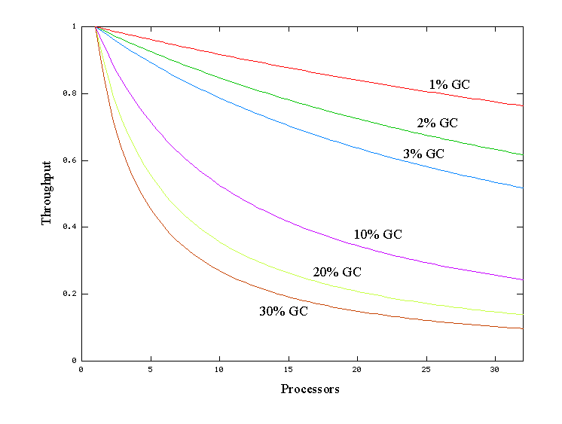
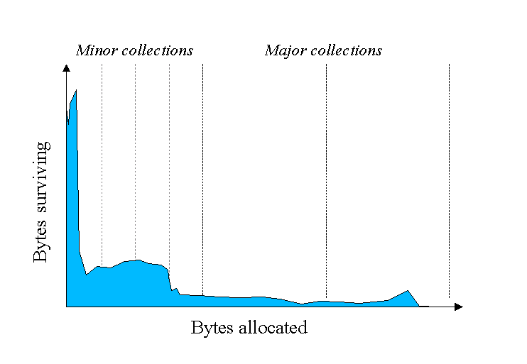
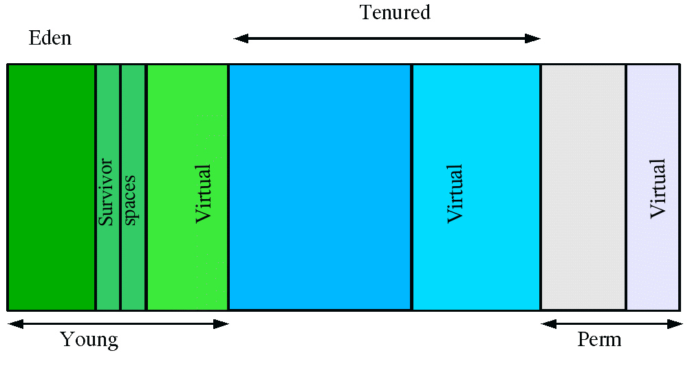
#1 Things to Know before Tuning
Serial GC - One thread used. Good for uniprocessor; throughput will be lost on multi-processor system.
Ergonomics - Goal is to provide good performance with little or no tuning by selecting gc, heap size and compiler. Introduced in J2SE 5.0
Generations - Most objects are short lived and they die young. Long lived objects are kept in different generations.
Tuning GC & Heap goes hand in hand
Sizing Heap
Tuning GC & Heap
Notes:
Here we will cover “What & How to Monitor GC”. We will talk about JVM Flags used for monitoring, GC log record format, Secondary Info hidden in GC logs, GC sequential overhead.
In earlier session we have discussed all that we must be knowing about fundamentals of GC. Now is the time to understand the various tuning options that are available which effects GC. We will discuss many GC Tuning techniques including using parallel GC (UseParallelGC) , using concurrent collector (UseConcMarkSweepGC), XX:ParallelGCThreads etc. We will briefly revisit the discussion we did on types of collectors.
Having understood about GC mechanism and the different collectors available, it is time to understand how to tune the Heap Memory Area. It is this area where all the application objects are created. Tuning the heap and GC goes hand in hand and impacts one another. In this unit we will understand how to size the different generations of Heap so that GC is efficient to its core. We will throughly look at the vm arguments used to do both - Gross Tuning (min, max sizes) and Fine Tuning (ratios between the spaces like eden, survivor etc.) of the heap.You will learn about JVM arguments like
MinHeapFreeRatio, MaxHeapFreeRatio, Xmx, Xms, NewRatio, SurvivorRatio
YoungGenerationSizeIncrement, TenuredGenerationSizeIncrement
AdaptiveSizeDecrementScaleFactor, DefaultInitialRAMFraction, DefaultMaxRAM

Slide 55
#2 Performance Considerations (Revisited)
Throughput : Total time spent in not doing GC.
Pause Time: The time for which the app threads stopped while collecting.
Footprint: Working size of JVM measured in terms of pages and cache lines (See glossary in notes)
Promptness: time between objects death and its collection.
Sizing Heap
Tuning GC & Heap

Slide 56


#3 Monitoring GC -verbose:gc
-verbose:gc : prints heap and gc info on each collection.
Example shows 2 minor and 1 major collections.
Number before and after arrow indicates live objects before and after.
After number also includes garbage which could not be claimed either because they are in tenured or being referenced from tenured or perm gen.
Number in parenthesis provides committed heap size - Runtime.getRuntime().totalMemory()
0.2300771 indicates time taken for collection
Sizing Heap
Tuning GC & Heap

Slide 57
#4 Monitoring GC -XX:+PrintGCDetails
Additional info as compared to -verbose:gc
Prints information about young generation.
DefNew : Shows the live objects before & after minor collection in young gen.
Second line shows the status of entire heap and the time taken.
-XX:+PrintGCTimeStamps will add time stamp at the start of collection.
Use of -verbose:gc is important with this options
Sizing Heap
Tuning GC & Heap

Slide 58
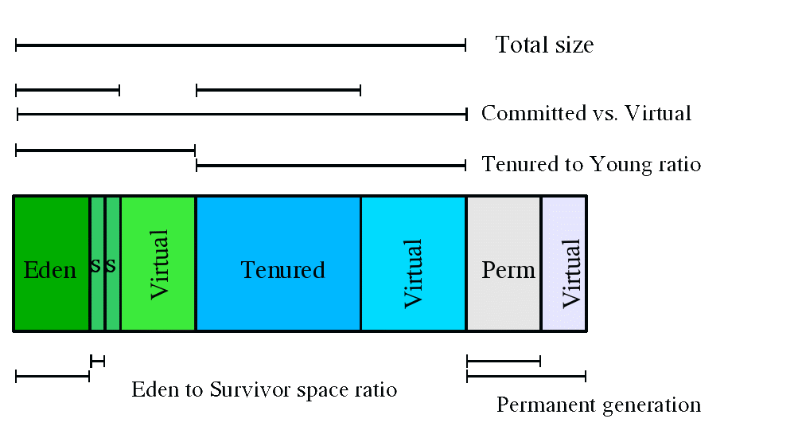
#5 Sizing Generations
Many parameters change the generation sizes.
Not all space is committed - Uncommitted space is labelled as Virtual.
Generations can grow and shrink; grow to the extent of -Xmx
Some of the parameters are ratios like NewRatio & SurvivorRatio.
Sizing Heap
Tuning GC & Heap

Slide 59
#6 Total Heap
Defaults are different for serial and parallel.
Throughput is inversely proportional to amount of memory available.
Total memory is the most important factor in GC performance.
Heap grows and shrinks based on -XX:MinHeapFreeRatio and -XX:MaxHeapFreeRatio
MinHeapFreeRatio is 40 by default and MaxHeapFreeRatio is 70 by default.
Defaults scaled by approx 30% in 64 bit
Max must be always smaller than OS can afford to give to avoid paging
Sizing Heap
Tuning GC & Heap

Slide 60
#7 Total Heap - (contd.)
Defaults has problems on large servers - defaults are small and will resule in several expansions and contractions
Recommendations
If pauses can be tolerated, use heap as much as possible
Consider setting -Xms and -Xmx same.
Increase memory if more processor so that memory allocation is parallelized.
Sizing Heap
Tuning GC & Heap

Slide 61
#8 Young Generation
Proportion of heap dedicated to Young is very crucial
Bigger the Young Gen, lesser minor collections.
Bigger Young will make tenured smaller (if heap size is limited) which will result in frequent Major Collections.
Young Gen size controlled by NewRatio -XX:NewRatio=3 means (Young + Survivors) will be 1/4th of total heap.
-XX:NewSize100M will set the initial size of Young to 100.
-XX:MaxNewSize=200M will set the max size.
Sizing Heap
Tuning GC & Heap

Slide 62
#9 Survivor Space Sizing
-XX:SurvivorRatio=6 will set the ratio between eden and survivor to 1:6 i.e. 1/8th of Young. (Not 1/7th because there are 2 survivor spaces)
You will rarely need to change this. Defaults are OK.
Small Survivors will throw objects in tenured.
Bigger Survivor will be a waste.
Ideally Survivors must be half full - this is the factor that determines the threshold for objects to be promoted
-XX:+PrintTenuringDistribution shows age of object in Young Generation.
Sizing Heap
Tuning GC & Heap

Slide 63
#10 Recommendations on New Gen Sizing
Identify max heap size you can afford
Plot your performance metric and identify Young Size
Do not increase Young such that tenured becomes too small to accommodate application cache data plus some 20% extra
Subject to above considerations increase the size of young to avoid frequent minor gc.
Sizing Heap
Tuning GC & Heap

Slide 64
#10 Recommendations on New Gen Sizing
Identify max heap size you can afford
Plot your performance metric and identify Young Size
Do not increase Young such that tenured becomes too small to accommodate application cache data plus some 20% extra
Subject to above considerations increase the size of young to avoid frequent minor gc.
Sizing Heap
Tuning GC & Heap

Slide 65
#1 Available Collectors
Serial Collector: Single thread, no overhead of coordinating threads, suited for uni processor for apps with small data sets (approx 100M). -XX:+UseSerialGC
Parallel Collector: Can take advantage of multiple processors, Efficient for systems with large data sets, aka throughput collector. -XX:+UseParallelGC.
Parallel Collector by default is used on New. For old use -XX:UseParallelOldGC
Concurrent Collector: Performs most of the work concurrently with minimal pauses. -XX:+UseConcMarkSweep
CMS (Concurrent Mark Sweep ) garbage collection does not do compaction. ParallelOld garbage collection performs only whole-heap compaction, which results in considerable pause times.
Concurrent Collector does not do compaction.
Selecting Collector
Tuning GC & Heap

Slide 66
#3 General Collector Selection Guidelines
-XX:+UseSerialGC if application has small data set, pause times are not required to be strict, Uniprocessor
-XX:+UseParallelGC with multiple processors
-XX:+UseParallelOldGC for parallel compaction in tenured generation (whole heap compaction - considerable pause times)
-XX:+UseConcMarkSweepGC if pause times must be lesser than 1 second. Note this works only on Old Generation - No Compaction; results in fragmented heap
Selecting Collector
Tuning GC & Heap
Notes:
If you start ConcurrentMarkSweep then you would use only ParNewGC in Young Generation. The difference between UseParallelGC and UseParNewGC is given by sun as follows:
The parallel copying collector (Enabled using -XX:+UseParNewGC). Like the original copying collector, this is a stop-the-world collector. However this collector parallelizes the copying collection over multiple threads, which is more efficient than the original single-thread copying collector for multi-CPU machines (though not for single-CPU machines). This algorithm potentially speeds up young generation collection by a factor equal to the number of CPUs available, when compared to the original singly-threaded copying collector.
The parallel scavenge collector (Enabled using -XX:UseParallelGC). This is like the previous parallel copying collector, but the algorithm is tuned for gigabyte heaps (over 10GB) on multi-CPU machines. This collection algorithm is designed to maximize throughput while minimizing pauses. It has an optional adaptive tuning policy which will automatically resize heap spaces. If you use this collector, you can only use the the original mark-sweep collector in the old generation (i.e. the newer old generation concurrent collector cannot work with this young generation collector).

Slide 67
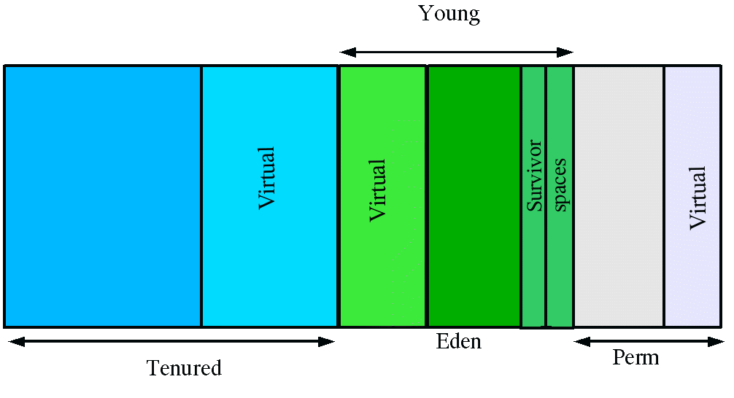
#4 Parallel Collector in Detail
-XX:ParallelGCThreads=4 will create 4 threads to collect in parallel.
Ideally the number of threads must be equal to number of processors.
Auto tuning based on Ergonomics
Generations in Parallel GC. The arrangement of generations and names may be different in case of different Collectors
Serial calls its Tenured and Parallel calls it Old
Selecting Collector
Tuning GC & Heap

Slide 68
#5 Parallel Collector Auto Tuning with Goals
Instead of you changing generation sizes etc. You specify the goal and let the JVM auto tune the generation sizes, number of threads etc.
There are 3 types of goals that can be specified
Pause Time
Throughput
Footprint
Selecting Collector
Tuning GC & Heap

Slide 69
#5 Parallel Collector Pause Time Goal
-XX:MaxGCPauseMillis=<N>
<N> milliseconds or lesser pause time is desired
Generation sizes adjusted automatically.
Throughput may be affected.
Meeting the goal is not guaranteed.
Selecting Collector
Tuning GC & Heap
Notes:
There are two JVM flags/options that control how many GC threads are used in the JVM: ParallelGCThreads and ParallelCMSThreads.
ParallelGCThreads
This flag controls the number of threads used in the parallel garbage collector. This includes the young generation collector used by default. If the parallel GC is used (-XX:+UseParallelGC) or turned on by default on a 'server-class' machine, this is what you care with regard to the number of GC threads. Here's the formula that decides how many GC threads are used in the JVM on Linux/x86:
ParallelGCThreads = (ncpus <= 8) ? ncpus : 3 + ((ncpus * 5) / 8)
Some examples are:
When ncpus=4, ParallelGCThreads=4
When ncpus=8, ParallelGCThreads=8
When ncpus=16, ParallelGCThreads=13
A rationale for the number of GC threads lower than the core count in higher core count machines, that I can think of, is that parallel GC does not scale perfectly and the extra core count didn't help or even degraded the performance.
ParallelCMSThreads
This flag controls the number of threads used for the CMS (concurrent mark and sweep) garbage collector (-XX:+UseConcMarkSweepGC). CMS is often used to minimize the server latency by running the old generation GC with the application threads mostly concurrently. Even when CMS is used (for the old gen heap), a parallel GC is used for the young gen heap. So, the value of ParallelGCThreads still matters. Here's how the default value of ParallelCMSThreads is computed on Linux/x86:
ParallelCMSThreads = (ParallelGCThreads + 3) / 4
Some examples are:
When ncpus=4, ParallelCMSThreads =1
When ncpus=8, ParallelCMSThreads =2
When ncpus=16, ParallelCMSThreads =4
Typically, when the CMS GC is active, the CMS threads occupy the cores. The rest of the cores are available for application threads. For example, on a 8 core machine, since ParallelCMSThreads is 2, the remaining 6 cores are available for application threads. (As a side note, because all the threads have the same scheduling priority at the POSIX thread level in the JVM under Linux/x86, the CMS threads may not necessarily be on cores all of the time.)
Takeaways
Here are the takeaways for GC tuners out there:
Since ParallelCMSThreads is computed based on the value of ParallelGCThreads, overriding ParallelGCThreads when using CMS affects ParallelCMSThreads and the CMS performance.
Knowing how the default values of the flags helps better tune both the parallel GC and the CMS GC. Since the Sun JVM engineers probably empirically determined the default values in certain environment, it may not necessarily be the best for your environment.
If you have worked around some multithreaded CMS crash bug in older Sun JDKs by running it single-threaded (for example this one), the workaround would have caused a tremendous performance degradation on many-core machines. So, if you run newer JDK and still uses the workaround, it's time to get rid of the workaround and allow CMS to take advantage of multicores.

Slide 70
#6 Parallel Collector Throughput Goal
Throughput goal is measure in terms of time spent doing gc vs. Time spent outside gc (application time)
-XX:GCTimeRatio=<N> which sets the ration of gc to application time to 1 / (1 + N)
i.e. If <N> is 19 then 1 / (1 + 19) is 1/20 i.e. 5% of time spent in GC is acceptable
Default value of <N> is 99 i.e. 1% (1 / 1 + 99) is 1/100 i.e. 1% of time in GC is acceptable
Selecting Collector
Tuning GC & Heap

Slide 71
#6 Parallel Collector Footprint Goal
Specified with none other than -Xmx.
GC tries to minimize the size as long as other goals are met
Goals are address in the order a) Pause time b) Throughput and finally c) Footprint
Selecting Collector
Tuning GC & Heap

Slide 72
#6 Controlling the Auto Tuning
Generation size adjustments are done automatically as per goals specified.
-XX:YoungGenerationSizeIncrement=<Y> where Y is the percentage by which the increments of Young Generation will happen
-XX:TenuredGenerationSizeIncrement=<T> for tenured
-XX:AdaptiveSizeDecrementScaleFactor for decrementing % of both generations
OOME : Parallel Collector will throw OOME if it spends 98% of time in GC and collects less than 2% of heap.
Selecting Collector
Tuning GC & Heap

Slide 73
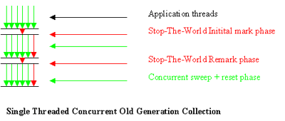
#7 Concurrent Collector
4 Phases
Initial Mark : Pauses all application threads and gets the root objects and object reachable from young.
Concurrent Mark: Marks rest of the object reachable from root, concurrently with application threads
Remark: Again pauses application threads to mark those objects that has changed references due to previous concurrent phase.
Concurrent Sweep: Sweeps the garbage concurrenly with application threads. Note it does NOT compact memory
Selecting Collector
Tuning GC & Heap
Notes:
As said by Performance Expert Kirk Perpendine :
Currently if we want a low latency collector, we must resort to using the Concurrent Mark and Sweep (CMS) collector. While this does a great job of increasing liveliness of our applications by reducing that stop-the-world nature of GC that we've all grown to know and love, CMS can still create some devastating pause times. It does this because CMS does not compact. A non-compacting collector will eventually leave your heap looking like swiss cheese and when it does, it needs to compact. If you need to compact you need to stop all application threads and perform memory to memory copying to eliminate these holes as well as free list management, which ain't cheap.

Slide 74
#7 Concurrent Collector - (contd.)
Initial Mark - is always done with 1 single thread.
Remaking can be tuned to use multiple threads.
Pauses are for a very minimal amount of time - only during initial mark and remark phase.
Concurrent mode failure: May stop all application threads if concurrently running app threads are unable to allocate before the gc threads completes collection.
Floating Garbage: It is possible that objects traced by gc may become unreachable before gc completes collection. This will be cleared in next generation
Selecting Collector
Tuning GC & Heap

Slide 75
#8 Available Collectors
 | UseSerialGC | UseParallelGC | UseConMarkGC
Young / New | Copy Collector Single Threaded Low Throughput | PS Scavenge Multiple Threads High Throughput Optimized | ParNewGC (mandatory) Multiple Threads / Copy Collector
Tenuered / Old | MarkSweepCompact Single Threaded Whole Heap Compaction | PS MarkSweep Multiple Threads Compaction with ParallelOldGC - but whole heap | ConcurrentMarkSweep Low pause times At cost of throughput No compaction (Fragmented Heap)
Selecting Collector
Tuning GC & Heap

Slide 76
#8 G1 Collector
Target - servers with multiprocessors & large memories
Meets pause time goals with high probability with high throughput
It is concurrent, parallel and compacting.
Global marking is concurrent.
Interruptions proportional to heap or live-data sets.
Selecting Collector
Tuning GC & Heap

Slide 77
#9 G1 Collector - How it Works
Divides heap into regions, each contiguous range of virtual memory.
Concurrent Global Marking to determine liveness of objects through heap.
G1 knows which regions are mostly empty - collects these regions first; hence the name - Garbage First.
Collecting mostly empty is very fast as fewer objects to copy
Selecting Collector
Tuning GC & Heap

Slide 78
#10 G1 Collector - How it Works
Uses Pause Prediction Model to meet user defined pause-time goals and selects regions based on this goal.
Concentrates on collection and compaction of regions that are full of dead matter (ripe for collection) - Again : fewer objects to copy.
Copies live objects from one or more regions to single region - in the process compacts and frees memory - this is evacuation.
Evacuating regions with mostly dead matter means again means fewer copies.
Selecting Collector
Tuning GC & Heap
Notes:
It is important to note that G1 is not a real-time collector. It meets the set pause time target with high probability but not absolute certainty. Based on data from previous collections, G1 does an estimate of how many regions can be collected within the user specified target time. Thus, the collector has a reasonably accurate model of the cost of collecting the regions, and it uses this model to determine which and how many regions to collect while staying within the pause time target

Slide 79
#11 G1 Collector - How it Works
Evacuation is done with multiple threads - decreasing pause times and increasing throughput.
Advantages
Continuously works to reduce fragmentation.
Thrives to work within user defined pause times.
CMS does not do compaction which results in fragmented heap
ParallelOld performs whole heap-compaction which results in considerable pause times
Selecting Collector
Tuning GC & Heap
Notes:
It is important to note that G1 is not a real-time collector. It meets the set pause time target with high probability but not absolute certainty. Based on data from previous collections, G1 does an estimate of how many regions can be collected within the user specified target time. Thus, the collector has a reasonably accurate model of the cost of collecting the regions, and it uses this model to determine which and how many regions to collect while staying within the pause time target

Slide 80
#8 Available Collectors
UseSerialGC | UseParallelGC | UseConMarkGC
No Parallelism resulting in loss of throughput on multi processor Whole Heap Compaction | No Compaction resulting in fragmented heap | No Compaction resulting in fragmented heap
G1
Global Marking to determine Liveliness is Concurrent
Evacuation is Parallel
During evacuation, compacts while copying to other regions
Algo ensures - there are fewer objects to copy
Regions
Global Marking to get regions liveliness
Collects mostly empty regions
Vigilant on regions that has max dead matter - evacuates such regions first
Evacuation is based on user defined pause-time requirements (Pause Prediction Model)
Evacuating regions that are mostly empty and those that are with max dead matter means fewer obhject to copy. - Less overhead of copying
Evacuation is parallel
Selecting Collector
Tuning GC & Heap
Notes:
The first focus of G1 is to provide a solution for users running applications that require large heaps with limited GC latency. This means heap sizes of around 6GB or larger, and stable and predictable pause time below 0.5 seconds.
Applications running today with either the CMS or the ParallelOld garbage collector would benefit switching to G1 if the application has one or more of the following traits.
More than 50% of the Java heap is occupied with live data.
The rate of object allocation rate or promotion varies significantly.
Undesired long garbage collection or compaction pauses (longer than 0.5 to 1 second)

Slide 81
Other important considerations
Permanent Generation - Use -XX:MaxPermSize=<N> if your application dynamically generates classes (jsps for e.g.). If perm gen goes out of space you will encounter OOME Perm Gen Space.
Beware of Finalizers. GC needs two cycles to clear objects with finalizers. Also, it is possible that before the finalize is called the JVM exits.
Explicit GC : System.gc() can force major collections when not needed
JVM Monitoring
Few more tips

Slide 82
Summary
Monitoring includes
GC Monitoring - Look for gc pauses, throughput and foot print.
Threads Monitoring - Look for deadlocks, starvation.
Method Profiling - Look for hot spots
Object Creation - Look for memory leaks
JVM Monitoring
Summary

Slide 83
www.mslearningandconsulting.com
shakir@mslearningandconsulting.com

