Slide 1
Dissecting the Hotspot JVM
Martin Toshev @martin_fmi Ivan St. Ivanov @ivan_stefanov

Slide 2
Agenda
Virtual Machine Basics
The Hotspot JVM
Understanding the Hotspot Source Code
Debugging Hotspot

Slide 3

DISCLAIMER

Slide 4
Why this presentation ?
Feeling comfortable with the JVM source code allows you to:
contribute to and improve the JVM itself
fork and customize the JVM for whatever reason you want (experimental, commercial,
academic …)

Slide 5

Why this presentation ?
Feeling comfortable with the JVM source code allows you to:
be a step ahead of Chuck Norris

Slide 6
Virtual Machine Basics
A typical virtual machine for an interpreted language provides:
Compilation of source language into VM specific bytecode
Data structures to contains instructions and operands (the data the instructions process)

Slide 7
Virtual Machine Basics
A typical virtual machine for an interpreted language provides:
A call stack for function call operations
An ‘Instruction Pointer’ (IP) pointing to the next instruction to execute

Slide 8
Virtual Machine Basics
A typical virtual machine for an interpreted language provides:
A virtual ‘CPU’ – the instruction dispatcher that:
Fetches the next instruction (addressed by the instruction pointer)
Decodes the operands
Executes the instruction

Slide 9
The Hotspot JVM
Provides:
bytecode execution - using an interpreter, two runtime compilers or On-Stack Replacement
storage allocation and garbage collection
runtimes - start up, shut down, class loading, threads, interaction with OS and others

Slide 10
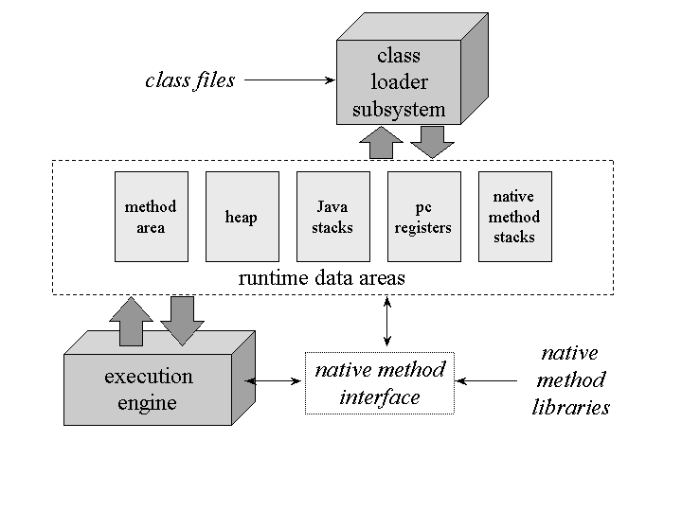
The Hotspot JVM
Architecture:

Slide 11
The Hotspot JVM
Architecture:

Slide 12
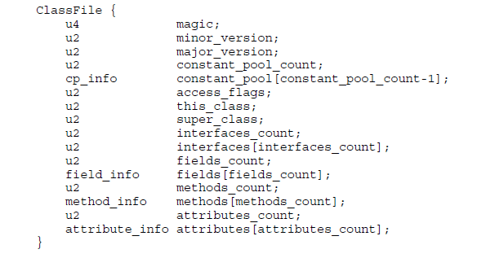
The Hotspot JVM
Notes:
magic
The magic item supplies the magic number identifying the class file format;
it has the value 0xCAFEBABE.
minor_version, major_version
The values of the minor_version and major_version items are the minor and
major version numbers of this class file.
constant_pool_count
The value of the constant_pool_count item is equal to the number of entries
in the constant_pool table plus one.
constant_pool[]
The constant_pool is a table of structures representing various string
constants, class and interface names, field names, and other constants that are
referred to within the ClassFile structure and its substructures. access_flags
The value of the access_flags item is a mask of flags used to denote access
permissions to and properties of this class or interface.
this_class
The value of the this_class item must be a valid index into the
constant_pool table.
super_class
For a class, the value of the super_class item either must be zero or
must be a valid index into the constant_pool table.
interfaces_count
The value of the interfaces_count item gives the number of direct
superinterfaces of this class or interface type.
interfaces[]
Each value in the interfaces array must be a valid index into
the constant_pool table.
fields_count
The value of the fields_count item gives the number of field_info
structures in the fields table. The field_info structures represent all
fields, both class variables and instance variables, declared by this class or
interface type.
fields[]
Each value in the fields table must be a field_info structure giving
a complete description of a field in this class or interface.
methods_count
The value of the methods_count item gives the number of method_info
structures in the methods table.
methods[]
Each value in the methods table must be a method_info structure giving
a complete description of a method in this class or interface.
attributes_count
The value of the attributes_count item gives the number of attributes
in the attributes table of this class.
attributes[]
Each value of the attributes table must be an attribute_info (§4.7)
structure.

Slide 13
The Hotspot JVM
Three phases of class-loading:
Loading
Linking
Initialization
Notes:
Loading: finding and importing the binary data for a type
Linking: performing verification, preparation, and (optionally) resolution
Verification: ensuring the correctness of the imported type
Preparation: allocating memory for class variables and initializing the memory to default values
Resolution: transforming symbolic references from the type into direct references.
Initialization: Invoking Java code that initializes class variables to their proper starting values.

Slide 14
The Hotspot JVM
Architecture:

Slide 15
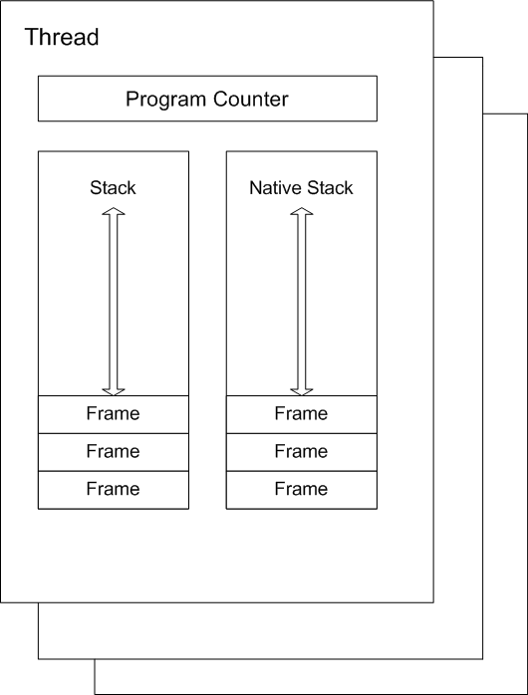
The Hotspot JVM

Slide 16
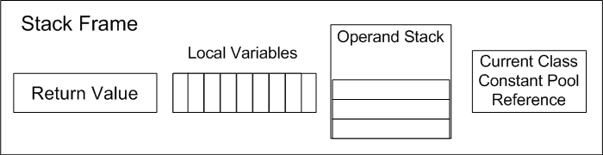
The Hotspot JVM
Notes:
A new frame is created and added (pushed) to the top of stack for every method invocation. The frame is removed (popped) when the method returns normally or if an uncaught exception is thrown during the method invocation.
Each frame contains:
Local variable array
Return value
Operand stack
Reference to runtime constant pool for class of the current method

Slide 17
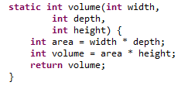
The Hotspot JVM
0 iload_0
1 iload_1
2 imul
3 istore_3
4 iload_3
5 iload_2
6 imul
7 istore 4
9 iload 4
11ireturn
Notes:
Some things to note here:
In case the method is not static then this is passed as the first argument implicitly.
The JVM is a stack-based virtual machine.

Slide 18
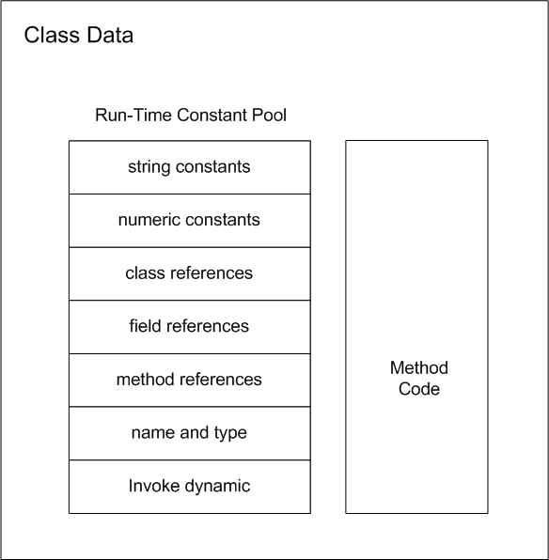
The Hotspot JVM
Notes:
A compiled class file consists of the following structure:
ClassFile {
u4 magic;
u2 minor_version;
u2 major_version;
u2 constant_pool_count;
cp_info contant_pool[constant_pool_count – 1];
u2 access_flags;
u2 this_class;
u2 super_class;
u2 interfaces_count;
u2 interfaces[interfaces_count];
u2 fields_count;
field_info fields[fields_count];
u2 methods_count;
method_info methods[methods_count];
u2 attributes_count;
attribute_info attributes[attributes_count];
}

Slide 19
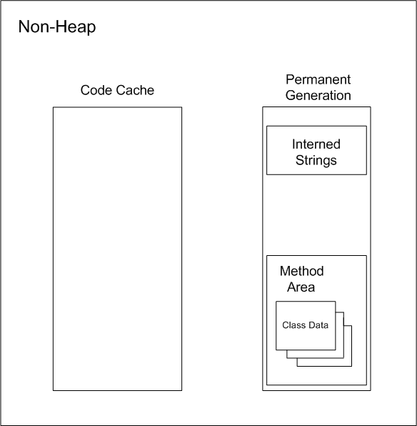
The Hotspot JVM
Notes:
Objects that are logically considered as part of the JVM mechanics are not created on the Heap.
The non-heap memory includes:
Permanent Generation that contains the method area and interned strings
Code Cache used for compilation and storage of methods that have been compiled to native code by the JIT compiler
The method area stores per-class information such as:
Class Loader Reference
Run Time Constant Pool
Numeric constants
Field references
Method References
Attributes
Field data (per field)
Name
Type
Modifiers
Attributes
Method data (per method)
Name
Return Type
Parameter Types (in order)
Modifiers
Attributes
Method code (Per method)
Bytecodes
Operand stack size
Local variable size
Local variable table
Exception table (per exception handler - start point, end point, PC offset for handler code, constant pool index for exception class being caught)

Slide 20
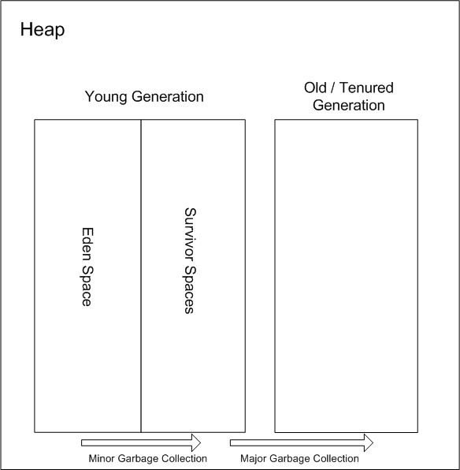
The Hotspot JVM
Notes:
The Heap is used to allocate class instances and arrays at runtime. Arrays and objects can never be stored on the stack because a frame is not designed to change in size after it has been created. The frame only stores references that point to objects or arrays on the heap. Unlike primitive variables and references in the local variable array (in each frame) objects are always stored on the heap so they are not removed when a method ends. Instead objects are only removed by the garbage collector.
To support garbage collection the heap is divided into three sections:
Young Generation - Often split between Eden and Survivor
Old Generation (also called Tenured Generation)
Permanent Generation
Objects and Arrays are never explicitly de-allocated instead the garbage collector automatically reclaims them.
Typically this works as follows:
1) New objects and arrays are created into the young generation
2) Minor garbage collection will operate in the young generation. Objects, that are still alive, will be moved from the eden space to the survivor space.
3) Major garbage collection, which typically causes the application threads to pause, will move objects between generations. Objects, that are still alive, will be moved from the young generation to the old (tenured) generation.
4) The permanent generation is collected every time the old generation is collected. They are both collected when either becomes full.
mark word - The first word of every object header. Usually a set of bitfields including synchronization state and identity hash code. May also be a pointer (with characteristic low bit encoding) to synchronization related information. During GC, may contain GC state bits.
klass pointer - The second word of every object header. Points to another object (a metaobject) which describes the layout and behavior of the original object. For Java objects, the "klass" contains a C++ style "vtable".
Note that both Java objects and VM-internal objects have a common object header format.
The Young Generation
The young generation must support fast allocation, but we expect most of those objects to become unreachable fairly quickly. We would like not to have to expend any effort on the unreachable objects, since there are so many of them. So when our young generations need to be collected, we identify the lreachable objects in them and copy them out of the young generation. Once we've copied out the reachable objects, the objects remaining in the young generation are unreachable, and the space for them can be recovered without attention to each individual unreachable object. This operation of copying the reachable objects out of a generation we call “scavenging”, so we often refer to our young generation collectors as “scavengers”. An advantage of scavenging is that it is fast. A disadvantage is that it requires room of a second copy of all the reachable objects from the scavenged generation.
The Old Generation
Once objects have been scavenged out of the young generation we expect them to remain reachable for at least a while, and to reference and be referenced by other objects that remain reachable. To collect the space in the old generation we need algorithms that can't depend on high density of unreachable objects. In particular we can't count on having enough space to scavenge such objects somewhere else. Copying objects in the old generation can be expensive, both because one has to move the objects, and because one has to update all the references to the object to point to the new location of the object. On the other hand, copying objects means that one can accumulate the recovered space into one large region, from which allocation is faster (which speeds up scavenging of the young generation), and allows us to return excess storage to the operating system, which is polite.
The Permanent Generation
In addition to the objects created by the Java application, there are objects created and used by the HotSpot virtual machine whose storage it is convenient to have allocated and recovered by the storage manager. To avoid confusing things, such objects are allocated in a separate generation, the so-called “permanent” generation. In fact, the objects in it are not “permanent”, but that's what it has been called historically. For example, information about loaded classes is stored in the permanent generation, and recovered when those classes are no longer reachable from the application.
Garbage collectors:
concurrent: the ability to work while application threads are still running
parallel: the ability to do work across multiple thread of execution
=> collectors can be parallel but not concurrent;
concurrent but not parallel or both concurrent and
parallel
Safepointing:
at a safepoints threads cannot modify the Java heap or stack
used to support GC, deoptimization, Java thread suspension, JVM Tool Interface operations (e.g. heap dumps)
works by polling (VM thread poisons/un-poisons polling page and threads poll for a safepoint)

Slide 21
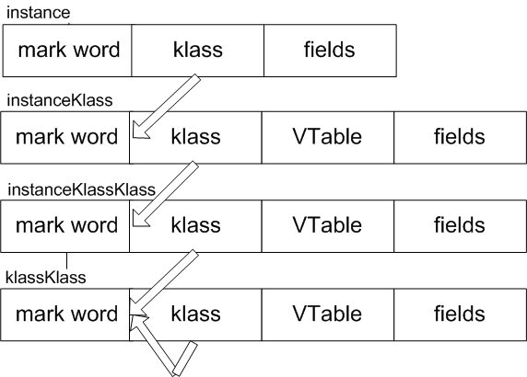
The Hotspot JVM
Heap memory:
new Data()
Data
Class<Data>
Class<Class>
Notes:
note 1: 'klass' is the Hotspot term for class metadata address
note 2: array instances share the same 'klass' hierarchy (instead of fields have a field denoting the 'size' of the array and an array of items
Klass (or Klass word):
pointer to the metadata of the object’s class
vtable of the methods of the class
constant vtable offset for methods

Slide 22
The Hotspot JVM
Mark word contains:
Identity hash code
age
lock record address
monitor address
state (unlocked, light-weight locked, heavy-weight locked, marked for GC)
biased / biasable (includes other fields such as
thread ID)
Notes:
When object is locked, mark word copied into lock record in frame on thread stack. Lock records track objects locked by currently executing methods.
Walk thread stack to find thread's locked objects.
The monitor address is the address of the object's wait queue.

Slide 23
The Hotspot JVM
Architecture:

Slide 24
The Hotspot JVM
Execution engine:
while(true) {
bytecode b = bytecodeStream[pc++];
switch(b) {
case iconst_1: push(1); break;
case iload_0: push(local(0)); break;
case iadd: push(pop() + pop()); break;
}
}

Slide 25
The Hotspot JVM
Execution engine:
while(true) {
bytecode b = bytecodeStream[pc++];
switch(b) {
case iconst_1: push(1); break;
case iload_0: push(local(0)); break;
case iadd: push(pop() + pop()); break;
}
} NOT that simple …

Slide 26
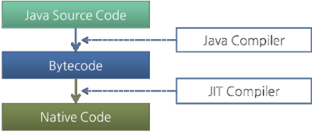
The Hotspot JVM
Different execution techniques:
interpreting
just-in-time (JIT) compilation
adaptive optimization (determines "hot spots" by monitoring execution)
Notes:
The bytecode is first interpreted while the JIT is translating it in the background. Once the JIT compilation is complete, the JVM switches to using that code instead of the interpreter.

Slide 27
The Hotspot JVM
JIT compilation:
triggered asynchronously by counter overflow for a method/loop (interpreted counts method entries and loopback branches)
produces generated code and relocation info (transferred on next method entry)
in case JIT-compiled code calls not-yet-JIT-compiled code control is transferred to the interpreter
Notes:
The bytecode is first interpreted while the JIT is translating it in the background. Once the JIT compilation is complete, the JVM switches to using that code instead of the interpreter.

Slide 28
The Hotspot JVM
JIT compilation:
compiled code may be forced back into interpreted bytecode (deoptimization)
is complemented by On-Stack Replacement (turn dynamically interpreted to JIT compiled code and vise-versa - dynamic optimization/deoptimization)
is more optimized for server VM (but hits start-up time compared to client VM)
Notes:
The bytecode is first interpreted while the JIT is translating it in the background. Once the JIT compilation is complete, the JVM switches to using that code instead of the interpreter.

Slide 29
The Hotspot JVM
JIT compilation flow (performed during normal
bytecode execution):
1) bytecode is turned into a graph
2) the graph is turned into a linear sequence of operations that manipulate an infinite loop of virtual registers (each node places its result in a virtual register)
Notes:
The bytecode is first interpreted while the JIT is translating it in the background. Once the JIT compilation is complete, the JVM switches to using that code instead of the interpreter.

Slide 30
The Hotspot JVM
JIT compilation flow (performed during normal
bytecode execution):
3) physical registers are allocated for virtual registers (the program stack might be used in case virtual registers exceed physical registers)
4) code for each operation is generated using its allocated registers

Slide 31
The Hotspot JVM
Typical execution flow (when using the java/javaw
launcher):
Parse the command line options
Establish the heap sizes and the compiler type (client or server)
Establish the environment variables such as CLASSPATH
If the java Main-Class is not specified on the command line fetch the Main-Class name from the JAR's manifest
Create the VM using JNI_CreateJavaVM in a newly created thread (non primordial thread)
Notes:
JNI_CreateJavaVM
The JNI invocation method performs, the following:
Ensures that no two threads call this method at the same time and that no two VM instances are created in the same process. Noting that a VM cannot be created in the same process space once a point in initialization is reached, “point of no return”. This is so because the VM creates static data structures that cannot be re-initialized, at this time.
Checks to make sure the JNI version is supported, and the ostream is initialized for gc logging. The OS modules are initialized such as the random number generator, the current pid, high-resolution time, memory page sizes, and the guard pages.
The arguments and properties passed in are parsed and stored away for later use. The standard java system properties are initialized.
The OS modules are further created and initialized, based on the parsed arguments and properties, are initialized for synchronization, stack, memory, and safepoint pages. At this time other libraries such as libzip, libhpi, libjava, libthread are loaded, signal handlers are initialized and set, and the thread library is initialized.
The output stream logger is initialized. Any agent libraries (hprof, jdi) required are initialized and started.
The thread states and the thread local storage (TLS), which holds several thread specific data required for the operation of threads, are initialized.
The global data is initialized as part of the I phase, such as event log, OS synchronization primitives, perfMemory (performance memory), chunkPool (memory allocator).
At this point, we can create Threads. The Java version of the main thread is created and attached to the current OS thread. However this thread will not be yet added to the known list of the Threads. The Java level synchronization is initialized and enabled.
The rest of the global modules are initialized such as theBootClassLoader, CodeCache, Interpreter, Compiler, JNI, SystemDictionary, and Universe. Noting that, we have reached our “point of no return”, ie. We can no longer create another VM in the same process address space.
The main thread is added to the list, by first locking the Thread_Lock. The Universe, a set of required global data structures, is sanity checked. The VMThread, which performs all the VM's critical functions, is created. At this point the appropriate JVMTI events are posted to notify the current state.
The following classes java.lang.String, java.lang.System,java.lang.Thread, java.lang.ThreadGroup,java.lang.reflect.Method, java.lang.ref.Finalizer,java.lang.Class, and the rest of the System classes, are loaded and initialized. At this point, the VM is initialized and operational, but not yet fully functional.
The Signal Handler thread is started, the compilers are initialized and the CompileBroker thread is started. The other helper threads StatSampler and WatcherThreads are started, at this time the VM is fully functional, the JNIEnv is populated and returned to the caller, and the VM is ready to service new JNI requests.

Slide 32
The Hotspot JVM
Typical execution flow (when using the java/javaw
launcher):
6. Once the VM is created and initialized, load the Main- Class
7. Invoke the main method in the VM using CallStaticVoidMethod
8. Once the main method completes check and clear any pending exceptions that may have occurred and also pass back the exit status
9. Detach the main thread using DetachCurrentThread,
by doing so we decrement the thread count so the DestroyJavaVM can be called safely
Notes:
DestroyJavaVM
This method can be called from the launcher to tear down the VM, it can also be called by the VM itself when a very serious error occurs.
The tear down of the VM takes the following steps:
Wait until we are the last non-daemon thread to execute, noting that the VM is still functional.
Call java.lang.Shutdown.shutdown(), which will invoke Java level shutdown hooks, run finalizers if finalization-on-exit.
Call before_exit(), prepare for VM exit run VM level shutdown hooks (they are registered through JVM_OnExit()), stop the Profiler,StatSampler, Watcher and GC threads. Post the status events to JVMTI/PI, disable JVMPI, and stop the Signal thread.
Call JavaThread::exit(), to release JNI handle blocks, remove stack guard pages, and remove this thread from Threads list. From this point on we cannot execute any more Java code.
Stop VM thread, it will bring the remaining VM to a safepoint and stop the compiler threads. At a safepoint, care should that we should not use anything that could get blocked by a Safepoint.
Disable tracing at JNI/JVM/JVMPI barriers.
Set _vm_exited flag for threads that are still running native code.
Delete this thread.
Call exit_globals(), which deletes IO and PerfMemoryresources.
Return to caller.

Slide 33
Demo

Slide 34
Summary
No JVMs were injured during this presentation …

Slide 35
Q & A
Thank you !

Slide 36
Resources
The Java Virtual Machine Specification Java SE7 Edition
http://docs.oracle.com/javase/specs/jvms/se7/jvms7.pdf
Mani Sarkar 's collection of Hotspot-related links
https://gist.github.com/neomatrix369/5743225
Hotspot documentation
http://openjdk.java.net/groups/hotspot/

Slide 37
Resources
Hacking Hotspot in Eclipse under Ubuntu 12.04
http://neomatrix369.wordpress.com/2013/03/12/hotspot-is-in-focus-again-aka-hacking-hotspot-in-eclipse-juno-under-ubuntu-12-04/
Garner R., The Design and Construction of High Performance Garbage Collectors, PhD thesis
https://digitalcollections.anu.edu.au/handle/1885/9053

Slide 38
Resources
Shi Y., Virtual Machine Shutdown: Stack versus Registers, PhD Thesis https://www.cs.tcd.ie/publications/tech-reports/reports.07/TCD-CS-2007-49.pdf
Compiler and JVM Research at JKU
http://www.ssw.uni-linz.ac.at/Research/Projects/JVM/

Slide 39
Resources
Xavier Leroy, Java bytecode veriﬁcation: algorithms and formalizations http://pauillac.inria.fr/~xleroy/publi/bytecode-verification-JAR.pdf
FOSDEM 2007
http://openjdk.java.net/groups/hotspot/docs/FOSDEM-2007-HotSpot.pdf

Slide 40
Resources
The Architecture of the Java Virtual Machine
http://www.artima.com/insidejvm/ed2/jvm2.html

