Slide 1
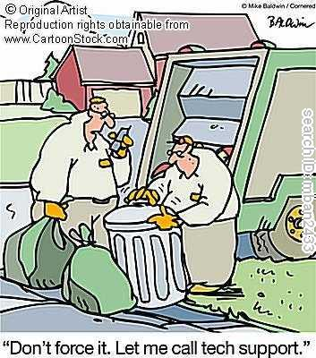
GARBAGE COLLECTION
CSCE-531
Ankur Jain
Neeraj Agrawal

Slide 2
OUTLINE
What is Garbage Collection?
Why Garbage Collection?
Garbage Collection in Java
  GC Approaches
Garbage Collection in .Net

Slide 3
WHAT IS GARBAGE COLLECTION?
Memory Management technique.
Process of freeing objects.
No longer referenced by the program.

Slide 4
WHY GARBAGE COLLECTION?
Free unreferenced objects.
Combat heap fragmentation.
Relieves programmer from manual freeing the memory.
Helps in ensuring program integrity.
Disadvantages
  Extra Overhead.
  Less control over scheduling of CPU time.

Slide 5
GARBAGE COLLECTION IN JAVA
Purpose
  Find and delete unreachable objects.
  Free space as much as possible.
When??
  GC is under control of JVM.
  One can request but no guarantees.
How??
  Discovery of unreachable objects.
  With the help of Algorithms.

Slide 6
GARBAGE COLLECTION IN JAVA
Ways for making objects eligible for collection
  Nulling a reference
  Reassigning a reference variable
  Isolating a reference
Forcing garbage collection
  Methods available to perform GC
  Only requests and no demands
  Using Runtime class
  Using static methods like System.gc()

Slide 7
GARBAGE COLLECTION ALGORITHMS
Basic Approaches
  Reference Counting
  Tracing
  Compacting
  Copying
  Generational
  The Train Algorithm

Slide 8
REFERENCE COUNTING
Reference Counting
  Count for each object.
  Count increases as number of reference increases.
  Eligible for GC when count equals zero.
Advantages
  Can run in small chunks of time
  Suitable for real time environments
Disadvantages
  Does not detect cycles
  Overhead of incrementing and decrementing reference count.

Slide 9
TRACING
Traverse through the graph
Starts from root node
Marking is done
  By setting flags in objects themselves
  By setting flags in separate bitmaps
Unmarked objects known to be unreachable
Also known as Mark and Sweep algorithm.

Slide 10
COMPACTING COLLECTORS
Combat heap fragmentation
Slide live objects to one end
References are updated
  Table of object handles as another approach
  Refers to actual object
  Simplifies heap defragmentation problem
  Performance overhead

Slide 11
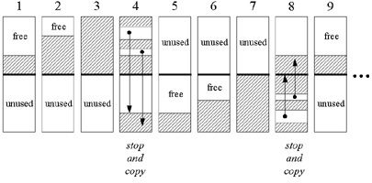
COPYING COLLECTORS
Heap is divided in two regions.
All live objects copied to new area.
Only one area is used at a time.
Objects are copied to new area on the fly.
Common method – Stop and Copy
Memory requirements is disadvantage.

Slide 12
GENERATIONAL COLLECTORS
Based on lifetimes of objects.
  Short lived objects
  Long lived objects
Collection of short lived objects done more often.
Heap is divided into two or more sub heaps
Objects are promoted to different heaps based on survival.
Can also be applied to mark & sweep as well as to Copying collectors.

Slide 13
THE TRAIN ALGORITHM
Potential Disadvantage
  No control over CPU scheduling.
Outcome
  Program stops execution
  May stop for arbitrary long time
  Known as disruptive algorithm.
Solution
  Incremental garbage collection
  Generational garbage collector.

Slide 14
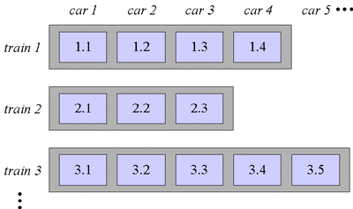
THE TRAIN ALGORITHM
Time bounded incremental collection
Divides mature object space in fixed size blocks known as cars.
Collection of these cars/blocks is trains/sets.
Old enough objects make it to mature object space.
Either shunted to one of the existing train or start new train.

Slide 15
THE TRAIN ALGORITHM
Working
  Collects lowest numbered car or train.
  Checks references inside and outside mature object space.
  Moves the object to lowest numbered car or to other train if references exist.
  Results in collection of large cyclic data.
  Also cyclic data ends up in same train.
Disadvantage
  Cant guarantee some limit below which algorithm will complete its functioning.

Slide 16
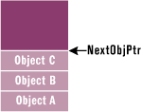
THE .NET WAY
Microsofts .NET common language runtime requires that all resources be allocated from the managed heap.
Managed heap has a pointer NextObjPtr which indicates where the next object is to be allocated within the heap.

Slide 17
THE GARBAGE COLLECTION ALGORITHM
The garbage collector checks to see if there are any objects in the heap that are no longer being used by the application.
If such objects exist, then the memory used by these objects can be reclaimed.
If no more memory is available for the heap, then the new operator throws an OutOfMemoryException.

Slide 18
HOW GC KNOWS IF APP. IS USING OBJECT OR NOT
Every application has a set of roots.
Roots identify storage locations, which refer to objects on the managed heap or to objects that are set to null.
The list of active roots is maintained by the just-in-time (JIT) compiler and common language runtime, and is made accessible to the garbage collector's algorithm.

Slide 19
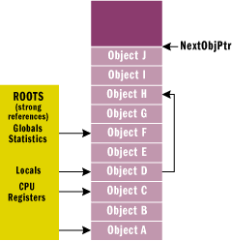
GC constructs graph of all reachable objects based on assumption that all objects are garbage.

Slide 20
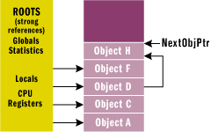
The GC walks through the heap linearly, looking for garbage objects (free space now).
GC then shifts non garbage objects down in the memory, removing all the gaps in the heap.

Slide 21
FINALIZATION
By using finalization, a resource representing a file or network connection is able to clean itself up properly when the garbage collector decides to free the resource's memory.
When the garbage collector detects that an object is garbage, the garbage collector calls the object's Finalize method (if it exists) and then the object's memory is reclaimed.

Slide 22
FINALIZATION
Finalize is very different from destructors.
Finalizable objects get promoted to older generations, which increases memory pressure.
All objects referred to directly or indirectly by this object get promoted as well.
Forcing the garbage collector to execute a Finalize method can significantly hurt performance.
Finalizable objects may refer to other (non-finalizable) objects, prolonging their lifetime unnecessarily.

Slide 23
FINALIZATION
You have no control over when the Finalize method will execute. The object may hold on to resources until the next time the garbage collector runs.
If you determine that your type must implement a Finalize method, then make sure the code executes as quickly as possible. Avoid all actions that would block the Finalize method

Slide 24
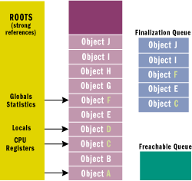
FINALIZATION INTERNALS
Each entry in the queue points to an object that should have its Finalize method called before the object's memory can be reclaimed.

Slide 25
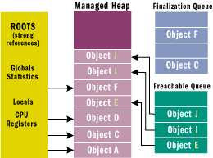
FINALIZATION INTERNALS
At this point, the garbage collector has finished identifying garbage.
There is a special runtime thread dedicated to calling Finalize methods.

Slide 26
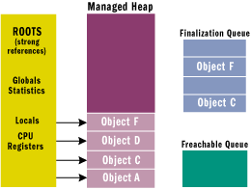
FINALIZATION INTERNALS
The next time the garbage collector is invoked, it sees that the finalized objects are truly garbage.
This time the memory for the object is simply reclaimed.

Slide 27
RESURRECTION
An object requiring finalization dies, lives, and then dies again, this phenomenon is called resurrection.
public class BaseObj {
protected override void Finalize() {
Application.ObjHolder = this;
GC.ReRegisterForFinalize(this);
}
}

Slide 28
REFERENCES
SCJP Sun Certified Programmer for Java 5 Study Guide – Kathy Sierra and Bert Bates.
Professional C# 2008 (Wrox Publications) – Christian Nagel, Bill Evjen, Jay Glynn, Morgan Skinner and Karli Watson.
http://www.artima.com/insidejvm/ed2/gc.html
http://msdn.microsoft.com/en-us/magazine/bb985010.aspx

Slide 29

QUESTIONS!!

Slide 30


