Slide 2



Java Flight Recorder Deep Dive
Marcus Hirt Consulting Member of Technical Staff

Slide 3
Agenda
Flight Recorder Overview (recap)
Producing Flight Recordings
Analyzing Flight Recordings
Overview/Key indicators
Method Profiling
Memory Allocation

Slide 4
Agenda cont’d
GC analysis
Weblogic plug-in
Using the Operative Set
Common pitfalls/misunderstandings
Customization (unsupported)
Adding custom events (unsupported)
Customizing the GUI (unsupported)

Slide 5
The following is intended to outline our general product direction. It is intended for information purposes only, and may not be incorporated into any contract. It is not a commitment to deliver any material, code, or functionality, and should not be relied upon in making purchasing decisions. The development, release, and timing of any features or functionality described for Oracle’s products remains at the sole discretion of Oracle.

Slide 6
Flight Recorder History
Started out with JRockit Runtime Analyzer
A means to get more information about the JVM and applications running on the JVM
Addition to JRA – LAT
Latency Analyzer Tool
Soft real time GC (Deterministic GC) – important to discover non-GC related latencies
Customer wanted always on capability – JRockit Flight Recorder
Low overhead imperative
Dump at any time to get data collected so far
Notes:
Thread start & stop
Recording metadata

Slide 7

Java Flight Recorder
JVM Convergence
Already released the engine with 7u4
JMC client has also released!
5.0 release (April 2012)
5.1 release (August 2012)
Only available for WLS customers (MOS)
Waited until 7u40 to release with JDK
Only a very limited number of Java and JVM events available!
Did not want to release with the JDK until proper events available
Lot’s of WLDF (third party) events though
Notes:
Thread start & stop
Recording metadata

Slide 8
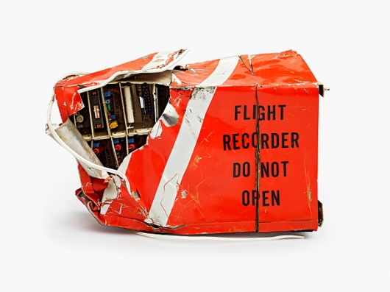
Flight Recorder
101
High Performance Event Recorder
Binary recordings
Chunks
Self contained
Self describing

Slide 9
Different Kinds of Recordings
Continuous Recordings
Have no end time
Must be explicitly dumped
Time Fixed Recordings (sometimes known as profiling recordings)
Have a fixed time
Will be automatically downloaded by Mission Control when done (if initiated by Mission Control)
Notes:
Thread start & stop
Recording metadata

Slide 10
How to Think About Recordings
Recordings are collections of event type settings
A “recording” can both mean an ongoing recording on the server side, as well as a recording file. The context usually separates the two.
It might help to think of the server side recording as:
A named collection of event type settings…
…that are active for a certain period of time.

Slide 11
How to Think About Recordings
Example
A continuous recording R₀ is started at T₀ with settings S₀. After a while, a time fixed recording R₁ is started at T₁ with settings S₁, where S₁ ⊃ S₀. The time fixed recording R₁ ends at T₂. This is what will be recorded:
If dumping R₀ for a time range intersecting [T₁,T₂], you will get information that you did not ask for in the settings (S₀). All this in the name of performance. Once T₂ arrives, the settings for R₁ will be popped, and we’re back to just recording S₀.
Time | Settings
T₀→T₁ | S₀
T₁→T₂ | S₀ ∪ S₁
>T₂ | S₀

Slide 12
Different Kinds of Events
Instant Event
Data associated with the time the data was captured
Requestable Event
Polled from separate thread
Has a user configurable period
Duration Event
Has a start time and a stop time
Timed Event
Like Duration Event, but with user configurable threshold

Slide 13
Flight Recorder Inner Workings
Performance, performance, performance
Extremely low overhead
Using data already gathered
High performance recording engine
Third party events
WLS events already available
DMS events already available
Glass Fish events on the way
You can add your own! (Not supported yet.)
Notes:
Thread start & stop
Recording metadata

Slide 14

Producing Recordings

Slide 15
Preparations
Hotspot
Need to have started the JVM from which to get recording with the appropriate flags (for now) -XX:+UnlockCommercialFeatures -XX:+FlightRecorder
Need to have a recent enough JDK
7u4, if having only WLS events are enough
7u40 and later if Java & JVM events are of interest
If remote monitoring is required:
Start with the appropriate com.sun.management flags
In 7u40 JDP can be used for easy discovery of manageable JVMs on the network
Notes:
Thread start & stop
Recording metadata

Slide 16
Creating Recordings Using Mission Control
Easy and intuitive
Find a JVM to do a recording on in the JVM Browser
Double click the Flight Recorder node under the JVM
Follow the wizard (will show demo soon)
Note: Ongoing recordings are listed as nodes under the Flight Recorder node. To dump one, simply drag and drop the ongoing recording to the editor area, or double click it. This is mostly useful for continuous recordings.
Notes:
Thread start & stop
Recording metadata

Slide 17
Creating Recordings Using Startup Flags
Useful for enabling continuous recordings at startup
Documentation of startup flags available in the JDK docs
The following example starts up a 1 minute recording 20 seconds after starting the JVM: -XX:+UnlockCommercialFeatures -XX:+FlightRecorder -XX:StartFlightRecording=delay=20s,duration=60s,name=MyRecording,filename=C:\TEMP\myrecording.jfr,settings=profile
The settings parameter takes either the path to, or the name of, a template
Default templates are located in the jre/lib/jfr folder.
Note: Using the settings parameter will require either a JRockit or a Hotspot 7u40 or later.
To get more information on what is going on, change the log level: -XX:FlightRecorderOptions=loglevel=info
Notes:
Thread start & stop
Recording metadata

Slide 18
The Default Recording
Shorthand for starting a continuous recording. With benefits.
Special short hand to start the JVM with a continuous recording
Started with -XX:FlightRecorderOptions=defaultrecording=true
The default recording will have the recording id 0
Only the default recording can be used with the dumponexit and dumponexitpath parameters
The following example will start up the continuous recording. It will be dumped when the JVM exits to C:\demos\dumponexit.jfr. -XX:+UnlockCommercialFeatures -XX:+FlightRecorder -XX:FlightRecorderOptions=defaultrecording=true,dumponexit=true,dumponexitpath=C:\demos\dumponexit.jfr
Notes:
Thread start & stop
Recording metadata

Slide 19
Creating Recordings Using JCMD
Useful for controlling JFR from the command line
Usage: jcmd <pid> <command>
Example starting a recording: jcmd 7060 JFR.start name=MyRecording settings=profile delay=20s duration=2m filename=c:\TEMP\myrecording.jfr
Example checking on recordings: jcmd 7060 JFR.check
Example dumping a recording: jcmd 7060 JFR.dump name=MyRecording filename=C:\TEMP\dump.jfr
Notes:
Thread start & stop
Recording metadata

Slide 20
Recording creation DEMO

Slide 21
Analyzing Recordings

Slide 22
Analyzing Flight Recordings in JMC
All tab groups except for the general Events tab group are preconfigured to show a certain aspect of the recording (sometimes referred to as static or preconfigured tabs)
The pre-configured tabs highlights various areas of common interest, such as code, memory & GC, threads and IO
General Events tab group - useful for drilling down further and for rapidly homing in on a set of events with certain properties

Slide 23
The Operative Set
Power Feature
The Operative Set is a global set of events
Events can be added or removed to the operative set from the context menu
The Events tabs usually have a check box to only show events in the operative set
Using the Events tabs together with the Operative Set is a powerful way to home in on events with a certain set of properties

Slide 24
Common Features in Most Tabs
Almost all tabs have a range selector at the top
Used to filter on a time range
Can be synchronized between all tabs
Highlights events in the operative set in cyan
The tabs in the Events tab group can be used in conjunction with the Event Types view to filter on Event Types
In filter boxes:
Kleene star can be used as wildcard (*.sun.*)
Start with regexp: if more power is needed (regexp:.*\.sun\..*) (not as performant though)

Slide 25
Programmatically Analyzing Flight Recordings
Using the JMC parser (Unsupported)
The parser included in Mission Control can be used to analyze recordings programmatically
If enough people want to, I can write a blog on how it can be used
The JMC team also have an experimental JDBC bridge

Slide 26
Some Common Pitfalls
Not accounting for thresholds
Thresholds are very useful for keeping performance up but still detecting outliers
Can be confusing. Example: Thread T has been running for 2 minutes and sum of latencies is a minute. Was the thread T running unblocked for a minute?
Not accounting for CPU load
Don’t make decisions based on method profiling data if there is no load
If you have full load, then looking at latencies may be a waste of time

Slide 27
Analyzing Recordings - DEMOS

Slide 28
Customization

Slide 29
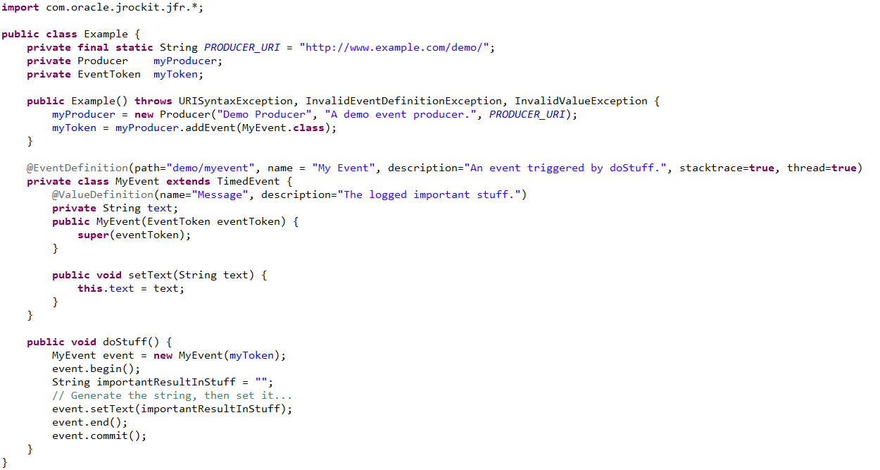
Adding Your Own Events (unsupported)

Slide 30
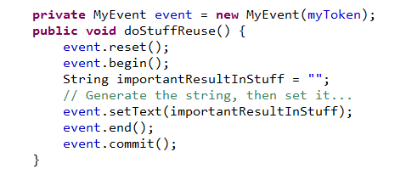
Minimizing Object Creation
Can reuse event objects
Use with care – only where you know it’s thread safe
!

Slide 31
Built in GUI editor (unsupported)
The JMC has a built in designer
Can be used to both customize the existing GUI and produce entirely new GUIs for events
The created GUIs can be exported as plug-ins and shared

Slide 32
Customization DEMOS

Slide 33
Future

Slide 34
Dynamic Flight Record Event Generation
BCI based JFR Event Generation Framework
Uses BCI to dynamically insert event generation probes
Also includes an annotation framework
Will provide easy to use syntax for generating flight recording events on method calls, entries or exits
Will use the same BCI framework, which allows for enabling/disabling the events dynamically

Slide 35
Flight Recorder Heuristics Engine
Automatic analysis of Flight Recordings
Provides automated analysis of Flight Recording data
Automatically provides diagnostics information
Automatically suggests potential performance enhancements
Engine can be used by third party consumers

Slide 36
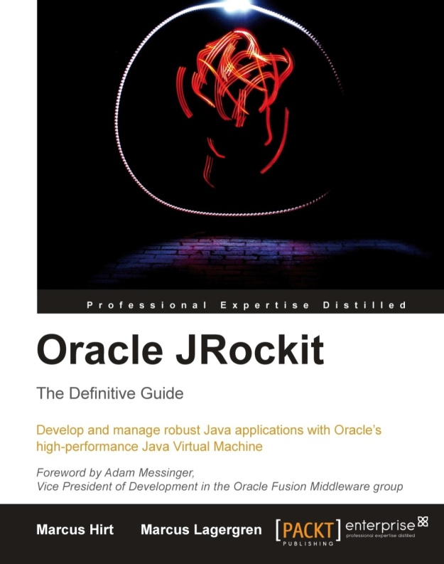
Shameless Book Plug
Oracle JRockit: The Definitive Guide

