Slide 1
Java Garbage Collection
Carol McDonald
  Java Architect
    Sun Microsystems, Inc.

Slide 2




Speaker
Carol cDonald:
  Java Architect at Sun Microsystems
  Before Sun, worked on software development of:
    Application to manage Loans for Big Banks (>10 million loans)
    Pharmaceutical Intranet (Roche Switzerland)
    Telecom Network Mgmt (Digital France)
    X.400 Email Server (IBM Germany)

Slide 3

Garbage
Collection
Notes:
Lets look at some of the changes and new features in the Java Virtual Machine

Slide 4
Classic Memory Leak in C
User does the memory management
void service(int n, char** names) {
for (int i = 0; i < n; i++) {
  char* buf = (char*) malloc(strlen(names[i]));
  strncpy(buf, names[i], strlen(names[i]));
}
// memory leaked here
}
User is responsible for calling free()
User is vulnerable to dangling pointers and double frees.
Notes:
Why are we here?
In C/C++ you do the memory management.
You make the calls to malloc() and the calls to free(). Forget the calls to free() and you're leaking memory..
And, of course, you don't use the memory once it's been freed.
And, you free memory exactly once.

Slide 5
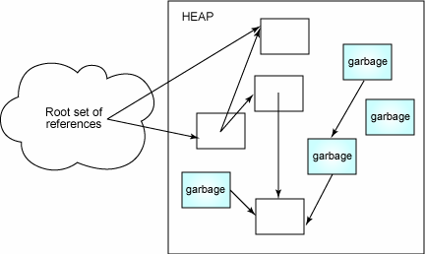
Garbage Collection
Find and reclaim unreachable objects
  not reachable from the application roots:
    (thread stacks, static fields, registers.)
  Traces the heap starting at the roots
    Visits every live object
  Anything not visited is unreachable
    Therefore garbage
Variety of approaches
  Algorithms: copying, mark-sweep, mark-compact, etc.
Notes:
In a nutshell, a GC
...
Our garbage collectors are generational, meaning we divide the heap into two regions and don't have to always collect the entire heap. When we only collect one of the regions we call it a minor collection. Minor collections are typically much faster than major collections and often collect enough memory so as to delay the more expensive major collection.

Slide 6
Garbage Collection
Garbage collection: Pros
  Increased reliability – no memory leaks, no dangling pointers
    Eliminates entire classes of (Pointer) bugs, no segmentation fault, no double frees
    Improved developer productivity
  True memory leaks are not possible
    possible for an object to be reachable but not used by the program
    unintentional object retention, Can cause OutOfMemoryError
    Happens less often than in C, and easier to track down
Cons
  Pauses
Notes:
So garbage collection is your friend.
The source of some ugly bugs has removed.
You spend more time on the interesting stuff.
You don't have to think about memory management as much in your design.
But there are some costs.
Your going to have pauses in the application execution when a GC occurs.
You don't know when a GC is going to occur and don't know how long it is going to take.
Finalization depends on GC's.
User's of you programs may want to choose among the different collectors to achieve a particular performance (e.g., better throughput or shorter pause times). Some tuning may be required.

Slide 7
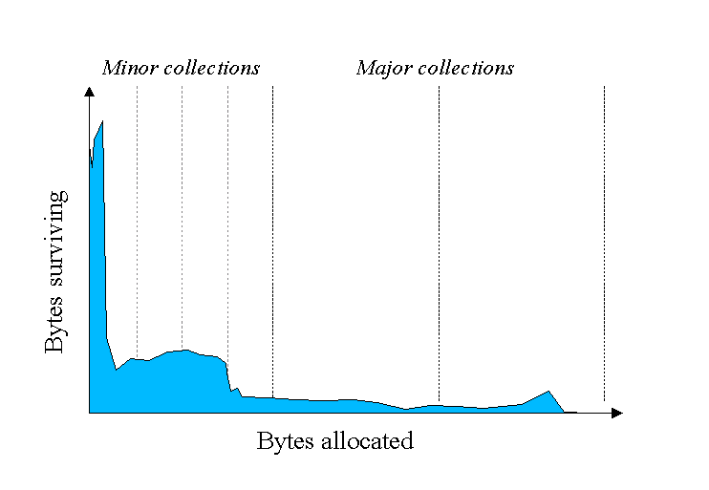
Statistics
Most objects are very short lived
  80-98%
Old objects tend to live a long time
  avoid marking and sweeping the old
Notes:
When Sun did the original work on the HotSpot development they did a lot of analysis of applications and how they behaved with respect to the VM (as we saw in the earlier slide showing the pie charts). Part of this analysis revealed some interesting data about the typical lifetime of objects. As we see here most objects are very short lived. Knowing this has a significant impact on the choice of algorithms used for GC and the design of the heap layout.

Slide 8
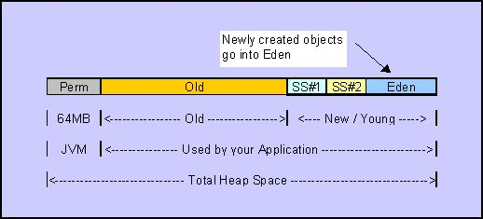
Generational Garbage Collection
Keep young and old objects separate
  In spaces called generations
Different GC algorithms for each generation
  “Use the right tool for the job”
Notes:
Java does the memory management for you.
The JVM finds the data that is still in use by the program. This data is referred to a reachable. Anything else is collected as garbage.
You never have the equivalent of a dangling pointer. If you have a reference to data, it's there, it has not been collected as garbage.
No free's obviously means no double frees.
In principle you cannot have a true memory leak but there are things that you can do that are as bad in practice.
Basically, you have a reference to data that is never going to be used again. This is more accurately described as unintential object retention but is often just called a memory leak.
If your program has such a memory leak, you'll ...

Slide 9
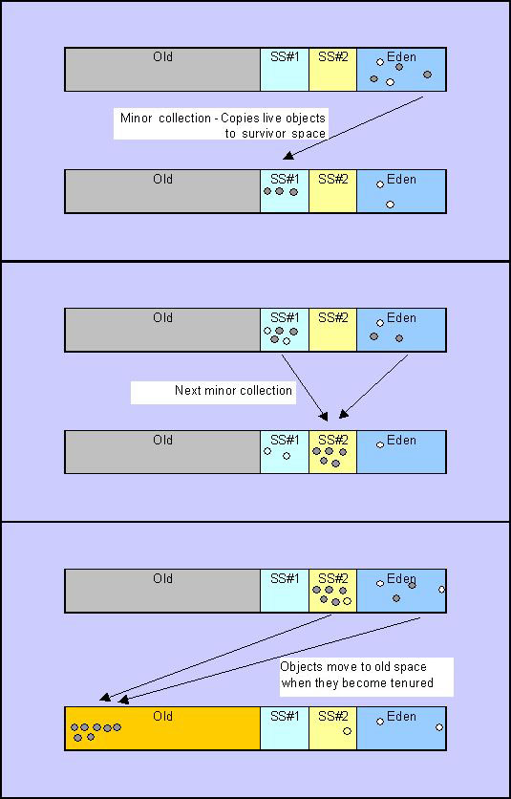
How Generational GC Works
Notes:
When we first allocate object, we treat it as Eden space it is stack based allocation, we allocation chunk of memory where we maintain a pointer to the beginning of it, and move the pointer along, putting the object in that space. No search for free list, very efficient. When Eden space is full, we do GC on this, we stamp the valid objects, if the object is valid we copy it from Eden to semi spaces “from space”, GC pause is directly proportional to total size of live objects, so this done very efficiently, ... do a copy into then “to space”, that's what we call Tenuring by doing this we are maturing objects. Most of the objects in Eden space are very young and short lived, and in 2 semi spaces are a little bit long lived. We actually tune how long the objects are going to stay in that young generation. We then copy all those valid objects from semi space to old generation. Again use simple stack based allocation to allocate the objects. For old generation, we have a different GC algorithm, may be incremental, mark-sweep compact, we have choices what we do that. Also another space is called permanent space, it's used for classes information. You don't allocate or put things in those objects, the VM will actually use it for classes information.
Default sizes: 64 KB for semi space is not very large, so we will talk how you can change that. Survivor ration is eden and 2 semi spaces, changing the value is going to impact the performance
??? Young generation fits for copy collect while old is more for the others

Slide 10
Incremental Garbage Collection
Minor Garbage Collection (scavenge)
  When eden is “full” a minor gc is invoked
  Sweeps through eden and the current survivor space, removing the dead and moving the living to survivor space or old
  Ss0 and ss1 switch which is “current” A new tenuring age is calculated
Major Garbage Collection
  When old is “full”
  All spaces are garbage collected including perm space
  All other activities in the jvm are suspended
Notes:
The point here is to make it so that the garbage collection proces is not as disruptive to your application. So the garbage collector works at the same time as your application , short stop do a little work then go back, so that you dont see one long pause. Has some overhead that lowers throughput a little. The young generatons collections are short already so there is no need to put that extra overhead on the young generation
We only do incremental of the old generation

Slide 11
New Old Space Tuning
25-40% should be new space
how much new space depends on App:
  Stateless Request centric Application with high morbidity rate needs more new space for scalability
  Stateful Workflow Application with more older objects needs more old space

Slide 12
Garbage Collection
Myths about garbage collection abound
  Myth: Allocation and garbage collection are slow
    In JDK 1.0, they were slow (as was everything else)
    Memory management (allocation + collection) in Java is often significantly faster than in C
      Cost of new Object() is typically ten machine instructions
      It's just easier to see the collection cost because it happens all in one place
Early performance advice suggested avoiding allocation
  Bad idea!
  Alternatives (like object pooling) are often slower, more error prone, and less memory-efficient
Notes:
Before going further let me tell you about memory management on a modern Java platform.
Allocation is definitely not slow. It was slow in ...
Garbage collection has gotten much, much faster than in the early days but a collection does still happen all at the same time so it's noticeable.
We don't use reference counting. That's notable because reference counting does slow down the execution of the program.
Because early performance was an issue, there's some lingering advice on how to get better performance. Much of that is out dated.
And some of the bad advice actually leads to memory leaks.

Slide 13
Object Allocation (1/2)
Typically, object allocation is very cheap!
  10 native instructions in the fast common case
  C/C++ has faster allocation? No!
Reclamation of new objects is very cheap too!
  Young GCs in generational systems
So
  Do not be afraid to allocate small objects for intermediate results
  Generational GCs love small, short-lived objects
Notes:
Memory allocation is fast , really cheap
You don't have to keep track of the remembered set, tracking pointers from old to young, does not have to be done for younger objects. Short lived objects can be reclaimed very fast

Slide 14
Object Allocation (2/2)
We do not advise
  Needless allocation
    More frequent allocations will cause more frequent GCs
We do advise
  Using short-lived immutable objects instead of
  long-lived mutable objects
  Using clearer, simpler code with more allocations instead of more obscure code with fewer allocations

Slide 15
Large Objects
Very large objects are:
  Expensive to allocate (maybe not through the fast path)
  Expensive to initialize (zeroing)
  Can cause performance issues
Large objects of different sizes can cause fragmentation
  For non-compacting or partially-compacting GCs
Avoid if you can
  And, yes, this is not always possible or desirable

Slide 16
Object Pooling (1)
Legacy of older VMs with terrible
allocation performance
Remember
  Generational GCs love short-lived,
  immutable objects…
Unused objects in pools
  Are like a bad tax, the GC must process them
  Safety
    Reintroduce malloc/free mistakes
  Scalability
    Must allocate/de-allocate efficiently
    synchronized defeats the VM’s fast allocation mechanism

Slide 17
Object Pooling (3/3)
Exceptions
  Objects that are expensive to allocate and/or initialize
  Objects that represent scarce resources
  Examples
    Threads pools
    Database connection pools
  Use existing libraries wherever possible

Slide 18
Memory Leaks?
But, the GC is supposed to fix memory leaks!
The GC will collect all unreachable objects
But, it will not collect objects that are
still reachable
Memory leaks in garbage collected heaps
  Objects that are reachable but unused
  Unintentional object retention
Notes:
Okay, so we don't have true memory leak, right?
But we can hold onto objects that are never going to be used again. You can find plenty of examples of such objects ...
In the best case such objects cause more work for the garbage collector. In the worst case you can get an out-of-memory exception because of them.
In the next few slides we'll look at three examples of these types of memory leaks.

Slide 19
Memory Leak Types
“Traditional” memory leaks
  Heap keeps growing, and growing, and growing…
  OutOfMemoryError
“Temporary” memory leaks
  Heap usage is temporarily very high, then it decreases
  Bursts of frequent GCs

Slide 20
Memory Leak Sources
Objects in the wrong scope
Lapsed listeners
Exceptions change control flow
Instances of inner classes
Metadata mismanagement
Use of finalizers/reference objects

Slide 21
Objects in the Wrong Scope (1/2)
Below, names really local to doIt()
  It will not be reclaimed while the instance of Foo is live
class Foo {
private String[] names;
public void doIt(int length) {
if (names == null || names.length < length)
names = new String[length];
populate(names);
print(names);
}
}
Notes:
In this example an object that stays around longer than it is needed.
“byteArray” is part of “LeakyChecksum” so will live as long as the LeakyChecksum object live. It is. however only. needed during the invocation of geFileChecksum.
Now maybe this is ok, but realize that byteArray is going to be as large as the largest file ever read, the garbage collector has to look at it at each collection, and the space would be used more profitably for the allocation of other objects.

Slide 22
Objects in the Wrong Scope (2/2)
Remember
  Generational GCs love short-lived objects
class Foo {
public void doIt(int length) {
String[] names = new String[length];
populate(names);
print(names);
}
}

Slide 23
Memory Leak Sources
Objects in the wrong scope
Lapsed listeners
Exceptions change control flow
Instances of inner classes
Metadata mismanagement
Use of finalizers/reference objects

Slide 24
Exceptions Change Control Flow (1/2)
Beware
  Thrown exceptions can change control flow
try {
ImageReader reader = new ImageReader();
cancelButton.addActionListener(reader);
reader.readImage(inputFile);
cancelButton.removeActionListener(reader);
} catch (IOException e) {
// if thrown from readImage(), reader will not
// be removed from cancelButton's listener set
}

Slide 25
Exceptions Change Control Flow (2/2)
Always use finally blocks
ImageReader reader = new ImageReader();
cancelButton.addActionListener(reader);
try {
reader.readImage(inputFile);
} catch (IOException e) {
...
} finally {
cancelButton.removeActionListener(reader);
}

Slide 26
Memory Leak Sources
Objects in the wrong scope
Lapsed listeners
Exceptions change control flow
Instances of inner classes
Metadata mismanagement
Use of finalizers/reference objects

Slide 27
Metadata Mismanagement (1/2)
Sometimes, we want to:
  Keep track of object metadata
  In a separate map
class ImageManager {
private Map<Image,File> map =
new HashMap<Image,File>();
public void add(Image image, File file) { ... }
public void remove(Image image) { ... }
Public File get(Image image) { ... }
}
Notes:
This third example of a memory leak is less easy to workaround.
You have an object and you want to associate some information with that object but you cannot put the information in the object itself. In this case you have a socket and want to associate a user id with the socket. A natural solution is to create a map between the socket and the user id as here in the SocketManager. Here the example uses a HashMap w

Slide 28
Metadata Mismanagement (2/2)
What happens if we forget to call remove(image)?
  never be removed from the map
  Very common source of memory leaks
We want:
  purge the corresponding entry when the key is not reachable…
That’s exactly what a WeakHashMap does
  purge the corresponding entry
private Map<Image,File> map =
new WeakHashMap<Image,File>();
Notes:
Here's the example with a fix using the WeakHasMap.
WeakHashMap give you the direct connection between the key and the metadata that you need here.
Don't replace all your HashMaps with WeakHashMaps. Reference processing does cost during GC and it would be a waste to always use it.

Slide 29
Some Memory Management Myths
Myth: Explicitly nulling references helps GC
  Rarely helpful
    Unless you are managing your own memory
  Can be harmful to correctness or performance
Myth: Calling System.gc() helps GC
  Triggers full collection – less efficient
  Can be a huge performance loss
Myth: Avoid object allocation
  Allocation in Java is lightning fast
    Avoidance techniques (e.g., pooling) are very tricky to get right
Notes:
Have a explicit reason if you are going to null a reference. Mostly it doesn't help. Occasionally it's exactly the wrong thing to do.
A System.gc() will trigger an full collections. In tuning the GC we often try hard to minimize full collections. Understand why you are doing System.gc().
Allocation is fast so just use it. Object pooling has costs in terms of filling up the heap so, again, understand what you are doing.

Slide 30
Local Variable Nulling
Local variable nulling is not necessary
  The JIT can do liveness analysis
void foo() {
int[] array = new int[1024];
populate(array);
print(array); // last use of array in method foo()
array = null; // unnecessary!
// array is no longer considered live by the GC
...
}

Slide 31
Some Memory Management Myths
Myth: Finalizers are Java's idea of destructors
  Finalizers are rarely needed and very hard to use correctly!
    Should only be used for native resources
    Adds significant work to GC, has significant performance effect
  Instead, use finally blocks to release resources
Resource r = acquireResource();
try {
useResource(r);
}
finally {
releaseResource(r);
}
    Note resource acquisition is outside the try block
    Use for file handles, database connections, etc
Notes:
You are not guaranteed that a finalizer will ever run so, if you use them, you need design for that contigency.
Regarding finalization we mostly hear from people who are trying to manage a scarce native resource which is probably the wrong thing to do.
Try to use finally block first. That's the simplest and most deterministic.

Slide 32
Virtual Machine
Smart Tuning
Notes:
Lets look at some of the changes and new features in the Java Virtual Machine

Slide 33
How “Smart Tuning” Works
Provide good “out of the box” performance without hand tuning
Determine type of machine JVM is running on configure Hotspot appropriately
Server machine
  Larger heap, parallel garbage collector, and server compiler
Client machine
  Same as 1.4.2 (small heap, serial garbage collector, and client compiler
Notes:
The big goal of “smart tuning” sometimes referred to as ergonomics, was good out-of-the-box performance for server applications. From the early days the VM has been tuned to run well with desktop applications because the overwelling majority of executions were for desktop applications.
That hurts when customers run benchmarks for large server applications because that is often done without tuning the VM.
In tiger we look at the machine we're running on and try to make some smarter choices.
We've also added a simplified way of tuning garbage collection.

Slide 34
“Smart Tuning”
Dynamically adjust Java HotSpot VM software environment at runtime
Adaptive Heap Sizing policy
Simple tuning options based on application requirements not JVM internals

Slide 35
Effects of Tuning
Tuned vs. Non-tuned JVM
Notes:
This slide shows the effects of tuning on 4 benchmarks. This is without “Smart tuning”. Bigger is better. The 1.4.2 untuned VM is in blue and the hand tuned tiger VM is in red. Tuning can make a big difference.
Business logic – specjbb2000
Bytecodes – specjvm98
i/o – jetstream
Scientific – scimark2

Slide 36
Hand Tuned vs. Smart Tuning
Notes:
This is tiger tuned versus out-of-the-box performance on the same benchmarks.
The blue is the out-of-the-box performance for tiger and the red again is the hand tuned tiger VM.
Smart tuning has made tiger out-of-the-box performance is much closer to the tuned performance.

Slide 37
Monitoring &
Management
Notes:
Lets look at some of the changes and new features in the Java Virtual Machine

Slide 38
Memory Leak Detection Tools
Many tools to choose from
“Is there a memory leak”?
  Monitor VM’s heap usage with jconsole and jstat
“Which objects are filling up the heap?”
  Get a class histogram with jmap or
  -XX:+PrintClassHistogram and Ctrl-Break
“Why are these objects still reachable?”
  Get reachability analysis with jhat

Slide 39
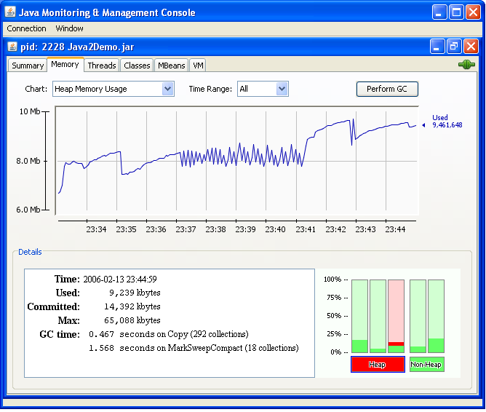
Monitoring, Management, Diagnostics
GUI tools: JConsole, jhat, VisualGC (NetBeans), dynamic attach
Command line tools: jps, jstat, jstack, jmap, jinfo
Diagnostics: CTRL-Break handler, heap dump, better OutOfMemoryError and fatal error handling, JNI crashes
Tracing/logging: VM tracing and HotSpot probes, DTrace integration
http://blogs.sun.com/roller/page/dannycoward/20060310

Slide 40
Monitoring and Management
Attach on demand for
  jconsole: can connect to applications that did not start up with the JMX agent
  jstack: takes a 'photograph' of all the threads and what they are up to in their own stack frames
  jmap: takes a detailed 'photograph' of what's going on in memory at any one point in time
  jhat: forensic expert that will help you interpret the result of jmap

Slide 41
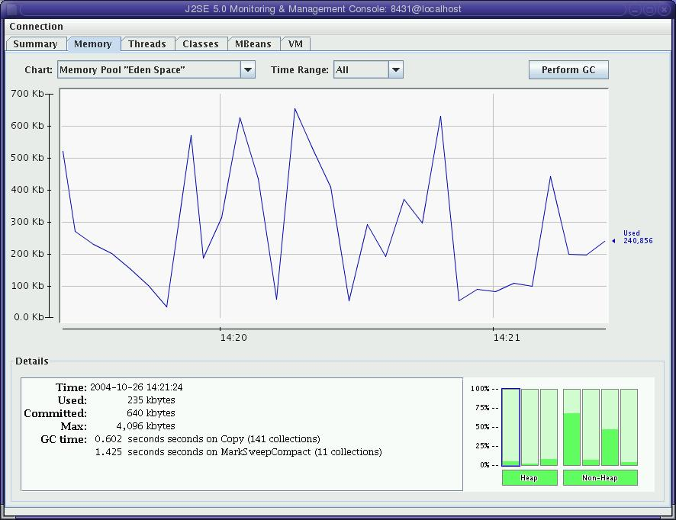
Jconsole
http://www.netbeans.org/kb/articles/jmx-getstart.html

Slide 42
NetBeans Profiler
Low overhead profiling
Attach to running applications
CPU performance profiling
Memory profiling
Memory leak debugging
Task based profiling
Processing collected data offline
http://www.netbeans.org/kb/55/profiler-tutorial.html

Slide 43
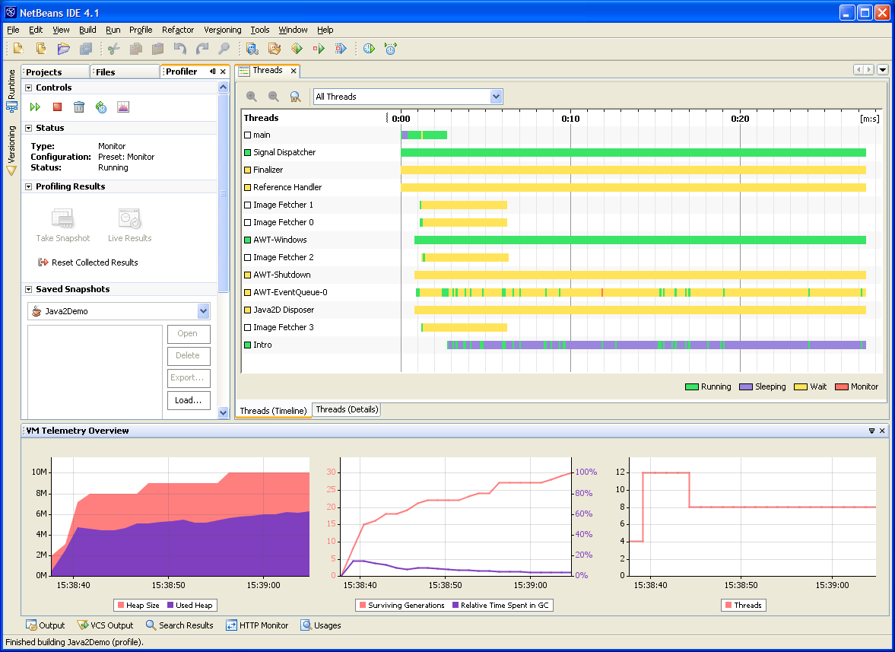
NetBeans Profiler

Slide 44
Demo
Memory leak detection with Netbeans Profiler
http://www.javapassion.com/handsonlabs/5116_nbprofilermemory.zip
Notes:
Lets look at some of the changes and new features in the Java Virtual Machine

Slide 45

VisualVM
A new Integrated and Extensible Troubleshooting Tool for the Java Platform
Integrates existing JDK Management, Monitoring and Troubleshooting tools and adds support for lightweight CPU and Memory profiling
Extensible through VisualVM Plugins Center
Production and development time tool
Audience: developers, administrators, performance and sustaining engineers, etc.
https://visualvm.dev.java.net

Slide 46
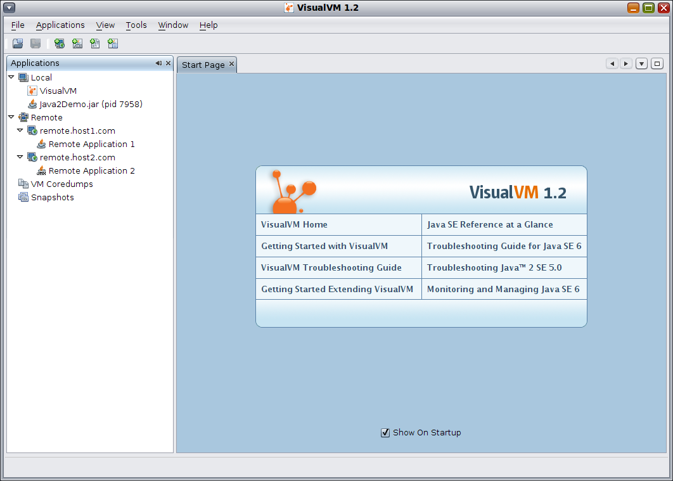
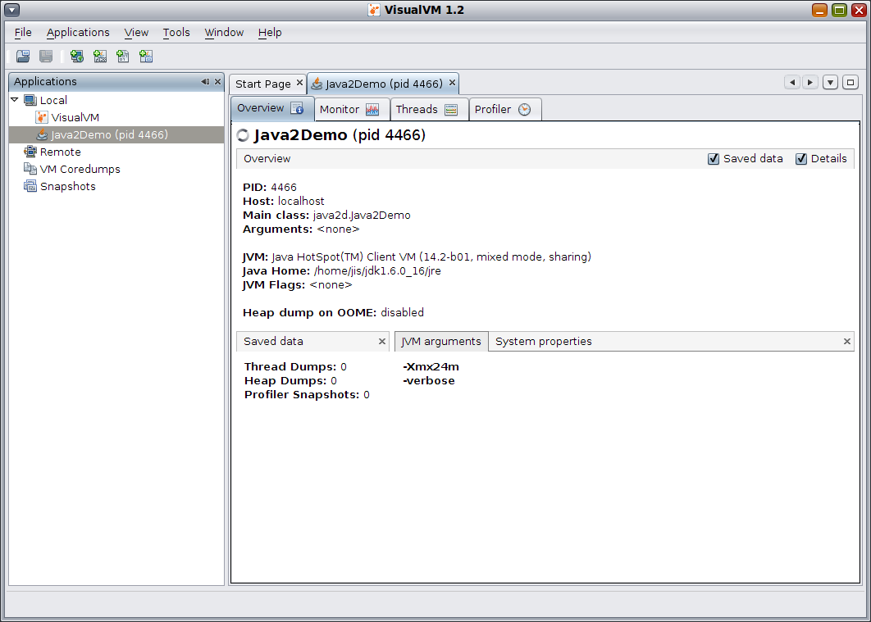
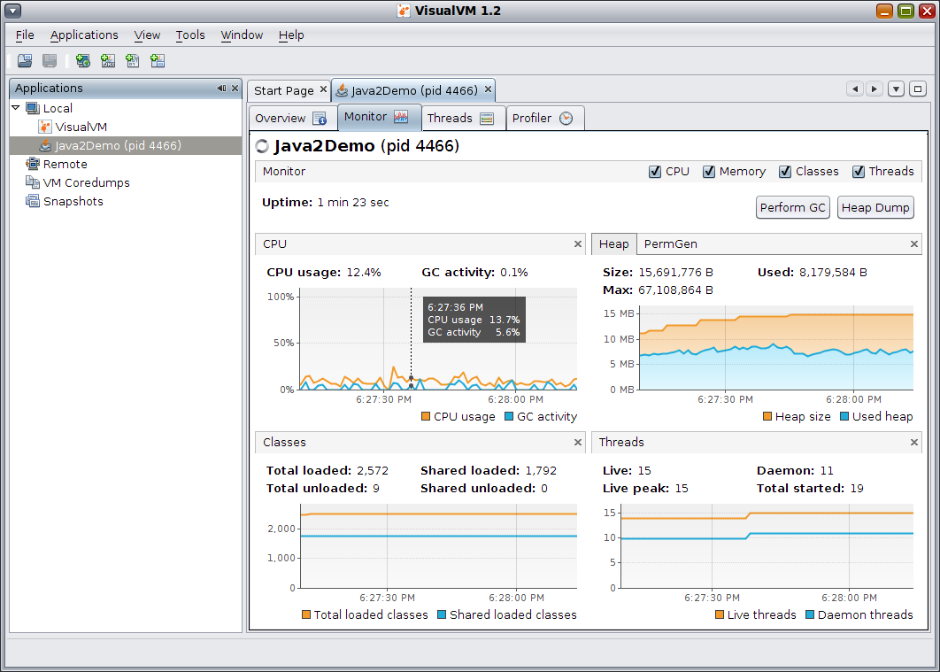
VisualVM Features (1/3)
Monitor local & remote Java applications
Show configuration & environment
Monitor performance, memory, classes...

Slide 47
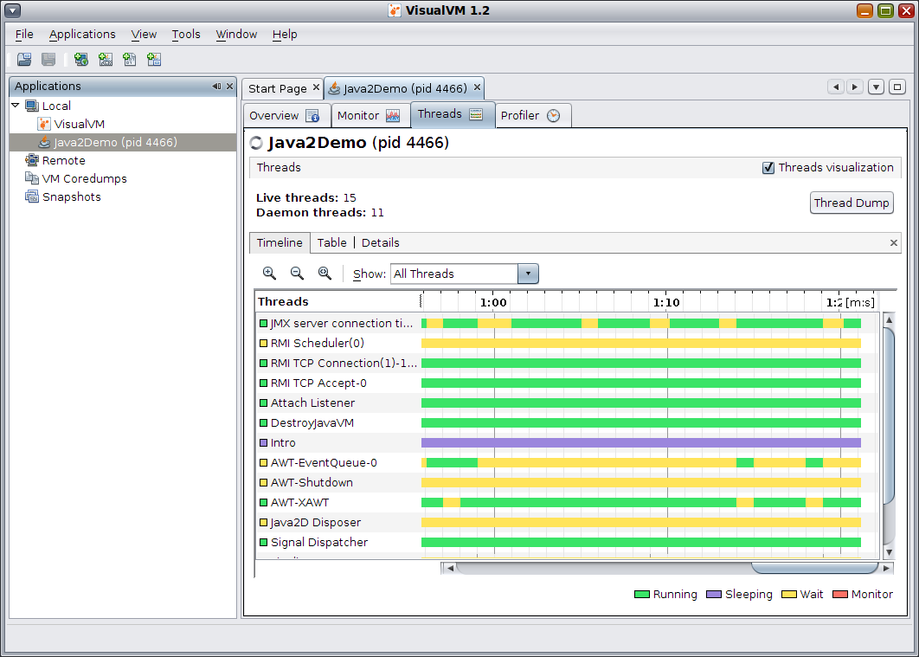
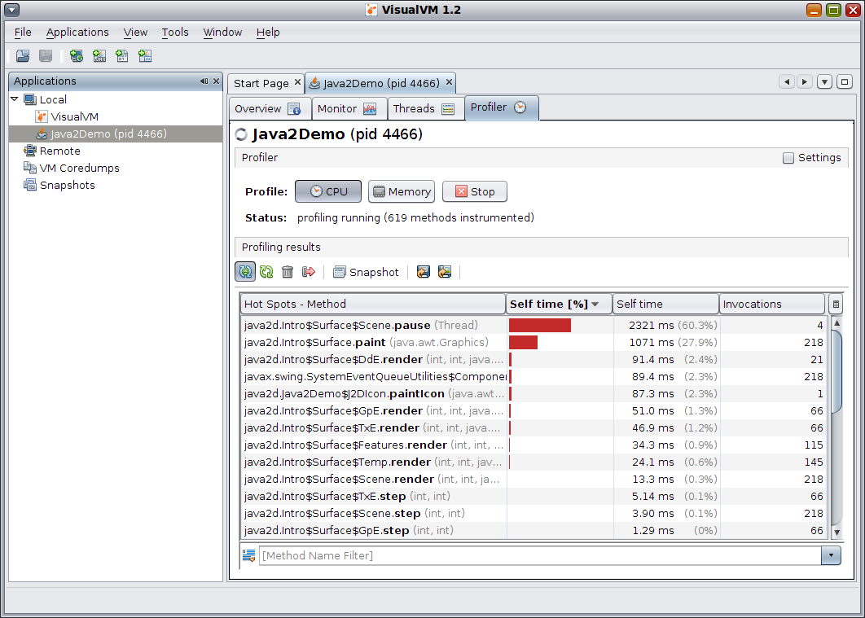
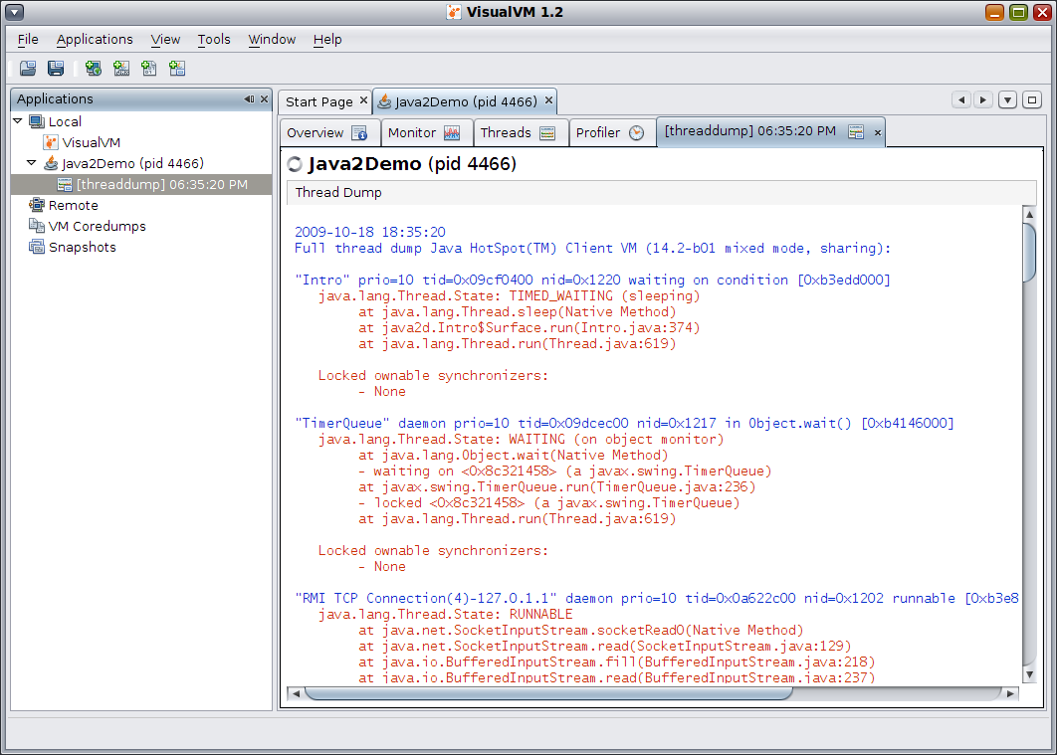
VisualVM Features (2/3)
Monitor threads
Profile performance & memory
Take & display thread dumps

Slide 48
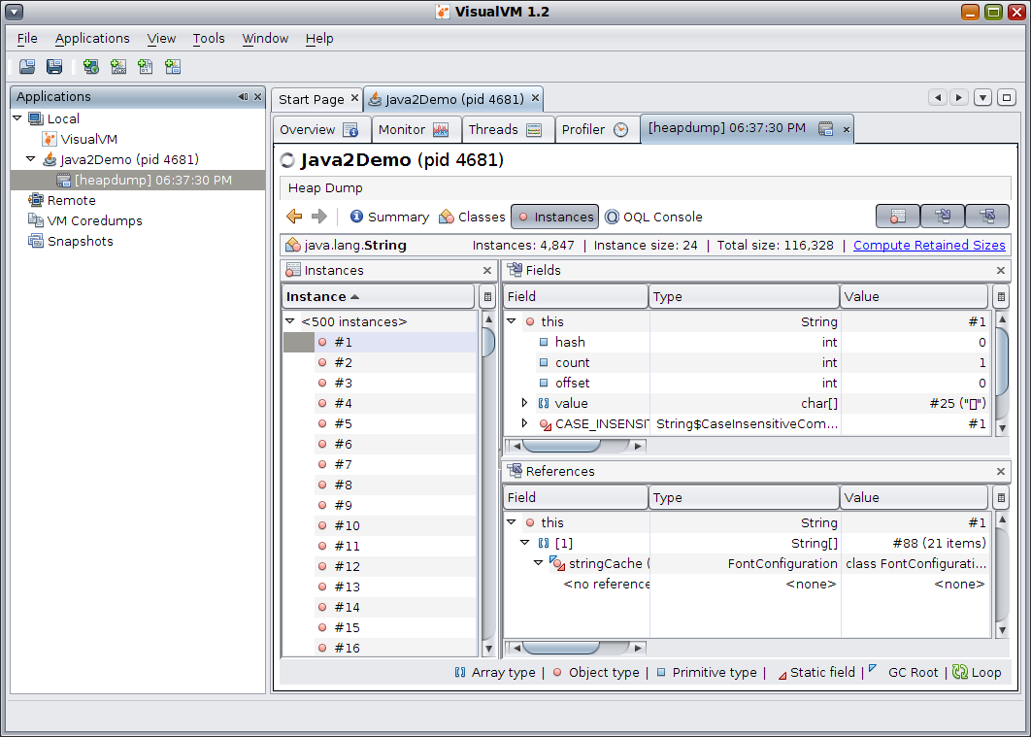
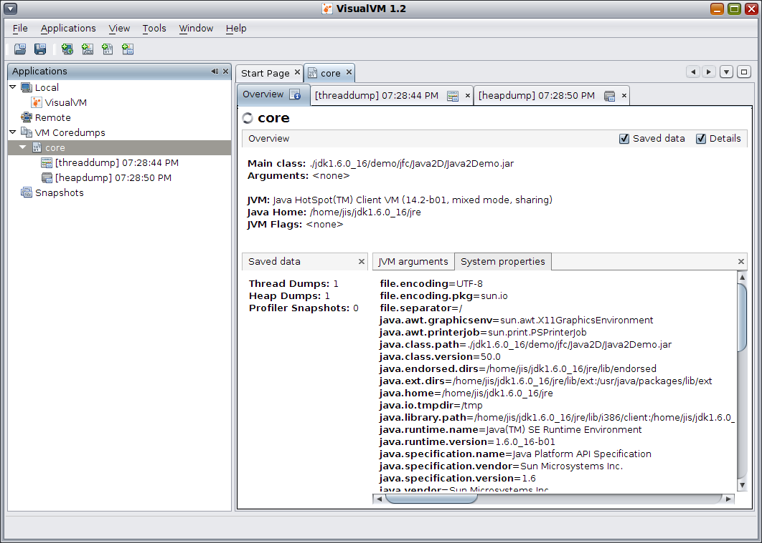
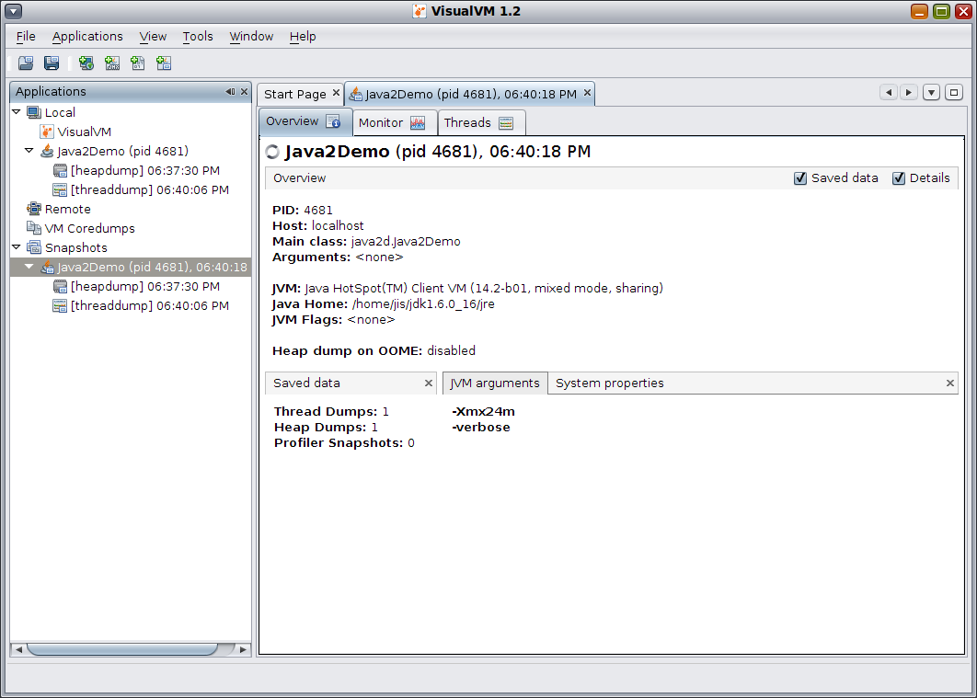
VisualVM Features (3/3)
Take & browse/analyze heap dumps
Analyze core dumps
Take & display application snapshots

Slide 49
Plugins
Sampler
MBeans Browser
Visual GC
BTrace
Buffer Monitor
ME Snapshot Viewer
GlassFish (+GFPM)
OQL Editor
TDA Plugin (3rd p.)
OSGi Plugin (3rd p.)
Message Queue (GF)
Sun Grid Engine Inspect
https://visualvm.dev.java.net/plugins.html

Slide 50

Resources and Summary

Slide 51
For More Information (1/2)
Memory management white paper
  http://java.sun.com/j2se/reference/whitepapers/
Destructors, Finalizers, and Synchronization
  http://portal.acm.org/citation.cfm?id=604153
Memory-retention due to finalization article
  http://www.devx.com/Java/Article/30192

Slide 52
For More Information (2/2)
FindBugs
  http://findbugs.sourceforge.net
Heap analysis tools
  Monitoring and Management
    http://java.sun.com/developer/technicalArticles/J2SE/monitoring/
  Troubleshooting guide
    http://java.sun.com/javase/6/webnotes/trouble/
  JConsole
    http://java.sun.com/developer/technicalArticles/J2SE/jconsole.html

Slide 53
Resources
Performance, Monitoring and Management, Testing, and Debugging of Java Applications
  http://www.javapassion.com/javaperformance/
  http://netbeans.org/kb/docs/java/profiler-intro.html
  http://www.netbeans.org/community/magazine/html/04/profiler.html

Slide 54
Resources
Performance, Monitoring and Management, Testing, and Debugging of Java Applications
Monitoring and Management in 6.0
  http://java.sun.com/developer/technicalArticles/J2SE/monitoring/
Troubleshooting guide
  http://java.sun.com/javase/6/webnotes/trouble/
JConsole
  http://java.sun.com/developer/technicalArticles/J2SE/jconsole.html

Slide 55
Stay in Touch with Java SE
http://java.sun.com/javase
JDK 6
  http://jdk6.dev.java.net/
  http://jcp.org/en/jsr/detail?id=270
JDK 7
  http://jdk7.dev.java.net/
  http://jcp.org/en/jsr/detail?id=277

Slide 56
Thank You!
Carol McDonald
  Java Technology Architect
    Sun Microsystems, Inc.

