Slide 1
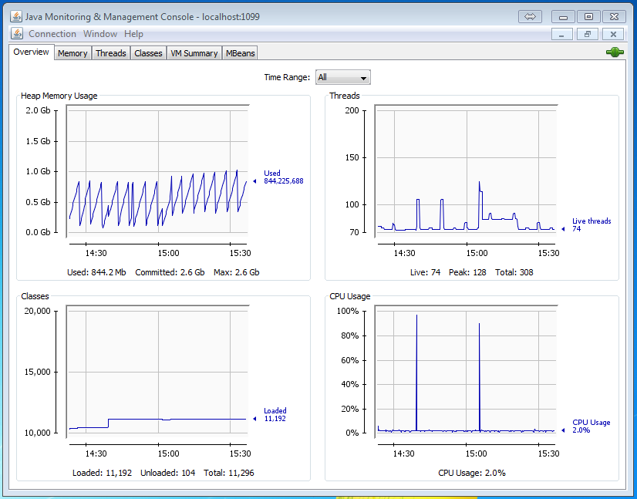
JConsole with IDM
Monitoring the performance and resource consumption for java applications
JConsole

Slide 2
Configure JMX with IDM
Change configuration
SSH Tunneling
Install/setup JConsole
Setting classpath
Start Jconsole
Connect Jconsole to remote IDM server
Monitor
Overview
Memory
Threads
Classes
VM Summary
MBeans
Agenda

Slide 3
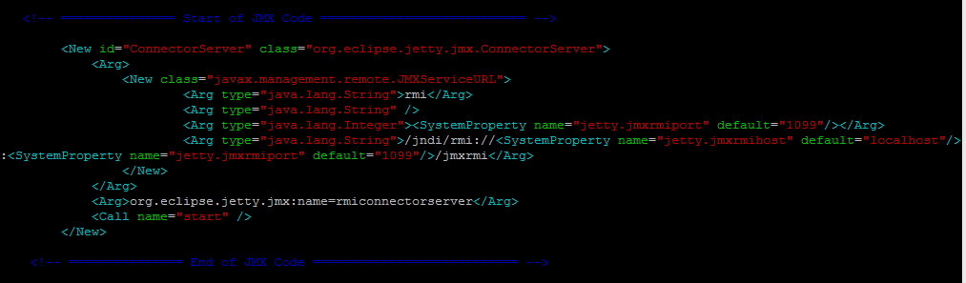
Configuration of JMX with IDM
Install
Locate openidm_home/conf/jetty.xml
Update the below code:
<!-- =============== Start of JMX Code =========================== -->
<New id="ConnectorServer" class="org.eclipse.jetty.jmx.ConnectorServer">
<Arg>
<New class="javax.management.remote.JMXServiceURL">
<Arg type="java.lang.String">rmi</Arg>
<Arg type="java.lang.String" />
<Arg type="java.lang.Integer"><SystemProperty name="jetty.jmxrmiport" default="1099"/></Arg>
<Arg type="java.lang.String">/jndi/rmi://<SystemProperty name="jetty.jmxrmihost" default="localhost"/>:<SystemProperty name="jetty.jmxrmiport" default="1099"/>/jmxrmi</Arg>
</New>
</Arg>
<Arg>org.eclipse.jetty.jmx:name=rmiconnectorserver</Arg>
<Call name="start" />
</New>
<!-- =============== End of JMX Code =========================== -->

Slide 4
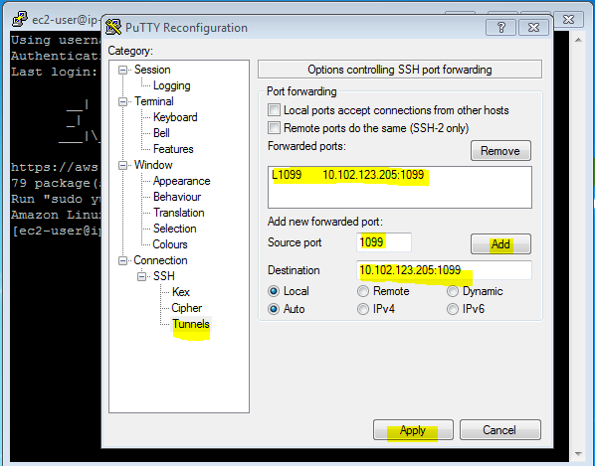
SSH Tunneling
Tunneling
Use PuTTY to connect your IDM server
Once connected, do the SSH tunneling by going to change setting of PuTTY
Add the IP & port for tunneling and apply.
According to the screen below, your tunneling is ready for IDM server to connect JMX at: localhost:1099
Now connect from your JConsole

Slide 5
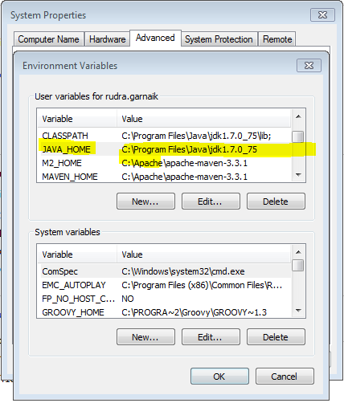
Setting classpath
Classpath
Install java on your machine
Set the JAVA_HOME classpath as shown below:
Ready to start JConsole

Slide 6
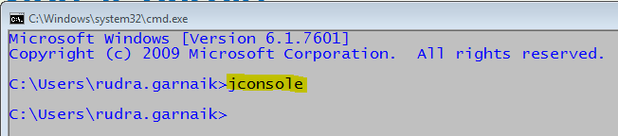
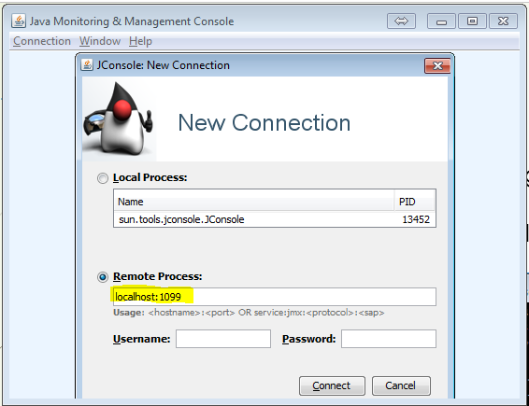
Start Jconsole & connect remore server
Connect
Open you command prompt, verify java classpath is set
Type jconsole on your command prompt and hit enter
The jconsole will pop up shown
Select remote process
Enter the tunneled host & port
Localhost:1099 as we tunneled
Click Connect.

Slide 7
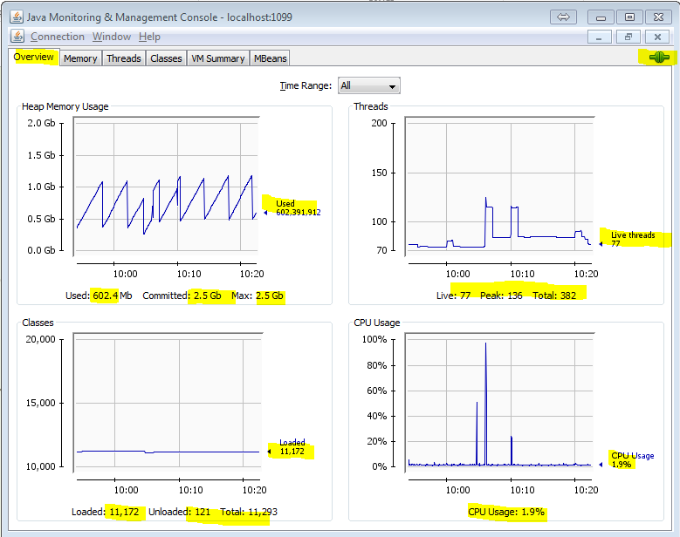
Monitor Jconsole - Overview
Monitor
Overview of heap memory usages, threads, classes & CPU Usages

Slide 8
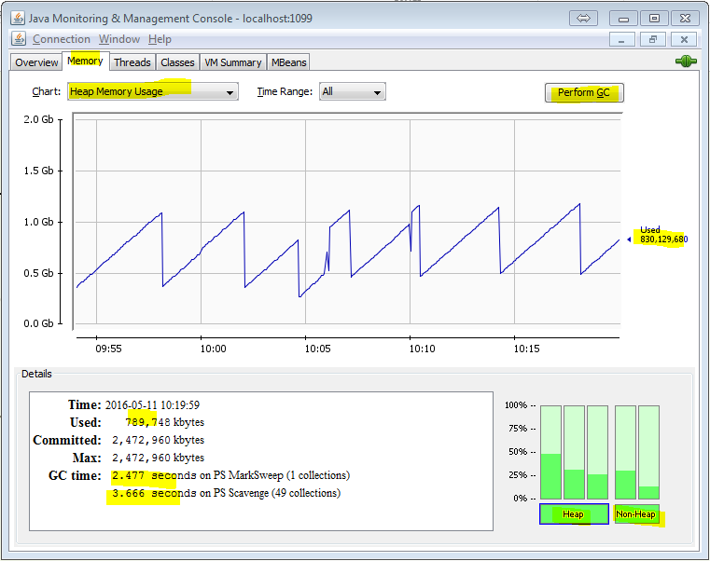
Monitor Jconsole - Memory
Monitor

Slide 9
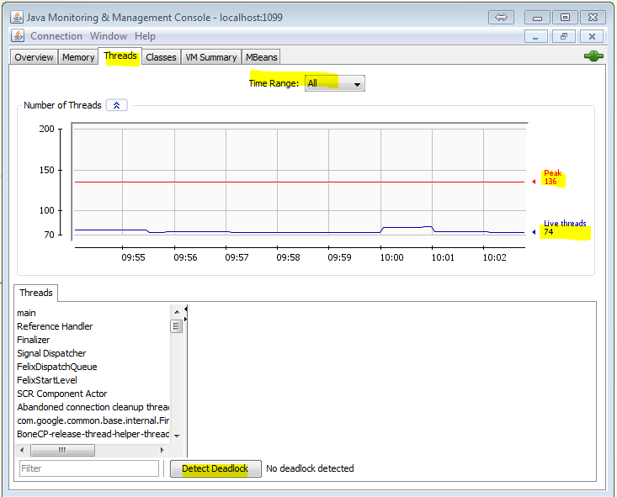
Monitor Jconsole - Threads
Monitor
Detect Deadlock
Live threads
Peak Threads
Time range

Slide 10
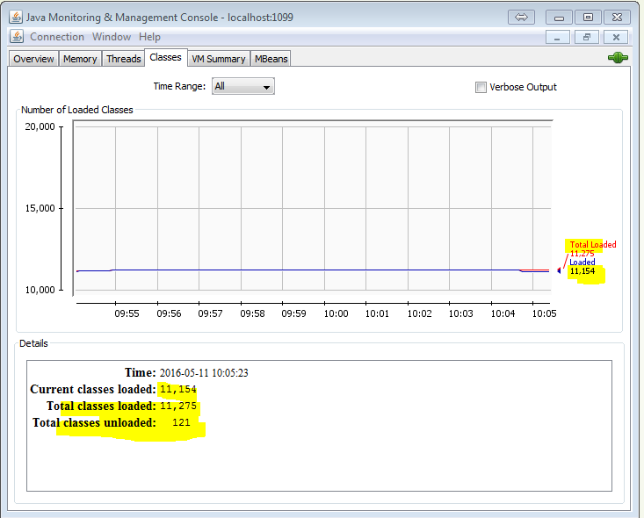
Monitor Jconsole - Classes
Monitor
Total classes loaded

Slide 11
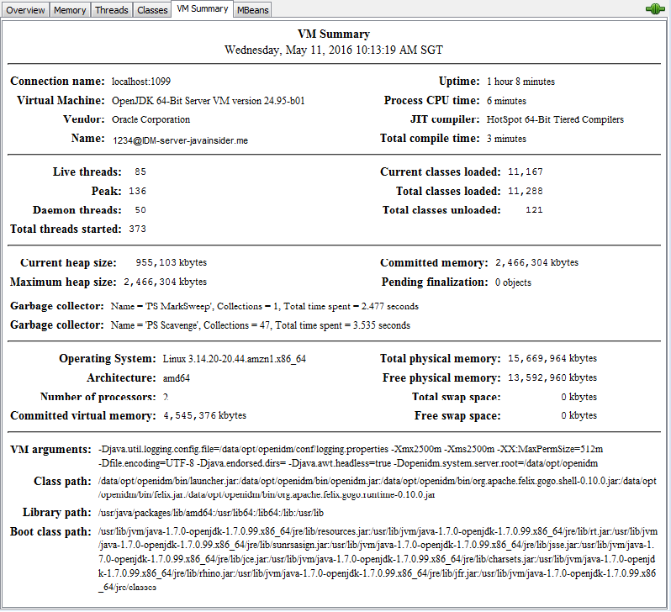
Monitor Jconsole – VM Summary
Monitor

Slide 12
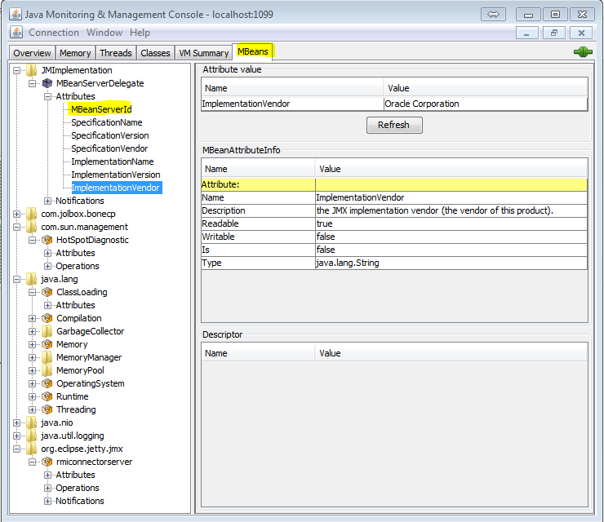
Monitor Jconsole – MBeans
Monitor

Slide 13
Contact
https://javainsider.wordpress.com/
www.garnaik.com

