Slide 1
Java Virtual Machine (JVM) in the Settop Box
Taeho Oh
http://ohhara.sarang.net
ohhara@postech.edu

Slide 2
Contents (1)
Introduction
Portable Embedded Application Development
Debugging Embedded Application
Porting JVM
Optimizing JVM
Java Native Interface (JNI)

Slide 3
Contents (2)
JPDA, JVMPI
Resource Management
References

Slide 4
Introduction

Slide 5
Introduction
About the Author
Preliminary Knowledge
About Alticast
JVM Overview
Sun JVM Editions

Slide 6
About the Author (1)
1997 ~ 2000
  Studied Computer Science and Engineering at Postech
2000 ~ 2003
  Worked for Alticast
  Developed JVM for Digital Broadcasting Settop Box
    The JVM is used for SkyLife settop box.

Slide 7
About the Author (2)
2003 ~
  Studying Electronic and Electrical Engineering at Postech

Slide 8
Preliminary Knowledge
C Language
Java Language
Java Native Interface ( JNI )

Slide 9

About Alticast (1)
Digital Broadcasting Total Solution

Slide 10
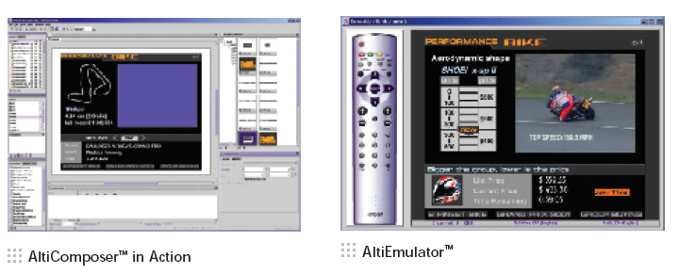
About Alticast (2)
AltiComposer

Slide 11




About Alticast (3)
DTV Applications

Slide 12
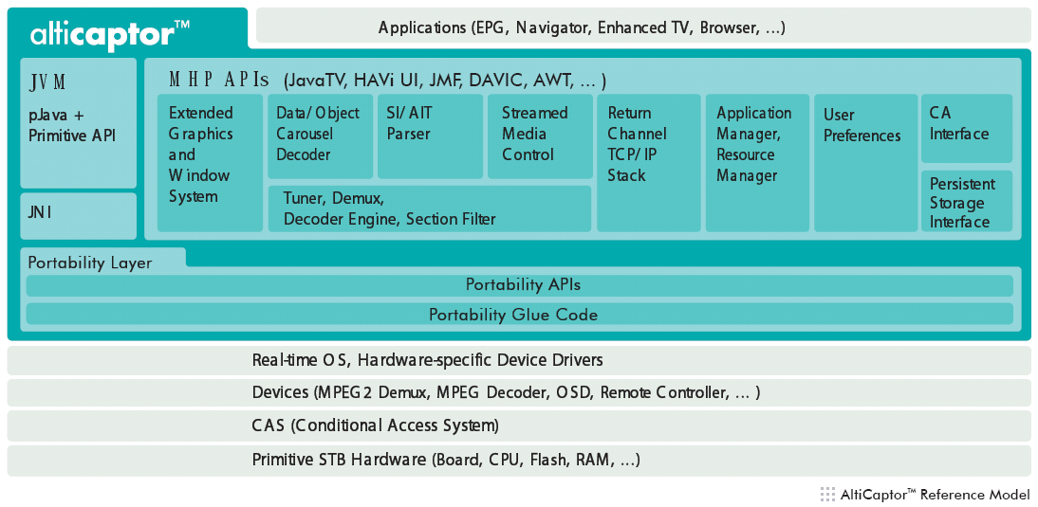
About Alticast (4)
AltiCaptor

Slide 13
JVM Overview (1)
Classloader
  Read class file stream.
  Verify the class file.
  Resolve the class link.
  Load into memory.
Interpreter
  Execute Java bytecode.

Slide 14
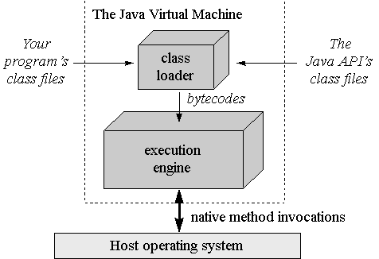
JVM Overview (2)
Garbage Collector
  Delete unused Java objects automatically.

Slide 15
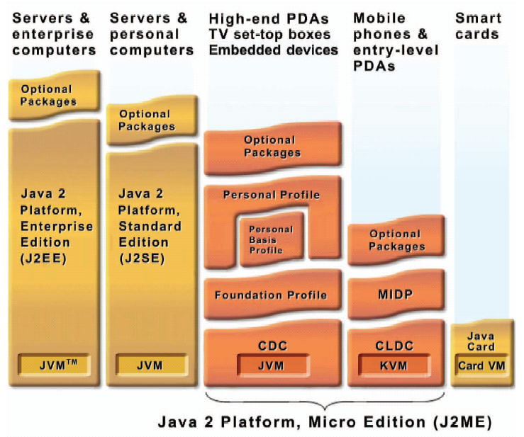
Sun JVM Editions

Slide 16
Portable Embedded Application Development

Slide 17
Portable Embedded Application Development (1)
External Library
Wrapper API
Byte Order
Memory Alignment
Evaluation Order
char Type
>> Operator

Slide 18
Portable Embedded Application Development (2)
va_list
Data Type Size
64bit Integer
Floating Point Number
Source Text Format
C Compiler Options
ANSI C (89)

Slide 19
Portable Embedded Application Development (3)
OS Abstraction
Portable Java Application

Slide 20
External Library
Do not use external library
  Even if it is ANSI C standard library.
    ex. fopen
#include <stdio.h>
FILE *file_open(char *file) {
return fopen(file, “r”);
}
Does not work properly if the platform doesn’t have fopen function ( ex. filesystem is not available )

Slide 21
Wrapper API
Make Wrapper API
  If a specific API is really needed.
platform independent
( no modification is needed while porting )
platform dependent
( modification is needed platform by platform )
extern int em_printf(char *str);
int em_init(void) {
return em_printf("Hello World\n");
}
extern int Print(char *str);
extern int em_printf(char *str);
extern int em_init(void);
int root() {
return em_init();
}
int em_printf(char *str) {
return Print(str);
}
Wrapper API
Implementation of the wrapper API

Slide 22
Byte Order (1)
Do not depend on byte order
  If it is impossible, make a wrapper API.
void endian_test(void) {
int a = 0x01020304, i;
char *ch = (char *)&a;
for (i = 0; i < 4; i++)
printf("%02x ", ch[i]);
}
little endian
( LSB first )
04 03 02 01
big endian
( MSB first )
01 02 03 04

Slide 23
Byte Order (2)
Floating point number and integer have a different byte order in some platforms
0x0102030405060708 is stored as 04 03 02 01 08 07 06 05 in some platforms

Slide 24
Memory Alignment (1)
Do not access misaligned memory
  The misaligned memory access may cause an unexpected result.
/* suppose the big endian CPU */
void align_test(void) {
char *a = { '\x01', '\x02', '\x03', '\x04', '\x05‘ };
int *i = (int *)(a + 1);
printf("%08x\n", *i);
printf("%08x\n", *i);
}
02030405
02030401
01020304
crash
different result,
because of cache

Slide 25
Memory Alignment (2)
Floating point number and integer have a different memory alignment policy in some platforms
  ex) 8byte alignment for 64bit integer, 4byte alignment for 64bit floating point number.

Slide 26
Evaluation Order
Do not depend on evaluation order
#include <stdio.h>
int f(int *a) {
return (*a *= 2);
}
main() {
int a = 5;
a = a + f(&a);
printf("%d\n", a);
}
If ‘a’ is evaluated first, print ’15’.
If ‘f(&a)’ is evaluated first, print ’20’.

Slide 27
char Type
Do not assume char type is signed ( or unsigned )
#include <stdio.h>
main() {
char c = (char)0xff;
int i = 1;
i += c;
printf("%d\n", i);
}
If ‘c’ is unsigned char, print ’256’.
If ‘c’ is signed char, print ’0’.

Slide 28
>> operator
Do not assume >> is arithmetic ( or logical )
#include <stdio.h>
main() {
int a = -1;
a >>= 1;
printf("%d\n", a);
}
If ‘>>’ is arithmetic, print ’-1’.
If ‘>>’ is logical, print ’ 2147483647’.

Slide 29
va_list (1)
Do not assume va_list is pointer ( or array )
#include <stdio.h>
#include <stdarg.h>
int main() {
va_list a;
va_list *ap = &a;
printf("%p %p\n", a, *ap);
}
If va_list is pointer, ‘a’ and ‘*ap’ are same.
If va_list is array, ‘a’ and ‘*ap’ are different.

Slide 30
va_list (2)
How to copy va_list?
  If it is a pointer
    va_list a, b; a = b;
  If it is an array
    va_list a, b; *a = *b;
  See va_copy macro
    va_copy is ANSI C ( 99 ) macro.

Slide 31
Data Type Size
char, short, int, long, float, double, pointer size is platform dependent
Typical data type size (bit)
char | short | int | long | float | double | pointer
8 | 16 | 32 | 32 | 32 | 64 | 32

Slide 32
64bit Integer (1)
In some compilers, 64bit integer is supported
  In Microsoft Visual C++, __int64
  In gcc, long long
In some compilers, 64bit integer is not supported
  Need to implement 64bit integer struct by combining two 32bit integers.

Slide 33
64bit Integer (2)
64bit Integer API from Alticast
ac_ll_shr(a, b)
ac_ll_ushr(a, b)
ac_ll_shl(a, b)
ac_ll_ushl(a, b)
ac_ll_or(a, b)
ac_ll_uor(a, b)
ac_ll_xor(a, b)
ac_ll_uxor(a, b)
ac_ll_and(a, b)
ac_ll_uand(a, b)
ac_ll_neg(a)
ac_ll_uneg(a)
ac_ll_not(a)
ac_ll_unot(a)
ac_ll_add(a, b)
ac_ll_uadd(a, b)
ac_ll_sub(a, b)
ac_ll_usub(a, b)
ac_ll_mul(a, b)
ac_ll_umul(a, b)
ac_ll_div(a, b)
ac_ll_udiv(a, b)
ac_ll_mod(a, b)
ac_ll_umod(a, b)
ac_ll_eq(a, b)
ac_ll_ueq(a, b)
ac_ll_ne(a, b)
ac_ll_une(a, b)
ac_ll_ge(a, b)
ac_ll_uge(a, b)
ac_ll_le(a, b)
ac_ll_ule(a, b)
ac_ll_lt(a, b)
ac_ll_ult(a, b)
ac_ll_gt(a, b)
ac_ll_ugt(a, b)
ac_ll_ll2ull(a)
ac_ll_ull2ll(a)
ac_ll_int2ll(a)
ac_ll_ll2int(a)
ac_ll_int2ull(a)
ac_ll_ull2int(a)
ac_ll_uint2ull(a)
ac_ll_ull2uint(a)
ac_ll_uint2ll(a)
ac_ll_ll2uint(a)
ac_ll_ll2double(a)
ac_ll_double2ll(a)

Slide 34
Floating Point Number
Even if floating point number data size are same, the result of calculation can be slightly different
  because internal floating point number data size are different for error correction.

Slide 35
Source Text Format
Unix text file format is recommended
  DOS text file format may cause an error in some compilers.
The source code file should be ended with End-Of-Line (EOL) character
  If not, it can cause an error in some compilers.

Slide 36
C Compiler Options
Add warning options to reduce mistakes
Microsoft Visual C++
  /W3 /WX
gcc
-pedantic -W -Wall -Wshadow -Wpointer-arith -Wcast-align
-Waggregate-return -Wstrict-prototypes -Wmissing-prototypes
-Wmissing-declarations -Wnested-externs -Werror -Wno-unused

Slide 37
ANSI C (89)
ANSI C (89) is more portable than assembly, ANSI C (99), C++
Following ANSI C (89) strictly is very tough
  However, should try to.
JAVA is portable but needs JVM

Slide 38
OS Abstraction
OS Abstraction API from Alticast
ac_t_create
ac_t_delete
ac_t_sleep
ac_t_suspend
ac_t_resume
ac_t_setPriority
ac_t_getPriority
ac_t_self
ac_t_comp
ac_tsd_create
ac_tsd_delete
ac_tsd_set
ac_tsd_get
ac_tm_set
ac_tm_get
ac_tm_setMillis
ac_tm_getMillis
ac_cv_create
ac_cv_delete
ac_cv_wait
ac_cv_signal
ac_cv_broadcast
ac_q_create
ac_q_delete
ac_q_receive
ac_q_send
ac_sm_create
ac_sm_delete
ac_sm_wait
ac_sm_signal
ac_mu_create
ac_mu_delete
ac_mu_lock
ac_mu_unlock
ac_mem_get
ac_mem_release

Slide 39
Portable Java Application (1)
Do not assume the external class implementation will not change in the future
  Extending from external class may not be portable.
  Serializing external class object may not be portable.

Slide 40
Portable Java Application (2)
Value.java ( External class )
UValue.java ( User class )
public class Value {
double v;
public void setValue(double v) {
this.v = v;
}
public void setValue(int v) {
setValue((double)v);
}
public double getValue() {
return v;
}
}
public class UValue extends Value {
public void setValue(double v) {
this.v = v * 2;
}
public static void main(String[] args) {
UValue uv = new UValue();
uv.setValue(10);
System.out.println(uv.getValue());
}
}
“uv.getValue()” returns “20.0”
If “setValue((double)y));” is changed to “this.v = (double)v;”, “uv.getValue()” will return “10.0”.

Slide 41
Portable Java Application (3)
System class can be GCed ( Garbage Collected ) in some JVM
  A class static variable can become 0 (or null) long time later even if it is set by some value.
  To prevent the class is GCed, create a dummy java object of the class.

Slide 42
Debugging Embedded Application

Slide 43
Debugging Embedded Application
Emulator
Serial I/O
Remote Debugging

Slide 44
Emulator (1)
embedded application for target H/W
platform independent code
platform dependent code for target H/W
Make Emulator
embedded application for PC
platform independent code
platform dependent code for PC

Slide 45
Emulator (2)
Debugging in the emulator is much easier than in the target H/W
  Many powerful debugging tools
    MS Visual Studio Debugger
    Rational PurifyPlus
    Numega DevPartner
  Short roundtrip test time
  Doesn’t need target H/W

Slide 46
Emulator (3)
Rational Purify Can Detect
  Uninitialized memory access
  Array out of bounds read/write
  Memory leak
  Invalid memory free
  Double free
  Freed memory read/write

Slide 47
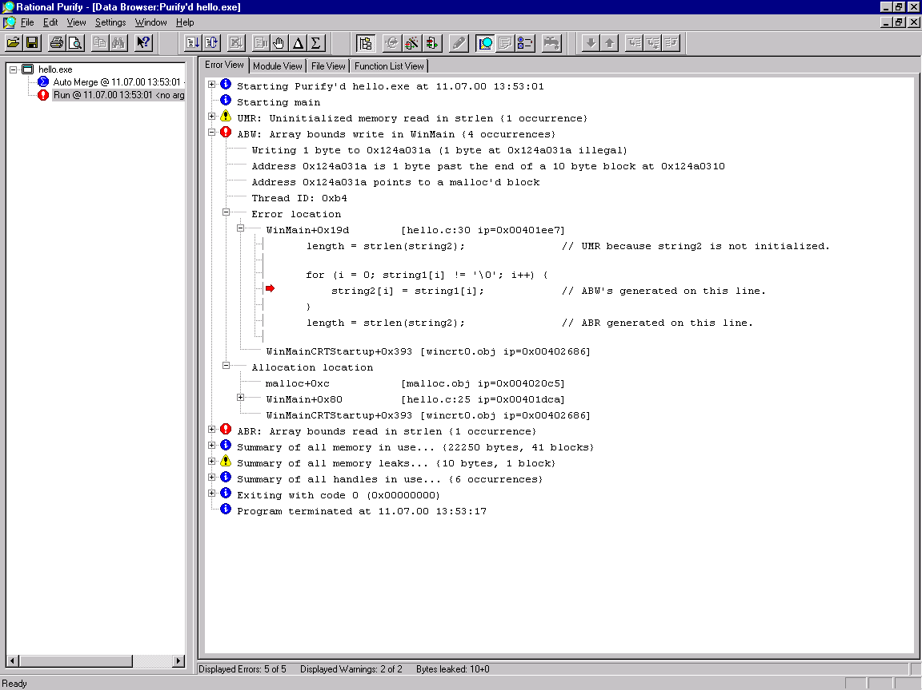
Emulator (4)

Slide 48
Emulator (5)
Debugging in the emulator is very good BUT
  Can’t debug platform dependent code for target H/W.
  If platform independent code has platform dependent code accidentally, it may not be easy to debug.
  There is something difficult to emulate.

Slide 49
Serial I/O
Primitive but powerful debugging tool in the target H/W
Needs to be
  Stable
  Non Buffered
Structured debug message system is needed like syslog

Slide 50
Remote Debugging
MultiICE, OpenICE, etc
  In Circuit Emulator for ARM
  Expensive
MS eMbedded Visual C++
gdb

Slide 51
Porting JVM
PersonalJava 3.1

Slide 52
Porting JVM
Personal Java 3.1 (1)
Overview
Time
Memory Allocation
IO
Startup
Thread
Monitor

Slide 53
Porting JVM
Personal Java 3.1 (2)
Dynamic Linking
Termination
Miscellaneous
Truffle, Network
Test
The Problems of Personal Java 3.1

Slide 54
Overview (1)
Derived from JDK 1.1.8 virtual machine
Java 2 security is integrated
Not supported anymore
  See CVM (CDC PBP)

Slide 55
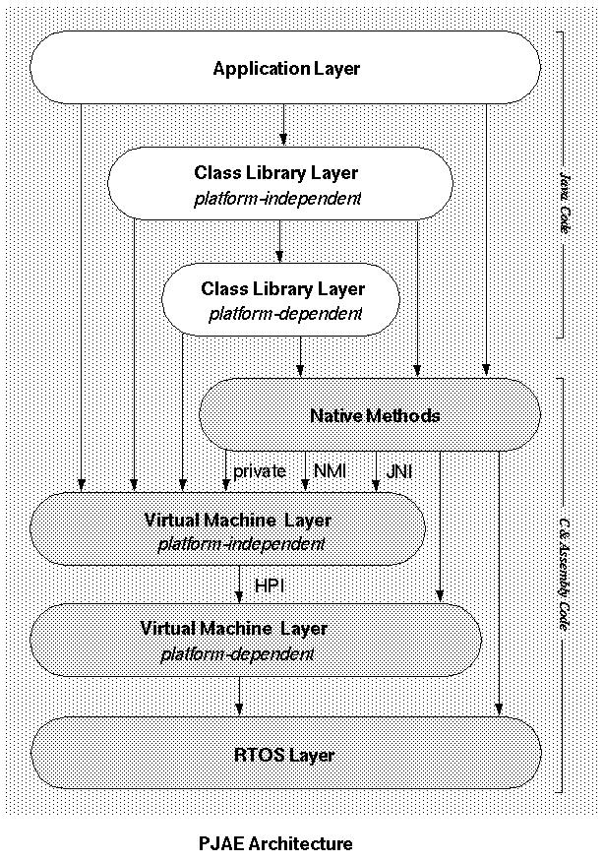
Overview (2)
If JVM is changed, it will cause a problem.
If RTOS is changed, it will cause a problem.

Slide 56
Time
long sysGetMilliTicks(void);
  Not needed.
  Use sysTimeMillis, instead.
int64_t sysTimeMillis(void);
  Use ac_tm_getMillis.

Slide 57
Memory Allocation (1)
void *sysMalloc(size_t size);
void *sysRealloc(void *ptr, size_t size);
void sysFree(void *ptr);
void *sysCalloc(size_t nelem, size_t elsize);
  Use ac_mem_get and Doug Lea’s malloc.

Slide 58
Memory Allocation (2)
void *sysMapMem(size_t requestedsize, size_t *mappedsize);
void *sysUnmapMem(void *requestedaddress, size_t requestedsize, size_t *unmappedsize);
void *sysCommitMem(void *requestedaddress, size_t requestedsize, size_t *unmappedsize);
void *sysUncommitMem(void *requestedaddress, size_t requestedsize, size_t *unmappedsize);
  Not needed.
  Use sysMalloc, instead.

Slide 59
Memory Allocation (3)
void *sysAllocBlock(size_t block, void **allocHead);
void sysFreeBlock(void *allocHead);
  Not needed.
  Only for page mode.

Slide 60
IO (1)
int sysAccess(const char *pFile, int perm);
int sysStat(const char *path, struct stat *sbuf);
int sysRename(const char *srcName, const char *dstName);
int sysUnlink(const char *file);
int sysMkdir(const char *path, int mode);
int sysRmdir(const char *path);
DIR *sysOpenDir(const char *path);
int sysCloseDir(DIR *dp);
struct dirent *sysReadDir(DIR *dp);
int sysIsAbsolute(const char *path);
int sysCanonicalPath(char *path, char *result, int result_len);
  Create memory based Unix style file system.

Slide 61
IO (2)
int sysOpenFD(Classjava_io_FileDescriptor *fd, const char *name, int openMode, int filePerm);
int sysCloseFD(Classjava_io_FileDescriptor *fd);
long sysSeekFD(Classjava_io_FileDescriptor *fd, long offset, int whence);
size_t sysReadFD(Classjava_io_FileDescriptor *fd, void *buf, unsigned int nBytes);
size_t sysWriteFD(Classjava_io_FileDescriptor *fd, const void *buf, unsigned int nBytes);
size_t sysSyncFD(Classjava_io_FileDescriptor *fd);
int sysAvailableFD(Classjava_io_FileDescriptor *fd, long *bytes);
void sysInitFD(Classjava_io_FileDescriptor *fdobj, int fd);
  Create memory based Unix style file system.

Slide 62
Startup
void sysGetDefaultJavaVMInitArgs(void *args_);
int sysInitializeJavaVM(void *ee_, void *args_);
  Use solaris port source code.
int sysFinalizeJavaVM(void *ee_);
  Not needed.
  JVM runs infinitely.
void sysAttachThreadLock(void);
void sysAttachThreadUnlock(void);
  Not needed.
  Don’t attach native thread to JVM by using JNI.

Slide 63
Thread (1)
Use native thread ( not green thread )
  To communicate with non-java thread.
int sysThreadBootstrap(sys_thread_t **ptid, void *cookie);
void sysThreadInitializeSystemThreads(void);
  Use solaris port source code.

Slide 64
Thread (2)
int sysThreadCreate(long stack_size, uint_t flags, void (*start)(void *), sys_thread_t **ptid, void *cookie);
void sysThreadExit(void);
sys_thread_t *sysThreadSelf(void);
void sysThreadYield(void);
int sysThreadSuspend(sys_thread_t *tid);
int sysThreadResume(sys_thread_t *tid);
int sysThreadSetPriority(sys_thread_t *tid, int priority);
int sysThreadGetPriority(sys_thread_t *tid, int priority);
  Use ac_t_* API from Alticast portability layer.

Slide 65
Thread (3)
void *sysThreadStackPointer(sys_thread_t *tid);
stackp_t sysThreadStackBase(sys_thread_t *tid);
void sysThreadSetStackBase(sys_thread_t *tid, stackp_t sp);
  Difficult to port.
  Set thread stack pointer as stack top when thread starts.
  For garbage collection.

Slide 66
Thread (4)
int sysThreadSingle(void);
void sysThreadMulti(void);
int sysThreadEnumerateOver(int (*)(sys_thread_t *, void *), void *arg);
void sysThreadInit(sys_thread_t *tid, stackp_t stack);
void *sysThreadGetBackPtr(sys_thread_t *t);
int sysThreadAlloc(sys_thread_t **ptid, stackp_t stack_base, void *cookie);
int sysThreadFree(sys_thread_t *tid);
  Use solaris port source code.

Slide 67
Thread (5)
void sysThreadInterrupt(sys_thread_t *tid);
  Set interrupted bit in the sys_thread_t struct.
int sysThreadIsInterrupted(sys_thread_t *tid, int ClearInterrupted);
  Check interrupted bit in the sys_thread_t struct.
void sysThreadPostException(sys_thread_t *tid, void *exc);
  Set exception in the sys_thread_t struct.

Slide 68
Thread (6)
int sysThreadCheckStack(void);
  Use solaris port source code.
  Use wider red zone than it in the solaris port source code.
void sysThreadDumpInfo(sys_thread_t *tid);
  Not needed.
  Only for debug.

Slide 69
Monitor (1)
size_t sysMonitorSizeof(void);
int sysMonitorInit(sys_mon_t *mid);
int sysMonitorDestroy(sys_mon_t *mid);
  Use solaris port source code.
bool_t sysMonitorEntered(sys_mon_t *mid);
void sysMonitorDumpInfo(sys_mon_t *mid);
  Not needed.
  Only for debug.

Slide 70
Monitor (2)
int sysMonitorEnter(sys_mon_t *mid);
int sysMonitorExit(sys_mon_t *mid);
  Use ac_mu_* API from Alticast portability layer.
  Check interrupted bit periodically.
    Polling

Slide 71
Monitor (3)
int sysMonitorNotify(sys_mon_t *mid);
int sysMonitorNotifyAll(sys_mon_t *mid);
int sysMonitorWait(sys_thread_t *mid, sys_mon_t *millis, int64_t clear);
  Use ac_cv_* API from Alticast portability layer.
  Check interrupted bit periodically.

Slide 72
Monitor (4)
sysCacheLockInit
sysCacheLock
sysCacheLocked
sysCacheUnlock
  Use solaris port source code.

Slide 73
Dynamic Linking (1)
char *sysInitializeLinker(void);
  Not needed.
  Linker doesn’t need to be initialized.
int sysAddDLSegment(char *function);
void sysBuildLibName(char *buf, int buflen, char *prefix, char *name);
  Not needed.
  The portable platform doesn’t support dynamic library loading.

Slide 74
Dynamic Linking (2)
long sysDynamicLink(char *symbol_name);
  Create a big table of the function pointer and name string. And search the function pointer by its name string in the table. It is possible because application can’t have native method and the portable platform doesn’t support dynamic library loading.
int sysBuildFunName(char *buf, int buflen, struct methodblock *mb, int encodingIndex);
  Use solaris port source code.

Slide 75
Dynamic Linking (3)
long *sysInvokeNative(JNIEnv_ *env, void *address, long *optop, char *sig, int argSize, void *staticRef);
  Strictly, it’s impossible to implement this in C language.
    Because C language can’t express calling the function whose number of arguments is not decided statically. So it should be implemented in assembly language.

Slide 76
Dynamic Linking (4)
  If the called native function always has 20 or less arguments, it can be implemented as follows in C language.
/* in the case of jint */
sp[0].i = (*(jint (*)(jint, jint, jint, jint, jint, jint, jint, jint, jint, jint, jint, jint, jint, jint, jint, jint, jint, jint, jint, jint))code)(args[0].i, args[1].i, args[2].i, args[3].i, args[4].i, args[5].i, args[6].i, args[7].i, args[8].i, args[9].i, args[10].i, args[11].i, args[12].i, args[13].i, args[14].i, args[15].i, args[16].i, args[17].i, args[18].i, args[19].i);
It’s not really portable. In some platforms, 32bit integer and 64bit integer have different alignment in the function call. In addition, some platforms passes floating point number as register and integer as stack.

Slide 77
Termination
void sysExit(int status);
int sysAtexit(void (*func)(void));
void sysAbort(void);
  Not needed.
  JVM runs infinitely.

Slide 78
Miscellaneous
sysCheckException(exception);
  Use solaris port source code.
sysStricmp(const char *s1, const char *s2);
  Implement it in C. ( trivial )
cpe_t **sysGetBootClassPath(void);
cpe_t **sysGetClassPath(void);
  Use solaris port source code.

Slide 79
Truffle, Network
Truffle
  Modify it to make truffle more portable.
  Use ac_g_* API from Alticast portability layer.
Network
  Use solaris port source code.
  Use ac_socket_* API from Alticast portability layer.

Slide 80
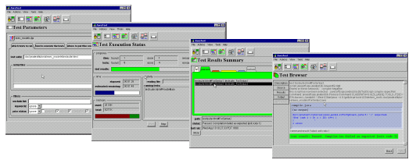
Test (1)
Technology Compatibility Kit (TCK)
  Sophisticated JVM compatibility test tool from Sun Microsystems.

Slide 81
Test (2)
How to use TCK in the Settop Box?
Broadcasting Server
Modulator
Broadcasting Stream
Test Case
Power on/off signal
Remote Controller
Power Switch
Test PC
Power Supply
Serial, Ethernet, Modem
Settop Box

Slide 82
The Problems of
Personal Java 3.1 (1)
Too old and too buggy
  It’s derived from JDK 1.1.8.
  Not supported anymore.
    See CDC PBP.
Porting guide is not well documented
The portable code assumes the platform supports ANSI C standard library and POSIX

Slide 83
The Problems of
Personal Java 3.1 (2)
The garbage collection has hard to fix bugs ( or non portable codes )
  Scan native stack to find alive java object.
  Suspend threads unsafe way.

Slide 84
Porting JVM
CVM 1.0.1

Slide 85
Porting JVM
CVM 1.0.1 (1)
defs.h
doubleword.h
endianness.h
float.h
globals.h
int.h
io.h

Slide 86
Porting JVM
CVM 1.0.1 (2)
jni.h
linker.h
net.h
path.h
sync.h
system.h
threads.h

Slide 87
Porting JVM
CVM 1.0.1 (3)
time.h

Slide 88
defs.h (1)
Primitive Type Definition
ANSI Header File Location
CVM Port Header File Location
Lock Optimization Definition

Slide 89
defs.h (2)
CVMfloat32
CVMfloat64
CVMInt8
CVMInt16
CVMInt32
CVMInt64
CVMSize
CVMUint8
CVMUint16
CVMUint32
CVMUint64

Slide 90
defs.h (3)
CVM_HDR_ANSI_ASSERT_H
CVM_HDR_ANSI_CTYPE_H
CVM_HDR_ANSI_ERRNO_H
CVM_HDR_ANSI_LIMITS_H
CVM_HDR_ANSI_SETJMP_H
CVM_HDR_ANSI_STDARG_H
CVM_HDR_ANSI_STDDEF_H
CVM_HDR_ANSI_STDIO_H
CVM_HDR_ANSI_STDLIB_H
CVM_HDR_ANSI_STRING_H
CVM_HDR_ANSI_TIME_H

Slide 91
defs.h (4)
CVM_HDR_DOUBLEWORD_H
CVM_HDR_ENDIANNESS_H
CVM_HDR_FLOAT_H
CVM_HDR_GLOBALS_H
CVM_HDR_INT_H
CVM_HDR_IO_H
CVM_HDR_JNI_H
CVM_HDR_LINKER_H
CVM_HDR_NET_H
CVM_HDR_PATH_H
CVM_HDR_SYNC_H
CVM_HDR_THREADS_H
CVM_HDR_TIME_H

Slide 92
defs.h (5)
CVM_ADV_ATOMIC_CMPANDSWAP
CVM_HAVE_PLATFORM_SPECIFIC_MICROLOCK
CVM_ADV_ATOMIC_SWAP
CVM_ADV_MUTEX_SET_OWNER
CVM_ADV_SCHEDLOCK

Slide 93
doubleword.h (1)
Native
64bit
Integer
Java
Long
Native
Pointer
Native
64bit
Float
Java
Double

Slide 94
doubleword.h (2)
void CVMdouble2Jvm(CVMUint32 location[2], CVMJavaDouble val);
CVMJavaDouble CVMjvm2Double(const CVMUint32 location[2]);
CVMJavaLong CVMjvm2Long(const CVMUint32 location[2]);
void CVMlong2Jvm(CVMUint32 location[2], CVMJavaLong val);
void CVMmemCopy64(CVMUint32 to[2], const CVMUint32 from[2]);

Slide 95
doubleword.h (3)
CVMJavaLong CVMdouble2Long(CVMJavaDouble val);
CVMJavaLong CVMdouble2LongBits(CVMJavaDouble val);
CVMJavaLong CVMint2Long(CVMJavaInt val);
CVMJavaDouble CVMlong2Double(CVMJavaLong val);
CVMJavaFloat CVMlong2Float(CVMJavaLong val);
CVMJavaInt CVMlong2Int(CVMJavaLong val);
void *CVMlong2VoidPtr(CVMJavaLong val);
CVMJavaDouble CVMlongBits2Double(CVMJavaLong val);
CVMJavaLong CVMvoidPtr2Long(void * val);

Slide 96
doubleword.h (4)
CVMJavaLong CVMlongAdd(CVMJavaLong op1, CVMJavaLong op2);
CVMJavaLong CVMlongAnd(CVMJavaLong op1, CVMJavaLong op2);
CVMJavaLong CVMlongDiv(CVMJavaLong op1, CVMJavaLong op2);
CVMJavaLong CVMlongMul(CVMJavaLong op1, CVMJavaLong op2);
CVMJavaLong CVMlongOr(CVMJavaLong op1, CVMJavaLong op2);
CVMJavaLong CVMlongRem(CVMJavaLong op1, CVMJavaLong op2);
CVMJavaLong CVMlongSub(CVMJavaLong op1, CVMJavaLong op2);
CVMJavaLong CVMlongXor(CVMJavaLong op1, CVMJavaLong op2);

Slide 97
doubleword.h (5)
CVMInt32 CVMlongCompare(CVMJavaLong op1, CVMJavaLong op2);
CVMJavaLong CVMlongConstZero();
CVMJavaLong CVMlongConstOne();
CVMInt32 CVMlongEq(CVMJavaLong op1, CVMJavaLong op2);
CVMInt32 CVMlongEqz(CVMJavaLong op);
CVMInt32 CVMlongGe(CVMJavaLong op1, CVMJavaLong op2);
CVMInt32 CVMlongGez(CVMJavaLong op);
CVMInt32 CVMlongGt(CVMJavaLong op1, CVMJavaLong op2);

Slide 98
doubleword.h (6)
CVMInt32 CVMlongLe(CVMJavaLong op1, CVMJavaLong op2);
CVMInt32 CVMlongLt(CVMJavaLong op1, CVMJavaLong op2);
CVMInt32 CVMlongLtz(CVMJavaLong op);
CVMInt32 CVMlongNe(CVMJavaLong op1, CVMJavaLong op2);
CVMJavaLong CVMlongNeg(CVMJavaLong op);
CVMJavaLong CVMlongNot(CVMJavaLong op);
CVMJavaLong CVMlongShl(CVMJavaLong op1, CVMJavaInt op2);
CVMJavaLong CVMlongShr(CVMJavaLong op1, CVMJavaInt op2);
CVMJavaLong CVMlongUshr(CVMJavaLong op1, CVMJavaInt op2);

Slide 99
doubleword.h (7)
CVMJavaFloat CVMdouble2Float(CVMJavaDouble val);
CVMJavaInt CVMdouble2Int(CVMJavaDouble val);
CVMJavaDouble CVMdoubleAdd(CVMJavaDouble op1, CVMJavaDouble op2);
CVMInt32 CVMdoubleCompare(CVMJavaDouble op1, CVMJavaDouble op2, CVMInt32 direction);
CVMJavaDouble CVMdoubleConstOne();
CVMJavaDouble CVMdoubleConstZero();

Slide 100
doubleword.h (8)
CVMJavaDouble CVMdoubleDiv(CVMJavaDouble op1, CVMJavaDouble op2);
CVMJavaDouble CVMdoubleMul(CVMJavaDouble op1, CVMJavaDouble op2);
CVMJavaDouble CVMdoubleNeg(CVMJavaDouble op);
CVMJavaDouble CVMdoubleRem(CVMJavaDouble op1, CVMJavaDouble op2);
CVMJavaDouble CVMdoubleSub(CVMJavaDouble op1, CVMJavaDouble op2);
CVMJavaDouble CVMint2Double(CVMJavaInt val);

Slide 101
endianness.h
CVM_DOUBLE_ENDIANNESS
  Floating point number endianness
CVM_ENDIANNESS
  Integer endianness

Slide 102
float.h
CVMJavaDouble CVMfloat2Double(CVMJavaFloat op);
CVMJavaInt CVMfloat2Int(CVMJavaFloat op);
CVMJavaLong CVMfloat2Long(CVMJavaFloat op);
CVMJavaFloat CVMfloatAdd(CVMJavaFloat op1, CVMJavaFloat op2);
CVMInt32 CVMfloatCompare(CVMJavaFloat op1, CVMJavaFloat op2, CVMInt32 direction);
CVMJavaFloat CVMfloatDiv(CVMJavaFloat op1, CVMJavaFloat op2);
CVMJavaFloat CVMfloatMul(CVMJavaFloat op1, CVMJavaFloat op2);
CVMJavaFloat CVMfloatNeg(CVMJavaFloat op1, CVMJavaFloat op2);
CVMJavaFloat CVMfloatRem(CVMJavaFloat op1, CVMJavaFloat op2);
CVMJavaFloat CVMfloatSub(CVMJavaFloat op1, CVMJavaFloat op2);

Slide 103
globals.h
void CVMinitStaticState();
void CVMdestroyStaticState();
  Per address space static state. ( Usually not used )
struct CVMTargetGlobalState {};
void CVMinitVMTargetGlobalState(CVMTargetGlobalState *);
void CVMdestroyVMTargetGlobalState(CVMTargetGlobalState *);
  Per VM global state. ( Usually not used )
const CVMProperties *CVMGetProperties(void);
  Get Properties. ( classpath, home dir, etc )

Slide 104
int.h (1)
Java
Int
Big Endian
32bit
Integer
Usual int operation is slightly different from Java int operation
Java
Primitive
Data Type
Native
32bit
Integer

Slide 105
int.h (2)
CVMJavaInt CVMintAdd(CVMJavaInt op1, CVMJavaInt op2);
CVMJavaInt CVMintSub(CVMJavaInt op1, CVMJavaInt op2);
CVMJavaInt CVMintMul(CVMJavaInt op1, CVMJavaInt op2);
CVMJavaInt CVMintDiv(CVMJavaInt op1, CVMJavaInt op2);
CVMJavaInt CVMintRem(CVMJavaInt op1, CVMJavaInt op2);
CVMJavaInt CVMintAND(CVMJavaInt op1, CVMJavaInt op2);
CVMJavaInt CVMintOr(CVMJavaInt op1, CVMJavaInt op2);
CVMJavaInt CVMintXor(CVMJavaInt op1, CVMJavaInt op2);
CVMJavaInt CVMintNeg(CVMJavaInt op);
CVMJavaInt CVMintUshr(CVMJavaInt op1, CVMJavaInt num);
CVMJavaInt CVMintShl(CVMJavaInt op1, CVMJavaInt num);
CVMJavaInt CVMintShr(CVMJavaInt op1, CVMJavaInt num);

Slide 106
int.h (3)
CVMJavaFloat CVMint2Float(CVMJavaInt val);
CVMJavaByte CVMint2Byte(CVMJavaInt val);
CVMJavaChar CVMint2Char(CVMJavaInt val);
CVMJavaShort CVMint2Short(CVMJavaInt val);
CVMUint16 CVMgetUint16(CVMconst CVMUint8 *ptr);
CVMUint32 CVMgetUint32(CVMconst CVMUint8 *ptr);
CVMInt16 CVMgetInt16(CVMconst CVMUint8 *ptr);
CVMInt32 CVMgetInt32(CVMconst CVMUint8 *ptr);
CVMInt32 CVMgetAlignedInt32(constCVMUint8 *ptr);

Slide 107
io.h (1)
File System
  Use memory based Unix style file system to make it portable in AltiCaptor.

Slide 108
io.h (2)
CVMInt32 CVMioGetLastErrorString(char *buf, int len);
char *CVMioReturnLastErrorString();
  Not needed.
  Only for debug.
char *CVMioNativePath(char *path);
CVMInt32 CVMioFileType(const char *path);
CVMInt32 CVMioOpen(const char *name, CVMInt32 openMode, CVMInt32 filePerm);
CVMInt32 CVMioClose(CVMInt32 fd);

Slide 109
io.h (3)
CVMInt64 CVMioSeek(CVMInt32 fd, CVMInt64 offset, CVMInt32 whence);
CVMInt32 CVMioSetLength(CVMInt32 fd, CVMInt64 length);
CVMInt32 CVMioSync(CVMInt32 fd);
CVMInt32 CVMioAvailable(CVMInt32 fd, CVMInt64 *bytes);
size_t CVMioRead(CVMInt32 fd, void *buf, CVMUint32 nBytes);
size_t CVMioWrite(CVMInt32 fd, const void *buf, CVMUint32 nBytes);
CVMInt32 CVMioFileSizeFD(CVMInt32 fd, CVMInt64 *size);

Slide 110
jni.h
CVMInt32 CVMjniInvokeNative(void *env, void *nativeCode, CVMUint32 *args, CVMUint32 *terseSig, CVMInt32 argsSize, void *classObject, CVMJNIReturnValue *returnValue);
  Similar to sysInvokeNative of Personal Java 3.1.

Slide 111
linker.h
void * CVMdynlinkOpen(const void *absolutePathName);
void * CVMdynlinkSym(void *dsoHandle, const void *name);
void * CVMdynlinkClose(void *dsoHandle);
CVMBool CVMdynlinkBuildLibName(void *holder, int holderlen, void *pname, void *fname);
  Similar to dynamic linking of Personal Java 3.1.

Slide 112
net.h (1)
Socket
  Use ac_socket_* APIs from Alticast portability layer.
  There is no gethostbyaddr and gethostbyname. Why?

Slide 113
net.h (2)
CVMInt32 CVMnetSocketClose(CVMInt32 fd);
CVMInt32 CVMnetSocketShutdown(CVMInt32 fd, CVMInt32 howto);
CVMInt32 CVMnetSocketAvailable(CVMInt32 fd, CVMInt32 *pbytes);
CVMInt32 CVMnetConnect(CVMInt32 fd, struct sockaddr *him, CVMInt32 len);
CVMInt32 CVMnetAccept(CVMInt32 fd, struct sockaddr *him, CVMInt32 *len);
CVMInt32 CVMnetSendTo(CVMInt32 fd, char *buf, CVMInt32 len, CVMInt32 flags, struct sockaddr *to, CVMInt32 tolen);
CVMInt32 CVMnetRecvFrom(CVMInt32 fd, char *buf, CVMInt32 nBytes, CVMInt32 flags, struct sockaddr *from, CVMInt32 *fromlen);
CVMInt32 CVMnetListen(CVMInt32 fd, CVMInt32 count);

Slide 114
net.h (3)
CVMInt32 CVMnetRecv(CVMInt32 fd, char *buf, CVMInt32 nBytes, CVMInt32 flags);
CVMInt32 CVMnetSend(CVMInt32 fd, char *buf, CVMInt32 nBytes, CVMInt32 flags);
CVMInt32 CVMnetTimeout(CVMInt32 fd, CVMInt32 timeout);
CVMInt32 CVMnetSocket(CVMInt32 domain, CVMInt32 type, CVMInt32 protocol);
CVMInt32 CVMnetSetSockOpt(CVMInt32 fd, CVMInt32 type, CVMInt32 dir, const void *arg, CVMInt32 argSize);
CVMInt32 CVMnetGetSockOpt(CVMInt32 fd, CVMInt32 proto, CVMInt32 flag, void *in_addr, CVMInt32 *inSize);
CVMInt32 CVMnetGetSockName(CVMInt32 fd, struct sockaddr *lclAddr, CVMInt32 *lclSize);
CVMInt32 CVMnetGetHostName(char *hostname, CVMInt32 maxlen);
CVMInt32 CVMnetBind(CVMInt32 fd, struct sockaddr *bindAddr, CVMInt32 size);

Slide 115
path.h (1)
File Path Definition
  Use Unix style path in AltiCaptor.

Slide 116
path.h (2)
CVM_PATH_CLASSFILEEXT
CVM_PATH_CLASSPATH_SEPARATOR
CVM_PATH_CURDIR
CVM_PATH_LOCAL_DIR_SEPARATOR
CVM_PATH_MAXLEN
int CVMcanonicalize(char* path, const char* out, int len);

Slide 117
sync.h (1)
CVMBool CVMmutexInit(CVMMutex *m);
void CVMmutexDestroy(CVMMutex *m);
CVMBool CVMmutexTryLock(CVMMutex *m);
void CVMmutexLock(CVMMutex *m);
void CVMmutexUnlock(CVMMutex *m);
CVMBool CVMcondvarInit(CVMCondVar *c, CVMMutex *m);
void CVMcondvarDestroy(CVMCondVar *c);
CVMBool CVMcondvarWait(CVMCondVar* c, CVMMutex *m, CVMJavaLong millis);
void CVMcondvarNotify(CVMCondVar *c);
void CVMcondvarNotifyAll(CVMCondVar *c);

Slide 118
sync.h (2)
void CVMschedLock(void);
void CVMschedUnlock(void);
CVMint32 CVMatomicCompareAndSwap(volatile CVMUint32 *addr, CVMUint32 new, CVMUint32 old);
CVMint32 CVMatomicSwap(volatile CVMUint32 *addr, CVMUint32 new);
CVMUint32 CVMatomicIncrement(CVMUint32 *addr);
CVMUint32 CVMatomicDecrement(CVMUint32 *addr);
CVMBool CVMmicrolockInit(CVMMicroLock *m);
void CVMmicrolockDestroy(CVMMicroLock *m);
void CVMmicrolockLock(CVMMicroLock *m);
void CVMmicrolockUnlock(CVMMicroLock *m);
void CVMmutexSetOwner(CVMThreadId *self, CVMMutex *m, CVMThreadID *ti);
CVM_FASTLOCK_TYPE
CVM_MICROLOCK_TYPE

Slide 119
system.h
void CVMhalt(CVMInt32 status);
void CVMSystemPanic(const char *msg);
  Not needed.
  JVM runs infinitely.

Slide 120
threads.h (1)
CVMInt32 CVMthreadCreate(CVMThreadID *thread, CVMSize stackSize, CVMInt16 priority, void (*func)(void *), void *arg);
void CVMthreadYield(void);
void CVMthreadSetPriority(CVMThreadID *thread, CVMInt32 prio);
void CVMthreadSuspend(CVMThreadID *thread);
void CVMthreadResume(CVMThreadID *thread);

Slide 121
threads.h (2)
void CVMthreadAttach(CVMThreadID *self, CVMBool orphan);
void CVMthreadDetach(CVMThreadID *self);
CVMThreadID * CVMthreadSelf(void);
void CVMthreadInterruptWait(CVMThreadID *thread);
CVMBool CVMthreadIsInterrupted(CVMThreadID *thread, CVMBool clearInterrupted);
CVMBool CVMthreadStackCheck(CVMThreadID *self, CVMUint32 redZone);

Slide 122
time.h
CVMInt64 CVMtimeMillis(void);
  Use ac_tm_getMillis.

Slide 123
JVM Optimization

Slide 124
JVM Optimization
Synchronization
Interpreter
Class Files
Garbage Collection

Slide 125
Synchronization (1)
Few contentions in Java Synchronization
CVM Fast Lock
  1) Try to lock with lightweight lock.
  2) If no contention occurred, go ahead.
    No system call occurred. Fast.
  3) If contention occurred, lightweight lock will be converted to heavyweight lock and the set the mutex owner.

Slide 126
Synchronization (2)
If “atomic compare and swap” and “atomic swap” are available
  Intel x86, PowerPC, MIPS(R4000)
#define CVM_ADV_MUTEX_SET_OWNER
#define CVM_ADV_ATOMIC_CMPANDSWAP
#define CVM_ADV_ATOMIC_SWAP
#undef CVM_HAVE_PLATFORM_SPECIFIC_MICROLOCK
/* #define CVM_FASTLOCK_TYPE CVM_FASTLOCK_NONE */
#define CVM_FASTLOCK_TYPE CVM_FASTLOCK_ATOMICOPS
/* #define CVM_FASTLOCK_TYPE CVM_FASTLOCK_MICROLOCK */
#define CVM_MICROLOCK_TYPE CVM_MICROLOCK_DEFAULT
/* #define CVM_MICROLOCK_TYPE CVM_MICROLOCK_SCHEDLOCK */

Slide 127
Synchronization (3)
If “atomic swap” is available
  arm
#define CVM_ADV_MUTEX_SET_OWNER
#undef CVM_ADV_ATOMIC_CMPANDSWAP
#define CVM_ADV_ATOMIC_SWAP
#define CVM_HAVE_PLATFORM_SPECIFIC_MICROLOCK
/* #define CVM_FASTLOCK_TYPE CVM_FASTLOCK_NONE */
/* #define CVM_FASTLOCK_TYPE CVM_FASTLOCK_ATOMICOPS */
#define CVM_FASTLOCK_TYPE CVM_FASTLOCK_MICROLOCK
#define CVM_MICROLOCK_TYPE CVM_MICROLOCK_DEFAULT
/* #define CVM_MICROLOCK_TYPE CVM_MICROLOCK_SCHEDLOCK */

Slide 128
Synchronization (4)
If “scheduler lock” is available
  mips(r3000), ST
#define CVM_ADV_MUTEX_SET_OWNER
#undef CVM_ADV_ATOMIC_CMPANDSWAP
#undef CVM_ADV_ATOMIC_SWAP
#undef CVM_HAVE_PLATFORM_SPECIFIC_MICROLOCK
/* #define CVM_FASTLOCK_TYPE CVM_FASTLOCK_NONE */
/* #define CVM_FASTLOCK_TYPE CVM_FASTLOCK_ATOMICOPS */
#define CVM_FASTLOCK_TYPE CVM_FASTLOCK_MICROLOCK
/* #define CVM_MICROLOCK_TYPE CVM_MICROLOCK_DEFAULT */
#define CVM_MICROLOCK_TYPE CVM_MICROLOCK_SCHEDLOCK

Slide 129
Interpreter (1)
C interpreter
  Portable.
  Slow.
Assembly interpreter
  Not portable.
  Faster than C interpreter.

Slide 130
Interpreter (2)
Just-In-Time(JIT) Compiler
  Not portable.
  Faster than assembly interpreter.
  Consumes a lot of ram.
  Takes long time to execute at first because of compiling the java bytecodes.

Slide 131
Interpreter (3)
Ahead-Of-Time(AOT) Compiler
  Not portable.
  Compiles java class files and creates native binary image.
  JVM binary size becomes bigger.
    Consumes rom ( flash memory ).
    Native code is bigger than Java bytecode.
  GCJ.

Slide 132
Interpreter (4)
Hotspot
  Not portable.
  Consumes less ram than JIT.
  Doesn’t takes long time to execute at first because interpreting java bytecodes at first.
    Analyzes the hotspot and compile it.

Slide 133
Interpreter (5)
H/W Acceleration
  Executes part of java bytecodes with H/W.
  ARM, Nazomi.

Slide 134
Class Files (1)
Romize Class Files
  Short class loading time.
  No extra ram is needed to load the class.
  Redundant, useless Strings are removed.
  Optimize bytecode.
    custom bytecode, bytecode inlining, etc.
  JVM binary size becomes bigger.
    Consumes rom ( flash memory ).
  Romizing widely used classes is recommended.

Slide 135
Class Files (2)
Zip Class Files
  Long class loading time.
    Unzip and load.
  Extra ram is needed to load the class.
  Smaller JVM binary size than romized class files.
  Zipping rarely used classes is recommended.

Slide 136
Class Files (3)
Obfuscate Class Files
  Make class files impossible to decompile.
  Strings becomes shorter.
    Reduces class files size.
    Can cause a problem in JNI or reflect.

Slide 137
Garbage Collection (1)
Reference Count
  If there is a circular reference, no way to collect the garbage.
Root
Root
Disconnect
X
A (1)
C (1)
A (1)
X
C (0)
X
B (1)
D (2)
B (1)
D (1)

Slide 138
Garbage Collection (2)
Mark and Sweep
  Mark all referenced objects from root object and sweep unmarked ( unreferenced ) objects.
Root
Disconnect
Root
X
A
C
A (V)
X
C ( )
B
D
B (V)
D (V)

Slide 139
Garbage Collection (3)
  Slow when there are many objects.
Generational
  Exploits recently created objects are reclaimed soon.
  Newly created objects are young generation.
  Long time alive objects are old generation.
  Only young generation objects are reclaimed.
  Need to track the reference from old generation objects to young generation objects.

Slide 140
Garbage Collection (4)
CVM 1.0.1
  Supports generational garbage collection.
  Supports pluggable garbage collection algorithm.

Slide 141
Java Native Interface
( JNI )

Slide 142
Java Native Interface
( JNI )
What is JNI?
Exception Handling
Garbage Collection
Reference Cache
Thread Context
Array Access
Miscellaneous

Slide 143
What is JNI? (1)
Standard Interface for JVM and Native Code
  There are also non standard alternatives.
    NMI, CNI, and so on.
  Very portable but not efficient.
With JNI
  Call native function from Java method.
  Almost everything Java method can do can be done in the native method.

Slide 144
What is JNI? (2)
In AltiCaptor
Only for interfacing between Java and Native
as simple as possible
Java
Java
Enhance portability
But bad performance
JNI
Native
JNI
Hard to maintain
Native

Slide 145
What is JNI? (3)
Book
  “Java Native Interface”
    Author : Liang
    Publisher : Addison Wesley

Slide 146
Exception Handling (1)
JNIEXPORT int JNICALL
Java_ExceptionTest_getHashCode(JNIEnv *env, jobject obj)
{
jclass objClass;
jmethodID hashCodeMid;
objClass = (*env)->FindClass(env, “com/alticast/lang/Object”);
hashCodeMid = (*env)->GetMethodID(env, objClass, “hashCode”, “()I”);
return (*env)->CallIntMethod(env, obj, hashCodeMid);
}
Can be null if exception occurred.
Not easy to be sure unexpected exception ( StackOverflowError, OutOfMemory, etc ) will not occur.

Slide 147
Exception Handling (2)
JNIEXPORT int JNICALL
Java_ExceptionTest_getHashCode(JNIEnv *env, jobject obj) {
jclass objClass;
jmethodID hashCodeMid;
objClass = (*env)->FindClass(env, “com/alticast/lang/Object”);
if (objClass == 0)
return 0;
hashCodeMid = (*env)->GetMethodID(env, objClass, “hashCode”, “()I”);
if (hashCodeMid == 0)
return 0;
return (*env)->CallIntMethod(env, obj, hashCodeMid);
}
If exception occurred, return to java code as soon as possible.

Slide 148
Garbage Collection (1)
JNIEXPORT int JNICALL
Java_GCTest_getHashCode(JNIEnv *env, jobject obj) {
jclass objClass;
jmethodID hashCodeMid;
objClass = (*env)->FindClass(env, “com/alticast/lang/Object”);
hashCodeMid = (*env)->GetMethodID(env, objClass, “hashCode”, “()I”);
return (*env)->CallIntMethod(env, obj, hashCodeMid);
}
If GC occurred here, will “objClass” be GCed? -> No

Slide 149
Garbage Collection (2)
Who has the reference to “objClass”?
  Java stack allocated before calling Java_GCTest_getHashCode native function.
  All JNI functions returning object reference ( jclass, jobject, jarray, jstring ) add the reference to java stack before returning the JNI function.

Slide 150
Garbage Collection (3)
When is the reference to “objClass” deleted?
  When the reference is deleted from the java stack by hand by calling DeleteLocalRef JNI function.
  When returning from Java_GCTest_getHashCode native function.
    Java stack is deleted when returning.

Slide 151
Garbage Collection (4)
How to prevent “objClass” from being GCed even after returning from Java_GCTest_getHashCode?
  Use NewGlobalRef JNI function.
    If not calling DeleteGlobalRef, “objClass” will not GCed forever.

Slide 152
Garbage Collection (5)
JNIEXPORT int JNICALL
Java_GCTest_getHashCode(JNIEnv *env, jobject obj) {
int i;
jclass objClass;
jmethodID hashCodeMid;
for (I = 0; I < 10; i++)
objClass = (*env)->FindClass(env, “com/alticast/lang/Object”);
hashCodeMid = (*env)->GetMethodID(env, objClass, “hashCode”, “()I”);
return (*env)->CallIntMethod(env, obj, hashCodeMid);
}
All “objClass” reference is alive in the java stack even if only one “objClass” is accessible. Therefore, all “objClass” will not be GCed before returning from Java_GCTest_getHashCode.

Slide 153
Reference Cache (1)
Getting jclass, jfieldID, jmethodID takes long time without caching
  FindClass, GetFieldID, GetMethodID is slow.

Slide 154
Reference Cache (2)
public class FidCache {
private int a = 15;
public native void getA();
public static void main(String[] args) {
FidCache fc = new FidCache();
System.out.println(fc.getA());
}
}
“objClass”, “a_fid” become garbage after returning from Java_FidCache_getA.
Not always returns FidCache class. The care must be taken.
JNIEXPORT int JNICALL
Java_FidCache_getA(JNIEnv *env, jobject obj) {
static jclass objClass = 0;
static jfieldID a_fid = 0;
if (objClass == 0) {
objClass = (*env)->GetObjectClass(env, obj);
a_fid = (*env)->GetFieldID(env, objClass, “a”, “I”);
}
return (*env)->GetIntField(env, obj, a_fid);
}

Slide 155
Reference Cache (3)
public class FidCacheChangeA extends FidCache {
private int a = 20;
public static void main(String[] args) {
FidCacheChangeA fcca = new FidCacheChangeA();
System.out.println(fcca.getA());
}
}
Print “20”.
The value of the private field “a” is changed.
It may or may not be intentional but it is very confusing.

Slide 156
Reference Cache (4)
public class FidCache {
static { initJNI(); }
private native static initJNI();
private int a = 15;
public native void getA();
public static void
main(String[] args) {
FidCache fc = new FidCache();
System.out.println(fc.getA());
}
}
static jfieldID _fid_FidCache_a;
JNIEXPORT void JNICALL
Java_FidCache_initJNI(JNIEnv *env,
jclass clazz) {
_fid_FidCache_a =
(*env)->GetFieldID(env, clazz, “a”, “I”);
}
JNIEXPORT int JNICALL
Java_FidCache_getA(JNIEnv *env,
jobject obj) {
return
(*env)->GetIntField(env, obj, a_fid);
}
Java_FidCache_initJNI is called when FidCache class is loaded.
Even if “obj” is not FidCache instance, returns FidCache.a.

Slide 157
Reference Cache (5)
public class HardFidCache {
static { initJNI(); }
private native static initJNI();
public native void getA(FidCache obj);
public static void main(String[] args) {
FidCache fc = new FidCache();
HardFidCache hfc = new HardFidCache();
System.out.println(hfc.getA(fc));
}
}

Slide 158
Reference Cache (6)
static jfieldID _fid_FidCache_a;
static jclass _class_FidCache;
JNIEXPORT void JNICALL
Java_HardFidCache_initJNI(JNIEnv *env, jclass clazz) {
if (_class_FidCache == 0 || _fid_FidCache_a == 0) {
jclass local_class;
local_class = (*env)->FindClass(env, “FidCache”);
if (local_class == 0) return;
_fid_FidCache_a = (*env)->GetFieldID(env, local_class, “a”, “I”);
if (_fid_FidCache_a == 0) return;
_fid_FidCache = (*env)->NewGlobalRef(env, local_class);
if (_fid_FidCache == 0) return;
(*env)->DeleteLocalRef(env, local_class);
}
}
JNIEXPORT int JNICALL
Java_HardFidCache_getA(JNIEnv *env, jobject obj, jobject obj_HardFidCache) {
if (obj_HardFidCache == 0) return 0;
return (*env)->GetIntField(env, obj_HardFidCache, _fid_FidCache_a);
}

Slide 159
Reference Cache (7)
No Class Finalizer
  No way to call DeleteGlobalRef for the NewGlobalRef when class initializer is called.
  Potential memory leaks.
  Use NewWeakGlobalRef.
    Too complex to use.

Slide 160
Thread Context (1)
Only Java thread can use JNI
If the native thread want to send data to Java thread
  1) Create new Java thread.
  2) Call native method which waits for the messages from native thread by using message queue.
  3) Get the message and call Java method with the message.

Slide 161
Thread Context (2)
  Or use AttachCurrentThread, DetachCurrentThread.
    The Java thread model and native thread model must be same.
      It can be difficult in some cases.
    Not recommended.

Slide 162
Thread Context (3)
Recommended
3) Detach Current Thread
Java
Java
1) Create Java Thread
3) Deliver the Message
2) Send data
Wait
Native
1) Attach Current Thread
Native
2) Send Message

Slide 163
Array Access (1)
(Get,Release)(Type)ArrayElements
  Buffer copy. Slow.
  If not call “Release”, memory will leak.
  Undo is possible.
(Get,Release)(Type)ArrayCritical
  Direct access to java heap. Fast.
  If not call “Release”, java heap fragmentation may occur.

Slide 164
Array Access (2)
(Get,Set)(Type)ArrayRegion
  Buffer copy. Slow.
  Not need to call “Release”.
String
  Unicode is faster than UTF.
    JVM uses Unicode String representation.

Slide 165
Miscellaneous (1)
Do not forget to call ReleaseXXX after calling GetXXX
  If forget, it may cause memory leak.
Native memory allocated in the native method is not GCed
  Need to free manually.

Slide 166
Miscellaneous (2)
Check the argument passed from java method to native method carefully
  If not, it can cause whole JVM crash.

Slide 167
JVMDI, JVMPI

Slide 168
JPDA, JVMPI
Java Platform Debugger Architecture (JPDA)
Java Virtual Machine Profiler Interface (JVMPI)

Slide 169
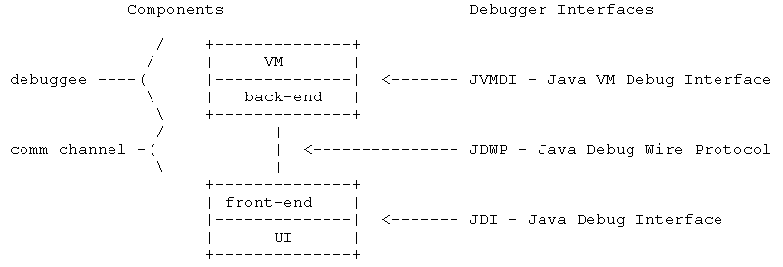
Java Platform Debugger Architecture (JPDA) (1)
Port here.
Usually based on socket.
Many third party debuggers using JDI are available.
JDB, NetBeans IDE, JSwat, JDebugTool, JBuilder, WebSphere Studio, BugSeeker, and so on.

Slide 170
Java Platform Debugger Architecture (JPDA) (2)
Java Source Level Debug
Easy to Port to Embedded Target
  If socket is available.
Sun JDK Provides “Socket Connection” and “Shared Memory Connection”

Slide 171
Java Platform Debugger Architecture (JPDA) (3)
Wait for debugger connection
$ javac -g HelloWorld.java
$ java -Xdebug -Xrunjdwp:transport=dt_socket,server=y,address=8000 HelloWorld
Connect to debugee
$ jdb -connect com.sun.jdi.SocketAttach:hostname=localhost,port=8000
Set uncaught java.lang.Throwable
Set deferred uncaught java.lang.Throwable
Initializing jdb ...
>
VM Started: No frames on the current call stack
main[1]

Slide 172
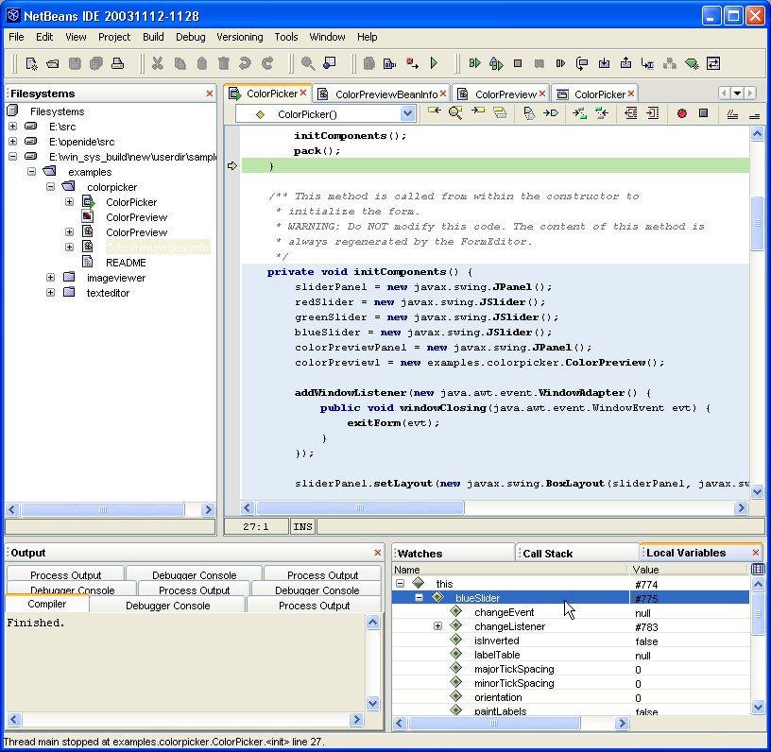
Java Platform Debugger Architecture (JPDA) (4)
NetBeans IDE Screenshot

Slide 173
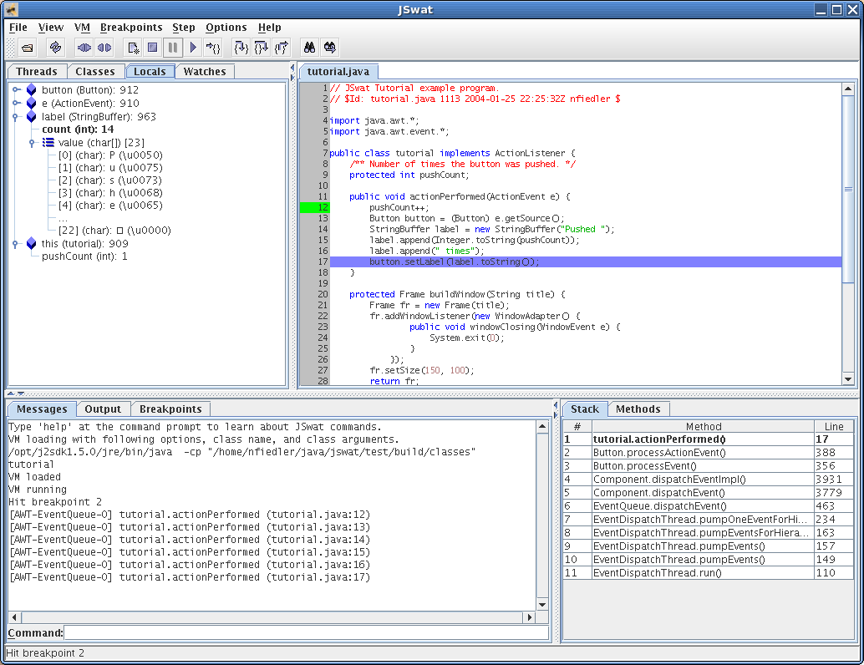
Java Platform Debugger Architecture (JPDA) (5)
JSwat Screenshot

Slide 174
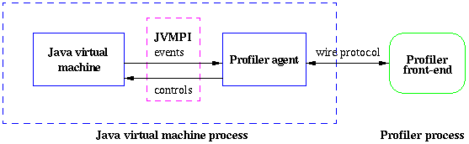
Java Virtual Machine Profiler Interface (JVMPI) (1)
Because there is no standard wire protocol, the profiler should handle the large potion. Absolutely, JVM platform dependent.
No standard wire protocol is available.
Not easy to use third party profiler.

Slide 175
Java Virtual Machine Profiler Interface (JVMPI) (2)
Several third party profiler available
  But usually, JVM platform dependent and source code is not available.
  Not easy to use in the target H/W.
  hprof, JProfiler, EJP, Optimizeit, Quantify, YourKit Java Profiler, JProbe, jProf, and so on.

Slide 176
Java Virtual Machine Profiler Interface (JVMPI) (3)
JProfiler
  Invocation Tree
  Memory Monitor
  Heap Walker - References
  Call Graph
  Allocation Hotspots
  Thread History
  Automatic Deadlock Detection
  Telemetry - Heap Usage
  Monitor usage history

Slide 177
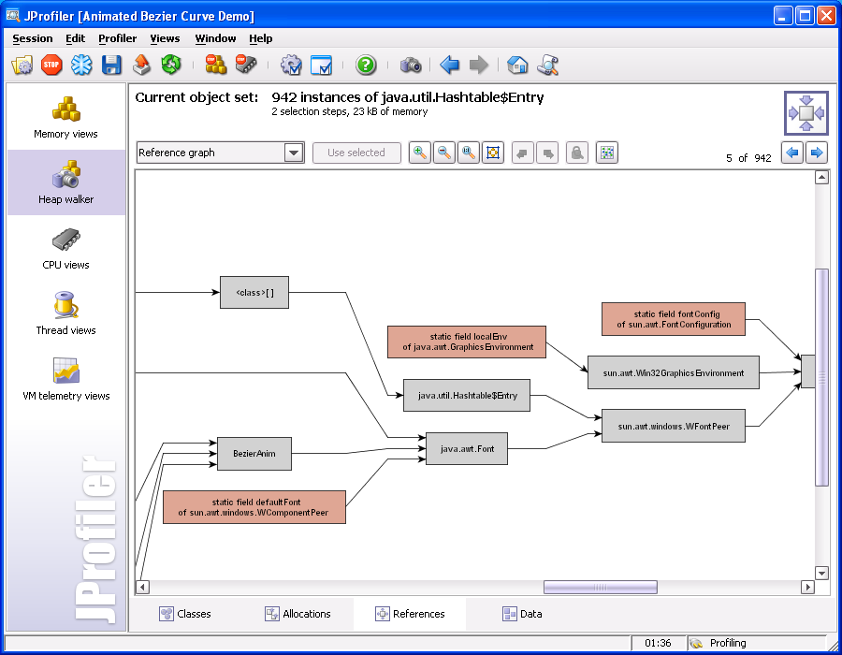
Java Virtual Machine Profiler Interface (JVMPI) (4)

Slide 178

Java Virtual Machine Profiler Interface (JVMPI) (5)

Slide 179
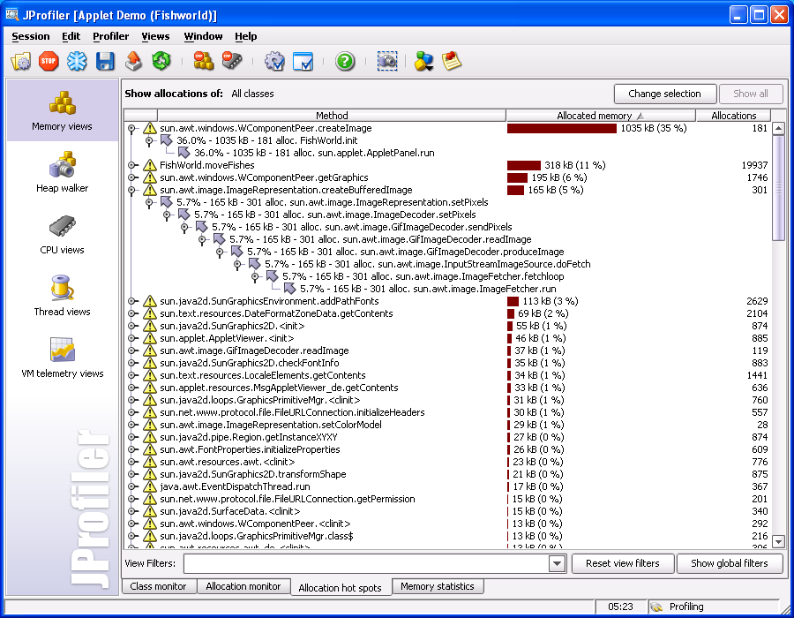
Java Virtual Machine Profiler Interface (JVMPI) (6)

Slide 180
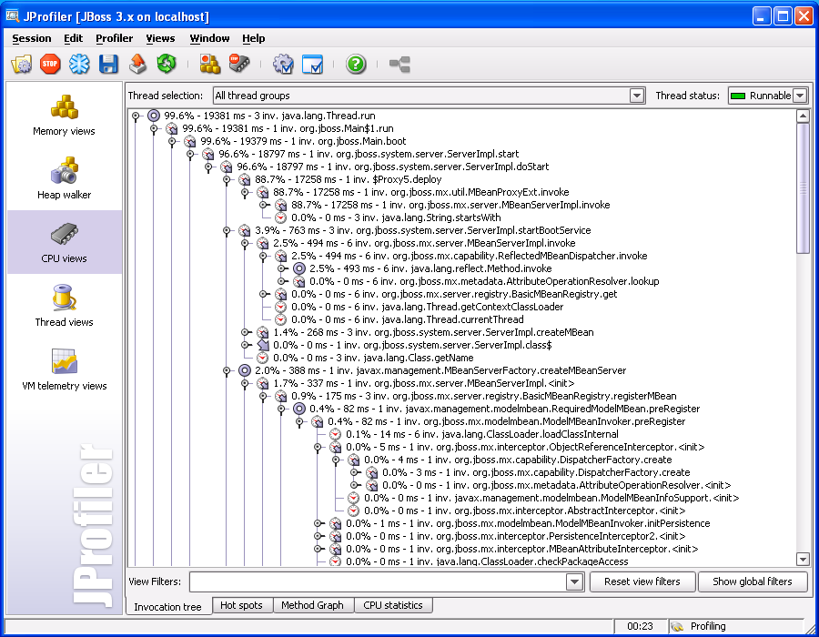
Java Virtual Machine Profiler Interface (JVMPI) (7)

Slide 181
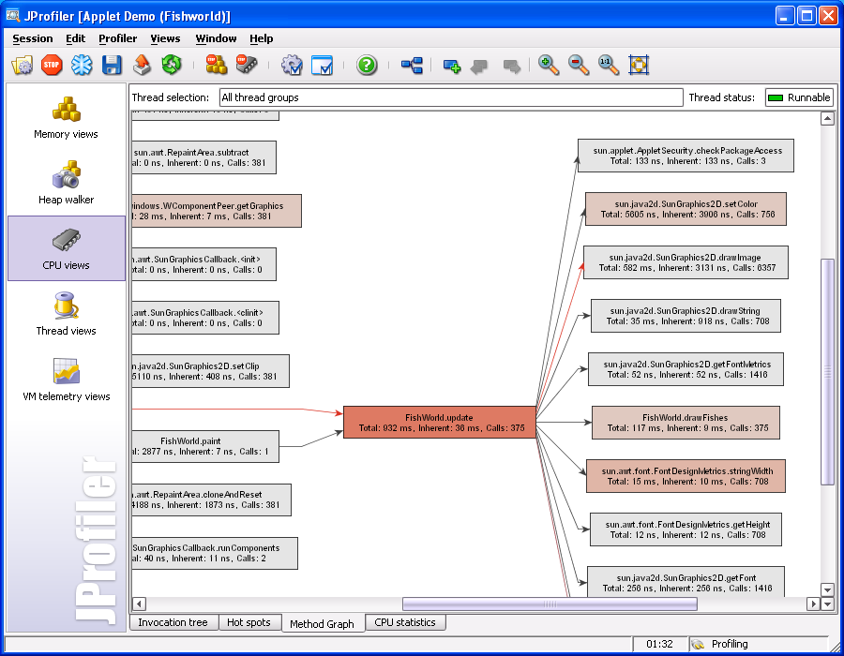
Java Virtual Machine Profiler Interface (JVMPI) (8)

Slide 182
Resource Management

Slide 183
Resource Management
Java Memory Leak
Java Heap and Native Heap
Thread Kill
Application Context
Resource Manager

Slide 184
Java Memory Leak (1)
Many Java programmers believe
  Not need to pay attention to memory leak in Java because the garbage collector handles it.
    It’s completely wrong.
JVM thinks the reachable Java objects are not garbage
  Therefore, to delete unused Java objects, they must not be reachable.

Slide 185
Java Memory Leak (2)
Object A
Object A
Call B.addListener(A)
Object B
Object B
Root
Root
If A doesn’t call B.removeListener(B), A will remain reachable and may not be deleted.

Slide 186
Java Heap and Native Heap (1)
Java Heap
  Java “new” allocates Java object in the Java heap.
  Divided into handle pool and data pool for the compaction.
  Java objects are deleted by GC.

Slide 187
Java Heap and Native Heap (2)
Native Heap
  Native “malloc” allocates memory in the native heap.
  “free” should be called for deleting the allocated memory.

Slide 188
Java Heap and Native Heap (3)
In AltiCaptor
  If only small free native heap is available, call GC.
    GC can increase the free native heap.
  It is also possible to use Java heap directly from native.
    By using internal private API.
    The great care must be taken because Java heap data can be moved by the compaction.

Slide 189
Thread Kill (1)
How to kill a thread by force?
  According to JVM specification, there is no way to kill the thread by force.
Make the thread do nothing by
  Setting the priority to the lowest.
  Removing all permission of the thread.
  But still alive and consumes memory.

Slide 190
Thread Kill (2)
Thread.interrupt()?
  If the thread is waiting in the “monitorenter” bytecode, can’t be interrupted.
Thread.stop()?
  Deprecated.

Slide 191
Thread Kill (3)
Modify JVM
  Create special “kill” method to kill thread.
  The “kill” method throws the special Exception to the target thread.
  The JVM handles the special Exception.
    Awake from “monitorenter”.
  Throws the Exception periodically until the thread die.

Slide 192
Application Context
How to translate current directory “.” into absolute directory?
  1) Load application classes with the special class loader.
    Different application is loaded by different class loader.
  2) Dump the java stack and search for the special class loader.
  3) The class loader will have the application context and have the current directory information.

Slide 193
Resource Manager (1)
How to kill the application by force without resource leak?
  1) When the application calls “addXXXListener” system class method, the system class method registers to the resource manager.
  2) Exit all monitor which was entered by the application.

Slide 194
Resource Manager (2)
  3) Kill all threads blocked in the application.
  4) The resource manager calls “removeXXXListener” registered by the application.

Slide 195
References (1)
Alticast
  http://www.alticast.com
  http://alticast.com/downloads/Solution%20Overview.pdf
Sun Microsystems
  http://www.sun.com
  http://java.sun.com/j2me/j2me-ds.pdf
  http://java.sun.com/j2se/1.4.2/docs/guide/jpda
  http://java.sun.com/j2se/1.4.2/docs/guide/jvmpi

Slide 196
References (2)
ej-technologies
  http://www.ej-technologies.com
  http://www.ej-technologies.com/products/jprofiler/overview.html

Slide 197
References (3)
Embedded System FAQ by Taeho Oh
  http://ohhara.sarang.net/history/info/embedded_system_faq.txt

