Slide 1
Technical
Meeting!
HotSpot JVM Tuning
By: Gilad Garon

Slide 2
What is JVM Tuning?
It’s more than just:
-Xmx2g
It’s a combination of:
Hardware selection
Software architecture
But most of all, JVM Tuning is about:
Understanding how your application works!

Slide 3
JVM Tuning
Agenda
The IDI Test Case
Choosing the right hardware
Garbage Collectors
JVM Tuning

Slide 4
The IDI Test Case
Technical Information
Swing desktop client application
Wicket web application
Mobile web application (In development)
Multiple AS: JBoss Clusters, Apache Cluster, Tomcat & Terracotta
Multiple frameworks: Spring, Guice, Wicket, Hibernate, Terracotta DSO, XStream, EJB 3.0, JMS, CGLib & Proprietary frameworks

Slide 5
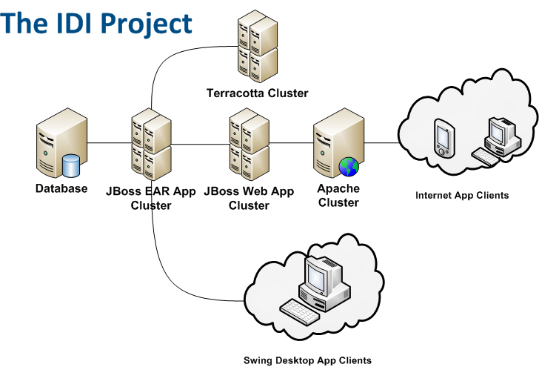

The IDI Test Case

Slide 6
The IDI Test Case
JBoss EAR cluster user load information
3000 +/- EJB Invocations per minute
100+ concurrent web sessions
Internal Print servers clients
Internal Mail servers clients
Internal Webservices clients

Slide 7
JVM Tuning
Agenda
The IDI Test Case
Choosing the right hardware
Garbage Collectors
JVM Tuning

Slide 8
Choosing the right hardware
How many software engineers does it take to change a light bulb?
None. It's a hardware problem.
Hardware choices affects code performance
Hardware choices affects OS offerings (Do you really want Windows?)
Hardware isn’t easily replaced, it costs a lot.

Slide 9
Choosing the right hardware
Which CPU architecture is right for you?
Higher clock speed? (what about Moore’s law?)
Higher core count?
Number of hardware threads?
Remember:
Not all CPU’s are created equally
Highly computational apps relay on clock speed
Highly concurrent / multi user app relay on number of threads
Hardware benchmarking helps a lot, but it’s difficult to arrange

Slide 10
Choosing the right hardware
What should be your opinion?
Intel Xeon / Itanium?
AMD Operton?
Sun SPARC?
IBM Power?
The winner is….
No one will ever ask for your opinion (almost)

Slide 11
Choosing the right hardware @ IDI
IDI Hardware history
Year | Machine | CPU
2005 | Sun Fire T1000 | UltraSparc T1 , 32 Threads @ 1.2 Ghz
2009 | Sun Fire T5120 | UltraSparc T2, 48 Threads @ 1.6 Ghz
2011 | HP VMWare | Intel Xeon, 8 Threads @ 3.0Ghz (VMWare)

Slide 12
JVM Tuning
Agenda
The IDI Test Case
Choosing the right hardware
Garbage Collectors
JVM Tuning

Slide 13
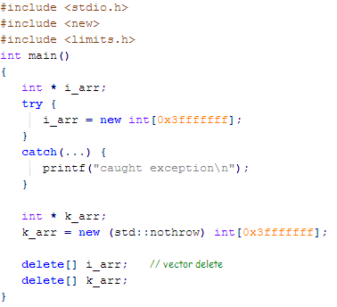
Garbage Collectors
Remember this?
Garbage Collection means that don’t have to anymore

Slide 14
Garbage Collectors
JVM Memory Handling
When the JVM starts, the host OS assigns a dedicated memory space to that VM
The VM allocates memory to the application within that dedicated memory space
The VM frees memory automatically via garbage collectors
Garbage Collection is an expensive algorithm

Slide 15
Garbage Collectors
Generational Memory Space
The memory space is divided into three separated memory spaces:
Eden Space Where objects are born
Survivor Spaces Where objects mature
Tenure Space Where objects grow old and die

Slide 16
Garbage Collectors
HotSpot VM‘s Generational Memory Space
Eden Space
Survivor Space 1
Survivor Space 2
Tenure (Old) Generation
Permanent Generation

Slide 17
Garbage Collectors
Technical Terms:
Concurrency Concurrency describes its ability to do work while application threads are still running
Parallelism Parallelism describes the collector's ability to perform its work across multiple threads of execution.
Hence, a collector can be parallel but not concurrent, concurrent but not parallel, or both parallel and concurrent.

Slide 18
Garbage Collectors
Technical Terms:
Copy Collector A collector that copies live object from one space to another
Low Pause Collector A collector that works along side the application threads
Throughput Collector A collector that doesn’t add to the serial execution time of the application

Slide 19
Garbage Collectors
Technical Terms, Continued:
Memory Fragmentation The amount of unusable free memory (small holes that object can’t be fitted in)
Stop the world: The application threads are stopped during the garbage collection
Minor Collection A garbage collection of the young generation
Major Collection A garbage collection of the old generation

Slide 20
Garbage Collectors
Types of GC Strategies (Generational):
Name | Young Collector | Old Collector | JVM Flag
Serial GC | Serial | Serial Old | UseSerialGC
Parallel New | Parallel New | Serial Old | UseParNewGC
Concurrent Mark and Sweep | Parallel New | CMS (With fail over to Serial Old) | UseConcMarkSweepGC
Parallel | Parallel Scavenge | Serial Old | UseParallelGC
Parallel Old | Parallel Scavenge | Parallel Old | UseParallelOldGC

Slide 21
Garbage Collectors
“Parallel New” Strategy
Young generation collection is done in parallel (CMS Version)
Old generation collection is done in serial
“Parallel” Strategy
Young generation collection is done in parallel
Old generation collection is done in serial
“Parallel Old” Strategy
Young generation collection is done in parallel
Old generation collection is done mostly in parallel

Slide 22
Garbage Collectors
Concurrent Mark-Sweep Strategy
Low pause collector (short Stop the World pauses)
Uses Parallel New for new generation GC
Uses CMS for old generation GC
Non compacting old generation collector
Starts before the memory space is full (68%)
Requires a larger heap

Slide 23
Garbage Collectors
Serial Collector (New Generation Space)
Eliminating dead object in “Eden” space.
Moving live object from “Eden” to empty survival space (“To” space).
Eliminating dead object in survival “From” space
Object that are to big, are copied directly to old space.
Moving live object from used survival space (“From”) to empty survival space (“To” space).
Mature objects are moved to old space
Object that are to big, are copied directly to old space.

Slide 24
Garbage Collectors
Serial GC Strategy - Young Generation
No more room! Promoting to Tenure space
Eden memory space
Garbage Collection!
Resuming Application
Survived! Earned it’s place in Tenure space
Survivor space (To)
Survivor space (From)
Tenure memory space

Slide 25
Garbage Collectors
Serial Collector (Old Generation Space)
Mark Phase
Marking live object in “Tenure” space.
Sweep Phase
Marking garbage objects
Compact phase
Compacting the live object by sliding them to the beginning of the space

Slide 26
Garbage Collectors
Concurrent Mark-Sweep
Initial Mark
Identifies root objects.
Stop the world phase
Concurrent Mark
Marks live object that are reachable from the root object graph.
Concurrent
Remark
Revisits changed objects for liveliness check (Objects change during the concurrent phases)
Stop the world phase
Concurrent Sweep
All garbage object are swept.
Concurrent
Concurrent Preclean
Remarking Phase ()
Concurrent

Slide 27

Garbage Collectors
CMS - Old Generation
Tenure memory space
Garbage Collection!
Resuming Application
Stop The World!
Phase:
Initial Mark
Concurrent Mark
Remark
Concurrent Sweep
Concurrent Pre-Clean

Slide 28
Garbage Collectors
Garbage First (G1) What’s the big deal?
High probability soft real time collector
One memory space for the young and tenure generation
Entire memory space is divided into equally sized cards
Cards are managed by regions and tracked by “Remembered Sets” for changes
A global card table track all the cards

Slide 29

Garbage Collectors
Garbage First (G1) - Heap Structure
Card
(512 Bytes)
Region A
Card
(512 Bytes)
Region B
Global Card Table
Card
(512 Bytes)
Region N
Remembered Set (Per Region)

Slide 30
Garbage Collectors
Garbage First - Minor Collection
Similar to Parallel New
Compacts young regions
Also compacts old regions if there’s time
Garbage First - Major Collection
Reclaims empty regions at once
Marks low lived ratio regions for collection in the minor collection phase

Slide 31
Garbage Collectors @ IDI
IDI GC Problem Related History
Problem | Cause | Solution
Long Stop The World GC every minute (JDK 1.5) | Sun RMI invokes GC every minute | Tuning the RMI GC
Frequent major collections with long pause times | Single threaded collector Tenure memory space leak Permanent memory space runs out because of proxy generation CMS abort preclean due to time | Move to CMS Smart load balancing for buying time in order to solve the memory leak Increasing the perm gen space Increasing CMSMaxAbortablePrecleanTime
System spends more then 30% of it’s uptime in minor GC | Weak hardware | Upgrade the hardware

Slide 32
Garbage Collectors @ IDI
IDI Garbage Collection Strategy:
Requirement | Problem | Solution
Fast and responsive | Requires low pause GC | CMS Collector
Needs to support a large number of concurrent users | Generates a lot of short lived objects Hardware support | Multi-threaded Hardware Large Eden memory space (1 GB)
Generates a large number of proxy classes | Requires Permanent generation tuning | Large permanent generation space (384 MB)
Holds large data collections in memory | Requires a large old memory space | Large Old memory space (4 GB)
Heap size is 5 GB | 32 Bit JVM is not enough | 64 Bit JVM and Hardware

Slide 33
JVM Tuning
Agenda
The IDI Test Case
Choosing the right hardware
Garbage Collectors
JVM Tuning

Slide 34
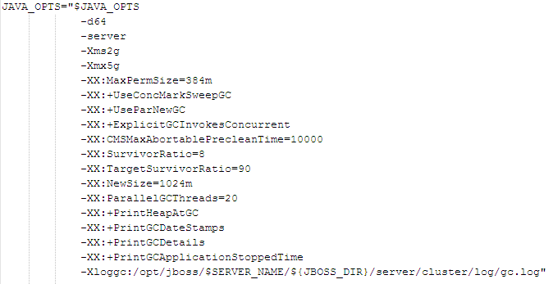
JVM Tuning
This is JVM Tuning:

Slide 35
JVM Tuning
The must know flags
-Xmx<size><units>
-Xms<size><units>
-d64
-server
-XX:MaxPermSize=<size><units>
-XX:-HeapDumpOnOutOfMemoryError

Slide 36
JVM Tuning
GC Logs
-Xloggc:<file_name>
-XX:+ PrintHeapAtGC
-XX:+ PrintGCDateStamps
-XX:+ PrintGCDetails
-XX:+ PrintGCApplicationStoppedTime
-XX:+ PrintGCApplicationConcurrentTime

Slide 37
JVM Tuning
Garbage Collector Strategies
-XX:+ UseSerialGC
-XX:+ UseParNewGC
-XX:+UseConcMarkSweepGC
-XX:+ UseParallelGC
-XX:+UseParallelOldGC
-XX:+UseG1GC (JDK 1.7)
-XX:+UnlockExperimentalVMOptions (for G1 JDK 1.6_14)

Slide 38
JVM Tuning
Tuning GC
Flag | Description | Default Value JDK 6
-XX:SurvivorRatio | Ratio of eden/survivor space size | 8
-XX:TargetSurvivorRatio | Desired percentage of survivor space used after scavenge | 50
-XX:-DisableExplicitGC | Disable calls to System.gc(). | false
-XX:+UseTLAB | Use thread-local object allocation | true
-XX:NewRatio | Ratio of new/old generation sizes | 2
-XX:NewSize | Default size of new generation (bytes) | (NewRatio)
-XX:ExplicitGCInvokesConcurrent | A System.gc() request invokes a concurrent collection

Slide 39
JVM Tuning
Tuning GC
Flag | Description | Default Value JDK 6
-Dsun.rmi.dgc.client.gcInterval | he maximum interval between garbage collections of the local heap enforced by the RMI implementation | 1 Hour
-Dsun.rmi.dgc.server.gcInterval | As above | 1 Hour
-XX:ParallelGCThreads | Number of parallel threads parallel gc will use | (ncpus <= 8) ? ncpus : 3 + ((ncpus * 5) / 8)
-XX:NewRatio | Ratio of new/old generation sizes | 2
-XX:NewSize | Default size of new generation (bytes) | (NewRatio)

Slide 40
JVM Tuning
Tuning GC
Flag | Description | Default Value JDK 6
-XX:ParallelCMSThreads | Max number of threads CMS will use for concurrent work | (ParallelGCThreads + 3) / 4
-XX:+CMSIncrementalMode | Enable incremental mode (minimizes pauses) | false
-XX:+CMSIncrementalPacing | Whether the CMS incremental mode duty cycle should be automatically adjusted | true
-XX:CMSIncrementalDutyCycle= | CMS incremental mode duty cycle (a percentage, 0-100). If" CMSIncrementalPacing is enabled, then this is just the initial" value | 10

Slide 41
JVM Tuning
Tuning GC
Flag | Description | Default Value JDK 6
-XX:+CMSClassUnloadingEnabled | Whether class unloading enabled when using CMS GC (good for proxies) | false
-XX:CMSInitiatingOccupancyFraction | Percentage CMS generation occupancy to start a CMS collection cycle (A negative value means that CMSTirggerRatio is used) | -1
And many many more…

Slide 42
References
Java SE 6 HotSpot[tm] Virtual Machine Garbage Collection Tuning
Memory Management Whitepaper
Garbage-First Garbage Collection Whitepaper
Setting Java GC Parameters For Large Heaps
Java Tuning White Paper
Java HotSpot VM Options
The most complete list of -XX options for Java 6 JVM
G1: Java's Garbage First Garbage Collector`

Slide 43
References
The Garbage-First Garbage Collector (JavaOne 2008)
JVM Internals - Garbage Collection & Runtime Optimizations
Garbage Collection in the Java HotSpot Virtual Machine

