Slide 1
Not all java code is an application!
Applets, Webstart and Servlets
Warning: this is just to show you where to look and some things to look for – by no means definitive
(or even necessarily completely correct)

Slide 2
Applets

Slide 3
An applet is a special type of Java program designed to run inside a web browser
(or an applet viewer.)
Applets are one way to create “live” web pages.
Applets are constrained in what they are allowed to do.
See: users.aber.ac.uk/ltt/test-applet

Slide 4
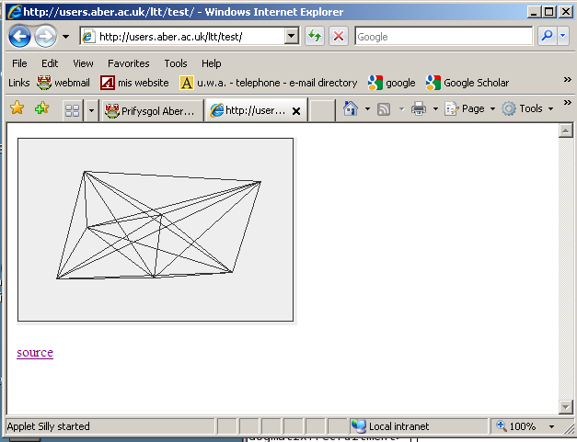
A Simple Applet Example also in this web space with lectures

Slide 5
Applet lifecycle 1: Browser - HTML - Java
Silly.java
public class
Silly
extends
JApplet {
:
a browser
}
javac
Silly.class
whatever.html
JVM
byte
code
<applet code=Silly.class width=100 height =100>
</applet>
class file is brought
into the browser and executed
Notes:
The Applet is effectively just a Panel
Browser acts as the frame
Browser creates applet, adds it to the display
And calls specific methods on Applet at specific times

Slide 6
Applet lifecycle 2: The Applet / Browser Protocol (in theory)
1. Browser accesses
init()
page
loads applet and
calls
2. Having loaded applet and
start()
called init()
calls
the applet is now running and has drawn itself
3. The browser leaves the page
calls
stop()
4. If the page is accessed again
start()
calls
5. If the browser is exited
calls
destroy()
Notes:
Init, start, stop and destroy are defined in the Applet class. Override start() if you need a main control thread: eg starting some animation. Use stop() to clear up resources. Note that exact calling sequence depends on the browser. Some browsers will reload the applet on each return to a page and therefore call init, and unload the applet classes when leaving the page, therefore calling stop and destroy. In many cases, simple applets don’t need to override start, stop or destroy. Also, even more complex applets often don’t need to override destroy since stop is called first anyway.

Slide 7
Notice that the applet runs on the client, but comes from the server
It should be obvious that this has implications with respect to reading and writing files.
You don’t want someone’s random applet writing and reading in your filestore!
See later about webstart
To debug you need the java console to show - settings
More on all this in later modules

Slide 8
Steps
The html to run it
issue of getting right version of JVM in browser
The applet code itself (extends Japplet)
issue of threads

Slide 9
The applet tag is now obsolete in html 5
You have to use <object> instead
I have not yet investigated this

Slide 10
1. Start with this html in whatever.html
<html>
<body>
<applet
code="Silly.class" width=305 height= 205>
</applet>
<p>
<a href="Silly.java"> source </a>
</body>
</html>

Slide 11
Issue of getting the right version of the JVM in the browser
Start with your html file as I showed
Run HtmlConverter on it
Will insert extra tags to enable:
  Dynamic download of Java plug-in on first request
  Use of local plug-in libraries subsequently instead of the browser’s default Java run-time libraries
Available in Windows or on Suns
  I used HtmlConverter index.html on Sun or HtmlConverter -gui
Don’t forget to set right permissions
  I did chmod 755 *

Slide 12
Ends up looking like:
<html>
<body>
<!--"CONVERTED_APPLET"-->
<!-- HTML CONVERTER -->
<object
classid = "clsid:CAFEEFAC-0016-0000-0002-ABCDEFFEDCBA"
codebase = "http://java.sun.com/update/1.6.0/jinstall-6u20-windows-i586.cab#Version=6,0,20,5"
WIDTH = 305 HEIGHT = 205 >
<PARAM NAME = CODE VALUE = "Silly.class" >
<param name = "type" value = "application/x-java-applet;jpi-version=1.6.0_02">
<param name = "scriptable" value = "false">
<comment>
<embed
type = "application/x-java-applet;jpi-version=1.6.0_02" \
CODE = "Silly.class" \
WIDTH = 305 \
HEIGHT = 205
scriptable = false
pluginspage = "http://java.sun.com/products/plugin/index.html#download">
<noembed>
</noembed>
</embed>
</comment>
</object>
<!--
<APPLET CODE = "Silly.class" WIDTH = 305 HEIGHT = 205>
</APPLET>
-->
<!--"END_CONVERTED_APPLET"-->
<p>
<a href="Silly.java"> source </a>
</body>
</html>

Slide 13
2. Defining the JApplet (note Swing stuff)
import java.applet.*;
import java.awt.event.*;
import java.awt.*;
import javax.swing.*;
public class Silly extends JApplet
implements MouseListener{
static final int MAXLOCS=100;
private Dimension Locs[];
private int NumClicks;
private DrawArea drawing;
public Silly() {
NumClicks=0;
Locs=new Dimension[MAXLOCS];
}
public void init() {
this.addMouseListener(this);
drawing=new DrawArea();
add(drawing,BorderLayout.CENTER);
setSize(300,200);
}
public void mouseReleased(MouseEvent e){}
public void mousePressed(MouseEvent e){}
public void mouseEntered( MouseEvent e){}
public void mouseExited( MouseEvent e){}
public void mouseClicked( MouseEvent e) {
int x=e.getX(); int y=e.getY();
if(NumClicks<MAXLOCS-1) {
Locs[NumClicks]=new Dimension(x,y);
NumClicks++;
repaint();
}
}
//////////////////////////////////////////
class DrawArea extends JPanel{
public DrawArea() {
setSize(300,200);
}
public void paintComponent(Graphics g) {
g.drawRect(1,1,299,199);
for (int i=0;i<NumClicks ; i++)
for (int j=0;j<NumClicks;j++)
g.drawLine(Locs[i].width, Locs[i].height,
Locs[j].width, Locs[j].height);
}
}
}

Slide 14
Methods
init() - Called by the browser or applet viewer to inform this applet that it has been loaded into the system.
destroy() - Called by the browser or applet viewer to inform this applet that it is being reclaimed and that it should destroy any resources that it has allocated.
start() - Called by the browser or applet viewer to inform this applet that it should start its execution. NOTE this may be called many times !, e.g. every time a window is resized, when a page is re-visited and so on.
stop() - Called by the browser or applet viewer to inform this applet that it should stop its execution. NOTE this may be called many times !, e.g. every time a window is resized, when a page is left

Slide 15
String getParameter(String name)
  Returns the value of the named parameter in the HTML tag.
void showStatus(String msg)
  Requests that the argument string be displayed in the "status window“
void play(URL url, String name)
  Plays the audio clip given the URL and a specifier that is relative to it.

Slide 16
In order to load an Image into an applet:
You use a method called getDocumentBase() to find the applet’s path and put Image file there
Relevant bits of code:
import java.net.URL;
….. Image my_gif; URL base;
….. try { base = getDocumentBase(); }
catch (Exception e) {}
….. my_gif = getImage(base,"icon1.gif");
public void paintComponent(Graphics g) {
g.drawImage(my_gif, 20,20,this);

Slide 17
The above should be enough to let you create an Applet version of your cartoonmaker
Write the application version
Replace ‘extends JFrame’ with ‘extends JApplet’
Pare it down (take out the save and load)
Remove the main, and put in an init() method
Write a basic html file and HtmlConvert it
Put it all in your public_html directory
Get the permissions right
Bob’s your uncle! (make sure you can see Java console – use controlpanel settings)

Slide 18
In order to get an applet to work with a JTextField in it
See applet-simple-input-too

Slide 19
Applets and SwingWorker
Applets are often (usually?) Swing applications
That means that we need to pay attention to the things we said about SwingWorker and threads:
First , in the init method we should ask the event dispatch thread to build our user interface rather than doing it ourself – see applet-simple (and over)
Second, we should use a SwingWorker thread to do complex processing so GUI doesn’t freeze - see applet-swingworker in this directory

Slide 20
public Silly() {
NumClicks=0;
Locs=new Dimension[MAXLOCS];
}
public void init() {
try {
SwingUtilities.invokeAndWait (
new Runnable() {
public void run() {
buildGUI();
}
}
);
}
catch (Exception e)
{ System.err.println("Attempt to use invoke and wait threw exception " + e);}
}
public void buildGUI() {
this.addMouseListener(this);
drawing=new DrawArea();
add(drawing,BorderLayout.CENTER);
setSize(300,200);
}

Slide 21
You can launch an applet by specifying the applet's launch properties directly in the applet tag. This old way of deploying applets imposes severe security restrictions on the applet.
Alternatively, you can launch your applet by using Java Network Launch Protocol (JNLP). Applets launched by using JNLP have access to powerful JNLP APIs and extensions.

Slide 22
webstart http://download.oracle.com/javase/tutorial/deployment/webstart/index.html

Slide 23
Another possibility is to use webstart instead to start an application.
There is an example of that in
http://users.aber.ac.uk/ltt/test-webstart
Along with some notes I made while getting it working

Slide 24
Webstart
With Java Web Start software, users can launch a Java application by clicking a link in a web page. The link points to a Java Network Launch Protocol (JNLP) file, which instructs Java Web Start software to download, cache, and run the application.

Slide 25
Servlets http://java.sun.com/developer/onlineTraining/Programming/BasicJava1/servlet.html

Slide 26
a Servlet is a Java class
server-side code
standards are set through Java APIs
  tighter, with more checking, that other technologies
an HTTP server (eg. Tomcat) knows that a URL represents a Java class instance
there must be a JVM running
the URL and a class must be associated
the server knows what method to call and what parameters
details of the HTTP request have to be delivered to the class
the result from the class has to be delivered as an HTTP response

Slide 27
Containers
a specialised server
typically a Java application
offers HTTP
has a running JVM
the servlet will be running in it
Examples
Tomcat - http://tomcat.apache.org/

Slide 28
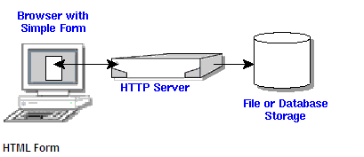
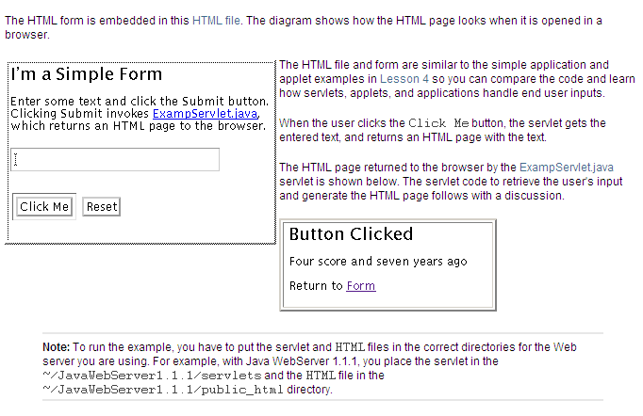

Slide 29
HTML is something like:
<html>
<head>
<title>The servlet example </title>
</head>
<body>
<h1>A simple web application</h1>
<form method="POST" action="/ExampServlet">
<label for=“DATA">Enter Some Text</label>
<input type="text" id=“DATA" name=“DATA"/><br><br>
<input type="submit" value="Submit Form"/>
<input type="reset" value="Reset Form"/>
</form>
</body>
</html>

Slide 30
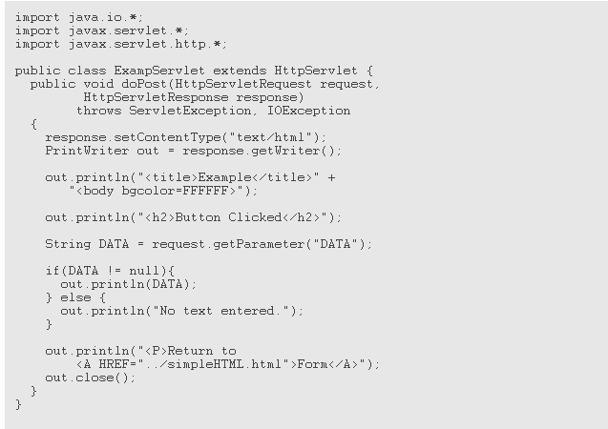
The doPost method performs the HTTP POST operation, which is the type of operation specified in the HTML form used for this example.
POST requests are for sending any amount of data directly over the connection without changing the URL
uses the response object to create an HTML page
and then puts html in it

Slide 31
Methods
doGet, doPost
also init() called at startup and destroy() called at shutdown

Slide 32
JSPs
JSPs are a higher level abstraction of servlets
They are compiled into servlets by a JSP Compiler
A JSP compiler may generate a servlet in Java code that is then compiled by the Java compiler, or it may generate byte code for the servlet directly.

Slide 33
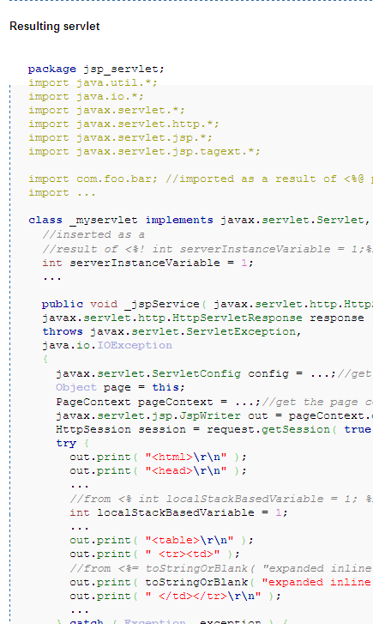
a JSP
<%@ page errorPage="myerror.jsp" %>
<%@ page import="com.foo.bar" %>
<html>
<head>
<%! int serverInstanceVariable = 1;%>
<% int localStackBasedVariable = 1; %>
<table> <tr><td>
<%= toStringOrBlank
( "expanded inline data " + 1 ) %>
</td></tr>

Slide 34
This has been a lot of ‘handwaving’ I know
Just introducing you here to some things that you may find useful before they are covered properly in years 2 and 3
Last year the 2nd year group project used JSPs for instance and I thought it would be useful for you to know some of the things to google

