Slide 1
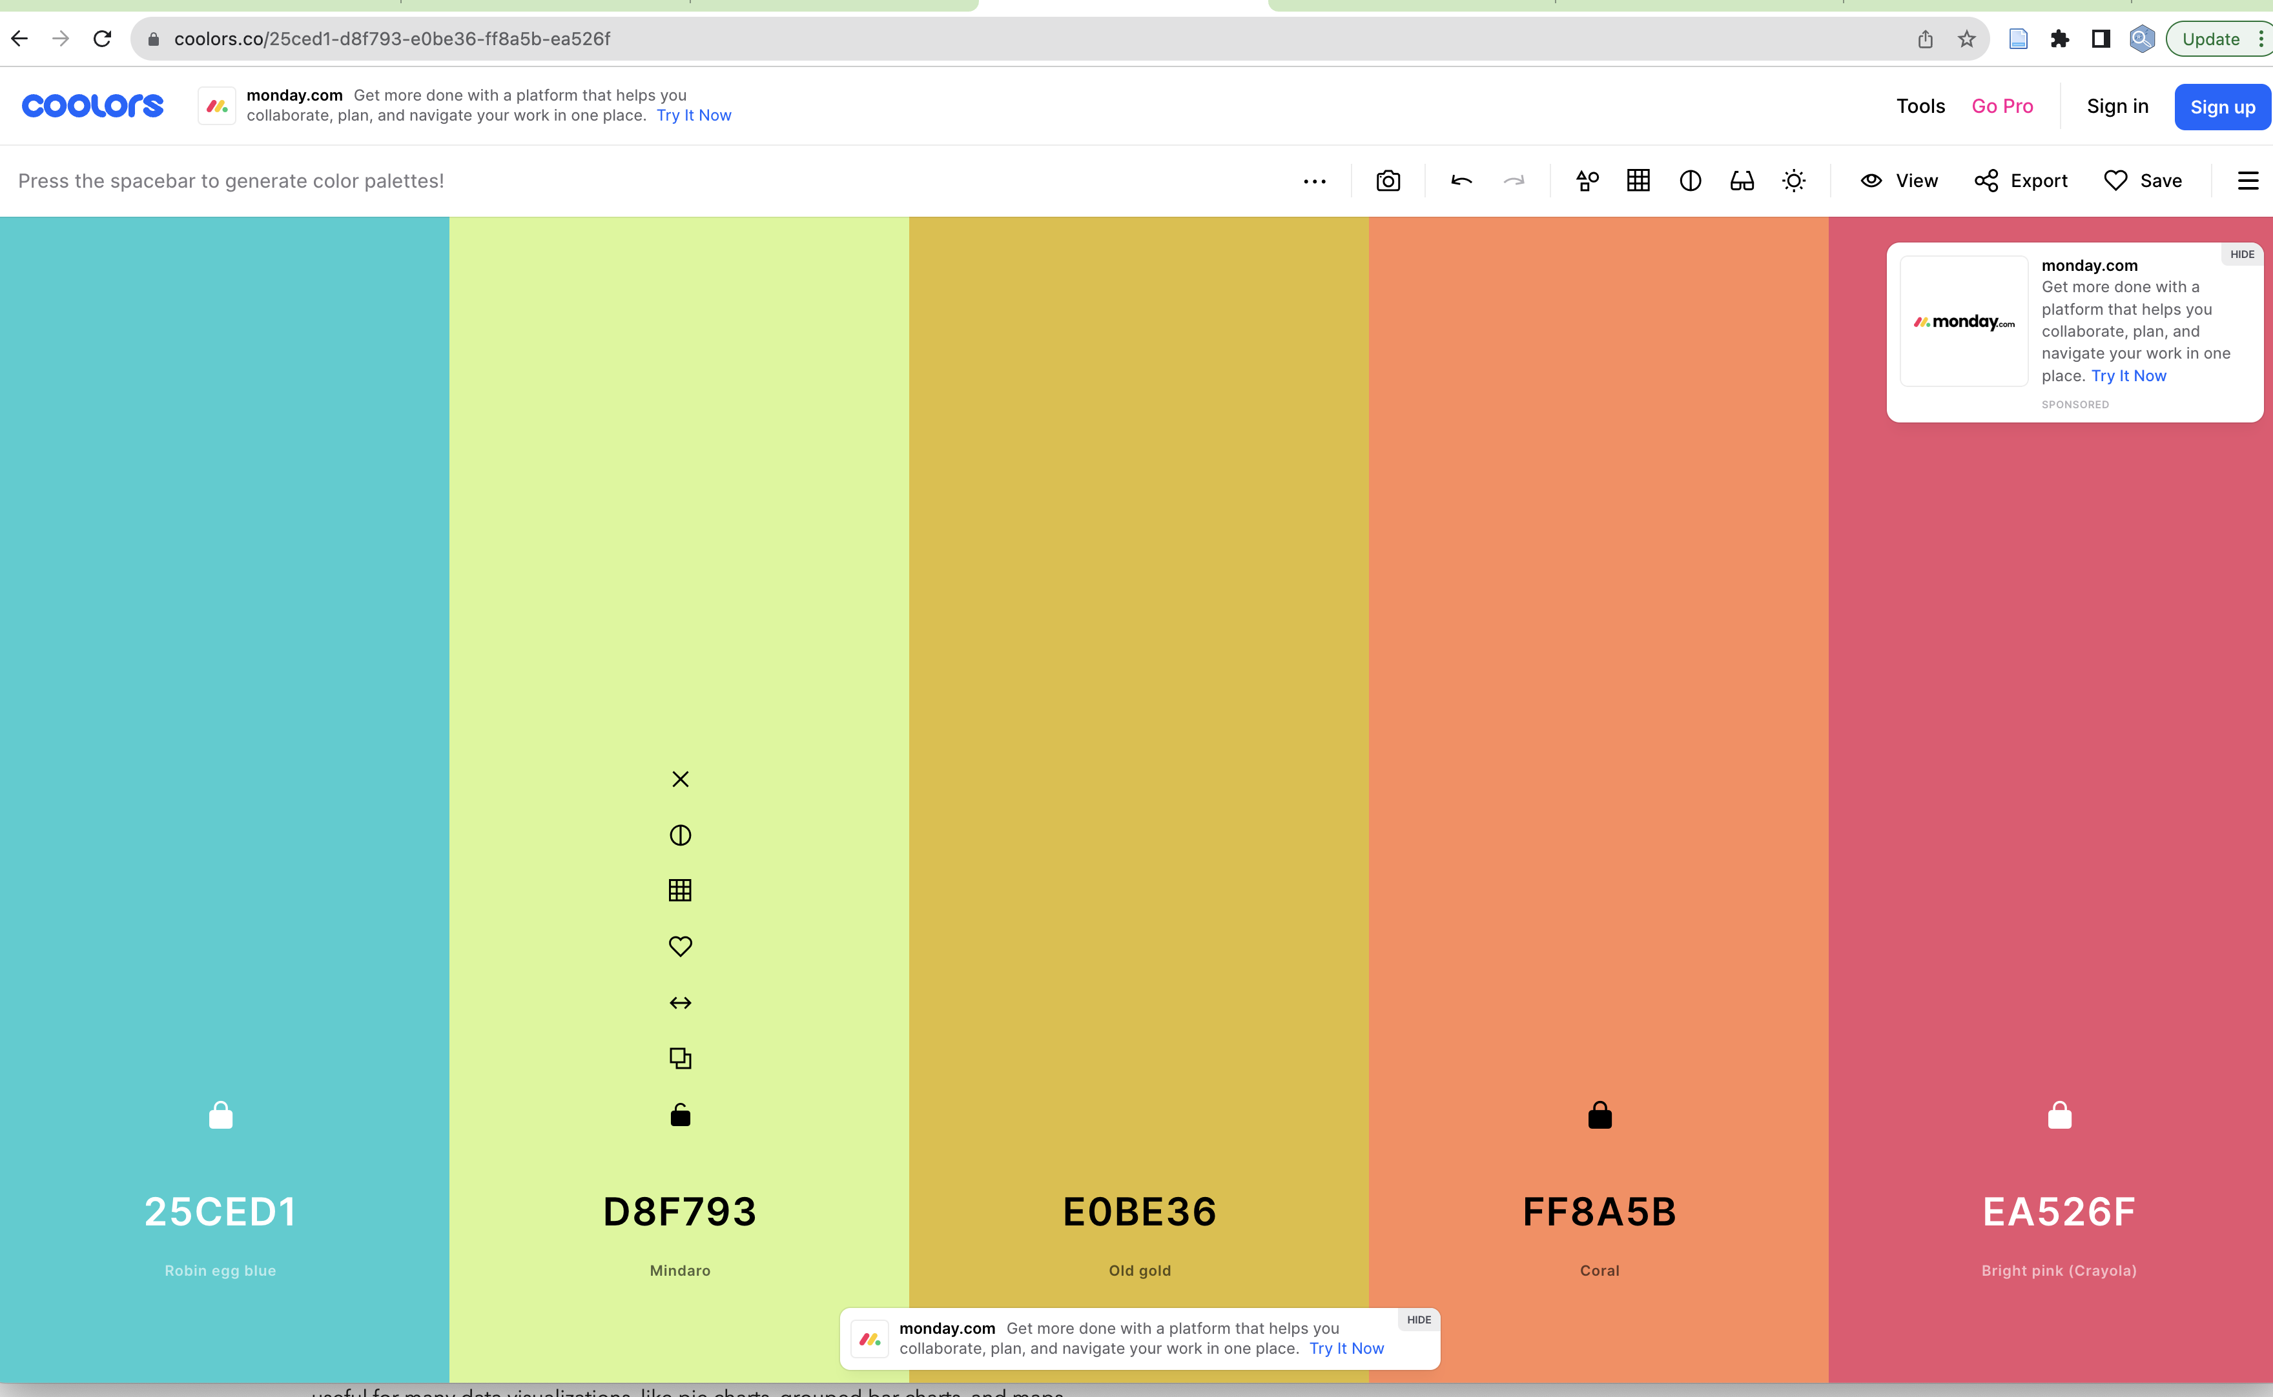
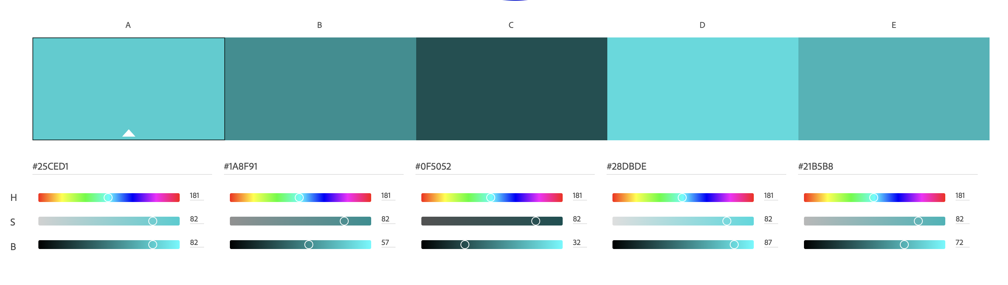
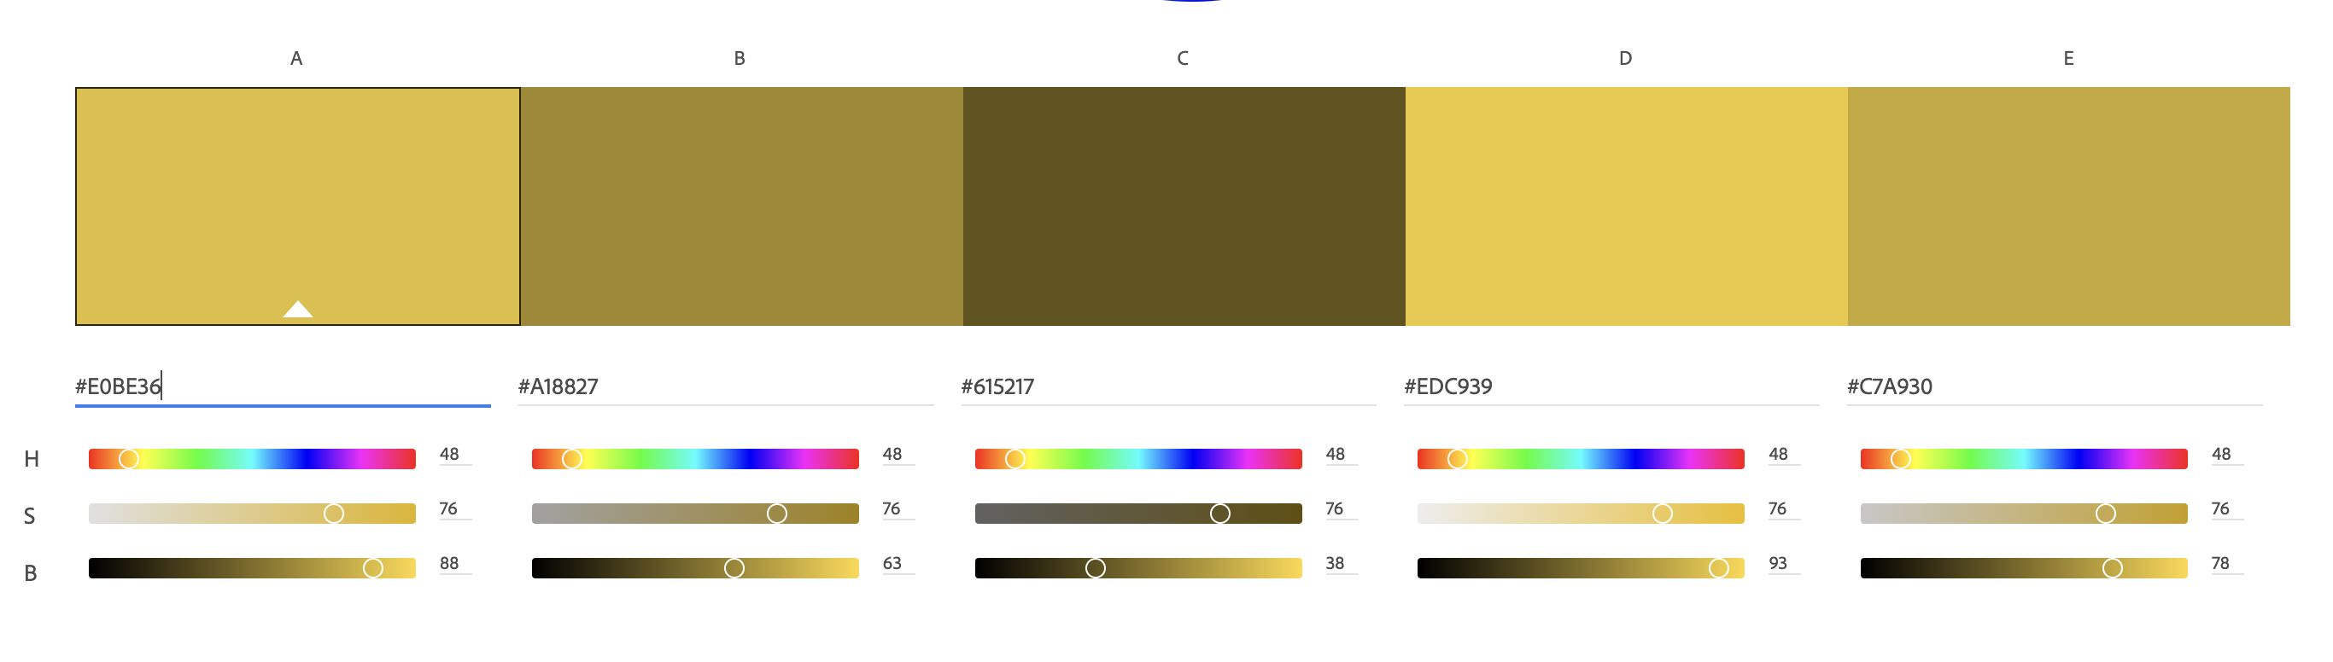
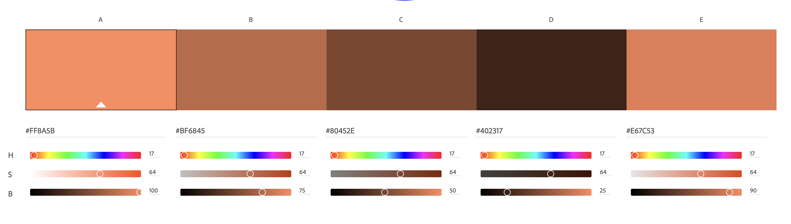
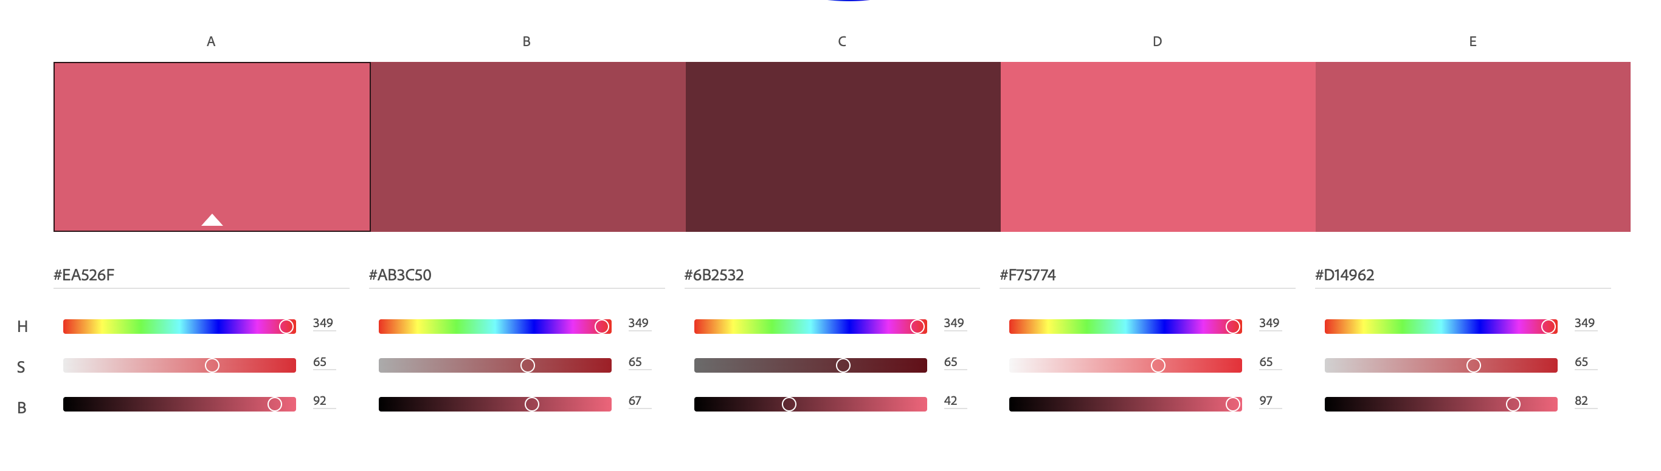
SHADES
GRAPH
https://color.adobe.com/create/color-wheel
PLOT
CHART
DATA
STORY
Main
Shades: Dark
Triad: Dark
Shades: Light
Triad: Light

Slide 2
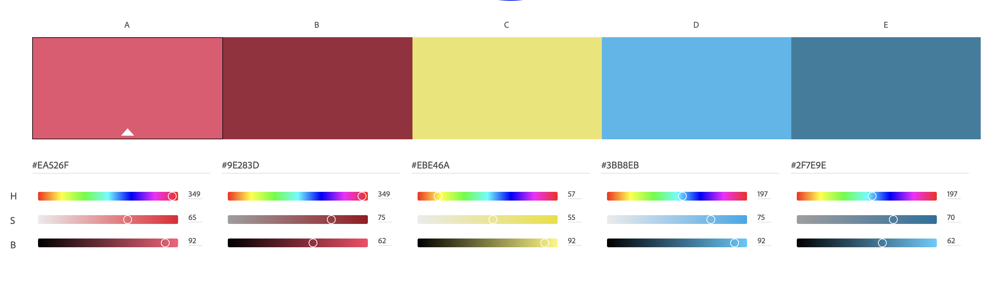
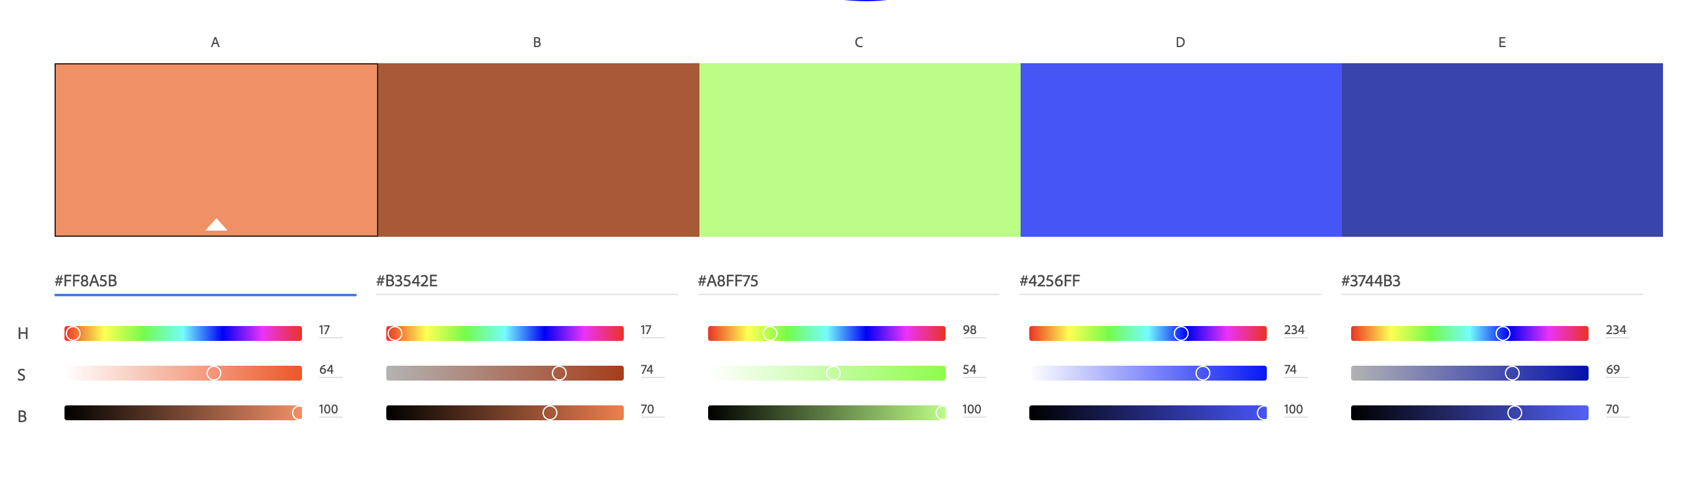
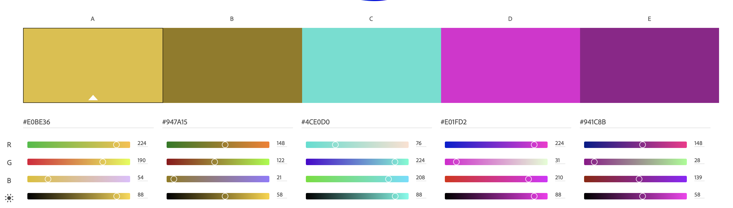
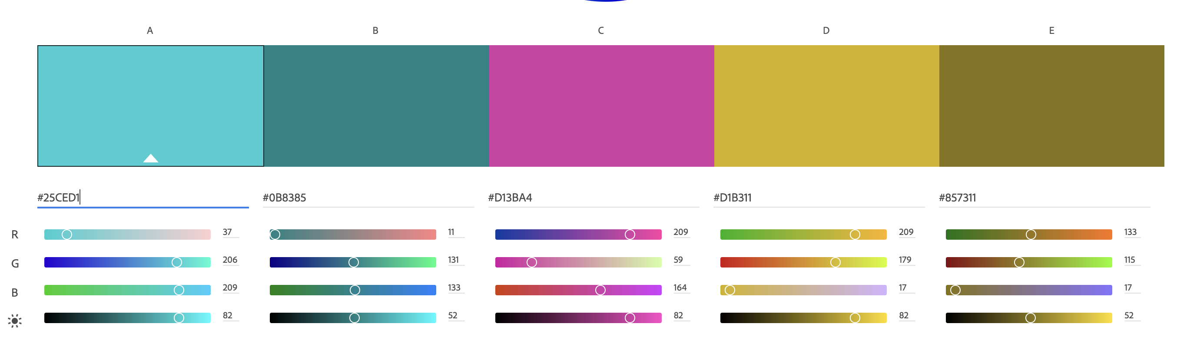
ANALOGOUS
GRAPH
PLOT
CHART
DATA
STORY
Main
Triad: Dark
Triad: Light

Slide 3
As many colours as possible
Graph
Plot
Chart
Data Story
Fifth Colour
GRAPH
Main
PLOT
30CED1
E0BE36
EB526F
FA8A5B
D8F794
Shades: Darkest
105052
615216
80452E
6B2332
697847
Shades: Darker
CHART
1E8F91
A18826
C06845
AA3D4F
A1B86D
DATA
Triad: Dark
1B8385
947A14
B3542F
9E283D
90AB55
STORY
Triad: alt
D13BA4
4CE0D0
A7FF75
EBE46A
AEC6F8
Dark grey
656370
UX blue
4464AD
Mid grey
BBBBBD
UX blue dark
2A3E6E
Light grey
DCDCDE
UX blue light
6B8EF3

