Slide 1
GPCDS
PLOT
GRAPH
CHART
DATA
GPCDS
STORY

Slide 2
Plots contain only numeric or categorical axes.
Colour can only be used for categorical variables
Geoms ONLY represent the data
Graph represent connections or shared attributes.
Usually nodes and edges
Charts extend plots by adding additional geoms or the use of Gestalt design principles to provide further context for the data.
Data storytelling is an art where pre-attentive attributes, Gestalt principles and narrative are combined to give data context to readers.

Slide 5
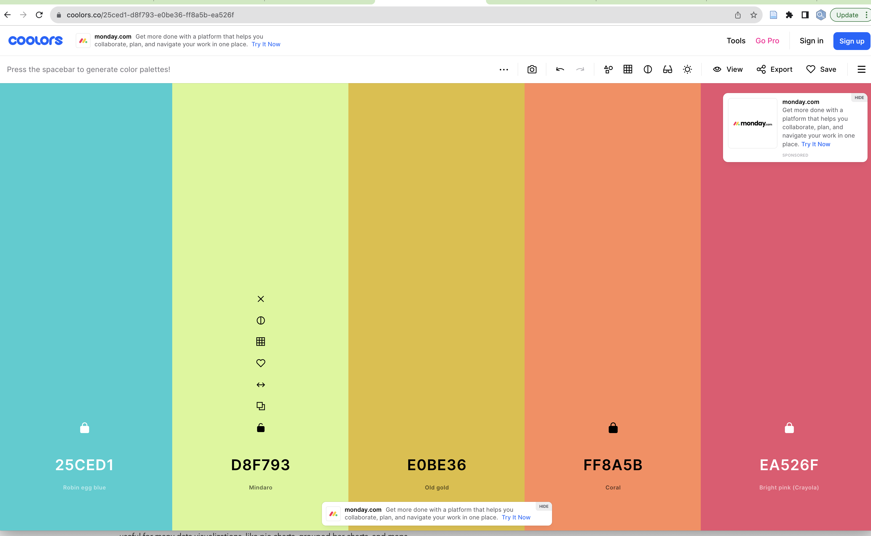
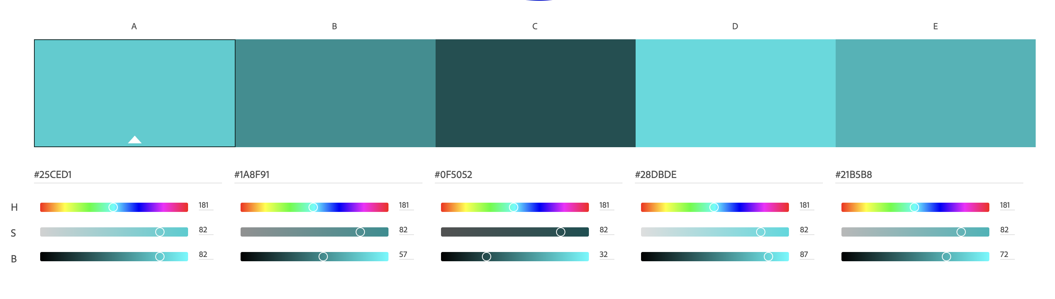
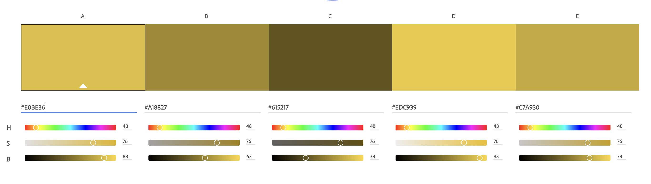
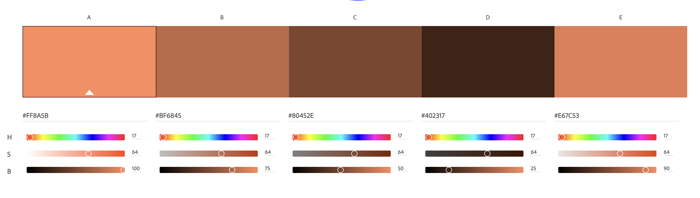
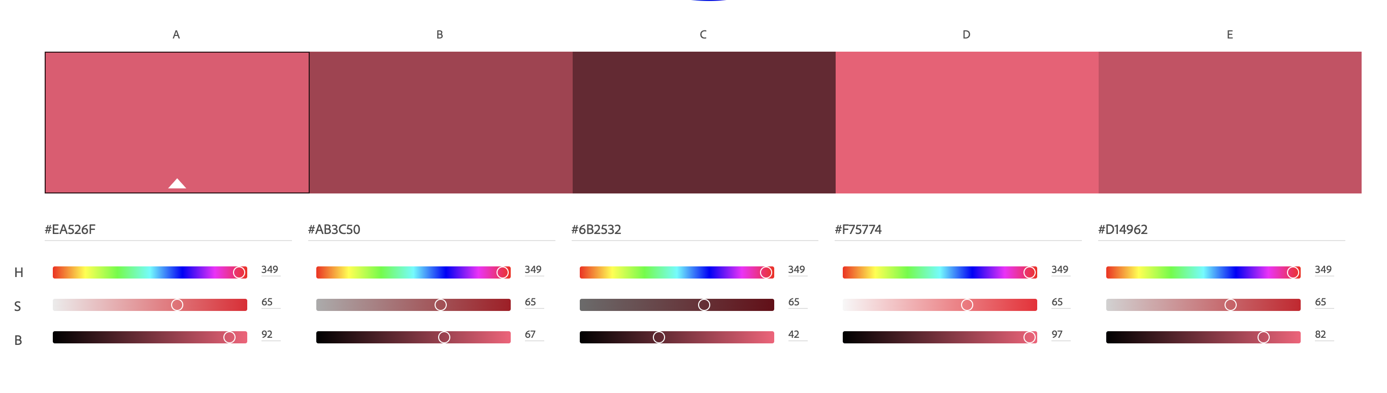
SHADES
GRAPH
https://color.adobe.com/create/color-wheel
PLOT
CHART
DATA
STORY
Main
Shades: Dark
Triad: Dark
Shades: Light
Triad: Light

Slide 6
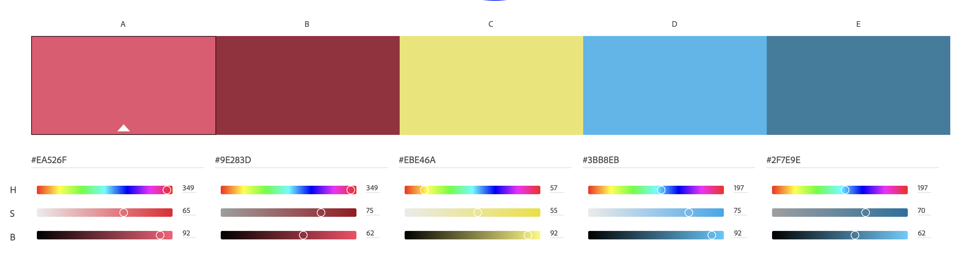
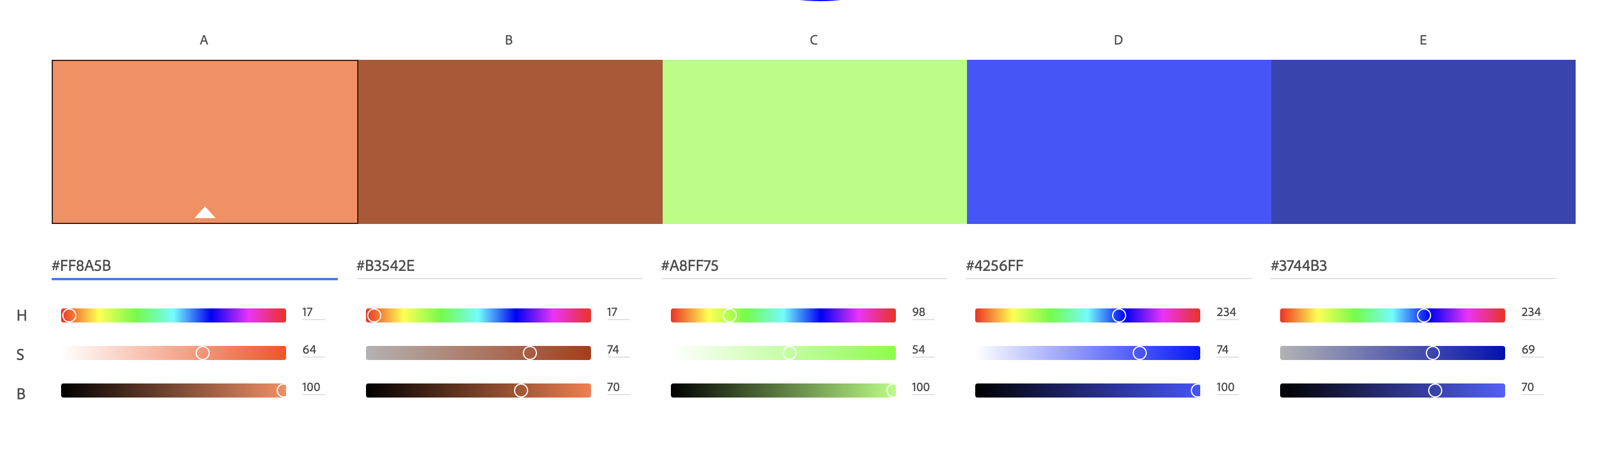
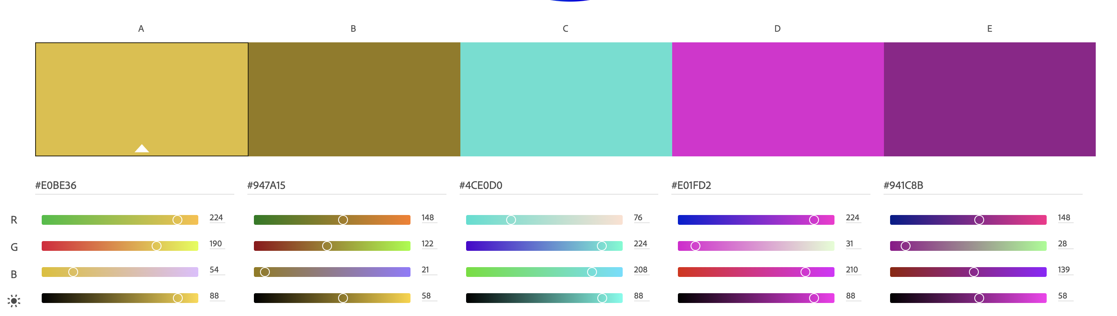
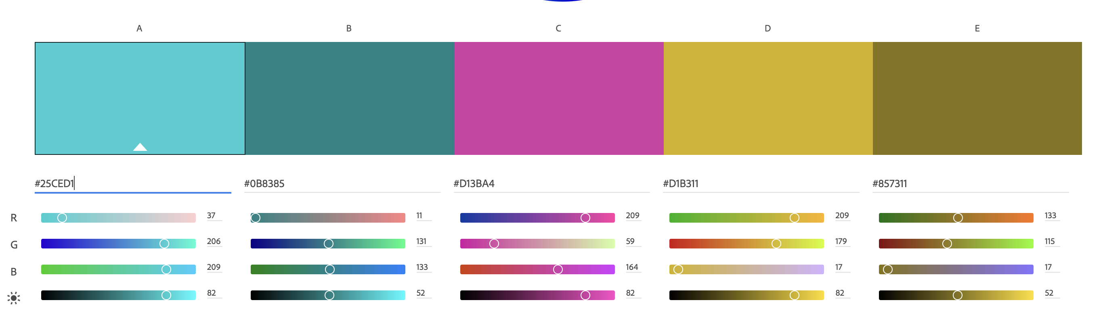
ANALOGOUS
GRAPH
PLOT
CHART
DATA
STORY
Main
Triad: Dark
Triad: Light

Slide 7
As many colours as possible
Graph
Plot
Chart
Data Story
Fifth Colour
GRAPH
Main
30CED1
E0BE36
FA8A5B
EB526F
D8F794
PLOT
Shades: Darkest
105052
615216
80452E
6B2332
697847
Shades: Darker
CHART
DATA
1E8F91
A18826
C06845
AA3D4F
A1B86D
Triad: Dark
STORY
1B8385
947A14
B3542F
9E283D
90AB55
Triad: alt
D13BA4
4CE0D0
A7FF75
EBE46A
AEC6F8
Dark grey
656370
UX blue
4464AD
Mid grey
BBBBBD
UX blue dark
2A3E6E
Light grey
DCDCDE
UX blue light
6B8EF3

Slide 8
Getting to the logo
PLOT
Graph
Plot
Chart
Data Story
Fifth Colour
GRAPH
Main
30CED1
E0BE36
FA8A5B
EB526F
D8F794
Shades: Darkest
105052
615216
80452E
6B2332
697847
Shades: Darker
CHART
DATA
1E8F91
A18826
C06845
AA3D4F
A1B86D
Triad: Dark
STORY
1B8385
947A14
B3542F
9E283D
90AB55
Triad: alt
D13BA4
4CE0D0
A7FF75
EBE46A
AEC6F8
Dark grey
656370
UX blue
4464AD
Mid grey
BBBBBD
UX blue dark
2A3E6E
Light grey
DCDCDE
UX blue light
6B8EF3

Slide 9
PLOT
PLOT
GRAPH
GRAPH
CHART
DATA
CHART
DATA
STORY
STORY

Slide 10
PLOT
PLOT
GRAPH
GRAPH
CHART
DATA
CHART
DATA
STORY
STORY

Slide 11
ACTUAL LOGO

Slide 12
PLOT
GRAPH
CHART
DATA
STORY

Slide 13
GRAPH
GRAPH
GRAPH

Slide 14
GRAPH
GRAPH
GRAPH

Slide 15
GRAPH
GRAPH
GRAPH

Slide 16
HOME PAGE BANNER
PLOT
GRAPH
CHART
DATA
STORY

Slide 17
Site

Slide 18
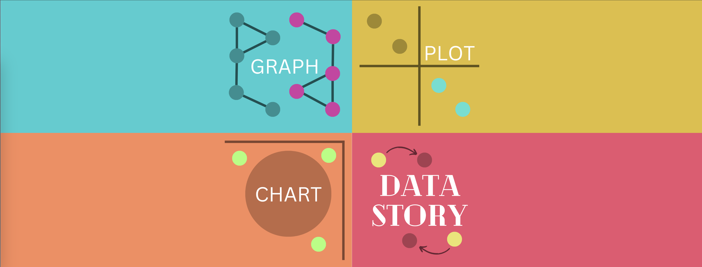
GPCDS is a light-hearted and inquisitive exploration of how graphs, plots and charts provide different paths to telling data stories.
Invite experts to explore a dataset within the confines of making a graph, plot and chart. Focusing on their process
Articles on the differences between graph, plots and charts
Podcasts episodes come two formats
Deep dives into visual perception theory, graph/network theory and quantitative experiments in dataviz
Advice and explorations of how to add data storytelling to your data visualisations
Advice and explorations of how to use interactivity or animations in data storytelling

Slide 19
