Slide 1
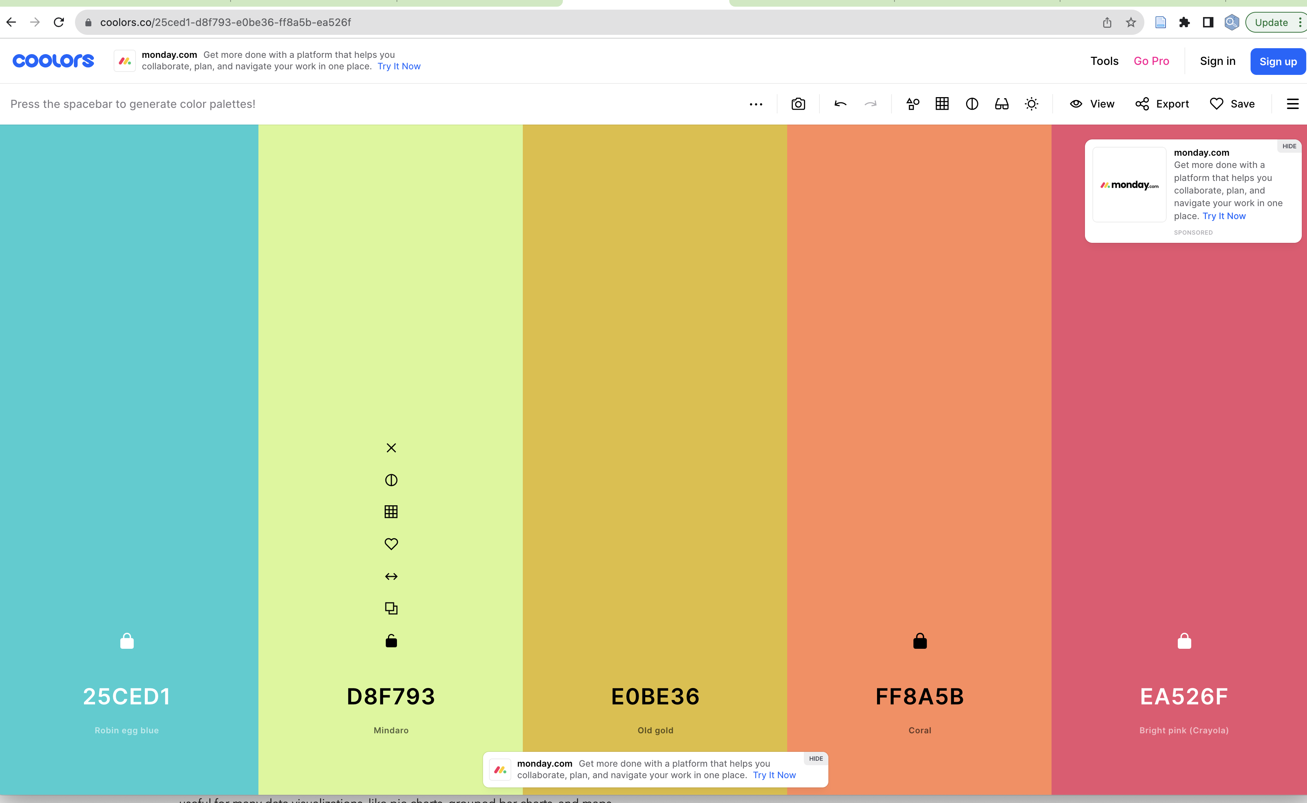
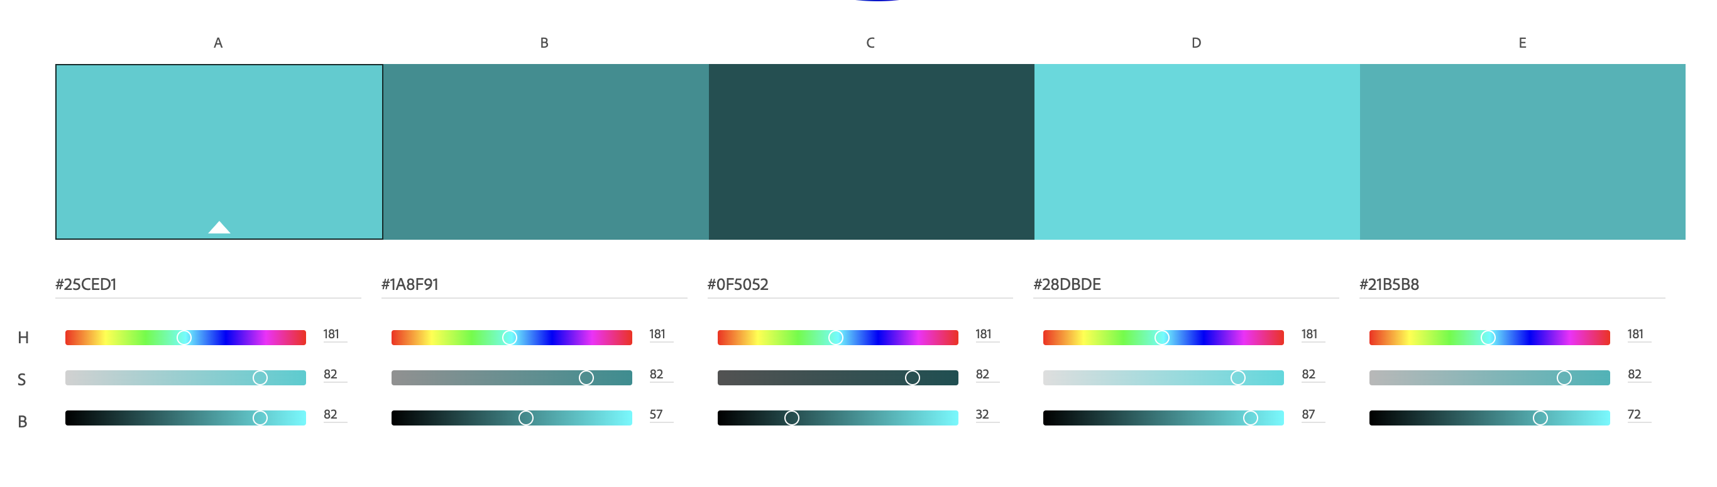
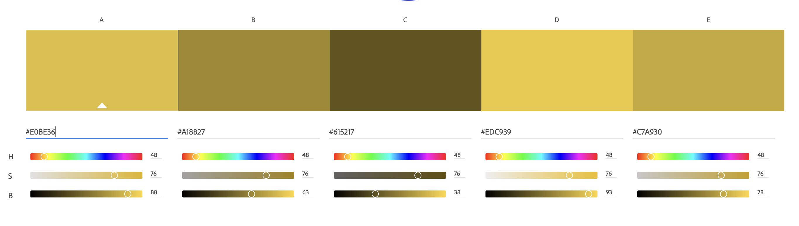
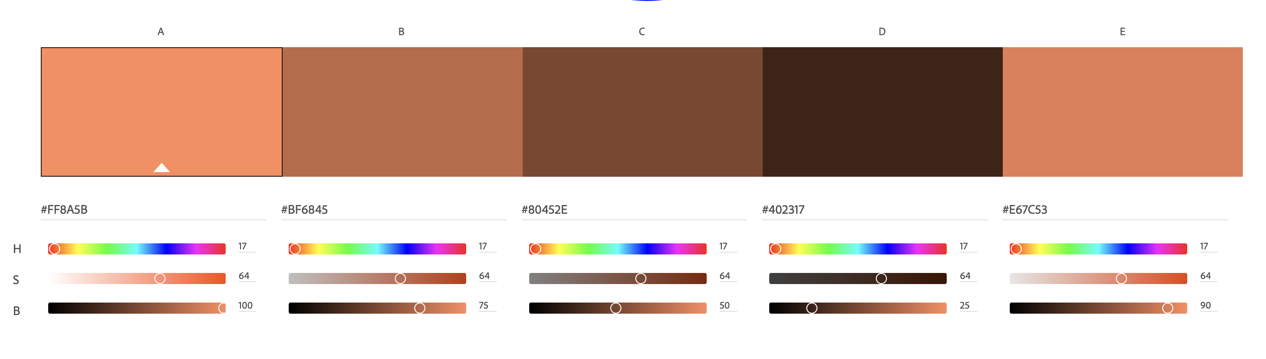
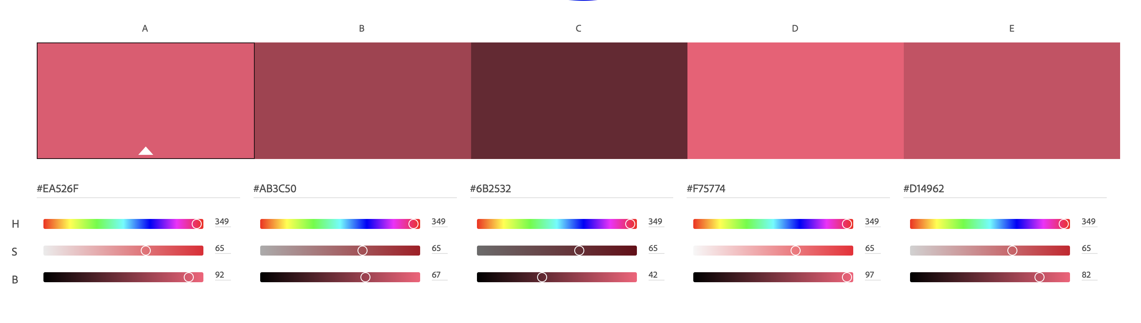
SHADES
GRAPH
https://color.adobe.com/create/color-wheel
PLOT
CHART
DATA
STORY
Main
Shades: Dark
Triad: Dark
Shades: Light
Triad: Light

Slide 2
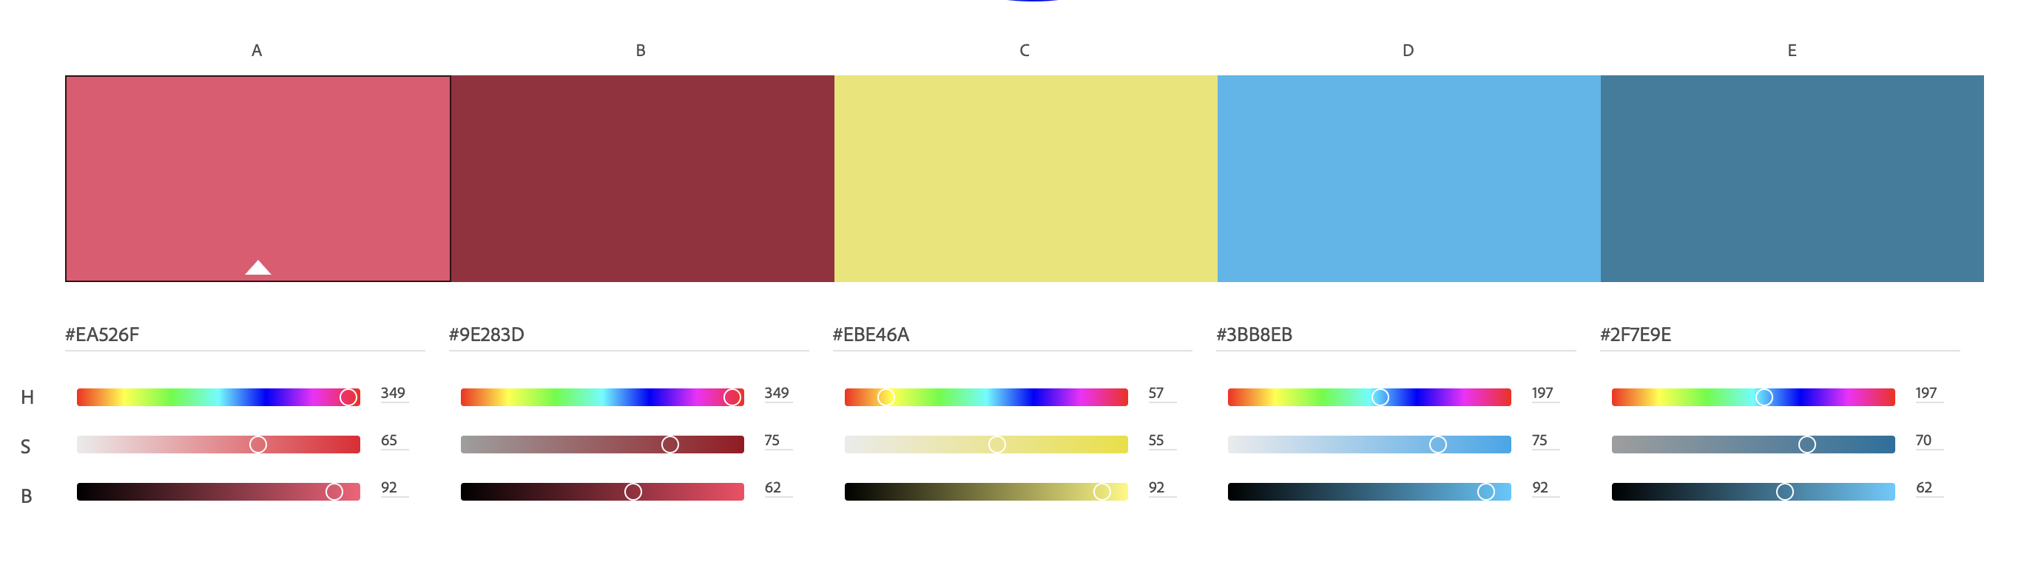
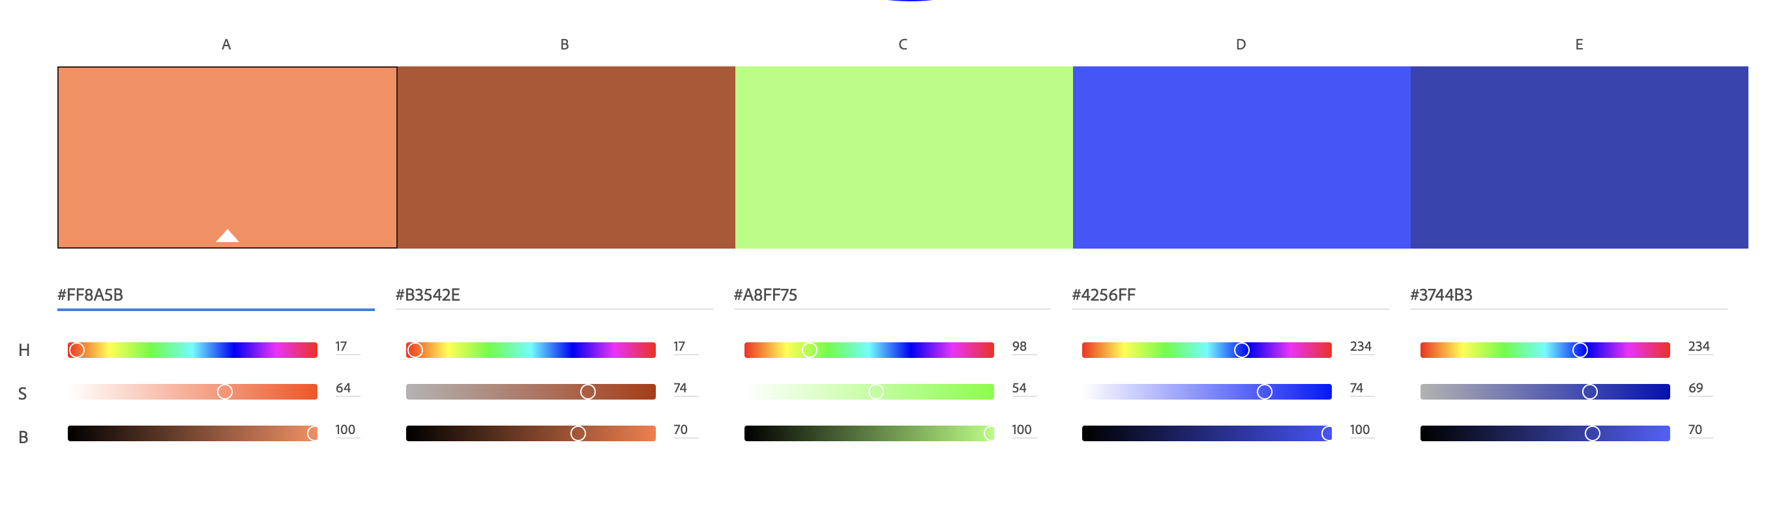
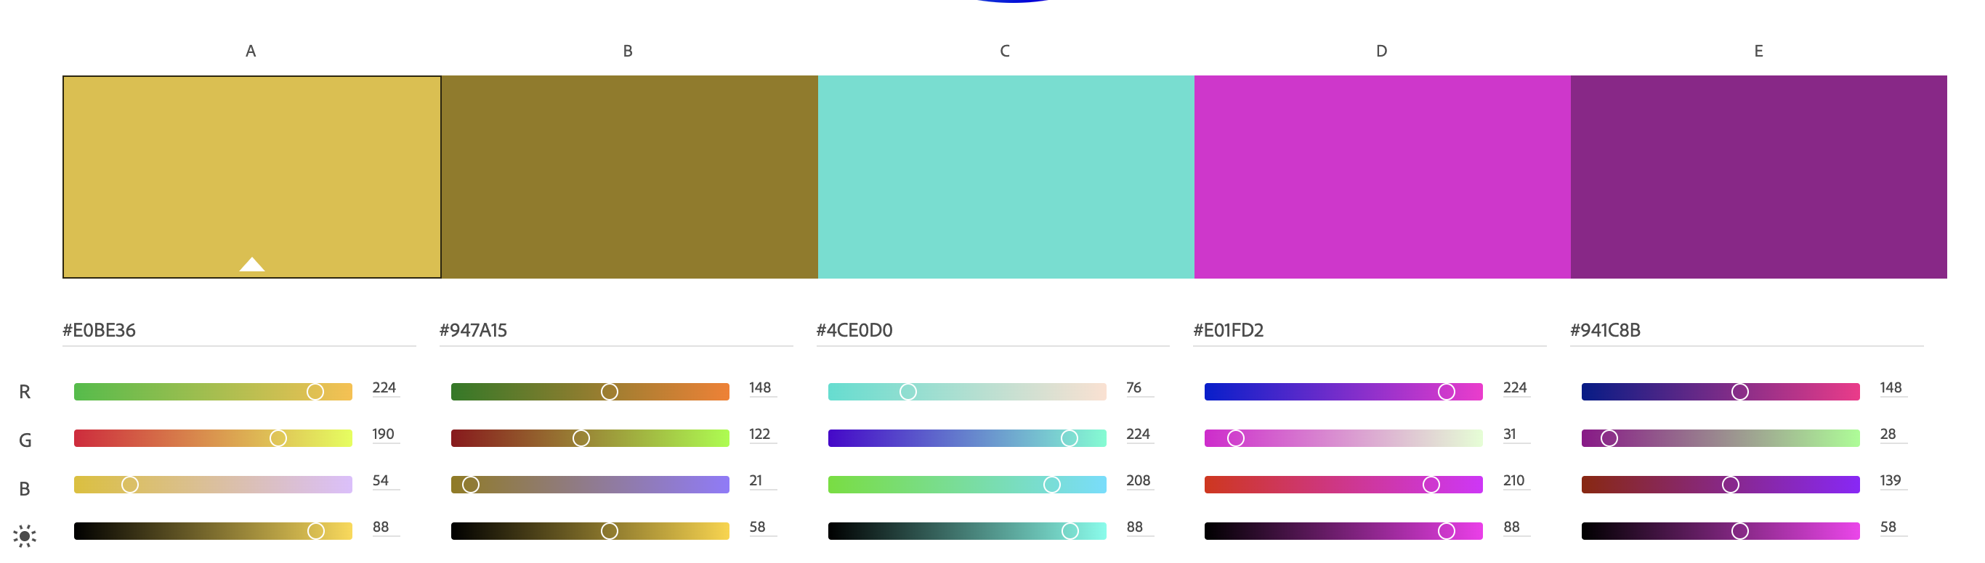
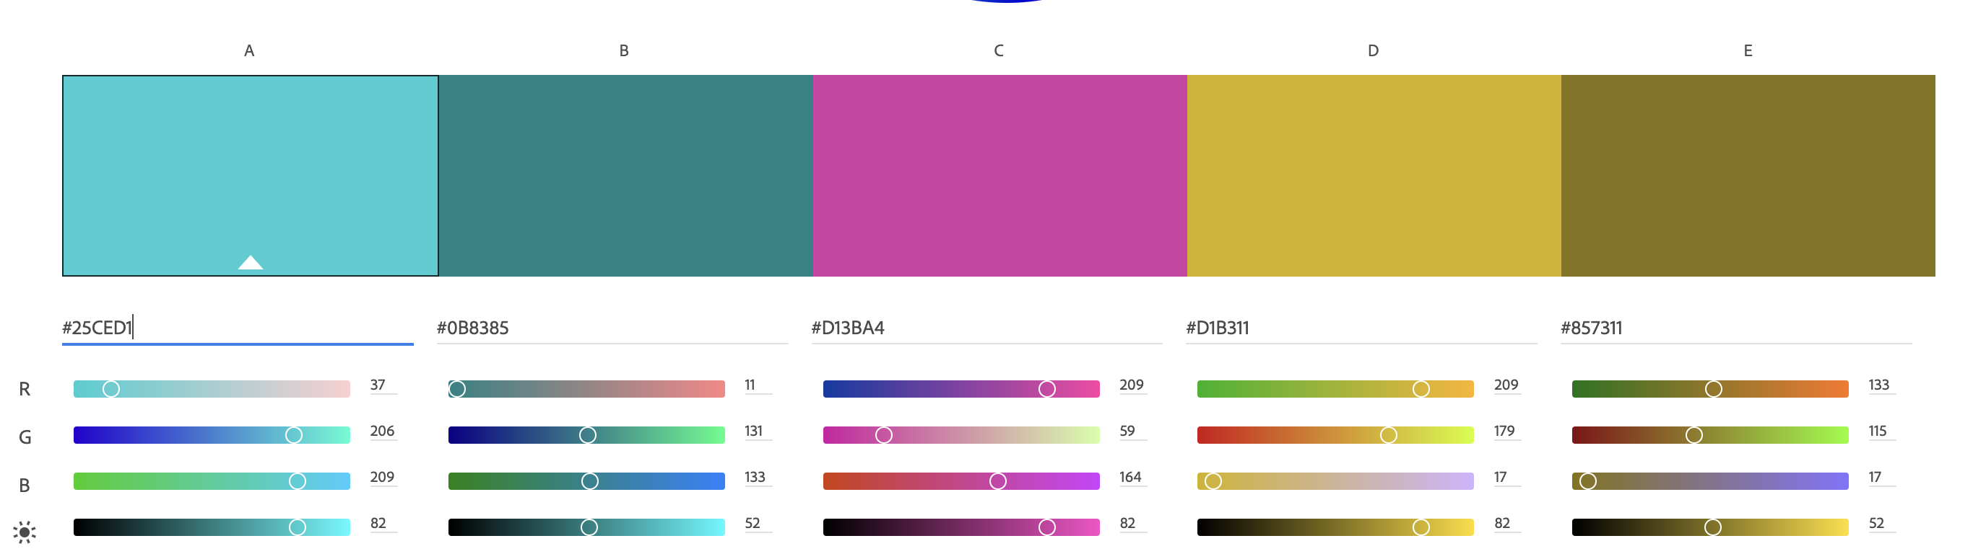
ANALOGOUS
GRAPH
PLOT
CHART
DATA
STORY
Main
Triad: Dark
Triad: Light

Slide 3
As many colours as possible
Graph
Plot
Chart
Data Story
Fifth Colour
GRAPH
PLOT
Main
Shades: Dark
Shades: Light
Triad: Dark
CHART
Triad: alt
DATA
STORY
Dark grey
Mid grey
Light grey

