Slide 1
Fintan Nagle
GradQuiz Traffic Analytics 1

Slide 2
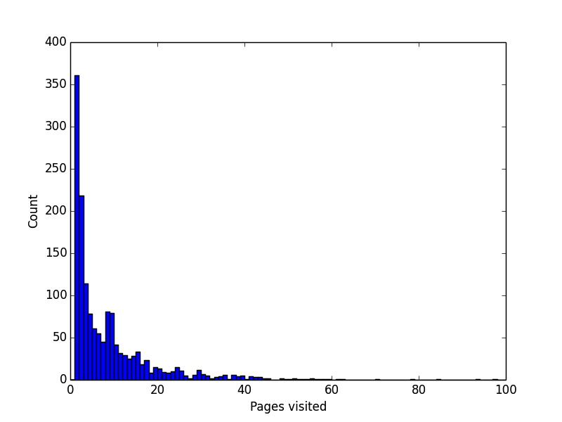
GradQuiz traffic analytics
Visit counts

Slide 3
GradQuiz traffic analytics
Visit counts
Very high spike at 2 pageviews
Spike after one set of questions completed Suggest attractor for question 2

Slide 4
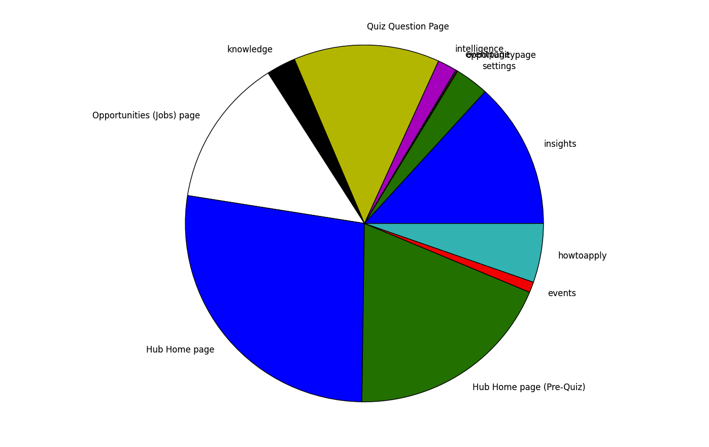
GradQuiz traffic analytics
Visited pages

Slide 5
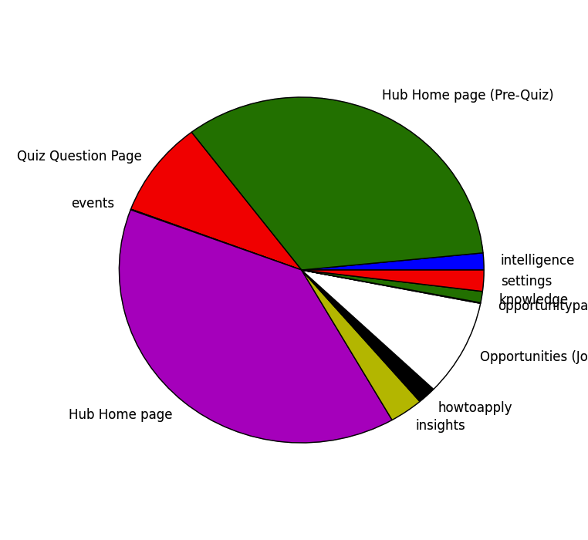
GradQuiz traffic analytics
Dropoff pages

Slide 6
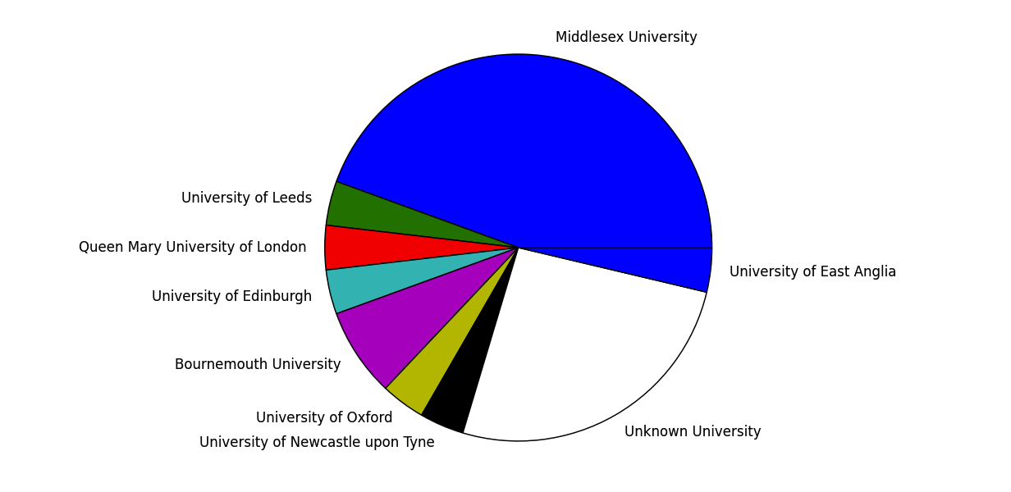
GradQuiz traffic analytics
Traffic sources

Slide 7
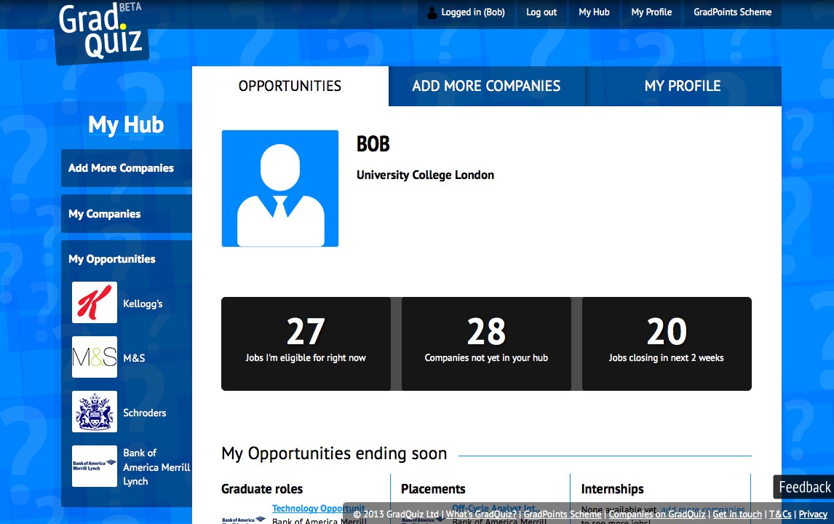
GradQuiz traffic analytics
Dropoff pages

Slide 8
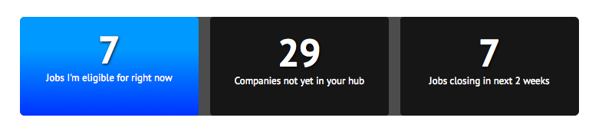
GradQuiz traffic analytics
Suggested Attractors

Slide 9
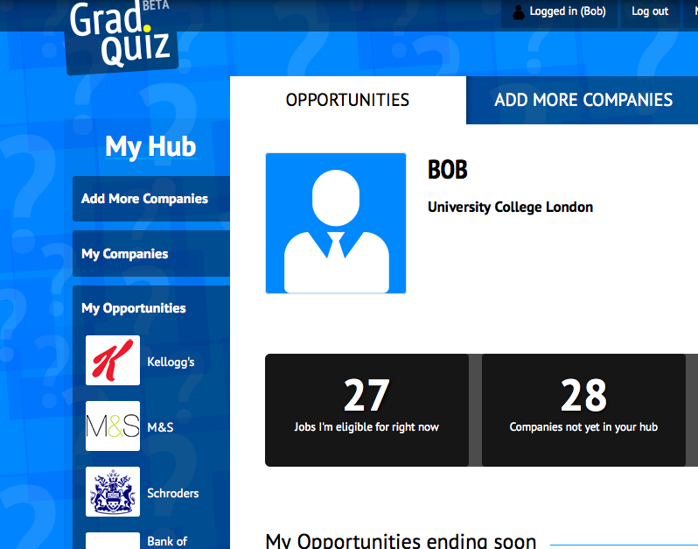

GradQuiz traffic analytics
Uni-specific targeting

Slide 10

GradQuiz traffic analytics
Uni-specific targeting

Slide 11
GradQuiz traffic analytics
General attractor strategy
Quick feedback is vital Set up analytics console showing effects of attractors by: University Attractor measured by: Visit length Quizzes completed
We measure the effects of attractors from the console
Sourcing: we can also measure the effects of campaigns on web traffic behaviour

Slide 12
GradQuiz traffic analytics
General attractor strategy
Modal attractors
Embedded attractors

Slide 13
GradQuiz traffic analytics
Notes
Company links should open in a new window, behind the current tab

