Slide 1
Dataspace Workshop
Moritz Eckert, Martin Lanz, Institute for AI-Safety and Security, 05.02.2025

Slide 2
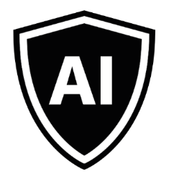
Agenda
10:00 - 10:30 Introduction
10:30 - 11:30 Frontend
11:30 - 12:30 Questions
12:30 - 13:30 Lunch break
13:30 - 14:30 Connector API (file transfer)
14:30 - 15:00 Policies
15:00 - 16:00 Connector API (services)
16:00 - 17:00 Questions

Slide 3
Documentation
https://github.com/vision-x-dataspace/dlr-dataspace-onboarding

Slide 4
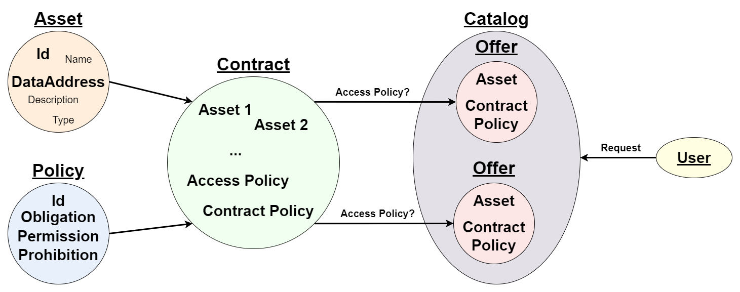
Entities

Slide 5
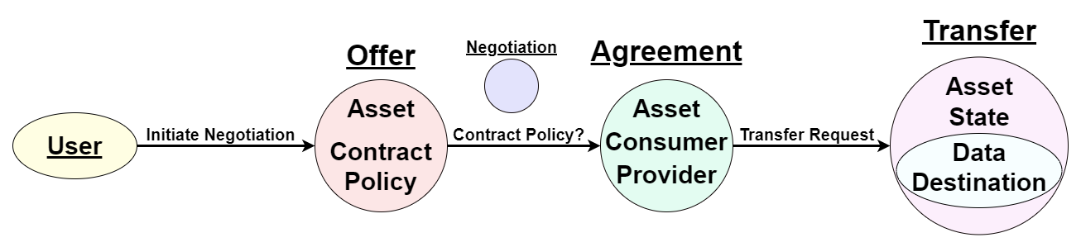
Entities

Slide 6
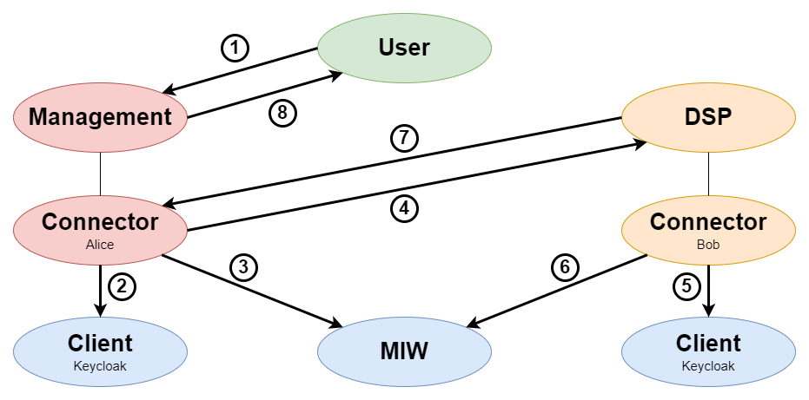
Communication

Slide 7
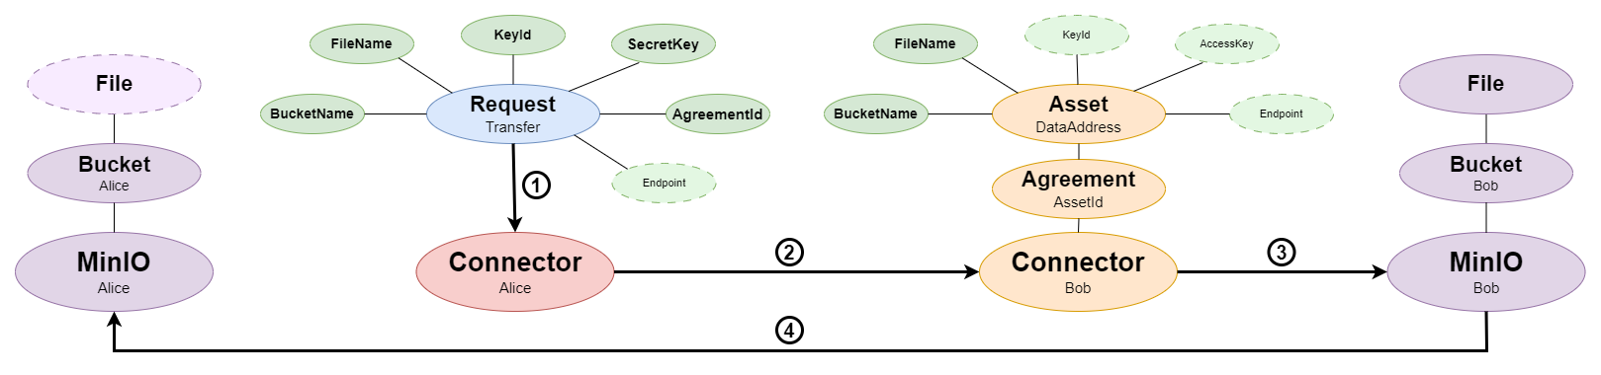
File Transfer

Slide 8
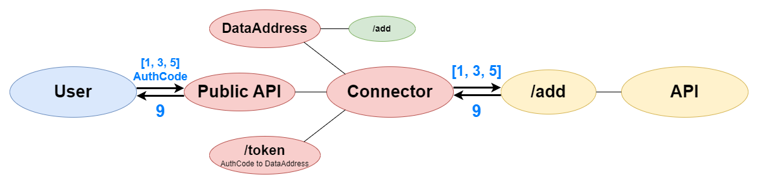
EDR Transfer

