Slide 1
A Predictive Model for Bank Loans
Martize T. Smith
Data Science Project
Springboard
1/12/2024

Slide 2
Introduction
Purpose: to uncover what factors contribute the most to a bank’s customers deciding to buy a personal loan then create a random forest predictive model
Data Science is used to help build predictive models to direct business actions that give the highest yield on the desired result
Data Science Framework: (1) Business Understanding (2) Data Understanding (3) Data Prep (4) Model (5) Evaluation
Bus. Und. = clarify business objectives; Data Und. = examine data source; Data prep = clean & explore; Model = Logistic Regression; Eva. = Confusion matrix, gains chart & accuracy

Slide 3
Business Understanding
Project Overview: Analyze customer data to pinpoint correlations to a customer deciding to buy a personal loan then construct random forest
Businesses are aggressively searching for more competitive advantages and to build a superior unique selling proposition
This project benefits technical and non-technical professionals and serves as one of many resources that contributes value added to help organizations find ways to get better results in their business goals

Slide 4
Data understanding
Data Source: Kaggle data set
Customer Segmentation/Marketing data from a Bank
Data consists of 14 columns & 5000 observations

Slide 5
Data preparation
Applied the Cross Industry Standard Process for Data Mining (CRISP-DM) to express methods used
1) Select independent and dependent variables (2) Visualize data & analyze (3) Identify correlations (4) Build logistic regression model (5) Evaluate Model
Data Cleaning: Checked for Duplicates, Checked for Wrong Data Types, Checked for Missing Values & Checked for Irrelevant Data
Data Explore: Box-plots, Bar plot, Combination bar & line plots & heatmap correlation matrix

Slide 6
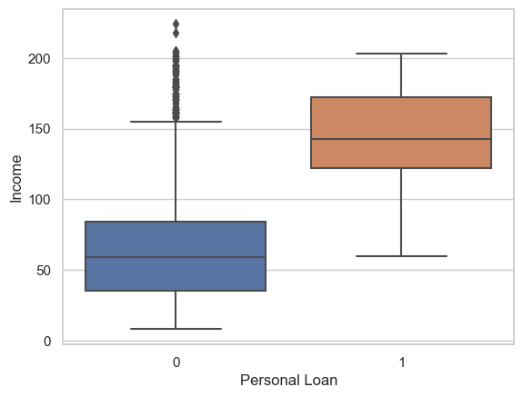
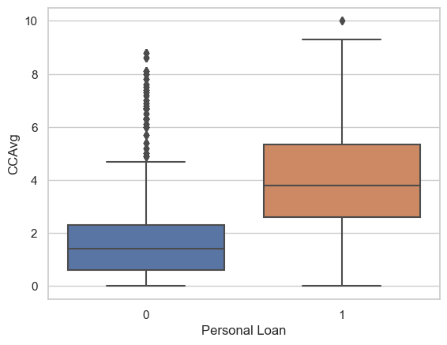
data explore
Box-Plot: Customer’s income compared to if customers accepted the loan product from the last campaign or not (0 = Did Not accept loan; 1 = Did accept loan)
Box-Plot: Customer’s avg. spending on credit cards per month compared to if customers accepted the loan product from the last campaign or not (0 = Did Not accept loan; 1 = Did accept loan)

Slide 7
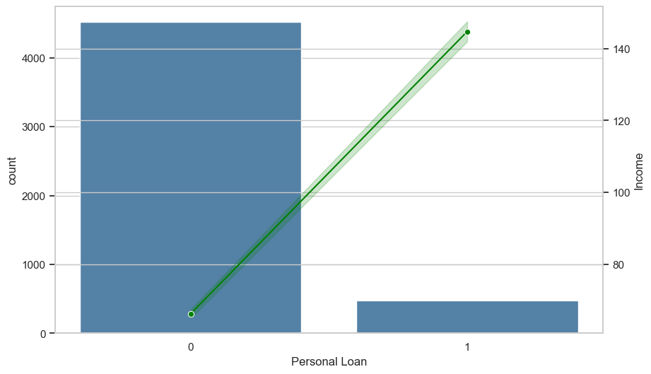
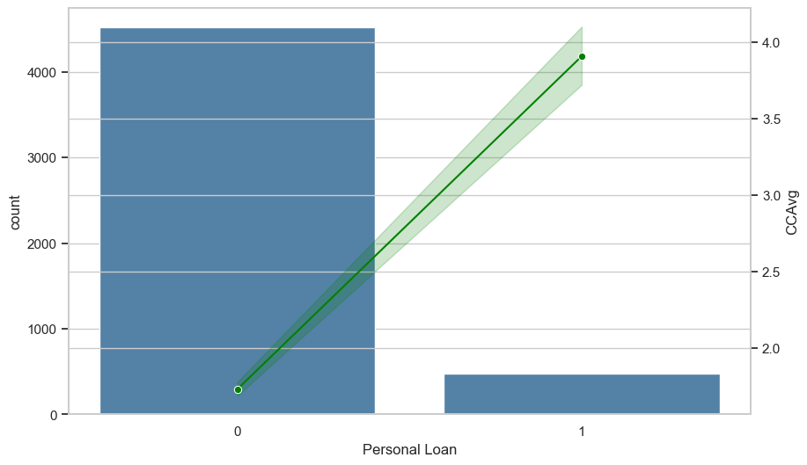
Data explore
Combo chart: Customer’s income compared to if customers accepted the loan product from the last campaign or not (0 = Did Not accept loan; 1 = Did accept loan)
Combo chart: customer’s average spending on credit cards per month compared to if customers accepted the loan product from the last campaign or not (0 = Did Not accept loan; 1 = Did accept loan)

Slide 8
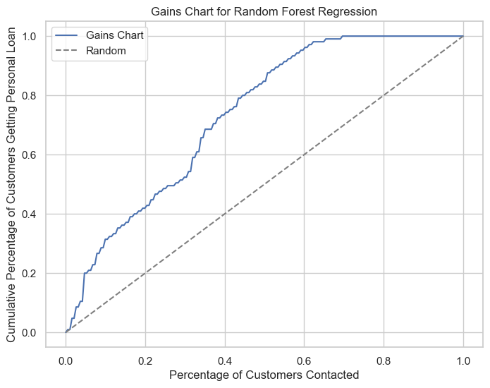
Model & evaluation
The dashed line expresses “no gain”, meaning, what companies would expect to achieve by marketing to customers at random.
The nearer the cumulative gains line is to the top-left corner of the chart, the bigger the gain; the higher the amount of the customer’s getting the personal loans that are reached for the lower amount of customers contacted

Slide 9
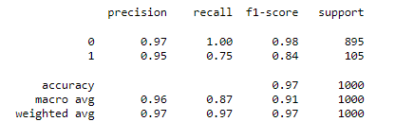
Classification report

Slide 10
Conclusion & Future Improvements
Random Forest model accuracy score is 97% but doesn’t mean it’s a perfect model
Improvements will be as follow:
Add more data from new incoming customers to help give deeper understandings to be applied to model for maximum optimum use.
Use multiple evaluation approaches to reveal more areas that could be targeted to boost model performance
Apply different algorithms to extend the scope of the predictive model’s performance then compare all to find the best model to act as the model of choice.

