Slide 2
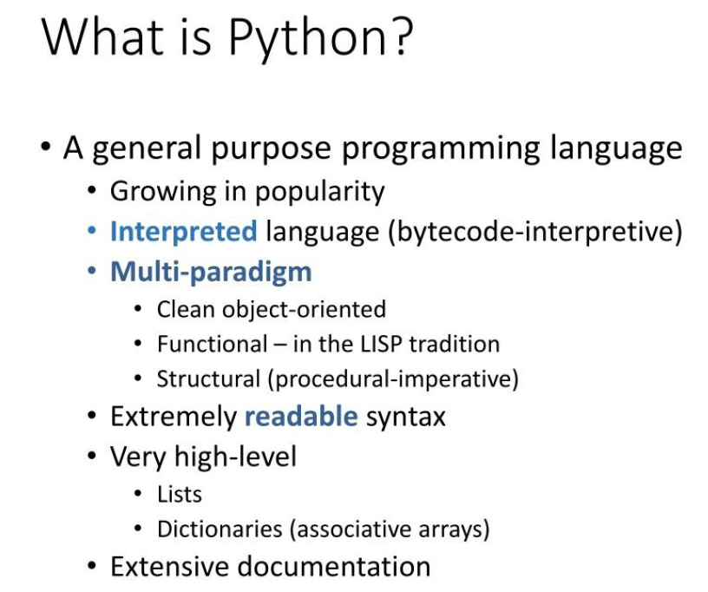

Slide 11
Python to Verilog HDL Conversion Examples

Slide 12
Combinational designs
Multiplexer with scalared inputs
Multiplexer with vectored inputs
Half-adder
Full-adder
ALU

Slide 13
Multiplexer with scalared inputs
from myhdl import block, always_comb, Signal
@block
def mux2x1_scalar(y, a, b, sel):
"""
Multiplexer
y -- scalar data output
a, b -- scalar data inputs
sel -- control input: select a if asserted, otherwise b
"""
@always_comb
def comb():
if sel == 1:
y.next = b
else:
y.next = a
return comb
def convert():
y,a,b,sel = [Signal(bool(0)) for i in range(4)]
convInst = mux2x1_scalar(y, a, b, sel)
convInst.convert(hdl='Verilog')
convert()

Slide 14
2. Multiplexer with vectored inputs
from myhdl import *
@block
def mux2x1_vectored(y, a, b, sel):
"""
Multiplexer 2x1
y -- mux output
a, b -- data inputs
sel -- control input: select b if asserted, otherwise a
"""
@always_comb
def comb():
if sel == 1:
y.next = b
else:
y.next = a
return comb
def convert():
sel = Signal(bool(0))
a,b,y= [Signal(intbv(0)[8:]) for i in range(3)]
convInst = mux2x1_vectored(y, a, b, sel)
convInst.convert(hdl='Verilog')
convert()

