Slide 1
Python for RTL generation for Digital IC design
for FPGAs and ASICs

Slide 2
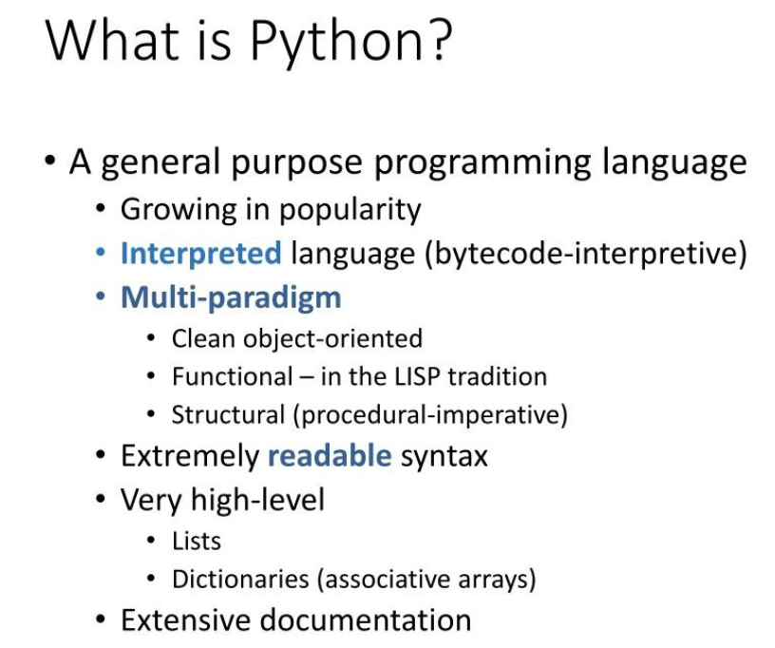

Slide 11
Python to Verilog HDL Conversion Examples

Slide 12
Combinational designs
Multiplexer with scalared inputs
Multiplexer with vectored inputs
Half-adder
Full-adder
ALU

Slide 13
Multiplexer with scalared inputs
from myhdl import block, always_comb, Signal
@block
def mux2x1_scalar(y, a, b, sel):
"""
Multiplexer
y -- scalar data output
a, b -- scalar data inputs
sel -- control input: select b if asserted, otherwise a
"""
@always_comb
def comb():
if sel == 1:
y.next = b
else:
y.next = a
return comb
def convert():
y,a,b,sel = [Signal(bool(0)) for i in range(4)]
convInst = mux2x1_scalar(y, a, b, sel)
convInst.convert(hdl='Verilog')
convert()

Slide 14
Multiplexer with scalared inputs -Cont’d.
// File: mux2x1Scalared.v
// Generated by MyHDL 0.11
// Date: Fri Dec 15 14:51:12 2023
`timescale 1ns/10ps
module mux2x1Scalared ( y, a,b,sel);
// Multiplexer
//
// y -- scalar data output
// a, b -- scalar data inputs
// sel -- control input: select b if asserted, otherwise a
output y;
reg y;
input a;
input b;
input sel;
always @(sel, b, a) begin: MUX2X1SCALARED_COMB
if ((sel == 1)) begin
y = b;
end
else begin
y = a;
end
end
endmodule

Slide 15
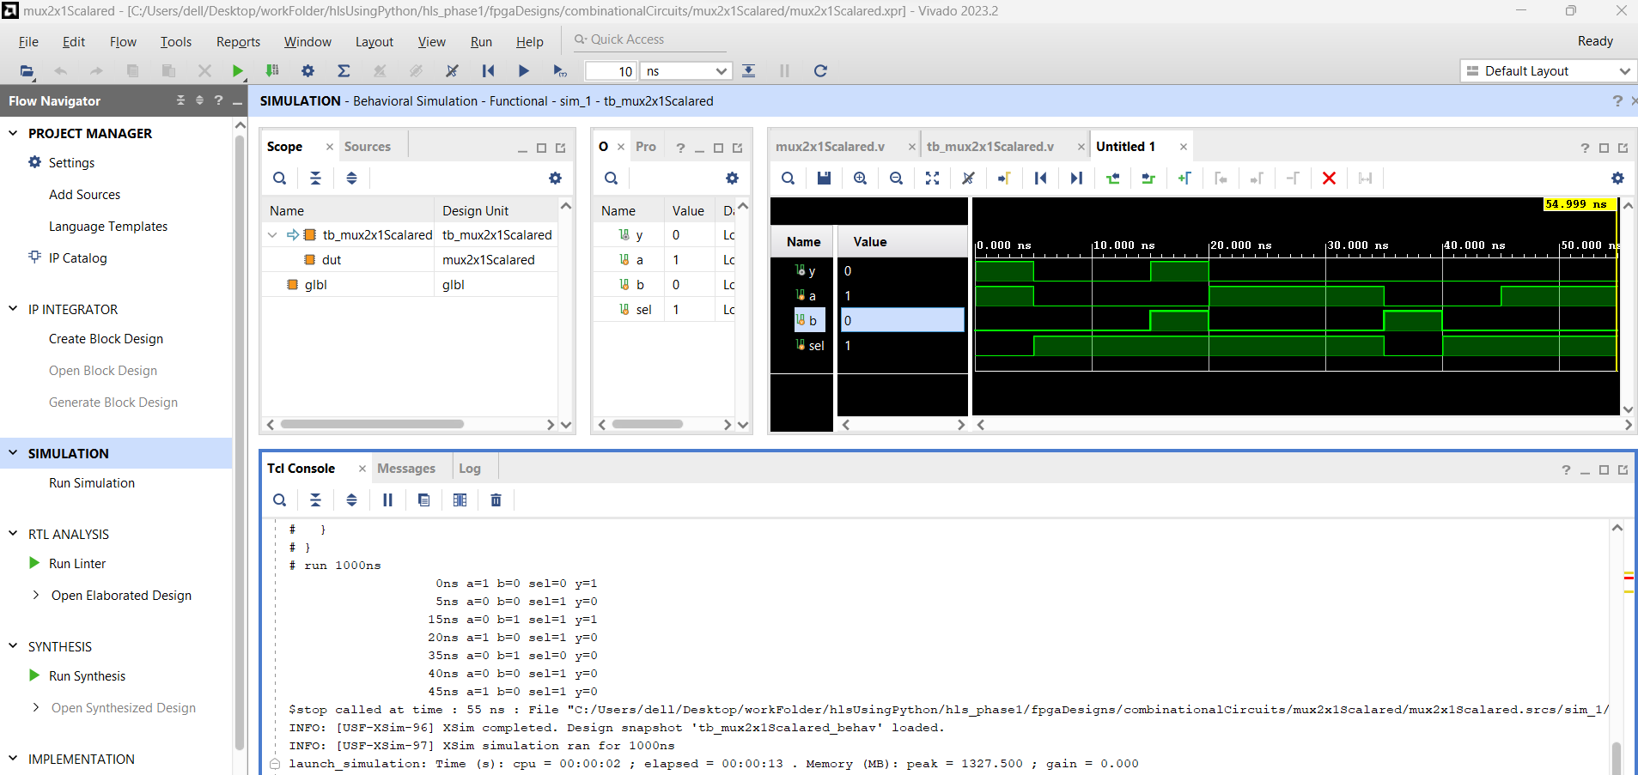
Multiplexer with scalared inputs -Cont’d.

Slide 16
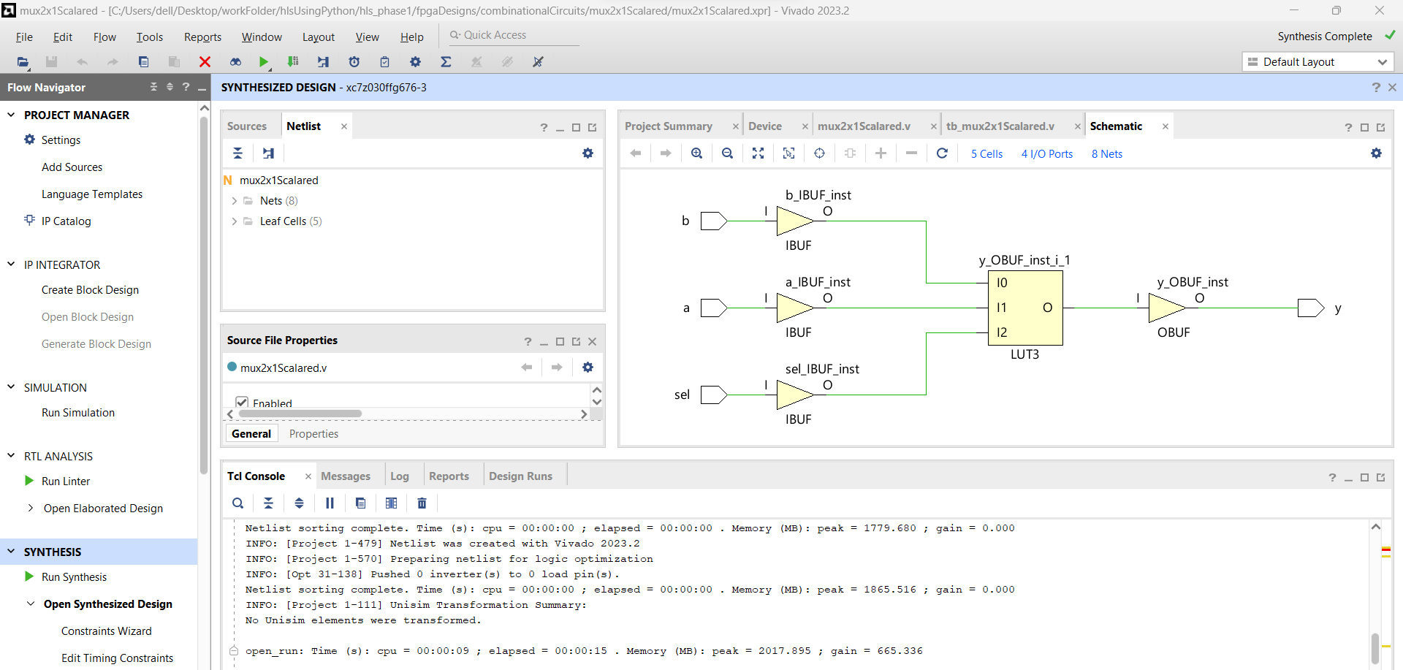
Multiplexer with scalared inputs -Cont’d.

Slide 17
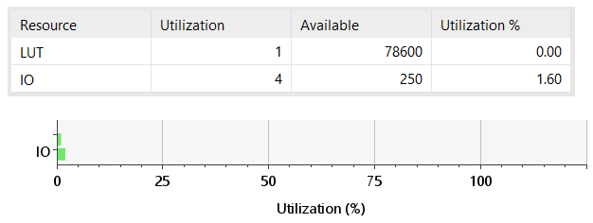
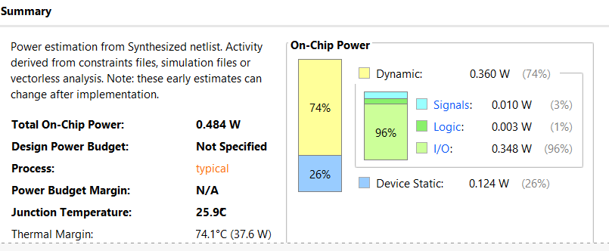
Multiplexer with scalared inputs -Cont’d.
Device utilization summary
Power report

Slide 18
2. Multiplexer with vectored inputs
from myhdl import *
@block
def mux2x1_vectored(y, a, b, sel):
"""
Multiplexer 2x1
y -- mux output
a, b -- data inputs
sel -- control input: select b if asserted, otherwise a
"""
@always_comb
def comb():
if sel == 1:
y.next = b
else:
y.next = a
return comb
def convert():
sel = Signal(bool(0))
a,b,y= [Signal(intbv(0)[8:]) for i in range(3)]
convInst = mux2x1_vectored(y, a, b, sel)
convInst.convert(hdl='Verilog')
convert()

Slide 19
2. Multiplexer with vectored inputs -Cont’d.
// File: mux2x1Vectored.v
// Generated by MyHDL 0.11
// Date: Fri Dec 15 14:52:13 2023
`timescale 1ns/10ps
module mux2x1Vectored (
y,
a,
b,
sel
);
// Multiplexer 2x1
// y -- mux output
// a, b -- data inputs
// sel -- control input: select b if asserted, otherwise a
output [7:0] y;
reg [7:0] y;
input [7:0] a;
input [7:0] b;
input sel;
always @(a, sel, b) begin: MUX2X1VECTORED_COMB
if ((sel == 1)) begin
y = b;
end
else begin
y = a;
end
end
endmodule

Slide 20
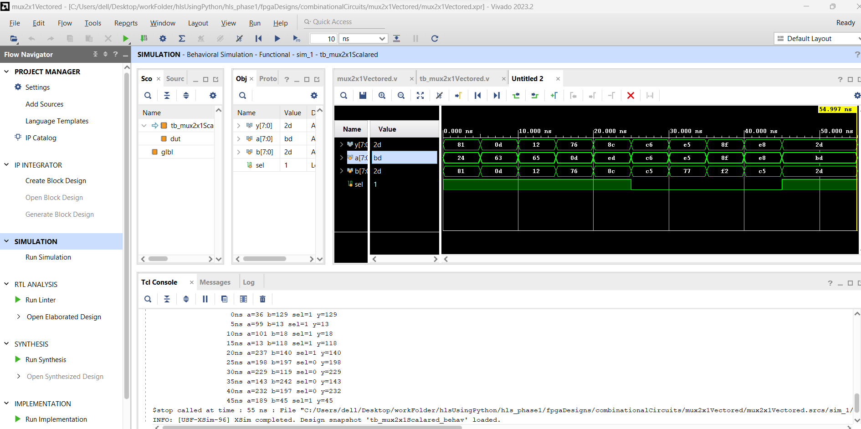
2. Multiplexer with vectored inputs -Cont’d.

Slide 21
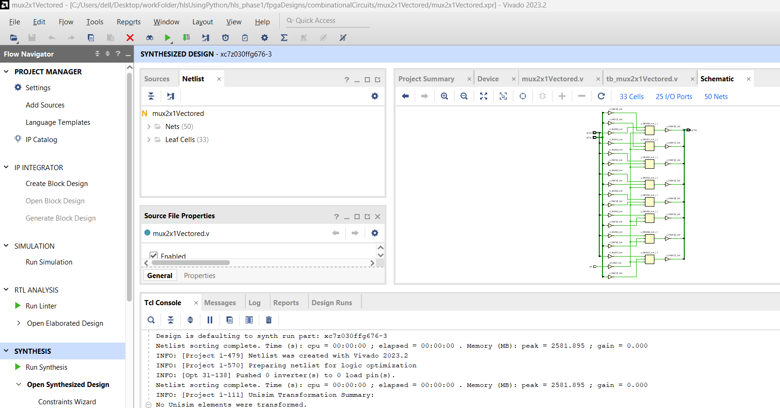
2. Multiplexer with vectored inputs -Cont’d.

Slide 22
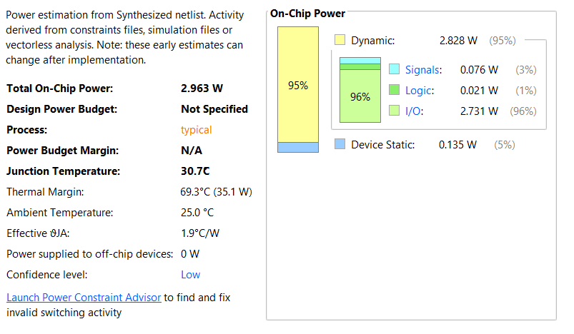
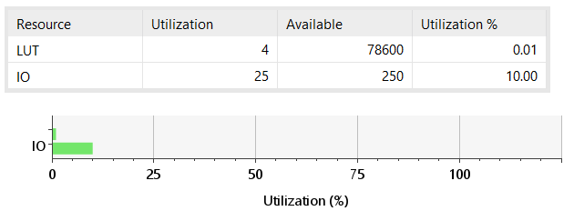
2. Multiplexer with vectored inputs -Cont’d.
Device Utilization Summary
Power report summary

Slide 23
3. Half-adder
from myhdl import *
@block
def ha(a,b,sum,co):
"""
Half Adder
sum,co - outputs
a,b - inputs
"""
@always_comb
def comb():
if a == 1 and b == 1:
sum.next=0
co.next=1
else:
sum.next=1
co.next=0
return comb
def convert():
a,b,sum,co = [Signal(bool(0)) for i in range(4)]
convInst = ha(a,b,sum,co)
convInst.convert(hdl='Verilog')
convert()

Slide 24
3. Half-adder -Cont’d.
// File: ha.v
// Generated by MyHDL 0.11.42
// Date: Sat Dec 16 04:29:10 2023
`timescale 1ns/10ps
module ha (
a,
b,
sum,
co
);
// Half Adder
// sum,co - outputs
// a,b - inputs
input a;
input b;
output sum;
reg sum;
output co;
reg co;
always @(b, a) begin: HA_COMB
if (((a == 1) && (b == 1))) begin
sum = 0;
co = 1;
end
else if (((a == 0) && (b == 0))) begin
sum = 0;
co = 0;
end
else begin
sum = 1;
co = 0;
end
end
endmodule

Slide 25
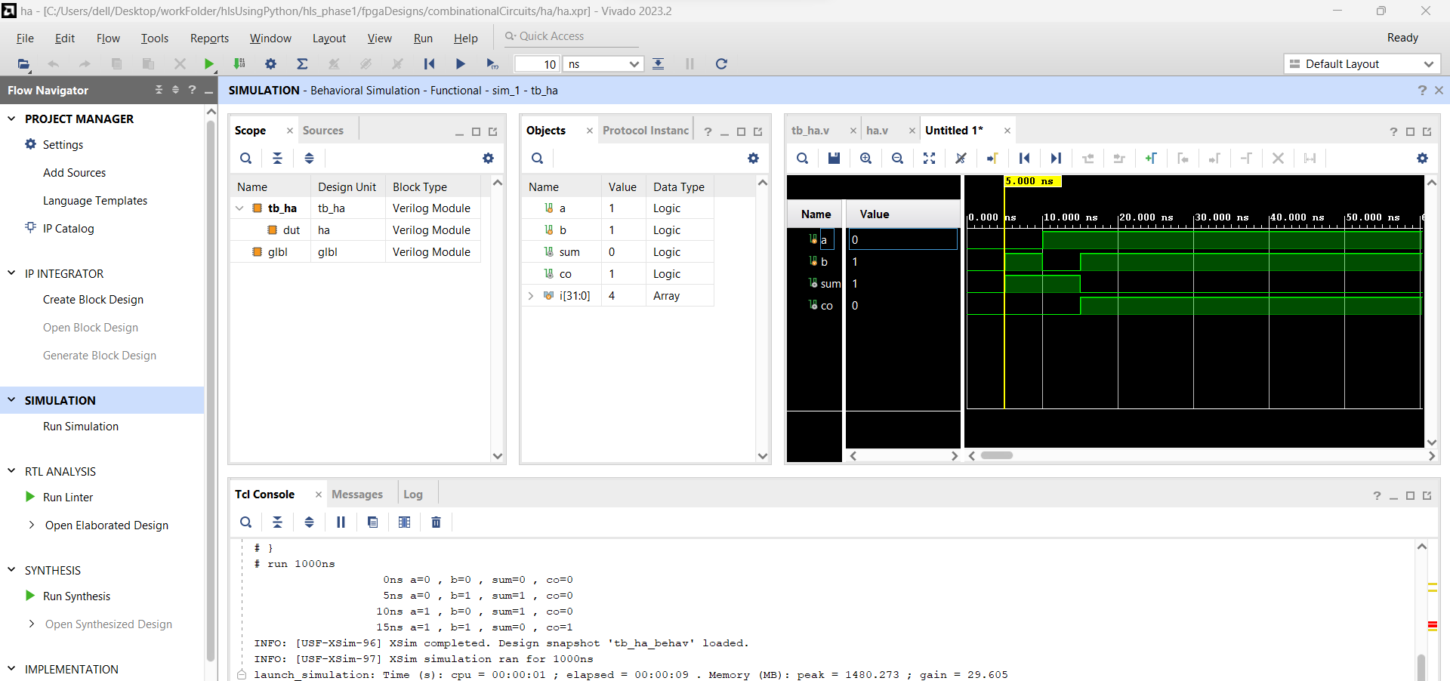
3. Half-adder -Cont’d.

Slide 26
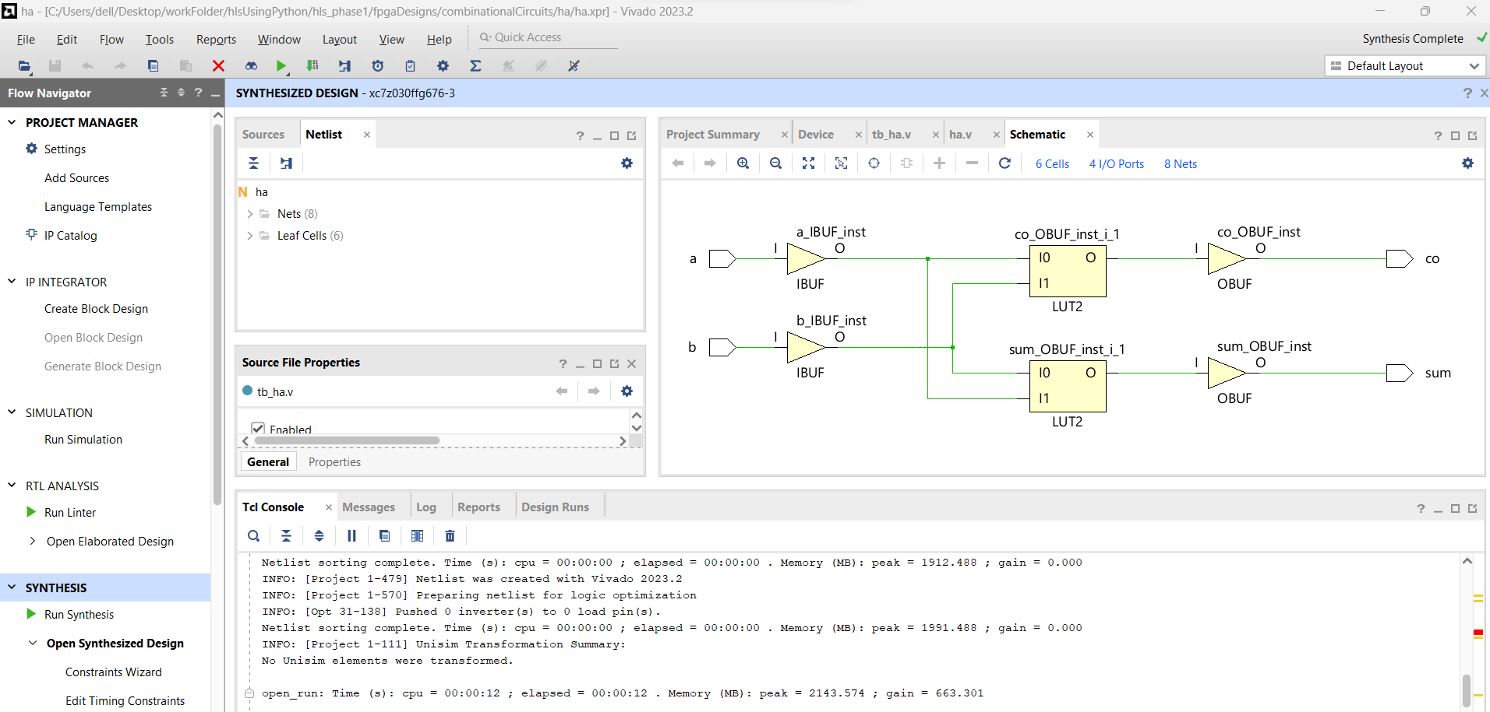
3. Half-adder -Cont’d.

Slide 27
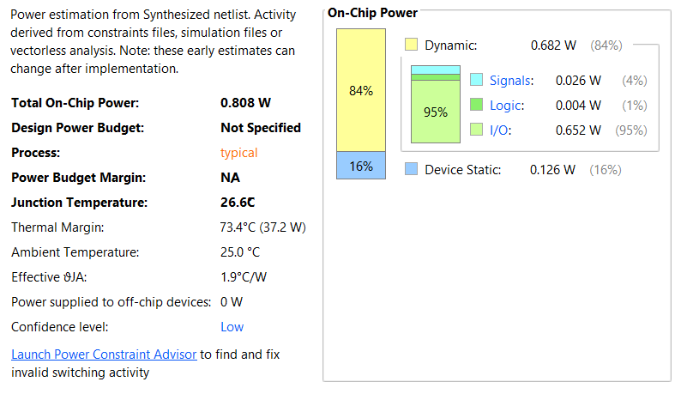
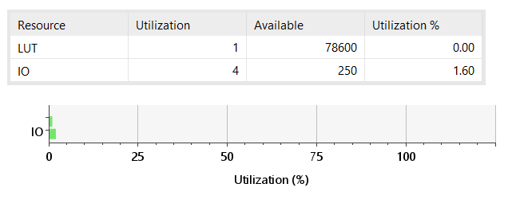
3. Half-adder -Cont’d.
Resource utilization summary
Power report summary

Slide 28
4. Full-adder using two-half adders and one or-gate
from myhdl import *
@block
def ha(a,b,sum,co):
@always_comb
def comb():
if a==0 and b==0:
sum.next=0
co.next=0
elif a==1 and b==1:
sum.next=0
co.next=1
else:
sum.next=0
co.next=1
return comb
from myhdl import *
@block
def orgate(a,b,y):
@always_comb
def comb():
if a==0 and b==0:
y.next=0
else:
y.next=1
return comb

Slide 29
4. Full-adder using two-half adders and one or-gate -Cont’d.
from myhdl import *
from ha import ha
from orgate import orgate
@block
def fa(a,b,c,sum,co):
s1=Signal(bool(0))
c1=Signal(bool(0))
c2=Signal(bool(0))
ha1=ha(a,b,s1,c1)
ha2=ha(s1,c,sum,c2)
orgate1=orgate(c1,c2,co)
return ha1, ha2, orgate1
def convert():
a,b,c,sum,co = [Signal(bool(0)) for i in range(5)]
convInst = fa(a,b,c,sum,co)
convInst.convert(hdl='Verilog')
convert()

Slide 30
4. Full-adder using two-half adders and one or-gate -Cont’d.
always @(a, b) begin: FA_HA0_COMB
if (((a == 0) && (b == 0))) begin
s1 = 0;
c1 = 0;
end
else if (((a == 1) && (b == 1))) begin
s1 = 0;
c1 = 1;
end
else begin
s1 = 1;
c1 = 0;
end
end
always @(s1, c) begin: FA_HA1_COMB
if (((s1 == 0) && (c == 0))) begin
sum = 0;
c2 = 0;
end
else if (((s1 == 1) && (c == 1))) begin
sum = 0;
c2 = 1;
end
else begin
sum = 1;
c2 = 0;
end
end
// File: fa.v
// Generated by MyHDL 0.11
// Date: Fri Dec 15 14:48:52 2023
`timescale 1ns/10ps
module fa ( a,b,c,sum,co);
input a;
input b;
input c;
output sum;
reg sum;
output co;
reg co;
reg s1;
reg c1;
reg c2;
always @(c1, c2) begin: FA_ORGATE0_COMB
if (((c1 == 0) && (c2 == 0))) begin
co = 0;
end
else begin
co = 1;
end
End
endmodule

Slide 31
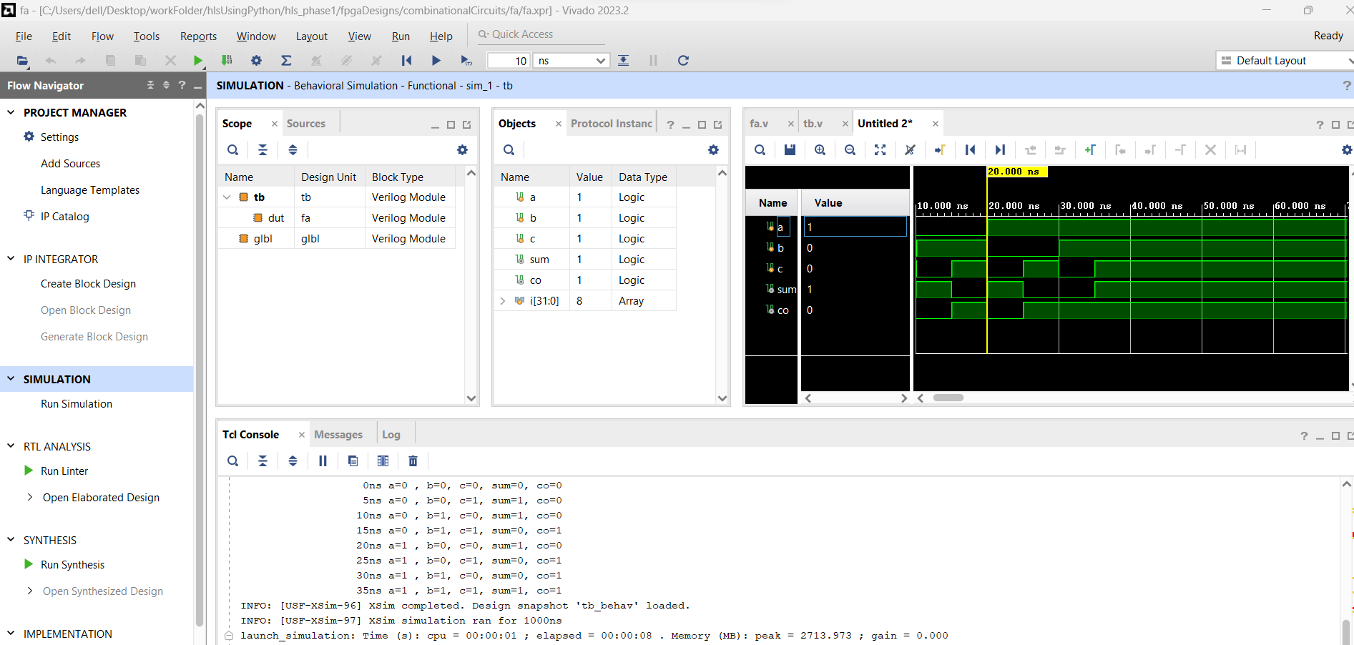
4. Full-adder using two-half adders and one or-gate -Cont’d.

Slide 32
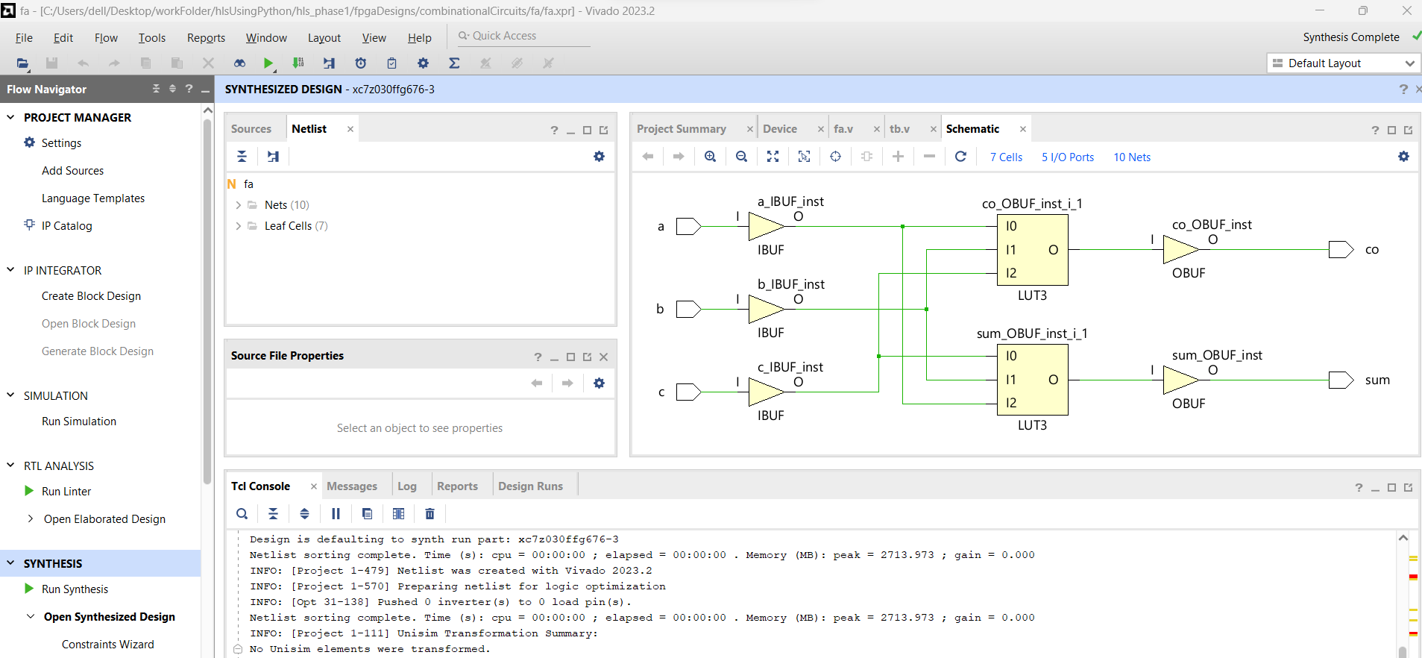
4. Full-adder using two-half adders and one or-gate -Cont’d.

Slide 33
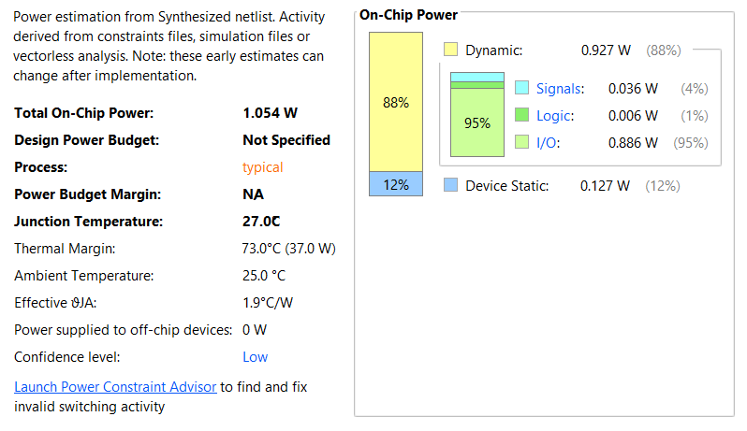
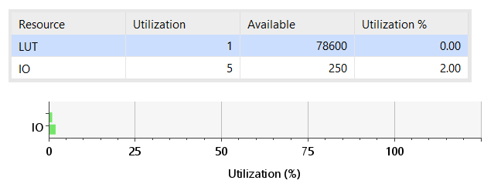
Resource utilization summary
Power report summary

Slide 34
@block
def ALU_combi(q, o, z, n, a, b, f, width=16):
"""
Simple ALU.
See ARM System Aerchitecture "Introduction To Processor Design"
"""
result = Signal(intbv(0)[width:])
@always_comb
def alu_func():
if f == t_ALU_FUNCTION.ZERO:
result.next = 0
elif f == t_ALU_FUNCTION.ONES:
result.next = 2 ** width - 1
elif f == t_ALU_FUNCTION.NEG_A:
result.next = -a % 2 ** width
elif f == t_ALU_FUNCTION.NEG_B:
result.next = -b % 2 ** width
elif f == t_ALU_FUNCTION.NOT_A:
result.next = ~a
elif f == t_ALU_FUNCTION.NOT_B:
result.next = ~b
elif f == t_ALU_FUNCTION.A:
result.next = a
ALU 16-bit
import myhdl
from myhdl import *
t_ALU_FUNCTION = enum(
"ZERO",
"ONES",
"A",
"NEG_A",
"A_PLUS_1",
"B",
"NEG_B",
"B_PLUS_1",
"A_PLUS_B",
"NOT_A",
"NOT_B",
"A_AND_B",
"A_OR_B",
"A_XOR_B",
)

Slide 35
ALU 16-bit -Cont’d.
@always_comb
def alu_status():
q.next = result
if result == 0:
z.next = 1
else:
z.next = 0
n.next = 0
# how to detect overflow?
o.next = 0
return instances()
elif f == t_ALU_FUNCTION.B:
result.next = b
elif f == t_ALU_FUNCTION.A_PLUS_1:
result.next = a + 1
elif f == t_ALU_FUNCTION.B_PLUS_1:
result.next = b + 1
elif f == t_ALU_FUNCTION.A_AND_B:
result.next = a & b
elif f == t_ALU_FUNCTION.A_OR_B:
result.next = a | b
elif f == t_ALU_FUNCTION.A_XOR_B:
result.next = a ^ b
elif f == t_ALU_FUNCTION.A_PLUS_B:
result.next = a + b
else:
result.next=0

Slide 36
ALU 16-bit -Cont’d.
def convert():
n = Signal(bool(0))
z = Signal(bool(0))
o = Signal(bool(0))
q = Signal(intbv(0)[16:])
a = Signal(intbv(0)[16:])
b = Signal(intbv(0)[16:])
f = Signal(t_ALU_FUNCTION.ZERO)
convInst = ALU_combi(q, o, z, n, a, b, f, width=16)
convInst.convert(hdl='Verilog')
convert()

Slide 37
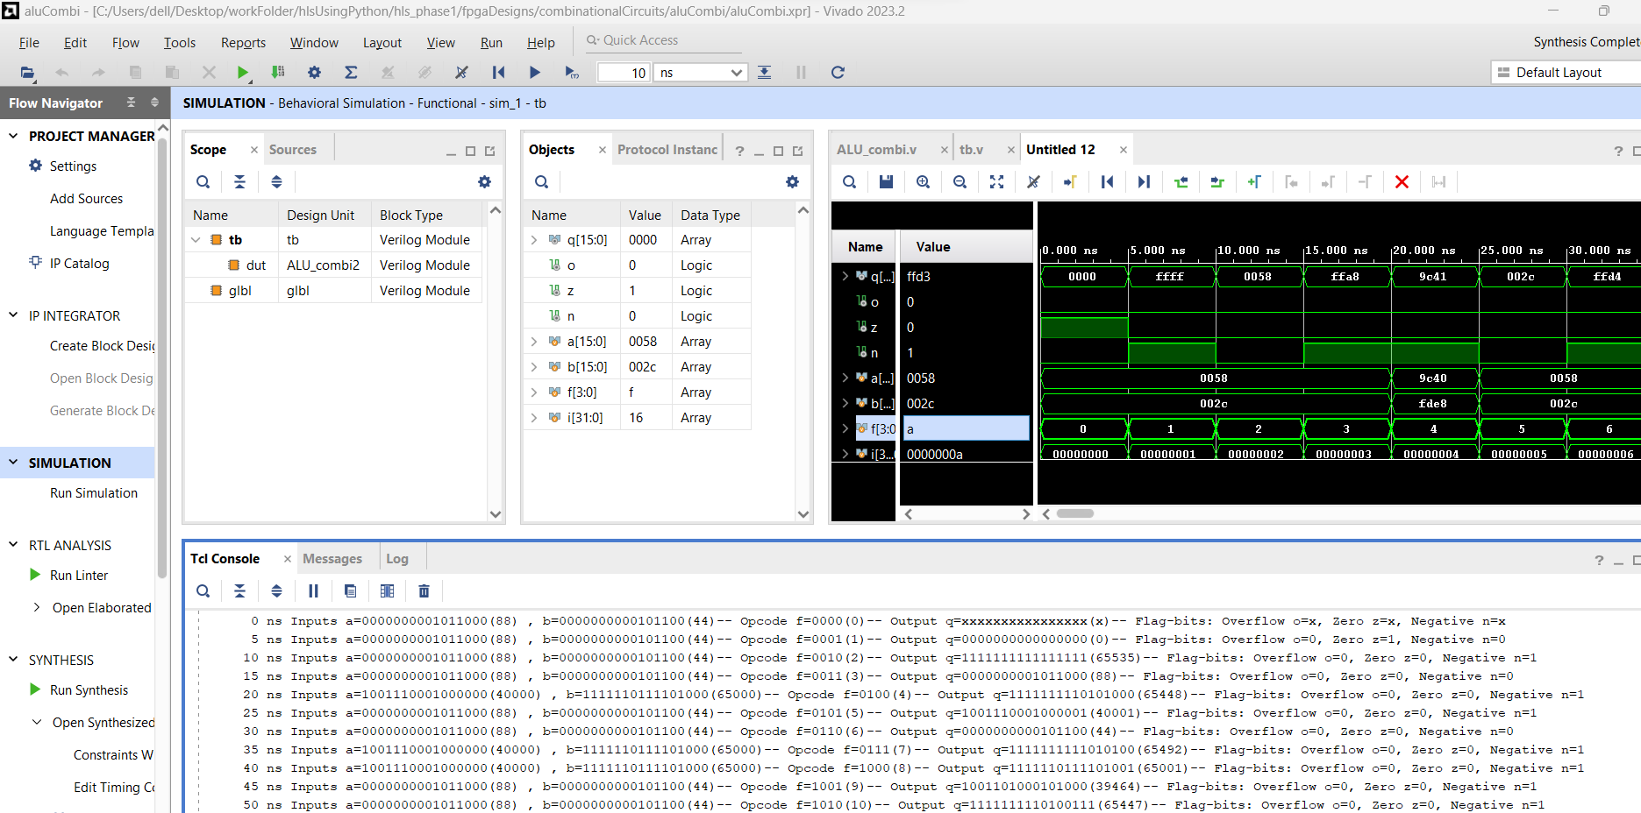
ALU 16-bit -Cont’d.

Slide 38
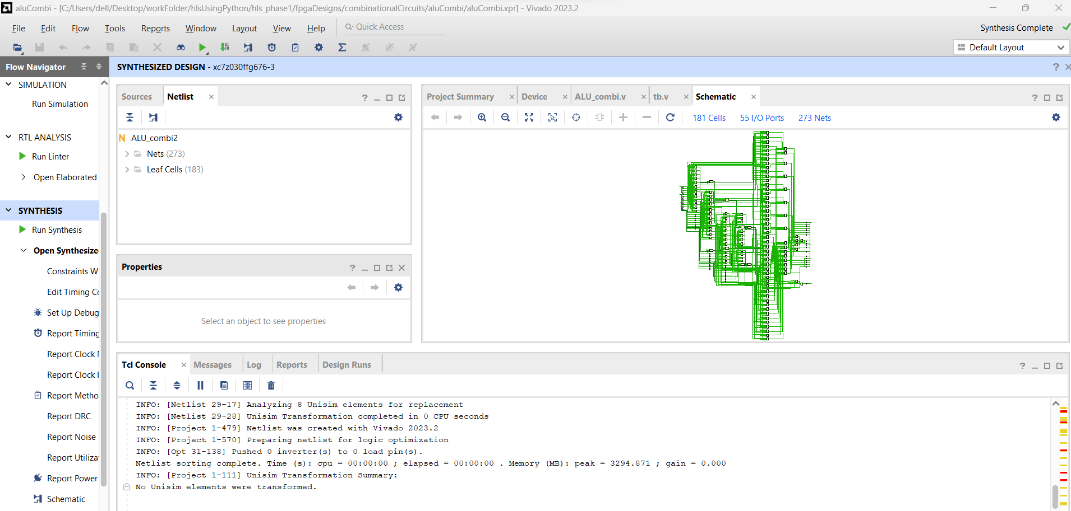
ALU 16-bit -Cont’d.

Slide 39
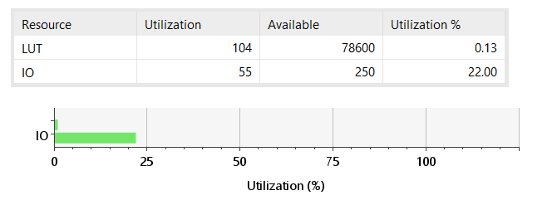
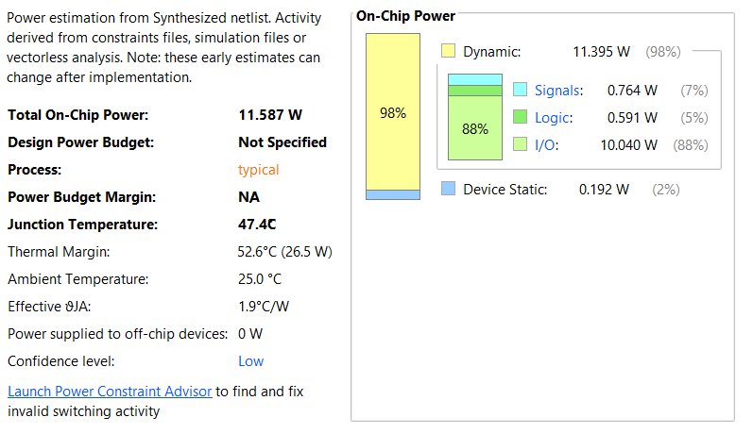
ALU 16-bit -Cont’d.
Resource utilization summary
Power report summary

Slide 40
Sequential designs
D Flipflop
D Flipflop with asynchronous reset
ALU
Counter
Shift register
RAM

Slide 41
Sequential designs: D Flipflop
from myhdl import *
@block
def dff(q, d, clk):
@always(clk.posedge)
def logic():
q.next = d
return logic
def convert():
q, d, clk = [Signal(bool(0)) for i in range(3)]
convInst = dff(q, d, clk)
convInst.convert(hdl='Verilog')
convert()

Slide 42
Sequential designs: D Flipflop with asynchronous reset
from myhdl import *
@block
def dffa(q, d, clk, rst):
@always_seq(clk.posedge, reset=rst)
def logic():
q.next = d
return logic
def convert():
q, d, clk = [Signal(bool(0)) for i in range(3)]
rst = ResetSignal(val=1, active=0, isasync=True)
convInst = dffa(q, d, clk, rst)
convInst.convert(hdl='Verilog')
convert()

Slide 43
Sequential designs: ALU
import myhdl
from myhdl import *
t_ALU_FUNCTION = enum(
"ZERO",
"ONES",
"A",
"NEG_A",
"A_PLUS_1",
"B",
"NEG_B",
"B_PLUS_1",
"A_PLUS_B",
"NOT_A",
"NOT_B",
"A_AND_B",
"A_OR_B",
"A_XOR_B",
)

Slide 44
Sequential designs: ALU -Cont’d.
elif f == t_ALU_FUNCTION.NEG_B:
result.next = -b % 2 ** width
elif f == t_ALU_FUNCTION.NOT_A:
result.next = ~a
elif f == t_ALU_FUNCTION.NOT_B:
result.next = ~b
elif f == t_ALU_FUNCTION.A:
result.next = a
elif f == t_ALU_FUNCTION.B:
result.next = b
elif f == t_ALU_FUNCTION.A_PLUS_1:
result.next = a + 1
elif f == t_ALU_FUNCTION.B_PLUS_1:
result.next = b + 1
elif f == t_ALU_FUNCTION.A_AND_B:
result.next = a & b
elif f == t_ALU_FUNCTION.A_OR_B:
result.next = a | b
elif f == t_ALU_FUNCTION.A_XOR_B:
result.next = a ^ b
elif f == t_ALU_FUNCTION.A_PLUS_B:
result.next = a + b
else:
result.next=0
@block
def aluSeq(q, o, z, n, a, b, f, clk, rst, width=16):
"""
Simple ALU.
See ARM System Architecture "Introduction To Processor Design"
"""
result = Signal(intbv(0)[width:])
"""@always(clk.posedge)"""
@always_seq(clk.posedge, reset=rst)
def alu_func():
if rst==0:
result.next = 0
elif f == t_ALU_FUNCTION.ZERO:
result.next = 0
elif f == t_ALU_FUNCTION.ONES:
result.next = 2 ** width - 1
elif f == t_ALU_FUNCTION.NEG_A:
result.next = -a % 2 ** width

Slide 45
Sequential designs: ALU -Cont’d.
@always_comb
def alu_status():
q.next = result
if result == 0:
z.next = 1
else:
z.next = 0
n.next = 0
# how to detect overflow?
o.next = 0
return instances()
def convert(hdl):
clk,n,z,o= [Signal(bool(0)) for i in range(4)]
q = Signal(intbv(0)[16:])
a = Signal(intbv(0)[16:])
b = Signal(intbv(0)[16:])
f = Signal(t_ALU_FUNCTION.ZERO)
rst = ResetSignal(0, active=0, isasync=True)
convInst = aluSeq(q, o, z, n, a, b, f, clk, rst, width=16)
convInst.convert(hdl=hdl)
convert(hdl='Verilog')

Slide 46
Sequential designs: Counter
from myhdl import Signal, ResetSignal, modbv
from counter import counter
def convert_inc(hdl):
"""Convert inc block to Verilog or VHDL."""
m = 8
count = Signal(modbv(0)[m:])
enable = Signal(bool(0))
clock = Signal(bool(0))
reset = ResetSignal(0, active=0, isasync=True)
inc_1 = counter(count, enable, clock, reset)
inc_1.convert(hdl=hdl)
convert_inc(hdl='Verilog')
from myhdl import block, always_seq
@block
def counter(count, enable, clock, reset):
""" Incrementer with enable.
count -- output
enable -- control input, increment when 1
clock -- clock input
reset -- asynchronous reset input
"""
@always_seq(clock.posedge, reset=reset)
def seq():
if enable:
count.next = count + 1
return seq

Slide 47
Sequential designs: RAM
import myhdl
from myhdl import *
@block
def RAM(dout, din, addr, we, clk, depth=128):
""" Ram model """
mem = [Signal(intbv(0)[8:]) for i in range(depth)]
@always(clk.posedge)
def write():
if we:
mem[addr].next = din
@always_comb
def read():
dout.next = mem[addr]
return instances()
dout = Signal(intbv(0)[8:])
dout_v = Signal(intbv(0)[8:])
din = Signal(intbv(0)[8:])
addr = Signal(intbv(0)[7:])
we = Signal(bool(0))
clk = Signal(bool(0))
inst = RAM(clk=clk, addr=addr, we=we, din=din, dout=dout)
inst.convert(hdl="VHDL")
inst.convert(hdl="Verilog", testbench=False)

