Slide 1
Digital IC
Design Flow

Slide 2
Digital IC Design Flow: A quick look
LEC=Logical Equivalence Checking
Floor planning
System Specifications
LEC
Static Timing Analysis
RTL coding
Power planning
LEC
Iterations until
STA is clean
Placement
Pre-synthesis simulation
(functional simulation)
Engineering Change
Order
LEC
Clock tree synthesis
LEC
Logic synthesis
Tapeout/GDSII
Routing
LEC
Post-synthesis simulation(GLS)
RC Extraction
Iterations until
Physical verification is clean
LEC
Physical Verification
Phase1: Logical design(Frontend design)
Phase2: Physical design (Backend design)

Slide 3
FPGA Design Flow (Xilinx)
Design Entry
Functional
Simulation
HDL files,
schematics
Synthesis
EDIF/XNF
netlist
Implementation
Timing
Simulation
NGD Xilinx
primitives file
Device
Programming

Slide 4
Design Flow with Test
Synthesized
Circuit
Post-synthesis simulation
Implementation
Timing simulation
Configuration
On chip testing

Slide 5

FPGA Implementation
Synthesis
Circuit netlist
Timing Constraints
Constraint Editor
Electronic Design
Interchange Format
Native
Constraint
File
EDIF
NCF
UCF
User Constraint File
Implementation
NGD
Native Generic Database file

Slide 6
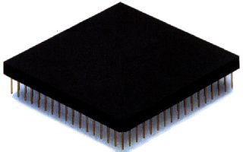
FPGA Configuration
Once a design is implemented, you must create a file that the FPGA can understand
This file is called a bit stream: a BIT file (.bit extension)
The BIT file can be downloaded directly to the FPGA, or can be converted into a PROM file which stores the programming information

Slide 7
VLSI Design Styles
Programmable Logic Devices
Standard Cell Based Design
Full Custom Design

Slide 8
Programmable Logic Device Families
Source: Dataquest
Logic
Standard
Logic
ASIC
Programmable
Logic Devices
(PLDs)
Gate
Arrays
Cell-Based
ICs
Full Custom
ICs
SPLDs
(PALs)
CPLDs
FPGAs
Acronyms
SPLD = Simple Prog. Logic Device
PAL = Prog. Array of Logic
CPLD = Complex PLD
FPGA = Field Prog. Gate Array
Common Resources
Configurable Logic Blocks (CLB)
Memory Look-Up Table
AND-OR planes
Simple gates
Input / Output Blocks (IOB)
Bidirectional, latches, inverters, pullup/pulldowns
Interconnect or Routing
Local, internal feedback, and global

Slide 9
What is FPGA?
Field Programmable Gate Arrays.
Array of logic cells connected via routing channels.
Special I/O cells.
Logic cells are mainly lookup tables (LUT) with associated registers.
Interconnection on SRAM basis or anti-fuse elements.

Slide 10
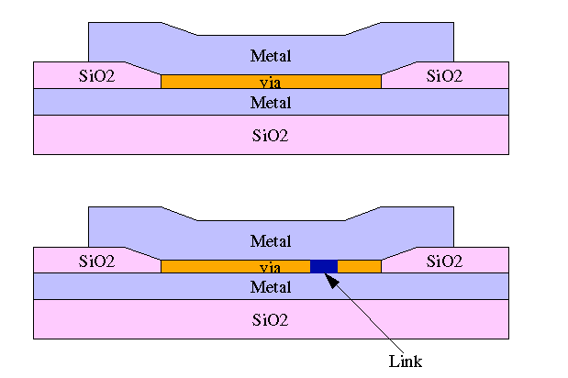
Technology and Architecture Tradeoffs
Anti-fuse elements
High density
Non volatile
Not reprogrammable
A programmable chip technology that creates permanent, conductive paths between transistors.
In contrast to "blowing fuses" in the fusible link method, which opens a circuit by breaking apart a conductive path, the antifuse method closes the circuit by "growing" a conductive via.

Slide 11
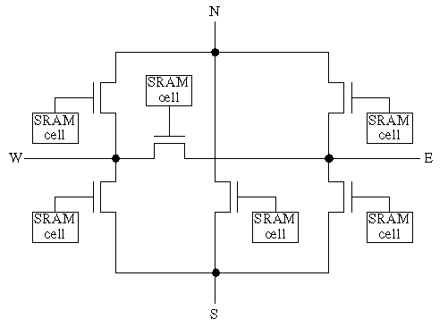
Technology and Architecture Tradeoffs
Contd.
SRAM cells
Uses more space
Reconfigurable
Volatile, requires PROM

Slide 12
CPLDs and FPGAs
CPLD FPGA
Complex Programmable Logic Device Field-Programmable Gate Array
Architecture PAL/22V10-like Gate array-like
More Combinational More Registers + RAM
Density Low-to-medium Medium-to-high
0.5-10K logic gates 1K to 500K system gates
Performance Predictable timing Application dependent
Up to 400 MHz Up to 800MHz
https://www.mouser.ca/c/semiconductors/programmable-logic-ics/cpld-complex-programmable-logic-devices/
https://www.microchip.com/en-us/products/fpgas-and-plds/spld-cplds?gclid=CjwKCAjw2vOLBhBPEiwAjEeK9ljTVCJayCkT0-y6DHJV7VTkiJ1ycm0YRFJz37JU-yt-DldgRJScPhoCujMQAvD_BwE#

Slide 13
Xilinx FPGA Routing
Fast Direct Interconnect - CLB to CLB
General Purpose Interconnect - Uses switch matrix
CLB
CLB
Switch
Matrix
Switch
Matrix
CLB
CLB

Slide 14





Design Flow
Design Entry in schematic, ABEL, VHDL, and/or Verilog. Vendors include Synopsys, Aldec (Xilinx Foundation), Mentor, Cadence, Viewlogic, and 35 others.
1
Implementation includes Placement & Routing and bitstream generation using Xilinx’s M1 Technology. Also, analyze timing, view layout, and more.
2
M1 Technology
Download directly to the Xilinx
hardware device(s) with
unlimited reconfigurations* !!
3
XC4000
XC4000
XC4000
*XC9500 has 10,000 write/erase cycles

Slide 15
Standard Cell Based Design

Slide 16
Introduction
One of the most prevalent custom design styles
Also called semi-custom design style
Basic idea:
All of the commonly used logic cells are developed, characterized, and stored in a standard cell library
A typical library may contain a few hundred cells including inverters, NAND gates, NOR gates, complex AOI, OAI gates, D-latches, and flip-flops

Slide 17
Introduction
Contd.
Each gate type can have multiple implementations to provide adequate driving capability for different fanouts.
For instance, the inverter can have
standard size transistors
double size transistors, and
quadruple size transistors
The chip designer can choose the proper size to achieve high circuit speed and layout density.

Slide 18
Characteristic of the Cells
Each cell is designed with a fixed height
To enable automated placement of the cells, and
Routing of inter-cell connections
A number of cells can be abutted side-by-side to form rows
The power and ground rails typically run parallel to the upper and lower boundaries of the cell
Neighboring cells share a common power and ground bus
nMOS transistors are located closer to the ground rail while the pMOS transistors are placed closer to the power rail
The input and output pins are located on the upper and lower boundaries of the cell

Slide 19
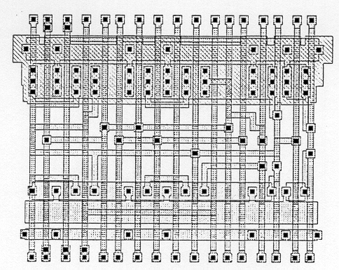
Layout of a Typical Standard Cell

Slide 20
Floorplan for Standard Cell Design
Inside the I/O frame which is reserved for I/O cells, the chip area contains rows or columns of standard cells
Between cell rows are channels for dedicated inter-cell routing
Over-the-cell routing is also possible
The physical design and layout of logic cells ensure that
When placed into rows, their heights match
Neighboring cells can be abutted side-by-side, which provides natural connections for power and ground lines in each row

Slide 21
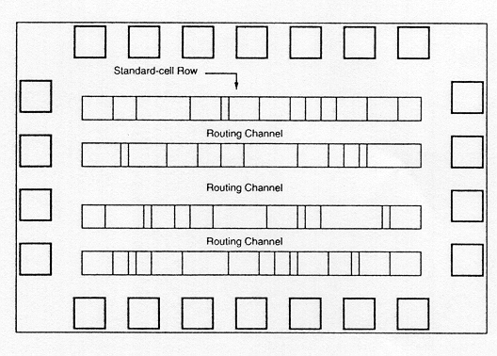
Floorplan for Standard Cell Design
Contd.

Slide 22
Floorplan for Standard Cell Design
Contd.
After chip logic design is done using standard cells in the library:
The most challenging task is to place individual cells into rows.
Interconnect them in a way that meets stringent design goals in
circuit speed
chip area
power consumption
Many advanced CAD tools for place-and-route have been developed and used to achieve the above goals

Slide 23
Full Custom Design

Slide 24
Introduction
The standard-cells based design is often called semi custom design
The cells are pre-designed for general use and the same cells are utilized in many different chip designs
In the full custom design, the entire mask design is done anew without use of any library
The development cost of such a design style is prohibitively high
The concept of design reuse is becoming popular in order to reduce design cycle time and cost

Slide 25
Introduction Contd.
The most rigorous full custom design can be the design of a memory cell
Static or dynamic
Since the same layout design is replicated, there would not be any alternative to high density memory chip design
For logic chip design, a good compromise can be achieved by using a combination of different design styles on the same chip
Standard cells, data-path cells and PLAs

Slide 26
Introduction Contd.
In real full-custom layout in which the geometry, orientation and placement of every transistor is done individually by the designer
Design productivity is usually very low
Typically 10 to 20 transistors per day, per designer
In digital CMOS VLSI, full-custom design is rarely used due to the high labor cost
Exceptions to this include the design of high-volume products such as memory chips, high-performance microprocessors and FPGA masters

Slide 27
Comparison Among Various Design Styles
 | Design Style
 | FPGA |  | Standard cell | Full custom
Cell size | Fixed |  | Fixed height | Variable
Cell type | Programmable |  | Variable | Variable
Cell placement | Fixed |  | In row | Variable
Interconnections | Programmable |  | Variable | Variable
Design time | Very fast |  | Medium | Slow

Slide 28
Open source EDA Tools

Slide 29
List of Digital ASIC design open source EDA tools
http://opencircuitdesign.com/
Icarus verilog – For simulation
Gtkwave – For waveform viewer
Graphviz – For visualization of netlist
Yosys – For Synthesis
Graywolf – For Placement
Qrouter – For Routing
Netgen – For LVS
Magic – For Layout and Floorplanning
Qflow – RTL2GDS integration
OpenSTA & Opentimer – Pre-layout and Post-layout Static timing analysis

Slide 30
Icarus verilog – For simulation Gtkwave – For waveform viewer
What Is Icarus Verilog?
Icarus Verilog is a Verilog simulation and synthesis tool
It operates as a compiler, compiling source code written in Verilog (IEEE-1364) into some target format
For batch simulation, the compiler can generate an intermediate form called vvp assembly
This intermediate form is executed by the “vvp” command
The main porting target is Linux, although it works well on many similar operating systems
GTKWave
This is the preferred waveform viewer for Icarus Verilog

Slide 31
Icarus verilog – For simulation Gtkwave – For waveform viewer
Icarus Verilog for windows https://bleyer.org/icarus/
on other os https://iverilog.fandom.com/wiki/Installation_Guide
More on gtkwave https://iverilog.fandom.com/wiki/GTKWave
GTKWave is a VCD waveform viewer based on the GTK library. This viewer support VCD and LXT formats for signal dumps
Generating VCD/LXT files for GTKWAVE
Waveform dumps are written by the Icarus Verilog runtime program vvp
The user uses $dumpfile and $dumpvars system tasks to enable waveform dumping, then the vvp runtime takes care of the rest
The output is written into the file specified by the $dumpfile system task
If the $dumpfile call is absent, the compiler will choose the file name dump.vcd or dump.lxt, depending on runtime flags

Slide 32
Yosys – synthesis tool
Yosys is a framework for Verilog RTL synthesis
It currently has extensive Verilog-2005 support
Provides a basic set of synthesis algorithms for various application domains
Yosys is controlled using synthesis scripts
Example:
Yosys synthesis script reads a design (with the top module mytop) from the verilog file mydesign.v
synthesizes it to a gate-level netlist using the cell library in the Liberty file mycells.lib and
writes the synthesized results as Verilog netlist to synth.v:

Slide 33
Yosys Contd.
Yosys – synthesis tool
# read design
read_verilog mydesign.v
# elaborate design hierarchy
hierarchy -check -top mytop
# the high-level stuff
proc; opt; fsm; opt; memory; opt
# mapping to internal cell library
techmap; opt
# mapping flip-flops to mycells.lib
dfflibmap -liberty mycells.lib
# mapping logic to mycells.lib
abc -liberty mycells.lib
# cleanup
clean
# write synthesized design
write_verilog synth.v

Slide 34
Yosys Contd.
Yosys – synthesis tool
The synth command provides a good default script that can be used as basis for simple synthesis scripts:
# read design
read_verilog mydesign.v
# generic synthesis
synth -top mytop
# mapping to mycells.lib
dfflibmap -liberty mycells.lib
abc -liberty mycells.lib
clean
# write synthesized design
write_verilog synth.v

Slide 35
graywolf - placement tool for digital VLSI design
USAGE
Typically, you would be in a directory with a [DESIGN].cel file and a [DESIGN].par file
and then run:
graywolf [DESIGN]
where [DESIGN] is the file name of the design. More information about the input and output
files is found below.
However, it is recommended to use the qflow digital design flow instead of running
graywolf directly. qflow prepares the input files from standardized files, and converts
the output to standardized files.

Slide 36
graywolf - placement tool for digital VLSI design Contd.
INPUT
Two input files are necessary to run graywolf.
A .cel file containing the design, and a
.par file containing the parameters which define the technology.
The .cel file may be created from a .blif design file and a .lef library file with the script "blif2cel.tcl" in the qflow package.
OUTPUT
The main output from graywolf is a .pl1 file containing the layout of the design.
This may be converted to a .def file using the script "place2def.tcl" in the qflow package.
A .def file is a standardized description of a layout.

Slide 37
Qrouter – detailed router tool
DESCRIPTION
Qrouter is a tool to generate metal layers and vias to physically connect together a netlist in a VLSI fabrication technology
It is a maze router, otherwise known as an "over-the-cell" router or "sea-of-gates" router
That is, unlike a channel router, it begins with a description of placed standard cells, usually packed together at minimum spacing, and places metal routes over the standard cells
Qrouter uses the open standard LEF and DEF formats as file input and output
It takes the cell definitions from a LEF file, and analyzes the geometry for each cell to determine contact points and route obstructions
It then reads the cell placement, pin placement, and netlist from a DEF file, performs the detailed route, and writes an annotated DEF file as output

Slide 38
Netgen – LVS tool
Netgen is a tool for comparing netlists, a process known as LVS, which stands for "Layout vs. Schematic"
This is an important step in the integrated circuit design flow, ensuring that the geometry that has been laid out matches the expected circuit
Very small circuits can bypass this step by confirming circuit operation through extraction and simulation. Very large digital circuits are usually generated by tools from high-level descriptions, using compilers that ensure the correct layout geometry
The greatest need for LVS is in large analog or mixed-signal circuits that cannot be simulated in reasonable time. Even for small circuits, LVS can be done much faster than simulation, and provides feedback that makes it easier to find an error than does a simulation

Slide 39
Magic – Layout tool
What is Magic?
Magic is an interactive system for creating and modifying VLSI circuit layouts
With Magic, you use a color graphics display and a mouse or graphics tablet to design basic cells and to combine them hierarchically into large structures
Magic is different from other layout editors you may have used
The most important difference is that Magic is more than just a color painting tool: it understands quite a bit about the nature of circuits and uses this information to provide you with additional operations.
For example, Magic has built-in knowledge of layout rules; as you are editing, it continuously checks for rule violations
Magic also knows about connectivity and transistors, and contains a built-in hierarchical circuit extractor
Magic also has a plow operation that you can use to stretch or compact cells
Lastly, Magic has routing tools that you can use to make the global interconnections in your circuits

Slide 40
Magic – Layout tool Contd.
Magic is based on the Mead-Conway style of design
This means that it uses simplified design rules and circuit structures
The simplifications make it easier for you to design circuits and permit Magic to provide
powerful assistance that would not be possible otherwise
However, they result in slightly less dense circuits than you could get with more complex rules and structures
For example, Magic permits only Manhattan designs (those whose edges are vertical or horizontal)
Circuit designers tell us that our conservative design rules cost 5-10% in density. We think that the density sacrifice is compensated for by reduced design time
Magic uses two windows: one for text and a separate window for displaying layouts
Magic runs under the window system X11 (use under Cygwin requires the presence of an X11 server in Windows; the server that comes packaged with Cygwin works well)

Slide 41
Qflow : An Open-Source Digital Synthesis Flow
A Digital Synthesis Flow using Open Source EDA Tools
A digital synthesis flow is a set of tools and methods used to turn a circuit design written in a high-level behavioral language like verilog or VHDL into a physical circuit
Which can either be configuration code for an FPGA target like a Xilinx or Altera chip, or
A layout in a specific fabrication process technology, that would become part of a fabricated circuit chip
Several digital synthesis flows targeting FPGAs are available, usually from the FPGA manufacturers, and while they are typically not open source, they are generally distributed for free

Slide 42
Qflow : An Open-Source Digital Synthesis Flow Contd.
Qflow is a complete tool chain for synthesizing digital circuits starting from verilog source and ending in physical layout for a specific target fabrication process
In the world of commercial electronics, digital synthesis with a target application of a chip design is usually bundled into large EDA software systems like Cadence or Synopsys
As commercial electronics designers need to maintain cutting-edge performance, these commercial toolchains get more and more expensive, and have largely priced themselves out of all but the established integrated circuit manufacturers
This leaves an unfortunate gap where startup companies and small businesses cannot afford to do any sort of integrated circuit design
The algorithms for digital synthesis are all tied up in closed-source software, and development is controlled by a few EDA software vendors

Slide 43
Qflow : An Open-Source Digital Synthesis Flow Contd.
Digital standard cell libraries are a major component of the flow
While synthesis tools can make use of proprietary digital standard cells provided by various vendors (usually the fabrication facility, such as X-Fab, or IBM, or TSMC, but sometimes by 3rd-party vendors), the problem with proprietary standard cell libraries is that they cannot be distributed, and cannot therefore be used for examples and posted on public websites
Fortunately, there have been a few sets of open-source standard cells for popular processes. Some of these are based on the "scalable CMOS rules" from MOSIS, a set of design rules that are more conservative than the vendor rules and are allowed by the vendors to be distributed openly
Physical layout generated using the scalable CMOS rules may be distributed as open-source, and can be fabricated in the processes for which the rules were designed
Oklahome State University (OSU) open-source standard cell library.
support for the open-source libraries from VLSI Technology (vlsitechnology.org)

Slide 44
Qflow : An Open-Source Digital Synthesis Flow Contd.
After mapping onto a standard cell library, a design needs to be placed and routed
The placement stage determines a rough estimate of the routing required, and tries to put all the cells into a block, ordering them to minimize the total amount of wiring connecting all the pins together
A placement tool known as graywolf was developed (under the name "TimberWolf") at Yale University, and was distributed as open source for a time until it was taken commercial
The last open-source version of this tool does not perform detail routing, but is a professional-grade placement tool

Slide 45
Qflow : An Open-Source Digital Synthesis Flow Contd.
The final step in creating a digital standard-cell layout is the detail route, describing exactly how the physical wiring should be generated to connect together all the pins in the design
An open source detail router has been pointedly missing. Eventually, knowing that an open source digital synthesis tool flow for chip design would never be created without one
and deciding that lack of cutting-edge performance should not be an impediment to the creation of a working flow, I coded up a moderately capable detail router, called qrouter, which has now become the final link in the open source synthesis chain.

Slide 46
Qflow : An Open-Source Digital Synthesis Flow Contd.
It should not be assumed that the qflow tool chain can be used to create the next generation of multi-gigahertz microprocessors
But the qflow tool chain is perfectly capable of handling digital subsystems needed by many chips, including
host-to-device communications (SPI and I2C, for example)
signal processing (digital filters, sigma-delta modulators)
arithmetic logic units, and so forth
Early versions of the qflow digital flow were used to create digital circuits used in high-performance commercial integrated circuits. It's real, and it works!

Slide 47
Full custom IC design flow
Design
Specification
Architecture
Parasitic
extraction
Design/Schematic Entry
(Transistor level)
Post-layout
SPICE
simulation
No
Circuit Simulation
Does design meet
specifications?
Does design meet
specifications?
No
Yes
Layout Design
DRC/LVS
errors found
Fabrication
Physical Verification
No DRC/LVS
errors found

Slide 48
Standard cell library development flow
Specification
Design New
Layout
Meet
Specifications
Design New
Schematic
Cell Layout
Abstract Generation
Generate
Simulation
Model
DRC/LVS
Symbol
Generation
Parasitic
Extraction
Simulation
Verilog/VHDL
Generation
Select best
Dimensions
Cell
Characterization
Standard Cell Library
Generation

Slide 49
Frontend design flow
System Specifications
RTL coding
Pre-synthesis simulation
(functional simulation)
Logic synthesis
Post-synthesis simulation(GLS)

Slide 50
Library Types
Logical libraries:
Provide timing and functionality information for all standard cells
Provide timing information for hard macros (RAM,ROM)
Defines DRV rules like max fanout, max transition and max capacitance
Physical Libraries:
Contain Physical information of standard, macro and pad(I/O) cells necessary for P&R
Define placement unit tile, height of placement rows, preferred routing directions, pitch of routing

Slide 51
Logical Library Types
Standard cell Library:
Gates, FFs
IO Library:
Input Buffer, Output Buffer and Bidirectional Buffer
Macro:
IP Library
Analog blocks, RAMs, ROMs

Slide 52
Library Details
Library has total about more than 800 cells of standard cells
which can be of type combinational and Sequential
Combinational:
E.g.: AND, OR, NAND, NOR,XOR, AOI, OAI, OA, AO, Adders
Wide range of drive strengths, X1, X2, X4, X8, X16, X32
Different number of inputs 2,3 inputs
Sequential:
E.g.: Latches, F/F, Scan F/F
Active high, Active low, clock gating cells
Positive and negative edge triggered

Slide 53
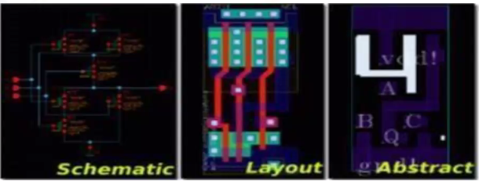
Physical library(.lef)
LEF abstracts lower level geometric details of cell. LEF provides all
details required by the router to connect to the cell without impacting internal cell constraints
An abstract view contains following info: Cell name, size of cell, Allowable orientation, pin names, layout geometries, routing blockages, power and ground pins, process antennae area

Slide 54
Standard Cell List
Inverter
Inverting Buffer
Non-inverting Buffer
Tristate Non-inverting Buffer
AND 2,3,4 inputs
NAND 2,3,4 inputs
OR 2,3,4 inputs
NOR 2,3,4 inputs
XNOR 2,3,4 inputs
AND-OR
AND-OR-Inverter
OR-AND
OR-AND-Inverter
Multiplexer 2 to 1
Multiplexer 4 to 1
Decoder 2 to 4
Half Adder 1-bit
Full Adder 1-bit
Pos edge DFF
Neg edge DFF
Scan Pos edge DFF
Scan Neg edge DFF
RS NAND Latch
High-Active
Clock Gating Latch
Non-inverting Delay line
Pass Gate
Bidirectional Switch
Hold 0/1 Isolation Cell

Slide 55
Process Design Kit
A process design kit (PDK) is a collection of verified data files that are used by a set of custom IC design EDA tools to provide a complete analog/mixed-signal/RF design flow
These data files include
schematic symbols
SPICE models
Parameterized Cells (PCELLS)
DRC/LVS runsets
parasitic extraction runsets
scripts that run by the EDA tools to automate the generation and verification of design data

Slide 56
Physical Design Flow
VLSI Physical Design Flow is an algorithm with several objectives. Some of them include
Minimum area
Wirelength
Power optimization
It also involves preparing timing constraints and making sure, that netlist generated after physical design flow meets those constraints

Slide 57
Physical Design Flow Contd.
The very first step in chip design is floor planning
in which the width and height of the chip,
basically the area of the chip, is defined
A chip consists of two parts, 'core' and 'die'
DIE
CORE
HDIE
HCORE
WCORE
WDIE
DEFINE WIDTH AND HEIGHT OF
CORE AND DIE

Slide 58
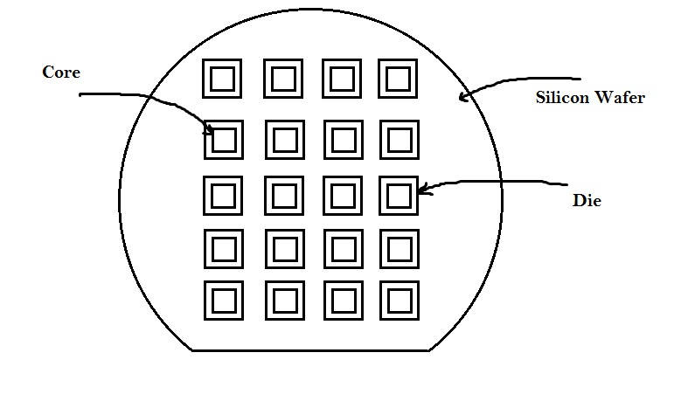
Physical Design Flow Contd.
A 'core' is the section of the chip where the fundamental logic of the design is placed.
A die, which consists of core, is small semiconductor material specimen on which the fundamental circuit is fabricated.
IC's are fabricated on a single 9 inch or 12 inch diameter silicon wafer, which contains hundreds of mirror images of the fundamental logic.
This wafer is then cut into small pieces, each piece has similar functionality of the fundamental logic. This is called 'die'

Slide 59
Physical Design Flow Contd.
During placement and routing, most of the placement tools, place/move logic cells based on floorplan specifications.
Some of the important or critical cell's locations has to be pre-defined before actual placement and routing stages.
The critical cells are mostly the cells related to clocks, viz. clock buffers, clock mux, etc. and also few other cells such as RAM's, ROM,s etc.
Since, these cells are placed in to core before placement and routing stage, they are called 'preplaced cells'. The above diagram describes the same.
DIE
CORE
CLOCK
MUX
OUTPUT
CLOCK
BUFFER
INPUT
CLOCK
BUFFER
DEFINING LOCATIONS OF PREPLACED CELSS

Slide 60
Physical Design Flow Contd.
Once the critical cells are placed on the chip, it becomes necessary to surround the critical cells by decoupling capacitors.
The placement of de-coupling capacitors surrounding the pre-placed cells improves the reliability and efficiency of the chip.
DIE
CORE
DECAP
D
E
C
A
P
D
E
C
A
P
CLOCK
MUX
DECAP
DECAP
D
E
C
A
P
D
E
C
A
P
OUTPUT
CLOCK
BUFFER
DECAP
D
E
C
A
P
DECAP
D
E
C
A
P
INPUT
CLOCK
BUFFER
DECAP
DE-COUPLING CAPACITORS SURROUNDING PREPLACED CELSS

Slide 61
Physical Design Flow Contd.
Usually, while drawing any circuit on paper, we have only one 'vdd' at the top and one 'vss' at the bottom.
But on a chip, it becomes necessary to have a grid structure of power, with more than one 'vdd' and 'vss’.
The concept of power grid structure would be uploaded soon. It is actually the scaling trend that drives chip designers for power grid structure.
DIE
Vdd
Vss
Vdd
Vss
Vdd
Vss
Vdd
CORE
Vss
DECAP
D
E
C
A
P
D
E
C
A
P
CLOCK
MUX
DECAP
Vdd
DECAP
D
E
C
A
P
D
E
C
A
P
OUTPUT
CLOCK
BUFFER
Vss
DECAP
D
E
C
A
P
DECAP
D
E
C
A
P
INPUT
CLOCK
BUFFER
Vdd
DECAP
Vss
Power planning

Slide 62

Physical Design Flow Contd.
During floorplan, we define the width and height of both, core and die. The space between core and die is reserved for pin placement. For eg. an 8085 has around 40 pins viz. reset, AD0, AD1, etc.
Also, the clock pins (for eg. CLK1, CLK2, CLKOUT1, CLKOUT2 in above diagram) are wider compared to other pins on the chip. It is the clock on a chip that drives most of the logic inside the chip. Hence, it should have very low resistance, and thus wide area, as resistance is inversely proportional to area.
AD6
AD7
RESET
$$\overline{CE}$$
DIE
Vdd
Vss
Vdd
Vss
Vdd
Vss
vdd
Vdd
CORE
DOUT1
vss
Vss
DECAP
D
E
C
A
P
D
E
C
A
P
CLOCK
MUX
DOUT0
DECAP
Vdd
DECAP
D
E
C
A
P
D
E
C
A
P
OUTPUT
CLOCK
BUFFER
CLKOUT1
CLK1
Vss
DECAP
D
E
C
A
P
DECAP
CLK2
D
E
C
A
P
INPUT
CLOCK
BUFFER
CLKOUT2
Vdd
AD0
DECAP
DOUT2
Vss
AD1
DOUT3
AD2
AD3
AD4
AD5
CE
PIN Placement

Slide 63
Physical Design Flow Contd.
To avoid the placement of cells by placement tools, in the area between core and die (which is reserved for pin placement), it needs to be blocked by logical cell placement blockages.
It is very similar to blocking a road under renovation, so that no one drives on that road, and that road is reserved for some special purpose.
Once the floorplan is freezed, it is given as an input to the placement and routing (PNR) tools.
These tools are built with intelligent algorithms which would consider the design requirements (usually called as 'constraints') such as clock frequency, timing margin, max capacitance etc., calculate the location of the logical cells (Flipflops, AND, OR, BUFFER, etc) and place them in the floorplan.
All the design requirements (or constraints) are stored in a single file called as 'design constraints' file, which is recognized by most of PNR tools.
The inputs to PNR tools are the design netlist, floorplan, timing libraries and design constraints.
Timing libraries is a database that stores complete information about input capacitances, timing arcs, etc. of the logical cells. It also stores the list of all logical cells of different sizes.

Slide 64

Physical Design Flow Contd.
AD7
$$\overline{CE}$$
DIE
Vdd
Vss
Vdd
Vss
CORE
Vdd
Vss
vdd
Vdd
DOUT1
vss
Vss
DECAP
D
E
C
A
P
D
E
C
A
P
CLOCK
MUX
DOUT0
DECAP
Vdd
DECAP
D
E
C
A
P
D
E
C
A
P
OUTPUT
CLOCK
BUFFER
CLKOUT1
CLK1
Vss
DECAP
D
E
C
A
P
DECAP
CLK2
D
E
C
A
P
INPUT
CLOCK
BUFFER
CLKOUT2
Vdd
AD0
DECAP
DOUT2
Vss
AD1
DOUT3
AD2
AD3
AD4
AD5
CE
PIN Placement

Slide 65
SkyWater Foundry Provided Standard Cell Libraries
https://www.skywatertechnology.com/
https://github.com/google/skywater-pdk

Slide 66

Libraries in the SKY130 PDK are named using the following scheme;
<Process name> _ <Library Source Abbreviation> _ <Library Type Abbreviation> [_ <Library Name>]
All sections are lower case and separated by an underscore. The sections are;
The Process name in is the name of the process technology, for this PDK it is always sky130.
The Library Source Abbreviations is a short abbreviation for who created and is responsible for the library. The table below shows the current list of Library Source Abbreviations;

Slide 67
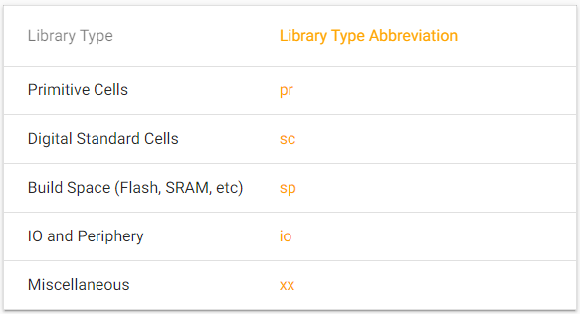
The Library Type Abbreviation is a short two letter abbreviation for the type of content found in the library. The table below shows the current list of Library Type Abbreviations;

Slide 68
The Library Name is an optional short abbreviated name used when there are multiple libraries of a given type released from a single library source. If only one library of a given type is going to ever be released, this can be left out.
Build Space Libraries
The SKY130 currently offers two build space libraries. Build space libraries are designed to be used with technologies like memory compilers and built into larger macros. The provided libraries have specially crafted design rules to enable higher density compared to other libraries.

Slide 69
There are seven standard cell libraries provided directly by the SkyWater Technology foundry available for use on SKY130 designs, which differ in intended applications and come in three separate cell heights.
Libraries
sky130_fd_sc_hs (high speed)
sky130_fd_sc_ms (medium speed)
sky130_fd_sc_ls (low speed), and
sky130_fd_sc_lp (low power)
are compatible in size, with a 0.48 x 3.33um site, equivalent to about 11 met1 tracks.
Libraries
sky130_fd_sc_hd (high density) and
sky130_fd_sc_hdll (high density, low leakage)
contain standard cells that are smaller, utilizing a 0.46 x 2.72um site, equivalent to 9 met1 tracks.
The sky130_fd_sc_hvl (high voltage) library contains 5V devices and utilizes a 0.48 x 4.07um site, or 14 met1 tracks.

Slide 70
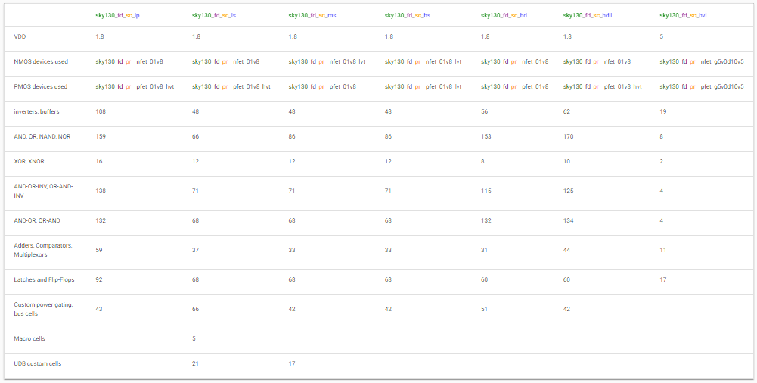
Supply voltage, FETs, and approximate cell counts for these libraries appear in the table below:

Slide 71
Projects [BE/BTECH & ME/MTECH]
DSP Domain
FFT
FIR
NN Domain
CNN
Chip Design of Convolution Computation for AI Network
Computational Units
Floating Point multiplier
Implementation and Physical Design of 8/4-Bit Signed Divider
Cryptoprocessors
Hash Algorithms
Area-Efficient Nano-AES Implementation for Internet-of-Things Devices
And many more

Slide 72
CONTACT US
VISION-VLSI INDUSTRY “An online only” Training Institute
Balapur, Hyderabad, Telangana State, INDIA
EMAIL: vvipvtltd@gmail.com
Mobile : 9949426362

Slide 73
Thank you

