Slide 1
Implementation of SHA-1 and SHA-2 Algorithms on Reconfigurable Hardware
1
Notes:
1

Slide 2
Purpose: Authentication Not Encryption
Authentication Requirements:
Masquerade – Insertion of message from fraudulent source
Content Modification – Changing content of message
Sequence Modification – Insertion, deletion and reordering sequence
Timing Modification – Replaying valid sessions
2
Notes:
2
Verify that received messages come from the alleged source and have not been altered. Also verify the sequence and timing. Digital Signature is used to combat denial of receipt of a message by either the source or desitination.

Slide 3
Background Theory
Message Digest or “Fingerprint”
→ Condensed Representation
→ Easy to generate for a given file.
Computationally infeasible to produce two messages with same message digest
Impossible to recreate a message given a message digest.
Data Integrity and Comparison Checking
→ Message Integrity Validation
3
Notes:
3

Slide 4
Applications: One-way hash functions
Public Key Algorithms
Password Logins
Encryption Key Management
Digital Signatures
Integrity Checking
Virus and Malware Scanning
Authentication
Secure Web Connections
(PGP, SSL, SSH, S/MIME)
4
Notes:
4

Slide 5
Variants
MD4 and MD5 by Ron Rivest
SHA-0, SHA-1 by NSA
RIPEMD-160
SHA-2 (224, 256, 385, 512)
Whirlpool
Tiger
GOST-3411
SHA-3
Winner selected from solicitations in 2012
5
Notes:
5
All variants have a similar framework. The variation is in the bits compressed into the digest. Thereby, differ in the number of blocks and words of data used in hashing.

Slide 6
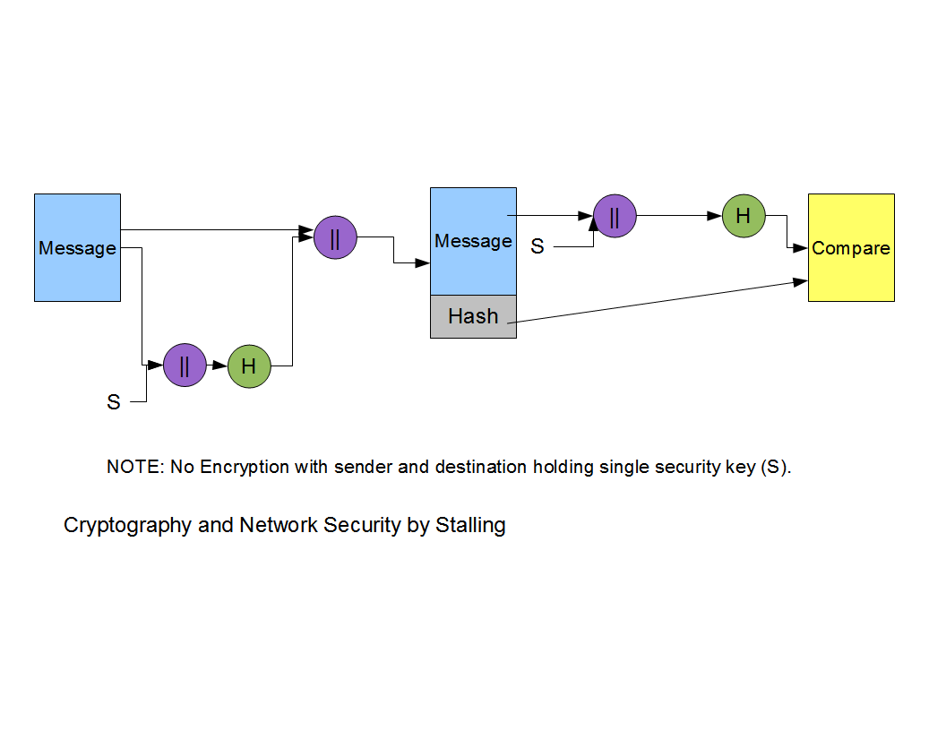
Basic Hash Function Diagram
6
Notes:
6

Slide 7
SHA-1 (160 bit message) Algorithm Framework
Step 1: Append Padding Bits….
Message is “padded” with a 1 and as many 0’s as necessary to bring the message length congruent to 448 modulo 512 .
Step 2: Append Length....
64 bits are appended to the end of the padded message. These bits hold the binary format of 64 bits indicating the length of the original message.
f
7

Slide 8
SHA-1 Framework Continued
Step 3: Prepare Processing Functions….
SHA1 requires 80 processing functions defined as:
f(t;B,C,D) = (B AND C) OR ((NOT B) AND D) ( 0 <= t <= 19)
f(t;B,C,D) = B XOR C XOR D (20 <= t <= 39)
f(t;B,C,D) = (B AND C) OR (B AND D) OR (C AND D) (40 <= t <=59)
f(t;B,C,D) = B XOR C XOR D (60 <= t <= 79)
Step 4: Prepare Processing Constants....
SHA1 requires 80 processing constant words defined as:
K(t) = 0x5A827999 ( 0 <= t <= 19)
K(t) = 0x6ED9EBA1 (20 <= t <= 39)
K(t) = 0x8F1BBCDC (40 <= t <= 59)
K(t) = 0xCA62C1D6 (60 <= t <= 79)
8
Notes:
8

Slide 9
SHA-1 Framework Continued
Step 5: Initialize Buffers….
SHA1 requires 160 bits or 5 buffers of words (32 bits):
H0 = 0x67452301
H1 = 0xEFCDAB89
H2 = 0x98BADCFE
H3 = 0x10325476
H4 = 0xC3D2E1F0
9
Notes:
9

Slide 10
SHA-1 Framework Final Step
Step 6: Processing Message in 512-bit blocks (L blocks in total message)….
This is the main task of SHA1 algorithm which loops through the padded and appended message in 512-bit blocks.
Input and predefined functions:
M[1, 2, ..., L]: Blocks of the padded and appended message f(0;B,C,D), f(1,B,C,D), ..., f(79,B,C,D): 80 Processing Functions K(0),
K(1), ..., K(79): 80 Processing Constant Words
H0, H1, H2, H3, H4, H5: 5 Word buffers with initial values
10
Notes:
10

Slide 11
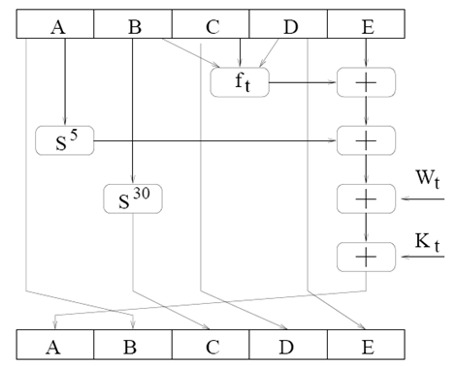
SHA-1 one step
11

Slide 12
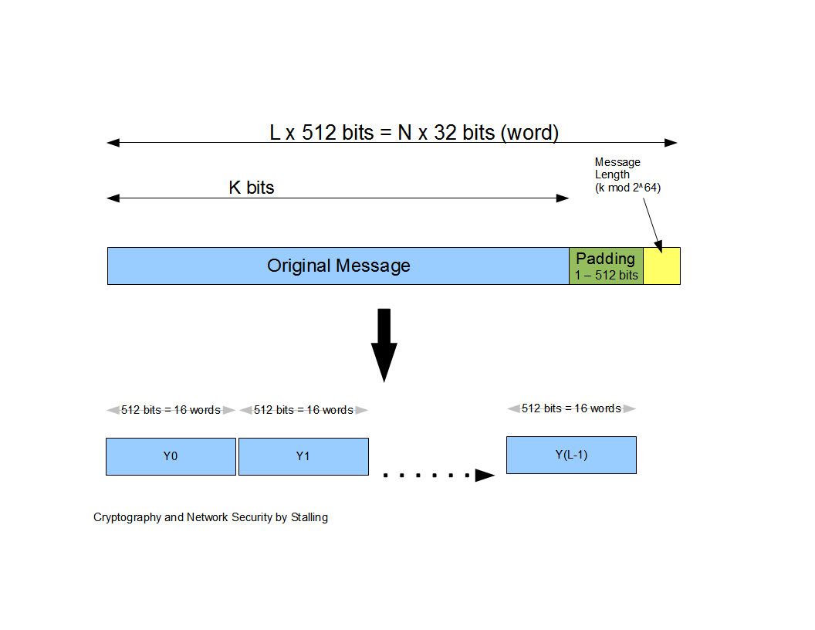
Message Diagram
12
Notes:
12

Slide 13
SHA-1 Message Digest
The message digest of the string:
“This is a test for theory of computation”
4480afca4407400b035d9debeb88bfc402db514f
13

Slide 14
SHA-1
Just a small change, e.g. from “dog” to “cog”, will completely change the hash value
“The quick brown fox jumps over the lazy dog”
SHA-1
2fd4e1c6 7a2d28fc ed849ee1 bb76e739 1b93eb12
“The quick brown fox jumps over the lazy cog”
SHA-1
de9f2c7f d25e1b3a fad3e85a 0bd17d9b 100db4b3
14

Slide 15



Verifying File Integrity
VIRUS
badFile
goodFile
NY Times
hash(goodFile)
BigFirm™
User
Software manufacturer wants to ensure that the executable file is received by users without modification …
Sends out the file to users and publishes its hash in NY Times
The goal is integrity, not secrecy
Idea: given goodFile and hash(goodFile), very hard to find badFile such that hash(goodFile)=hash(badFile)
15

Slide 16
SHA-1 Algorithm
Step 4: Cont’d
At the beginning of processing each M_{j}, initialize (A, B, C, D, E) = (H₀, H₁, H₂, H₃, H₄)
Then 80-step processing of 512-bit blocks – 4 rounds, 20 steps each
Each step t (0 ≤ t ≤ 79):
W_{t}
If t < 16, W_{t} = t^{th} 32-bit word of M_{j}
If t ≥ 16, W_{t} = (W_{t-3} ⊕ W_{t-8} ⊕ W_{t-14} ⊕ W_{t-16}) <<< 1
where <<< denotes circular shift to the left by s bits
and ⊕ denotes bit-wise XOR
16

Slide 17
SHA-1 Algorithm
Step 4: Cont’d
Each step t (0 ≤ t ≤ 79):
K_{t}
0 ≤ t ≤ 19, K_{t} = 5a827999
20 ≤ t ≤ 39, K_{t} = 6ed9eba1
40 ≤ t ≤ 59, K_{t} = 8f1bbcdc
60 ≤ t ≤ 79, K_{t} = ca62c1d6
17

Slide 18
SHA-1 Algorithm
Step 4: Cont’d
Each step t (0 ≤ t ≤ 79):
Define F(B, C, D) as follows:
0 ≤ t ≤ 19, F(B, C, D) = (B ^ C) ⊕ (¬B ^ D)
20 ≤ t ≤ 39, F(B, C, D) = B ⊕ C ⊕ D
40 ≤ t ≤ 59, F(B, C, D) = (B ^ C) ⊕ (B ^ D) ⊕ (C ^D)
60 ≤ t ≤ 79, F(B, C, D) = B ⊕ C ⊕ D
where ^ is bit-wise AND and ¬ is bit-wise complement
Then compute (called the SHA-1 step function)
T = (A <<< 5) + F(B, C, D) + W_{t} + K_{t} + E
18

Slide 19
SHA-1 Algorithm
Step 4: Cont’d
Each step t (0 ≤ t ≤ 79):
The values of (A, B, C, D, E) are updated as follows:
(A, B, C, D, E) = (T, A, B <<< 30, C, D)
19

Slide 20
SHA-1 Algorithm
Step 4: Cont’d
Finally, when all 80 steps have been processed, set
H₀ = H₀ + A
H₁ = H₁ + B
H₂ = H₂ + C
H₃ = H₃ + D
H₄ = H₄ + E
20

Slide 21
SHA-1 Algorithm
Step 5: Output
When all M_{j} have been processed, the 160-bit hash of M is available in H₀, H₁, H₂, H₃, and H₄
21

Slide 22
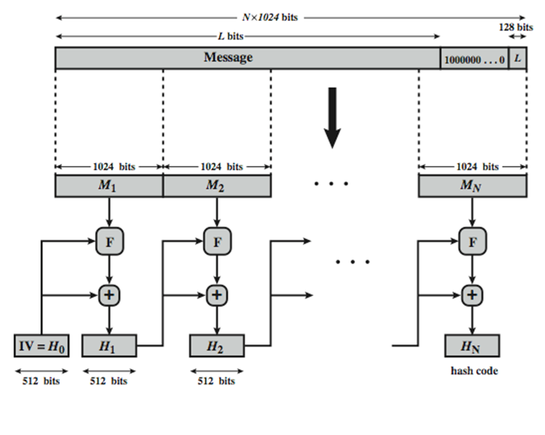
SHA-512 Overview
22
Notes:
22

Slide 23
SHA-512 Compression Function
heart of the algorithm
processing message in 1024-bit blocks
consists of 80 rounds
updating a 512-bit buffer
using a 64-bit value Wt derived from the current message block
23
Notes:
23

Slide 24
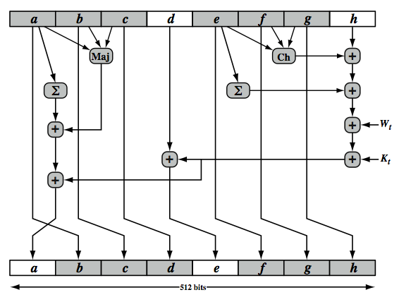
SHA-512 Round Function
24

Slide 25
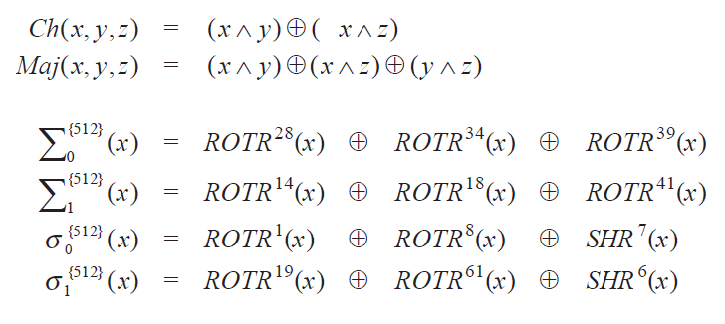
SHA 512 FUNCTIONS
25

Slide 26
The elements are:
Ch(e,f,g) = (e AND f) XOR (NOT e AND g)
Maj(a,b,c) = (a AND b) XOR (a AND c) XOR (b AND c)
∑(a) = ROTR(a,28) XOR ROTR(a,34) XOR ROTR(a,39)
∑(e) = ROTR(e,14) XOR ROTR(e,18) XOR ROTR(e,41)
+ = addition modulo 2^64
Kt = a 64-bit additive constant
Wt = a 64-bit word derived from the current 512-bit input block.
Six of the eight words of the output of the round function involve simply permutation (b, c, d, f, g, h) by means of rotation.
Only two of the output words (a, e) are generated by substitution.
Word e is a function of input variables d, e, f, g, h, as well as the round word W t and the constant Kt.
Word a is a function of all of the input variables, as well as the round word W t and the constant Kt.
26

Slide 27
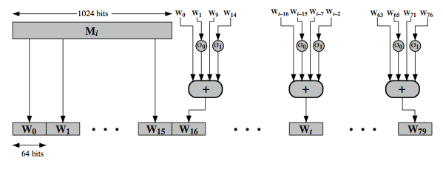
SHA-512 Round Function
27

Slide 28
Figure in Slide 27(previous) illustrates
How the 64-bit word values Wt are derived from the 1024-bit
message.
The first 16 values of Wt are taken directly from the 16 words of the
current block.
The remaining values are defined as a function of the earlier values
using ROTates, SHIFTs and XORs as shown.
28

Slide 29
The function elements are:
σ0(x) = ROTR(x,1) XOR ROTR(x,8) XOR SHR(x,7)
σ1(x) = ROTR(x,19) XOR ROTR(x,61) XOR SHR(x,6)
Thus, in the first 16 steps of processing, the value of W_{t} is equal to the corresponding word in the message block.
29

Slide 30
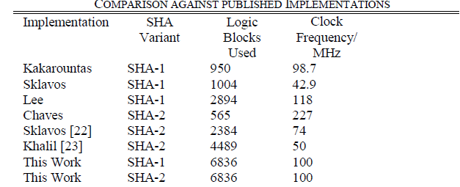
Device utilization summary:sha 512
---------------------------
Selected Device : 4vlx200ff1513-11
Number of Slices: 2578 out of 89088 2%
Number of Slice Flip Flops: 2129 out of 178176 1%
Number of 4 input LUTs: 3710 out of 178176 2%
Number of IOs: 580
Number of bonded IOBs: 580 out of 960 60%
Number of FIFO16/RAMB16s: 3 out of 336 0%
Number used as RAMB16s: 3
Number of GCLKs: 1 out of 32 3%
Device utilization summary: sha1
---------------------------
Selected Device : 4vlx200ff1513-11
Number of Slices: 798 out of 89088 0%
Number of Slice Flip Flops: 886 out of 178176 0%
Number of 4 input LUTs: 995 out of 178176 0%
Number of IOs: 196
Number of bonded IOBs: 196 out of 960 20%
Number of GCLKs: 1 out of 32 3%
Timing Summary: sha512
---------------
Speed Grade: -11
Minimum period: 10.348ns (Maximum Frequency: 96.637MHz)
Timing Summary: sha1
---------------
Speed Grade: -11
Minimum period: 7.551ns (Maximum Frequency: 132.424MHz)
30

Slide 31
Conclusion and Future Scope
This work demonstrate the advantage of using shift register
method to implement message scheduler .
To the great extend, It has minimized the logic consumption.
And also improved the operating speed of the hardware.
This work can be extended to implement on ASIC for further enhancing the operating speed of the device.
31

