Slide 1

CHAPTER-1 Measurement
ANSWER VERY BRIEFLY.
Define measurement.
Measurement is defined as the process of finding the size, quantity, or degree of a physical quantity by comparing it with a standard unit.
EXAMPLE:WEIGHT MACHINE
Known value
Unknown value

Slide 2

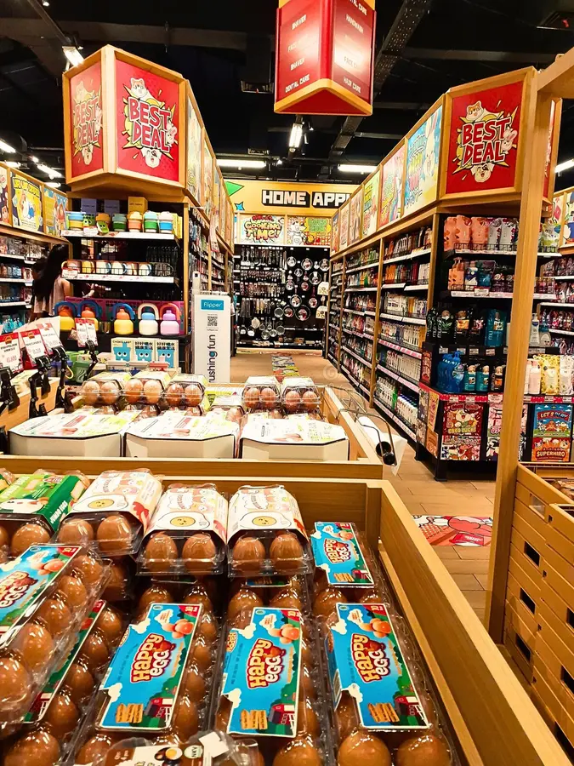
2) Define standard unit.
A standard unit is a fixed and universally accepted value used for the measurement of physical quantities, ensuring that measurements are consistent and accurate across different places and times.
REAL TIME EXAMPLE: Buying 2kg rice in TN rationshop and other country super market
EXACT AMOUNT (because of KILOGRAM)

Slide 3
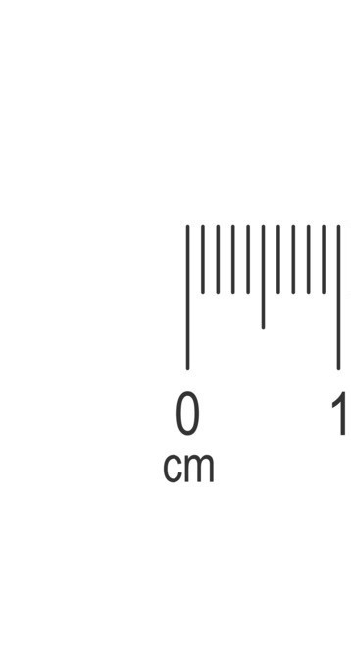
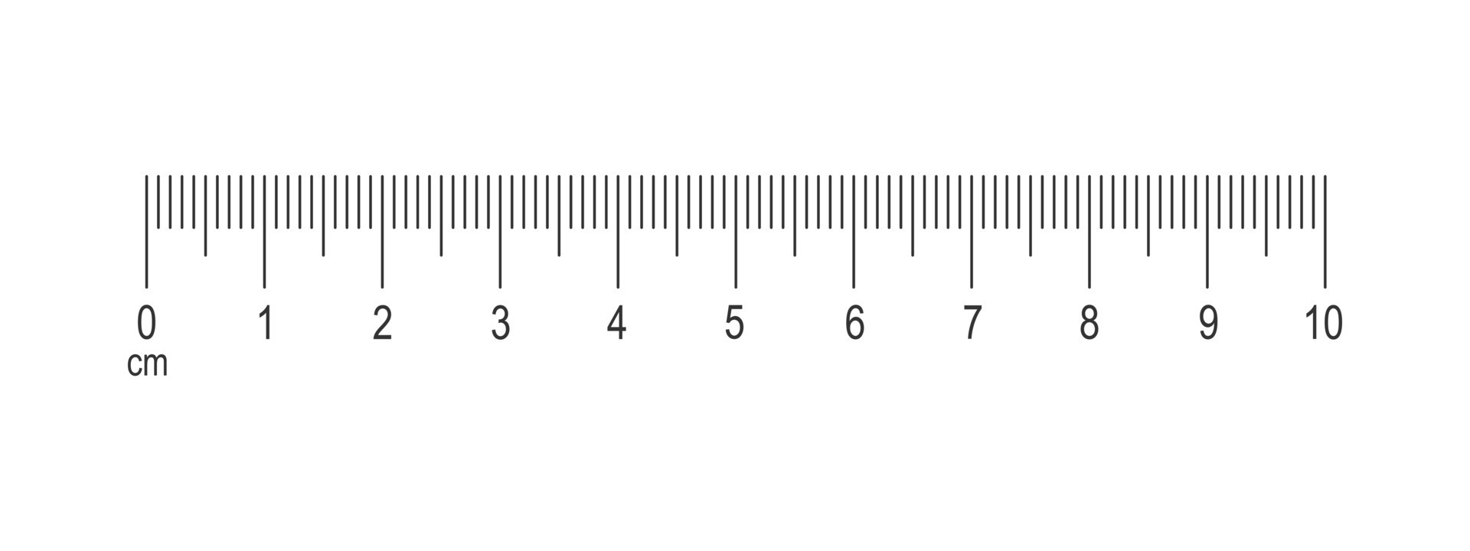
What is the full form of the SI system?
The full form of the SI system isInternational System of Units.
4) Define least count of any device?
The smallest value that can be measured accurately with a measuring instrument is called its Least Count (L.C.).
REAL TIME EXAMPLE:
Consider a standard metric ruler used in schools. The distance between the 0 cm and 1 cm marks is divided into 10 equal small parts. Each small part represents 1 millimeter (1 mm). Therefore, the least count of a common school ruler is 1 mm or 0.1 cm.
1mm or 0.1cm

Slide 4
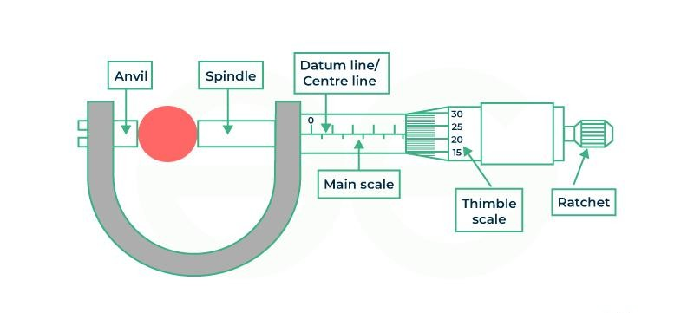
5) What do you know about pitch of screw gauge?
The pitch of a screw gauge is defined as the distance moved by the tip of the screw on the pitch scale (main scale) for one complete rotation of the head (thimble).
EXAMPLE:
6) Can you find the diameter of a thin wire of length 2 m using the ruler from your instrument box?
NO,The diameter of a thin wire represents its thickness, which is typically much smaller than the 1 mm smallest division (least count) of a standard ruler.

