Slide 1
Hibernate Framework
BY
Krishna Reddy

Slide 2
ORM
Object-relational mapping or ORM is the programming technique to map application domain model objects to the relational database tables. Hibernate is a Java-based ORM tool that provides a framework for mapping application domain objects to the relational database tables and vice versa.
Object-relational mapping (ORM) is a mechanism that makes it possible to address, access and manipulate objects without having to consider how those objects relate to their data sources. ORM lets programmers maintain a consistent view of objects over time, even as the sources that deliver them, the sinks that receive them and the applications that access them change.
ORM hides and encapsulates change in the data source itself, so that when data sources or their APIs change, only ORM needs to change to keep up—not the applications that use ORM to insulate themselves from this kind of effort. This capacity lets developers take advantage of new classes as they become available and also makes it easy to extend ORM-based applications. In many cases, ORM changes can incorporate new technology and capability without requiring changes to the code for related applications.

Slide 3
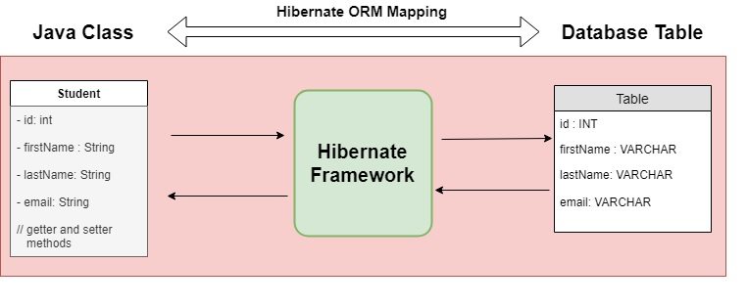
Hibernate Framework
Hibernate is a java based ORM tool that provides a framework for mapping application domain objects to the relational database tables and vice versa.
Hibernate is probably the most popular JPA implementation and one of the most popular Java frameworks in general. Hibernate acts as an additional layer on top of JDBC and enables you to implement a database-independent persistence layer. It provides an object-relational mapping implementation that maps your database records to Java objects and generates the required SQL statements to replicate all operations to the database.
Example: Below diagram shows an Object Relational Mapping between Student Java class and student table in the database.

Slide 4
public class Employee {
private int id;
private String first_name;
private String last_name;
private int salary;
public Employee() {}
public Employee(String fname, String lname, int salary) {
this.first_name = fname;
this.last_name = lname;
this.salary = salary;
}
public int getId() { return id; }
public String getFirstName() { return first_name; }
public String getLastName() { return last_name; }
public int getSalary() { return salary; }
}

Slide 5
What are the advantages of Hibernate over JDBC?
Hibernate removes a lot of boiler-plate code that comes with JDBC API, the code looks cleaner and readable.
Hibernate supports inheritance, associations, and collections. These features are not present with JDBC API.
Hibernate implicitly provides transaction management, in fact, most of the queries can’t be executed outside a transaction. In JDBC API, we need to write code for transaction management using commit and rollback.
JDBC API throws SQLException which is a checked exception, so we need to write a lot of try-catch block code. Most of the time it’s redundant in every JDBC call and used for transaction management. Hibernate wraps JDBC exceptions and throws JDBCException or HibernateException un-checked exception, so we don’t need to write code to handle it. Hibernate built-in transaction management removes the usage of try-catch blocks.
Hibernate Query Language (HQL) is more object-oriented and close to a Java programming language. For JDBC, we need to write native SQL queries.
Hibernate supports caching that is better for performance, JDBC queries are not cached hence performance is low.
Hibernate provides an option through which we can create database tables too, for JDBC tables must exist in the database.
Hibernate configuration helps us in using JDBC like connection as well as JNDI DataSource for a connection pool. This is a very important feature in enterprise applications and completely missing in JDBC API.
Hibernate supports JPA annotations, so the code is independent of the implementation and easily replaceable with other ORM tools. JDBC code is very tightly coupled with the application.

Slide 6
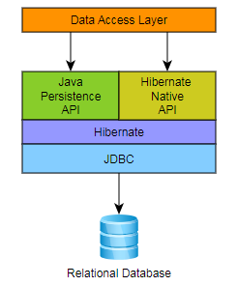
Architecture

Slide 7
@Entity - This annotation specifies that the class is an entity.
@Table - This annotation specifies the table in the database with which this entity is mapped.
@Column - The @Column annotation is used to specify the mapping between a basic entity attribute and the database table column.
@Id - This annotation specifies the primary key of the entity
@GeneratedValue - This annotation specifies the generation strategies for the values of primary keys.

Slide 8
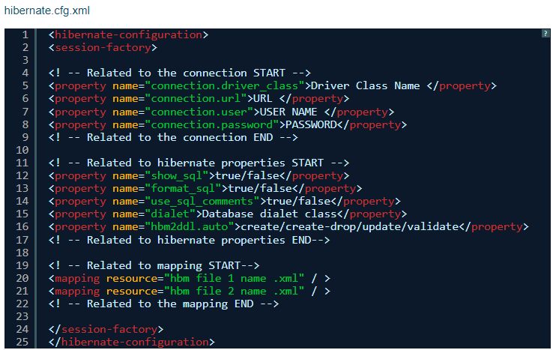
Sample Configuration File

Slide 9
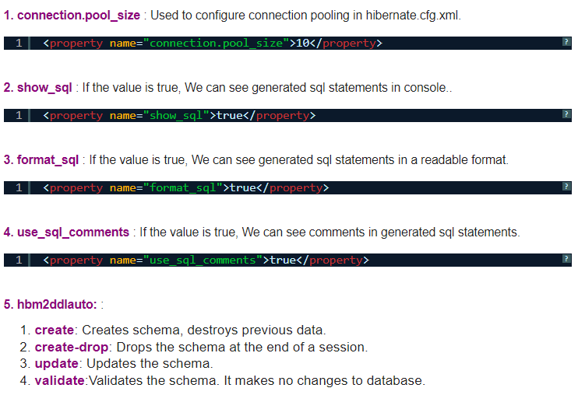

Slide 10
import javax.persistence.Column;
import javax.persistence.Entity;
import javax.persistence.Id;
import javax.persistence.Table;
@Entity
@Table(name="students")
public class Student {
@Id
@Column(name="sid")
private int studentId;
@Column(name="sname", length=10)
private String studentName;
}
}
@Column(name="grp",length=10)
private String grp;
public String getGrp() {return grp; }
public void setGrp(String grp) {
this.grp = grp; }
public int getStudentId() {
return studentId; }
public void setStudentId(int studentId) {
this.studentId = studentId;
}
public String getStudentName() {
return studentName;
}
public void setStudentName(String studentName) {
this.studentName = studentName;
}
}

Slide 11
import javax.persistence.CascadeType;
import javax.persistence.Column;
import javax.persistence.Entity;
import javax.persistence.Id;
import javax.persistence.JoinColumn;
import javax.persistence.OneToOne;
import javax.persistence.Table;
@Entity
@Table(name="Address")
public class Address {
@Id
@Column(name="addrid")
private int addressId;
@Column(name="place",length=10)
private String place;
@OneToOne(targetEntity=Student.class,cascade=CascadeType.ALL)
@JoinColumn(name="stu_id",referencedColumnName="sid")
private Student parent;
public int getAddressId() {return addressId; }
public void setAddressId(int addressId) {
this.addressId = addressId;
}
public String getPlace() {
return place;
}
public void setPlace(String place) {
this.place = place;
}
public Student getParent() {
return parent;
}
public void setParent(Student parent) {
this.parent = parent;
}
}

Slide 12
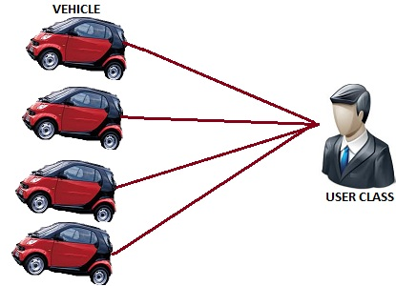
One to Many Mapping in Hibernate Example

Slide 13
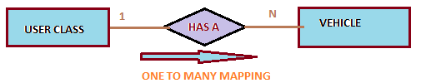
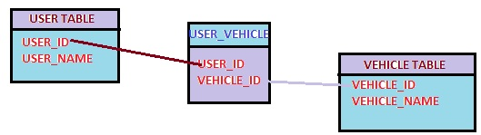
One to Many Mapping in Hibernate Example

Slide 14
@OneToMany:
Target: Fields (including property get methods)Defines a many-valued association with one-to-many multiplicity. If the collection is defined using generics to specify the element type, the associated target entity type need not be specified; otherwise the target entity class must be specified. If the relationship is bidirectional, the mappedBy element must be used to specify the relationship field or property of the entity that is the owner of the relationship. The OneToMany annotation may be used within an embeddable class contained within an entity class to specify a relationship to a collection of entities. If the relationship is bidirectional, the mappedBy element must be used to specify the relationship field or property of the entity that is the owner of the relationship.

