Slide 1

Customer Shopping Behavior Analysis
Uncovering insights from 3,900 purchases to drive strategic decisions

Slide 2
Dataset Overview
3.9K
18
35
25
Transactions
Data Columns
Missing Data in Review Rating
Products

Slide 3



Data Preparation Process
Load & Clean
Engineer
Integrate
Data loaded and Missing Data Handled
Feature Engineering and Data Consistency Check
Database Integration using MYSQL

Slide 4
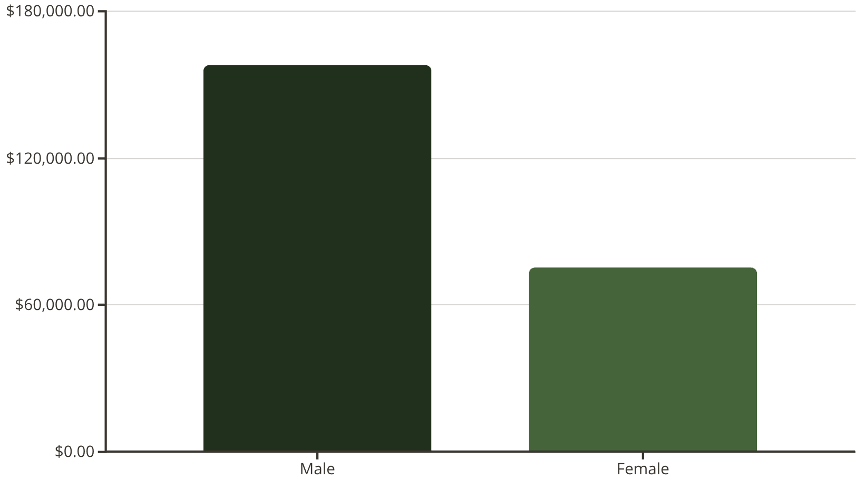
Revenue by Gender
Key Insight
Male customers generate 2x more revenue than female customers

Slide 5
Top Products & Ratings
Highest Rated
Most Discounted
Gloves — 3.86★
Hat — 50.00%
Sandals — 3.84★
Sneakers — 49.66%
Boots — 3.82★
Coat — 49.07%
Hat — 3.80★
Sweater — 48.17%
Skirt— 3.78★
Pants— 47.37%

Slide 6
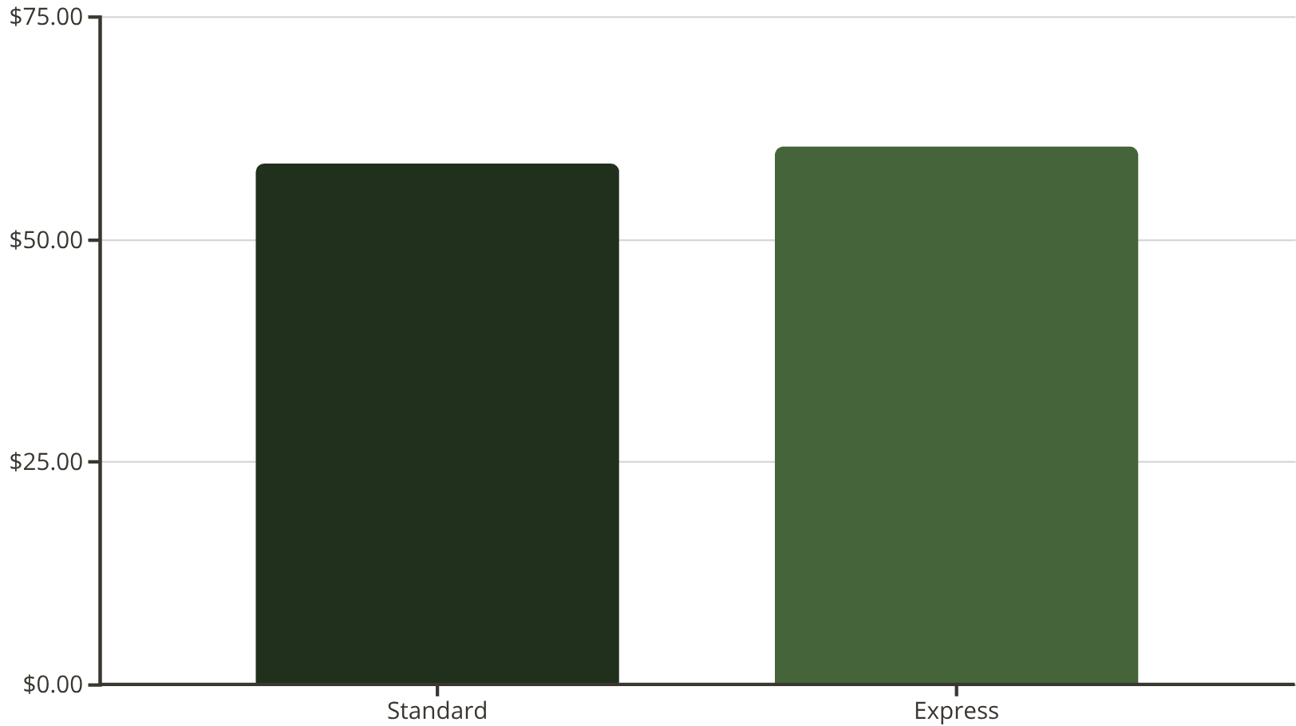
Shipping Type Comparison
Key Insight
Express shipping customers have slightly higher average purchase amounts ($60.48 vs $58.46), suggesting premium service attracts higher-value transactions.

Slide 7
Subscription Impact
Subscribers
Non-Subscribers
1053 Customers
2847 Customers
$62,645.00 Revenue
$170,436.00 Revenue
$59.49 Avgerage spend
$59.87 Avgerage spend

Slide 8



Customer Segmentation
80%
18%
2%
Loyal Customers
Returning Customers
New Customers
3,116 customers
701 customers
83 customers
Loyal customers dominate the base at 80%, indicating strong customer retention. Focus on converting the 18% Returning segment into Loyal status.

Slide 9
Repeat Buyers & Subscriptions
Non-Subscribers with >5 Purchases
Subscribers with >5 Purchases
2,518 customers
958 customers
72% of repeat buyers (>5 purchases) are non-subscribers, representing a significant opportunity to convert loyal customers into the subscription model.

Slide 10
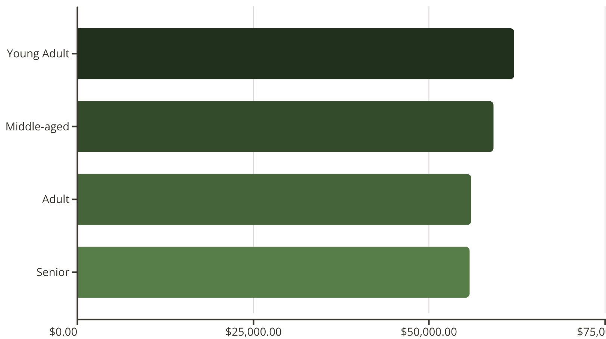
Revenue by Age Group
Key Insight
Young Adults lead revenue contribution at $62,143 — prioritize this demographic for targeted marketing campaigns and product development.

Slide 11

Business Recommendations
Boost Subscriptions
Loyalty Programs
Promote exclusive benefits for subscribers
Reward repeat buyers to build loyalty
Review Discounts
Targeted Marketing
Balance sales boosts with margin control
Focus on high-revenue age groups

