Slide 1
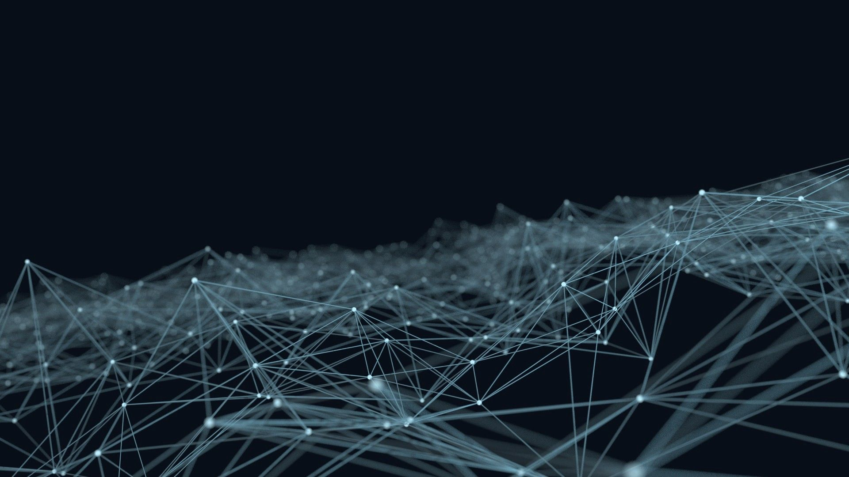
SKIN CANCER CLASSIFICATION USING CONVOLUTIONAL NEURAL NETWORKS
Presented By:
Shraddha Narale 2GI17CS121
Vinodkumar Talawar 2GI17CS163
Vismay Gunda 2GI17CS169
Vishal K 2GI17CS167
Under the Guidance of:
Prof. P.S. Khangoudar
Dept of Computer Science and Engineering
KLS Gogte Institute of Technology, Belgaum
2020-21

Slide 2
Problem Statement
To Design and develop a software which
Categorizes given test image under various skin cancer images (malignant)
Training the model using various Deep Neural Network technologies i.e., FastAI, Resnet50.

Slide 3
Comparison
Existing System
Made with traditional CNN Model
Complex Neural Networks library are used ike Pytorch
Accuracy of 85%-90% maximum
Old HAM Dataset of skin cancer data is used.
Our System
Made with latest trendy ResNet 50 CNN Model
Latest Powerful FastAI Neural Network is used.
Accuracy is more than 95%.
Huge amount of data from ISIC Archive Challenge Data from 2016-2020 are used .

Slide 4
Various Categories of Skin cancer cells
Actinic Keratoses (Sun exposure)
Benign Keratosis Lesions (Damaged tissue)
Basal Cell Carcinoma (These cells produce
new cells as old one dies)
Dermatofibroma
Melanocytic Nevi
Melanoma
Vascular Lesions

Slide 5
Design Details
Flowchart:
Preprocessing the data
Save the preprocessed file
Feeding the preprocessed file to the CNN Model
Train
Save the model
Prediction

Slide 6
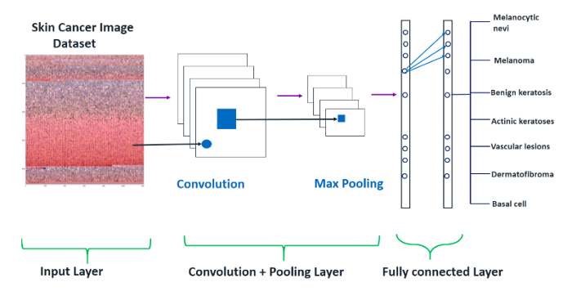
Convolutional Neural Network

Slide 7
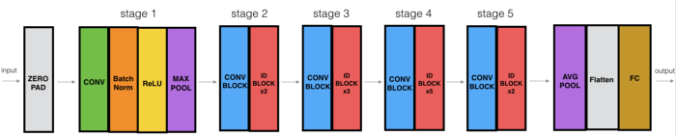
Resnet50 Architecture
Residual Networks is a classical neural network used as a backbone for many computer vision tasks.
“50” stands for 50 stacking convolutional layers.
Resnet50 was the winner of Image Net Challenge in 2015.
Resnet is better than traditional neural networks as a problem of vanishing gradients (back propagation)

Slide 8
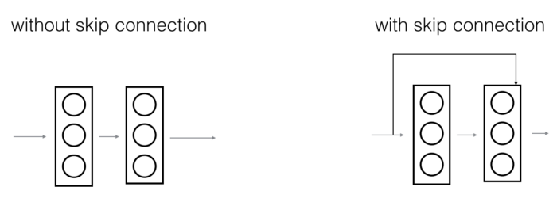
Resnet50 Architecture
Skip Connection( The strength of RESNET)
Diagram below illustrates skip connection.Figure on left is Stacking Convolution one after the other.On right we still stack ,but now we also add original input to output of convolution block.

Slide 9
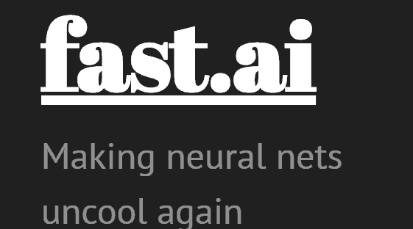
FastAI is a deep learning open source library which provides users with high-level components that can quickly and easily provides standaard deep learning domains and provides researchers with low level components that can be mixed and matched to build new approaches.
Founded in 2016 by Jeremy Howard(CEO).

Slide 10
System Flow Diagram
Training Data
Deep Learning Algorithm
Train Neural Network
Run Neural Network with weight
Prediction

Slide 11
Implementation Details:
Data processing Code
#Data cleaning steps
import pandas as pd
df=pd.read_csv("Dataset")
df.dx.unique()
#array([‘bkl’,’nv’,’df’,’mel’,’vasc’,’bcc’,’akiec’],dtype=object)
import os
for i in df.dx.unique():
print(i)
os.system(f"mkdir data\\train\\{i}")
for i,j in zip(df.image_id,df.dx):
print(i,j)
os.system(f"copy dataset1\\{i}.jpg data\\train\\{j}\\{i}.jpg" )
for i,j in zip(df.image_id,df.dx):
print(i,j)
os.system(f"copy dataset2\\{i}.jpg data\\train\\{j}\\{i}.jpg" )

Slide 12
Implementation Details:
Mounting Data into Drive
from google.colab import drive
drive.mount('/content/drive')
ls
#Ignore any warnings during runtime
import warnings
warnings.filterwarnings('ignore')
%reload_ext autoreload
%autoreload 2
%matplotlib inline
# !pip install intel-openmp
Fast AI Library
from fastai.vision import *
from fastai.metrics import error_rate

Slide 13
Implementation Details:
Training Data Code
#batch
>bs = 128
>path = "/content/drive/MyDrive/data"
#random.seed helps in mainatining constant randomness which helps
>np.random.seed(42)
data = ImageDataBunch.from_folder(path, train='.', valid_pct=0.2,ds_tfms=get_transforms(), size=224,num_workers=4).normalize(imagenet_stats)
>data.show_batch(rows=3, figsize=(7, 8))
>print(data.classes)
>len(data.classes),data.c

Slide 14
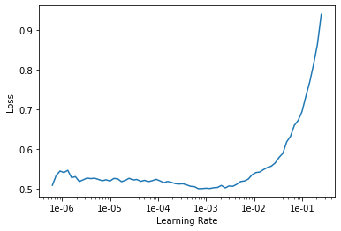
Implementation Details:
CNN Model and Weight File Generation
# CNN Model
>learn = cnn_learner(data, models.resnet50, metrics=error_rate)
>learn.model
# Epoch running
>learn.fit_one_cycle(4)
>learn.save('stage-1') ##Weight file generated
>interp = ClassificationInterpretation.from_learner(learn)
losses,idxs = interp.top_losses()
len(data.valid_ds)==len(losses)==len(idxs)

Slide 15
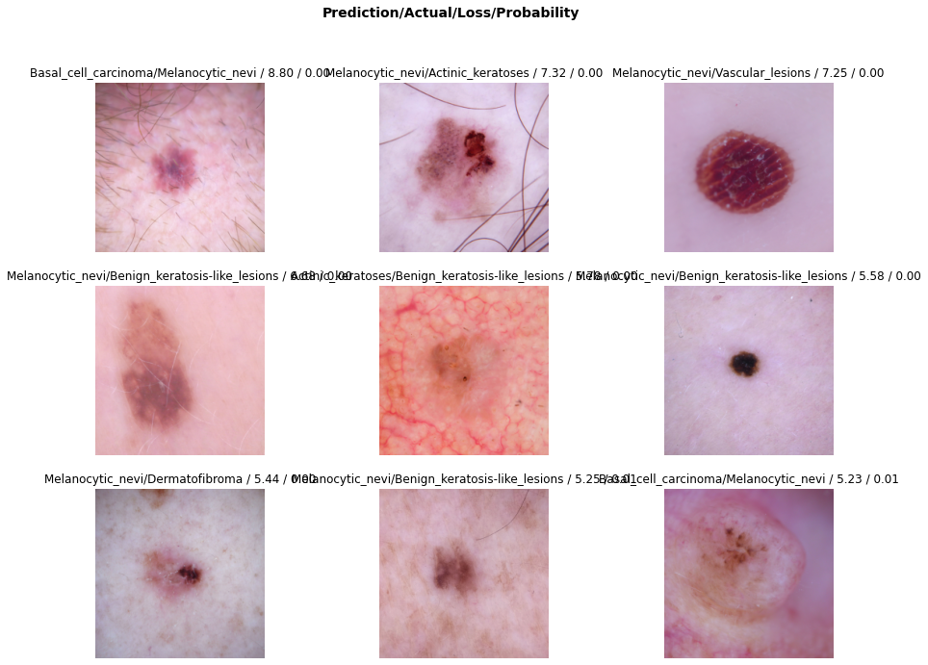
Implementation Details:
Plot of Prediction
>interp.plot_top_losses(9, figsize=(15,11))
>interp.most_confused(min_val=2)
# loading weight file
>learn = cnn_learner(data, models.resnet50).load('stage-1')
>data1 = []
local_download_path="/content/drive/MyDrive/skin_test"
for filename in os.listdir(local_download_path):
if filename.endswith("jpg"):
# Your code comes here such as
# print(filename)
data1.append(filename)
type(data1)

Slide 16
Implementation Details:
Plot of Prediction
#input
>for i in data1:
print(i)
#output
>predictions=[]
for i in data1:
img=f'/content/drive/MyDrive/skin_test/{i}'
cat, tensor, probs = learn.predict(open_image(img))
print(cat.__str__())
predictions.append(cat.__str__())
Melanoma
Dermatofibroma
Basal_cell_carcinoma
Actinic_keratoses

Slide 17
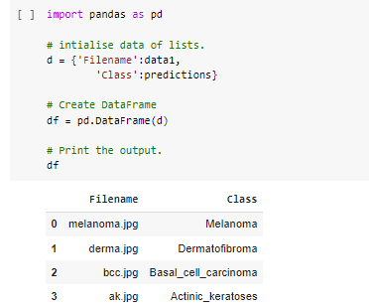
Implementation Details:
Output:

Slide 18
Future Scope
From time to time new images can be added to the existing dataset for higher accuracy.
Can be medically improved a lot.
Also proper User GUI for Web, Android and iOS can be developed using latest technology ike Streamlit.
Also extra information like symptoms and chance of cure can also be displayed.

Slide 19
Conclusion:
Constantly gaining knowledge for building better neural network model with maximum accuracy.
Making skin cancer diagnosis more quick and accurate.
Even non-medical person can be easily able to diagnose through our model without prior knowledge of it.
Making use of latest technologies like FastAI (2016),Resnet50(2015), applying them to latest available dataset.

Slide 20
References:
Dr. Chinmay Gunda.(MBBS ,MD General Medicine)
https://www.kaggle.com/kmader/skin-cancer-mnist-ham10000
https://www.fast.ai/
https://www.ncbi.nlm.nih.gov/pmc/articles/PMC6091241/
https://challenge.isic-archive.com/data
https://towardsdatascience.com/understanding-and-coding-a-resnet-in-keras-446d7ff84d33
https://towardsdatascience.com/a-comprehensive-guide-to-convolutional-neural-networks-the-eli5-way-3bd2b1164a53

Slide 21
Thank You

