Slide 1


Speech Recognition
Internal Guide:
Rajesh Patel
(Assistant Professor)
Prepared by:
Shivani Desai (17DCE007)
Prachi Modi (17DCE028)
Pramey Modi (17DCE029)
Vismay Patel (17DCE051)
Yash Patel (17DCE053)
Dhruvin Kotak (D18DCE071)

Slide 2
Index
Sample
Overview
Individual Contribution
Programming Languages Used
Functionality
Flowchart
ER Diagram
Demo
References

Slide 3
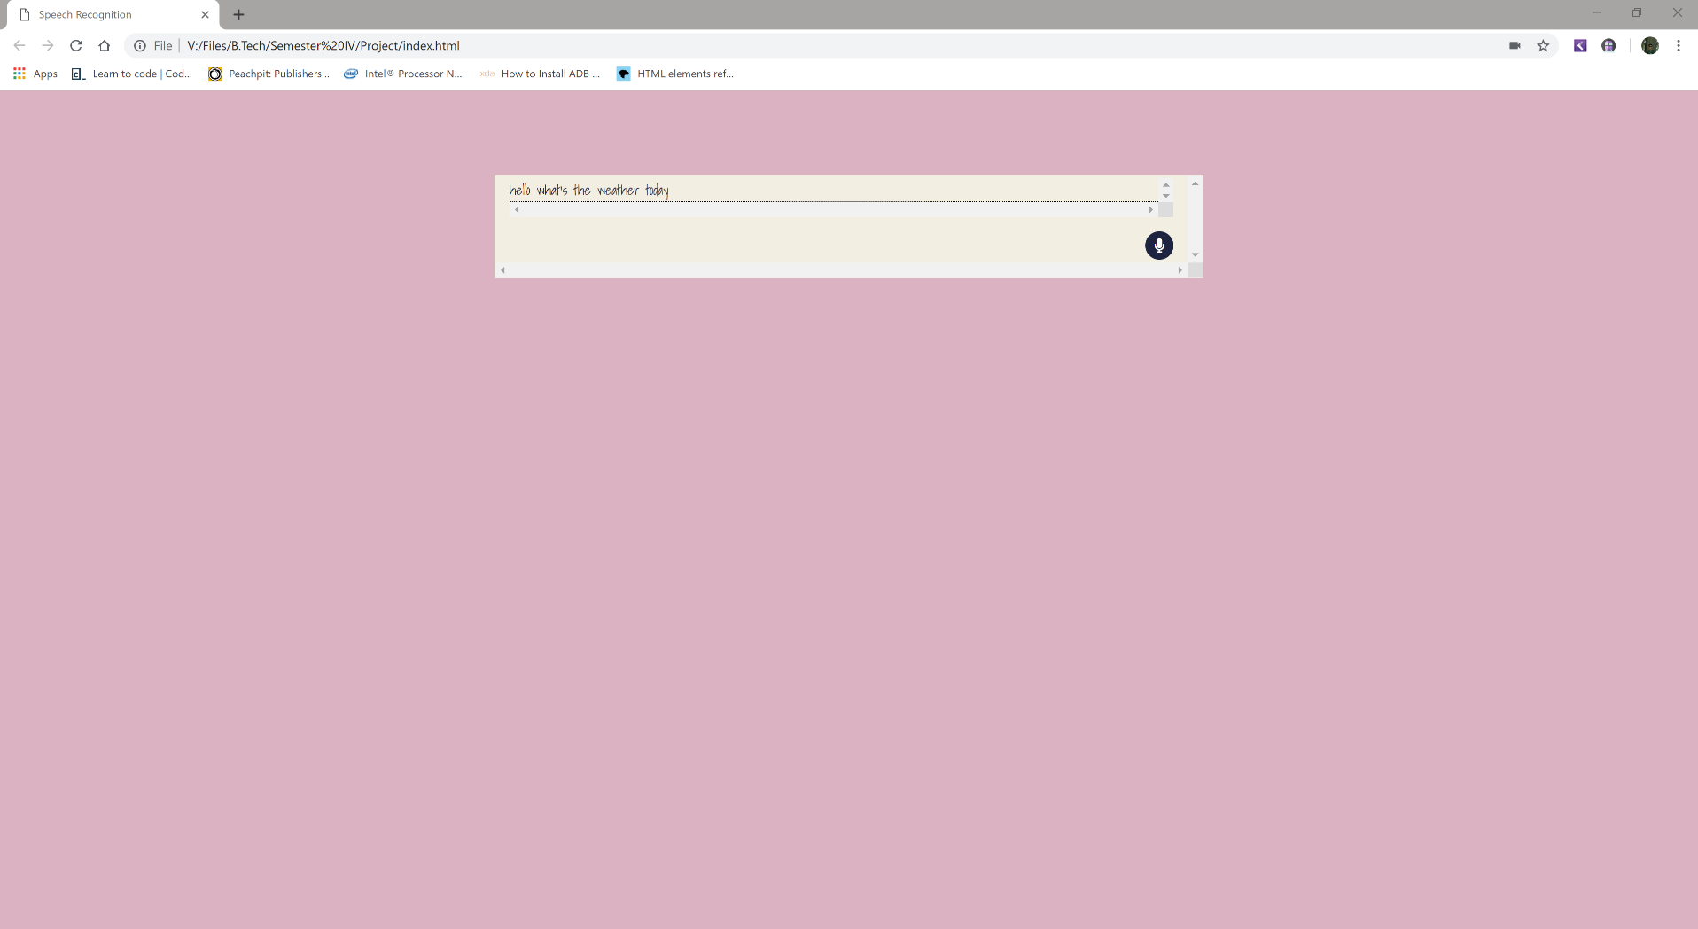
Sample

Slide 4
Overview
Speech recognition is based on the voice as the research object.
Speech recognition allows the machine to turn the speech signal into text or commands through the process of identification and understanding, and also makes the function of natural voice communication.
Speech recognition involves many fields of physiology, psychology, computer science and signal processing, and is even related to the person's body language, and its ultimate goal is to achieve natural language communication between man and machine.
The speech recognition technology is gradually becoming the key technology of the IT man-machine interface that analyzed the problems faced by the speech recognition.

Slide 5
Individual Contribution
Creation of Database and data tables ,Data Entries ,Flow chart and ER diagrams:
Prachi Modi (17DCE028)
Pramey Modi (17DCE029)
Vismay patel (17DCE051)
Dhruvin kotak (d18DCE071)
Web page designing ,Searching about project and Data Entries :
Shivani Desai (17DCE007)
Yash Patel (17DCE053)

Slide 6
Programming Languages Used
Java Script
CSS
HTML

Slide 7
Functionality
Speech recognition is the ability of a machine or program to identify words and phrases in spoken language and convert them to a machine-readable format.
Rudimentary speech recognition software has a limited vocabulary of words and phrases, and it may only identify these if they are spoken very clearly.
The most frequent applications of speech recognition within the enterprise include call routing, speech-to-text processing, voice dialing and voice search.

Slide 8
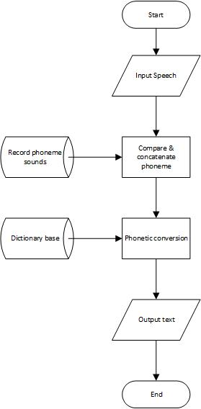
Flow Chart

Slide 9
ER diagram

Slide 10
Demo

Slide 11
References
https://www.google.com/intl/en/chrome/demos/speech.html
https://developer.mozilla.org/en-US/docs/Web/API/Web_Speech_API
https://w3c.github.io/speech-api/

Slide 12
Thank You!

