Slide 1
Welcome to PacificVis 2021
IEEE
2021.4.19

Slide 2
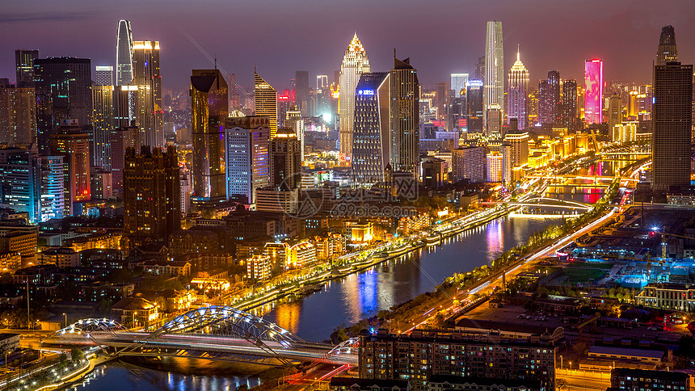
One of the Best Vis Conference
Held in Tianjin
A beautiful city in China

