Slide 1
Alarm Flood Analysis (Lazy Geeks) DAAC-A-THON 2018
Siemens Corporate Technology
Restricted © Siemens 2018

Slide 2
Problem Statement
Alarm Flooding is one of the main problems in alarm management.
An alarm flood is a situation where tens or hundreds of alarms may arise during a very short period. EEMUA and ISA standard define an alarm flood as period of more than 10 alarms per 10 min per operator.
Proposed Solution
To study the historic alarm flood data on the basis of rule based algorithm.
Determine which floods are similar and should be classified in one group based on similarity index.
Based on the clustered data we find root cause of each group.
Predict root cause of new flood.

Slide 3

Machine Learning
Machine Learning is used to solve alarm flood problem.
Machine learning algorithms discover pattern among data and construct a model using these pattern . Then we can use these models to make prediction on new data.
Most popular applications using Machine Learning:
Amazon
Netflix
Facebook
Our Data+ Machine Leaning = Smart Applications

Slide 4
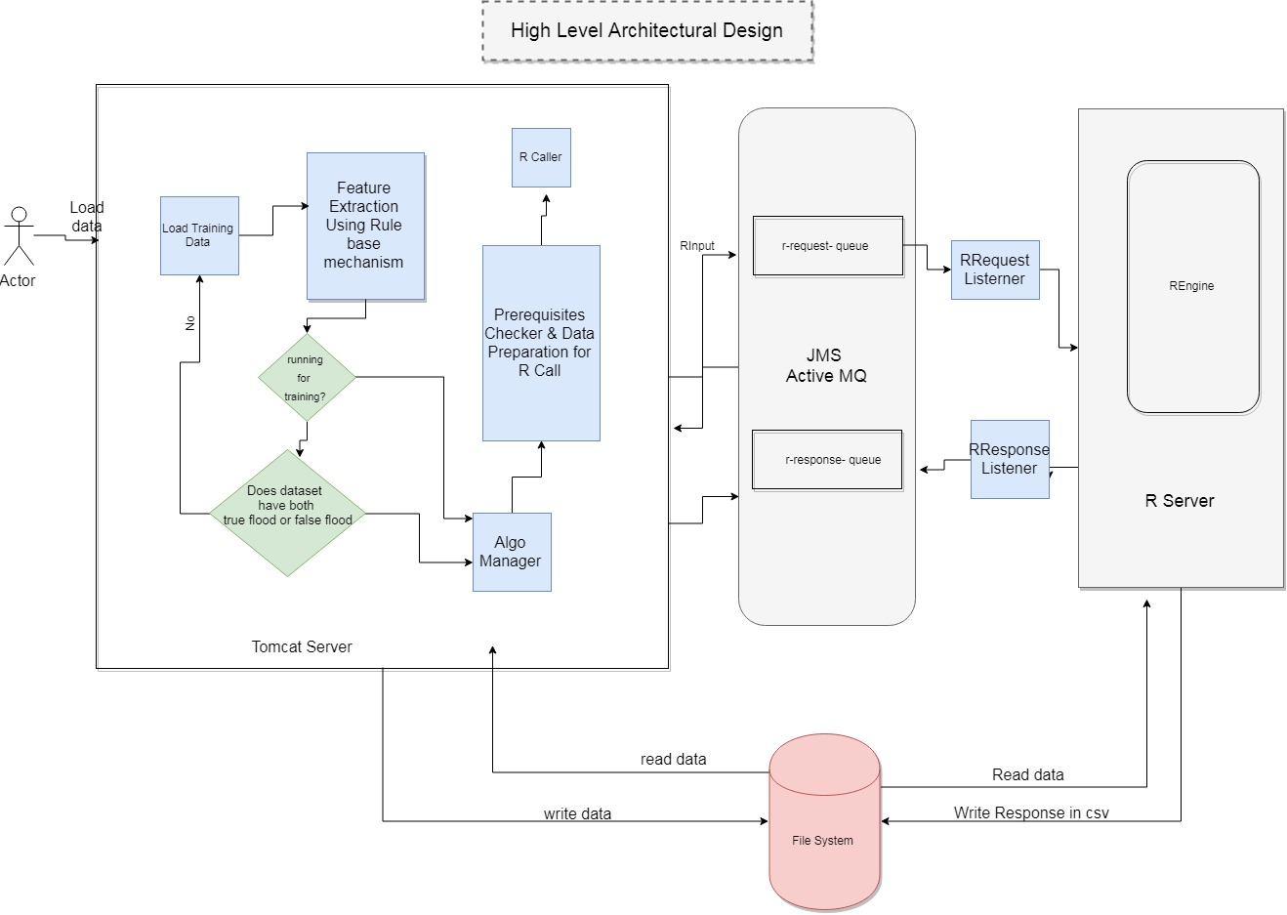
High Level Architecture Design

Slide 5

Technologies Used
Purpose | Technology
MVC Framework | Spring Framework
View Layer | Thymleaf,D3.js,Plotly.js,Bootstrap
Machine Learning Algorithms | R programming language
Messaging Queue | Active MQ
IDE | Eclipse, R Studio

Slide 6
Developed Solution Details
Training Set
User uploads Historic Alarm Flood Data
Flood data analyzed and classified into true and false flood.
(Rule based algorithm and Naïve Bayes Algorithm)
User clicks train data to build machine learning model

Slide 7
Developed Solution Details
Machine Learning Model
Similarity Between true floods is calculated
(Prefilter+Modified Smith Waterman Algorithm)
Floods which are similar are clustered together
(Clustering Algorithm)
Root Cause Analysis of each cluster is found.
(Most frequently occurring pattern algorithm)

Slide 8
Developed Solution Details
Test Set
Upload the incoming flood
Compare the flood data with the alarm flood machine learning model
Get result as the cluster to which the alarm flood belongs and the root cause of the alarm flood.

Slide 9
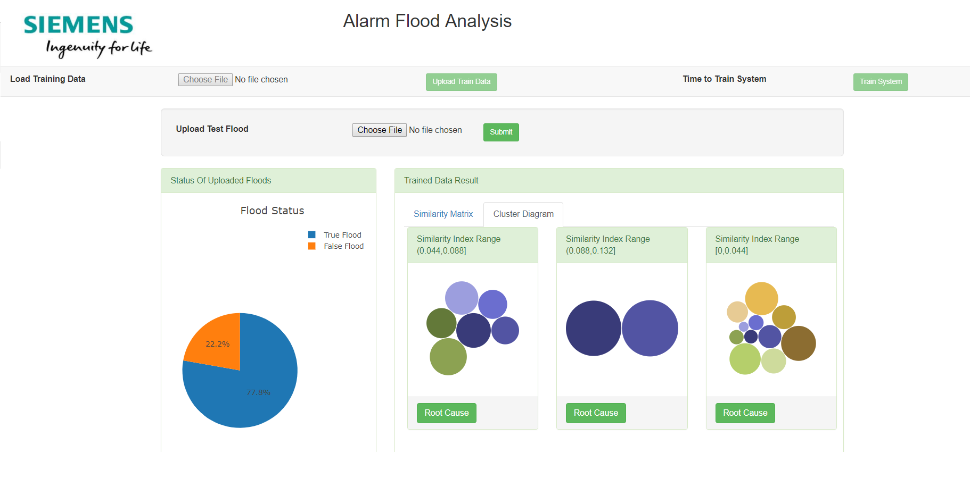
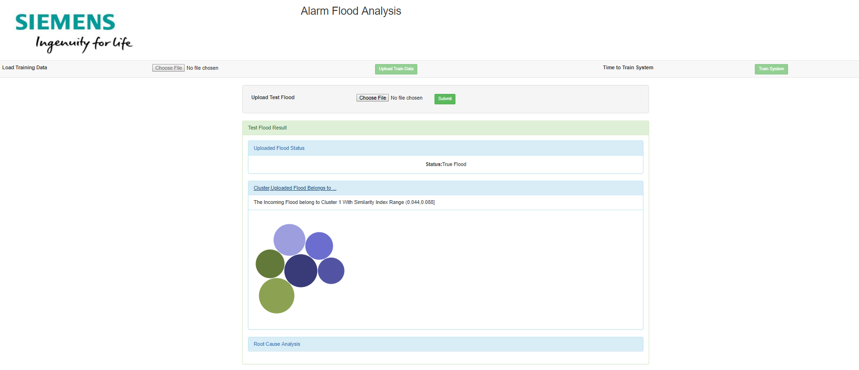
Highlights
The developed POC makes use of Machine Learning to solve alarm flood root cause analysis problem.
Machine Learning Algorithms have been optimized to meet the requirements of our POC.
Distributed Architecture.
Data delivery guaranteed.
The POC has been developed using open source technologies and machine learning algorithms have been implemented in R which is an open source programming language rather than using built in Machine Learning models provided by Amazon ML services which are paid.
Spring Framework has been used to allow easy extensibility of the application.
Screenshot of our solution

Slide 10

Thanks for your attention!
Lazy Geeks
CT RDA DS AA PD DAAC
Siemens Technology and Services Private Limited
IFFCO Tower, Plot No. 3, Sector 29 Gurgaon 122001, India
siemens.com

