Slide 1
Who am I
Cyrille Rossant
Postdoc in computational neuroscience at UCL/Collège de France (London & Paris)
Models of spike-based neuronal computation
Analysis of experimental data(electrophysiological recordings)
Algorithms and software for data processing

Slide 2
Interest in visualization (early 2012)
PhD work: analyze intracellular recordings
1 hour recording, 10 kHz: 36,000,000 points (~70 MB)
Let’s load th data with NumPy
  y=fromfile(…)
Let’s plot that with matplotlib!
  plt.plot(x, y);
  plt.show() # uh-oh…

Slide 3
DEMO TIME
1-a-mpl.py

Slide 4
Can’t we do better than that??
Looked for alternative solutions
  ➔ no library scales to plots with millions of points…
Why not use the GPU?
  (Py)OpenGL: hardware accelerated, interactive, real-time visualization: looks perfect:
Quick hacks ➔ glplot (never released publicly)

Slide 5
DEMO TIME
2-b-glplot.py

Slide 6
glplot
How does it work?
  Put the data in a Vertex Buffer Object
  glDrawArrays(GL_LINE_STRIP…)
  Pan & zoom: glScalef & glTranslatef
    (Warning: this is not what we do now in Vispy…)
  No CPU-GPU transfers during pan & zoom
  The GPU loves this ➔ nearly optimal performance
I used glplot for the rest of my PhD…

Slide 7
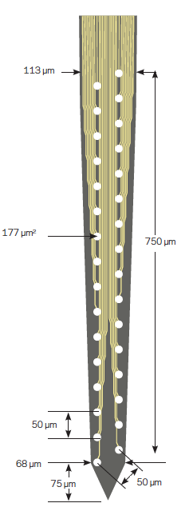
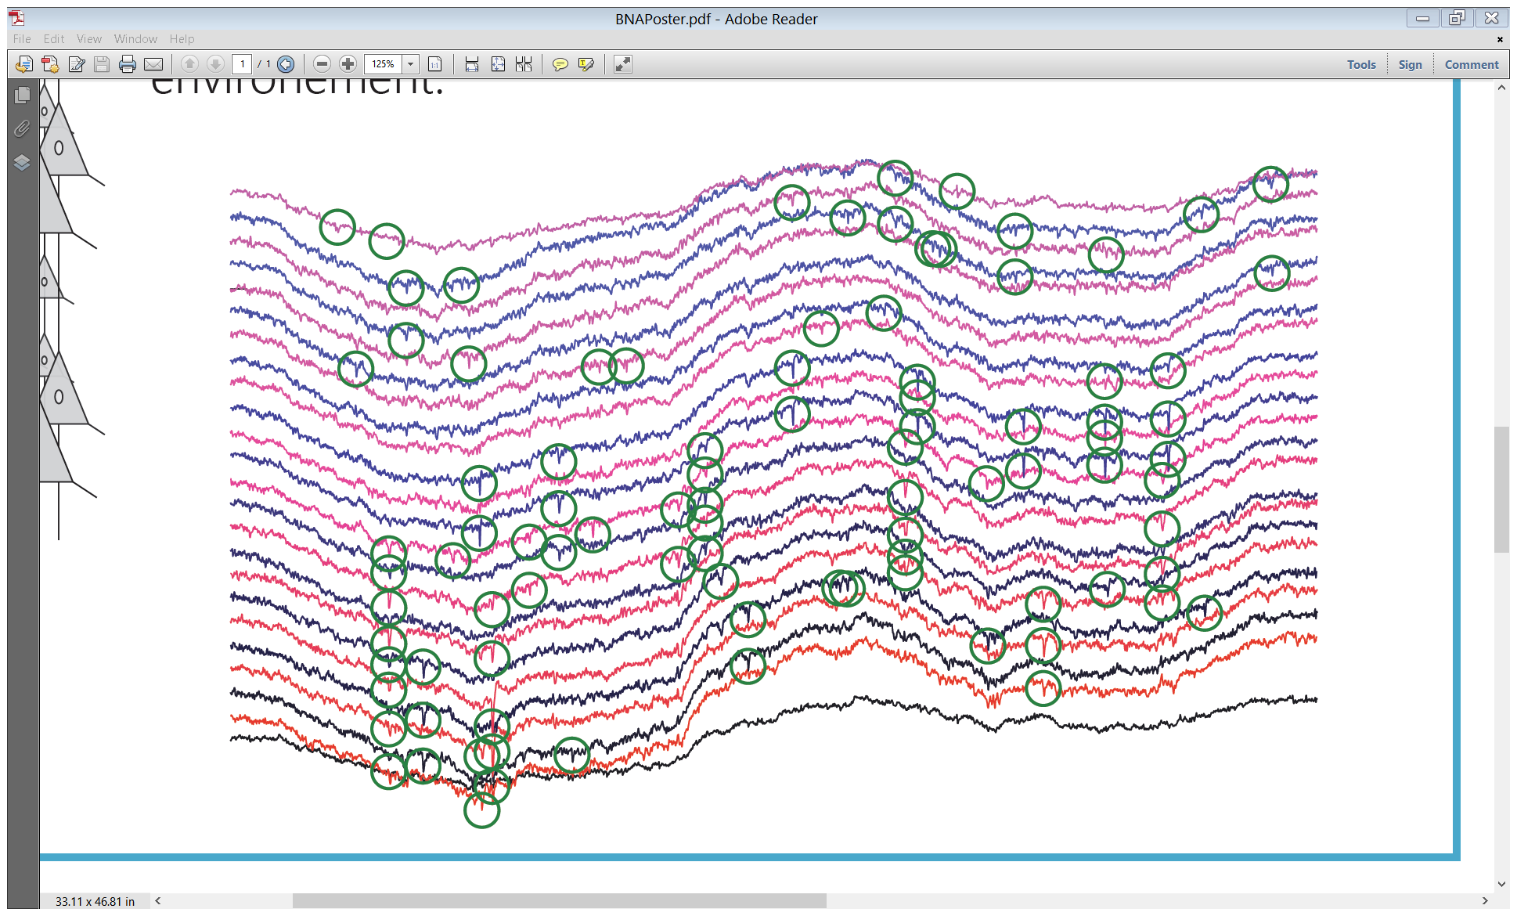
Late 2012: postdoc at UCL
New project: analyze extracellular multichannel recordings
Like intracellular recordings (20-40 kHz)…
… x 100 (or x 1000)

Slide 8
