Slide 1
Visuals

Slide 2
GLOO
The idea is to define OpenGL objects
We can change attributes naturally
Example
  program = ...
  program['a_color'] = ...
  program['a_position'] = ...

Slide 3
Visuals
Same idea, but higher-level
Instead of defining OpenGL objects, we define visual objects (discs, lines, curves, graphs, 3D meshes, surfaces, etc.)
Example:
  mydisc = Disc(position=(…))
  mydisc.color = 'red'
    immediately triggers a change of uniform variable (interactive)
  mydisc.line_color = 'green'

Slide 4
Collections
Manage a large number of similar objects very efficiently (batch processing)
Example
  discs = DiscCollection(position=rand(N,2))
  discs.color = 'red' # change a uniform
  discs.color = rand(N,4) # change an attribute
Internally, a single VBO, a single program, a single vertex shader, a single drawing command (glDrawArrays)
10 or 100 x faster than drawing many instances

Slide 5
Structure of a visual
High-level (public) traitlets-like attributes
initialize()
  Create several GLOO objects
  Create the shaders
paint()
  custom method
  loop over all GLOO objects
  drawing command(s)
resize()
  handle window resize event
Updating a trait attribute triggers GLOO update commands (set_(sub)data, uniform update…)
possibly, custom public methods

Slide 6
Visual classes
Visuals are implemented in classes
  SpriteVisual, DiscVisual, LineVisual, BezierVisual, NurbsVisual, MeshVisual, etc.
One can derive a visual class (specialization)
One can create compound visuals
  Example: GraphVisual
  Create a SpriteCollection (or DiscCollection…) for nodes
  Create a LineCollection for edges (shares the SpriteCollection position VBO + list of edges for indexed rendering)

Slide 7
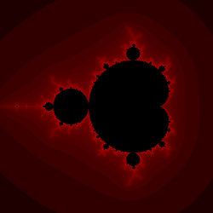
Shader chaining
Visuals come with templatable shaders
Example: SquareVisual
One should have the possibility to hook into the fragment shader and compute a fractal in GLSL

Slide 8
Shader chaining
Something like
  square = RectangleVisual(position=(...))
  square.fragment.add_function("""
  int mandelbrot(vec2 texcoords) {
  ...
  }""")
  square.fragment['final'] = """
  glFragColor = mandelbrot(v_texcoords);
  """

Slide 9
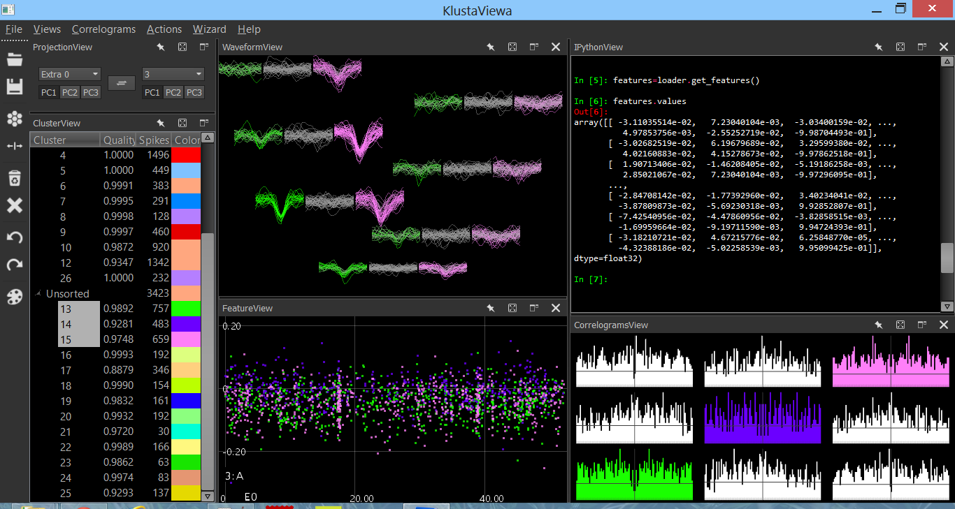
Qt GUI and MVC

