Slide 1
Who am I
Cyrille Rossant
2012: PhD in computational neuroscience at Ecole Normale Supérieure (Paris)
Now: Postdoc in computational neuroscience at UCL/Collège de France (London & Paris)
Models of spike-based neuronal computation
Analysis of experimental data (electrophysiological recordings)
Algorithms and software for data processing

Slide 2
Interest in visualization (early 2012)
PhD work: analyze intracellular recordings
1 hour recording, 10 kHz: 36,000,000 points (~70 MB)
Let’s load th data with NumPy
  y=fromfile(…)
Let’s plot that with matplotlib!
  plt.plot(x, y);
  plt.show() # uh-oh…

Slide 3
DEMO TIME
1-mpl.py

Slide 4
Can’t we do better than that??
Looked for alternative solutions
  ➔ no library scales to plots with millions of points…
Why not use the GPU?
  (Py)OpenGL: hardware accelerated, interactive, real-time visualization: looks perfect:
Quick hacks ➔ glplot (never released publicly)

Slide 5
DEMO TIME
2-glplot.py

Slide 6
glplot
How does it work?
  Put the data in a Vertex Buffer Object
  glDrawArrays(GL_LINE_STRIP…)
  Pan & zoom: glScalef & glTranslatef
    (Warning: this is not what we do now in Vispy…)
  No CPU-GPU transfers during pan & zoom
  The GPU loves this ➔ nearly optimal performance
I used glplot for the rest of my PhD…

Slide 7
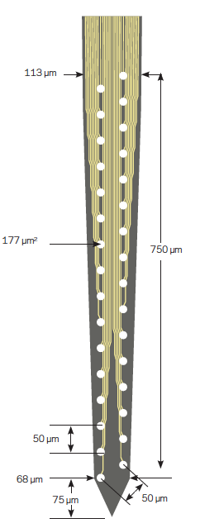
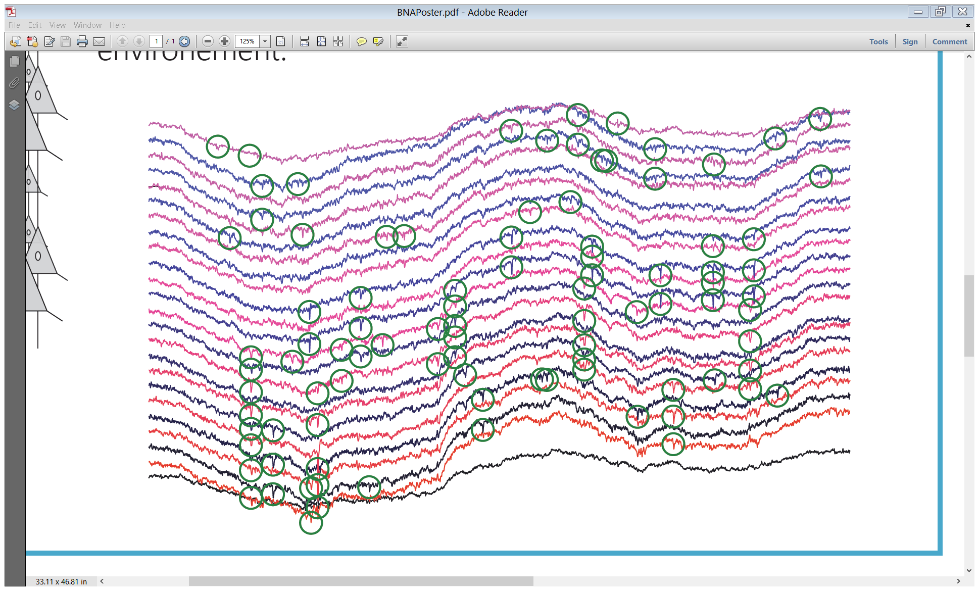
Late 2012: postdoc at UCL
New project: analyze extracellular multichannel recordings
Like intracellular recordings (20-40 kHz)…
… but x 100 (or x 1000) :

Slide 8
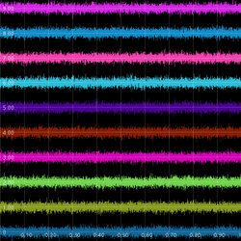
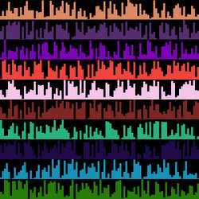
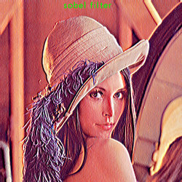
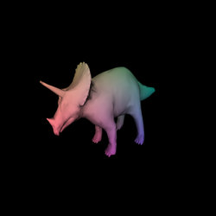
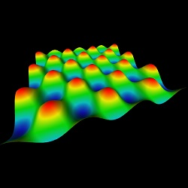
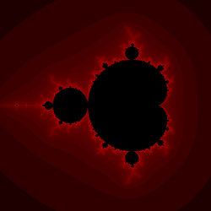
Galry (late 2012)
New, experimental library that I could use to build a scalable visualization GUI

Slide 9
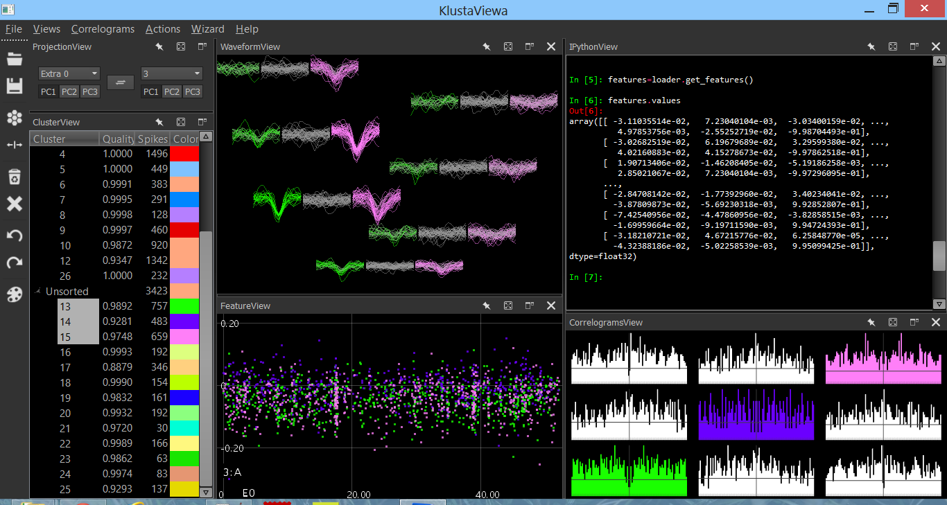
KlustaViewa (early 2013)
Open-source, cross-platform, PyQt GUI for visualization and processing of electro-physiological HDF5 data (PyTables)

Slide 10
Vispy
Collaborative project
Aims at superseding our respective libraries (including Galry)
Once mature enough, I will rewrite KlustaViewa on top of Galry
I am especially interested in
  HDF5 dynamic (out-of-memory) visualization
  Visuals layer (object-oriented traitlets-like interface)
  WebGL backend (online & offline)

