Slide 1
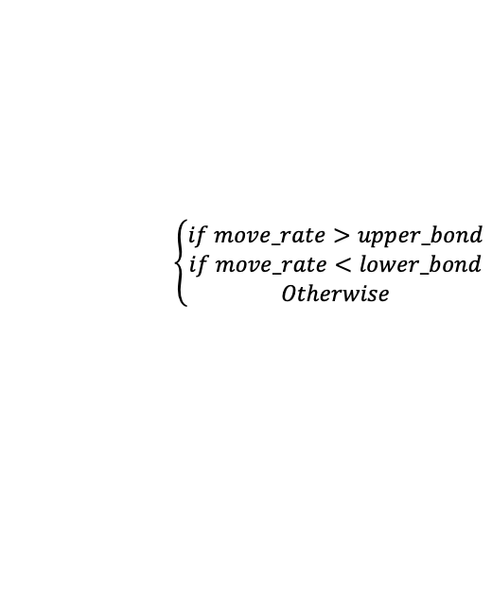

Hyperparameters:
no_of_days_to_lookforward = [5,10,20,50,63] # Label set development.
lower_bound= -0.015 # Label set development.
upper_bound= 0.015 # Label set development.
no_of_days_to_lookback = [5,7,10] # Input development for each step.
max_text_per_iter = 100 # Training.
epoch = 20 # Training
batch_size = 32 # Training
PLM_NAME =‘roberta-large’
$$move_rate=\frac{{close_price}_{t+n}}{{close_price}_{t}}$$
upper_bound = 0.015
lower_bound = -0.015
$$\left\{\begin{aligned}if move_rate>upper_bond \\ if move_rate<lower_bond \\ Otherwise\end{aligned}\right.$$
Positive
Negative
Neutral

Slide 2
positive | negative | neutral, given by no_of_days_to_lookforward
self.Linear2_{x1}
ReLU(self.Linear1_{x1})
The last hidden state
The last hidden state
self.LSTM_num _{x1}
self.LSTM_text _{x1}
Numerical features from t- no_of_days_to_lookback to t
[[ 0.33 -0.48 -0.58 0.43 -0.2 -0.44 -0.58 -0.94]
[ 0.02 -0.16 0.94 -0.18 -0.36 -0.21 0.37 -0.99]
[-0.05 0.33 0.25 0.62 0.93 0.41 -0.58 -0.94]
[ 0.83 -0.69 0.42 -0.97 0.15 -0.81 -0.35 -0.41]]
[[ 0.85 -0.22 … -0.11 0.54]
[-0.42 0.37 … 0.19 -0.15]
[-0.59 -0.64 … -0.91 -0.36]
[-0.71 -0.71 … 0.58 0.69]
[-0.07 0.71 … -0.76 0.84]
[ 0.83 -0.81 … 0.49 -0.43]
[ 0.47 -0.49 … -0.77 0.94]
[-0.35 -0.19 … 0.83 0.28]
[-0.03 0.32 … 0.56 -0.29]
[ 0.03 0.42 … 0.03 0.88]]
PLM_ NAME generated textual features from t- no_of_days_to_lookback to t
Numerical Features
Shape: [batch_size, no_of_days_to_lookback, num_dim]
Textual Features
Shape: [batch_size, min(total news over no_of_days_to_lookback, max_text_per_iter), num_dim]
PS: use the news from the nearest days, if total no. of news over no_of_days_to_lookback > max_text_per_iter
Fine-tuning-based RoBERTa-Large
News 1 on Day t
News 2 on Day t
…
News 1 on Day t-1
News 2 on Day t-1
…
News 1 on Day t- no_of_days_to_lookback
…
News m on Day t- no_of_days_to_lookback

