Slide 1

Internal Project Review
Hardware
Hybrid Charging System for Electric Vehicle
Department of Electrical & Electronics Engineering
Shri Vishnu Engineering College For Women
(Autonomous)
Project Guide:
Dr. Y. T. R. Palleswari
Assistant Professor
Department of EEE
Project Associates:
YALLABANDI DIVYANJALI (23B01A0256)
VISSA J S MEGHANA (23B01A0255)

Slide 2
Presentation Layout
Abstract
Introduction
Problem Statement
Objective of the Project
Block Diagram
Components
Working of the hybrid system
Results and Conclusion
References

Slide 3
Abstract
Electric Vehicles (EVs) have emerged as a key solution for reducing carbon emissions and promoting sustainable transportation. This project focuses on developing a hybrid EV charging system that leverages solar energy as its primary source. During periods of sufficient sunlight, the vehicle's battery is charged directly from solar panels. In scenarios where solar energy is insufficient or unavailable, the system seamlessly switches to grid power, enabling battery charging through a single-phase electrical supply. This dual-mode charging mechanism, controlled by a microcontroller, ensures reliable and continuous operation while minimizing dependency on fossil fuels. By integrating renewable energy with conventional grid power, the project contributes to enhanced environmental sustainability and energy efficiency.

Slide 4
Introduction
The integration of renewable energy sources into transportation systems has gained significant attention due to concerns about climate change and the environmental impact of traditional fossil fuel-powered vehicles.
The widespread use of conventional fuels, such as gasoline and diesel, for transportation contributes significantly to air pollution and greenhouse gas emissions.
One of the best solutions to the problems caused by conventional fuels is the adoption of electric vehicles (EVs) powered by renewable energy sources like solar power.
This project develops a hybrid charging system with automatic switching, using solar power as the primary source and grid power as a backup, controlled by a microcontroller.

Slide 5
Problem Statement
The ever-growing environmental concerns caused due to fossil fuel depletion and greenhouse gas (GHG) emissions has paved way to consider Solar Electric Vehicles. Reducing dependency on fossil fuels can help mitigate environmental degradation.
But the intermittent nature of solar energy causes problems with the available power for the solar electric vehicles. Thus, to avoid environmental pollution solar powered vehicles are required and for their continuous operation, conventional power is used from the single-phase supply.

Slide 6
Objective of the Project
The main objective of the project is to propel the vehicle sustainably by harnessing solar renewable energy, independent on conventional fuels and promoting eco-friendly transportation.
To ensure continuous vehicle operation by seamlessly integrating a grid system as a backup power source when solar energy is unavailable, enhancing reliability and adaptability.
Provide seamless switching between modes to ensure consistent and reliable vehicle performance under varying operational and environmental conditions.

Slide 7
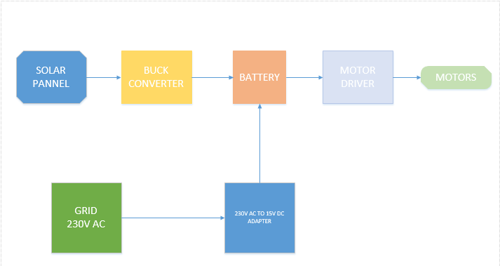
Block Diagram

Slide 8
Components
Components | Specifications | Cost
Solar Pannel | 12 Volts, 5 Watts | 550
Battery | 12 Volts, 5Ah | 1500
Adapter | Input: 230V AC , Output: 15V DC, 2 Amps | 320
DC Motors | 12 Volts | 300
Buck Converter (Lm2596) | Input: 12V DC, Output: 5V DC | 240
Arduino UNO | 5 Volts | 550
Motor Driver (L298N) | Logic Voltage : 5V, Driver Voltage : (5 – 35 V), 2 Amps | 180
DC Voltage Sensors | (0 - 25) Volts | 300
16/2 LCD Display & I2C Module | 5 Volts | 300
Bluetooth Module | 3.3 Volts | 219
4 Channel Relay | 5 Volts, | 250
Diodes |  | 20
Switch (SPDT) | - | 20
Wheels | - | 60
Total | - | 4809/-

Slide 9
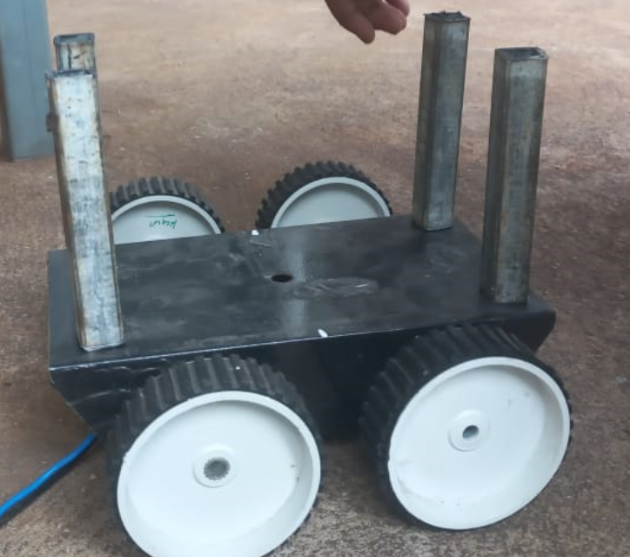
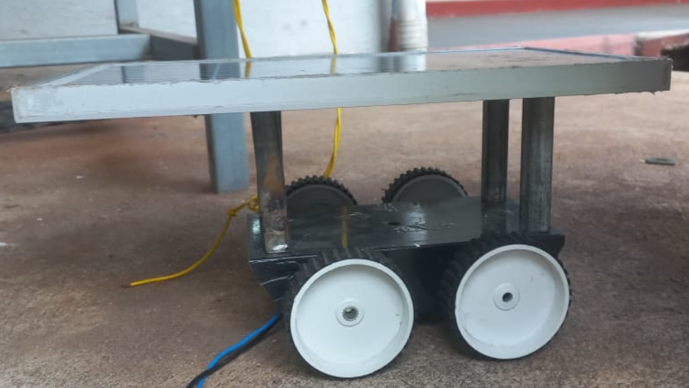
Working of Hybrid System
Developed a rear-wheel vehicle
Completed the prototype of the vehicle, which is constructed by using 4 pillar pipes connected to the base and solar panel of the vehicle

Slide 10
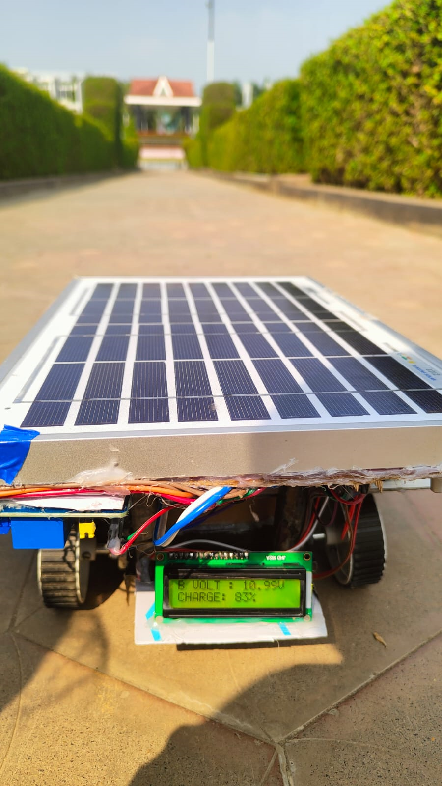
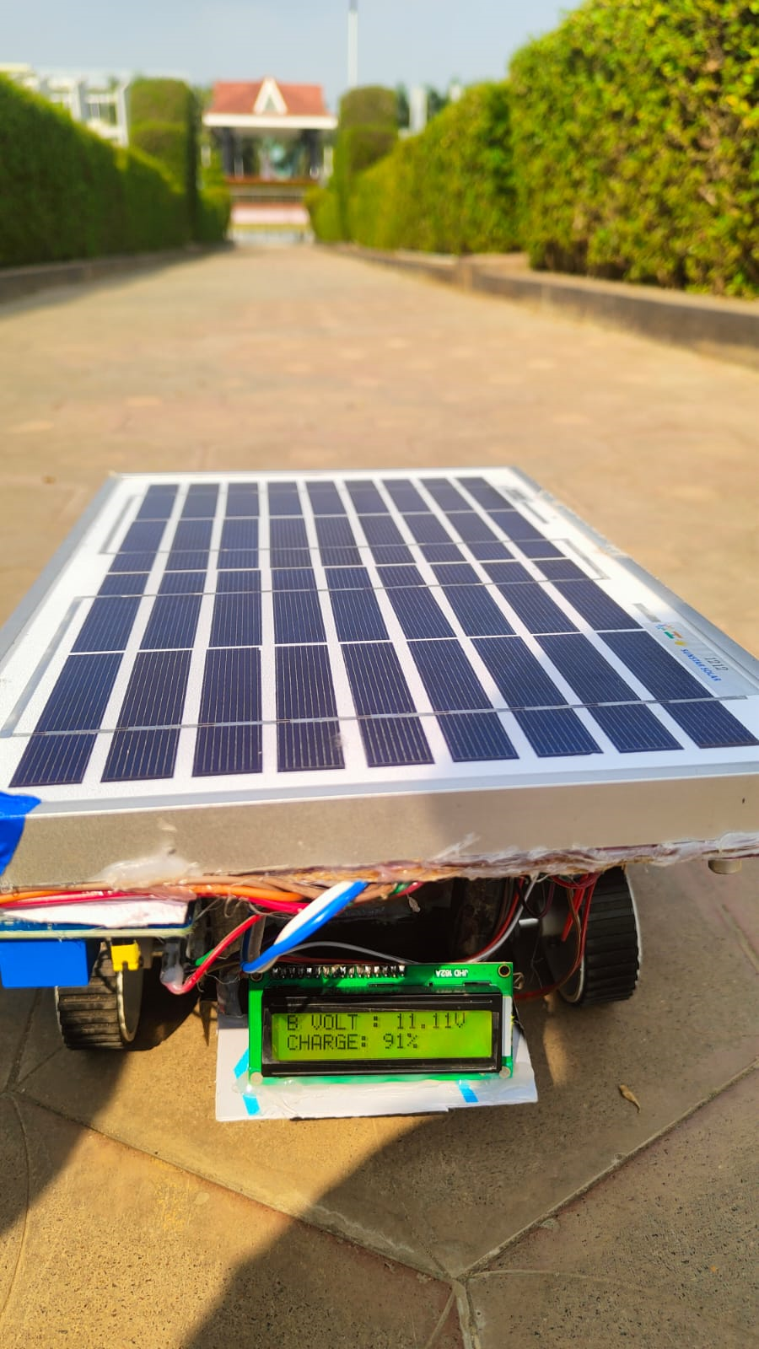
Battery is charged by using solar power
When solar energy is available, it charges the battery through a solar panel. The stored energy in the battery is then used to propel the vehicle.

Slide 11
Results
Case 1: Vehicle is propelled by using Solar Source
In this case, the vehicle is powered by solar energy, which drives the electric motor to propel the vehicle
MODE: HYBRID MODE
When the battery’s SOC level is decreased, a microcontroller-based system automatically switches to solar power, ensuring seamless operation. This mechanism will enable uninterrupted EV charging while prioritizing renewable energy usage.
LINK:Case-1(solar mode)
LINK:Case-2(Battery mode)
LINK:Case-3(Charge mode)

Slide 12
Case2: Vehicle is propelled by using Battery Source
In this case, the vehicle is powered by the battery, which drives the electric motor to propel the vehicle
MODE : BATTERY MODE
When solar power is insufficient, the vehicle continues to run using the stored energy in the battery. The battery supplies power to the motor, ensuring uninterrupted operation
12

Slide 13
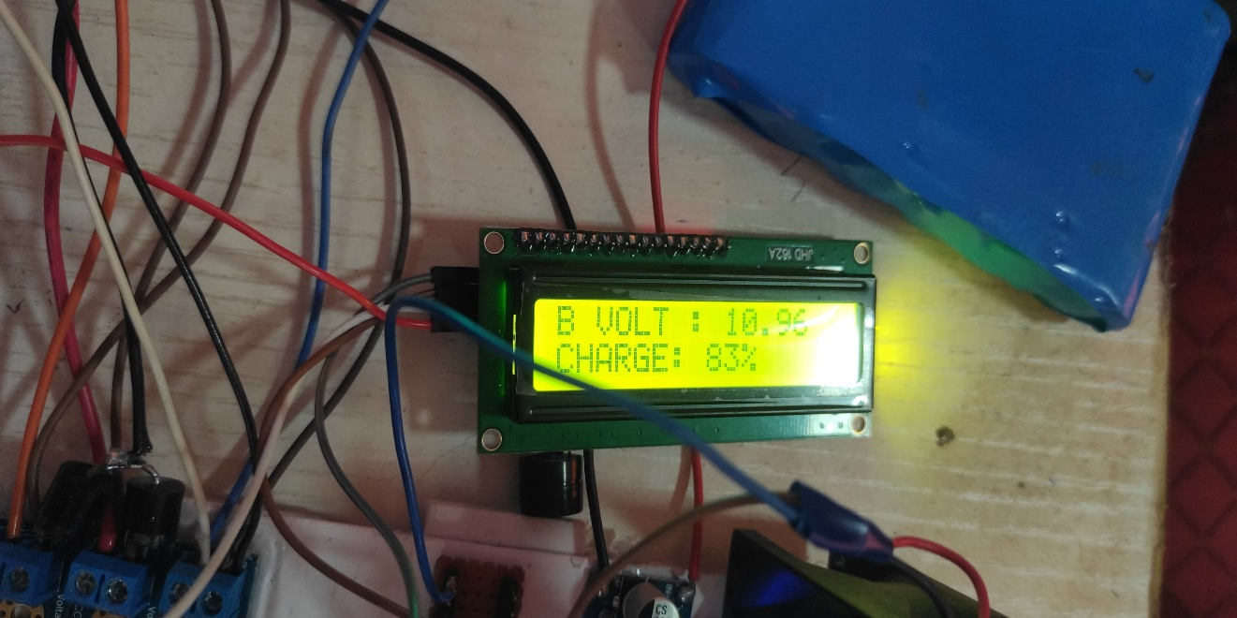
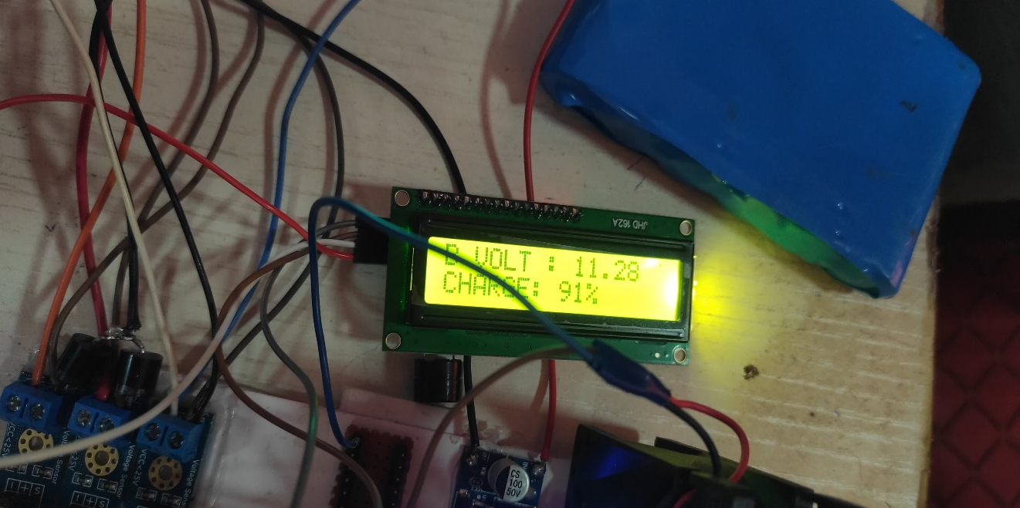
Case-3: Battery is charge by using the conventional power source
During the case of no solar energy and charge level in battery, then the battery is charged by use conventional power source from grid of 230V AC supply to the conversion of 15V Dc supply through adapter
MODE : CHARGING MODE
BATTERY VOLTAGE : 10.96V
CHARGE : 83%
Battery is charging by using conventional grid power through adapter
BATTERY VOLTAGE : 11.28V
CHARGE : 91%
13

Slide 14
Automatic switching
When solar power is available, the EV runs directly using solar energy. If solar is unavailable, the system automatically switches to the battery, which was charged using solar power, ensuring uninterrupted operation of the EV. When both solar and battery power are unavailable, the system switches to a single-phase supply to charge the battery, ensuring continuous operation. This smart switching mechanism eliminates manual intervention, optimizes energy usage, and improves efficiency.
LINK: Automatic Switching

Slide 15
Conclusion
Our Project, “Hybrid Charging System for Electric Vehicles”, efficiently operates in three modes—Solar, Battery, and Grid—ensuring continuous power supply with an automatic microcontroller-based switching mechanism. Solar charging offers a sustainable solution by utilizing photovoltaic cells to convert renewable energy into electricity. In hybrid mode, the vehicle runs on solar power; in battery mode, stored energy is used when solar power is insufficient; and in charging mode, the grid supplies power. This system enhances efficiency, reliability, and sustainability while reducing grid dependency and promoting renewable energy use.

Slide 16
References
 | Suvarna Rode, Rashmi Kale, Devoushka Yadav, Dhananjay Pawar , Jatin satyam, Nishant shelar, “DEVELOPMENT OF SOLAR POWERED ELECTRIC VEHICLE PROTOTYPE”, 7th INTERNATIONAL CONFERENCE ON PRODUCTION AND INDUSTRIAL ENGINEERING (CPIE-2023)
 | Mohammad Waseem, Ahmad Faizan Sherwani, Mohd Suhaib, Integration of solar energy in electrical, hybrid, autonomous vehicles: a technological review, Integration of solar energy in electrical, hybrid, autonomous vehicles: a technological review, Received: 18 July 2019 / Accepted: 3 October 2019 / Published online: 22 October 2019
 | Hybrid Optimization for Economic Deployment of ESS in PV-Integrated EV Charging Stations Chaudhari K, Ukil A, Kollimalla S IEEE Transactions on Industrial Informatics (2018) 14(1) 106-116 DESIGN AND IMPLEMENTATION OF SOLAR POWERED ELECTRIC VEHICLE FOR ON-CAMPUS UNIVERSITY APPLICATIONS: Ahmad F. Tazay1. DESIGN OF SOLAR POWERED ELECTRIC VEHICLE: AruliousJora A, Earlina D, Harish D ,SakthiPriya P, InbaRexy A, Nancy Mary J S

Slide 17
THANK YOU

