Slide 1
OBE Implementation
Module-1: Course reference
Submitted By:
Raja Vardhan - AP23110011177
Nikitha - AP23110011195
Thanvitha - AP23110011199
Neelima - AP23110011190
Olive - AP23110011192
Narendra - AP23110011169
Department : CSE
Semester : III
Regulation : 2023-2027

Slide 2
Introduction to Project:
The Course_Reference program is designed to streamline the management of course-related resources. The application supports basic CRUD (Create, Retrieve, Update, Delete) operations on these records, with functionalities for sorting and searching. The data is stored in a text file for persistence,This project demonstrates effective data management techniques, basic algorithm comparisons, and efficiency evaluation for sorting and searching operations.

Slide 3
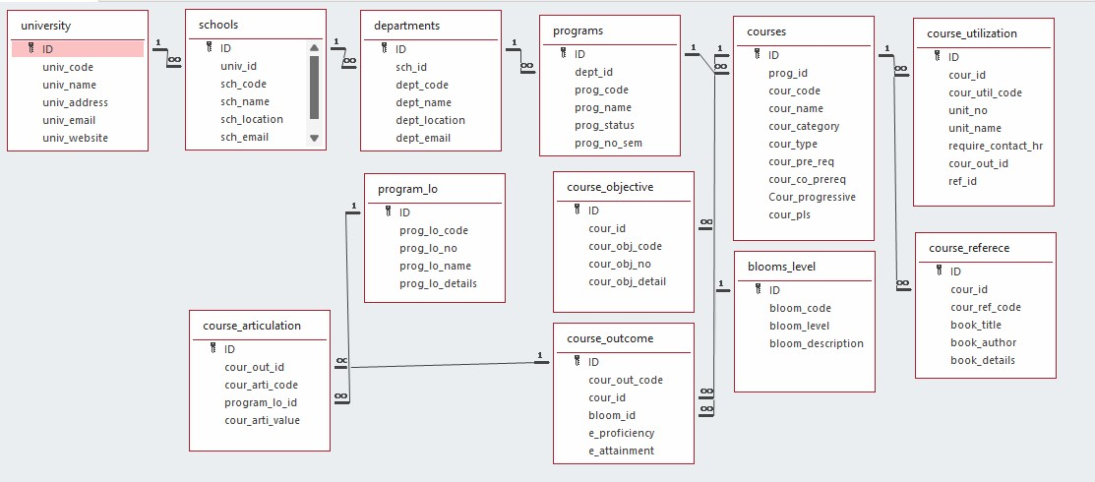

Architecture Diagram[*highlight your module as shown]

Slide 4
Module Description : Course Reference Setting
This system provides several key features: users can create new course references, update or delete existing ones, and retrieve a complete list of course references. The program also includes a Linear Search feature to find a course reference by its reference code and a Selection Sort feature to sort the references alphabetically by the reference code. Data is read from and written to a file, ensuring that the course references are preserved between sessions.

Slide 5
Course Reference Setting :Field/table details
Field Name | Data type
id | Integer
cour_id | Integer
cour_ref_code | String
book_title | String
book_author | String
book_details | String

Slide 6
Course Reference Setting :Programming Details
File name:power_rangers_course_reference.cpp
Function/method name
Create: power_rangers_course_reference_create
Update:power_rangers_course__reference_update
Retrieve: power_rangers_course_reference _retrive
Delete: power_rangers_course_reference _delete
Sorting:power_rangers_course_reference_Insertion_Sort
Searching:power_rangers_course_reference_Linear_Search
Storing: power_rangers_course_reference_sorting

Slide 7
Course Reference Setting :Programming Details
Comparison(both searching and Sorting):
For Searching-
power_rangers_course_reference _compare_search_binary_search
For Sorting-
power_rangers_course_reference _compare_sorting_selection_sort
Time Complexity(both searching and Sorting):
For Searching- power_rangers_course_reference _complexity_search
For Sorting- power_rangers_course_reference _compexity_sorting

Slide 8
Course Reference Setting :Programming Details
Algorithm Details(pseudocode or steps)(both searching and Sorting):
For Searching-
power_rangers_course_reference _linear_search_details
For Sorting-
power_rangers_course_reference_insertion_sort _details
File name(for storing the details)
File name to be used is:-course_reference_setting.txt

Slide 9
Course Reference Setting : Sorting Algorithm used
Sorting Algorithm Name:Insertion sort
Algorithm:
Step 1 : Start with the second element in the list (index 1) and assume the first
element (index 0) is already sorted.
Step 2 : For each element from index 1 to the end of the list:
->Let the current element be the key.
->Compare the key with the elements in the sorted portion
->Move each element that is greater than the key one position to the
right to create space.
->Insert the key into the created space, so the sorted portion of the list
is now one element larger.
Step 3 : Repeat until all elements are sorted.

Slide 10
Course Reference Setting : Comparison of Sorting Algorithm
Algorithm used for comparison:selection sort
Algorithm
Step 1 : Start with the first element in the list.
Step 2 : For each position i from 0 to N-2 (where N is the number of course
references):
->Assume the element at position i is the minimum.
->For each element from i+1 to N-1:
->Compare the current element with the assumed minimum.
->If a smaller element is found, update the minimum position.
->After finding the smallest element in the unsorted portion, swap it
with the element at position i.
Step 3 : Repeat until the entire list is sorted.

Slide 11
Course Reference Setting : Time Complexity of Sorting Algorithm
Sl.No | Algorithm Name | Complexity of Algorithm
1. | Insertion Sort | O(n^2)
2. | Selection Sort | O(n^2)

Slide 12
Course Reference Setting : Searching Algorithm used
Algorithm Name:Linear search
Algorithm:
Step 1 : Start with the first element in the list.
Step 2 : For each element in the list.
->Check if the cour_ref_code of the current element matches the
target reference code.
->If a match is found:
->Return the current element (or display its details, depending
on your use case).
->End the search.
Step 3 : If the end of the list is reached without finding a match, indicate that the
item was not found.

Slide 13
Course Reference Setting : Comparison of Searching Algorithm
Algorithm used for comparison:Binary search
Algorithm:
Step 1 : Ensure the list of course references is sorted by cour_ref_code.
Step 2 : Set two pointers: low at the start (index 0) and high at the end (index N-1, where N
is the number of course references).
Step 3 : While low is less than or equal to high:
->Calculate the midpoint index as mid = (low + high) / 2.
->If the cour_ref_code at mid matches the target reference code:
->Return the element at mid (or display its details).
->If the target reference code is less than cour_ref_code at mid:
->Update high to mid - 1 (search in the left half).
->If the target reference code is greater than cour_ref_code at mid:
->Update low to mid + 1 (search in the right half).
Step 4 : If the target reference code is not found, indicate that it is not present in the list.

Slide 14
Course Reference Setting : Time Complexity of Searching Algorithm
Sl.No | Algorithm Name | Complexity of Algorithm
1. | Linear Search | O(n)
2. | Binary Search | O(logn)

Slide 15
Sample Source Code:
#include<iostream>
#include<fstream>
#include<vector>
#include<iomanip>
using namespace std;
class Course_Reference {
public:
int id;
int cour_id;
string cour_ref_code;
string book_title;
string book_author;
string book_details;
};
int course_reference_count = 0;
vector<Course_Reference> course_references;
const char* FILE_NAME = "course_reference_setting.txt";
void power_rangers_course_reference_create();
void power_rangers_course_reference_update();
void power_rangers_course_reference_retrive();
void power_rangers_course_reference_delete();
void power_rangers_course_reference_storing();
void power_rangers_course_reference_sort_by_ref_code();
void power_rangers_course_reference_search_by_ref_code();

Slide 16
void power_rangers_course_reference_complexity_search(){
cout<<"Time Complexity analysis:"<<endl;
cout<<"Linear Search: O(n)"<<endl;
cout<<"Binary Search: O(logn)"<<endl;
}
void power_rangers_course_reference_complexity_sorting(){
cout<<"Time Complexity analysis:"<<endl;
cout<<"Insertion Sort: O(n)"<<endl;
cout<<"Selection Sort: O(n)"<<endl;
}
void load_from_file() {
ifstream file(FILE_NAME);
if(!file.is_open()) {
cerr<<"Failed to open file: "<<FILE_NAME<<endl;
return;
}
Course_Reference course_ref;
while(file >> course_ref.id >> course_ref.cour_id) {
file.ignore();
getline(file, course_ref.cour_ref_code);
getline(file, course_ref.book_title);
getline(file, course_ref.book_author);
getline(file, course_ref.book_details);
course_references.push_back(course_ref);
course_reference_count++;
}
file.close();
}

Slide 17
void power_rangers_course_reference_storing() {
ofstream file(FILE_NAME, ios::out | ios::trunc);
if(!file.is_open()) {
cerr<<"Failed to open file: "<<FILE_NAME<<endl;
return;
}
for(int i = 0;i < course_references.size();i++) {
file << course_references[i].id << " "
<< course_references[i].cour_id << "\n"
<< course_references[i].cour_ref_code << "\n"
<< course_references[i].book_title << "\n"
<< course_references[i].book_author << "\n"
<< course_references[i].book_details << "\n";
}
file.close();
}
void power_rangers_course_reference_create() {
Course_Reference c;
cout<<"Enter ID: ";
cin>>c.id;
cout<<"Enter Course ID: ";
cin>>c.cour_id;
cin.ignore();
cout<<"Enter Course Reference Code: ";
getline(cin,c.cour_ref_code);
cout<<"Enter Book Title: ";
getline(cin,c.book_title);
cout<<"Enter Book Author: ";
getline(cin,c.book_author);
cout<<"Enter Book Details: ";
getline(cin,c.book_details);

Slide 18
course_reference_count++;
course_references.push_back(c);
power_rangers_course_reference_storing();
cout<<"Course Reference created successfully!"<<endl;
}
void power_rangers_course_reference_update() {
int id;
cout<<"Enter ID to update: ";
cin>>id;
bool found = false;
for(int i = 0;i < course_references.size();i++){
if(course_references[i].id == id){
cout<<"Enter new ID: ";
cin>>course_references[i].id;
cout<<"Enter new Course ID: ";
cin>>course_references[i].cour_id;
cin.ignore();
cout<<"Enter new Course Reference Code: ";
getline(cin,course_references[i].cour_ref_code);
cout<<"Enter new Book Title: ";
getline(cin,course_references[i].book_title);
cout<<"Enter new Book Author: ";
getline(cin,course_references[i].book_author);
cout<<"Enter new Book Details: ";
getline(cin,course_references[i].book_details);
power_rangers_course_reference_storing();
cout<<"Course Reference updated successfully!"<<endl;
found = true;
break;
}
}
if(!found) cout<<"Course Reference with ID "<<id<<" not found!"<<endl;
}

Slide 19
void power_rangers_course_reference_retrieve() {
cout << "\n\t\t\t\t\tList of Course References" << endl;
cout << "----------------------------------------------------------------------------------------------------" << endl;
if (course_references.size() <= 0) {
cout << "No Course References found!" << endl;
return;
}
cout << left << setw(10) << "ID"
<< setw(15) << "Course ID"
<< setw(20) << "Reference Code"
<< setw(25) << "Book Title"
<< setw(20) << "Author"
<< "Details" << endl;
cout << "----------------------------------------------------------------------------------------------------" << endl;
for (int i = 0; i < course_references.size(); i++) {
cout << left << setw(10) << course_references[i].id
<< setw(15) << course_references[i].cour_id
<< setw(20) << course_references[i].cour_ref_code
<< setw(25) << course_references[i].book_title
<< setw(20) << course_references[i].book_author
<< course_references[i].book_details << endl;
}
}

Slide 20
power_rangers_course_reference_delete() {
int id;
cout<<"Enter ID to delete: ";
cin>>id;
bool found = false;
for(int i = 0;i < course_references.size();i++) {
if(course_references[i].id == id) {
course_references.erase(course_references.begin()+i);
course_reference_count--;
fovoidund = true;
cout<<"Course Reference deleted successfully!"<<endl;
break;
}
}
if(found) power_rangers_course_reference_storing();
else cout<<"Course Reference with ID "<<id<<" not found!"<<endl;
}
void power_rangers_course_reference_insertion_sort() {
int sort_by;
cout << "Sort Course References by:\n";
cout << "1. Course ID\n";
cout << "2. Course Reference Code\n";
cout << "3. Book Title\n";
cout << "Enter your choice (1/2/3): ";
cin >> sort_by;
cout<<"Sorted using Insertion Sort: "<<endl;
for (int i = 1; i < course_references.size(); i++) {
Course_Reference temp = course_references[i];
int j = i - 1;

Slide 21
while (j >= 0 &&
((sort_by == 1 && course_references[j].cour_id > temp.cour_id) ||
(sort_by == 2 && course_references[j].cour_ref_code > temp.cour_ref_code) ||
(sort_by == 3 && course_references[j].book_title > temp.book_title))) {
course_references[j + 1] = course_references[j];
j--;
}
course_references[j + 1] = temp;
}
if (sort_by == 1) {
cout << "Course References sorted by ID." << endl;
} else if (sort_by == 2) {
cout << "Course References sorted by Course ID." << endl;
} else if (sort_by == 3) {
cout << "Course References sorted by Book Title." << endl;
} else {
cout << "Invalid Choice." << endl;
return;
}
power_rangers_course_reference_storing();
power_rangers_course_reference_retrieve();
}
void power_rangers_course_reference_compare_sorting_selection_sort() {
int sort_by;
cout << "Sort Course References by:\n";
cout << "1. Course ID\n";
cout << "2. Course Reference Code\n";
cout << "3. Book Title\n";
cout << "Enter your choice (1/2/3): ";
cin >> sort_by;
cout<<"Sorted using Selection Sort: "<<endl;

Slide 22
for (int i = 0; i < course_references.size() - 1; i++) {
int minIndex = i;
for (int j = i + 1; j < course_references.size(); j++) {
if ((sort_by == 1 && course_references[j].cour_id < course_references[minIndex].cour_id) ||
(sort_by == 2 && course_references[j].cour_ref_code < course_references[minIndex].cour_ref_code) ||
(sort_by == 3 && course_references[j].book_title < course_references[minIndex].book_title)) {
minIndex = j;
}
}
if (minIndex != i) {
swap(course_references[i], course_references[minIndex]);
}
}
if (sort_by == 1) {
cout << "Course References sorted by ID." << endl;
} else if (sort_by == 2) {
cout << "Course References sorted by Course ID." << endl;
} else if (sort_by == 3) {
cout << "Course References sorted by Book Title." << endl;
} else {
cout << "Invalid Choice." << endl;
return;
}
power_rangers_course_reference_storing();
power_rangers_course_reference_retrieve();
}

Slide 23
void power_rangers_course_reference_insertion_sort_details(){
cout<<"for i = 1 to n-1"<<endl;
cout<<"key = array[i]"<<endl;
cout<<"j = i - 1"<<endl;
cout<<"while j >= 0 and array[j] > key"<<endl;
cout<<"array[j + 1] = array[j]"<<endl;
cout<<"j = j - 1"<<endl;
cout<<"array[j + 1] = key"<<endl;
}
void power_rangers_course_reference_linear_search_details(){
cout<<"function linearSearch(array, target):"<<endl;
cout<<"for i = 0 to array.length - 1"<<endl;
cout<<"if array[i] == target"<<endl;
cout<<"return i"<<endl;
cout<<"return -1 " ;
}
void power_rangers_course_reference_linear_search() {
int choice;
cout << "Choose attribute to search by:\n";
cout << "1) Course ID\n";
cout << "2) Course Reference Code\n";
cout << "3) Book Title\n";
cout << "Enter your choice: ";
cin >> choice;
cin.ignore();
bool found = false;

Slide 24
switch (choice) {
case 1: {
int search_cour_id;
cout << "Enter Course ID to search: ";
cin >> search_cour_id;
for (int i = 0; i < course_references.size(); i++) {
if (course_references[i].cour_id == search_cour_id) {
cout << "ID : " << course_references[i].id << endl;
cout << "Course ID : " << course_references[i].cour_id << endl;
cout << "Course Reference Code : " << course_references[i].cour_ref_code << endl;
cout << "Book Title : " << course_references[i].book_title << endl;
cout << "Book Author : " << course_references[i].book_author << endl;
cout << "Book Details : " << course_references[i].book_details << endl;
found = true;
break;
}
}
if (!found) cout << "Course Reference with Course ID " << search_cour_id << " not found!" << endl;
break;
}
case 2: {
string search_ref_code;
cout << "Enter Course Reference Code to search: ";
getline(cin, search_ref_code);
for (int i = 0; i < course_references.size(); i++) {
if (course_references[i].cour_ref_code == search_ref_code) {
cout << "ID : " << course_references[i].id << endl;
cout << "Course ID : " << course_references[i].cour_id << endl;
cout << "Course Reference Code : " << course_references[i].cour_ref_code << endl;
cout << "Book Title : " << course_references[i].book_title << endl;
cout << "Book Author : " << course_references[i].book_author << endl;
cout << "Book Details : " << course_references[i].book_details << endl;
found = true;
break;
}
}

Slide 25
if (!found) cout << "Course Reference with Code " << search_ref_code << " not found!" << endl;
break;
}
case 3: {
string search_title;
cout << "Enter Book Title to search: ";
getline(cin, search_title);
for (int i = 0; i < course_references.size(); i++) {
if (course_references[i].book_title == search_title) {
cout << "ID : " << course_references[i].id << endl;
cout << "Course ID : " << course_references[i].cour_id << endl;
cout << "Course Reference Code : " << course_references[i].cour_ref_code << endl;
cout << "Book Title : " << course_references[i].book_title << endl;
cout << "Book Author : " << course_references[i].book_author << endl;
cout << "Book Details : " << course_references[i].book_details << endl;
found = true;
break;
}
}
if (!found) cout << "Course Reference with Book Title \"" << search_title << "\" not found!" << endl;
break;
}
default:
cout << "Invalid choice!" << endl;
break;
}
}

Slide 26
void power_rangers_course_reference_compare_search_binary_search() {
int choice;
cout << "Choose attribute to search by:\n";
cout << "1) Course ID\n";
cout << "2) Course Reference Code\n";
cout << "3) Book Title\n";
cout << "Enter your choice: ";
cin >> choice;
cin.ignore();
bool found = false;
switch (choice) {
case 1: {
for (int i = 1; i < course_references.size(); i++) {
Course_Reference temp = course_references[i];
int j = i - 1;
while (j >= 0 && course_references[j].cour_id > temp.cour_id) {
course_references[j + 1] = course_references[j];
j--;
}
course_references[j + 1] = temp;
}
int search_id;
cout << "Enter Course ID to search: ";
cin >> search_id;
int left = 0, right = course_references.size() - 1;
while (left <= right) {
int mid = left + (right - left) / 2;

Slide 27
if (course_references[mid].cour_id == search_id) {
cout << "ID: " << course_references[mid].id << endl;
cout << "Course ID: " << course_references[mid].cour_id << endl;
cout << "Course Reference Code: " << course_references[mid].cour_ref_code << endl;
cout << "Book Title: " << course_references[mid].book_title << endl;
cout << "Book Author: " << course_references[mid].book_author << endl;
cout << "Book Details: " << course_references[mid].book_details << endl;
found = true;
break;
} else if (course_references[mid].cour_id < search_id) {
left = mid + 1;
} else {
right = mid - 1;
}
}
break;
}
case 2: {
for (int i = 1; i < course_references.size(); i++) {
Course_Reference temp = course_references[i];
int j = i - 1;
while (j >= 0 && course_references[j].cour_ref_code > temp.cour_ref_code) {
course_references[j + 1] = course_references[j];
j--;
}
course_references[j + 1] = temp;
}

Slide 28
cout << "Enter Course Reference Code to search: ";
getline(cin, search_code);
int left = 0, right = course_references.size() - 1;
while (left <= right) {
int mid = left + (right - left) / 2;
if (course_references[mid].cour_ref_code == search_code) {
cout << "ID: " << course_references[mid].id << endl;
cout << "Course ID: " << course_references[mid].cour_id << endl;
cout << "Course Reference Code: " << course_references[mid].cour_ref_code << endl;
cout << "Book Title: " << course_references[mid].book_title << endl;
cout << "Book Author: " << course_references[mid].book_author << endl;
cout << "Book Details: " << course_references[mid].book_details << endl;
found = true;
break;
} else if (course_references[mid].cour_ref_code < search_code) {
left = mid + 1;
} else {
right = mid - 1;
}
}
break;
}
case 3: {
for (int i = 1; i < course_references.size(); i++) {
Course_Reference temp = course_references[i];
int j = i - 1;
while (j >= 0 && course_references[j].book_title > temp.book_title) {
course_references[j + 1] = course_references[j];
j--;
}
course_references[j + 1] = temp;
}

Slide 29
string search_title;
cout << "Enter Book Title to search: ";
getline(cin, search_title);
int left = 0, right = course_references.size() - 1;
while (left <= right) {
int mid = left + (right - left) / 2;
if (course_references[mid].book_title == search_title) {
cout << "ID: " << course_references[mid].id << endl;
cout << "Course ID: " << course_references[mid].cour_id << endl;
cout << "Course Reference Code: " << course_references[mid].cour_ref_code << endl;
cout << "Book Title: " << course_references[mid].book_title << endl;
cout << "Book Author: " << course_references[mid].book_author << endl;
cout << "Book Details: " << course_references[mid].book_details << endl;
found = true;
break;
} else if (course_references[mid].book_title < search_title) {
left = mid + 1;
} else {
right = mid - 1;
}
}
break;
}
default:
cout << "Invalid choice!" << endl;
return;
}
if (!found) {
cout << "Course Reference not found with the specified attribute!" << endl;
}
}

Slide 30
int main() {
load_from_file();
int choice;
while(1) {
cout<<"\n1)Create Course Reference\n2)Update Course Reference\n3)Retrieve Course References\n4)Delete Course Reference\n5)Linear Search by Course Reference Code\n6)Insertion Sort by Course Reference Code\n7)Display Complexity for searching\n8)Selection Sort by Course Reference Code\n9)Binary Search by Course Reference Code\n10)Display Complexity for sorting\n11)pseudocode for linear search\n12)pseudocode for Insertion sort\n13)Exit \n";
cout<<"Enter your choice : ";
cin>>choice;
switch(choice) {
case 1:
power_rangers_course_reference_create();
break;
case 2:
power_rangers_course_reference_update();
break;
case 3:
power_rangers_course_reference_retrieve();
break;
case 4:
power_rangers_course_reference_delete();
break;
case 5:
power_rangers_course_reference_linear_search();
break;
case 6:
power_rangers_course_reference_insertion_sort();
break;
case 7:
power_rangers_course_reference_complexity_search();
break;
case 8:
power_rangers_course_reference_compare_sorting_selection_sort();
break;

Slide 31
case 9:
power_rangers_course_reference_compare_search_binary_search();
break;
case 10:
power_rangers_course_reference_complexity_sorting();
break;
case 11:
power_rangers_course_reference_linear_search_details();
break;
case 12:
power_rangers_course_reference_insertion_sort_details();
break;
case 13:
exit(0);
default:
cout<<"Invalid Choice\n";
}
}
return 0;
}

Slide 32
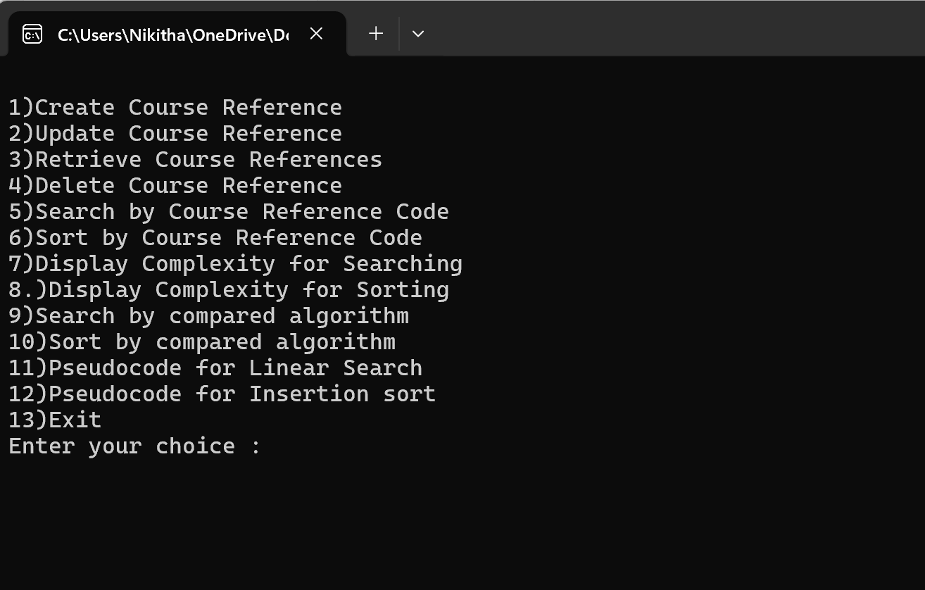
Sample Screen Shots
Menu:

Slide 33
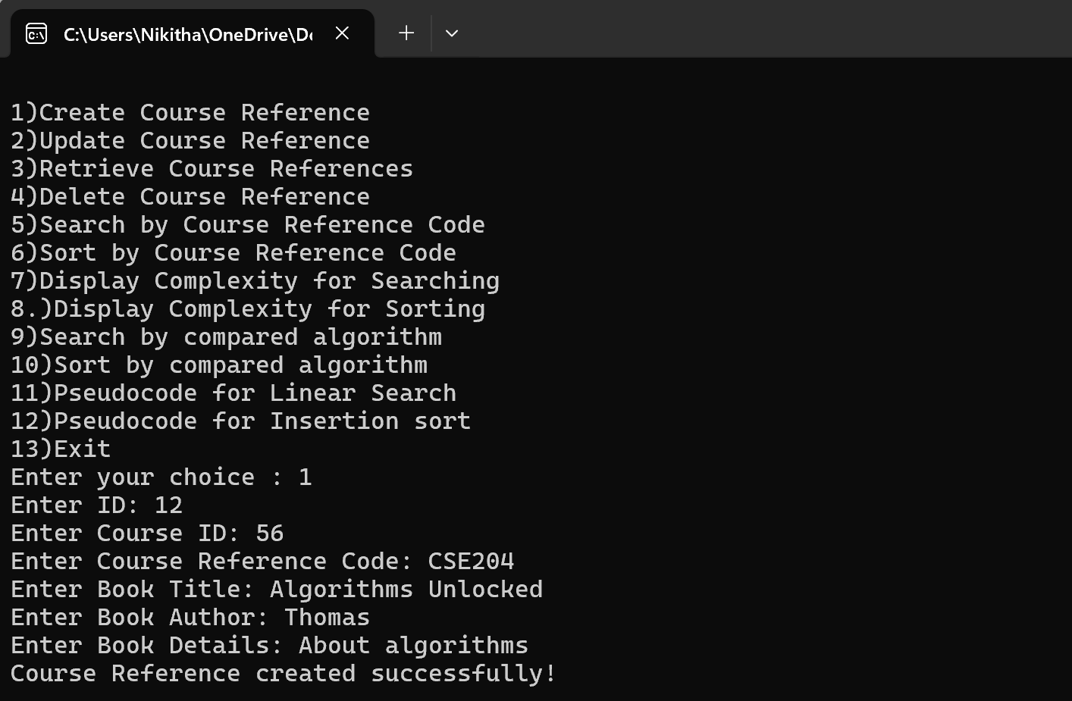
To create a Course Reference

Slide 34
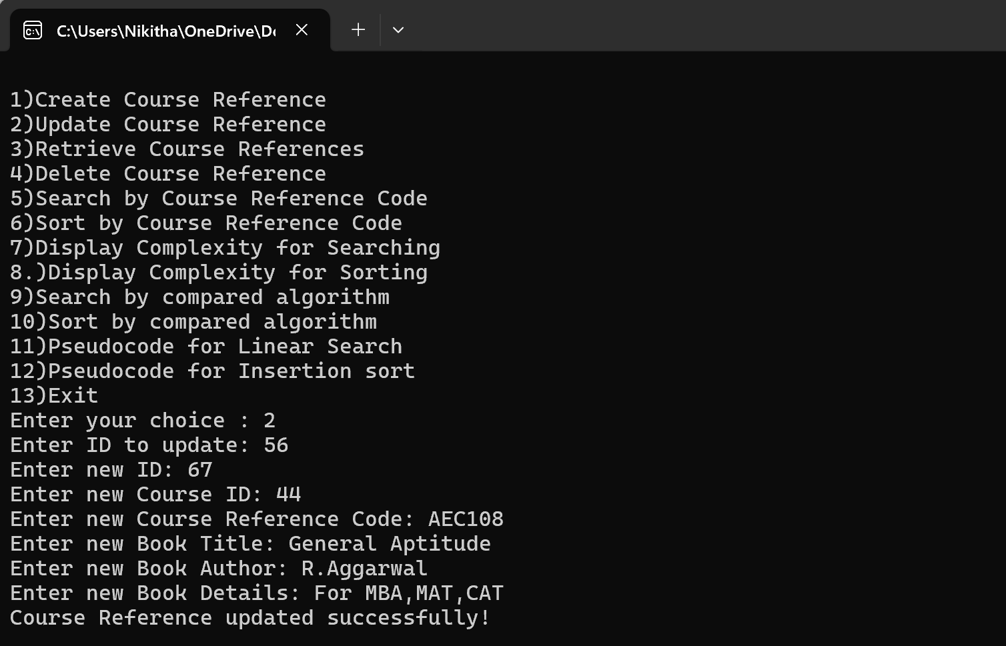
To update a Course Reference

Slide 35
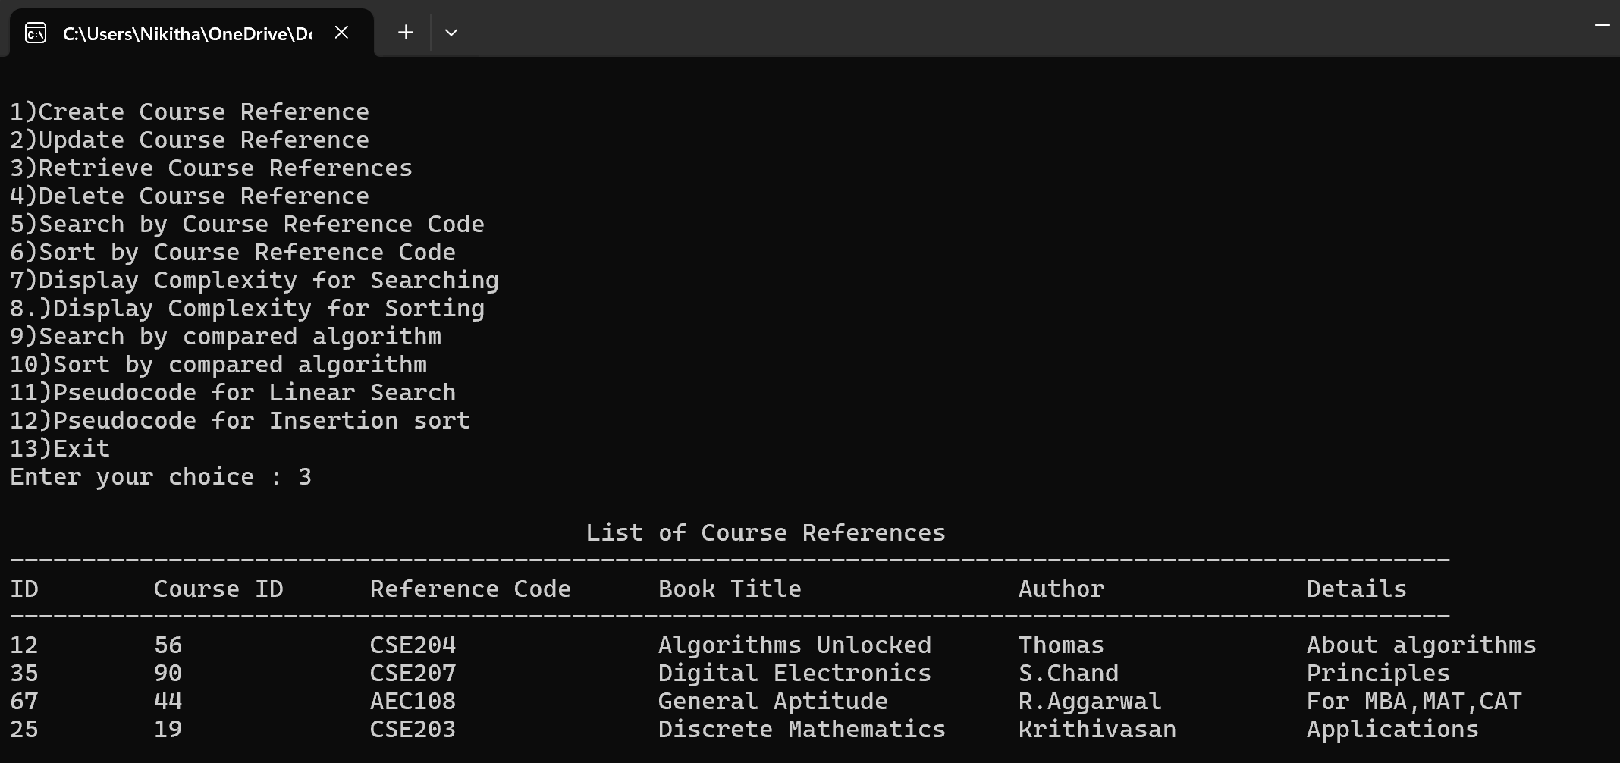
To retrieve all Course References

Slide 36
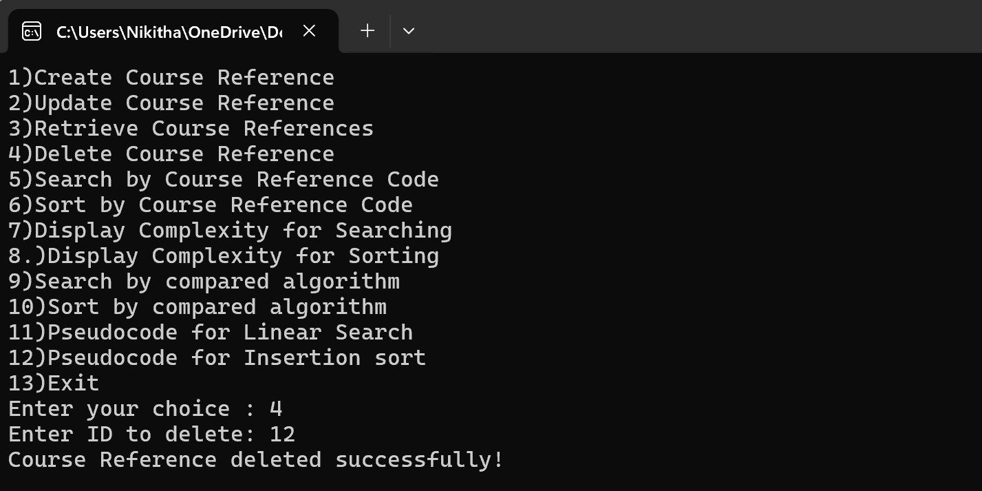
To delete a Course Reference

Slide 37
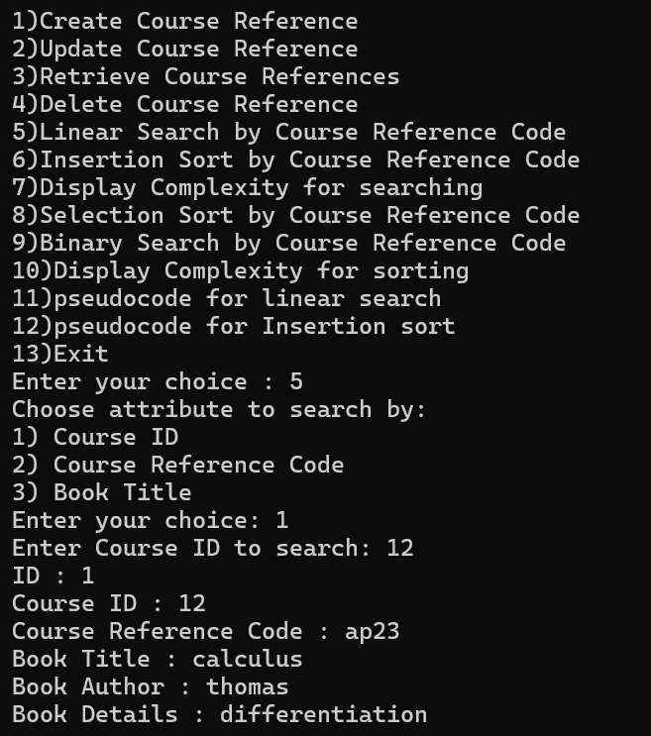
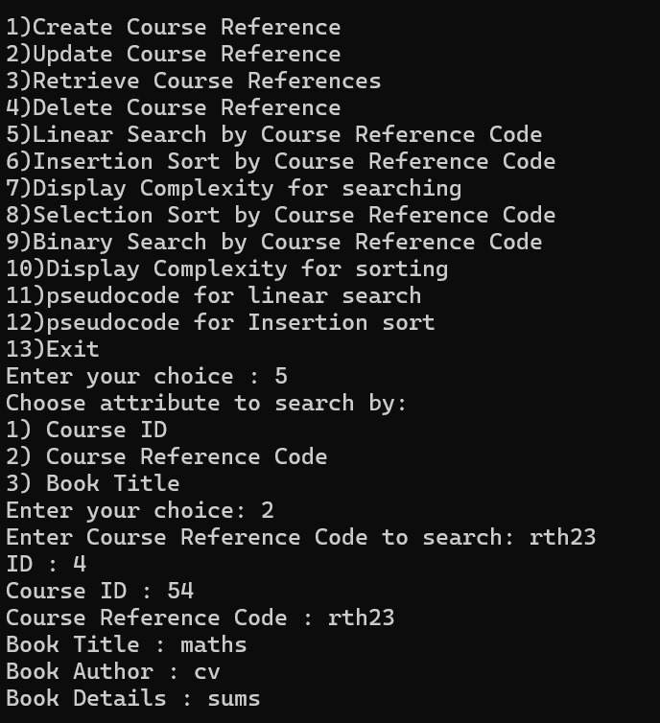
To search a Course Reference (used Linear Search)

Slide 38
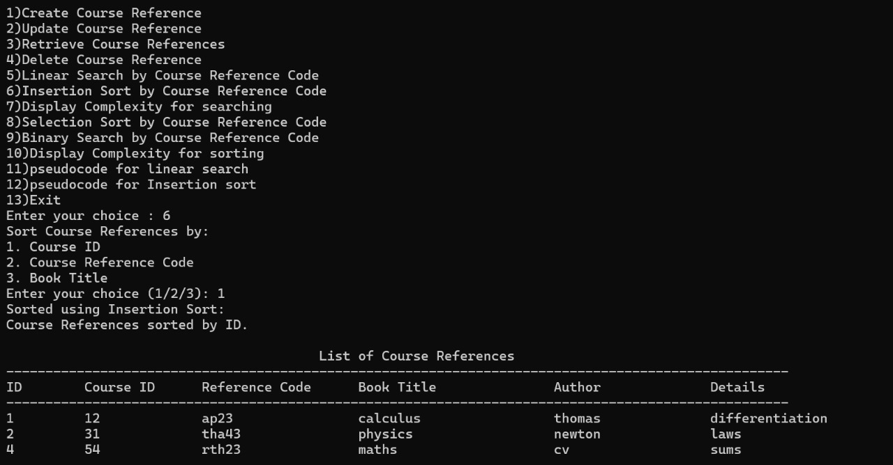
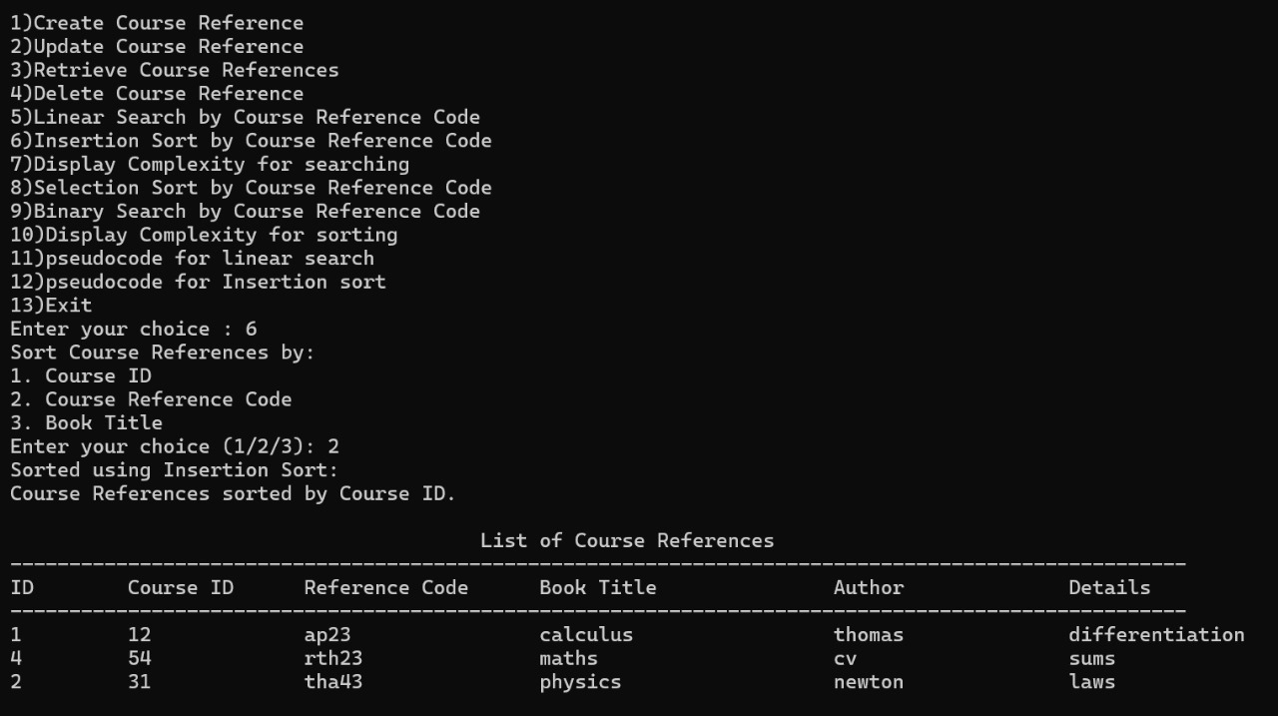
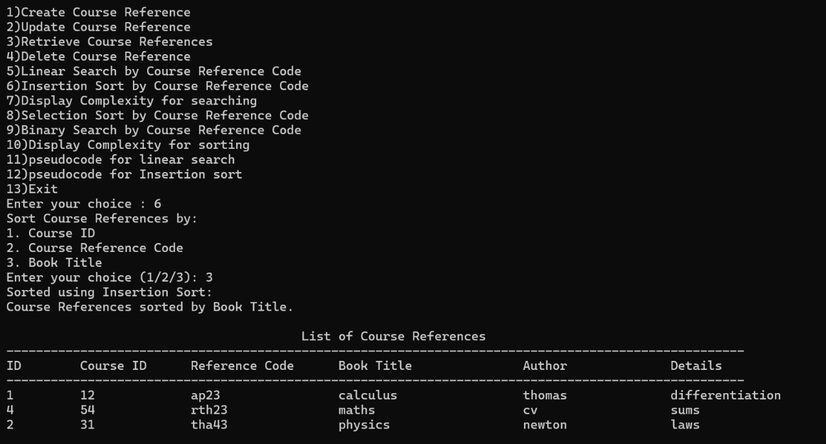
To sort all Course References and display them (used Insertion Sort)

Slide 39

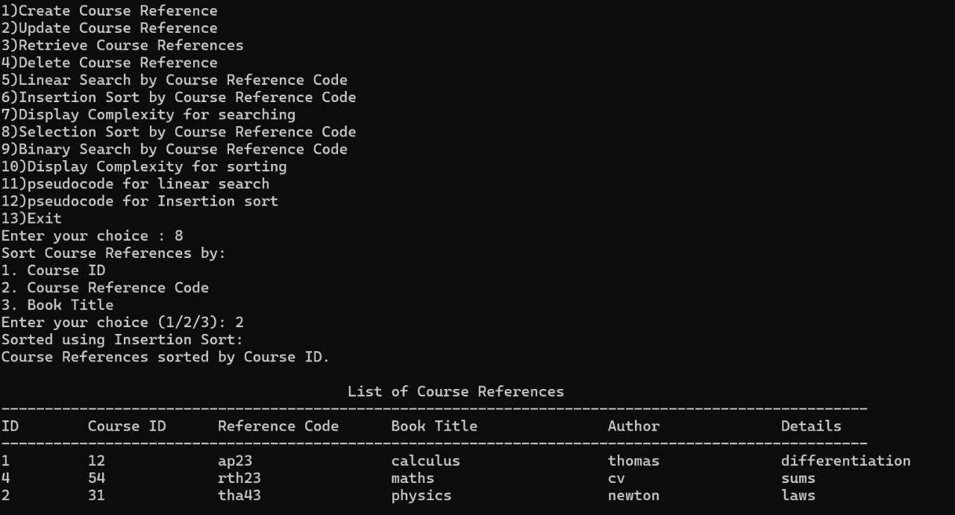

To sort all Course References using compared algorithm and display them (used Selection Sort)

Slide 40
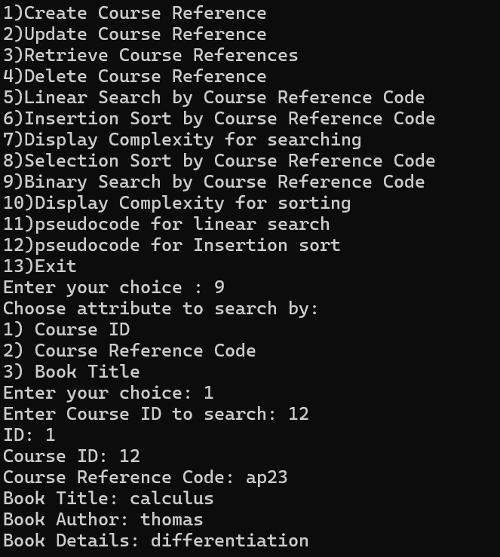
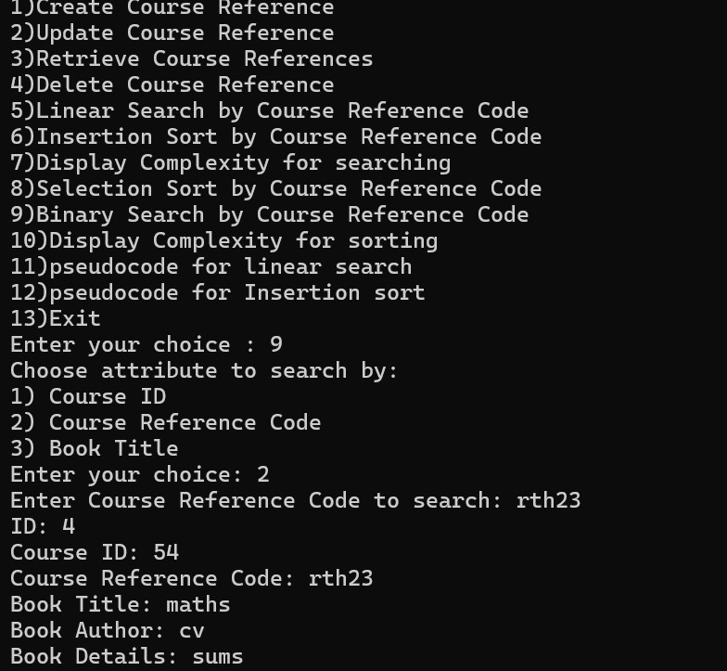
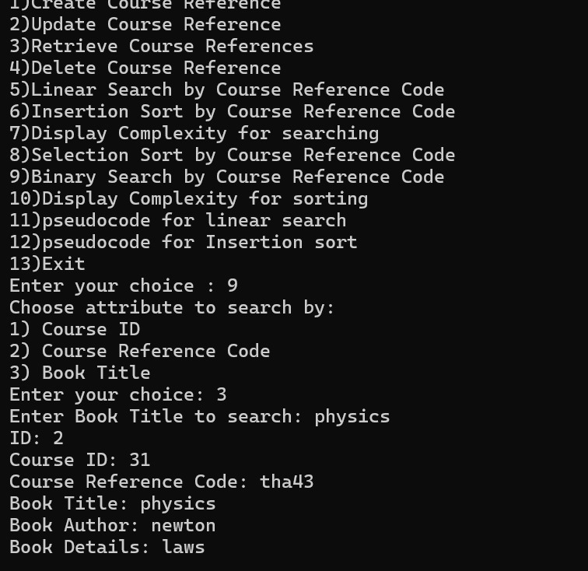
To search a Course Reference using compared algorithm (used Binary Search)

Slide 41
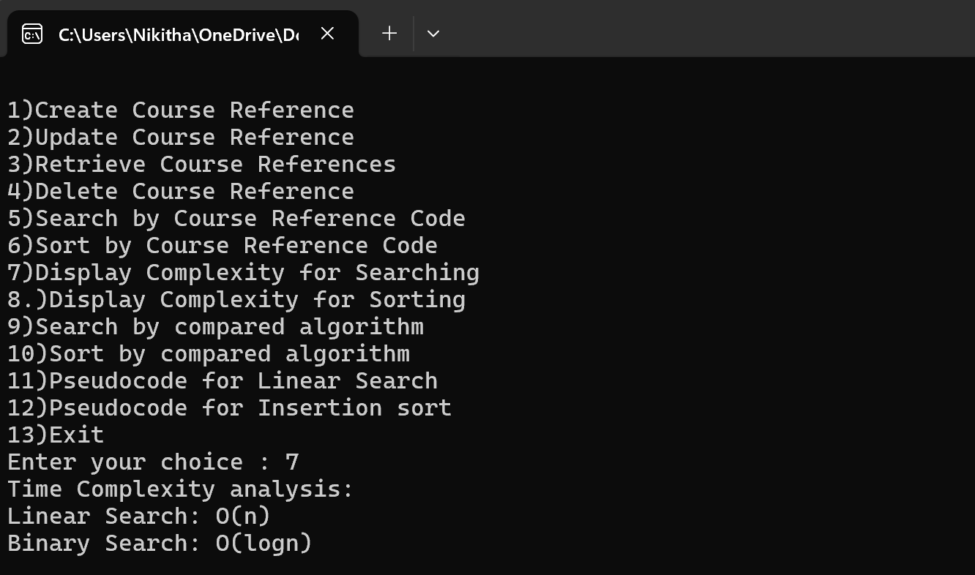
To display Search Time Complexities

Slide 42
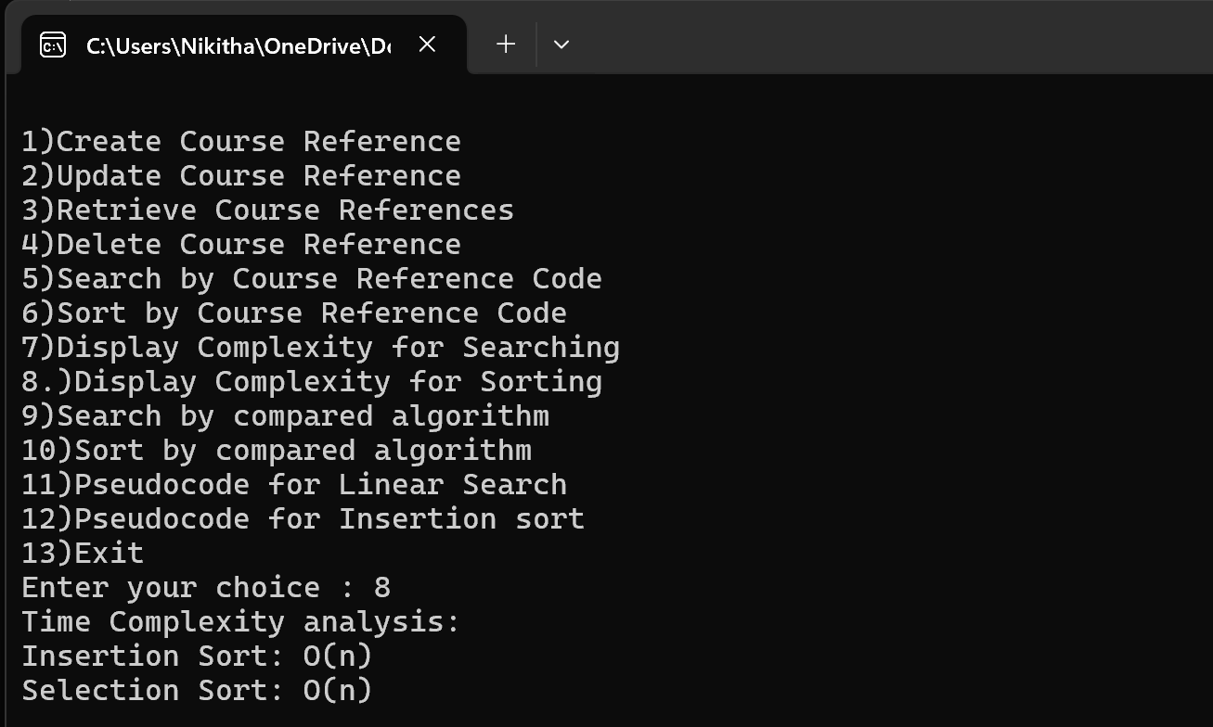
To display Sort Time Complexities

Slide 43
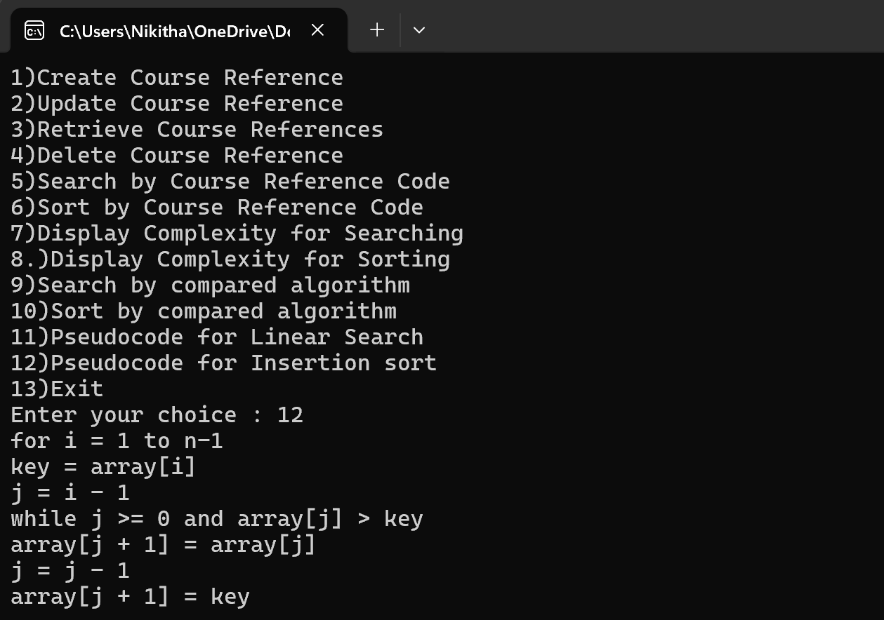
To display pseudocode details for Sorting Algorithm

Slide 44
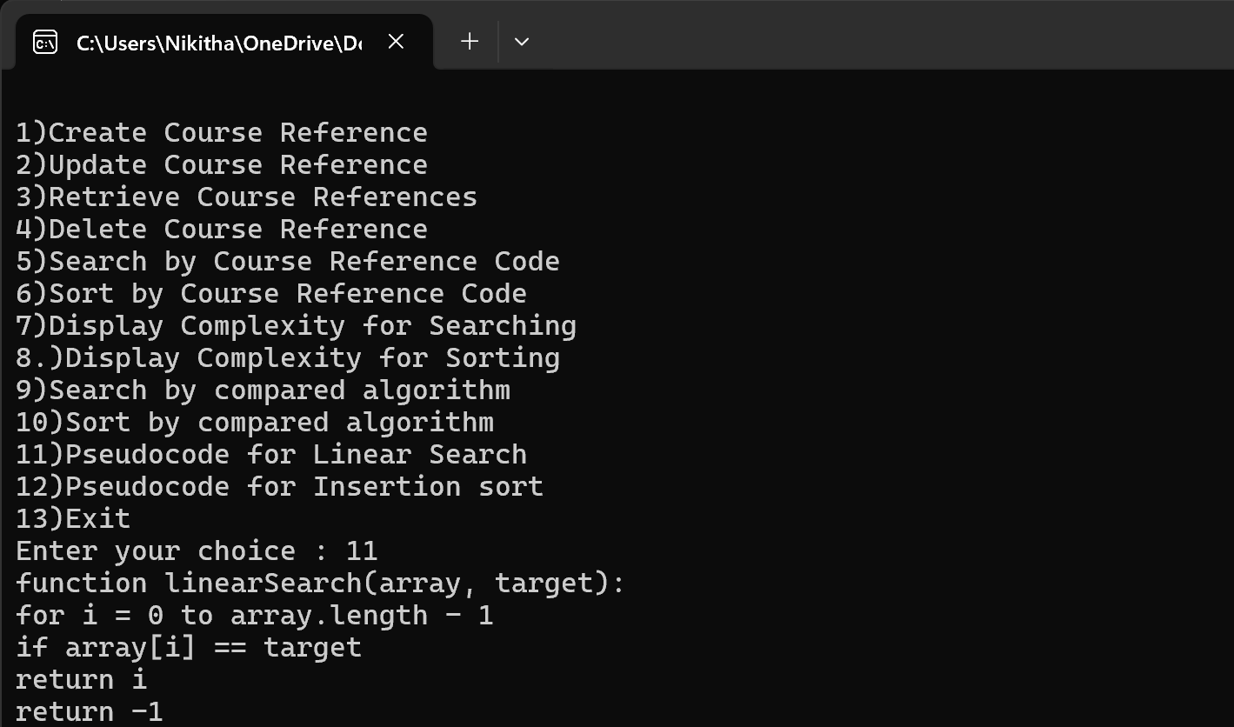
To display pseudocode details for Searching Algorithm

Slide 45
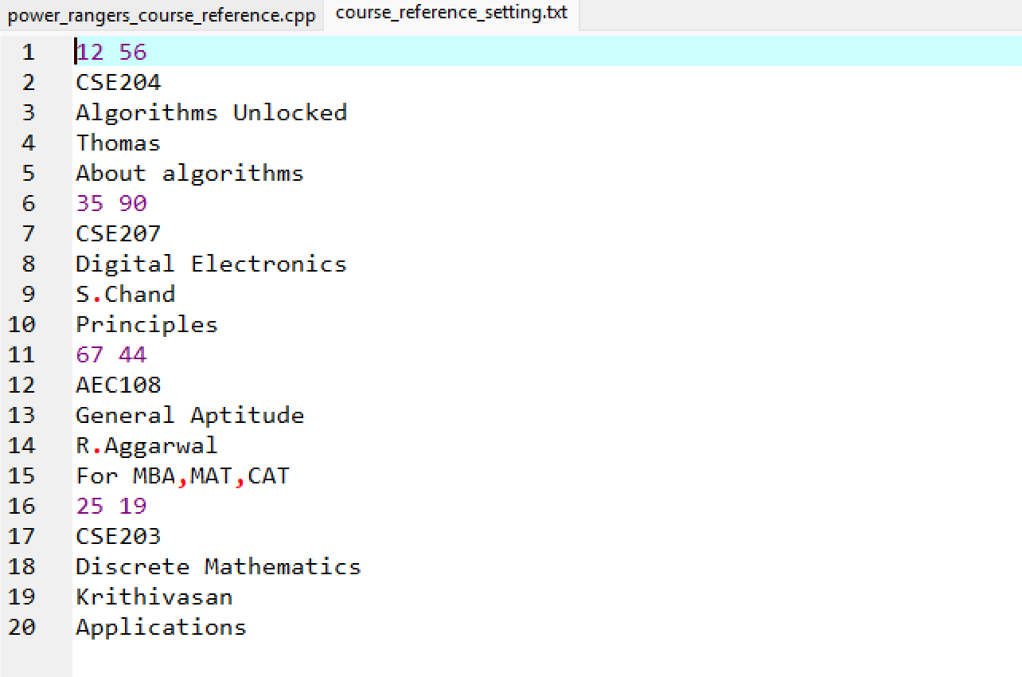
Details of module being stored in "course_reference_setting.txt" file and updated dynamically based on CRUD operations.

Slide 46
Conclusion:
In summary, the Course_Reference program is a comprehensive and efficient tool for managing course materials. By using Linear Search and Selection Sort, it offers simple yet powerful functionality for searching and sorting references. This system helps keep course references organized, making it a valuable resource for administrators and educators in any academic setting.

Slide 47
Thank You

