Slide 1

LECTURE 2: CAUSALITY
Vissého ADJIWANOU, Ph.D.
Senior Lecturer
21 February 2018
Notes:
In this chapter, we consider causality, one of the most central concepts of quantitative social science. Much of social science research is concerned with the causal effects of various policies and other societal factors. For instance: do small class sizes raise students ‘ standardized test scores? Would universal health care improve the health improve the health and finances of the poor? Does education reduces the number of children?

Slide 2
What have we learned last time?
Statistics
Causal relationship
Counterfactual
Randomized controlled trial (gold standard for causality)
Example:
Racial discrimination
Social pressure
R
Understanding R environment
Installing and loading library
Use of RMarkDown or RNoteBook
R for Demography measures

Slide 3
Topic outline
Review randomized controlled trials
Observational studies
Example : Minimum wage and unemployment (cross sectional comparison)
Problems
Counfounding bias
Solutions
Before-and-after
Difference-in-defference
In R
Subsetting data set
Function tapply
Questions

Slide 4
Conditions of cause-effect relation
Temporal precedence: The presumed cause must occur before the presumed effect
Association: There is observed covariance, that is, variation in the presumed cause must be related to that in the presumed effect
Isolation: There are no other plausible alternative explanations (i.e., extraneous variables) of the covariation between the presumed cause and the presumed effect
Notes:
Temporal precedence is established in experimental or quasi-experimental design when treatment clearly begins (and perhaps ends, too) before outcome is measured. However, if all variables are simultaneously measured- as is generally true in nonesperimental designs, then temporal precedence may be ambiguous; that is, which variable is the cause and which is the effect?
The condition about the absence of plausible alternative explanations (isolation) is typically the most challenging. This is so because it is virtually impossible to control all plausible extraneous variables, in a particular study. A plausible alternative explanation is also a threat to internal validity

Slide 5
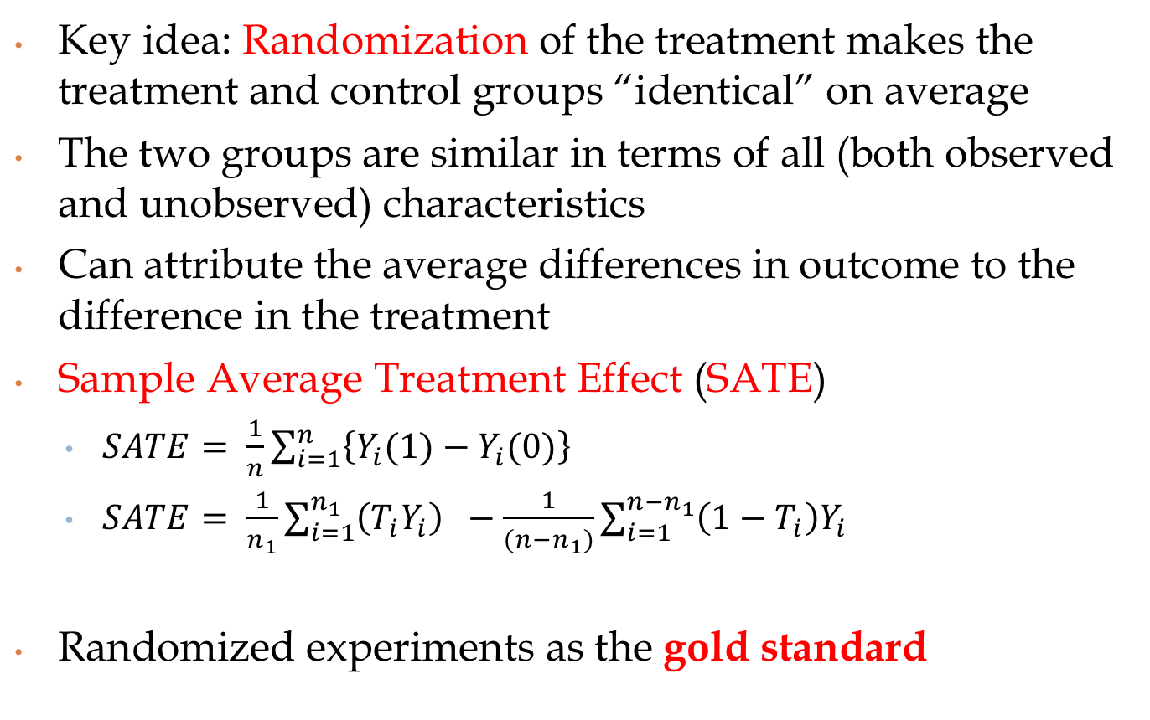
Randomized Controlled Trials (RCT)
Key idea: Randomization of the treatment makes the treatment and control groups “identical” on average
The two groups are similar in terms of all (both observed and unobserved) characteristics
Can attribute the average differences in outcome to the difference in the treatment
Sample Average Treatment Effect (SATE)
$SATE= \frac{1}{n}\sum_{i=1}^{n}{\left\{Y_{i}(1)−Y_{i}(0)\right\}}$
$SATE= \frac{1}{n_{1}}\sum_{i=1}^{n_{1}}{\left({T_{i}Y}_{i}\right) −\frac{1}{(n−n_{1})}\sum_{i=1}^{{n−n}_{1}}{\left(1−T_{i}\right)Y_{i} }}$
Randomized experiments as the gold standard
Notes:
The SATE is not directly observable. For the treatment group that received the treatment, we observed the average outcome under the treatment but do not know what their average outcome would have been in the absence of the treatment.
The same problem exist for the control group because this group does not receive the treatment and as a result we do not observe the average outcome that would occur under the treatment condition.
In order to estimate the average counterfactual outcome for the treatment, we may use the observed average outcome of the control group. Similarly, we can use the observed average outcome of the treatment group as an estimate of the average counterfactual outcome for the control group.
Sate can be estimated by calculating the difference in the average outcome between the treatment and control groups or the difference-in-means estimator.

Slide 6
Social pressure and experiment
In many RCT, there is a concern that study subjects may behave differently if they are aware of being observed by researchers ➔ Hawthorne effect
Examples:
When providing contraceptive message to a treatment group
During cash transfer
Social pressure and voter turnout

Slide 7
Social pressure and experiment
Social pressure and voter turnout
Authors: Alan S. Gerber, Donald P. Green, and Christopher W. Larimer. 2008. “Social Pressure and Voter Turnout: Evidence from a LargescaleField Experiment”. American Political Science Review. Vol 102, No1. p.32.48.
Question: Does social pressure within neighborhood increases participation (especially during a primary election)?
Three treatments groups and one control.
Civil duty
Neighbords
Hawthorne

Slide 8
Social pressure and experiment
Treatment group 1 Civic duty? | Treatment group 2 Hawthorne | Treatment group 3 Neighbors | Control group
Common message: Why do so many people fail to vote? We’ve been talking about the problem for years, but it only seems to get worse. This year, we’re taking a new approach. |  |  | Nothing send
The whole point of democracy is that citizens are active participants in government; that we have a voice in government. Yous voice starts with your vote. On august 8, remember your rights and responsibilities as a citizen. Remember to vote. DO YOUR CIVIC DUTY – VOTE! | Message start with: "You are being study! » This year, we are trying to figure out why people do or do not vote. Our analysis will be based on public records, so you will not be contacted again or disturbed in any way. Anything we learn about your voting or not voting will remain confidential and will not be disclosed to anyone. DO YOUR CIVIC DUTY – VOTE! | We’re sending this email to you and your neighbors to publicise who does and does not vote. The chart shows the names of some of your neighbors, showing which have voted in the past. After the August 8 election, we intend to ail an updated chart. You and your neighbors will all know who voted and who did not.

Slide 9
Social pressure and experiment
Data file : social.csv
Load the data and present the summary
library("qss")
data("social", package = "qss")
Or social <- read_csv("social.csv")
Summary(social)
Variable | Description
hhsize | household size of the voter
message | GOTV message the voter received (Civic duty, Control, Neighbors, Hawthorne)
sex | sex of the voter (female or male)
yearofbirth | yeasr of birth of the voter
primary2004 | whether the voter voted in the 2004 primary election (1 = voted, 0 = abstained)
primary 2006 | whether the voter turned out in the 2006 primary election (1 = voted, o = abstained)

Slide 10
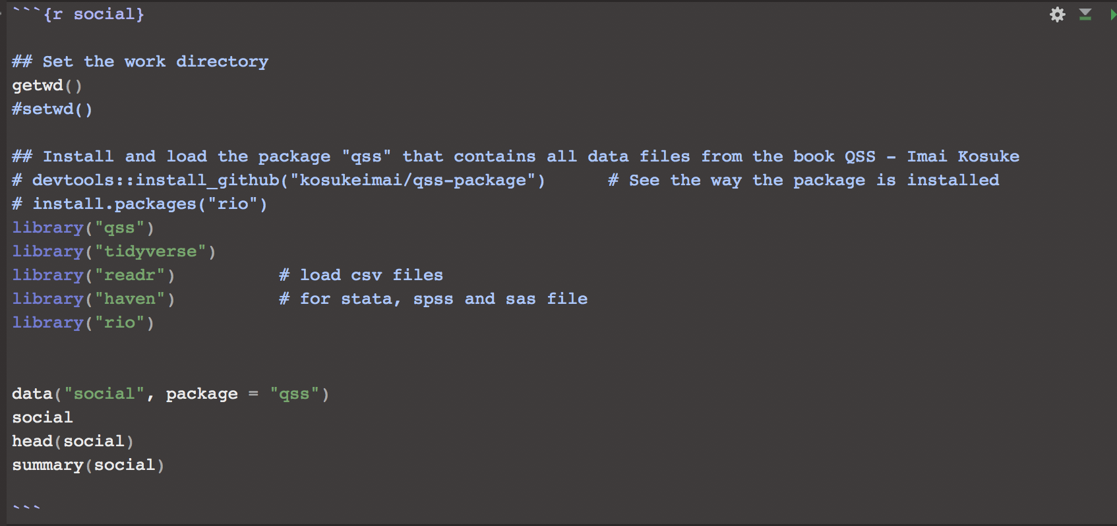
Social pressure and experiment
Load the library and the data

Slide 11
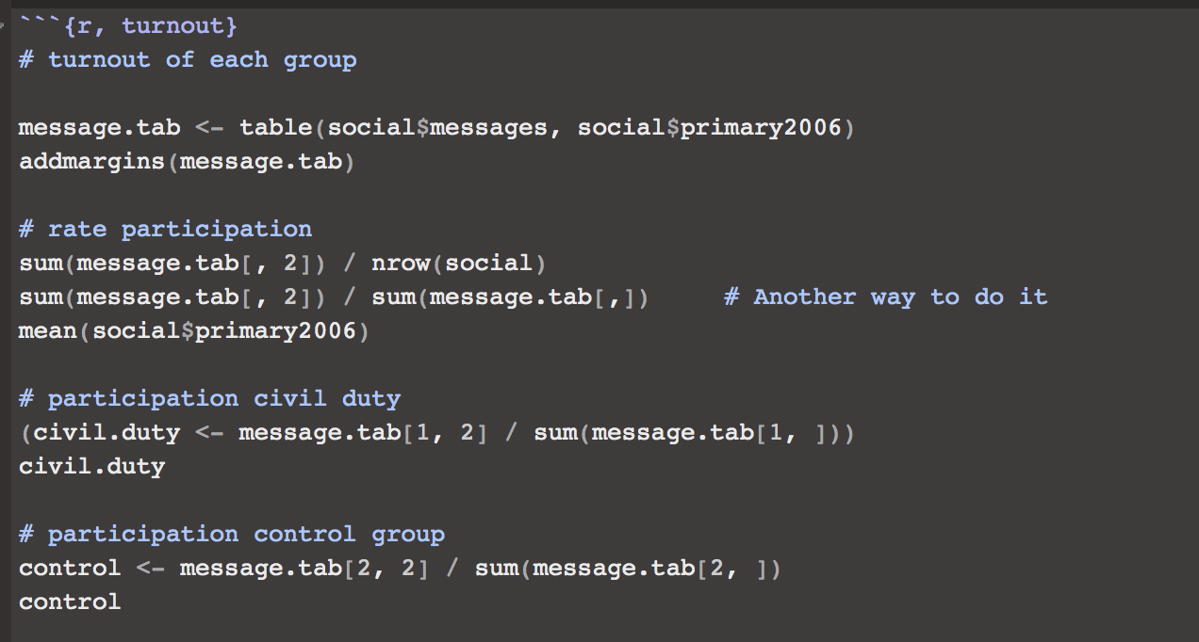
Social pressure and experiment
Turnout and SATE

Slide 12
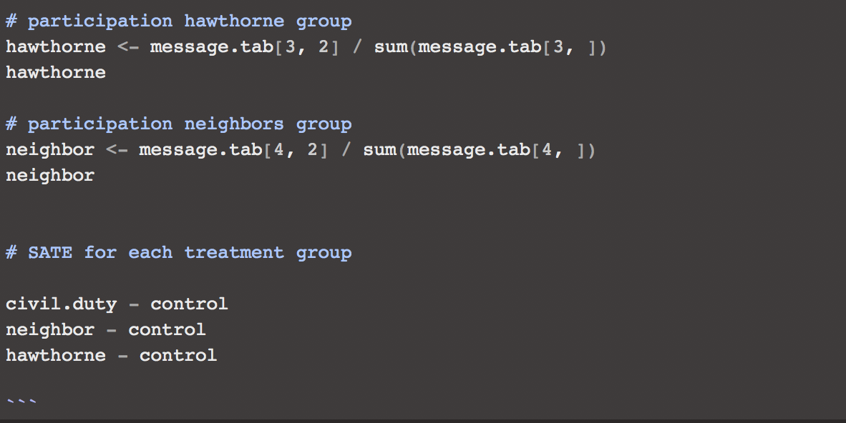
Social pressure and experiment
Turnout and SATE

Slide 13
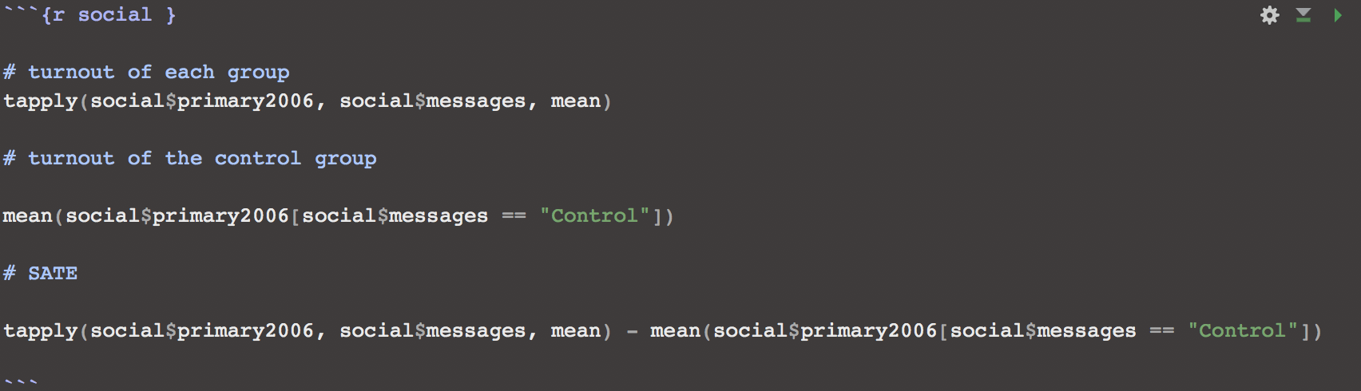
Social pressure and experiment
Use of the function (tapply): What we have done is a very long process. We can do that with less steps by taking advantage of the function in R. here, we are going to use the function tapply.

Slide 14
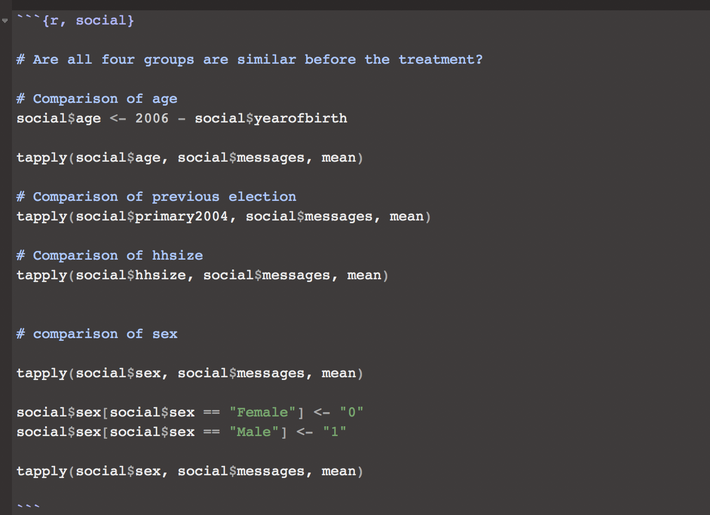
Social pressure and experiment
How can we be sure that the treatment groups are similar to the control group?

Slide 15
Observational studies
Example
Notes:
Design provides the conceptual framework that holds together the five structural elements of an empirical study (Trochim & Donnely, 2007)

Slide 16
Observational studies
Often, we can’t randomize treatment for ethical and logistical reasons:
e.g., smoking and lung cancer
Observational studies: naturally assigned treatment
Passive observational designs or correlational designs
No random assignment, no control group…

Slide 17
Observational studies
Better external validity for generalization beyond experiment
Weaker internal validity:
pre-treatment variables may differ between (treatment) and (control) groups
confounding bias due to these differences
selection bias from self-selection into treatment
unobserved confounding poses a threat
statistical control needed

Slide 18
Confounding bias and selection bias
A pretreatment variable that is associated with both the treatment and the outcome variables is called a confounder and is a source of confounding bias in the estimation of the treatment effect
Confounding bias due to self selection into the treatment group is called selection bias. Selection bias often arises in observational studies because researchers have no control over who receives the treatment.
This cannot be ruled out in observational studies == > statistical control
Notes:
Monfardini et Radice (2008), Rondman 2011 mettent quand même l’accent sur la necessité du critère d’exclusion en cas de mauvaise spécification du modèle.

Slide 19
Confounding (observed and unobserved)
Key assumption “Unconfoundedness”: (treatment) and (control) groups comparable with respect to everything other than treatment
X?
Fête (T)
Accident (Y)

Slide 20
Confounding
Adjiwanou, V. et LeGrand, T. (2013). Does antenatal care matter in the use of skilled birth attendance in rural Africa: A multi-country analysis, Social Science & Medicine 86: 26-34.
Quality of services
Number of ANC
Skilled Birth Attendance
Notes:
Monfardini et Radice (2008), Rondman 2011 mettent quand même l’accent sur la necessité du critère d’exclusion en cas de mauvaise spécification du modèle.

Slide 21
Selection bias
Adjiwanou, V. (In revision). Stepfamilies in sub-Saharan Africa and their consequences in terms of children’s well-being, Presented at the Population Association of America (PAA) 2017.
Effect of living with stepfather and children wellbeing
Selection to divorce and to remarriage
Women who remarry may be different to those who don’t
Remarriage is a choice made by the women, based on their expectation about what the remarriage will bring to them or to their children (Reniers 2003)
The decision to remarry can be dictated by the specific situation of the children

Slide 22
Selection bias
Selection to stepfather family arrangement
Fostering often supersedes the role of the parent. Unlike in developed countries, a significant proportion of children in SSA are fostered to allow their mother to remarry (Grant and Yeatman 2014).
The children who remain with their mothers when they remarry may have different characteristics to those who were out-fostered

