Slide 1
LECTURE 2: CAUSALITY
Vissého ADJIWANOU, Ph.D.
Senior Lecturer
26 February 2018
Notes:
In this chapter, we consider causality, one of the most central concepts of quantitative social science. Much of social science research is concerned with the causal effects of various policies and other societal factors. For instance: do small class sizes raise students ‘ standardized test scores? Would universal health care improve the health improve the health and finances of the poor? Does education reduces the number of children?

Slide 2
What have we learned last time?
Statistics
Randomized controlled trial: Hawthorne effect
Three conditions of causality
Observational study and its problems
Confounding bias
Self selection
R
Use of tidyverse R code (instead of base R code)
Tidyverse: (ggplot2, dplyr, tidyr, readr, purrr, tibble, and a few others) == > change very quickly. Think to update it.
Pipes with magritt – (RforDS, P261)
Subsetting dataset
Collaboration: allowed, but write up the solution on your own

Slide 3
https://www.rstudio.com/resources/cheatsheets/
dplyr provides a grammar for manipulating tables in R. This cheat sheet will guide you through the grammar, reminding you how to select, filter, arrange, mutate, summarise, group, and join data frames and tibbles.
The ggplot2 package lets you make beautiful and customizable plots of your data. It implements the grammar of graphics, an easy to use system for building plots. See docs.ggplot2.org for detailed examples.

Slide 4
Outline
Observational studies
Example : Minimum wage and unemployment (cross sectional comparison)
Solutions
Before-and-after
Difference-in-difference
Validity
In R
Continue with tidyverse R code
Creating factor variables, recoding variable
You have to send me your article by the end of the week

Slide 5
Observational study -
Confounding bias
Self selection bias
Reverse causation bias
Unobserved confounding
Simultaneity
Examples:
Adjiwanou, V. et LeGrand, T. (2013). Does antenatal care matter in the use of skilled birth attendance in rural Africa: A multi-country analysis, Social Science & Medicine 86: 26-34.
Adjiwanou, V. (In revision). Stepfamilies in sub-Saharan Africa and their consequences in terms of children’s well-being, Presented at the Population Association of America (PAA) 2017.
Endogeneity bias
Statistical control

Slide 6
Conditions of cause-effect relation
Temporal precedence: The presumed cause must occur before the presumed effect
Association: There is observed covariance, that is, variation in the presumed cause must be related to that in the presumed effect
Isolation: There are no other plausible alternative explanations (i.e., extraneous variables) of the covariation between the presumed cause and the presumed effect
Notes:
Temporal precedence is established in experimental or quasi-experimental design when treatment clearly begins (and perhaps ends, too) before outcome is measured. However, if all variables are simultaneously measured- as is generally true in nonesperimental designs, then temporal precedence may be ambiguous; that is, which variable is the cause and which is the effect?
The condition about the absence of plausible alternative explanations (isolation) is typically the most challenging. This is so because it is virtually impossible to control all plausible extraneous variables, in a particular study. A plausible alternative explanation is also a threat to internal validity

Slide 7
Example: minimum wage and unemployment
How does the increase in minimum wage affect employment?
Current debate: federal minimum wage increase
Many economists believe the effect is negative
especially for the poor
also for the whole economy
Hard to randomize the minimum wage increase
Two social scientists tested this using fast food chains in NJ and PA
In 1992, NJ minimum wage increased from $4.25 to $5.05
Neighboring PA stays at $4.25
Observe employment in both states before and after increase
NJ and (eastern) PA are similar
Fast food chains in NJ and PA are similar: price, wages, products, etc.
They are most likely to be affected by this increase

Slide 8
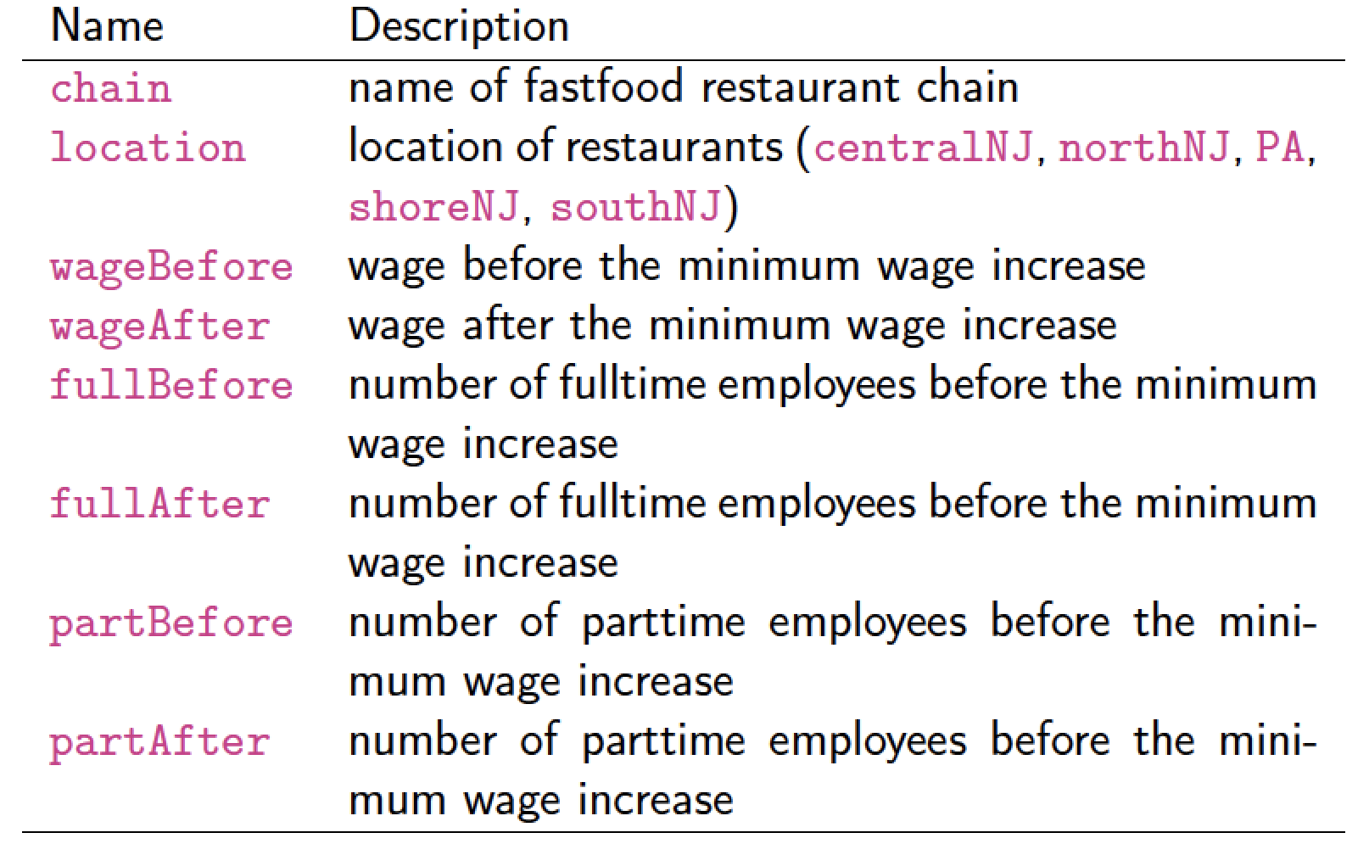
Minimum wage and unemployment
The data

Slide 9
Observational studies
How does the increase in minimum wage affect employment?
How will you respond to this question?

Slide 10
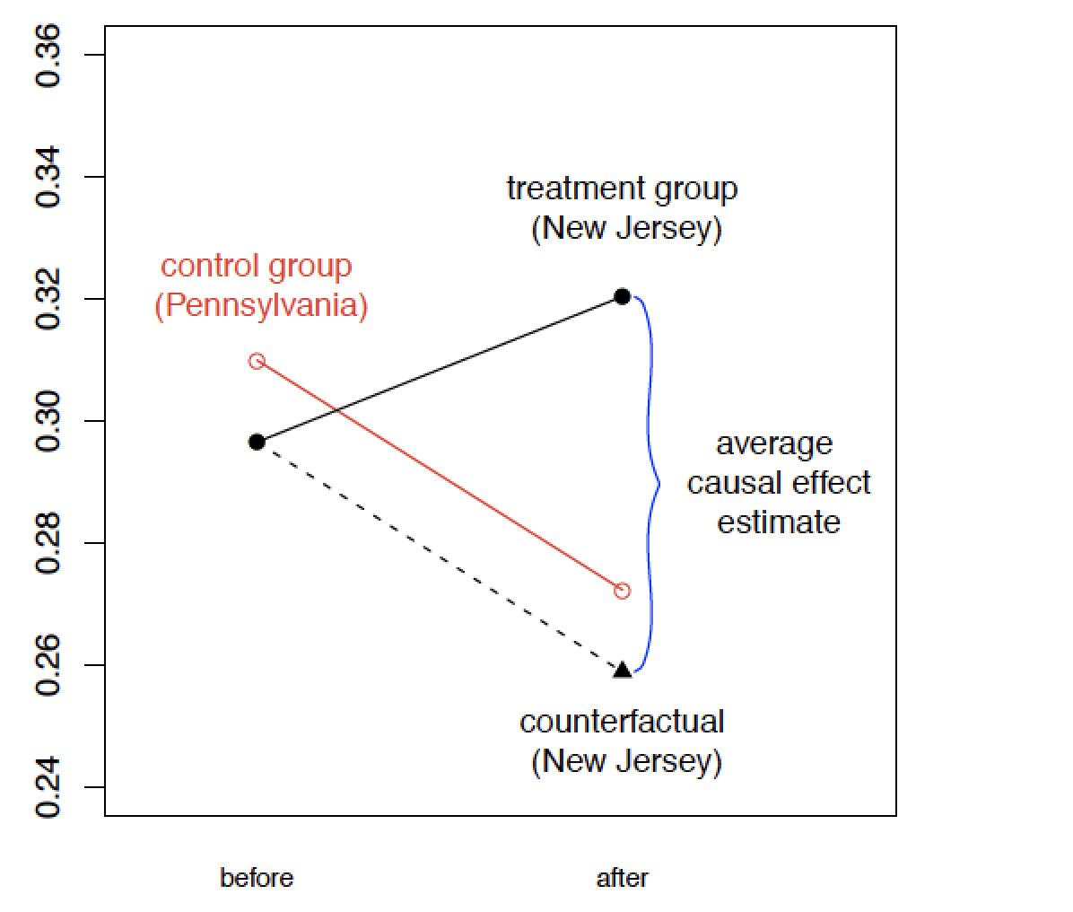
Observational studies
The three solutions to the problem

Slide 11
Observational studies
Summary of three identification strategies
Cross-section comparison
Compare treated units with control units after the treatment
Assumption: the treated and control units are comparable
Possible unit-specific confounding
Before-and-after comparison
Compare the same units before and after the treatment
Assumption: no time-varying confounding
Difference-in-Differences
Assumption: parallel time trend
Under this assumption, it accounts for both unit-specific and time-varying confounding
Neither approach is best. They require different assumptions.

Slide 12
Concepts
VALIDITY

Slide 13
Validity
Validity can be defined as the best available approximation to the truth of a given proposition, inference, or conclusion
We have discussed already two type of validity:
Internal validity
External validity
Notes:
Quality is one of the most important issues in research. I introduce the idea of validity to refer to the quality of various conclusions you might reach based on a research project.
Validity can be defined as the best available approximation to the truth of a given proposition, inference, or conclusion. Researchers make lots of different inferences or conclusions while conducting research. Many of these are related to the process of doing research and are not the major hypotheses of the study. Nevertheless, like the bricks that go into building a wall, these intermediate processes and methodological propositions provide the foundation for the substantive conclusions that they wish to address. For instance, virtually all social research involves measurement or observation, and, no matter what researchers measure or observe, they are concerned with whether they are measuring what they intend to measure or with how their observations are influenced by the circumstances in which they are made. They reach conclusions about the quality of their measures – conclusions that will play an important role in addressing the broader substantive issues of their study.

Slide 14
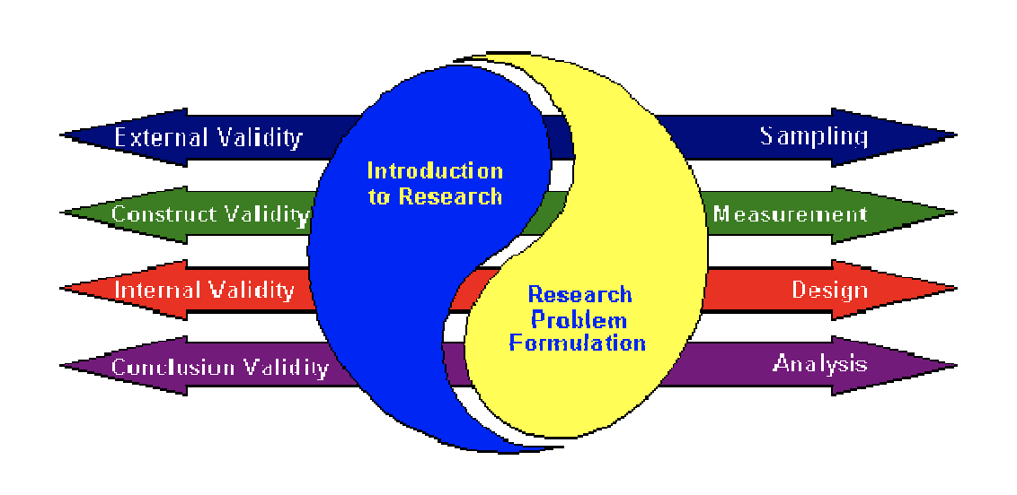
Different types of validity
Source: Trochim, W.R. and J.P. Donnely. 2007. The research methods knowledge base (3rd ed.). Mason, OH: Atomic Dog.
Notes:
Validity is typically subdivides into four types. They built on one another, and each type addresses a specific methodological question.

Slide 15
Different types of validity
Conclusion validity (Analysis)
Is there a relationship between the cause and effect?
Internal validity (Design)
Is the relationship causal?
Construct validity (Measurement)
Can we generalize to the constructs?
External validity (Sampling)
Can we generalize to other persons, places, times?

Slide 16
Different types of validity
Example:
Imagine that you want to examine whether the use of a World Wide Web (WWW) virtual classroom improves student understanding of course material.
Or any of the example we have seen already in class
Notes:
Imagine that you want to examine whether use of a World Wide Web virtual classroom improves student understanding of course material.
Conclusion validity: In this study, is there a relationship between the two variables? In the context of the example, the question might be worded: in this study, is there a relationship between the WWW site and knowledge of course material? There are several conclusions for inferences you might draw to answer such question, relationship or positive relationship.
Internal validity: Assuming that there is a relationship in this study, is the relationship a causal one? Just because you find that use of WWW site and knowlledge are correlated, you can’t necessarily assume that WWW site use cause the knowledge. Both could, for example, be caused by the same factor. For instance, it may be that wealthier students, who have greater resources, would be more likely to have access to a WWW site and would excel on objective tests. Another issues compromising internal validity concerns the lurk variable and the confounding variables discussed later.
Construct validity: Assuming there is a causal relationship in this study, can you claim that the program reflected your construct of the program well and that your measure reflected well you idea of the construct of the measure? In simpler terms, did you implement the program you intended to implement and did you measure the outcome you wanted to measure?
External validity: Assuming that there is a causal relationship in this study between the constructs of the cause and the effect, can you generalize this effect to other persons, places, or times?

Slide 17
Different types of validity
Conclusion validity: In this study, is there a relationship between the two variables?
In the context of the example, the question might be worded: in this study, is there a relationship between the WWW site and knowledge of course material?
There are several conclusions for inferences you might draw to answer such question, negative relationship or positive relationship.
Notes:
Imagine that you want to examine whether use of a World Wide Web virtual classroom improves student understanding of course material.
Conclusion validity: In this study, is there a relationship between the two variables? In the context of the example, the question might be worded: in this study, is there a relationship between the WWW site and knowledge of course material? There are several conclusions for inferences you might draw to answer such question, relationship or positive relationship.
Internal validity: Assuming that there is a relationship in this study, is the relationship a causal one? Just because you find that use of WWW site and knowlledge are correlated, you can’t necessarily assume that WWW site use cause the knowledge. Both could, for example, be caused by the same factor. For instance, it may be that wealthier students, who have greater resources, would be more likely to have access to a WWW site and would ecel on objective tests. Another issues compromising internal validity concerns the lurk variable and the confounding variables discussed later.
Construct validity: Assuming there is a causal relationship in this study, can you claim that the program reflected your construct of the program well and that your measure reflected well you idea of the construct of the measure? In simpler terms, did you implement the program you intended to implement and did you measure the outcome you wanted to measure?
External validity: Assuming that there is a causal relationship in this study between the constructs of the cause and the effect, can you generalize this effect to other persons, places, or times?

Slide 18
Different types of validity
Internal validity: Assuming that there is a relationship in this study, is the relationship a causal one?
Just because you find that use of WWW site and knowledge are correlated, you can’t necessarily assume that WWW site use cause the knowledge. Both could, for example, be caused by the same factor.
For instance, it may be that wealthier students, who have greater resources, would be more likely to have access to a WWW site and would excel on objective tests.
Another issues compromising internal validity concerns the lurk variables and the confounding variables discussed previously.
Notes:
Imagine that you want to examine whether use of a World Wide Web virtual classroom improves student understanding of course material.
Conclusion validity: In this study, is there a relationship between the two variables? In the context of the example, the question might be worded: in this study, is there a relationship between the WWW site and knowledge of course material? There are several conclusions for inferences you might draw to answer such question, relationship or positive relationship.
Internal validity: Assuming that there is a relationship in this study, is the relationship a causal one? Just because you find that use of WWW site and knowlledge are correlated, you can’t necessarily assume that WWW site use cause the knowledge. Both could, for example, be caused by the same factor. For instance, it may be that wealthier students, who have greater resources, would be more likely to have access to a WWW site and would ecel on objective tests. Another issues compromising internal validity concerns the lurk variable and the confounding variables discussed later.
Construct validity: Assuming there is a causal relationship in this study, can you claim that the program reflected your construct of the program well and that your measure reflected well you idea of the construct of the measure? In simpler terms, did you implement the program you intended to implement and did you measure the outcome you wanted to measure?
External validity: Assuming that there is a causal relationship in this study between the constructs of the cause and the effect, can you generalize this effect to other persons, places, or times?

Slide 19
Different types of validity
Construct validity: Assuming there is a causal relationship in this study, can you claim that the program reflected your construct of the program well and that your measure reflected well you idea of the construct of the measure?
In simpler terms, did you implement the program you intended to implement and did you measure the outcome you wanted to measure?
Notes:
Imagine that you want to examine whether use of a World Wide Web virtual classroom improves student understanding of course material.
Conclusion validity: In this study, is there a relationship between the two variables? In the context of the example, the question might be worded: in this study, is there a relationship between the WWW site and knowledge of course material? There are several conclusions for inferences you might draw to answer such question, relationship or positive relationship.
Internal validity: Assuming that there is a relationship in this study, is the relationship a causal one? Just because you find that use of WWW site and knowlledge are correlated, you can’t necessarily assume that WWW site use cause the knowledge. Both could, for example, be caused by the same factor. For instance, it may be that wealthier students, who have greater resources, would be more likely to have access to a WWW site and would ecel on objective tests. Another issues compromising internal validity concerns the lurk variable and the confounding variables discussed later.
Construct validity: Assuming there is a causal relationship in this study, can you claim that the program reflected your construct of the program well and that your measure reflected well you idea of the construct of the measure? In simpler terms, did you implement the program you intended to implement and did you measure the outcome you wanted to measure?
External validity: Assuming that there is a causal relationship in this study between the constructs of the cause and the effect, can you generalize this effect to other persons, places, or times?

Slide 20
Different types of validity
External validity: Assuming that there is a causal relationship in this study between the constructs of the cause and the effect, can you generalize this effect to other persons, places, or times?
Notes:
Imagine that you want to examine whether use of a World Wide Web virtual classroom improves student understanding of course material.
Conclusion validity: In this study, is there a relationship between the two variables? In the context of the example, the question might be worded: in this study, is there a relationship between the WWW site and knowledge of course material? There are several conclusions for inferences you might draw to answer such question, relationship or positive relationship.
Internal validity: Assuming that there is a relationship in this study, is the relationship a causal one? Just because you find that use of WWW site and knowlledge are correlated, you can’t necessarily assume that WWW site use cause the knowledge. Both could, for example, be caused by the same factor. For instance, it may be that wealthier students, who have greater resources, would be more likely to have access to a WWW site and would ecel on objective tests. Another issues compromising internal validity concerns the lurk variable and the confounding variables discussed later.
Construct validity: Assuming there is a causal relationship in this study, can you claim that the program reflected your construct of the program well and that your measure reflected well you idea of the construct of the measure? In simpler terms, did you implement the program you intended to implement and did you measure the outcome you wanted to measure?
External validity: Assuming that there is a causal relationship in this study between the constructs of the cause and the effect, can you generalize this effect to other persons, places, or times?

Slide 21
Summary
Your research question is the core element of your research
5 structural elements of an empirical study
Samples (groups)
Conditions (treatment or control)
Method of assignment to groups or conditions (i.e, random or otherwise)
Observations (i.e., the data)
Time, or the schedule for measurement or when treatment begins or ends
The best research computer is your brain

Slide 22
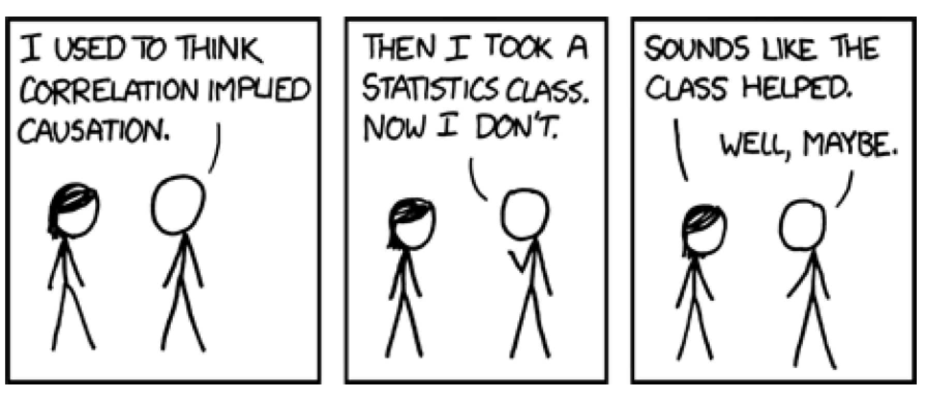
Conclusion of the chapter

