Slide 1
AegisOps
Unified AI VAPT Agent · Problem Statement 1
Participant: Visshva R (solo)
Event: DataOps Innovation Hackathon 2026
GitHub: github.com/visshva-r/AegisOps
Mission: Turn analyst intent into correlated, auditable VAPT results with lab-only scope control and mandatory human approval.
AegisOps | DataOps Innovation Hackathon 2026 | PS-1 Slide 1/14

Slide 2
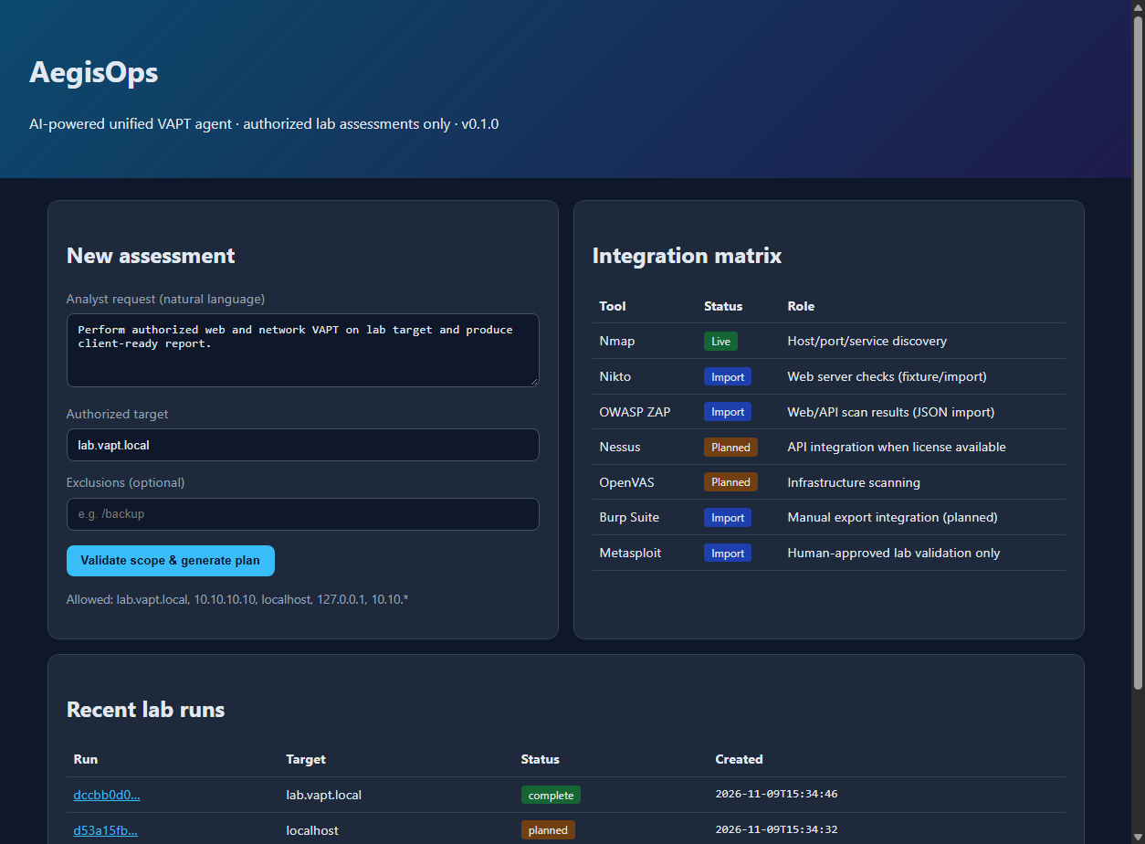
1. Team Introduction & Problem Statement
• Solo builder: Visshva R
• Challenge: PS-1 AI Unified VAPT Agent
• Product: conversational orchestration + audit trail
• Principle: augment analysts, never bypass scope or approval
Live/Import/Planned matrix and recent lab runs.
AegisOps | DataOps Innovation Hackathon 2026 | PS-1 Slide 2/14

Slide 3
2. The Problem
• Many scanners, many formats (XML, JSON, text)
• Duplicate alerts and mismatched severity waste analyst time
• Autonomous pentest bots can hit out-of-scope assets
• Executives need findings linked to verifiable raw evidence
AegisOps | DataOps Innovation Hackathon 2026 | PS-1 Slide 3/14

Slide 4
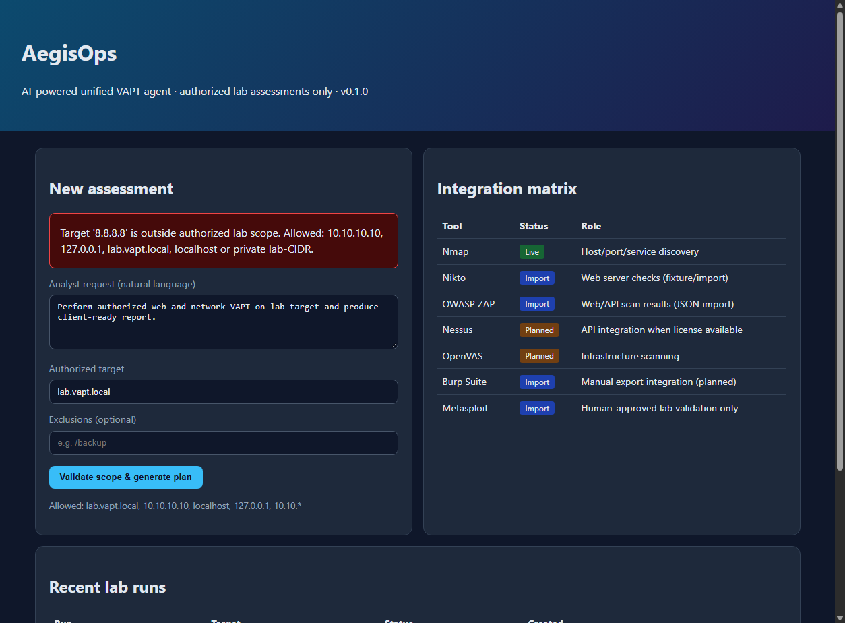
3. Your Solution
Out-of-scope targets are rejected before any scan is queued.
AegisOps | DataOps Innovation Hackathon 2026 | PS-1 Slide 4/14

Slide 5
4. Project Architecture & Structure
Scope
→
Plan
→
Scan
→
Correlate
→
Approve
→
PDF
• FastAPI UI and SQLite state for runs, tools, findings, audit
• Adapters: Nmap (live or fixture), Nikto and ZAP (import)
• Correlation engine: dedupe, confidence, risk order
• ReportLab generates the client VAPT PDF
AegisOps | DataOps Innovation Hackathon 2026 | PS-1 Slide 5/14

Slide 6
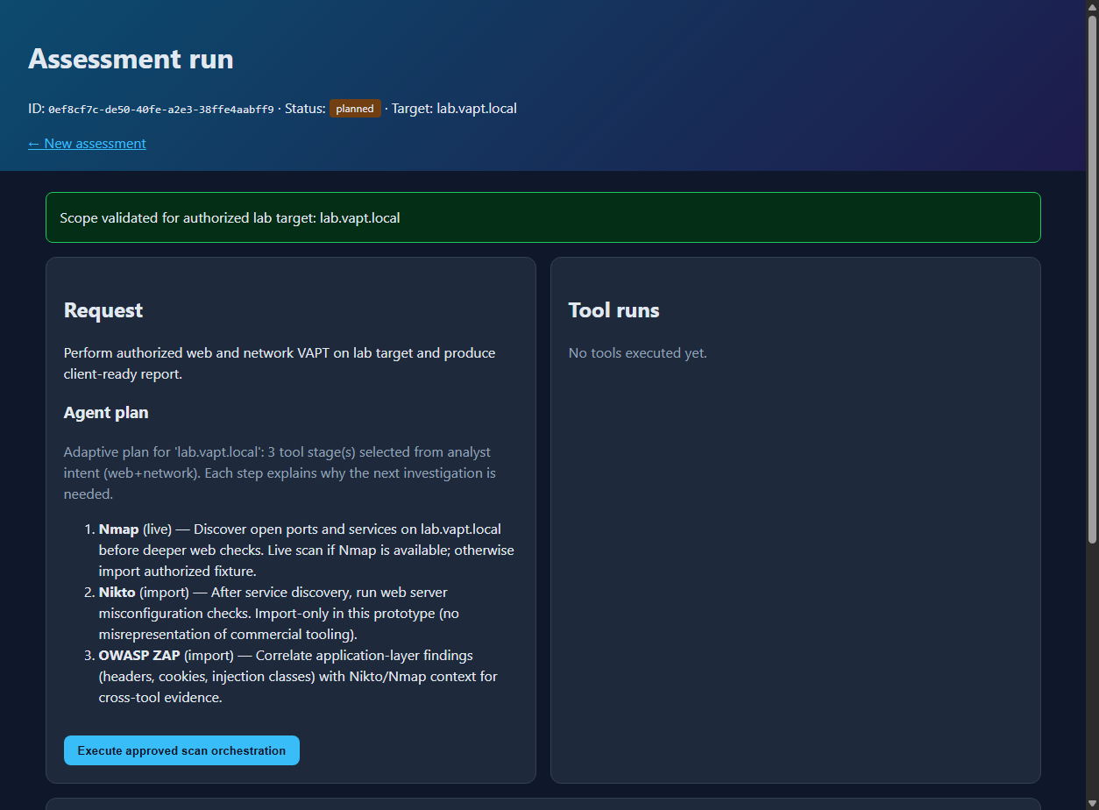
4. Architecture (Live Workflow)
Adaptive plan with explicit rationale for each tool stage.
AegisOps | DataOps Innovation Hackathon 2026 | PS-1 Slide 6/14

Slide 7
5. Tech Stack
• Python 3.10+, FastAPI, Pydantic v2, SQLite
• Jinja2 templates and responsive CSS dashboard
• ReportLab PDF (executive + technical sections)
• Nmap, Nikto, OWASP ZAP integrations; Metasploit approval stub
AegisOps | DataOps Innovation Hackathon 2026 | PS-1 Slide 7/14

Slide 8
6. Features (Judge Checklist §10)
All seven PS-1 demonstration items implemented
• NL request and lab scope validation
• Adaptive plan with tool rationale
• Multi-tool ingest with traceable output paths
• Correlation, dedupe, confidence, observed vs inferred
• Human approval before active validation
• VAPT PDF download and honest integration matrix
AegisOps | DataOps Innovation Hackathon 2026 | PS-1 Slide 8/14

Slide 9
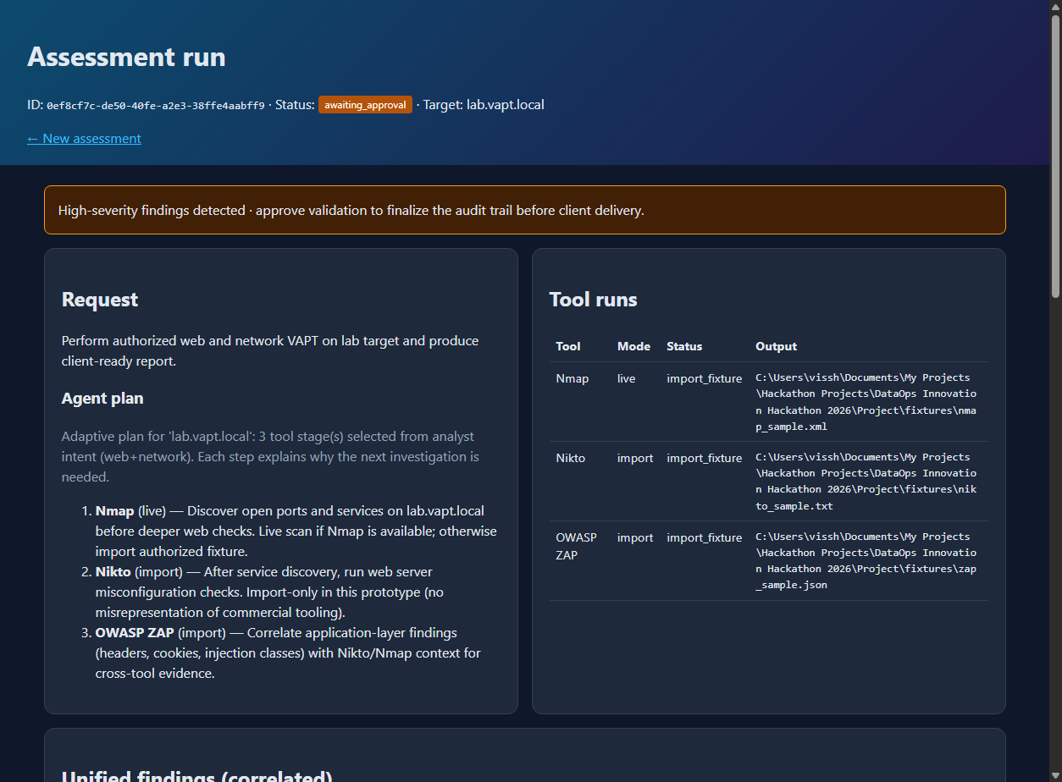
6. Features — Approval Gate
Execution pauses until the analyst approves validation.
AegisOps | DataOps Innovation Hackathon 2026 | PS-1 Slide 9/14

Slide 10
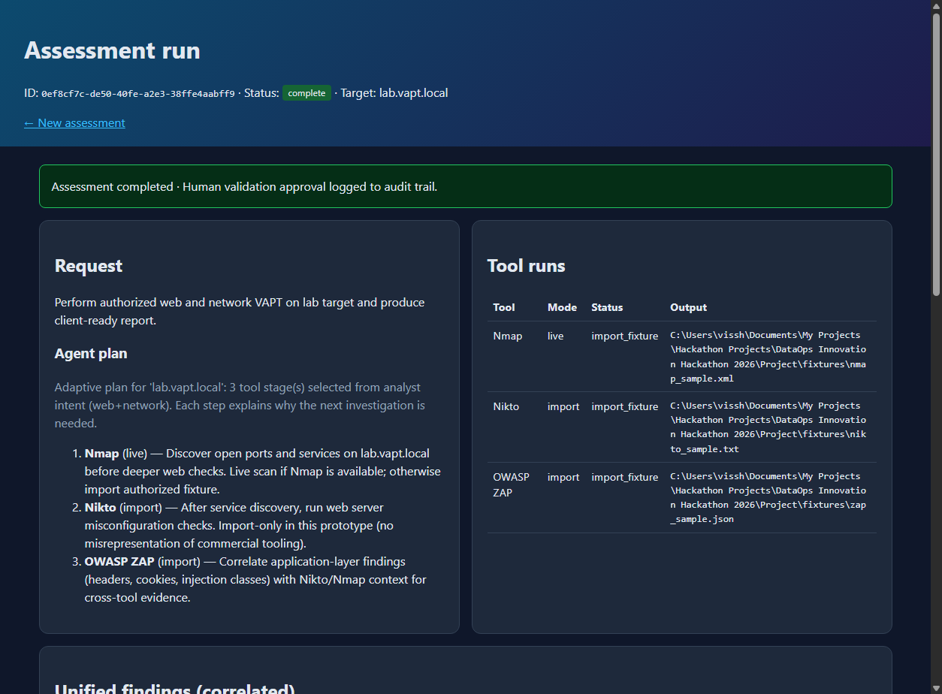
6. Features — Audit & Report
Audit trail and one-click VAPT PDF export.
AegisOps | DataOps Innovation Hackathon 2026 | PS-1 Slide 10/14

Slide 11
7. Feasibility
• Runs locally: pip install and python run.py
• Fixtures keep demos stable without commercial licenses
• Transparent Live / Import / Planned labels in UI and API
• Ready to extend with workers, Docker, and enterprise APIs
AegisOps | DataOps Innovation Hackathon 2026 | PS-1 Slide 11/14

Slide 12
8. Limitations
• Lab allowlist only (no multi-tenant RBAC yet)
• Long live scans need background jobs at scale
• No autonomous exploitation; Metasploit stub after approval
• Nessus, OpenVAS, Burp not live in this prototype
AegisOps | DataOps Innovation Hackathon 2026 | PS-1 Slide 12/14

Slide 13
9. Future Scope
• LLM planner and remediation narratives
• Nessus, OpenVAS, and Burp enterprise connectors
• Attack-path visualization and SIEM export
• CI/CD security gate for release pipelines
AegisOps | DataOps Innovation Hackathon 2026 | PS-1 Slide 13/14

Slide 14
Thank You
github.com/visshva-r/AegisOps
Questions welcome.
AegisOps keeps the analyst in control:
scope, evidence, approval, and report.
AegisOps | DataOps Innovation Hackathon 2026 | PS-1 Slide 14/14

